Slide 1
Introduction to Database
Software College
2018.3

Slide 2
Course Information
Course
  Name: Introduction to Database (数据库概论)
Teacher
  Name: Huang Liping(黄利萍)
  E-mail: huanglp@swc.neu.edu.cn
Course Information

Slide 3



Text Book and Reference
Text Book
  Database System Concepts (6th Edition),
  McGraw-Hill, 2010
    http://codex.cs.yale.edu/avi/db-book/
Reference
  First Course in Database Systems,A
  (3rd Edition), Prentice Hall , 2008
  数据库系统概论(第4版)，
  高等教育出版社，2007
Course Information

Slide 4
Contents and Requirements
Basic Concepts
Data Model
  Relational Model
Database Language
  SQL
Database Programming
  Embedded SQL
  Triggers
  Stored Procedure
  ODBC, JDBC
Understand
Master Skillfully
Master Skillfully
Master
Understand
Course Information

Slide 5
Contents and Requirements
Cont.
Database Design
  E-R Model
  Transform Rule
  Normalize
DBMS Functions
  Query optimization
  Concurrency Control
  Recovery Systems
Master Skillfully
Master Skillfully
Master
Understand
Course Information

Slide 6
Grading Policy
Assignments: 30%
Final Exam: 70%
May change if necessary
Course Information

Slide 7

Chapter 1 Introduction

Slide 8
Contents
Purpose of Database Systems
View of Data
Database Languages
Relational Databases
Database Design
Data Storage and Querying
Transaction Management
Database Architecture
Database Users and Administrators
Overall Structure
History of Database Systems
Chapter1 Introduction

Slide 9
Database System
Database System (DBS)
  Collection of interrelated data
  Set of programs to access the data
Database (DB): contains information about a particular enterprise
Database Management System (DBMS) : Provide a way to store and retrieve database information that is both convenient and efficient
Like OS, DBMS is a system software
Chapter1 Introduction

Slide 10
Hierarchical Architecture
User/Application
DBMS
OS
DB
Chapter1 Introduction

Slide 11
Database System Applications
Representative Database Applications
  Banking: all transactions
  Airlines: reservations, schedules
  Universities: registration, grades
  Sales: customers, products, purchases
  Online retailers: order tracking, customized recommendations
  Manufacturing: production, inventory, orders, supply chain
  Human resources: employee records, salaries, tax deductions
Databases touch all aspects of our lives
Chapter1 Introduction

Slide 12
Purpose of Database Systems
In the early days, applications were built directly on top of file systems
Using file systems to store and manipulate data have several drawbacks
Chapter1 Introduction

Slide 13
Purpose of Database Systems
Cont.
Drawbacks of using file system
  Data redundancy and inconsistency
    duplication of information in different files
Example
Fortran
Program 1
Saving account
C
Customer Name Phone number
Program n
JAVA
Program m
Checking account
Banking Application
Chapter1 Introduction

Slide 14
Purpose of Database Systems
Cont.
Cont.
Drawbacks of using file system
  Difficulty in accessing data
    Need to write a new program to carry out each new task
Customer info
Example
Program 1
Names of all customer who lives within particular postal-code area
Program n
Program m
Names of all customer who is older than 50
Banking Application
Chapter1 Introduction

Slide 15
Purpose of Database Systems
Cont.
Cont.
Drawbacks of using file system
  Data isolation — multiple files and formats
Example
Saving account
Fortran
Program 1
Checking account
C
Program n
VIP customer
Names of all VIP customers who have a checking account
JAVA
Program m
Program p
Banking Application
Chapter1 Introduction

Slide 16
Purpose of Database Systems
Cont.
Drawbacks of using file system
  Integrity problems
    Integrity constraints (e.g. account balance > 0) become “buried” in program code rather than being stated explicitly
    Hard to add new constraints or change existing ones
Cont.
Chapter1 Introduction

Slide 17
Purpose of Database Systems
Cont.
Cont.
Drawbacks of using file system
  Atomicity of updates
    Failures may leave data in an inconsistent state with partial updates carried out
    Transfer of funds from one account to another should either complete or not happen at all
Example
200$
A
200$
100$
(200-100)$
China Bank
100$
500$
B
500$
(500+100)$
600$
City Bank
Chapter1 Introduction
600$

Slide 18
Purpose of Database Systems
Cont.
Drawbacks of using file system
  Concurrent access by multiple users
    Concurrent access is needed for performance
    Uncontrolled concurrent accesses can lead to inconsistencies
    Two people reading a balance and updating it at the same time
Cont.
Example
2000
2000
2000-500
2000
2000-300
1500
1700
Chapter1 Introduction

Slide 19

Purpose of Database Systems
Cont.
Drawbacks of using file system
  Security problems
    Hard to provide user access to some, but not all, data
Cont.
Database systems offer solutions to all the above problems
Chapter1 Introduction

Slide 20
View of data
database system provide an abstract view of the data
  Hide certain complexity details of how data is stored and maintained
  Achieved through several level of abstraction
    Physical level
    Logical level
    View level
Chapter1 Introduction

Slide 21
Level of Abstraction
Physical level:
  describes how a record (e.g., customer) is stored
Logical level:
  describes what data are stored in the database, and the relationships among the data
  describe entire database
View level:
  Describe part of the database
  A way to hide: (a) details of data types and (b) information (such as an employee’s salary) for security purposes
Chapter1 Introduction

Slide 22
Level of Abstraction
Cont.
Application 1
Application N
Administrator
View Level
View 1
View N
DBMS
Logical Level
Physical Level
OS (File System)
Secondary Memory
Chapter1 Introduction

Slide 23
Instances and Schemas
Similar to types and variables in programming languages
Schema – the overall design of the database
  Analogous to type information of a variable in a program
Instance – the collection of information stored in the database at a particular point in time
  Analogous to the value of a variable
Chapter1 Introduction

Slide 24
Instances and Schemas
Cont.
Several Schemas of DBS
  Physical schema: database design at the physical level
  Logical schema: database design at the logical level
  Subschema: describe different views at the view level
Chapter1 Introduction

Slide 25
Instances and Schemas
Cont.
Physical Data Independence – application do not depend on physical schema, and thus need not be rewritten if the physical schema changes
  Applications depend on the logical schema
  Physical schema is hidden beneath the logical schema
Chapter1 Introduction

Slide 26
Data Models
A collection of tools for describing
  Data
  Data relationships
  Data semantics
  Data constraints
Provides a way to describe the design of a database at the physical, logical and view levels.
Chapter1 Introduction

Slide 27
Data Models
Cont.
Relational model
Entity-Relationship data model
  mainly for database design
Object-based data models
  Object-oriented
  Object-relational
Semistructured data model
  XML
Other older models:
  Network model
  Hierarchical model
Chapter1 Introduction

Slide 28
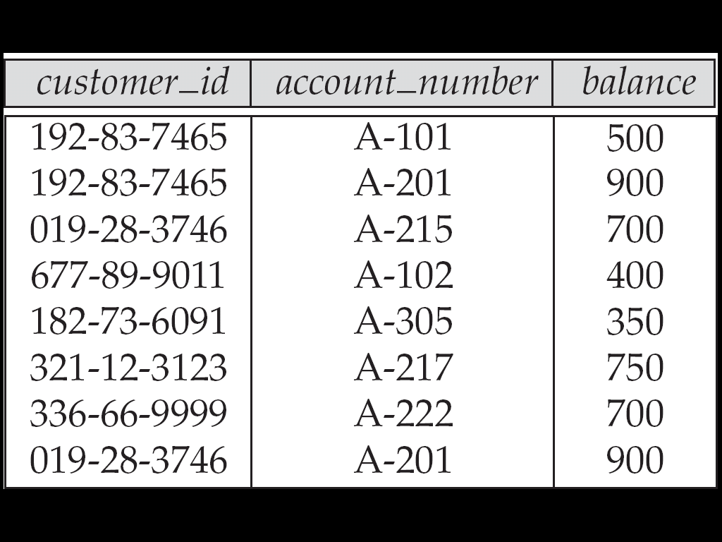
Relational Model
Use a collection of tables to represent both data and relationships among those data
Each table has several columns
Each column has a unique name
Chapter1 Introduction

Slide 29

Chapter1 Introduction

Slide 30
The Entity-Relationship Model
Models an enterprise as a collection of entities and relationships
Entity: a “thing” or “object” in the real world that is distinguishable from other objects
  Described by a set of attributes
Each person, bank accounts, customer
Account: described by account_number, balance
Customer: described by customer_name, customer_street, customer_city
, customer_id
Chapter1 Introduction

Slide 31
The Entity-Relationship Model
Cont.
Relationship: an association among several entities
Entity Set: the set of all entities of the same type
Relationship Set: the set of all relationships of the same type
A deposit relationship associates a customer with a account that she has
Chapter1 Introduction

Slide 32
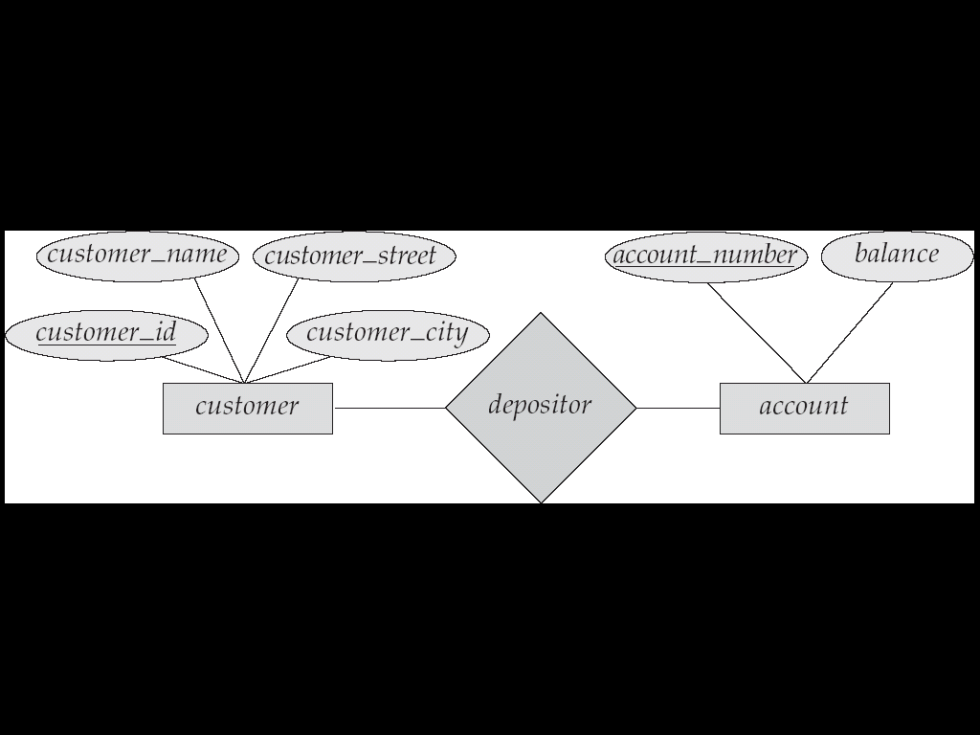
The Entity-Relationship Model
Cont.
Represented diagrammatically by an entity-relationship diagram:
Chapter1 Introduction

Slide 33
Database Languages
Database system provides
  Data Definition Language (DDL) to specify database schema
  Data Manipulation Language (DML) to express database queries and updates
In practice, DDL and DML form parts of a single database language
  SQL (Structured Query Language)
Chapter1 Introduction

Slide 34
Data Definition Language (DDL)
Specification notation for defining the database schema
Example
  create table account (
  account-number char(10),
  balance integer)
Chapter1 Introduction

Slide 35
Data Definition Language (DDL)
Cont.
DDL compiler generates tables according to DDL statements and store the schema definitions of these tables in data dictionary
Data dictionary contains metadata (i.e., data about data)
  Database schema
  Integrity constraints
  Authorization
Chapter1 Introduction

Slide 36
Data Manipulation Language (DML)
Language for accessing and manipulating the data organized by the appropriate data model
  Retrieval of information
  Insertion of new information
  Deletion of information
  Modification of information
DML also known as query language
Query
Chapter1 Introduction

Slide 37
Data Manipulation Language (DML)
Cont.
Two classes of languages
  Procedural – user specifies what data is required and how to get those data
  Declarative (nonprocedural) – user specifies what data is required without specifying how to get those data
SQL is the most widely used nonprocedural query language
Chapter1 Introduction

Slide 38
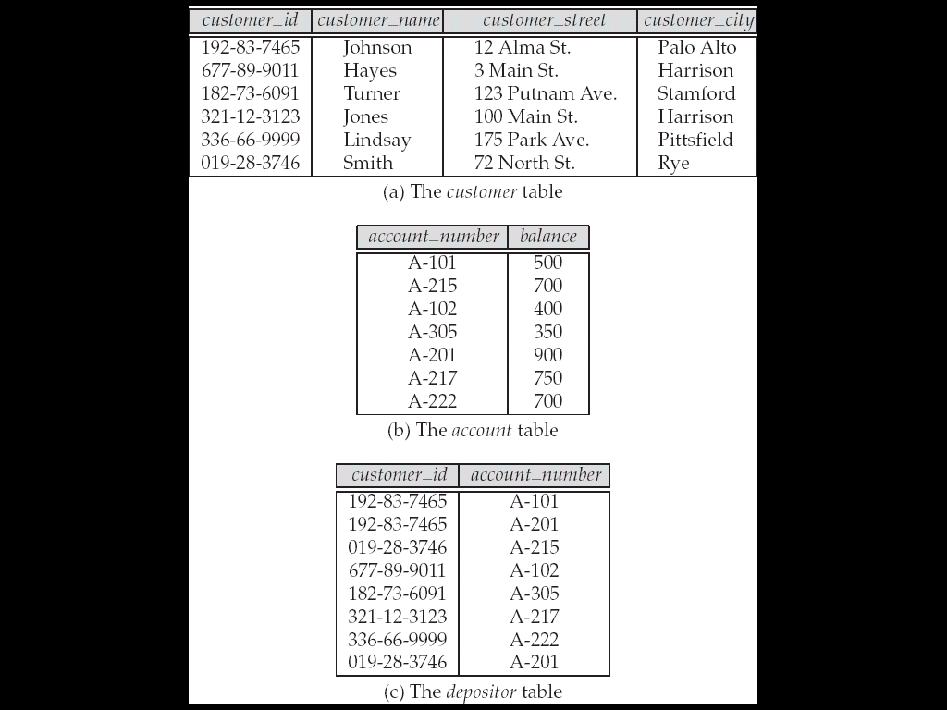
SQL
    Find the name of the customer with customer-id 192-83-7465
Example
    Select customer.customer_name
    from customer
    where customer.customer_id = ‘192-83-7465’
Chapter1 Introduction

Slide 39
Cont.
SQL
Example
    Find the balances of all accounts held by the customer with customer-id 192-83-7465
    select account.balance
    from depositor, account
    where depositor.customer_id = ‘192-83-7465’ and
    depositor.account_number =
    account.account_number
Chapter1 Introduction

Slide 40
Access from application programs
Application programs generally access databases through one of
  Language extensions to allow embedded SQL
  Application program interface (e.g., ODBC/JDBC) which allow SQL queries to be sent to a database
JAVA
Database
Connectivity
Open
Database
Connectivity
Chapter1 Introduction

Slide 41
Relational Databases
A relational database is based on the relational data model
Data and relationships among the data is represented by a collection of tables
Includes both a DML and a DDL
Most commercial relational database systems employ the SQL query language
Chapter1 Introduction

Slide 42
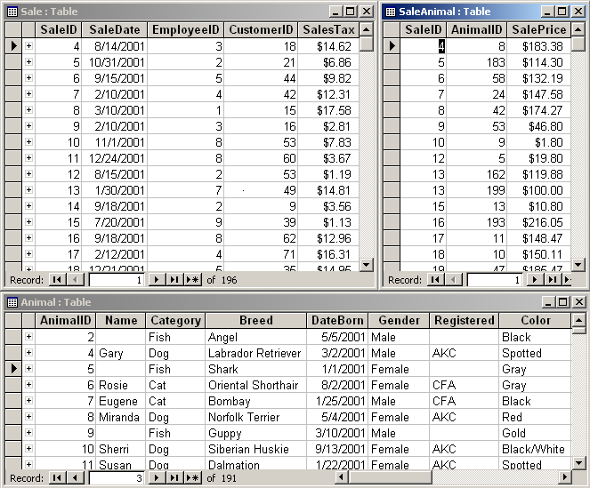
Database Tables (Access)
Chapter1 Introduction

Slide 43
Database Design
The process of designing the general structure of the database:
  Logical Design
  Physical Design
Chapter1 Introduction

Slide 44
Database Design
Cont.
Logical Design – Deciding on the database schema. Database design requires that we find a “good” collection of relation schemas.
  Business decision – What attributes should we record in the database?
  Computer Science decision – What relation schemas should we have and how should the attributes be distributed among the various relation schemas?
Physical Design – Deciding on the physical layout of the database
Chapter1 Introduction

Slide 45
Tools:
Database Design
SQL (queries)
Programming
Design
Program
SQL
Best:
Spend your time
on design and SQL.
Program
Design
SQL
Worst:
Compensate for poor design
and limited SQL with programming.
Chapter1 Introduction

Slide 46
Database Users
Users are differentiated by the way they expect to interact with the system
Application programmers – interact with system through DML calls
Sophisticated users – form requests in a database query language
Chapter1 Introduction

Slide 47
Database Users
Cont.
Specialized users – write specialized database applications that do not fit into the traditional data processing framework
Naive users – invoke one of the permanent application programs that have been written previously
  Examples, people accessing database over the web, bank tellers, clerical staff
Chapter1 Introduction

Slide 48
Database Administrator
Database Administrator ➔ DBA
A person who have central control of the database system, coordinates all the activities of the database system
Has a good understanding of the enterprise’s information resources and needs
Chapter1 Introduction

Slide 49
Database Administrator
Cont.
Database administrator's duties include:
  Schema definition
  Storage structure and access method definition
  Granting user authority to access the database
  Specifying integrity constraints
  Acting as liaison with users
  Monitoring performance and responding to changes in requirements
Chapter1 Introduction

Slide 50
Database System Structure
Function components of DBMS
  Storage Management
  Query Processing
Chapter1 Introduction

Slide 51
Storage Management
Database data is typically stored on secondary memory (hard disk), using file system
Storage Manager is a program module responsible to
  Interact with the file sytem
  Efficient storing, retrieving and updating of data
Chapter1 Introduction

Slide 52
Storage Management
Cont.
Storage Manager include following components
  Authorization and integrity manager
  Transaction manager
  File manager
  Buffer manager
Chapter1 Introduction

Slide 53
Storage Management
Cont.
Authorization and integrity manager
  Tests for the satisfaction of integrity constraints and check the authority of users to access data
Transaction manager
  Ensure database remains in a consistent state despite system failure
  Ensure concurrent transaction execution proceed without conflicting
Chapter1 Introduction

Slide 54
Storage Management
Cont.
File manager
  Allocate space on disk storage
  Manage data structures used to represent information stored on disk
Buffer manager
  Fetch data from disk storage to main memory
  Decide what data to cache in main memory
Chapter1 Introduction

Slide 55
Storage Management
Cont.
Storage Manager implements following data structures
  Data File: store database itself
  Data Dictionary: store metadata about the structure of database, in particular the schema of database
  Indices: provide fast access to data items that hold particular value
Chapter1 Introduction

Slide 56
Query Processing
One of the main purpose of DBS is to simplify and facilitate access to data
DBS achieve this goal by
  Data abstraction
  Nonprocedural language
Query Processor translates updates and queries written in a nonprocedural language, at the logical level, into an efficient sequence of operations at the physical level
Chapter1 Introduction

Slide 57
Query Processing
Cont.
Query processor components include
  DDL Interpreter
  DML Compiler
  Query Evaluation Engine
Chapter1 Introduction

Slide 58
Query Processing
Cont.
DDL interpreter
  Interprets DDL statement and record definitions in the data dictionary
DML Compiler
  Translate DML statement into an evaluation plan consisting low-level instructions
Query evaluation engine
  Executes low level instructions generated by DML compiler
Chapter1 Introduction

Slide 59
*Query Processing
Cont.
Alternative ways of evaluating a given query
  Equivalent expressions
  Different algorithms for each operation
Cost difference between a good and a bad way of evaluating a query can be enormous
Need to estimate the cost of operations
  Depends critically on statistical information about relations which the database must maintain
  Need to estimate statistics for intermediate results to compute cost of complex expressions
Chapter1 Introduction

Slide 60
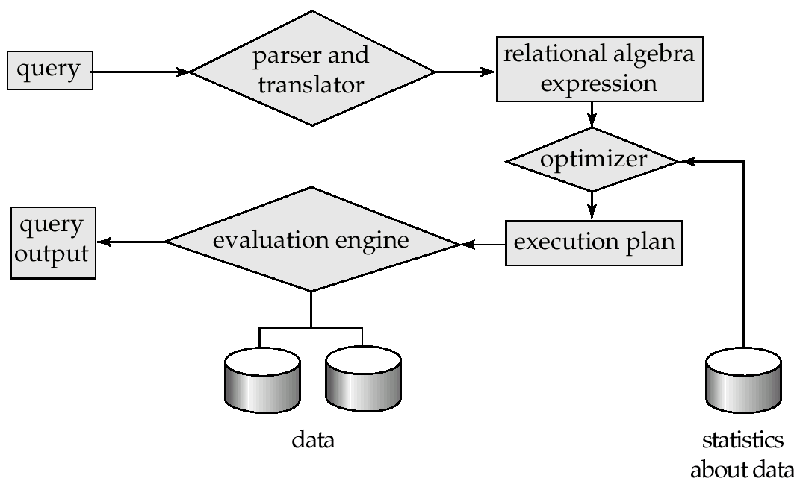
*Steps of query processing
1.Parsing and translation
2.Optimization
3.Evaluation
Chapter1 Introduction

Slide 61
Transaction Management
A transaction is a collection of operations that performs a single logical function in a database application
Transaction-management component ensures that the database remains in a consistent (correct) state despite system failures (e.g., power failures and operating system crashes) and transaction failures.
Concurrency-control manager controls the interaction among the concurrent transactions, to ensure the consistency of the database
Chapter1 Introduction

Slide 62
Application Programmer
Naïve users
Sophisticated users
DBA
Overall System Structure
Application interface
Application programs
Query tools
Administration tools
Application program object code
Compiler and linker
DDL interpreter
DML queries
Query evaluation engine
DML compiler and organizer
Query Processor
Authorization and integrity manager
Buffer manager
File manager
Transaction manager
Database Management System
Storage Manager
Data dictionary
Data
indices
Statistical data
Disk Storage
Chapter1 Introduction

Slide 63
Database Architecture
The architecture of a database systems is greatly influenced by the underlying computer system on which the database is running
  Centralized
  Client-server
  Parallel (multi-processor)
  Distributed
Chapter1 Introduction

Slide 64
History of Database Systems
1950s and early 1960s:
  Data processing using magnetic tapes for storage
    Tapes provide only sequential access
  Punched cards for input
Late 1960s and 1970s:
  Hard disks allow direct access to data
  Network and hierarchical data models in widespread use
  Ted Codd defines the relational data model
    Would win the ACM Turing Award for this work
    IBM Research begins System R prototype
    UC Berkeley begins Ingres prototype
Chapter1 Introduction

Slide 65
History of Database Systems
Cont.
1980s:
  Research relational prototypes evolve into commercial systems
    SQL becomes industrial standard
  Parallel and distributed database systems
  Object-oriented database systems
1990s:
  Large decision support and data-mining applications
  Large multi-terabyte data warehouses
  Emergence of Web commerce
Chapter1 Introduction

Slide 66

Conclusions
Chapter1 Introduction

Slide 67

Questions?
Chapter1 Introduction

Slide 68
END of CHAPTER 1
Chapter1 Introduction

