Slide 1
Chapter 3: SQL

Slide 2
Contents
Data Definition
Basic Query Structure
Set Operations
Aggregate Functions
Null Values
Nested Subqueries
Complex Queries
Views
Modification of the Database
Joined Relations**
Chapter3 SQL

Slide 3
History
IBM Sequel language developed as part of System R project at the IBM San Jose Research Laboratory
Renamed Structured Query Language (SQL)
ANSI and ISO standard SQL:
  SQL-86, SQL-89, SQL-92, SQL:1999, SQL:2003
Chapter3 SQL

Slide 4
History
Cont.
Commercial systems offer most, if not all, SQL-92 features, plus varying feature sets from later standards and special proprietary features.
  Not all examples here may work on your particular system
Chapter3 SQL

Slide 5
Data Definition Language
Allows the specification of information about each relation, including:
  The schema for each relation.
  The domain of values associated with each attribute.
  Integrity constraints
  The set of indices to be maintained for each relations.
  Security and authorization information for each relation.
  The physical storage structure of each relation on disk.
Chapter3 SQL

Slide 6
Domain Types in SQL
char(n). Fixed length character string, with user-specified length n.
varchar(n). Variable length character strings, with user-specified maximum length n.
int. Integer (a finite subset of the integers that is machine-dependent).
smallint. Small integer (a machine-dependent subset of the integer domain type).
Chapter3 SQL

Slide 7
Domain Types in SQL
Cont.
numeric(p,d). Fixed point number, with user-specified precision of p digits, with d digits to the right of decimal point.
real, double precision. Floating point and double-precision floating point numbers, with machine-dependent precision.
float(n). Floating point number, with user-specified precision of at least n digits.
More are covered in Chapter 4.
Chapter3 SQL

Slide 8
Create Table Construct
An SQL relation is defined using the create table command:
  r is the name of the relation
  each A_{i} is an attribute name in the schema of relation r
  D_{i} is the data type of values in the domain of attribute A_{i}
create table r (A1 D1, A2 D2, ..., An Dn,
(integrity-constraint1),
...,
(integrity-constraintk))
Chapter3 SQL

Slide 9
Create Table Construct
Cont.
null values is not allowed in attribute brach_name
Example:
create table branch
(branch_name char(15) not null,
branch_city char(30),
assets integer)
Chapter3 SQL

Slide 10
Integrity Constraints
automatically ensures not null in SQL-92 onwards
not null
primary key (A₁, ..., A_{n} )
Example: Declare branch_name as the primary key for branch
create table branch
(branch_name char(15),
branch_city char(30),
assets integer,
primary key (branch_name))
Chapter3 SQL

Slide 11
Drop Table Constructs
The drop table command deletes all information about the dropped relation from the database.
Deletes not only all tuples of r, but also the schema for r
drop table r
More drastic than
Retains relation r, but deletes all tuples in r
delete table r
Chapter3 SQL

Slide 12
Alter Table Constructs
The alter table command is used to add attributes to an existing relation:
  where A is the name of the attribute to be added to relation r, D is the domain of A.
alter table r add A D
All tuples in the relation are assigned null as the value for the new attribute
Chapter3 SQL

Slide 13
Alter Table Constructs
Cont.
The alter table command can also be used to drop attributes of a relation:
  where A is the name of an attribute of relation r
alter table r drop A
Dropping of attributes ➔not supported by many databases
Chapter3 SQL

Slide 14
Basic Query Structure
SQL is based on relational algebra and relational calculus
A typical SQL query has the form:
Attributes
select A₁, A₂, ..., A_{n}
from r₁, r₂, ..., r_{m}
where P
Relations
Predicate
Chapter3 SQL

Slide 15
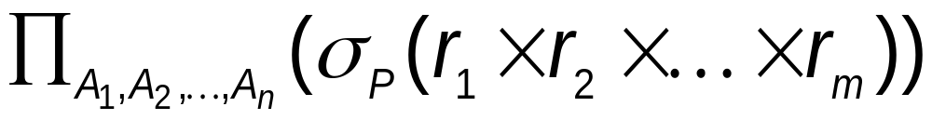
Basic Query Structure
Cont.
equivalent to the relational algebra expression
The result of an SQL query is a relation
Chapter3 SQL

Slide 16
The select Clause
The select clause list the attributes desired in the result of a query
  corresponds to the projection operation of the relational algebra
Example
find the names of all branches in the loan relation
select branch_nam
from loan
∏_{branch_name} (loan)
corresponds to
Chapter3 SQL

Slide 17
The select Clause
Cont.
SQL names are case insensitive (i.e., you may use upper- or lower-case letters.)
SQL allows duplicates in relations as well as in query results
Example
Branch_Name ≡ BRANCH_NAME ≡ branch_name
Chapter3 SQL

Slide 18
The select Clause
Cont.
To force the elimination of duplicates, insert the keyword distinct after select.
Example
Find the names of all branches in the loan relations, and remove duplicates
select distinct branch_name
from loan
Chapter3 SQL

Slide 19
The select Clause****
Cont.
The keyword all specifies that duplicates not be removed.
Default is all
select all branch_name
from loan
Chapter3 SQL

Slide 20
The select Clause
Cont.
An asterisk in the select clause denotes “all attributes”
select *
from loan
Equal to
select loan_number, branch_name, amount
from loan
Chapter3 SQL

Slide 21
The select Clause
Cont.
The select clause can contain arithmetic expressions involving the operation, +, –, ∗, and /, and operating on constants or attributes of tuples
  would return a relation that is the same as the loan relation, except that the value of the attribute amount is multiplied by 100
select loan_number, branch_name, amount*100
from loan
Chapter3 SQL

Slide 22
The where Clause
The where clause specifies conditions that the result must satisfy
  Corresponds to the selection predicate of the relational algebra
Example
find all loan number for loans made at the Perryridge branch with loan amounts greater than $1200
select loan_number
from loan
where branch_name = 'Perryridge' and amount > 1200
Chapter3 SQL

Slide 23
The where Clause
Cont.
SQL use the logical connectives and, or, not in the where clause
Operands of logical connectives can be expressions involving the comparison operation ＜, ＞, ＜=, ＞=, ==, ＜＞
Comparisons can be applied to results of arithmetic expressions, strings, special types such as date types
Chapter3 SQL

Slide 24
The where Clause
Cont.
SQL includes a between comparison operator
Example
Find the loan number of those loans with loan amounts between $90,000 and $100,000 (that is, ≥$90,000 and ≤$100,000)
select loan_number
from loan
where amount between 90000 and 100000
Chapter3 SQL

Slide 25
The from Clause
The from clause lists the relations involved in the query
  Corresponds to the Cartesian product operation of the relational algebra.
Example
Find the Cartesian product borrower × loan
select *
from borrower, loan
Chapter3 SQL

Slide 26
Example
Find the name, loan number and loan amount of all customers having a loan at the Perryridge branch
select customer_name, borrower.loan_number, amount
from borrower, loan
where borrower.loan_number = loan.loan_number and
branch_name = ‘Perryridge’
Chapter3 SQL

Slide 27
The Rename Operation
The SQL allows renaming attributes in the select clause using the as clause:
old-name as new-name
Example
Find the name, loan number and loan amount of all customers; rename the column name loan_number as loan_id
select customer_name,
borrower.loan_number as loan_id, amount
from borrower, loan
where borrower.loan_number = loan.loan_number
Chapter3 SQL

Slide 28
Tuple Variables_
Tuple variables are defined in the from clause via the use of the as clause.
Example
Find the customer names and their loan numbers and loan amounts for all customers having a loan at some branch
select customer_name, T.loan_number, S.amount
from borrower as T, loan as S
where T.loan_number = S.loan_number
Chapter3 SQL

Slide 29
Example
Find the names of all branches that have greater assets than some branch located in Brooklyn
select distinct T.branch_name
from branch as T, branch as S
where T.assets > S.assets and S.branch_city = 'Brooklyn'
Keyword as is optional and may be omitted
borrower as T ≡ borrower T
Chapter3 SQL

Slide 30
String Operations
SQL includes a string-matching operator for comparisons on character strings.
The operator “like” uses patterns that are described using two special characters:
  percent (%). The % character matches any substring that have any length (can be 0).
  underscore (_). The _ character matches any character.
Chapter3 SQL

Slide 31
Example
Find the names of all customers whose street includes the substring “Main”.
select customer_name
from customer
where customer_street like '% Main%'
Match the string “80%”
like ‘80\%' escape '\'
Chapter3 SQL

Slide 32
String Operations
Cont.
SQL supports a variety of string operations such as
  concatenation (using “||”)
  converting from upper to lower case (and vice versa)
  finding string length, extracting substrings, etc.
Chapter3 SQL

Slide 33
Ordering the Display of Tuples
The order by clause causes the tuples in the result of a query to appear in sorted order
Example
List in alphabetic order the names of all customers having a loan in Perryridge branch
select distinct customer_name
from borrower, loan
where borrower loan_number = loan.loan_number and
branch_name = 'Perryridge'
order by customer_name
Chapter3 SQL

Slide 34
Ordering the Display of Tuples
Cont.
We may specify desc for descending order or asc for ascending order
Ordering can be performed on multiple attributes
select *
from loan
order by amount desc, loan_number asc
For each attribute, ascending order is the default
Chapter3 SQL

Slide 35
Duplicates
Multiset versions of some of the relational algebra operators – given multiset relations r₁ and r₂:
  1. σ_{θ} (r₁): If there are c₁ copies of tuple t₁ in r₁, and t₁ satisfies selections σ_{θ,}, then there are c₁ copies of t₁ in σ_{θ} (r₁).
  2. Π_{A} (r ): For each copy of tuple t₁ in r₁, there is a copy of tuple Π_{A} (t₁) in Π_{A} (r₁) where Π_{A} (t₁) denotes the projection of the single tuple t₁.
  3. r₁ x r₂: If there are c₁ copies of tuple t₁ in r₁ and c₂ copies of tuple t₂ in r₂, there are c₁ * c₂ copies of the tuple t₁. t₂ in r₁ x r₂
Chapter3 SQL

Slide 36
Duplicates
Cont.
Example: Suppose multiset relations R₁ (A, B) and R₂ (C) are as follows:
r₁ = {(1, a) (2,a)} r₂ = {(2), (3), (3)}
Then Π_{B}(r₁) would be {(a), (a)}, while Π_{B}(r₁) x r₂ would be
{(a,2), (a,2), (a,3), (a,3), (a,3), (a,3)}
SQL duplicate semantics:
select A₁,, A₂, ..., A_{n}
from r₁, r₂, ..., r_{m}
where P
is equivalent to the multiset version of the expression
Chapter3 SQL

Slide 37
Set Operations
The set operations union, intersect, and except operate on relations and correspond to the relational algebra operations ∪, ∩, −.
Each of the above operations automatically eliminates duplicates
Chapter3 SQL

Slide 38
Set Operations
Cont.
To retain all duplicates use the corresponding multiset versions union all, intersect all and except all
Suppose a tuple occurs m times in r and n times in s, then, it occurs:
  m + n times in r union all s
  min(m,n) times in r intersect all s
  max(0, m – n) times in r except all s
Chapter3 SQL

Slide 39
Example
Find all customers who have a loan, an account, or both
(select customer_name from depositor)
union
(select customer_name from borrower)
Find all customers who have both a loan and an account
(select customer_name from depositor)
intersect
(select customer_name from borrower)
Find all customers who have an account but no loan.
(select customer_name from depositor)
except
(select customer_name from borrower)
Chapter3 SQL

Slide 40
Aggregate Functions
These functions operate on the multiset of values of a column of a relation, and return a value
avg: average value
min: minimum value
max: maximum value
sum: sum of values
count: number of values
Chapter3 SQL

Slide 41
Example
Find the average account balance at the Perryridge branch
select avg (balance)
from account
where branch_name = 'Perryridge'
Find the number of tuples in the customer relation.
Count the number of tuples in a relation
select count (*)
from customer
Find the number of depositors in the bank.
select count (distinct customer_name)
from depositor
eliminate duplicates
Chapter3 SQL

Slide 42
Aggregate Functions – Group By
Find the number of depositors for each branch
select branch_name, count (distinct customer_name)
from depositor, account
where depositor.account_number = account.account_number
group by branch_name
Attributes in select clause outside of aggregate functions must appear in group by list
Chapter3 SQL

Slide 43
Aggregate Functions – Having
Find the names of all branches where the average account balance is more than $1,200
select branch_name, avg (balance)
from account
group by branch_name
having avg (balance) > 1200
predicates in the having clause are applied after the formation of groups whereas predicates in the where clause are applied before forming groups
Chapter3 SQL

Slide 44
Null Values
It is possible for tuples to have a null value, denoted by null, for some of their attributes
null signifies an unknown value or that a value does not exist.
The predicate is null can be used to check for null values
Example
Find all loan number which appear in the loan relation with null values for amount
select loan_number
from loan
where amount is null
Chapter3 SQL

Slide 45
Null Values
Cont.
The result of any arithmetic expression involving null is null
Any comparison with null returns unknown
5 + null returns null
5 < null or null <> null or null = null
null is null
true
null = null
unknown
Chapter3 SQL

Slide 46
Null Values
Cont.
Three-valued logic using the truth value unknown:
  OR: (unknown or true) = true,
  (unknown or false) = unknown
  (unknown or unknown) = unknown
  AND: (true and unknown) = unknown,
  (false and unknown) = false,
  (unknown and unknown) = unknown
  NOT: (not unknown) = unknown
Chapter3 SQL

Slide 47
Null Values
Cont.
Result of where clause predicate is treated as false if it evaluates to unknown
All aggregate operations except count(*) ignore tuples with null values on the aggregated attributes
select sum (amount )
from loan
Example
Total all loan amounts
Above statement ignores null amounts
Result is null if there is no non-null amount
Chapter3 SQL

Slide 48
Nested Subqueries
SQL provides a mechanism for the nesting of subqueries.
A subquery is a select-from-where expression that is nested within another query.
A common use of subqueries is to perform tests for set membership, set comparisons, and set cardinality
Chapter3 SQL

Slide 49
Set Membership
Set is produced by subquery
Find all customers who have both an account and a loan at the bank.
Test for set membership
select distinct customer_name
from borrower
where customer_name in (select customer_name
from depositor )
Find all customers who have a loan at the bank but do not have an account at the bank
Test for absence of set membership
select distinct customer_name
from borrower
where customer_name not in (select customer_name
from depositor )
Chapter3 SQL

Slide 50
Example Query
Find all customers who have both an account and a loan at the Perryridge branch
select distinct customer_name
from borrower, loan
where borrower.loan_number = loan.loan_number and
branch_name = 'Perryridge' and
(branch_name, customer_name ) in
(select branch_name, customer_name
from depositor, account
where depositor.account_number =
account.account_number )
Chapter3 SQL

Slide 51
Set Comparison
Find all branches that have greater assets than some branch located in Brooklyn.
select distinct T.branch_name
from branch as T, branch as S
where T.assets > S.assets and
S.branch_city = 'Brooklyn'
Same query using > some clause
select branch_name
from branch
where assets > some
(select assets
from branch
where branch_city = 'Brooklyn')
Chapter3 SQL

Slide 52
Definition of Some Clause
F <comp> some r
  ∃ t ∈ r such that (F <comp> t ), Where <comp> can be: <, ≤, >, =, ≠
0
0
(5 ≠ some
) = true (since 0 ≠ 5)
)
5
) = true
(5 < some
)
5
6
(= some) ≡ in
However, (≠ some) ≡ not in
0
(5 < some
) = false
)
5
5
) = true
(5 = some
)
Chapter3 SQL

Slide 53
Example Query
Find the names of all branches that have greater assets than all branches located in Brooklyn
select branch_name
from branch
where assets > all
(select assets
from branch
where branch_city = 'Brooklyn')
Chapter3 SQL

Slide 54
Definition of all Clause
F <comp> all r ⇔ ∀ t ∈ r (F <comp> t)
0
6
(5 < all
) = true
(5 < all
5
) = false
)
)
10
6
4
) = false
(5 = all
)
5
4
(5 ≠ all
) = true (since 5 ≠ 4 and 5 ≠ 6)
)
6
(≠ all) ≡ not in
However, (= all) ≡ in
Chapter3 SQL

Slide 55
Test for Empty Relations
The exists construct returns the value true if the argument subquery is nonempty.
exists r ⇔ r ≠ Ø
not exists r ⇔ r = Ø
Chapter3 SQL

Slide 56
Example Query
Find all customers who have both an account and a loan at the bank.
select distinct customer_name
from borrower
where exists (select *
from depositor
where depositor.customer_name =
borrower.customer_name )
select distinct customer_name
from borrower
where customer_name in (select customer_name
from depositor )
Chapter3 SQL

Slide 57
Example Query
Find all customers who have an account at all branches located in Brooklyn.
select distinct S.customer_name
from depositor as S
where not exists (
(select branch_name
from branch
where branch_city = 'Brooklyn')
except
(select R.branch_name
from depositor as T, account as R
where T.account_number = R.account_number and
S.customer_name = T.customer_name ))
Chapter3 SQL

Slide 58
Test for Absence of Duplicate Tuples*****
The unique construct tests whether a subquery has any duplicate tuples in its result.
Find all customers who have at most one account at the Perryridge branch
select T.customer_name
from depositor as T
where unique (
select R.customer_name
from account, depositor as R
where T.customer_name = R.customer_name and
R.account_number = account.account_number and
account.branch_name = 'Perryridge')
Chapter3 SQL

Slide 59
Example Query
Find all customers who have at least two accounts at the Perryridge branch.
select distinct T.customer_name
from depositor as T
where not unique (
select R.customer_name
from account, depositor as R
where T.customer_name = R.customer_name and
R.account_number = account.account_number and
account.branch_name = 'Perryridge')
Variable from outer level is known as a correlation variable
Chapter3 SQL

Slide 60
Derived Relations
SQL allows a subquery expression to be used in the from clause
Find the average account balance of those branches where the average account balance is greater than $1200
select branch_name, avg_balance
from (select branch_name, avg (balance)
from account
group by branch_name )
as branch_avg ( branch_name, avg_balance )
where avg_balance > 1200
Chapter3 SQL

Slide 61
With Clause
The with clause provides a way of defining a temporary view whose definition is available only to the query in which the with clause occurs.
Find all accounts with the maximum balance
with max_balance (value) as
select max (balance)
from account
select account_number
from account, max_balance
where account.balance = max_balance.value
Chapter3 SQL

Slide 62
Complex Queries using With Clause
Find all branches where the total account deposit is greater than the average of the total account deposits at all branches.
with branch_total (branch_name, value) as
select branch_name, sum (balance)
from account
group by branch_name
with branch_total_avg (value) as
select avg (value)
from branch_total
select branch_name
from branch_total, branch_total_avg
where branch_total.value >= branch_total_avg.value
Chapter3 SQL

Slide 63
Views
In some cases, it is not desirable for all users to see the entire logical model (that is, all the actual relations stored in the database.)
Consider a person who needs to know a customer’s name, loan number and branch name, but has no need to see the loan amount. This person should see a relation described, in SQL.
(select customer_name, borrower.loan_number, branch_name
from borrower, loan
where borrower.loan_number = loan.loan_number )
Chapter3 SQL

Slide 64
Views
Cont.
A view is defined using the create view statement which has the form
  where <query expression> is any legal SQL expression. The view name is represented by v
create view v as < query expression >
Chapter3 SQL

Slide 65
Views
Cont.
Once a view is defined, the view name can be used to refer to the virtual relation that the view generates.
When a view is created, the query expression is stored in the database; the expression is substituted into queries using the view
Chapter3 SQL

Slide 66
Example Query
A view consisting of branches and their customers
create view all_customer as
(select branch_name, customer_name
from depositor, account
where depositor.account_number =
account.account_number )
union
(select branch_name, customer_name
from borrower, loan
where borrower.loan_number = loan.loan_number)
Chapter3 SQL

Slide 67
Example Query
Find all customers of the Perryridge branch
select customer_name
from all_customer
where branch_name = 'Perryridge'
Chapter3 SQL

Slide 68
Views Defined Using Other Views
One view may be used in the expression defining another view
A view relation v₁ is said to depend directly on a view relation v₂ if v₂ is used in the expression defining v₁
Chapter3 SQL

Slide 69
Views Defined Using Other Views
Cont.
A view relation v₁ is said to depend on view relation v₂ if either v₁ depends directly to v₂ or there is a path of dependencies from v₁ to v₂
A view relation v is said to be recursive if it depends on itself.
Chapter3 SQL

Slide 70
View Expansion
A way to define the meaning of views defined in terms of other views.
Let view v₁ be defined by an expression e₁ that may itself contain uses of view relations.
Chapter3 SQL

Slide 71
View Expansion
Cont.
View expansion of an expression repeats the following replacement step:
As long as the view definitions are not recursive, this loop will terminate
repeat
Find any view relation vi in e1
Replace the view relation vi by the expression defining vi
until no more view relations are present in e1
Chapter3 SQL

Slide 72
Modification of the Database Deletion
Delete all account tuples at the Perryridge branch
delete from account
where branch_name = 'Perryridge'
Delete all accounts at every branch located in the city ‘Needham’.
delete from account
where branch_name in
(select branch_name
from branch
where branch_city = 'Needham')
Chapter3 SQL

Slide 73
Example Query
Delete the record of all accounts with balances below the average at the bank.
delete from account
where balance < (select avg (balance )
from account )
Problem: as we delete tuples from deposit, the average balance changes
Solution used in SQL:
  1. First, compute avg balance and find all tuples to delete
  2. Next, delete all tuples found above (without recomputing avg or retesting the tuples)
Chapter3 SQL

Slide 74
Modification of the Database Insertion
Add a new tuple to account
insert into account
values ('A-9732', 'Perryridge', 1200)
Or Equivalently
insert into account (branch_name, balance, account_number)
values ('Perryridge', 1200, 'A-9732')
Add a new tuple to account with balance set to null
insert into account
values ('A-777','Perryridge', null )
Chapter3 SQL

Slide 75
Example Query
Provide as a gift for all loan customers of the Perryridge branch, a $200 savings account. Let the loan number serve as the account number for the new savings account
insert into account
select loan_number, branch_name, 200
from loan
where branch_name = 'Perryridge'
insert into depositor
select customer_name, loan_number
from loan, borrower
where branch_name = 'Perryridge'
and loan.account_number = borrower.account_number
Chapter3 SQL

Slide 76
Modification of the Database Updates
Increase all accounts with balances over $10,000 by 6%, all other accounts receive 5%.
  Write two update statements:
  The order is important
  Can be done better using the case statement (next slide)
1.
2.
update account
set balance = balance ∗ 1.06
where balance > 10000
update account
set balance = balance ∗ 1.05
where balance ≤ 10000
Chapter3 SQL

Slide 77
Case Statement for Conditional Updates
Same query as before: Increase all accounts with balances over $10,000 by 6%, all other accounts receive 5%.
update account
set balance = case
when balance <= 10000 then balance *1.05
else balance * 1.06
end
Chapter3 SQL

Slide 78
Update Through Views
Create a view of all loan data in the loan relation, hiding the amount attribute
Add a new tuple to branch_loan
create view loan_branch as
select loan_number, branch_name
from loan
insert into branch_loan
values ('L-37‘, 'Perryridge‘)
represented by the insertion of the tuple ('L-37', 'Perryridge', null ) into the loan relation
Chapter3 SQL

Slide 79
Update Through Views
Cont.
Some updates through views are impossible to translate into updates on the database relations
  create view v as
  select loan_number, branch_name, amount
  from loan
  where branch_name = ‘Perryridge’
insert into v values ( 'L-99','Downtown', '23')
Chapter3 SQL

Slide 80
Update Through Views
Cont.
Others cannot be translated uniquely
  Have to choose loan or account, and
  create a new loan/account number!
Most SQL implementations allow updates only on simple views (without aggregates) defined on a single relation
insert into all_customer values ('Perryridge', 'John')
Chapter3 SQL

Slide 81
Joined Relations
Join operations take two relations and return as a result another relation.
These additional operations are typically used as subquery expressions in the from clause
Join condition – defines which tuples in the two relations match, and what attributes are present in the result of the join
Chapter3 SQL

Slide 82
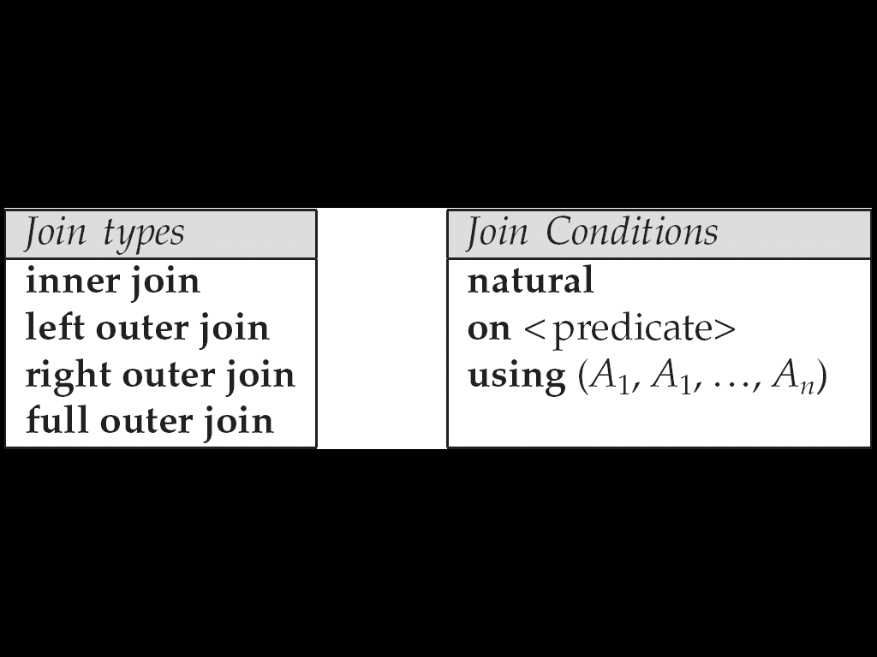
Joined Relations
Cont.
Join type – defines how tuples in each relation that do not match any tuple in the other relation (based on the join condition) are treated
Chapter3 SQL

Slide 83
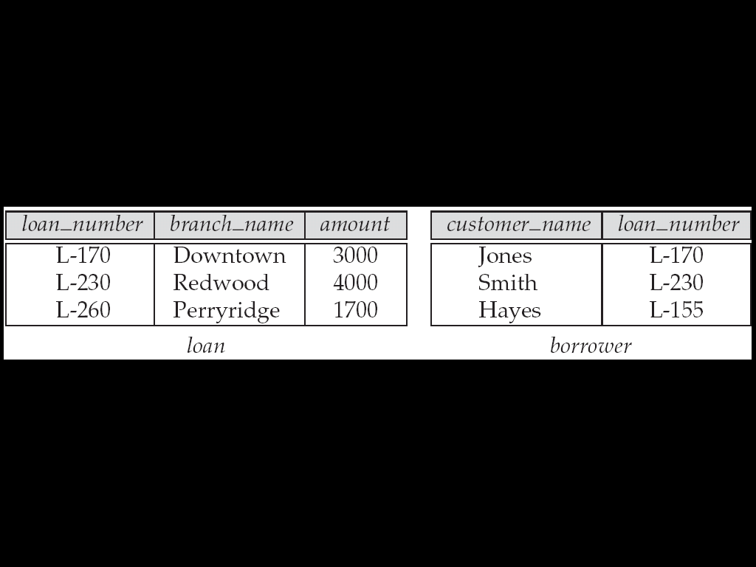
Joined Relations Datasets for Examples
Relation loan
Relation borrower
borrower information missing for L-260 and loan information missing for L-155
Chapter3 SQL

Slide 84


Joined Relations – Examples
loan inner join borrower on
loan.loan_number = borrower.loan_number
loan left outer join borrower on
loan.loan_number = borrower.loan_number
Chapter3 SQL

Slide 85

Joined Relations – Examples
Cont.
loan natural inner join borrower
loan natural right outer join borrower
Chapter3 SQL

Slide 86

Joined Relations – Examples
Cont.
loan full outer join borrower using (loan_number)
Find all customers who have either an account or a loan (but not both) at the bank.
select customer_name
from (depositor natural full outer join borrower )
where account_number is null or loan_number is null
Chapter3 SQL

Slide 87

Conclusions
Chapter3 SQL

Slide 88

Questions?
Chapter3 SQL

Slide 89
End of Chapter 3

