Slide 1
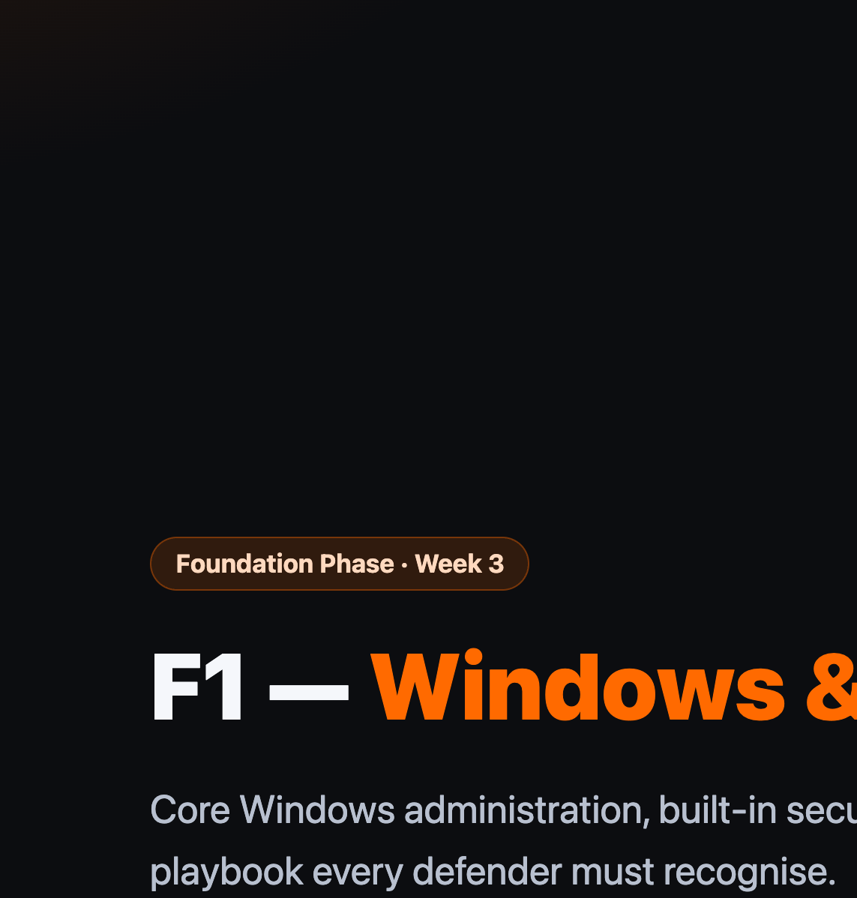
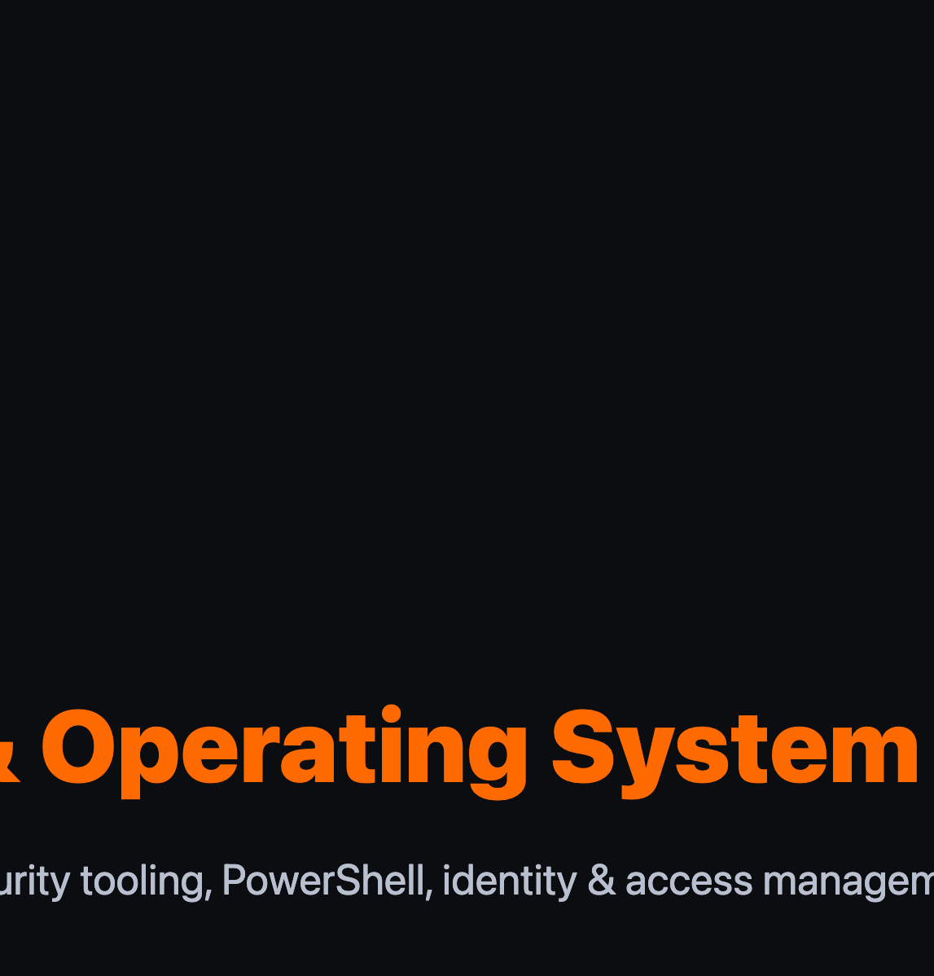
Notes:
Welcome learners to Module F1, the first shared Foundation module. Every learner — regardless of eventual CyberOps or DFIR track — covers this material.

Slide 2
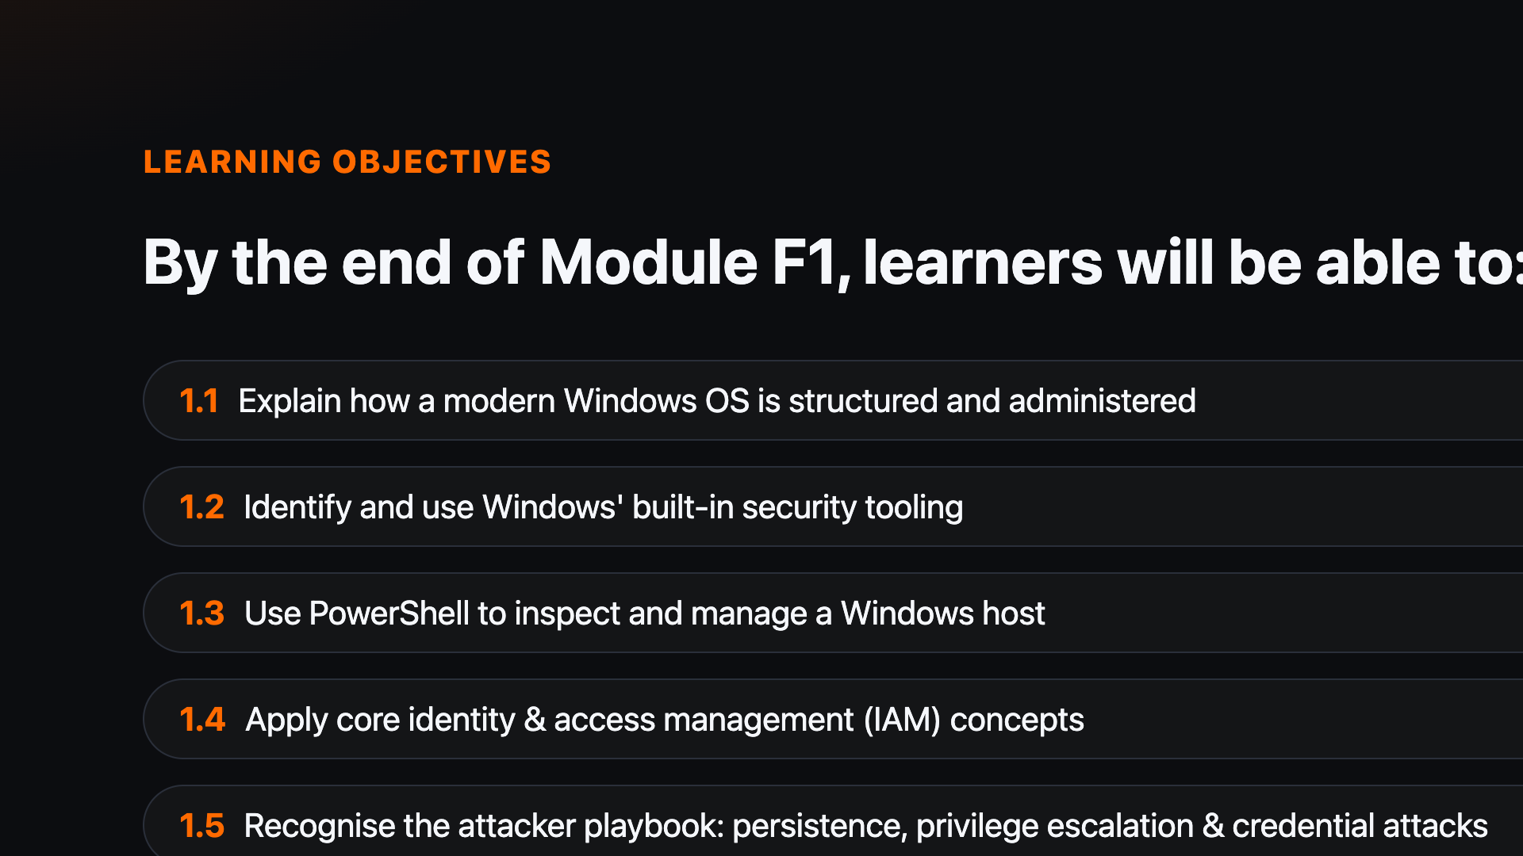
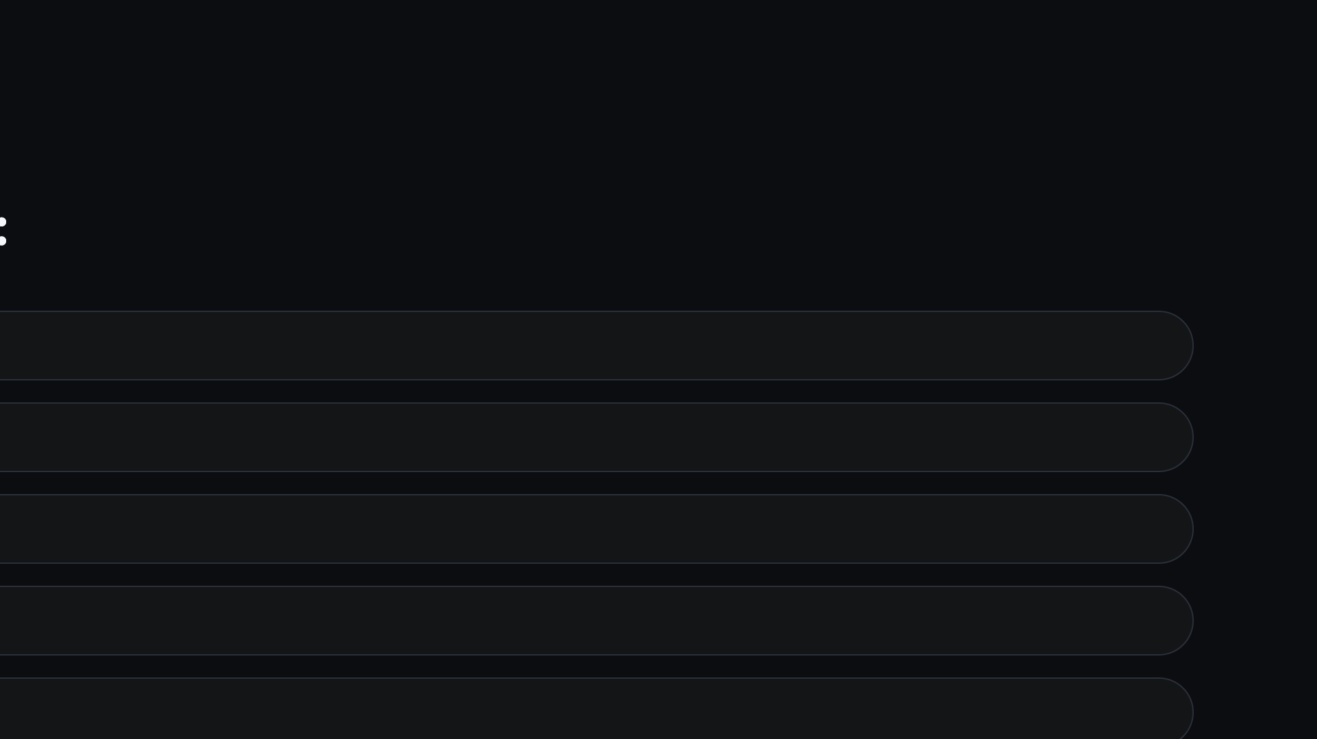
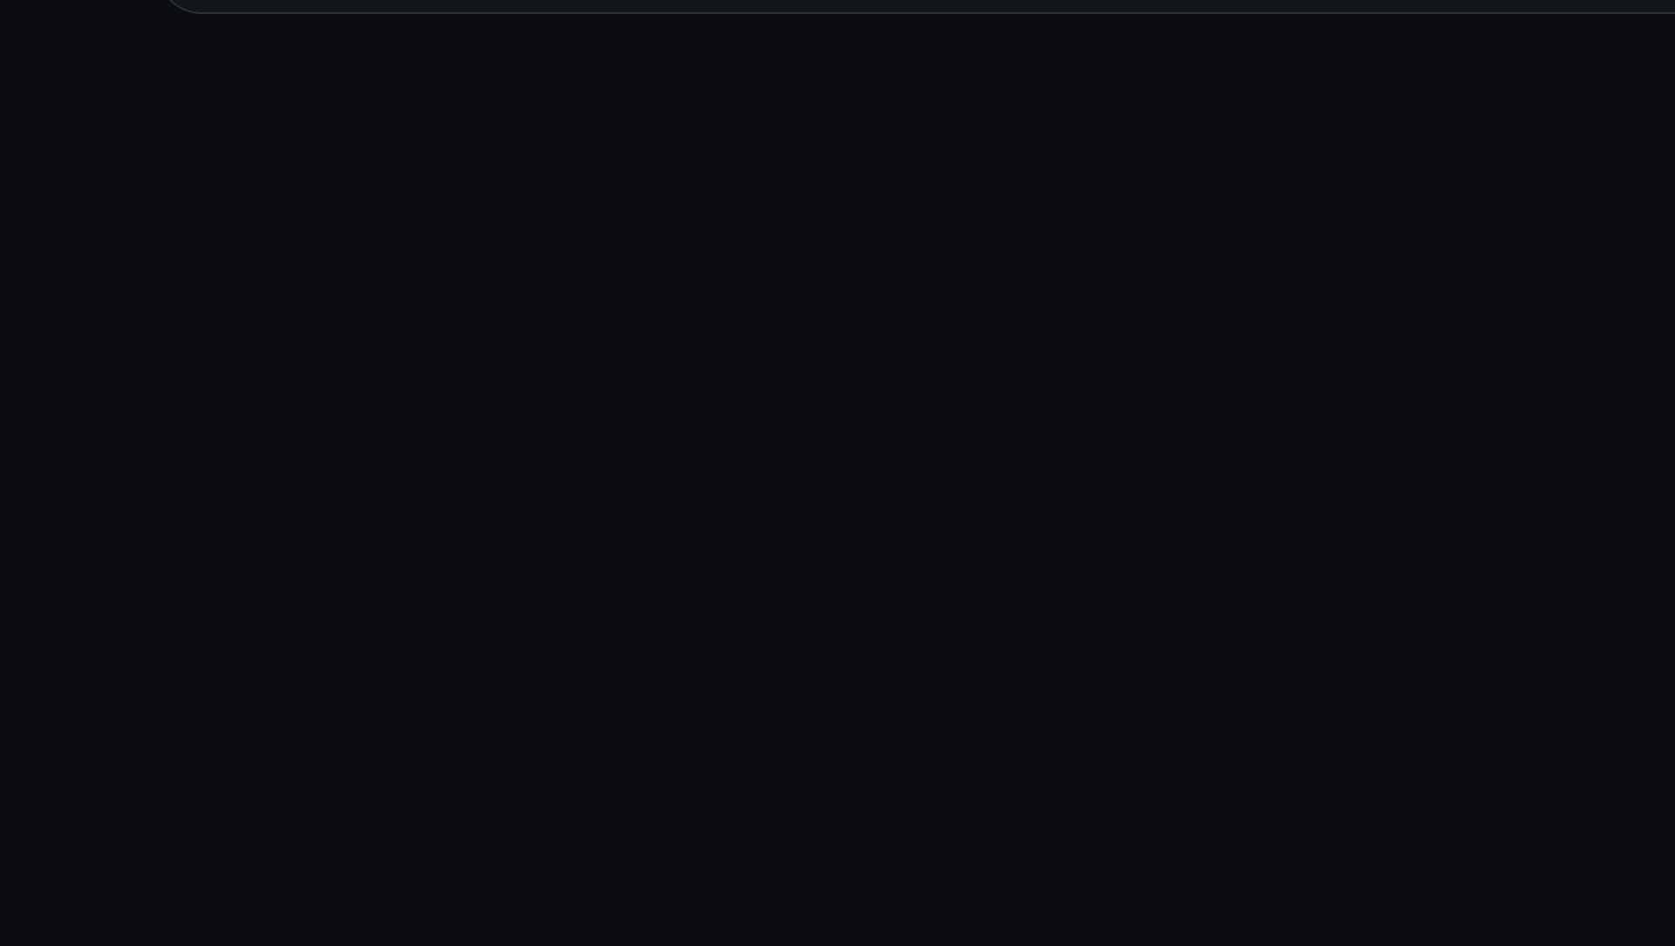
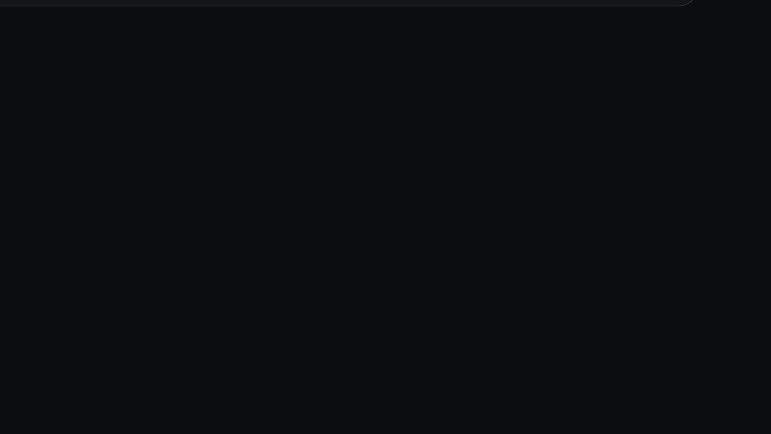
Notes:
Walk through all five sub-objectives. Flag that 1.5 sets up the mindset split between CyberOps and DFIR.

Slide 3
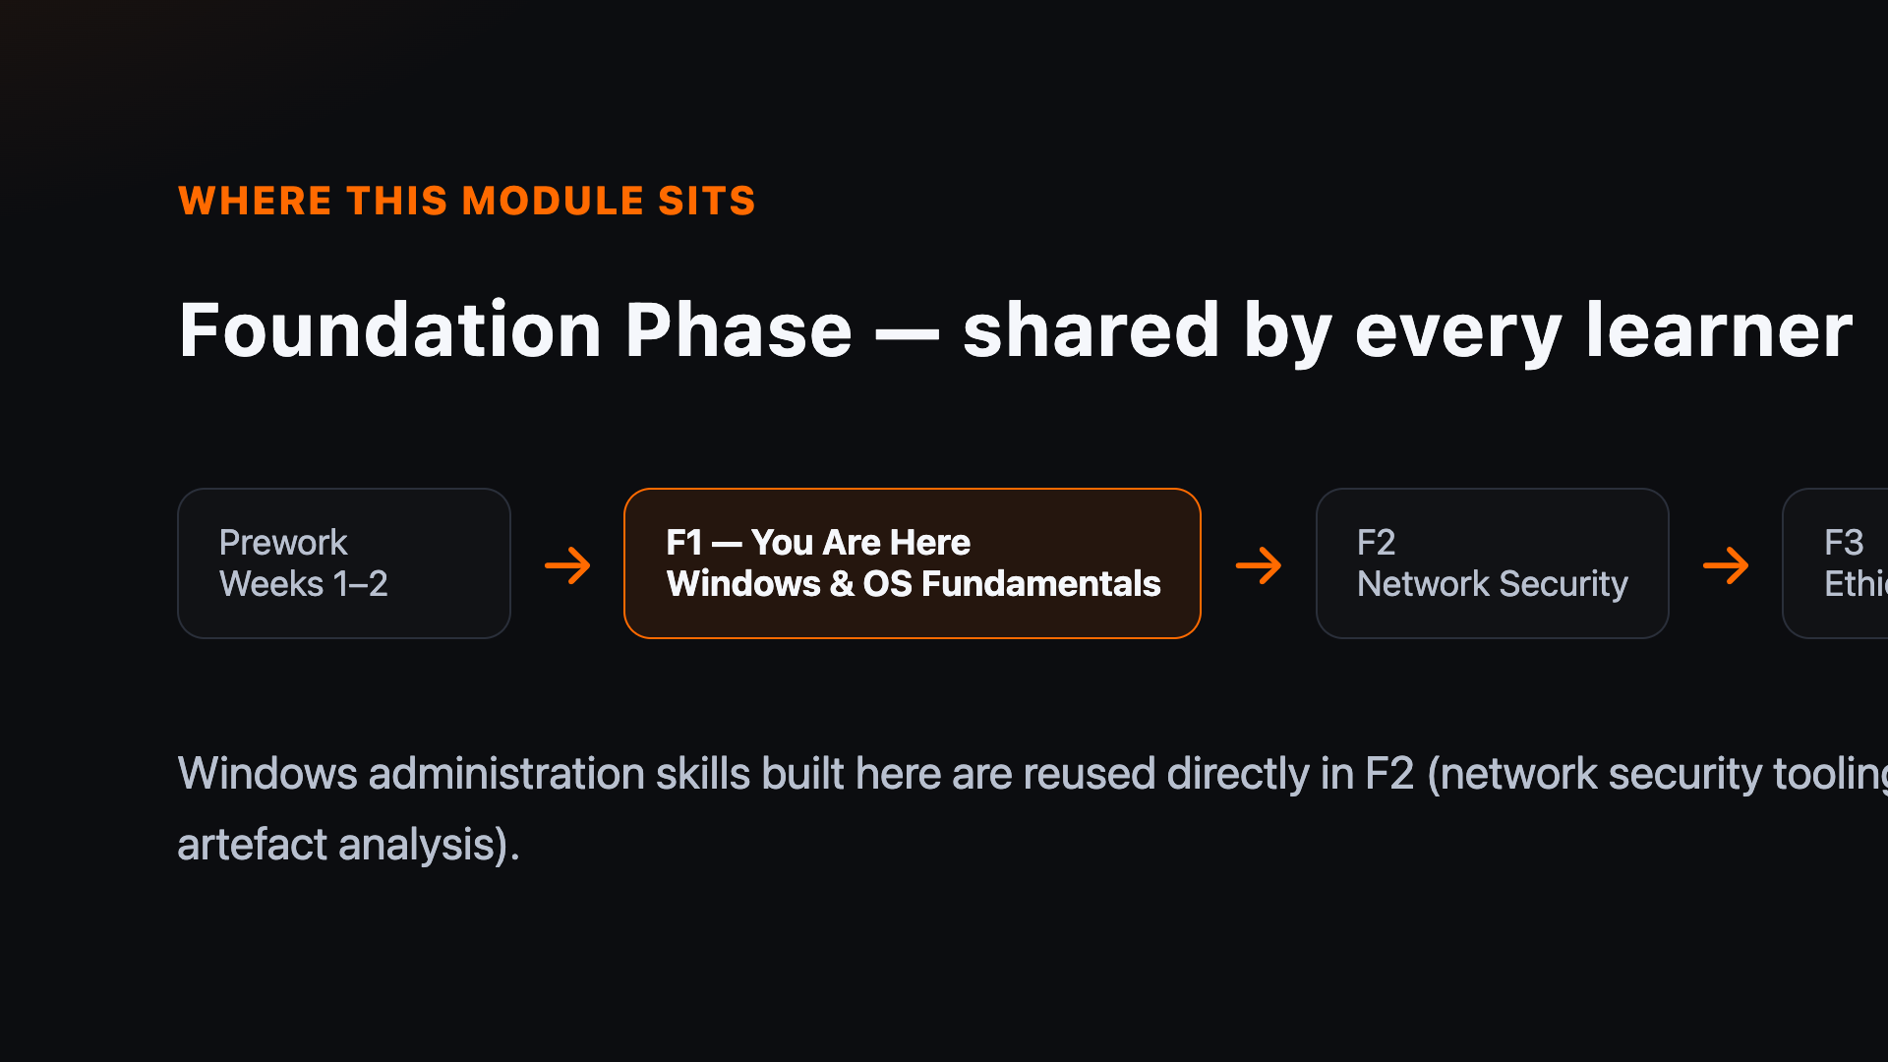
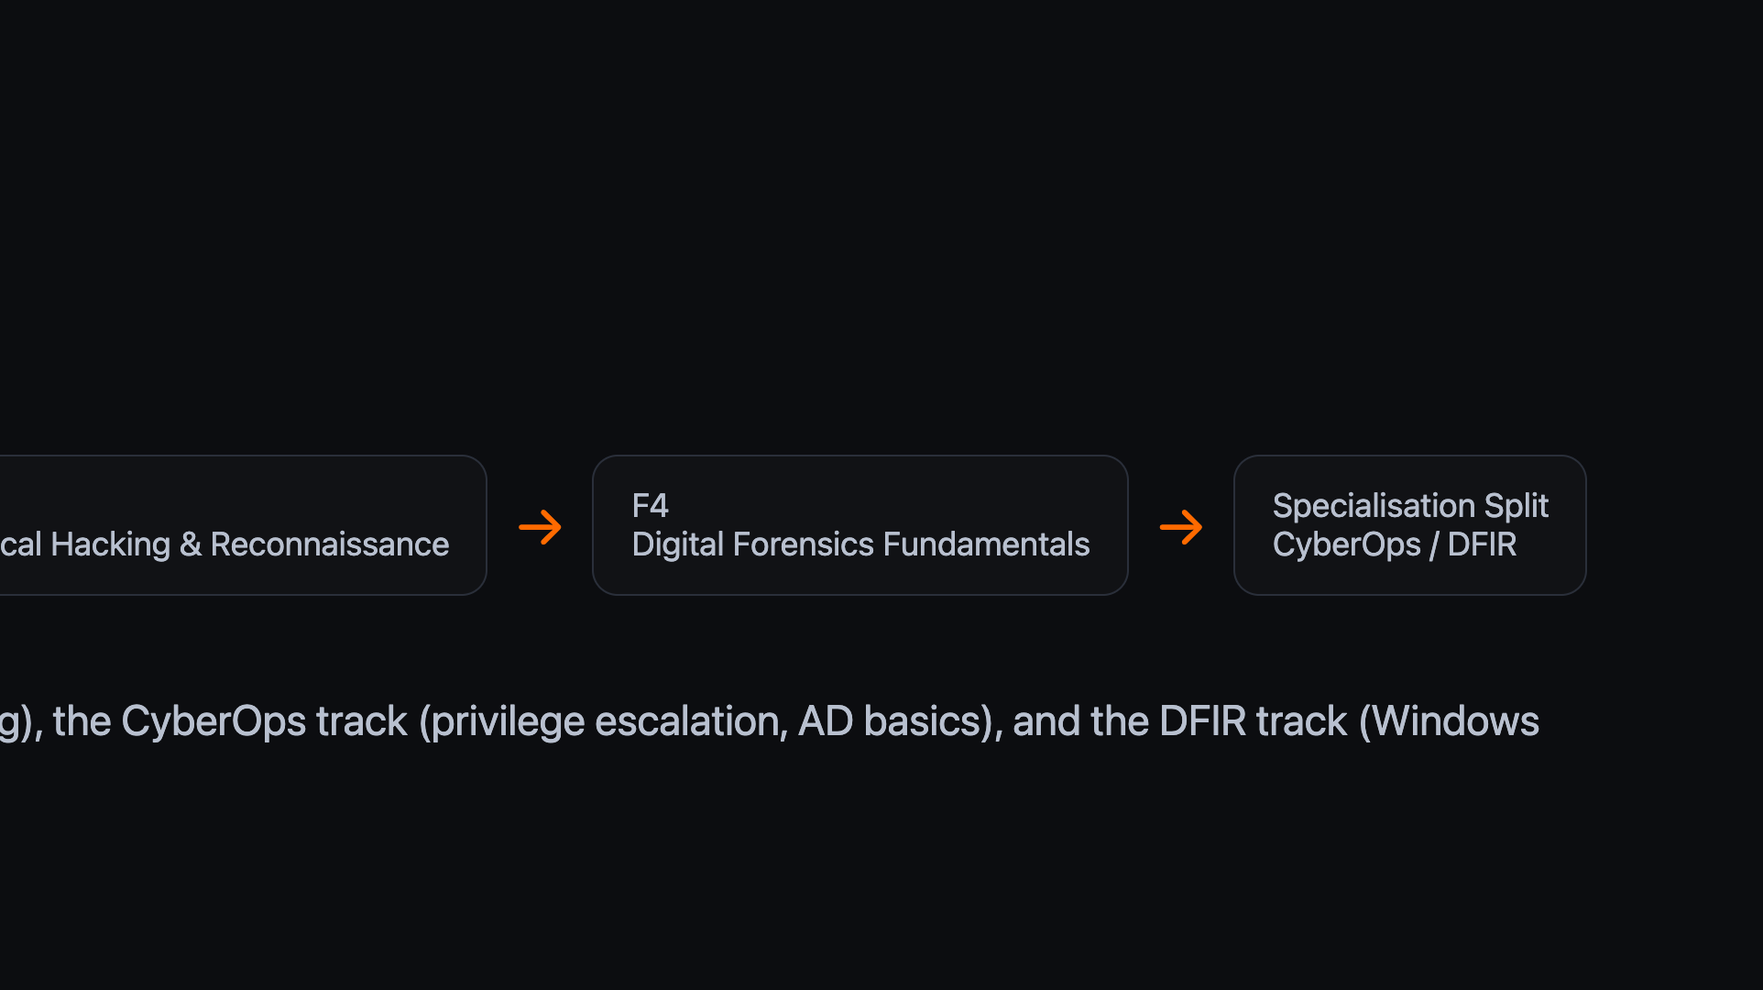


Notes:
Show learners where F1 sits: shared Foundation before the CyberOps/DFIR specialisation split in week 7.

Slide 4
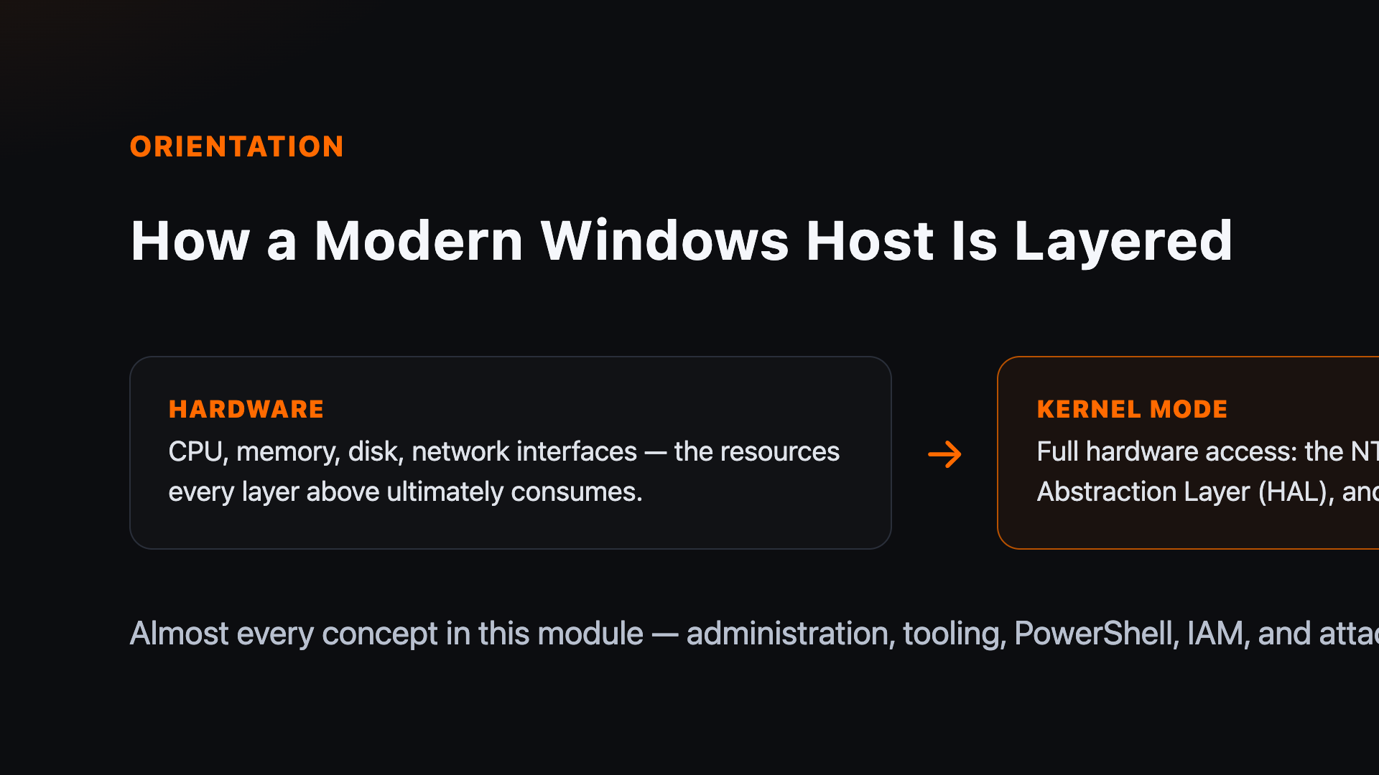
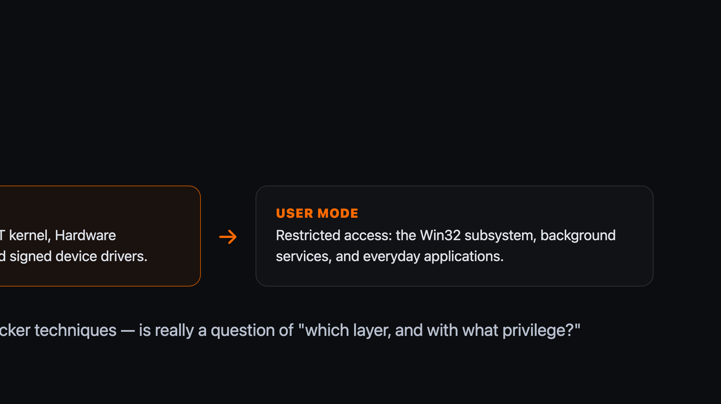
Notes:
Set the mental model before diving into sub-objectives: two privilege rings, and where security tooling sits in each.

Slide 5
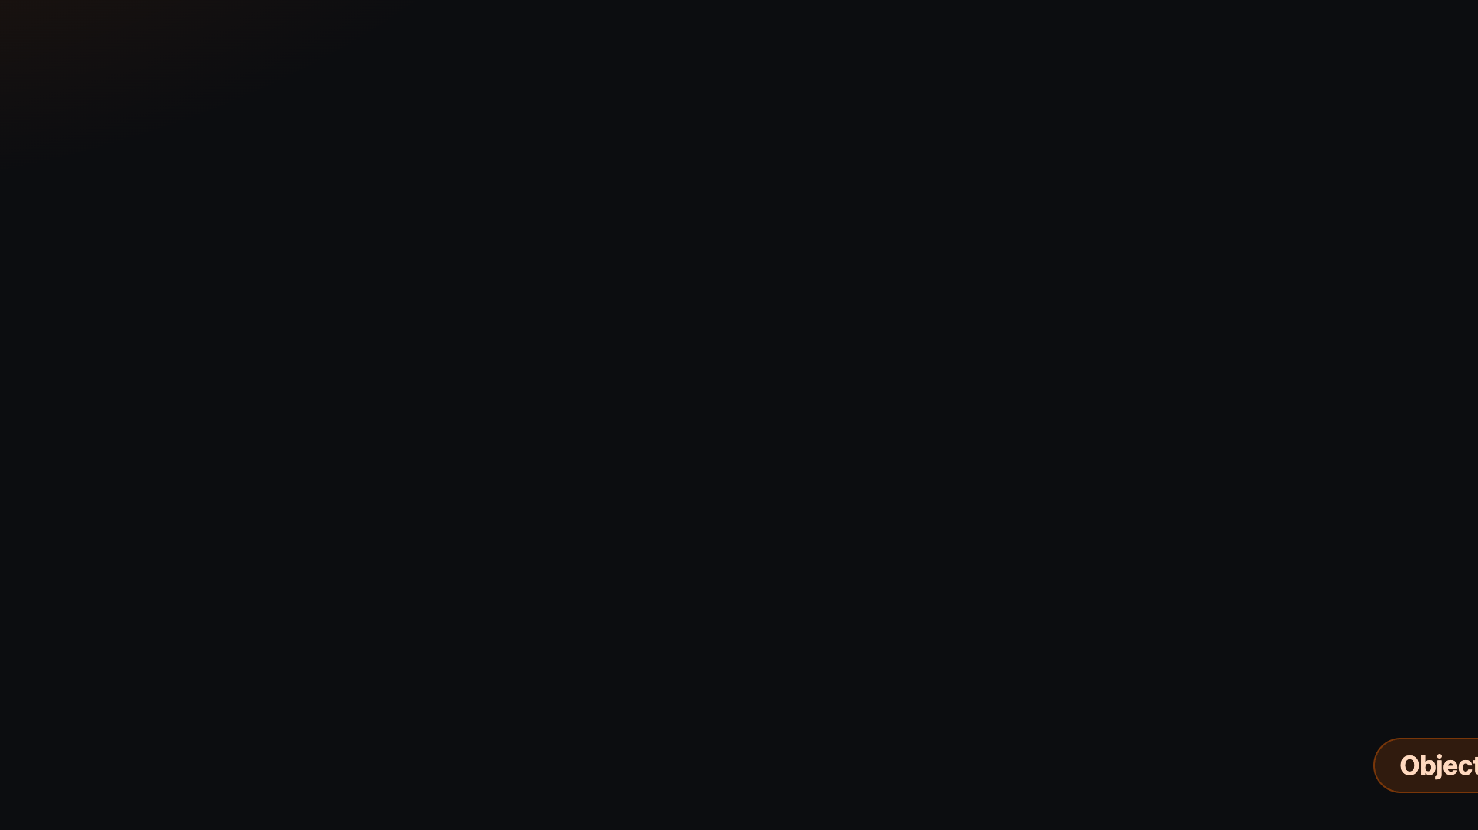
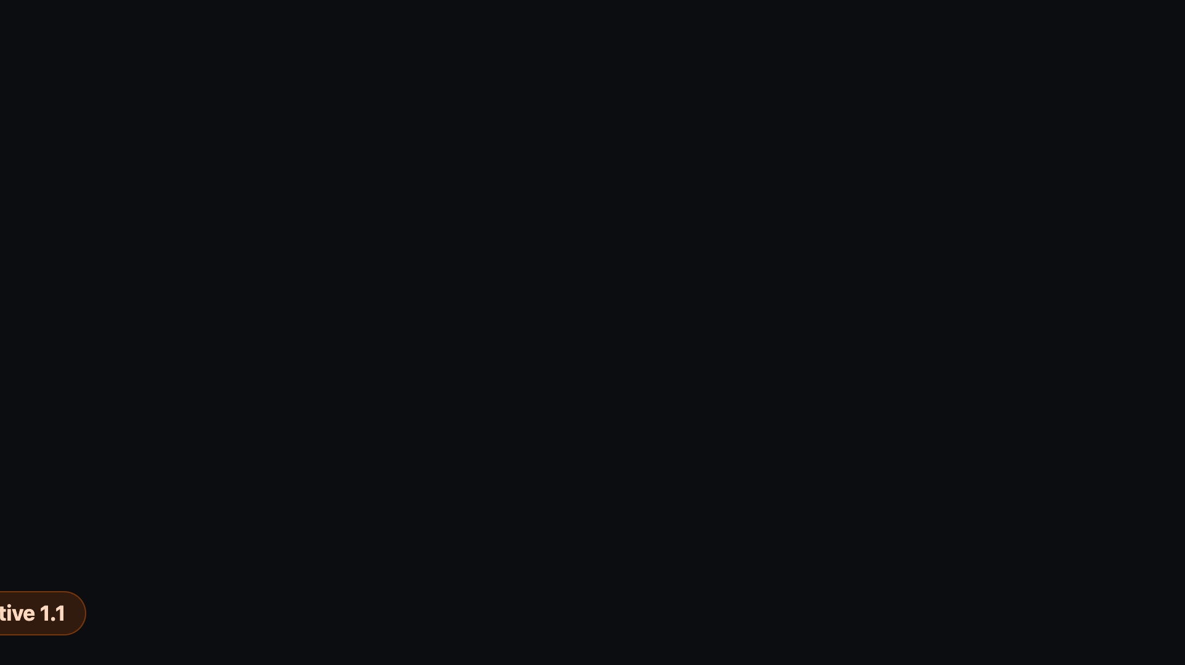
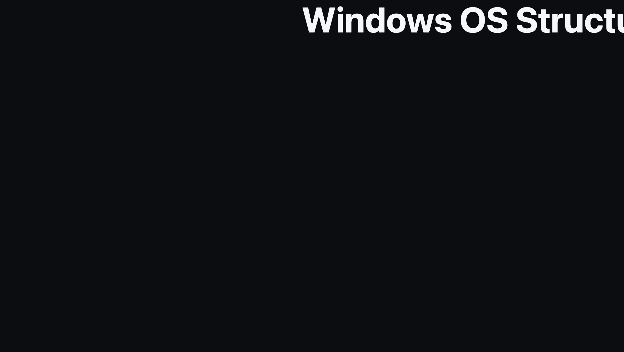
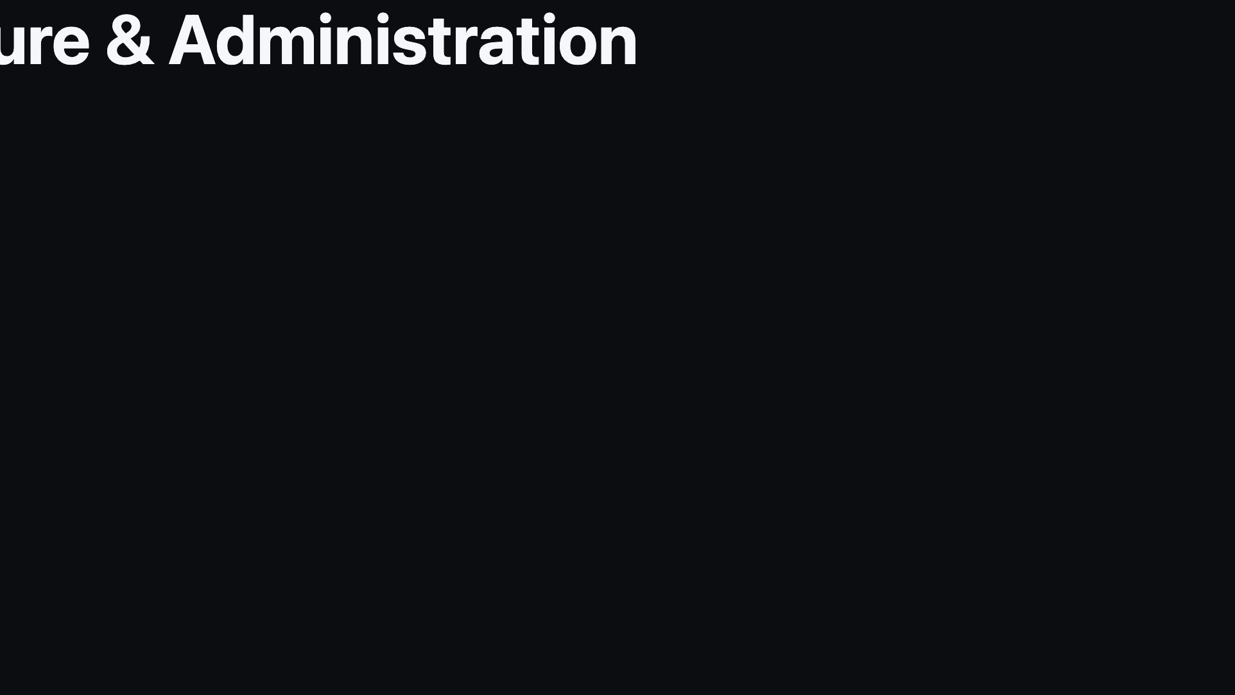
Notes:
Divider: transition into OS structure and administration.

Slide 6
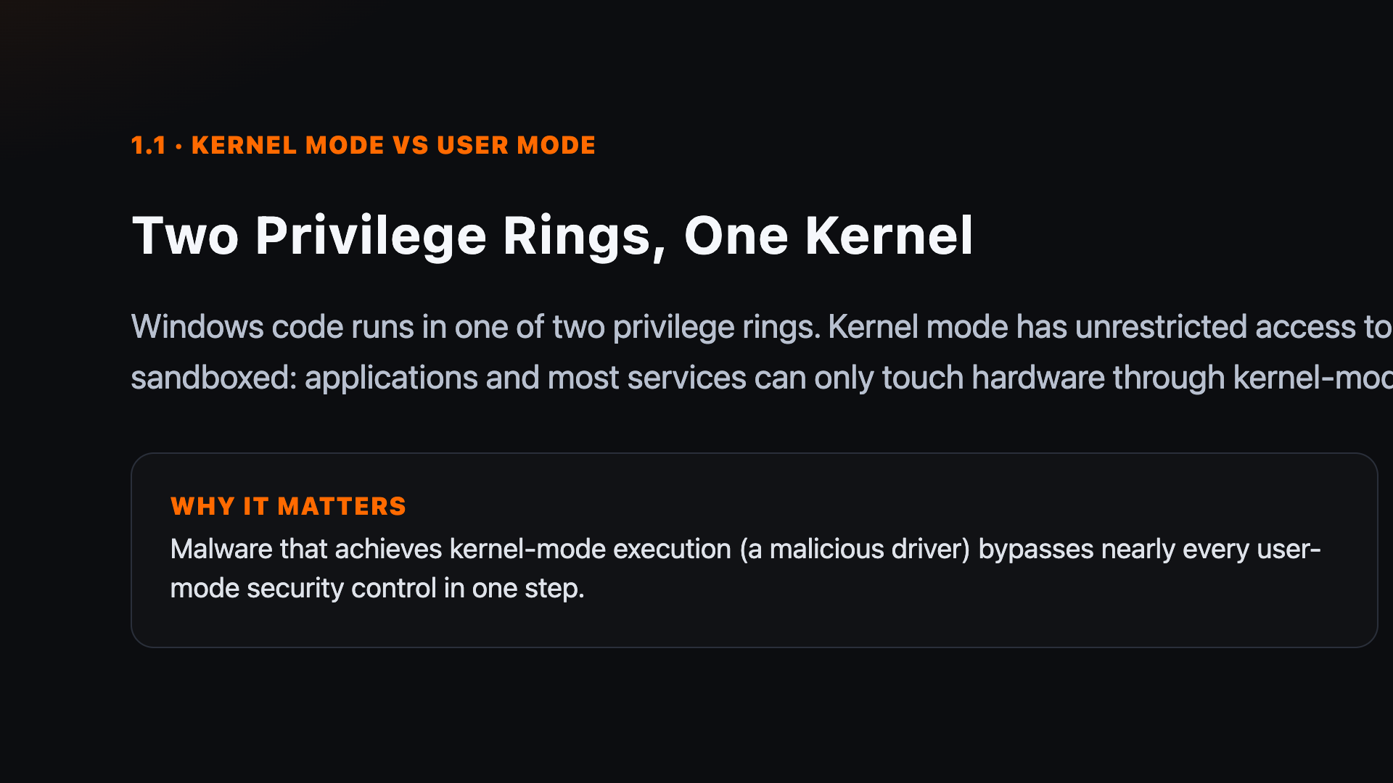
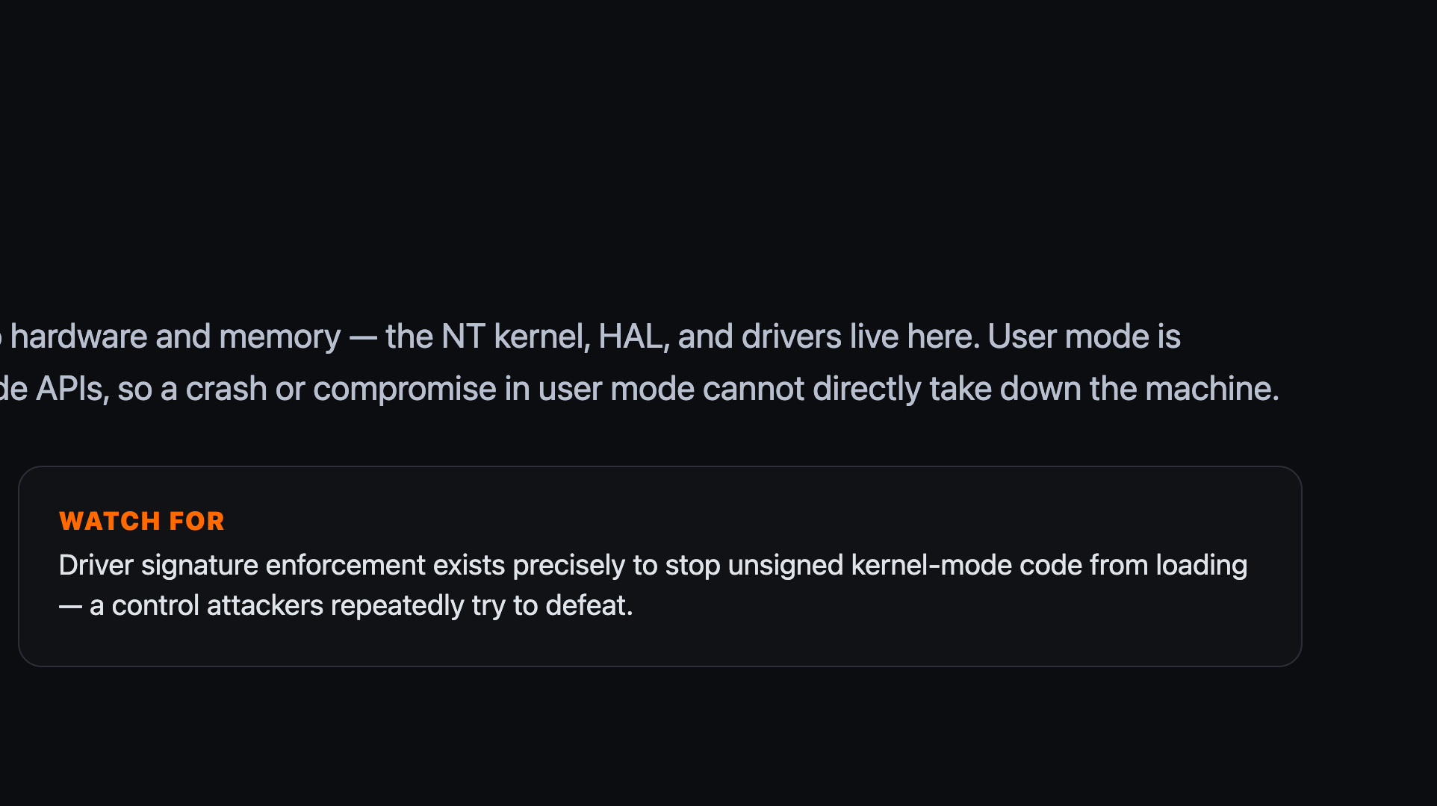
Notes:
Emphasise: a driver running in kernel mode can crash or compromise the entire system, which is why kernel-mode code must be signed.

Slide 7
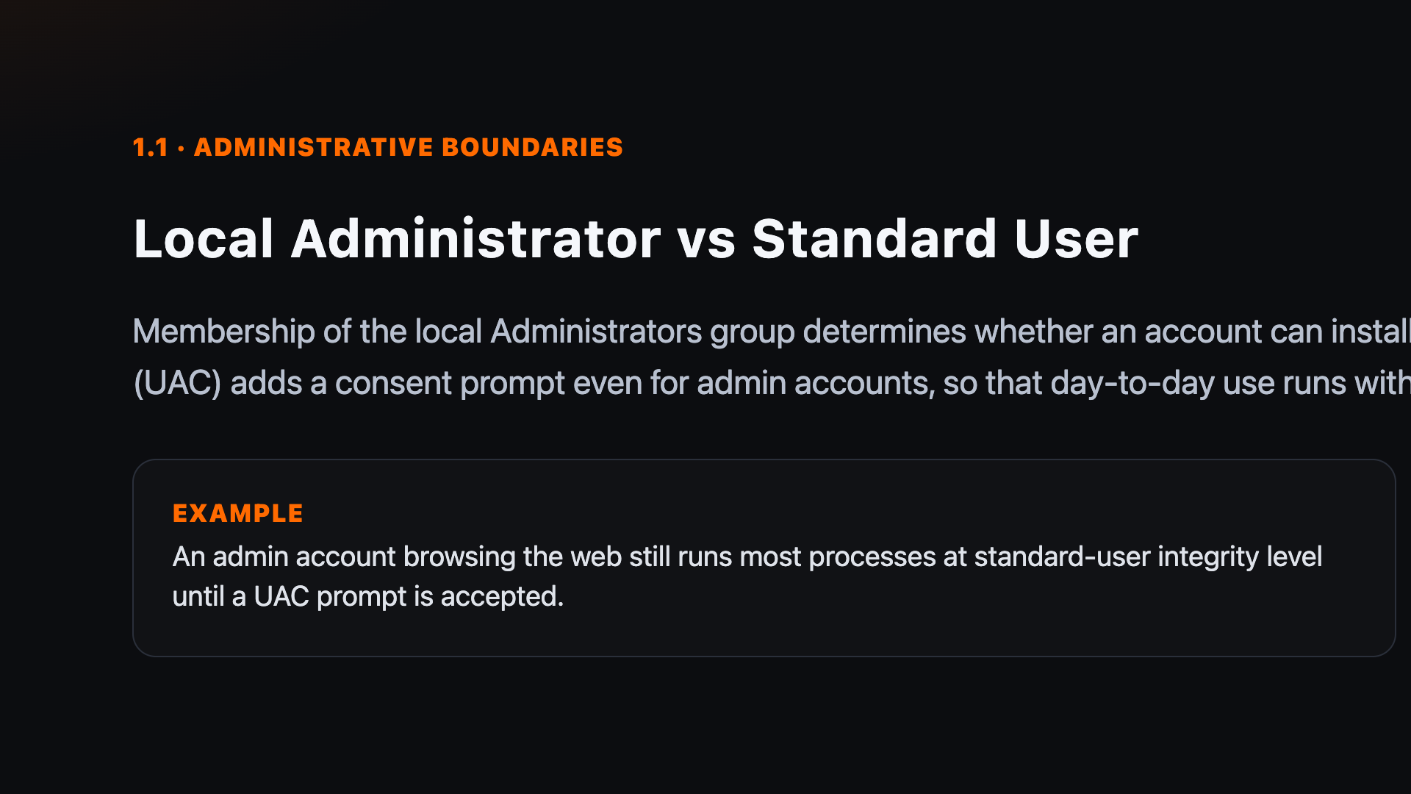
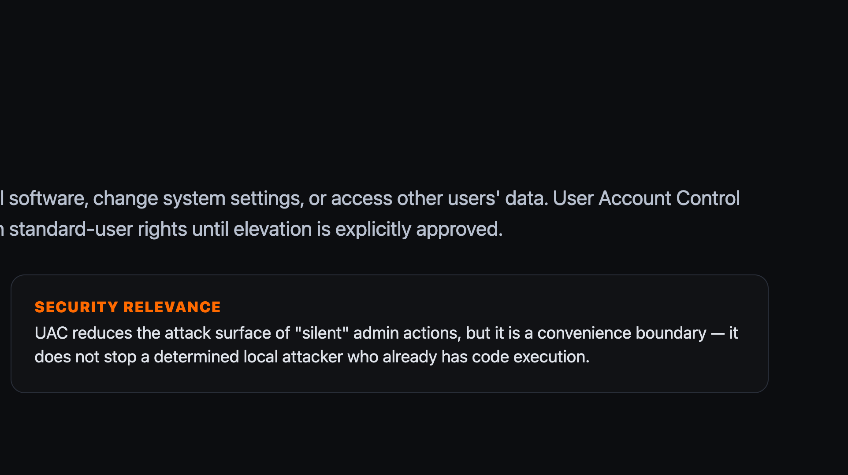
Notes:
UAC is a consent boundary, not a security boundary between two different users — that distinction trips learners up later in privilege escalation.

Slide 8


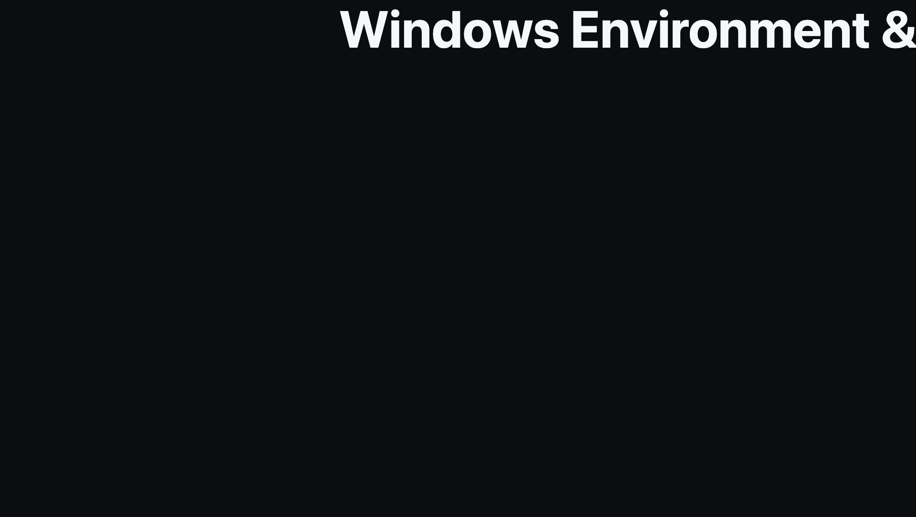
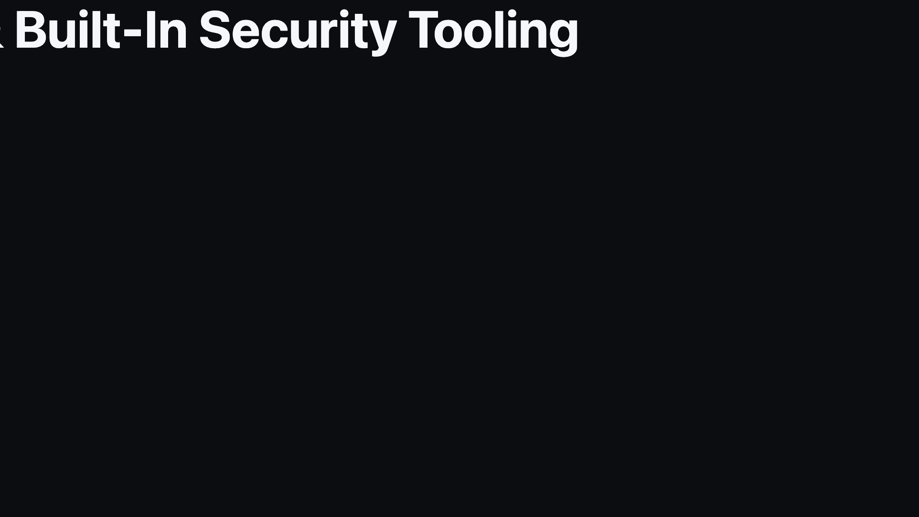
Notes:
Divider: transition into Windows built-in security tooling.

Slide 9
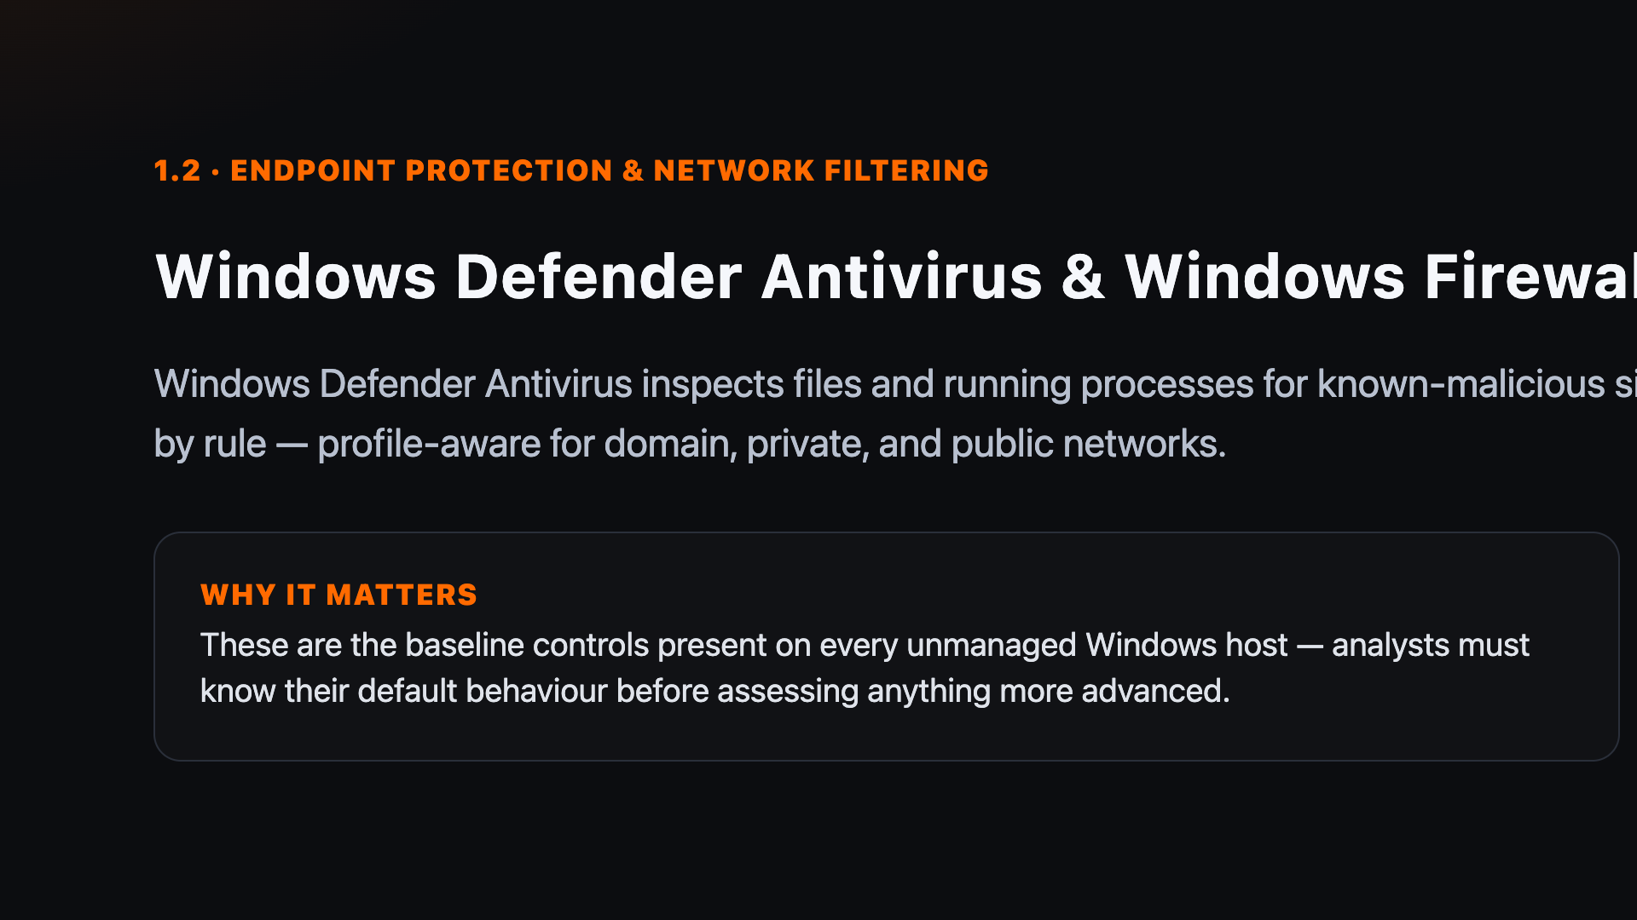
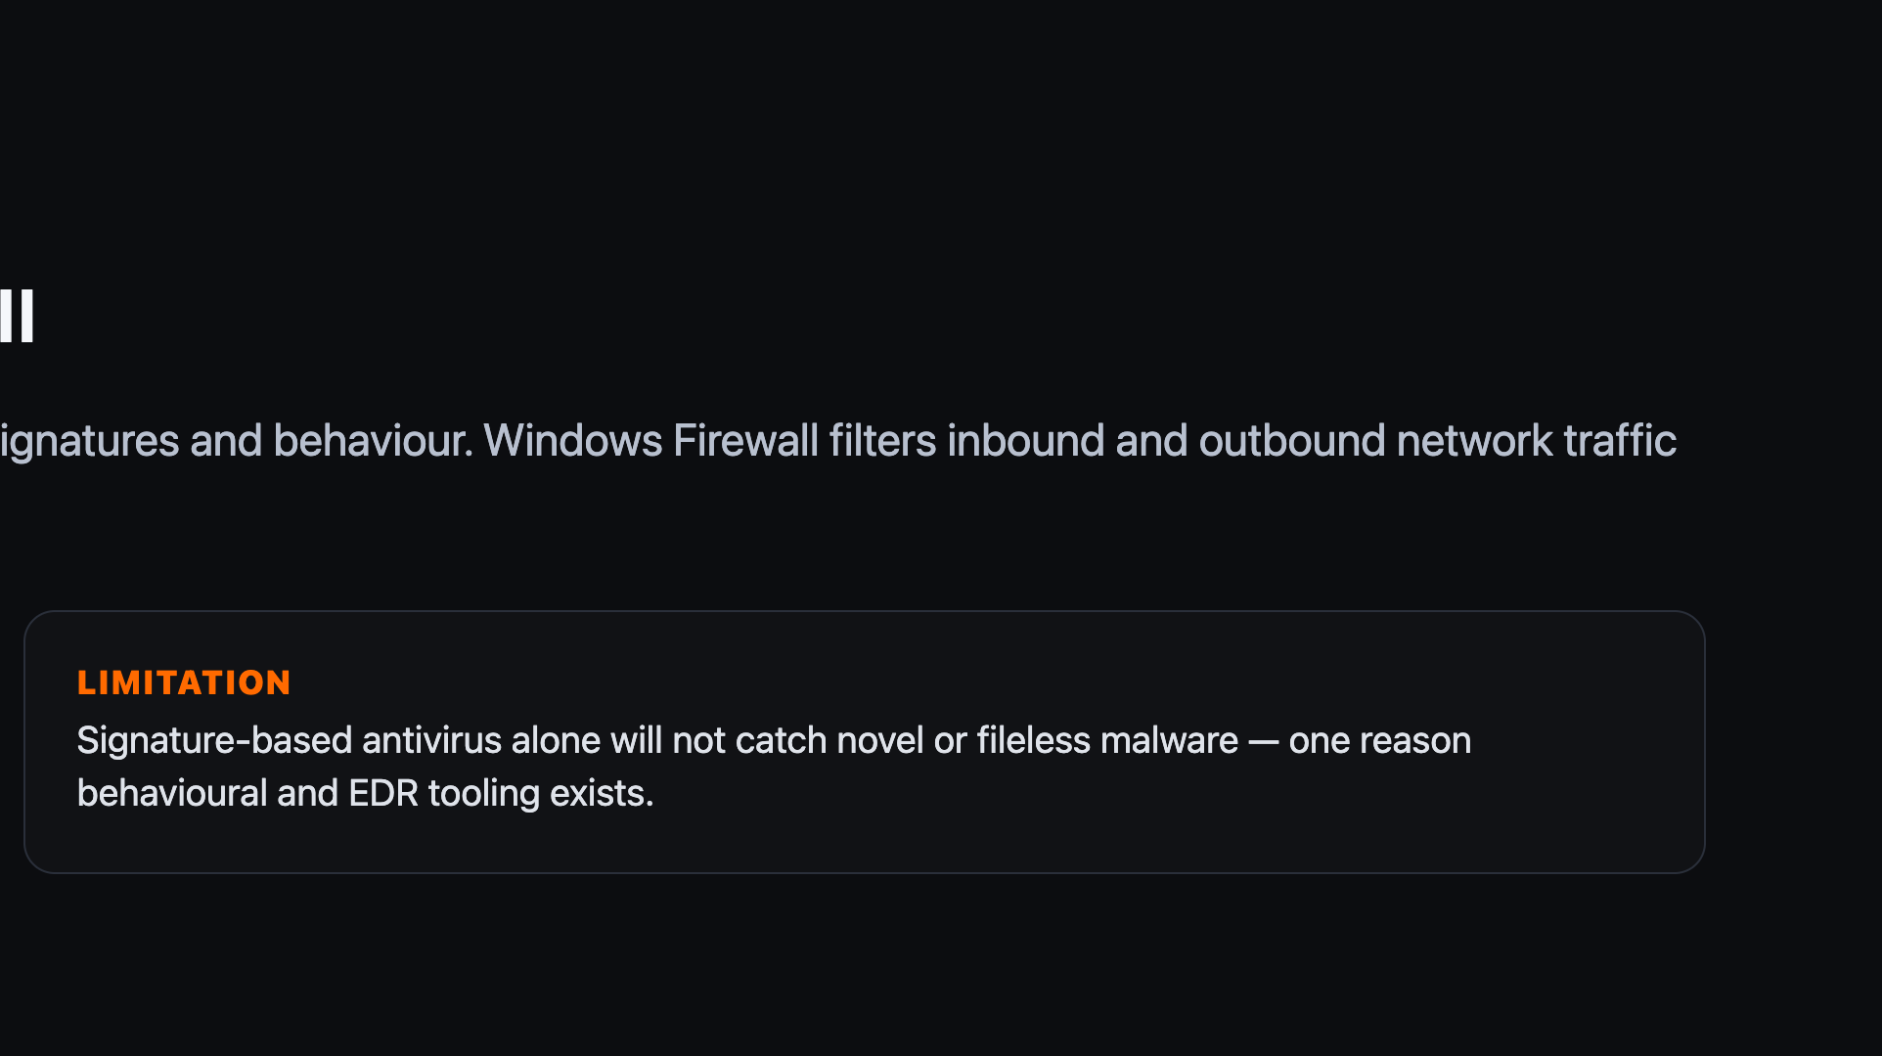
Notes:
Distinguish antivirus (endpoint file/process scanning) from firewall (network traffic filtering) — students often conflate the two.

Slide 10
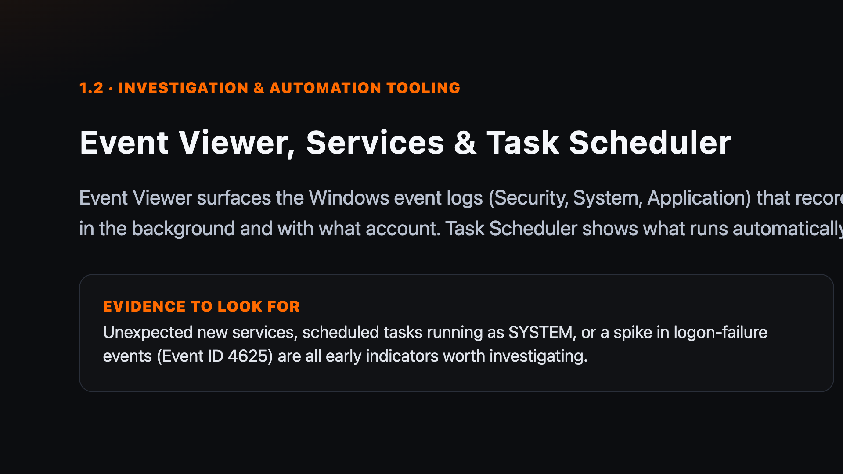
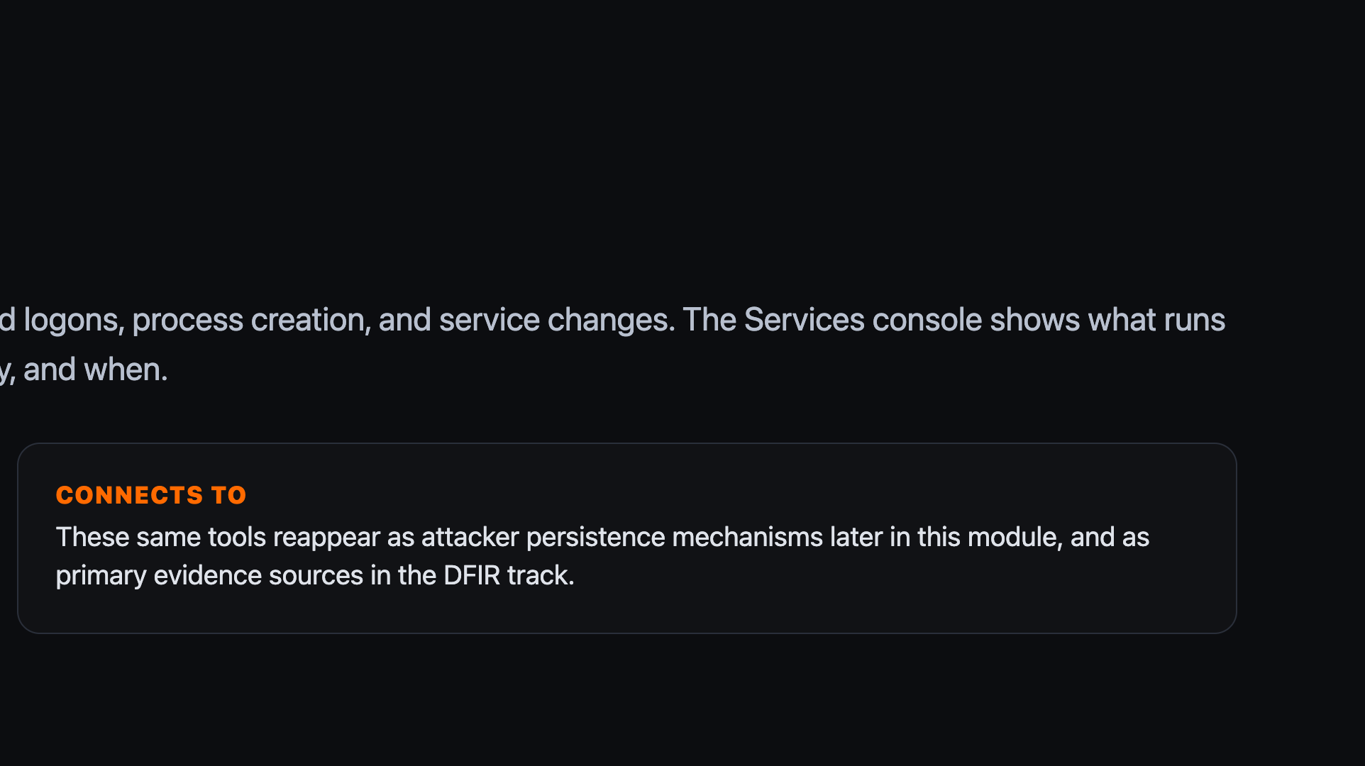
Notes:
These three tools are the ones learners will keep coming back to in the DFIR track — worth a live demo if time allows.

Slide 11
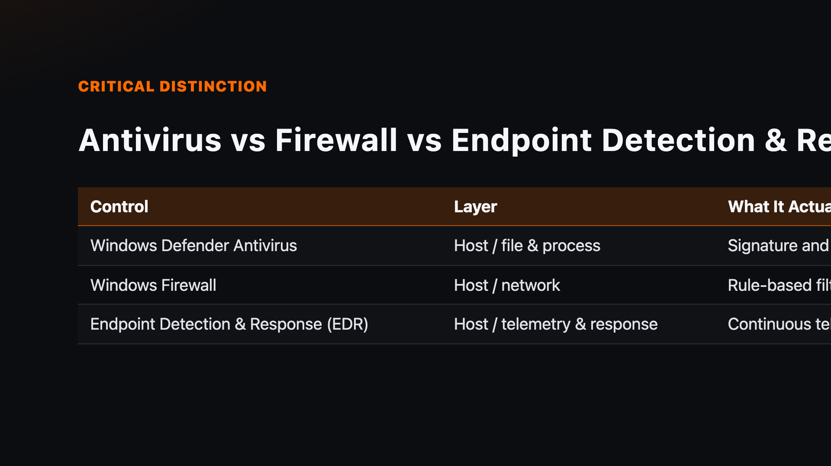
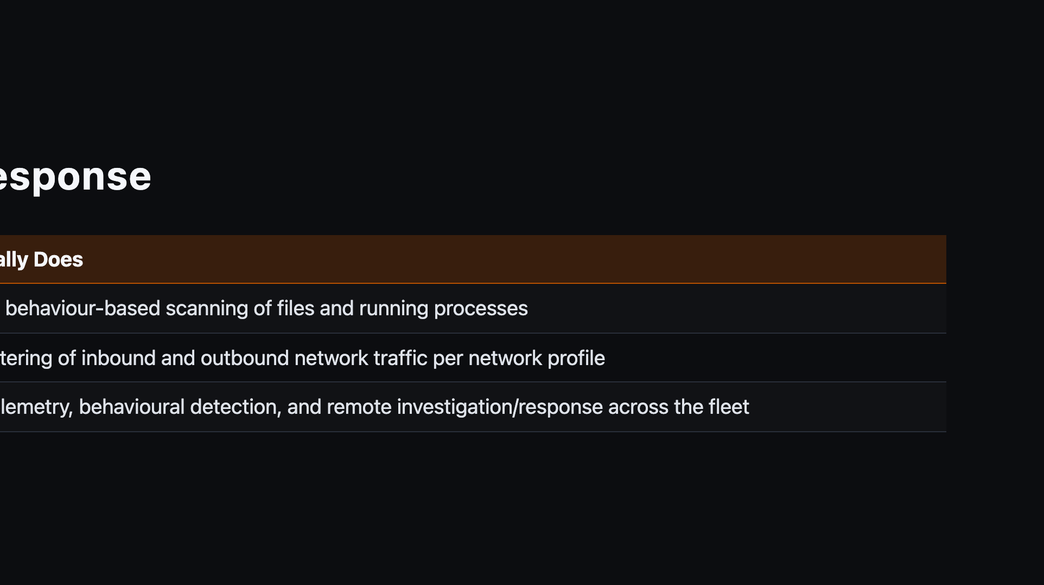
Notes:
Comparison slide — make sure learners can place any given tool in the right column.

Slide 12


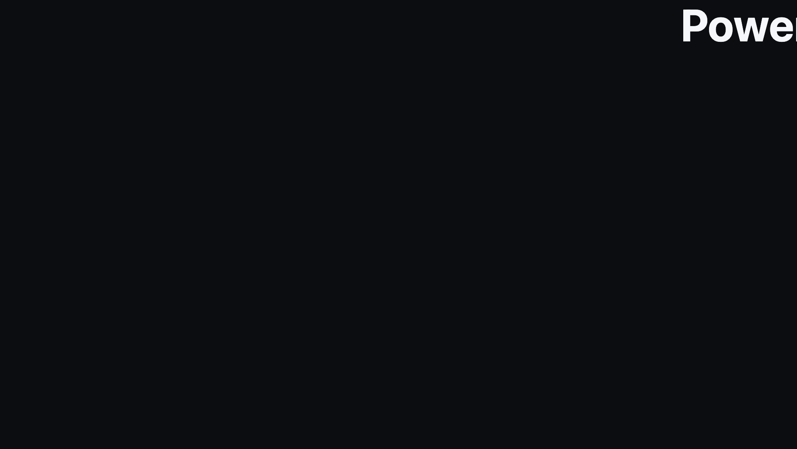
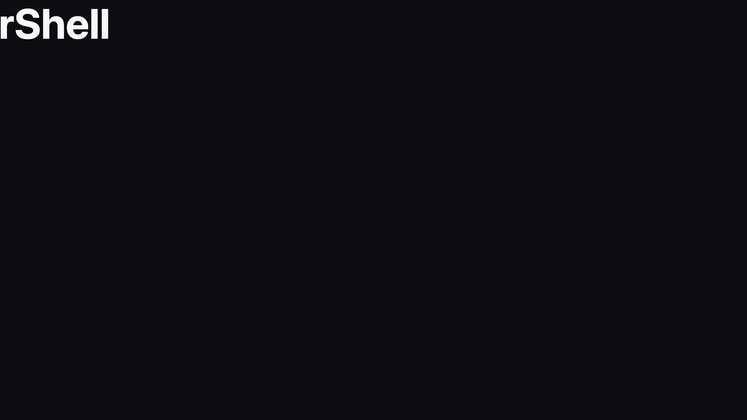
Notes:
Divider: transition into PowerShell.

Slide 13
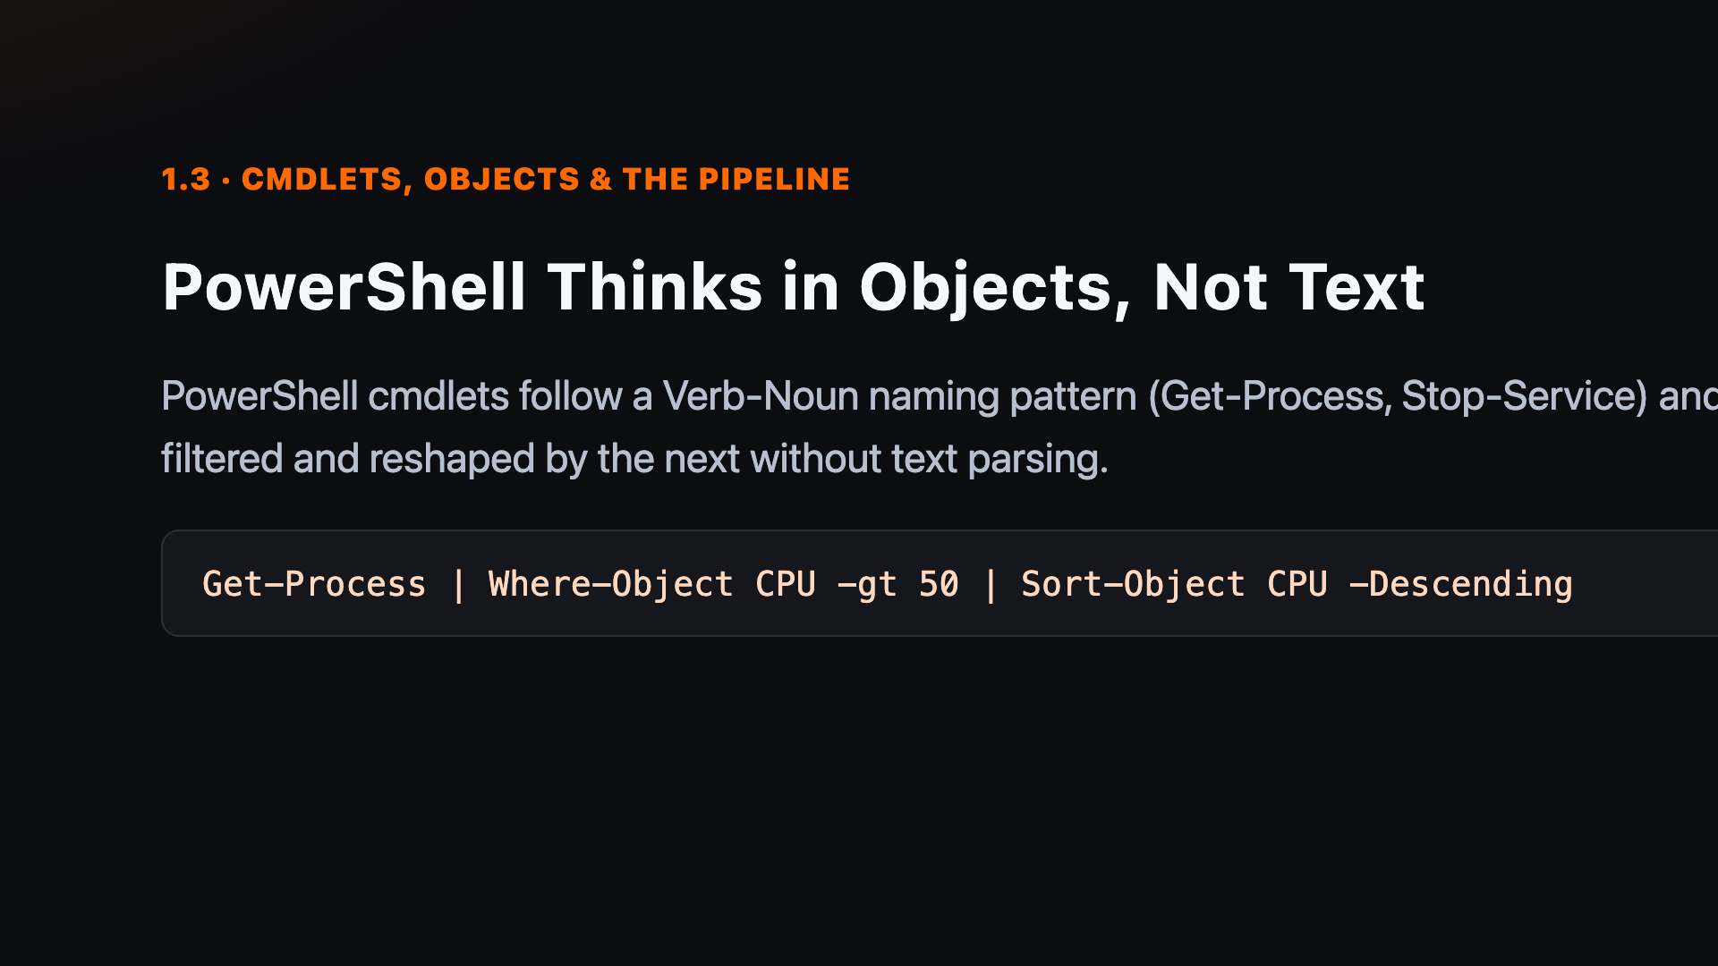
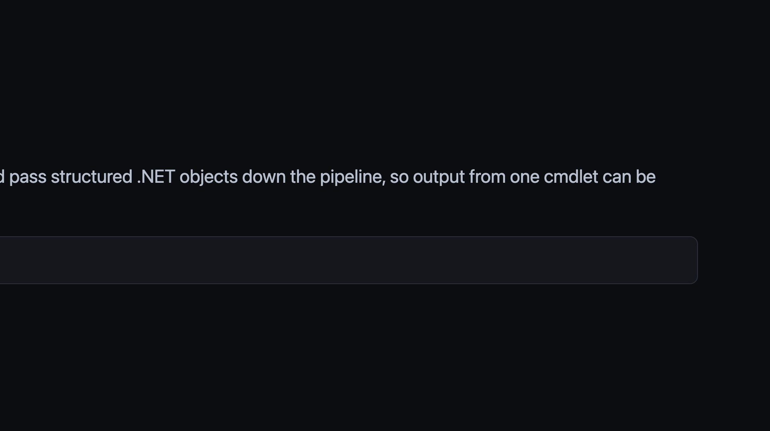
Notes:
Stress that PowerShell passes objects, not text, between cmdlets — this is what makes filtering and piping so powerful compared with legacy cmd.exe.

Slide 14
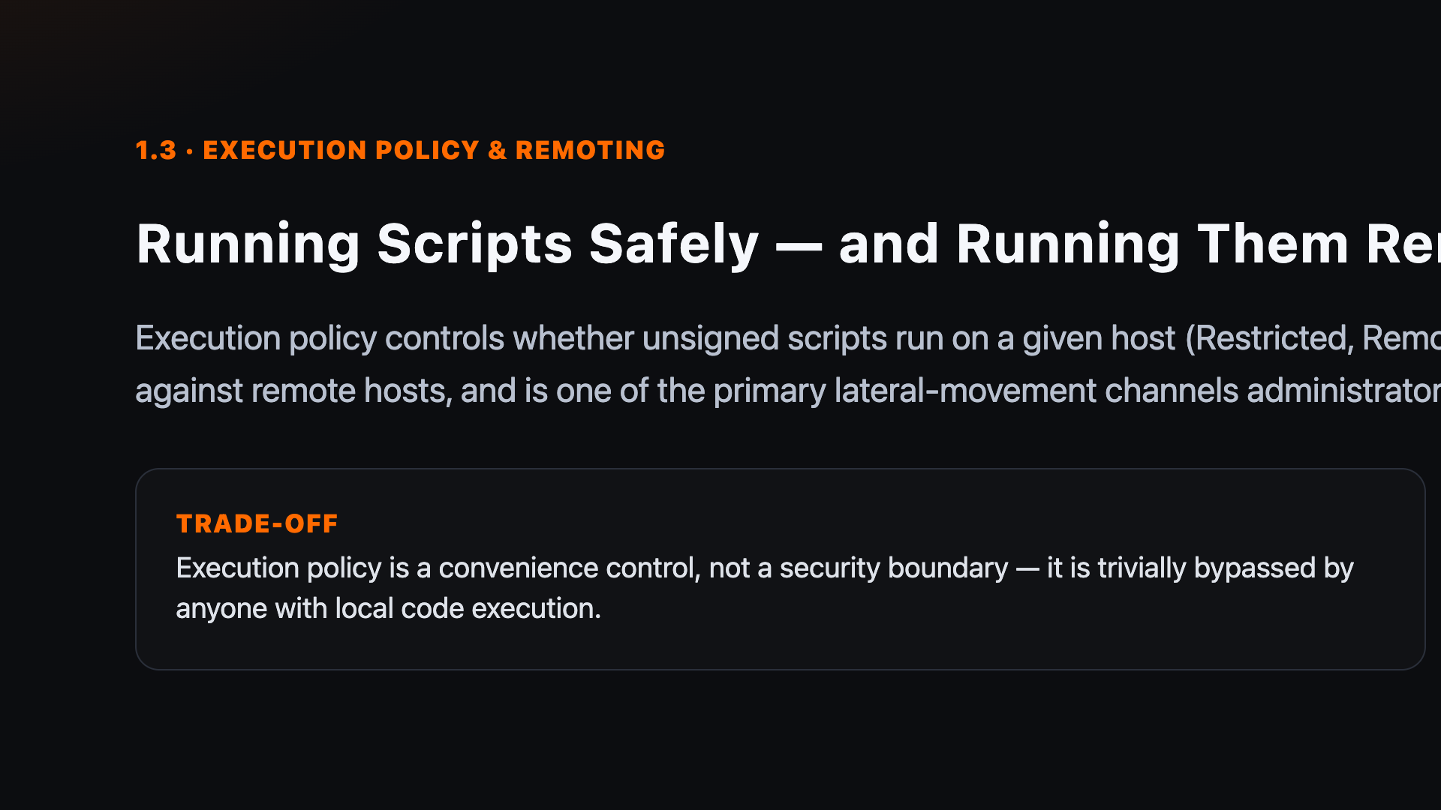
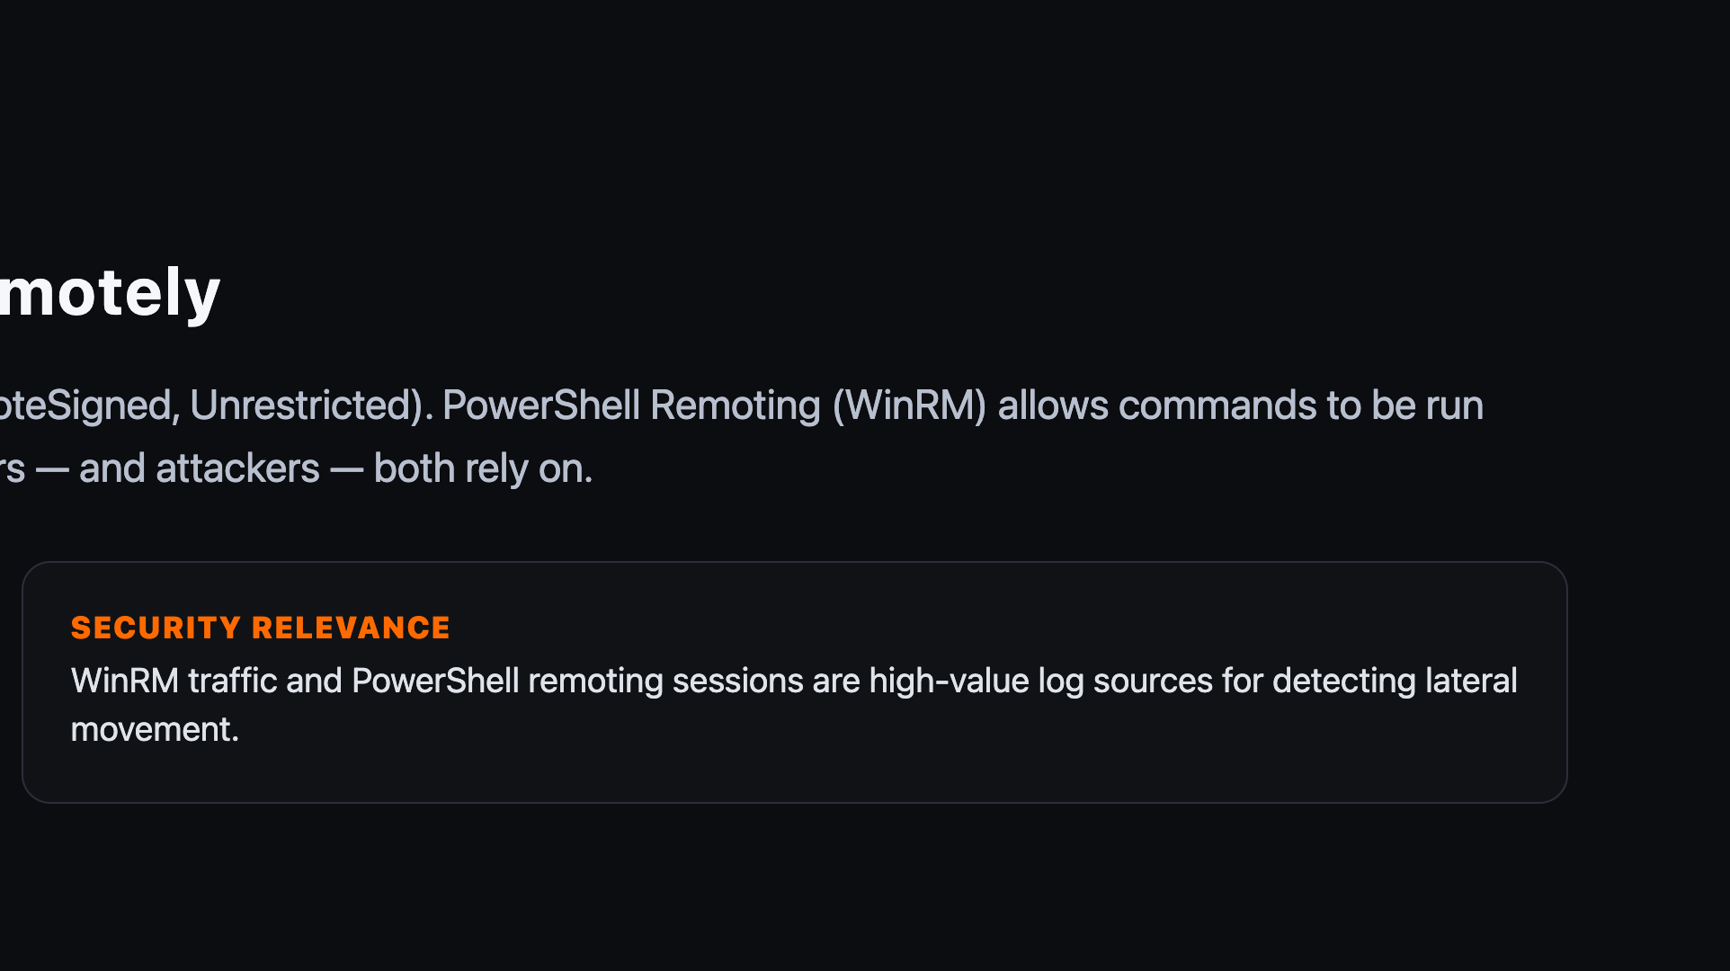
Notes:
Execution policy is not a security boundary — it is a safety guard rail, and easily bypassed by anyone with local execution rights. Worth flagging explicitly.

Slide 15


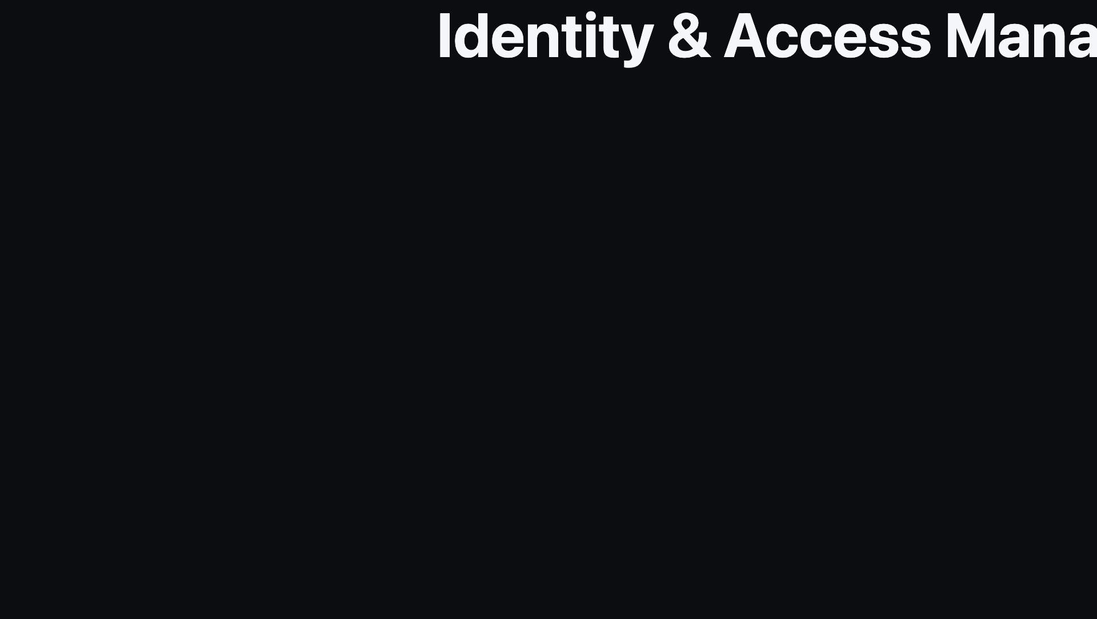
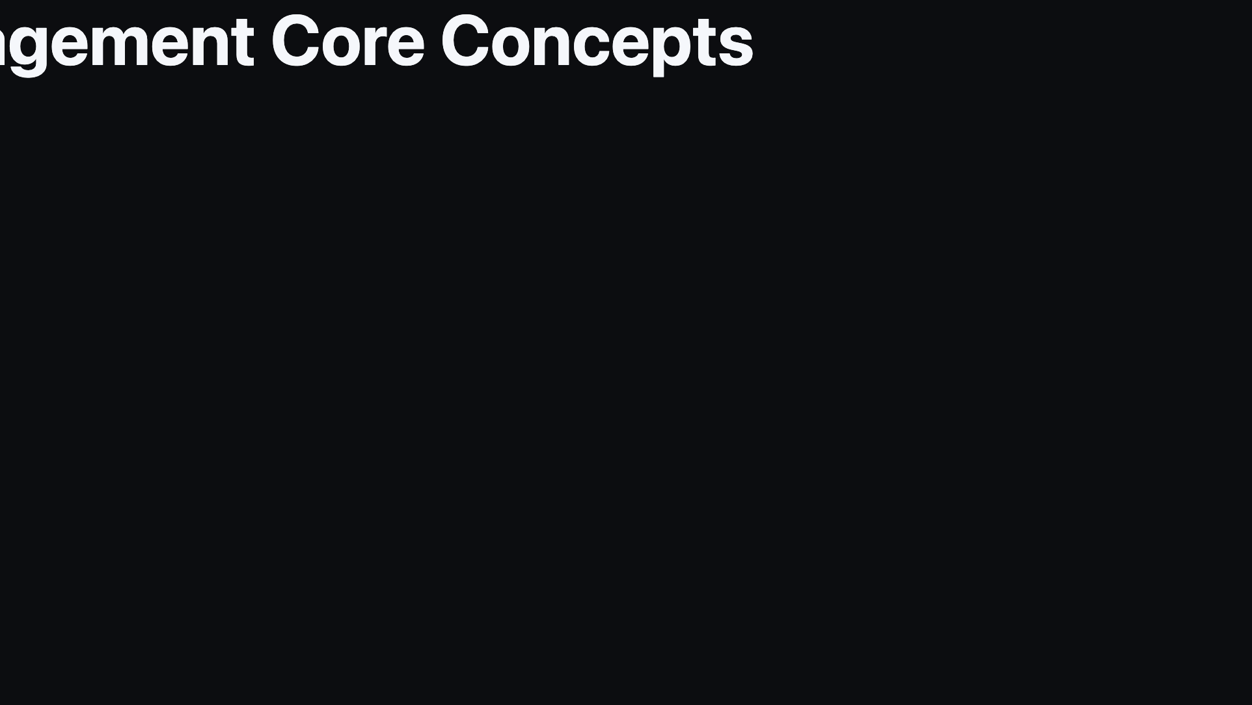
Notes:
Divider: transition into identity and access management.

Slide 16
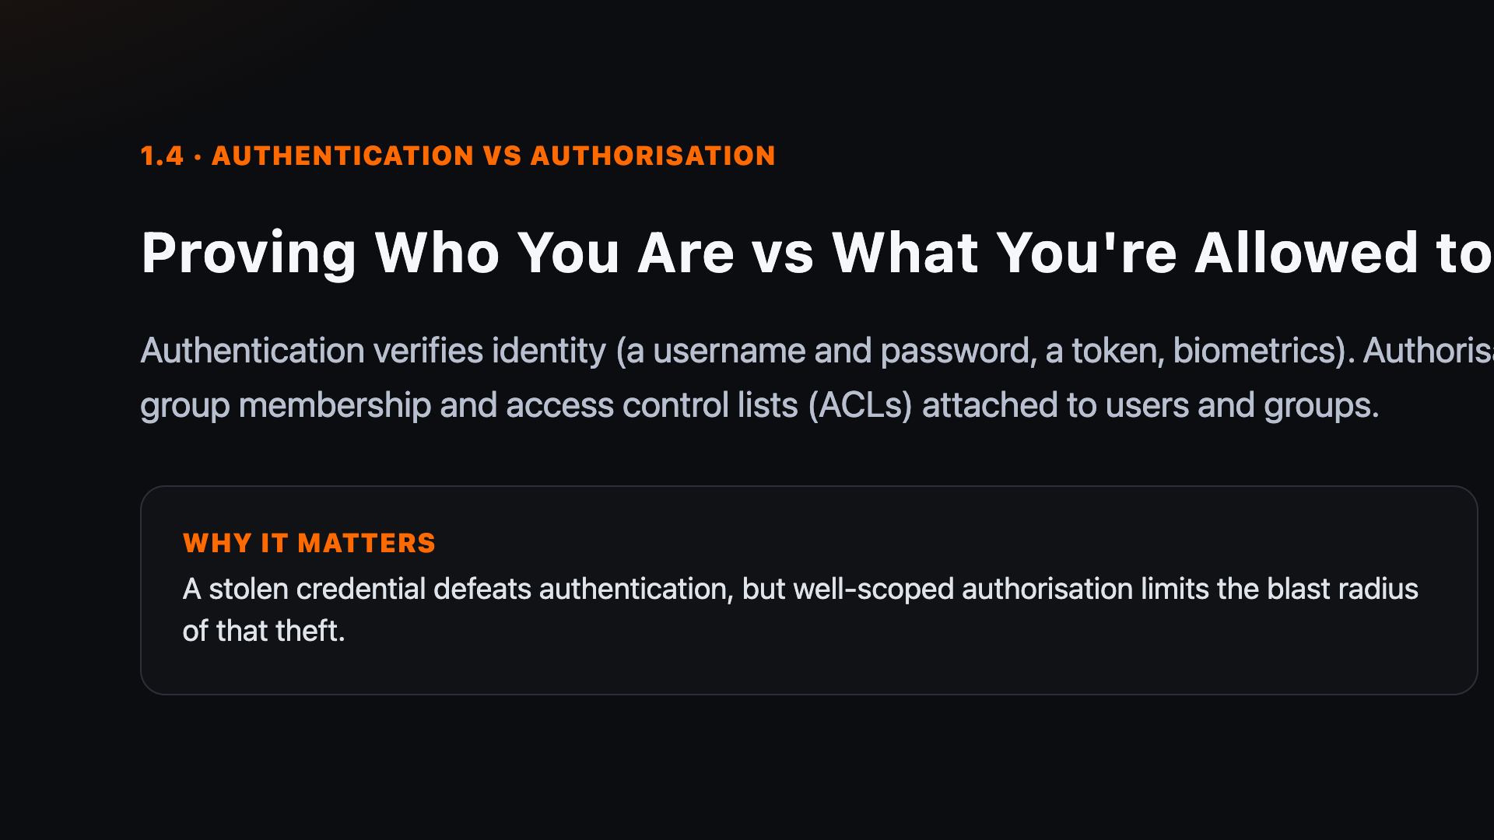
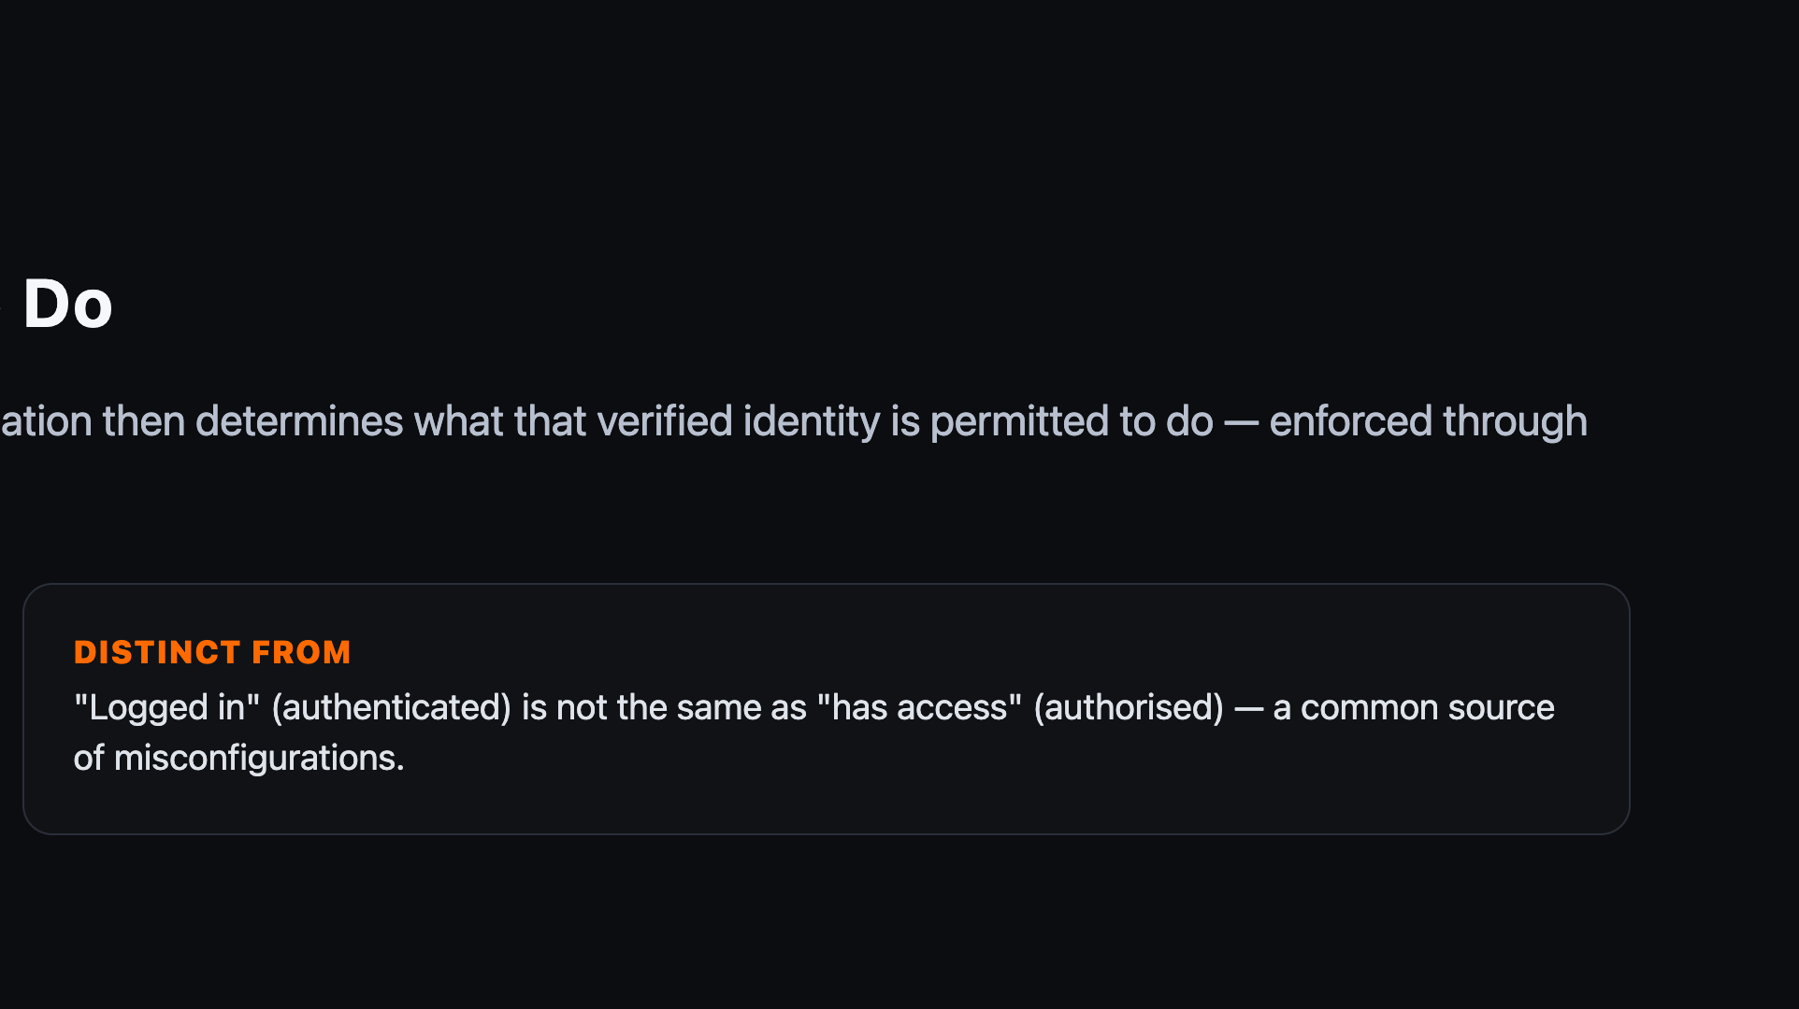
Notes:
This distinction — proving who you are vs what you're allowed to do — recurs constantly in AD and cloud IAM modules later in the programme.

Slide 17
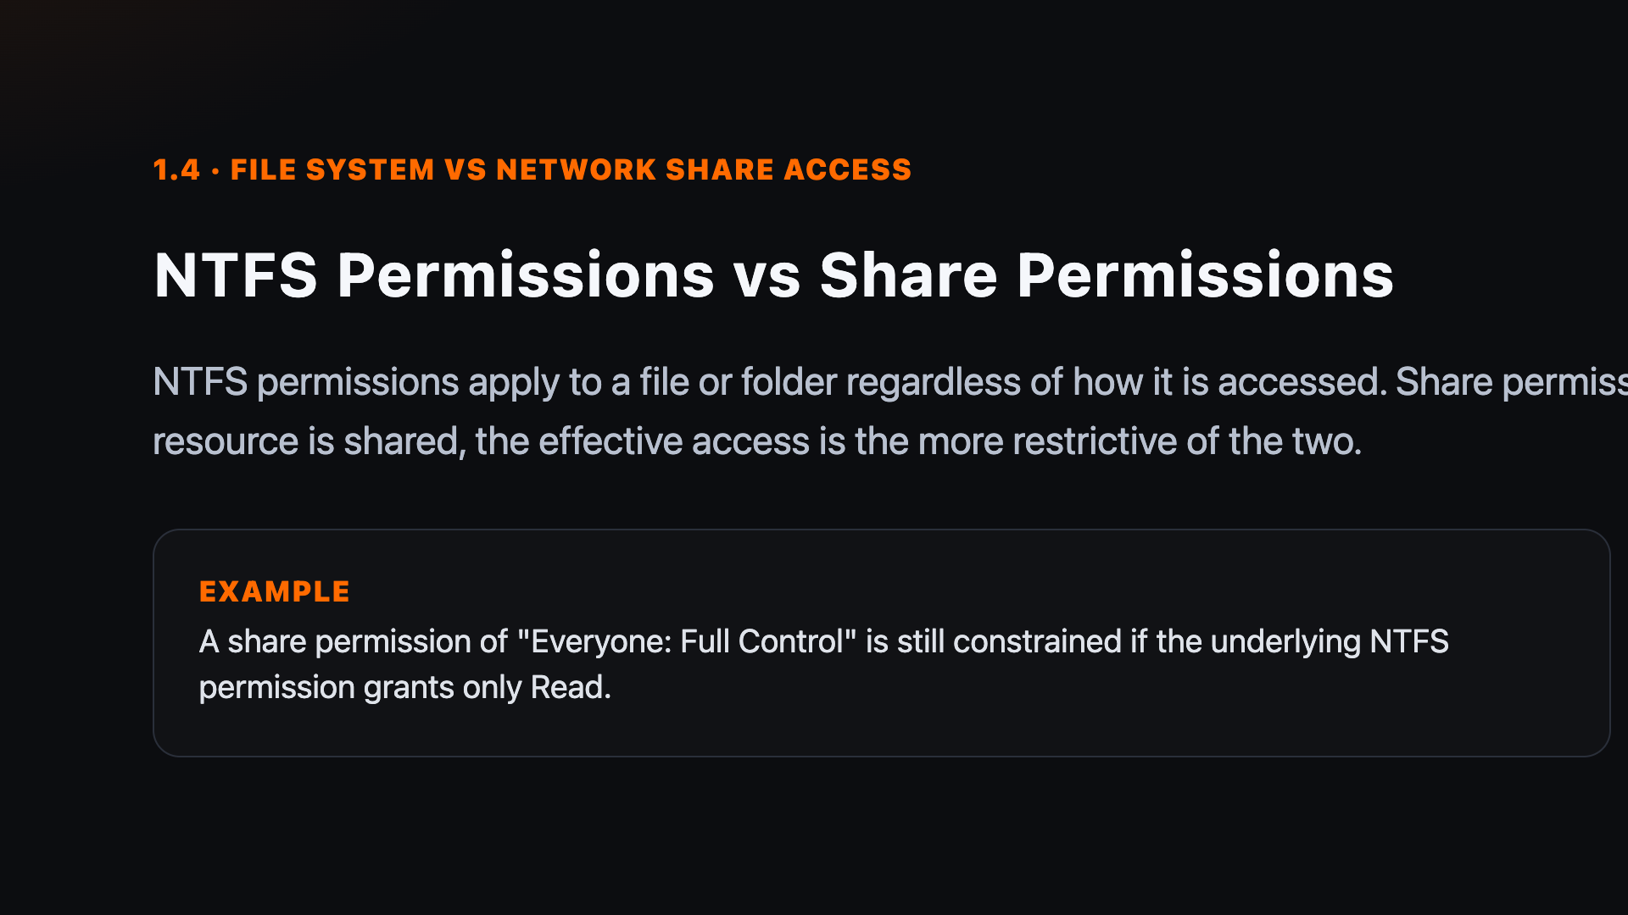
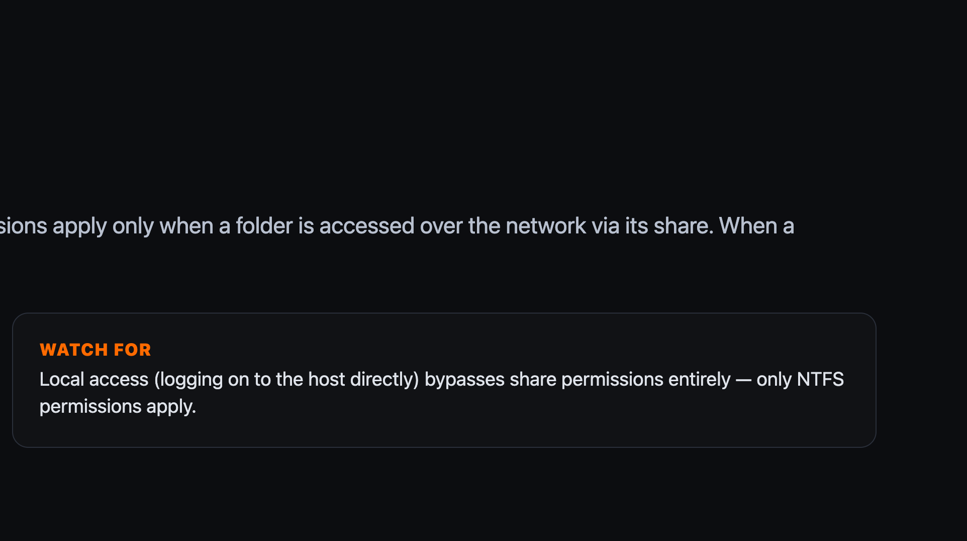
Notes:
This is a classic exam-style trap: when NTFS and share permissions conflict, the more restrictive of the two always wins.

Slide 18
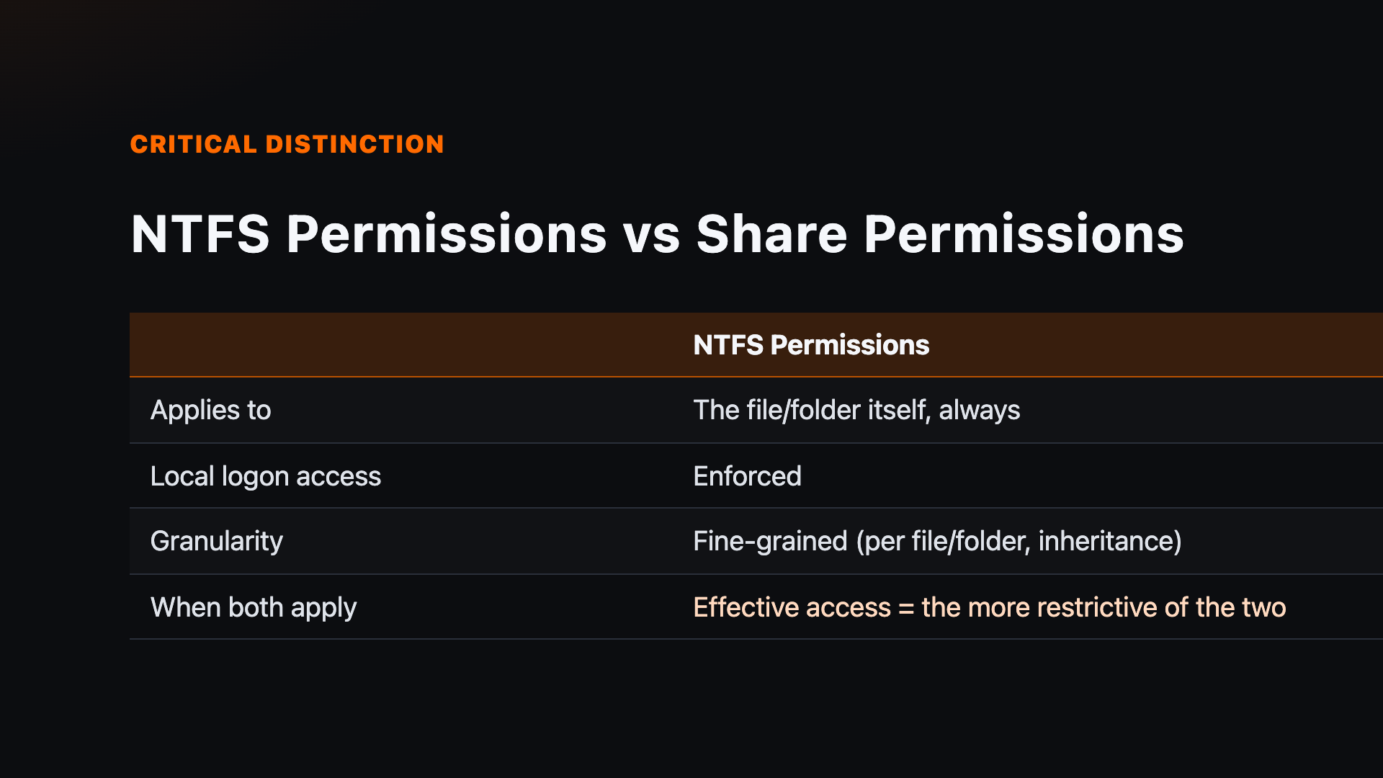
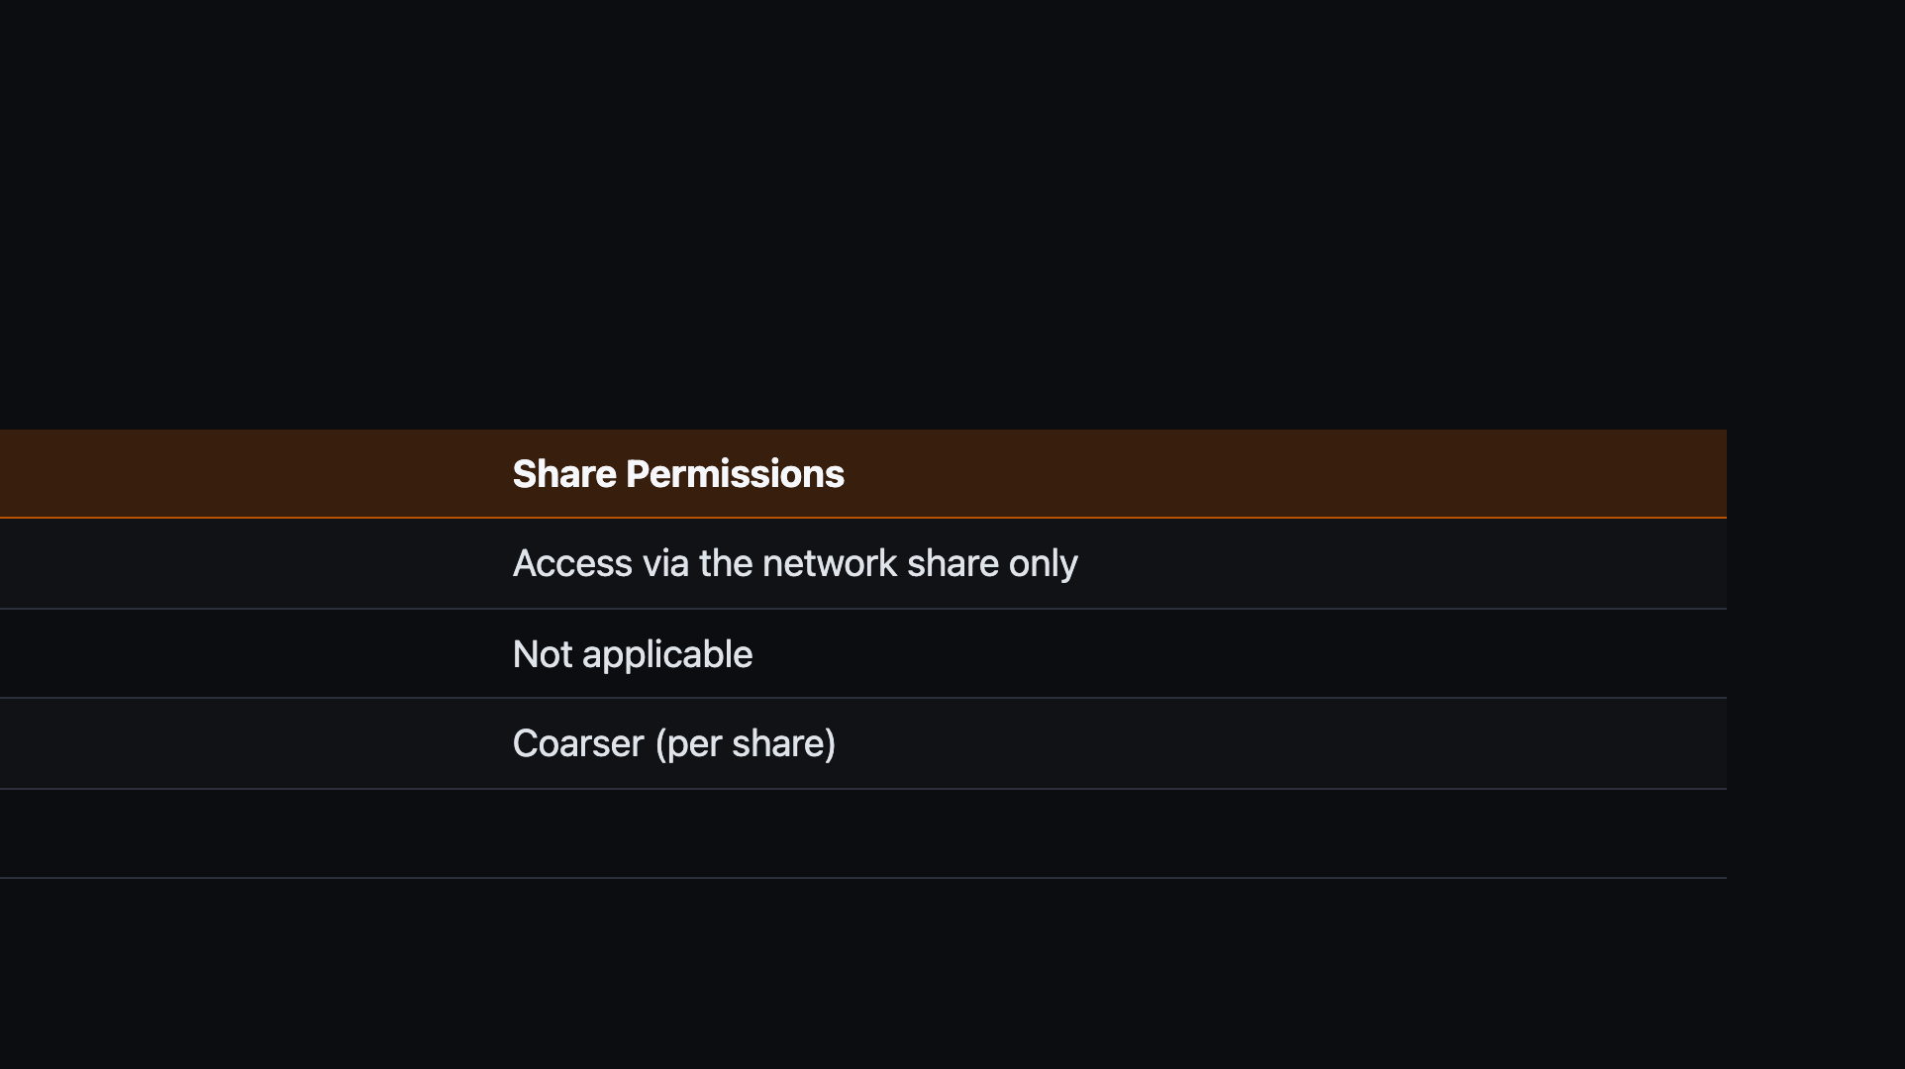
Notes:
Reinforce with the table before moving to the attacker playbook — this is one of the most commonly confused pairs in the module.

Slide 19
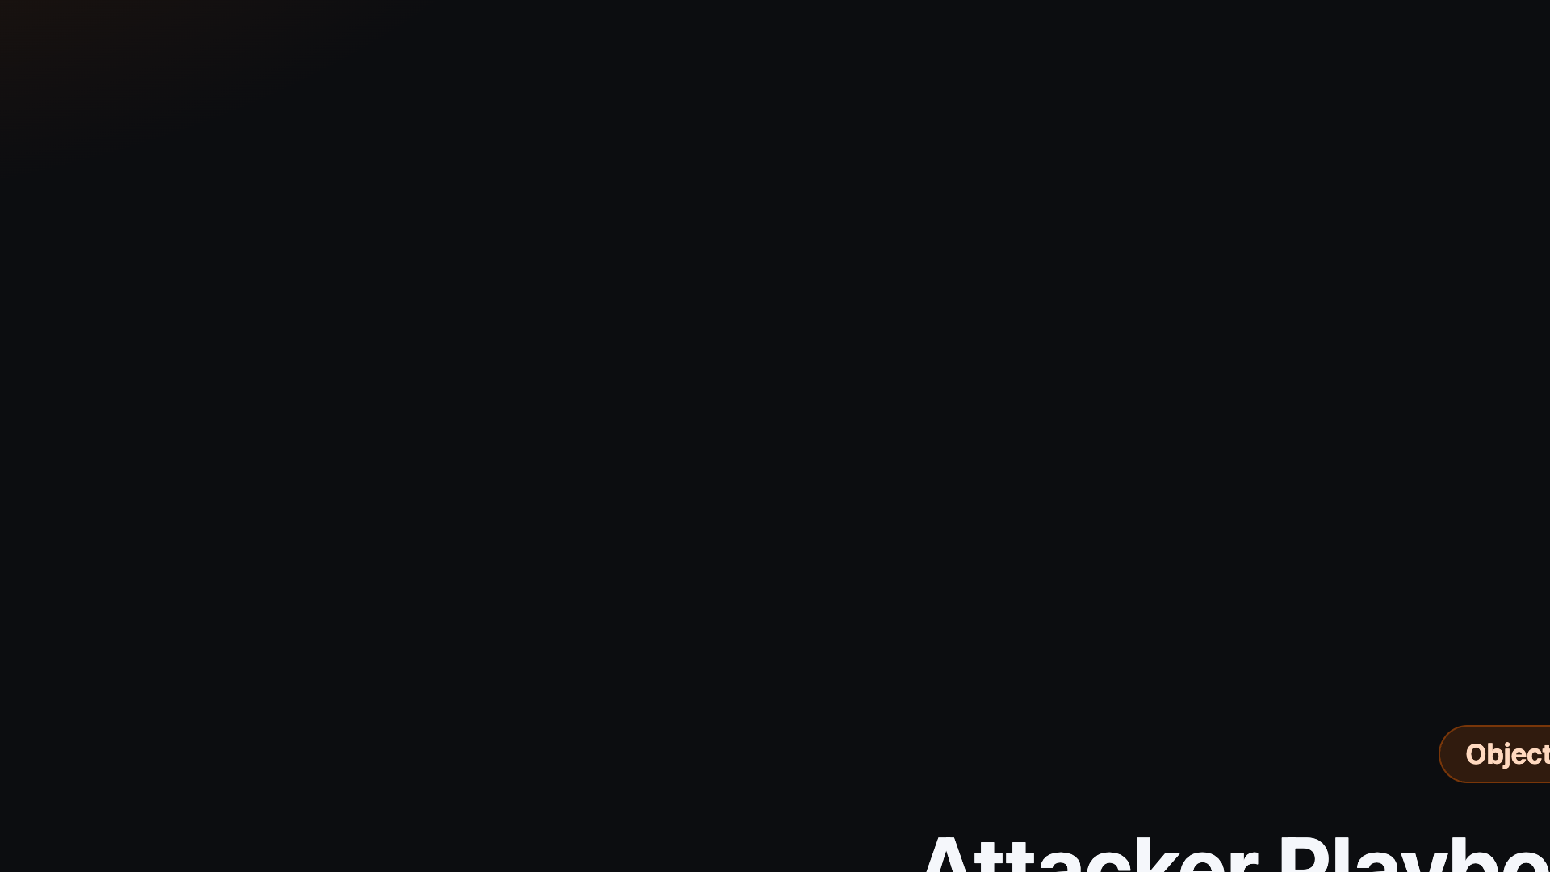
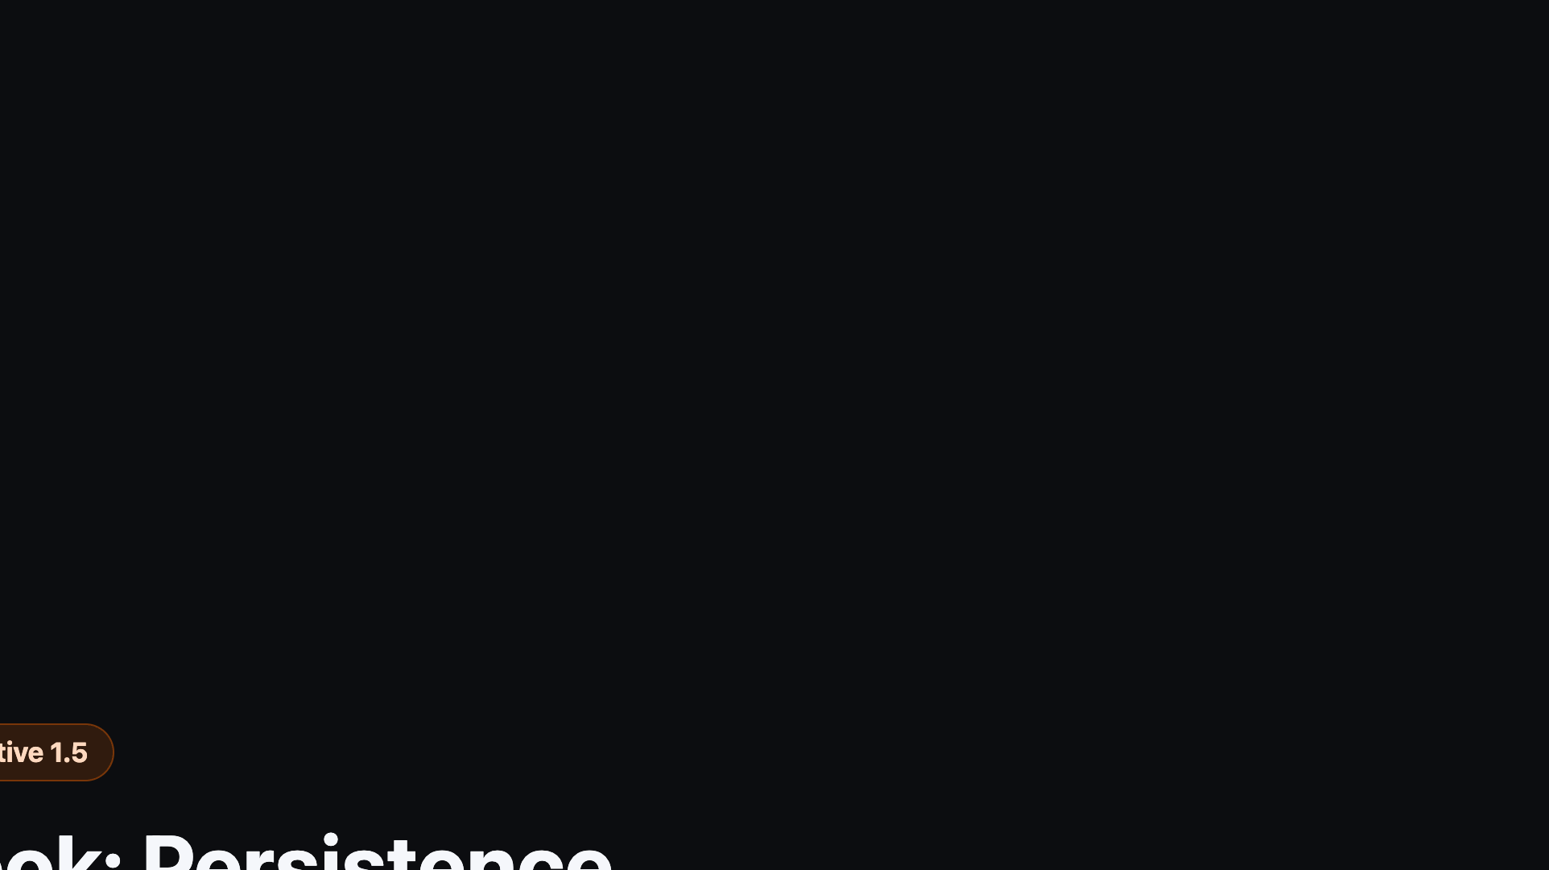
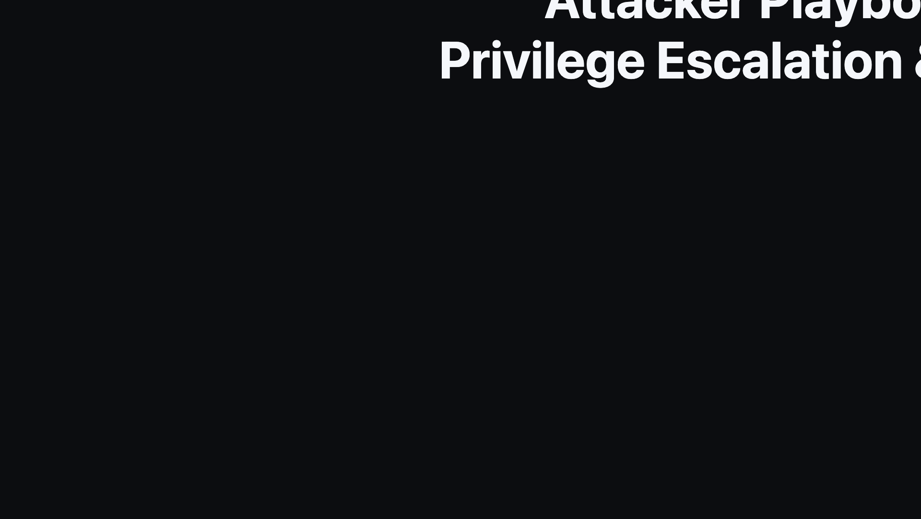
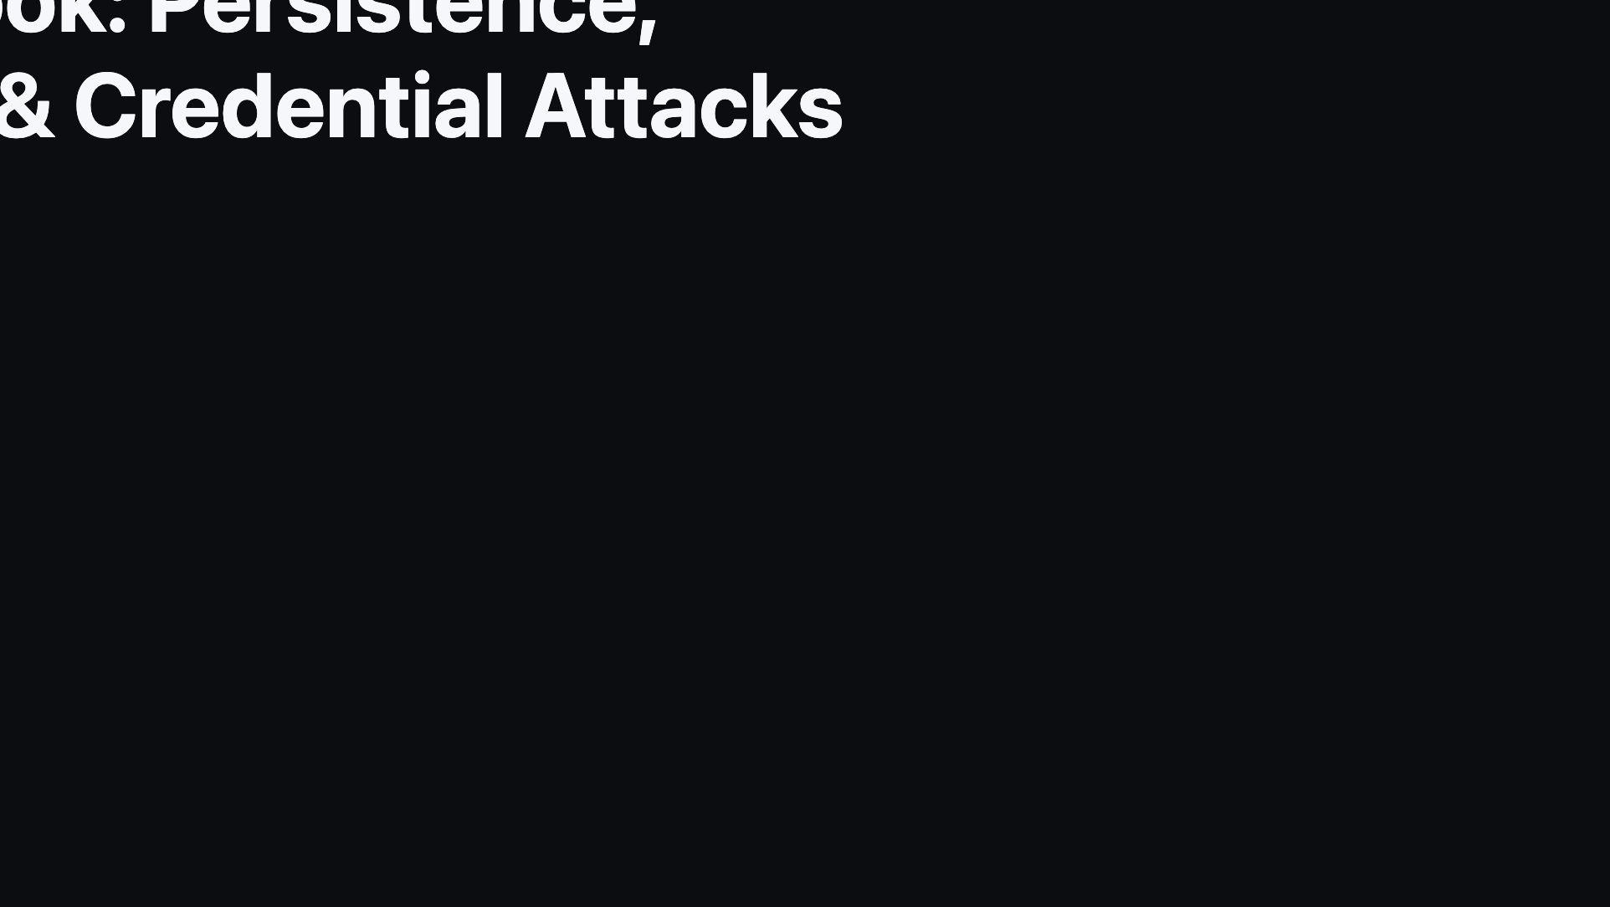
Notes:
Divider: transition into the attacker playbook — this sets up the offensive/defensive mindset shift referenced in the P2 kickoff session.

Slide 20
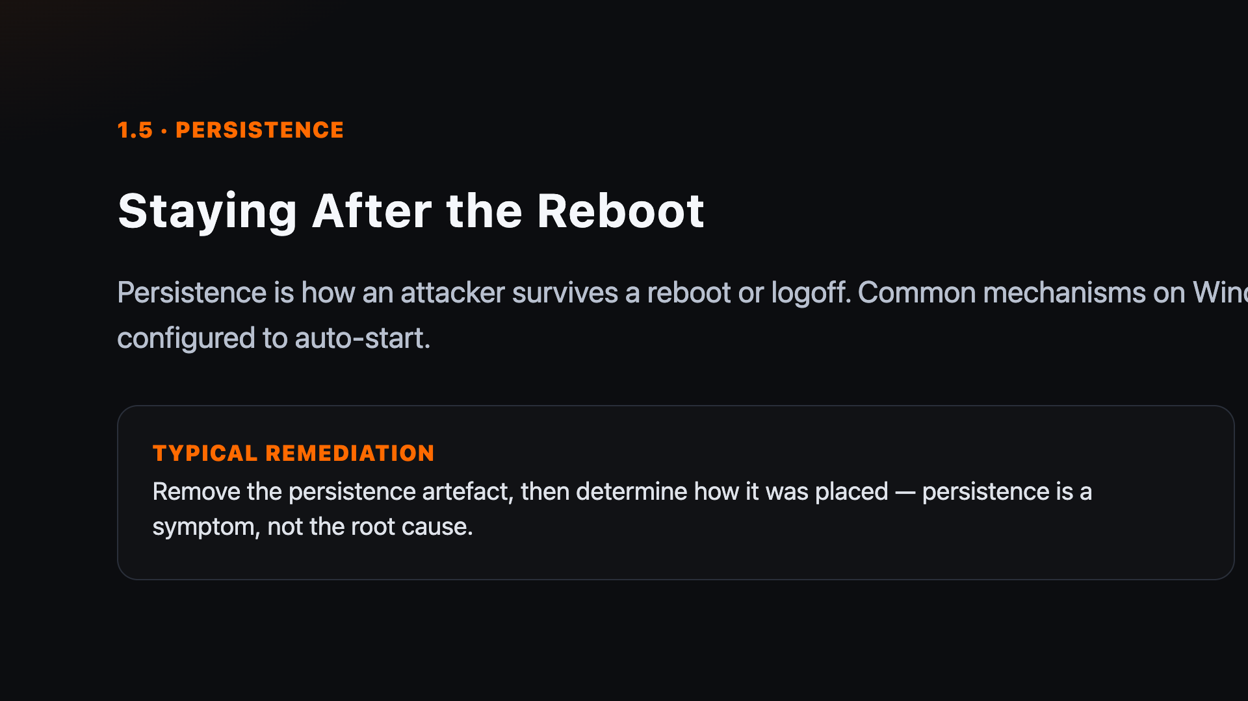
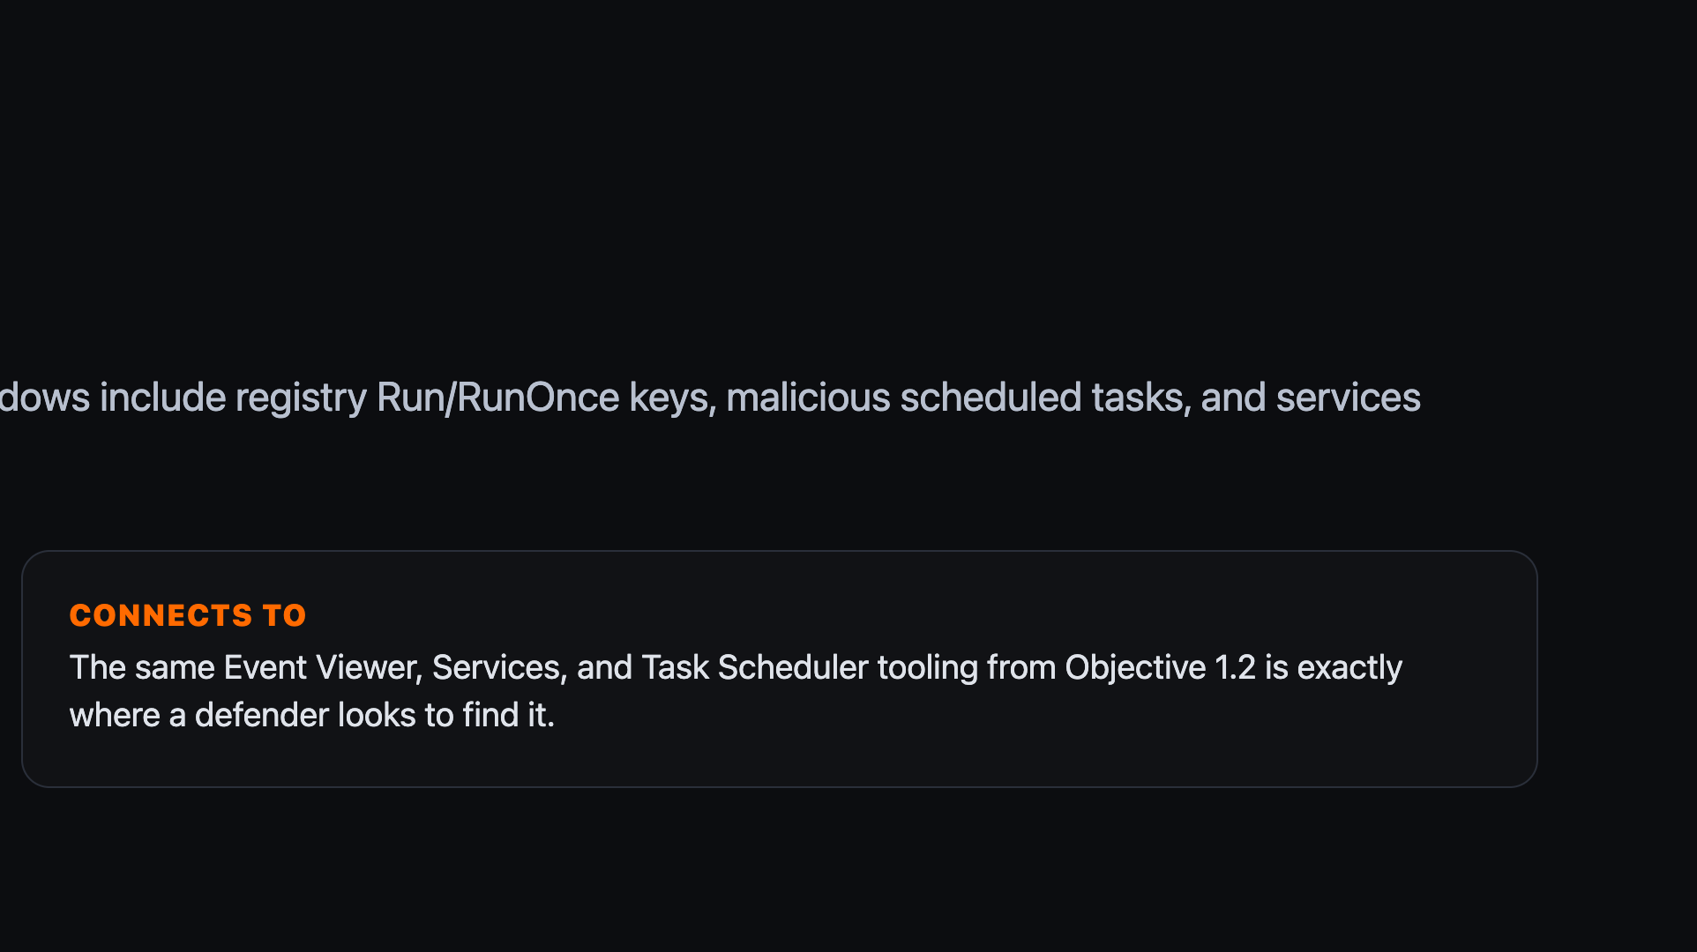
Notes:
Every persistence mechanism here maps onto a piece of tooling covered in 1.2 — worth pointing that out explicitly.

Slide 21
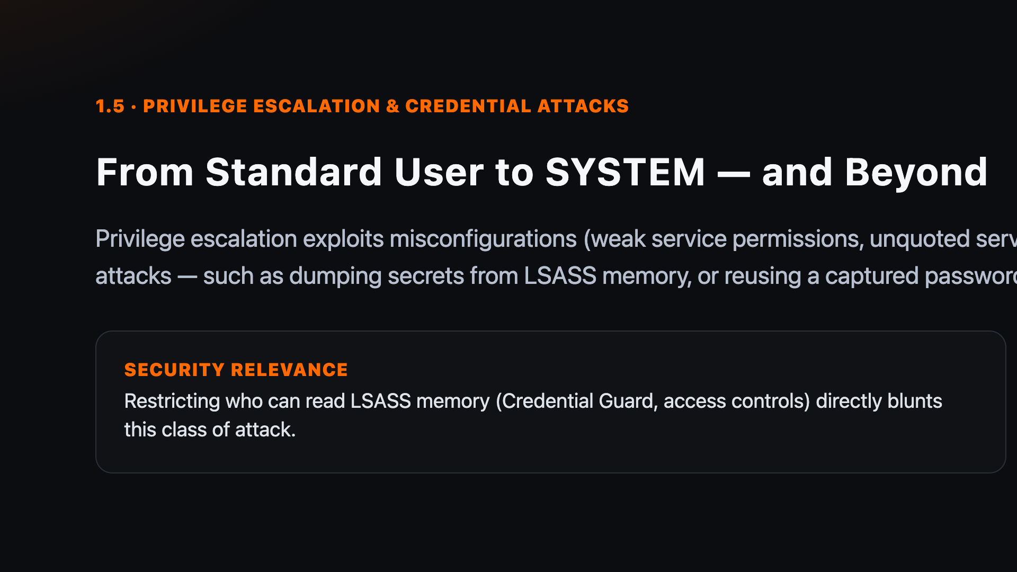
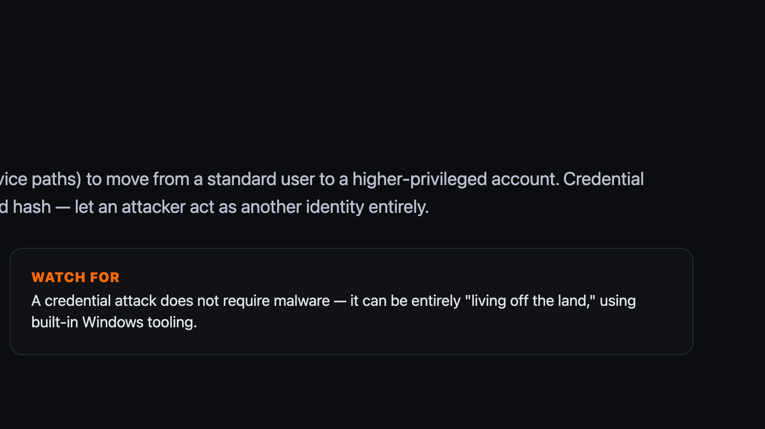
Notes:
LSASS memory access is a recurring theme — it reappears in privilege escalation content in the CyberOps track and memory forensics in the DFIR track.

Slide 22
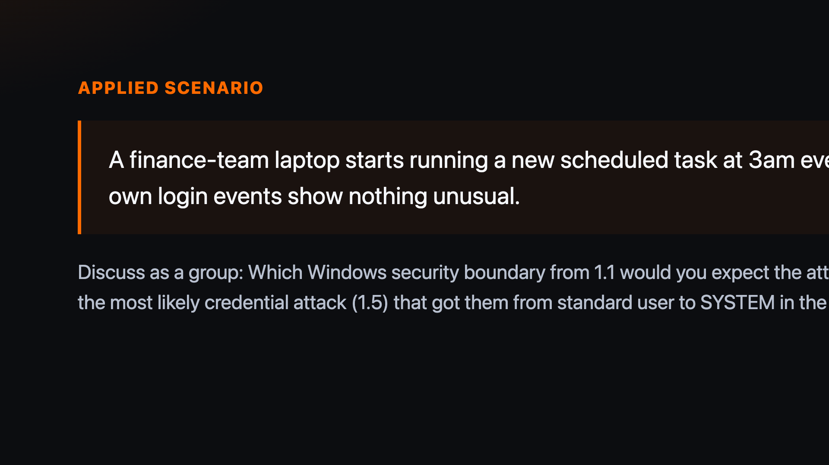
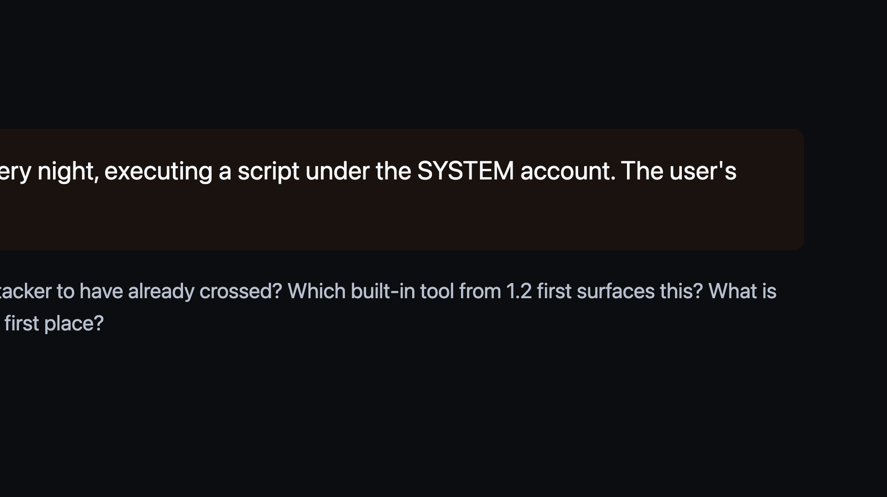
Notes:
Discussion-based — no lab dependency. Ask learners to talk through detection AND remediation at each stage before revealing the next.

Slide 23


Notes:
These are discussion/walkthrough points, not a hands-on lab — keep them tool-agnostic.

Slide 24




Notes:
Run through quickly — these acronyms recur constantly for the rest of the programme.

Slide 25


Notes:
These mirror common exam-style distractors learners will meet in the knowledge check and PBQ.

Slide 26


Notes:
Pause for learner response before revealing the answer: B — the more restrictive permission wins when NTFS and share permissions conflict.

Slide 27


Notes:
Recap all five sub-objectives briefly before moving to the next-steps slide.

Slide 28




Notes:
Preview F2, which builds directly on the Windows administration model just covered.

