Slide 1

Automated Circuit Failover
NetBox Cloud · Ansible Automation Platform
Red Hat Summit 2026
Matt York | Sales Engineer, NetBox Labs

Slide 2
A Customer Came to Us With a Problem
“Our intercontinental IPLC link between Bristol and Atlanta went down.
We had a secondary link available. But it took our team 45 minutes to find it,
identify which routers were affected, and manually reconfigure the failover path.
In that 45 minutes, we lost hundreds of thousands of dollars in business.
We need to make sure this never happens again.”
Enterprise Network Customer | Intercontinental WAN Operations

Slide 3
When a Circuit Fails, Three Things Have to Happen
Every time. Under pressure. With the clock running.
1
Disable the failed circuit
Identify the failed link, confirm it is down, and mark it as offline in your systems. With no single source of truth, just finding it can take 10–15 minutes.
2
Fail over to the most appropriate alternative
Find a backup circuit that serves the same sites. Determine which routers are involved. Choose the best option based on capacity and cost — manually, from memory or spreadsheets.
3
Document everything for management
Record what failed, when, what was done, and who made each decision. This is often skipped under pressure — or done hours later from memory.

Slide 4
Why Did It Take 45 Minutes?
0:00
Alert fires. Engineers are paged.
0:05
Team opens spreadsheets and old Visio diagrams to find the secondary circuit.
0:15
Secondary circuit details found — but which routers does it use?
0:22
Cross-reference IPAM, check interface logs, ask a colleague who “knows the network”.
0:30
SSH into Bristol router. Find the right interface. Apply config.
0:37
SSH into Atlanta router. Repeat.
0:43
Test connectivity. Something is wrong. Roll back. Try again.
0:45
Traffic restored. Documentation updated... maybe.

Slide 5
The Root Cause
No single source of truth
No automation
No audit trail
Circuit inventory lived in spreadsheets, Visio diagrams, and people’s heads. No one system had the full picture.
Every failover step was manual: find the backup, identify the routers, SSH in, apply config, test, document.
After the incident, the team couldn’t easily answer: what changed, when, and who made the call?
The technology existed to fix all three of these problems. It just wasn’t joined up.

Slide 6
What We Recommended
The old world
The NetBox + AAP world
✗ Spreadsheet inventory
✓ 1. Disable the failed circuit
Copilot AI marks it offline in NetBox with a single sentence. No spreadsheet hunting.
✗ Manual failover runbooks
✓ 2. Fail over to the best alternative
AAP queries NetBox, finds the highest-capacity backup, pushes router config automatically.
✗ 45+ minute MTTR
✓ 3. Document for management
AAP generates a full incident report: what failed, what ran, who triggered it, timestamps.
✗ No automation
✓
→
✗ Stale documentation
✓ Visual Explorer
Live topology map shows the new state the moment the workflow completes.
✗ Errors under pressure
✓ Full audit trail
Every action recorded in NetBox change log and AAP job history.

Slide 7
How It Works
• NetBox Cloud holds every circuit, device, and connection as structured data
• Copilot AI translates plain English into a precise API action
• A circuit status change fires a webhook to AAP automatically
• AAP discovers the best backup circuit dynamically from NetBox
• Router config is pushed and NetBox is updated in a single workflow
• Visual Explorer map reflects the new topology in real time
• Automated failover: under 30 seconds · Full audit trail

Slide 8
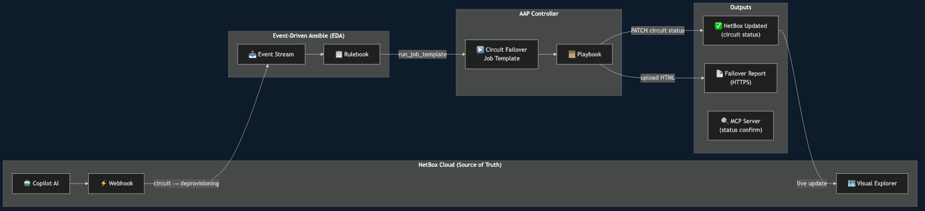
Architecture

Slide 9
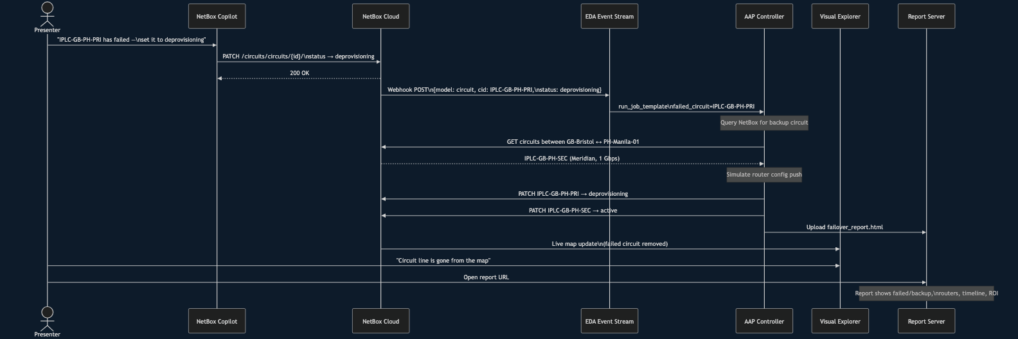
Demo Sequence

Slide 10
Demo Flow — Step by Step
1
Visual Explorer
Open the global WAN map — GB-Bristol hub with active circuit to US-Atlanta via IPLC-GB-AT-PRI
2
Copilot AI
Tell Copilot: “IPLC-GB-AT-PRI has failed — set it to offline”
3
AAP Workflow
NetBox event rule fires webhook → AAP launches Circuit Failover Workflow automatically
4
Step 1: Failover
Playbook queries NetBox, finds backup (IPLC-GB-AT-SEC), pushes router config, updates NetBox
5
Step 2: Report
Second workflow step generates HTML incident report and deploys it to the report server
6
Visual Explorer
Refresh map — primary circuit gone, backup confirmed active on new router path
7
Claude + MCP
Ask Claude: “What is the current status of IPLC-GB-AT-PRI?” — live NetBox data confirms

Slide 11
The Playbook: Driven Entirely by NetBox Data
• Input: just the failed circuit CID (e.g. IPLC-GB-AT-PRI)
• Discovers A-side and Z-side sites from circuit terminations in NetBox
• Finds all active circuits between those two sites tagged for failover
• Selects the best backup by highest committed bandwidth
• No hardcoded backup mappings — add a new circuit to NetBox and it is automatically considered
• Pushes router config changes to all routers at both ends
• Writes back to NetBox: primary → offline, backup → active
• Generates and publishes the HTML failover incident report

Slide 12
The Business Case
~45 min
< 30 sec
Manual failover
Automated failover
❖ NetBox is not just a CMDB — it is an active source of truth that drives automation
❖ The moment a circuit changes state, the response is already running
❖ The playbook discovers backup paths dynamically — works for any circuit, any site
❖ Every failover is logged in NetBox, captured in AAP job history, and published as a report
❖ MCP lets Claude query live NetBox data — confirm outcomes in natural language

Slide 13
Step 7: Confirm with Claude + NetBox MCP
What is the NetBox MCP Server?
Example queries at the end of the demo
• Runs on a dedicated AWS VM
❯ What is the current status of IPLC-GB-AT-PRI?
• Connected to your NetBox Cloud instance
Confirms: Offline — the failed circuit is recorded
• Read-only — queries only, no writes
❯ What is the status of IPLC-GB-AT-SEC?
Confirms: Active — the backup is live
• Accessed via SSH stdio transport
❯ Show me all active circuits between GB-Bristol and US-Atlanta.
• Registered once with Claude Code: claude mcp add netbox-mcp ...
Lists the surviving circuits on that route
• Claude calls NetBox API tools automatically behind the scenes
❯ Which circuits are currently not active?
Full view of any degraded paths across the WAN
❯ When was IPLC-GB-AT-PRI last changed, and by whom?
Audit trail: timestamp and username from NetBox change log

