Slide 1
Hello, Python!
CMSC 320 - Introduction to Data Science
A quick introduction to
Python syntax, variable assignment, and numbers
Dr. Fardina Alam

Slide 2
Importance
Python: It's a user-friendly language for data analysis.
Git: Helps manage code and data changes when working with a team. (LATER TOPIC)
Pandas: Simplifies data cleaning and manipulation. (LATER TOPIC)
Databases: Needed for storing and retrieving data efficiently. (LATER TOPIC)
These skills are essential for effective data analysis, collaboration, and handling data in real-world projects.

Slide 3
Topics to Cover
Introduction to Python
Syntax
Variable
Assignment
Numbers
In -class exercises (LATER TOPIC)

Slide 4

Before we get started
We're going to be working in Google Colab today and also for the course!
Quick Note: Google Colab is a free, cloud-based platform provided by Google that allows you to write and execute Python code in a web-based interactive environment. It is particularly popular in the field of machine learning and data analysis;
requires no setup to use
provides free access to computing resources, including GPUs and TPUs.
allows multiple people to work on the same notebook simultaneously

Slide 5
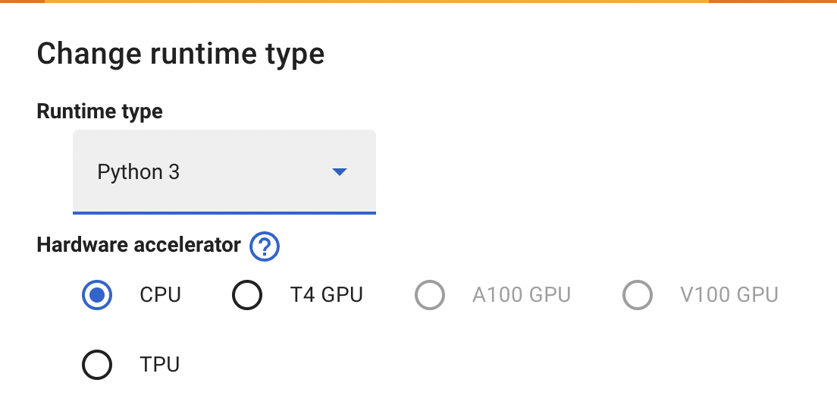
Before we get started
We're going to be working in Google Colab today and also for the course!
To load yours, do the following:
Sign in with your Google account
Once signed in, click on the "New Notebook" button. This will create a new Jupyter notebook hosted on Google Colab. Rename it as “CMSC320-class1-Your_UID.ipynb”
Default Runtime is given: Python3 (with CPU).
If you want to change it; Go to the "Runtime" menu at the top and click on "Change runtime type."
Use Colab's notebook cells to write and execute Python code.
Use “+code/+text” to create new code block/ comment block
Execute a cell by clicking 'Play' button next to the cell or using 'Shift + Enter'.
Save manually through 'File' or let Colab auto-save to Google Drive for work preservation.
More Details

Slide 6

Before we get started
There is another populer alternative: Jupyter Notebook !
Quick Note: Jupyter Notebook is an open-source web application that allows you to create and share documents that contain live code, equations, visualizations, and narrative text.
It runs on your local machine, and you can access it through your web browser.
Means you have full control over your environment and can easily install any libraries or packages you need.
Check:https://medium.com/@jknrjayalath/jupyter-notebook-vs-google-colab-colaboratory-77dbbafdc636

Slide 7
Before we get started
There is another populer alternative: Jupyter Notebook !
Ensure Python is installed on your system. Download from python.org.
Open a command prompt or terminal.
Install: Run the following command to install Jupyter: pip install jupyter
Start: In the command prompt or terminal, type jupyter notebook and press Enter. A new browser window/tab will open with the Jupyter Notebook interface.
Using Jupyter Notebook: Create a new notebook, add cells for code or text, and execute code interactively.
Use Markdown cells for narrative text and visualizations.
Save and share notebooks in various formats, including HTML and PDF.

Slide 8
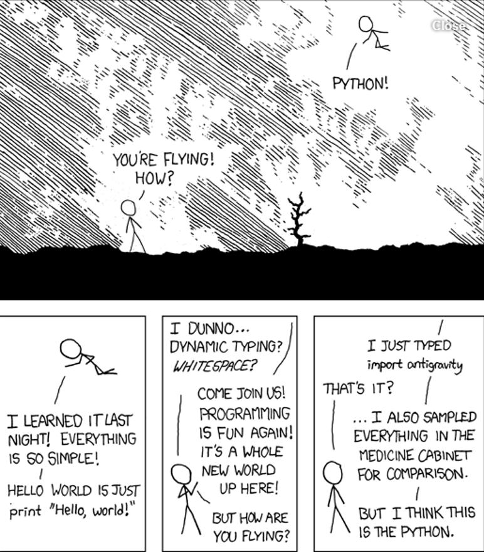
What is Python?
Python is a Interpreted (i.e. non-compiled), high-level programming language
A widely used programming language known for its readability and simplicity.
Interpreter executes source code directly; do not require a separate compilation step
Designed to be intuitive and easy to program in (read/write)
Supports dynamic typing, allowing variables to change types during runtime
Also has a focus on importing modules, a feature that makes it useful for scientific computing.
Runs on most operating systems and platforms
Slow to run

Slide 9
Getting Started with Python
Download and install Python 3 from python.org.
Note: Python 2.7 is no longer maintained; transition to Python 3.
Install useful Dependencies: Use pip to install essential data science libraries
pip install numpy, matplotlib, scipy, pandas, sklearn, …
Download an IDE of your choice
Visual Studio, PyCharm, Sublime Text, Spyder, etc.
https://stackoverflow.com/questions/81584/what-ide-to-use-for-python
Run interactively in a Jupyter notebook, Google Colab
Recap: For this course, we will mostly use Google Colab.

Slide 10
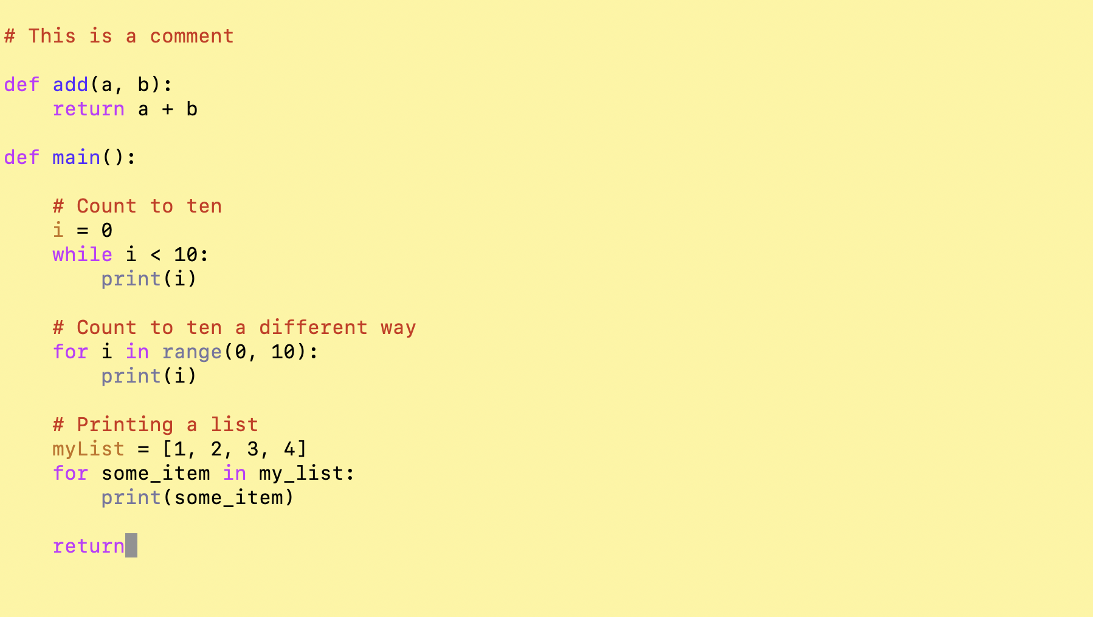
A Python Code
This is unintentionally an infinite loop, needs an i += 1

Slide 11
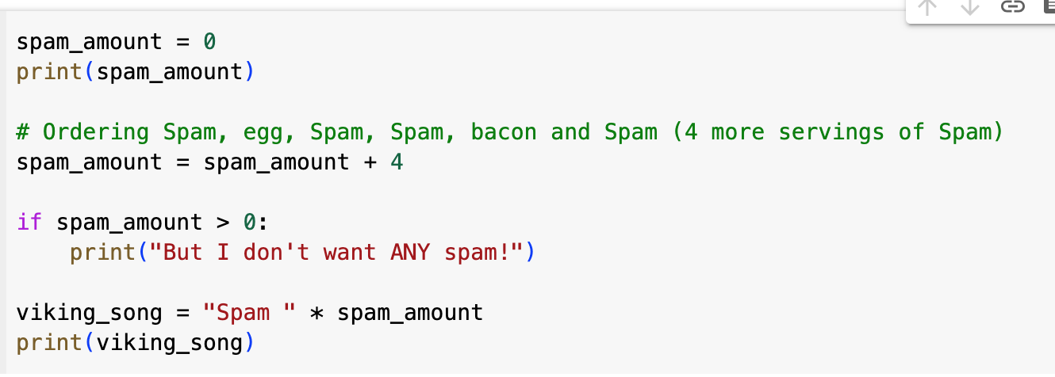
Try! What’s the output?

Slide 12
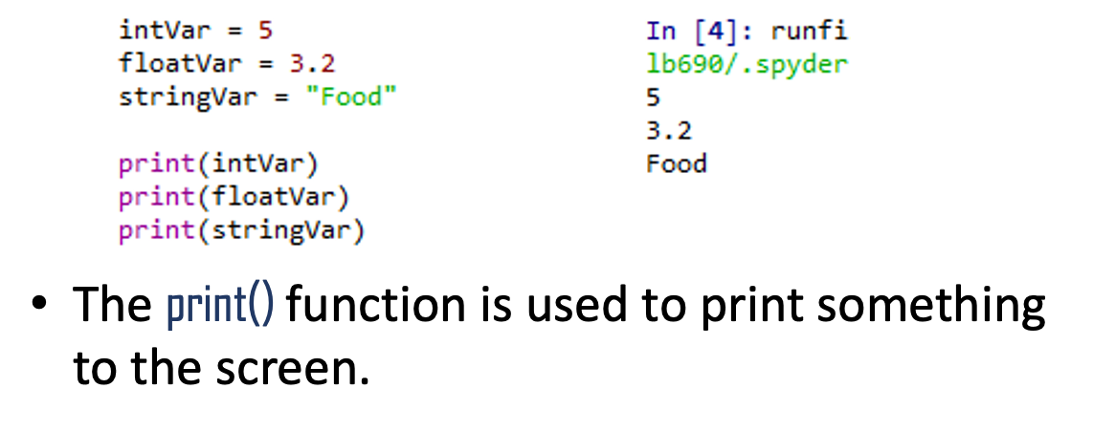
Variables and Types
Dynamically typed: the type of the variable is derived from the value it is assigned.
Numbers
Integer
Float
Complex
Boolean
String
A variable is assigned using the = operator; i.e:

Slide 13
Basic Operators
Arithmetic Operators
+ #addition
- #subtraction
* #multiplication
** # power
% # modulus
“in” # check if element is in container
Increment Operator: x += y
Others: x *= y, x -= y etc.
Boolean Operators (useful for conditional statements )
and, or,not
Comparison Operators
Greater than: >
Lesser than: <
Greater than or equal to: >=
Lesser than or equal to: <=
Is equal to: ==

Slide 14
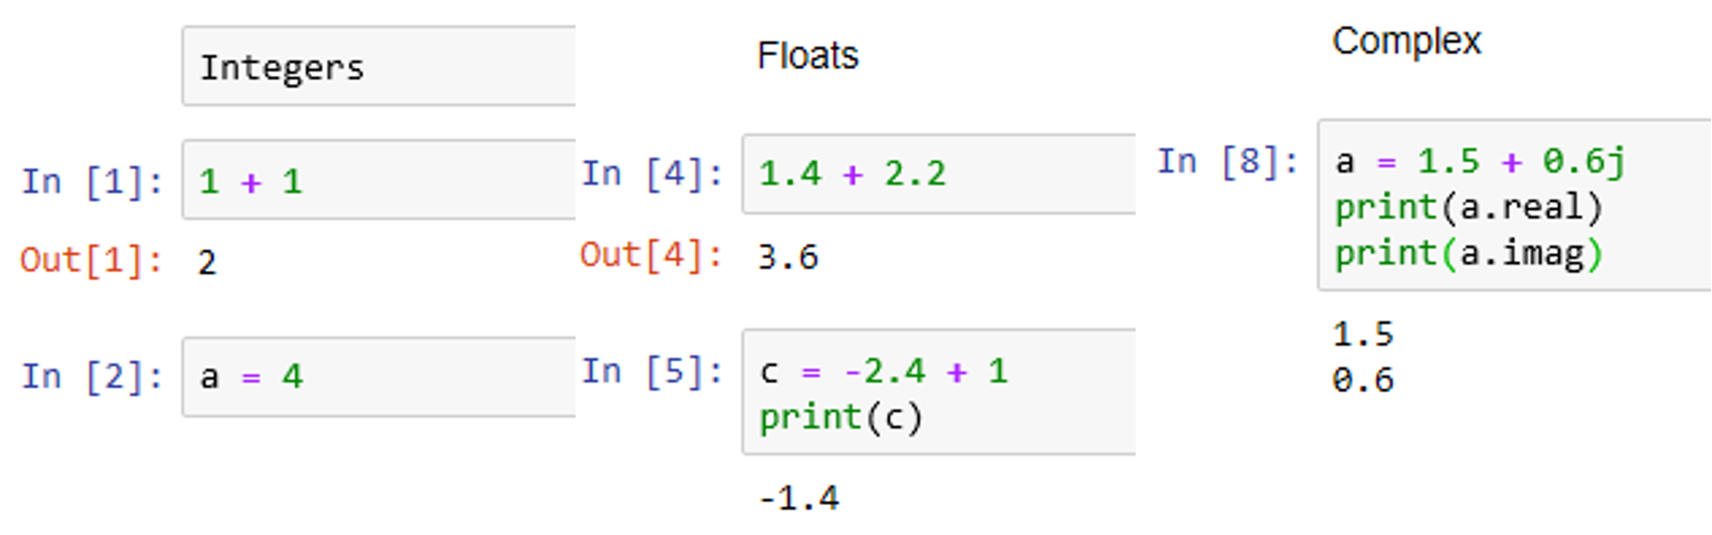
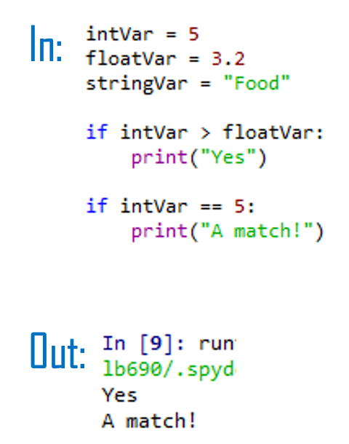
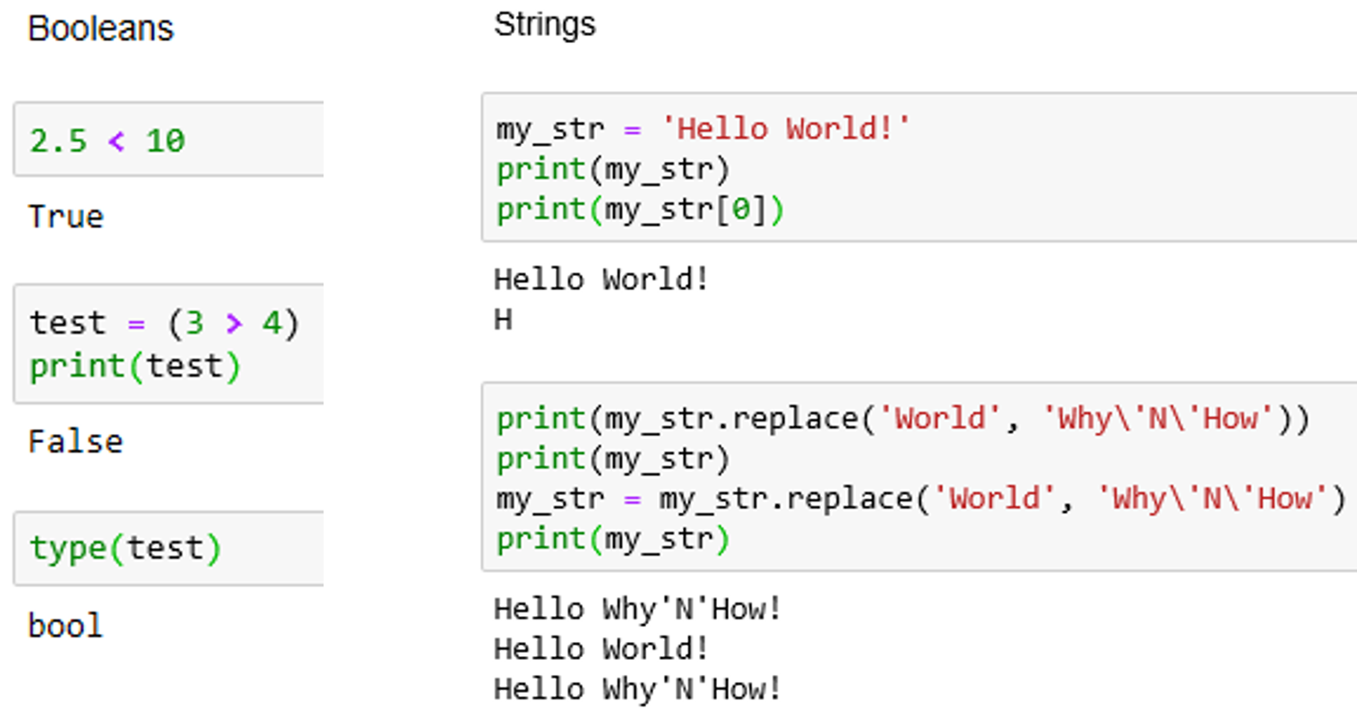
Examples: Basic Operators

Slide 15
Variable Assignment
Interesting Facts:
No need to
explicitly “declare” a variable before assigning a value to it.
“specify” the type of value the variable will refer to; can re-assign it to different types (string, boolean etc.)
Variable
Assign the value
spam_amount = 0
Assignment Operator

Slide 16
Function Call
print(spam_amount)

Slide 17
What is Function in Python?
A function is a block of code which only runs when it is called.
Two types of functions:
User-defined functions – The user defines these functions to carry out a certain task.
Built-in functions – These Python functions are built-in functions.

Slide 18
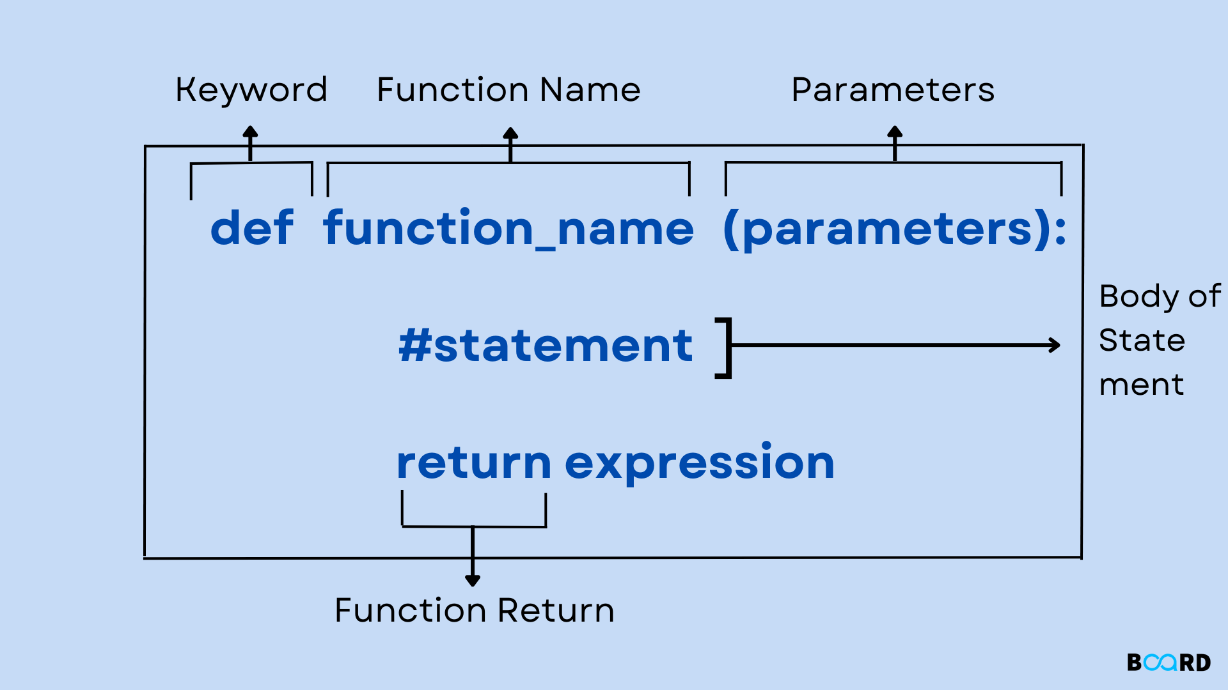
Function Structure
You can pass data, known as parameters, into a function.
A function can return data as a result

Slide 19
Built-in functions: function Call
print(spam_amount)

Slide 20
User-defined functions
# User-defined function with .split() method to count words
def count_words(sentence):
words = sentence.split()
return len(words)
# Example usage
input_sentence = "Python is a versatile programming language."
word_count = count_words(input_sentence)
# Print the result
print("Number of words:", word_count)
Functions (Custom) operations that take one or more pieces of data as arguments
Methods: functions called directly off data using the “.” operator (ex: .split())

Slide 21
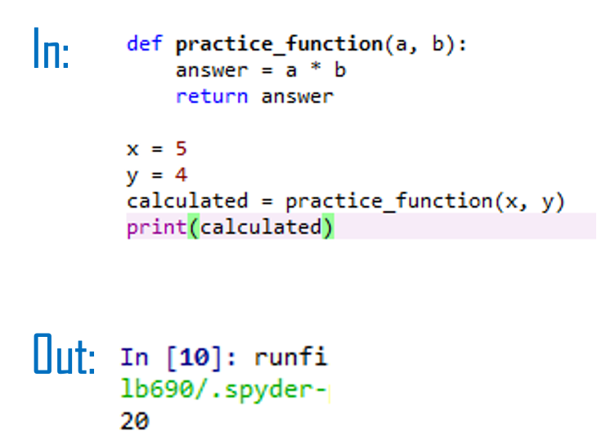
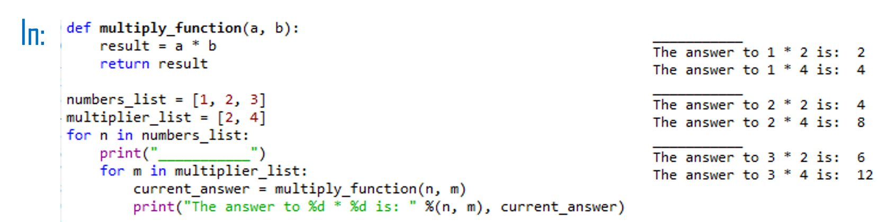
Function Call cont.
The function must be defined before it is called.
In other words, the block of code that makes up the function must come before the block of code that makes use of the function.

Slide 22
Comment
Reassign the value of an existing variable
Begin with the # symbol.

Slide 23
Python Data Structures
Lists (ordered, mutable set of objects): var = ['one', 1, 1.0]
Tuples (ordered, immutable set of objects): var = ('one', 1, 1.0)
Dictionaries (Unordered lists of key-valued pairs): var = {'one': 1, 'two': 2, 1: 'one', 2: 'two’}
Each of the above has its own set of methods. E.g: Dictionaries methods are keys(), values(), items(), etc.

Slide 24
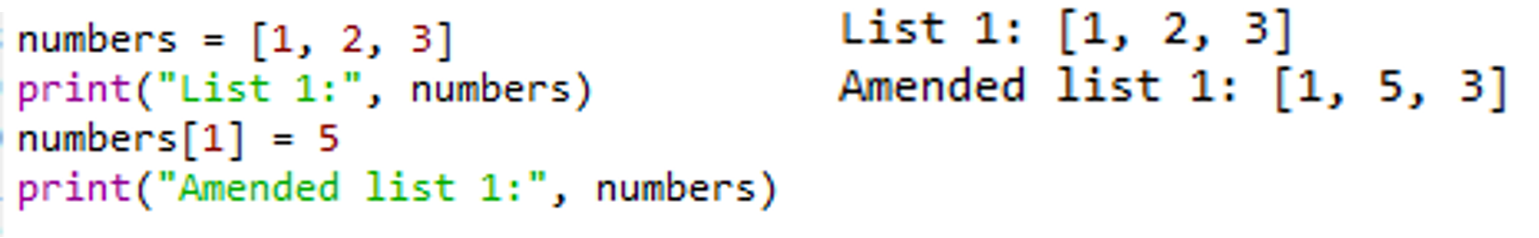
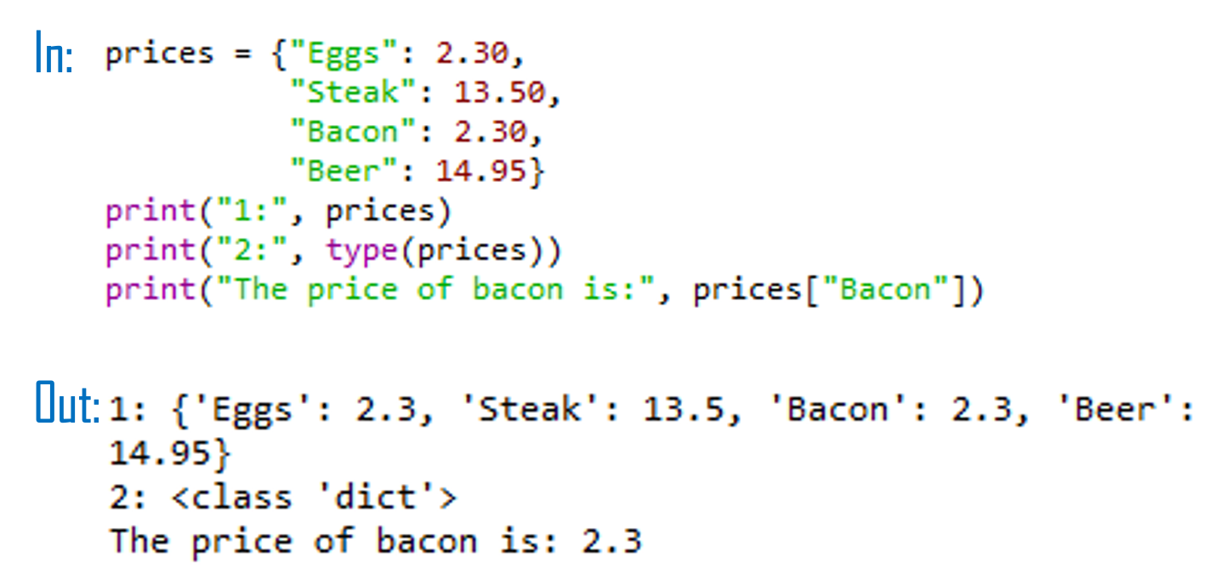
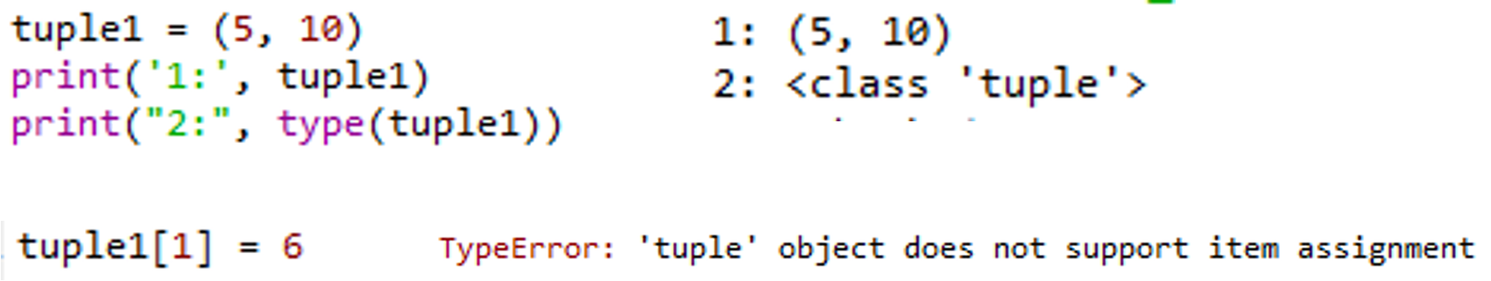
Examples: Python Data Structures

Slide 25
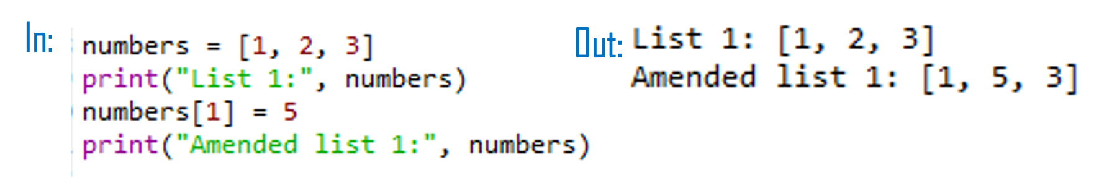
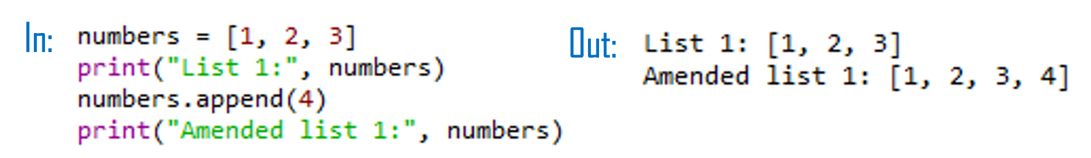
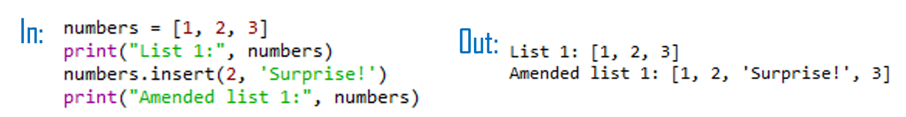
Adding elements to a list
Use of an index to replace a current element with a new one.
Use the insert() function in order to add an element to a list at a specific indexed location, without overwriting any of the original elements.
Add an element to the end of a list using the append() function
Try: Replace the second element in your string with the integer 2.
Try: Use insert() to put the integer 3 after the 2 that you just added to your string.
Try: Use append() to add the string “end” as the last element in your list.

Slide 26
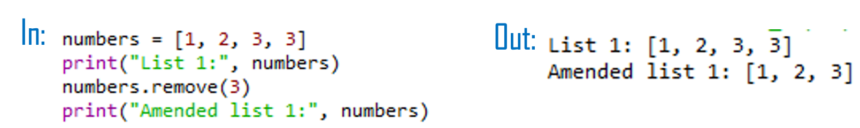
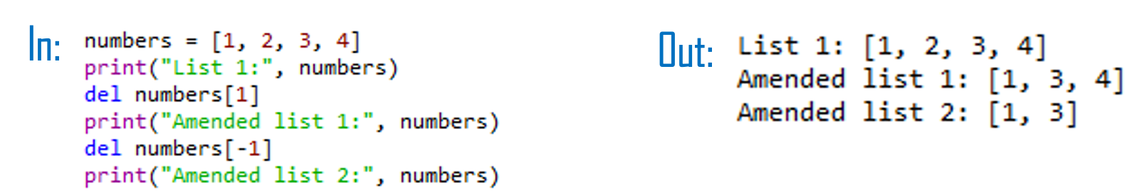
Removing elements from a list
You can remove an element using remove() from a list based upon the element value.
Remember: If there is more than one element with this value, only the first occurrence will be removed.
Also remove elements by their index using the del function.
Try: Use del to remove the 3 that you added to the list earlier.

Slide 27
Indexing
Indexing in Python is 0-based, meaning that the first element in a string, list, array, etc, has an index of 0. The second element then has an index of 1, and so on.
You can cycle backwards through a list, string, array, etc, by placing a minus symbol in front of the index location.

Slide 28
Slicing
In Python, slicing is a way to extract a portion of a sequence (like a list, tuple, or string).
The syntax: start:stop:step. Step is optional; If step is not specified, it defaults to 1
my_list = [1, 2, 3, 4, 5, 6, 7, 8, 9, 10]
# Using slicing to get elements from index 4 to the end
subset_list = my_list[4:]
# Print the result
print(subset_list)
# Using slicing to get elements from the beginning up to (, but not including) index 4
subset_list = my_list[:4]
# Print the result
print(subset_list)
Output: [5, 6, 7, 8, 9, 10]
Output: [1, 2, 3, 4]
Up to (but not including) the element at index 4

Slide 29
Try: Slicing
Create a string that is 10 characters in length.
Print the second character to the screen.
Print the third to last character to the screen.
Print all characters after the fourth character.
Print characters 2-8.

Slide 30
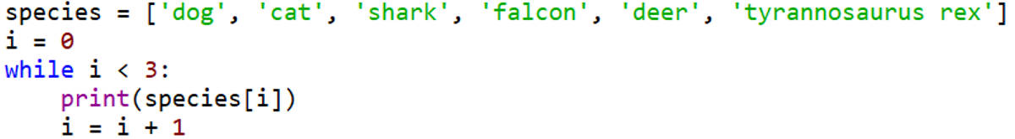
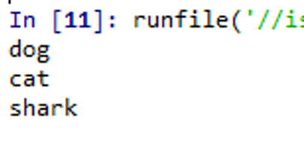
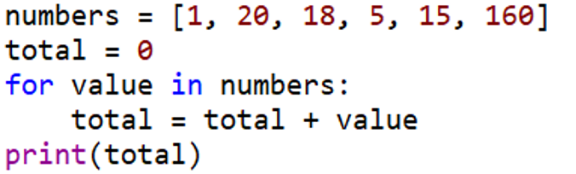
Python For and While Loops
The for loop is used to iterate over elements in a sequence, and is often used when you have a piece of code that you want to repeat a number of times.
For loops essentially say: “For all elements in a sequence, do something”
The while loop tells the computer to do something as long as a specific condition is met.
It essentially says: “while this is true, do this.”

Slide 31
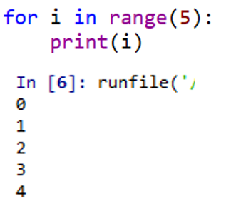
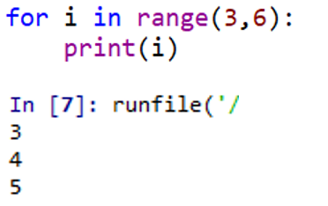
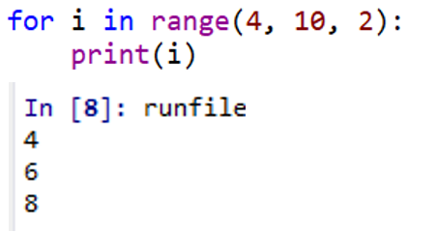
Functions: range()
The range() function generates a list of numbers, which is generally used to iterate over within for loops.
Syntax: range(stop)
stop: Number of integers (whole numbers) to generate, starting from 0.
Syntax: range([start], [stop], step)
start: Starting number of the sequence.
stop: Generate numbers up to, but not including this number.
step: Difference between each number in the sequence
Note:
All parameters must be integers (can be positive or negative).
The range() function (and Python in general) is 0-index based (list indexes start at 0, not 1).
Eg. mylist[0] = the first element of a list. Therefore the last integer generated by range() is up to, but not including, stop.

Slide 32
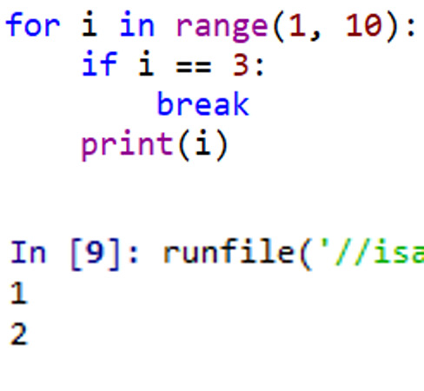
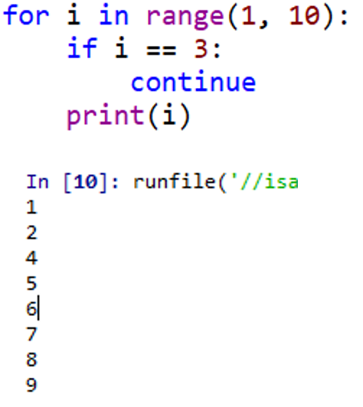
Functions: break. continue
the break() function: terminate a loop sd it breaks out of the innermost enclosing for or while loop.
The continue() statement is used to tell Python to skip the rest of the statements in the current loop block, and then to continue to the next iteration of the loop

Slide 33
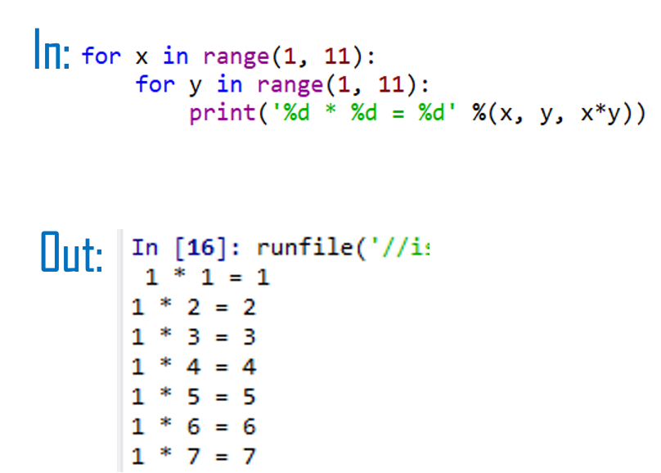
Nested loops
In some situations, you may want a loop within a loop; this is known as a nested loop.

Slide 34
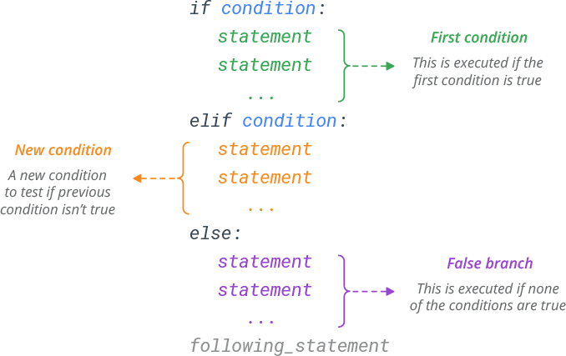
Python Condition: If-Elif-Else Statement
There are three main conditional statements in Python; if, else, elif.

Slide 35
If-Elif-Else Statement
Imagine, you need to write a python program to decipher messages from friendly aliens. You want to decode an alien's mood based on the number of eyes and tentacles it has.
If the alien has 3 eyes and up to 5 tentacles, it's curious and friendly.
If the alien has more than 3 eyes and more than 5 tentacles, it might be grumpy.
But if the alien has 2 or fewer eyes or no tentacles, it seems shy or possibly invisible.
For other cases, the mood is uncertain, and it's an alien mystery.
Task: Write down the code using if-elif-else conditions to accomplish this alien mood decoding task

Slide 36
Additional Reading Slides

Slide 37
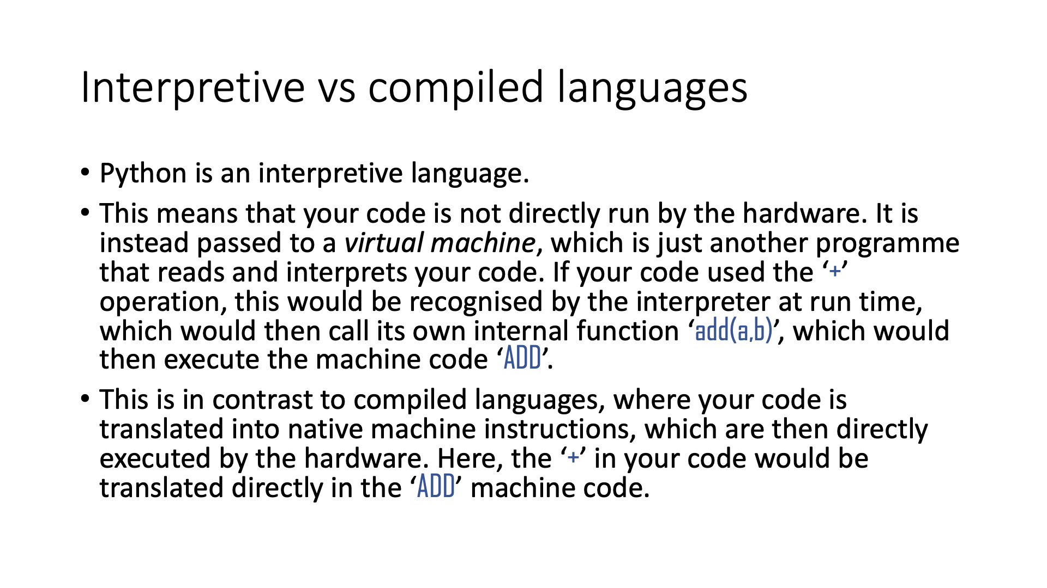

Slide 38
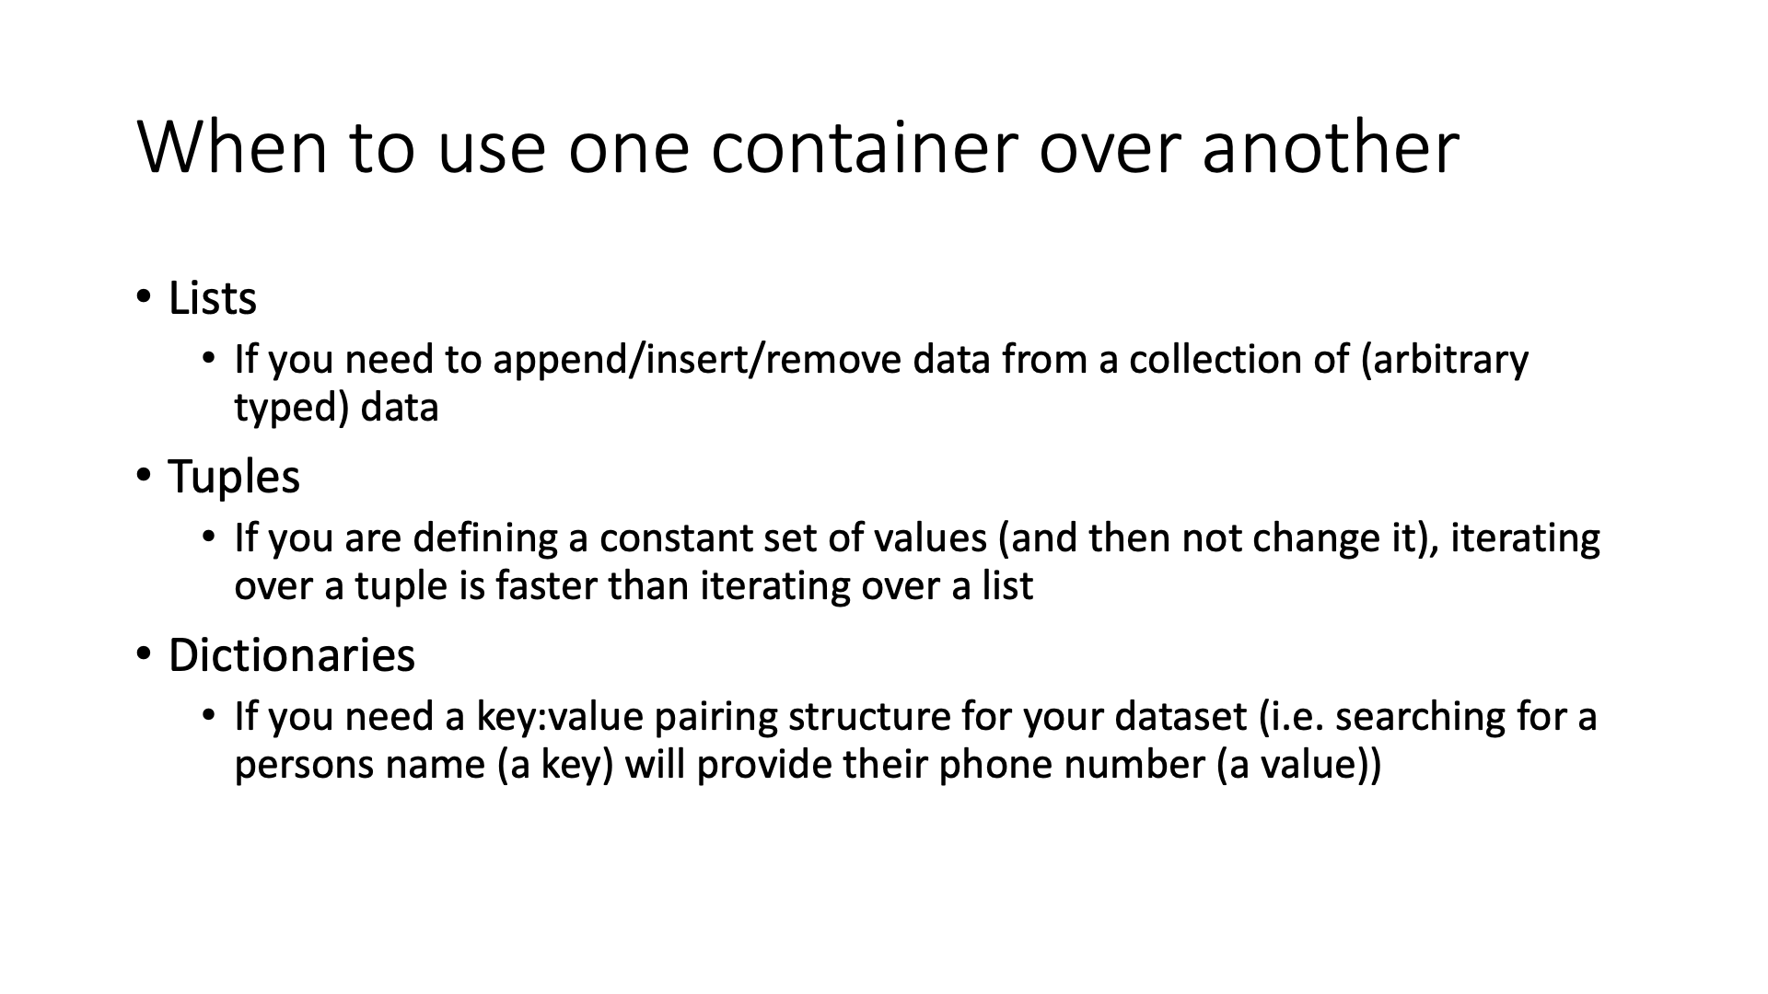
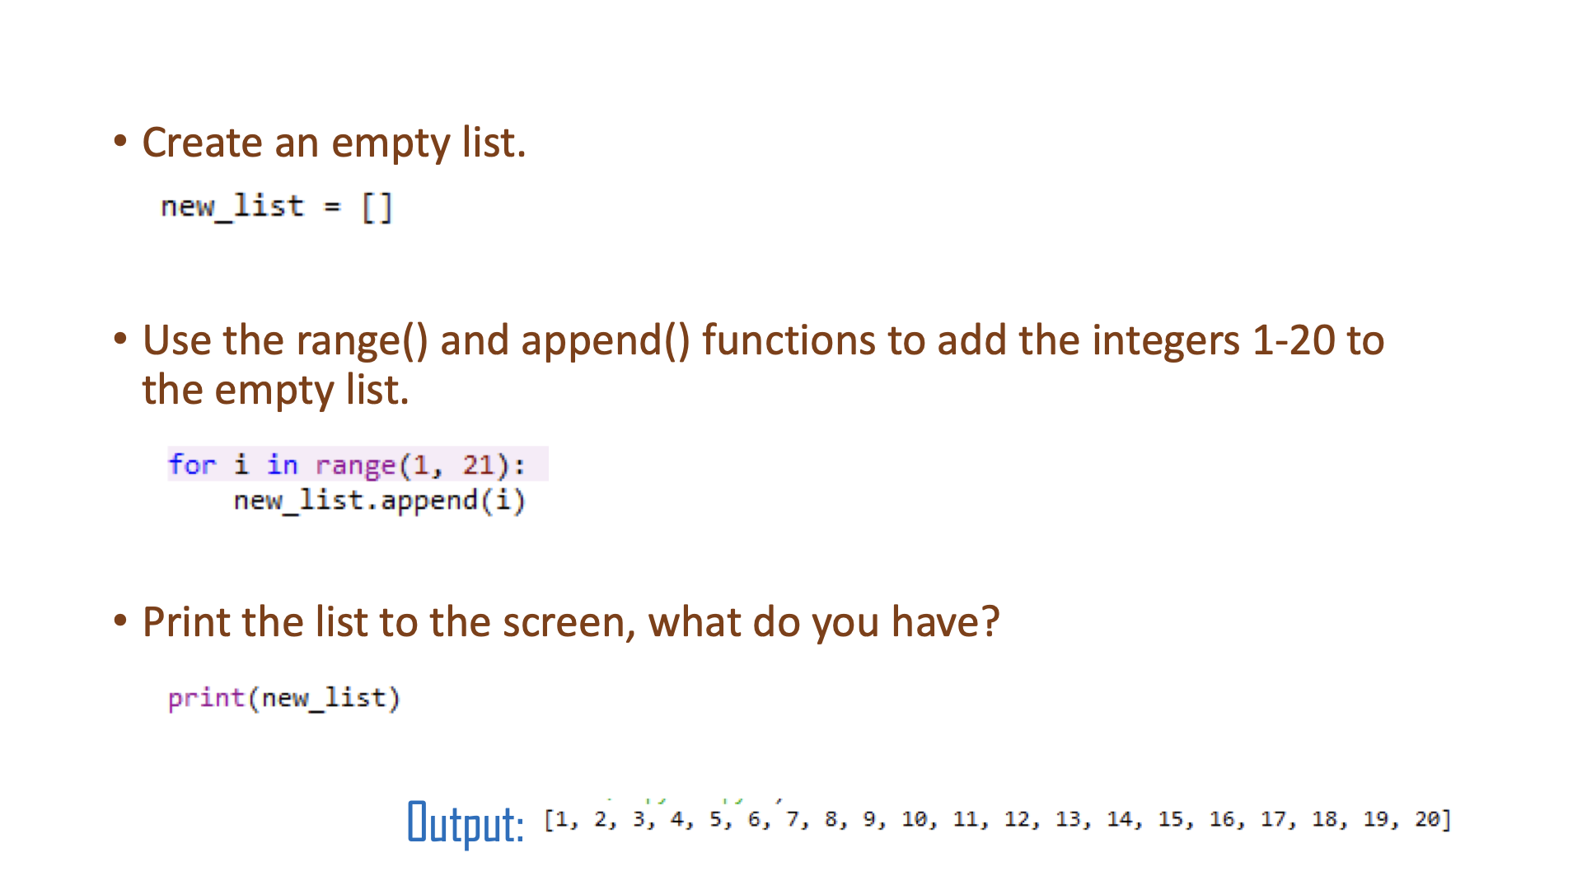

Slide 39
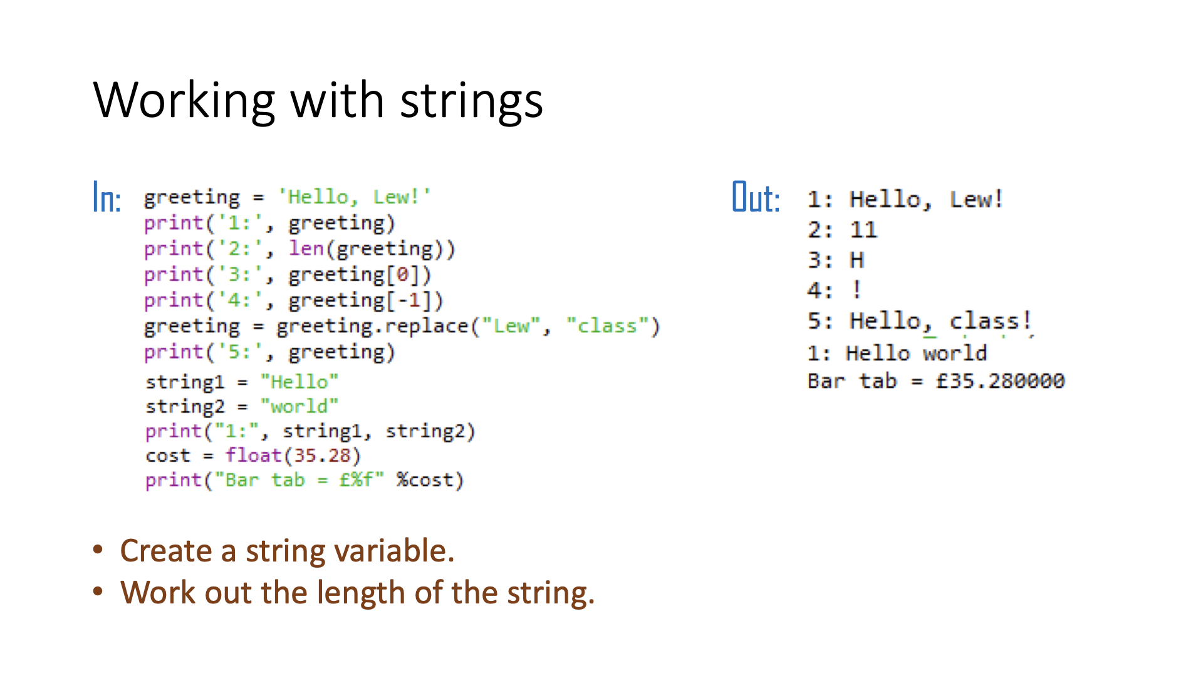
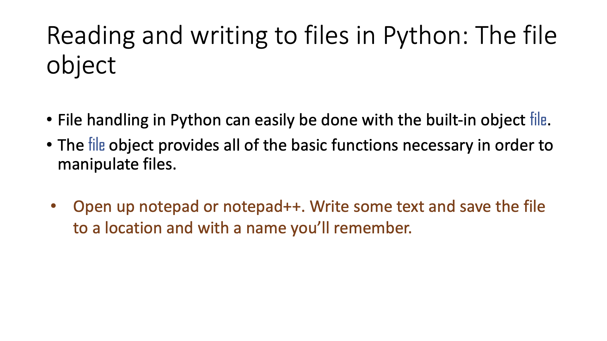

Slide 41
