Slide 1

Basic of Git & GitHub
CMSC 320
INTRODUCTION TO DATA SCIENCE
Lecture
– FARDINA FATHMIUL ALAM
(fardina@umd.edu)
2024

Slide 2
RECAP: Importance
Python: It's a user-friendly language for data analysis.
Git: Helps manage code and data changes when working with a team.
Pandas: Simplifies data cleaning and manipulation.
Databases: Needed for storing and retrieving data efficiently.
These skills are essential for effective data analysis, collaboration, and handling data in real-world projects.

Slide 3
Git

Slide 4
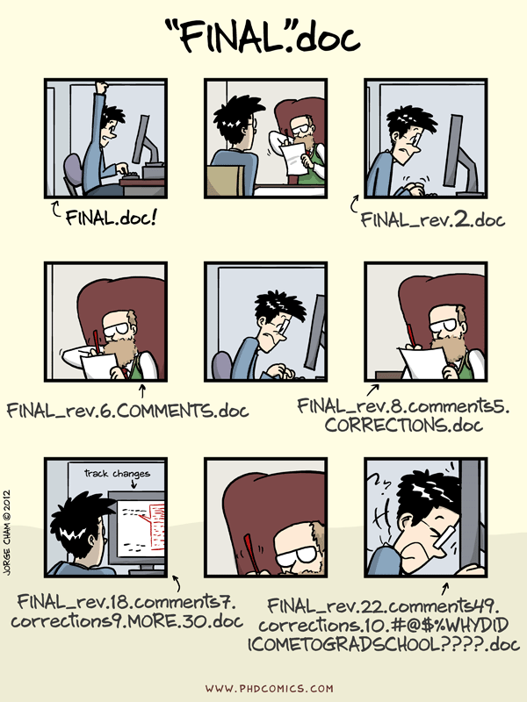
Version Control System (VCS)
A software tool used by developers to manage changes to source code over time.
Tracks modifications to files, allowing multiple developers to collaborate on a project simultaneously while maintaining a complete history of all changes made to the codebase.
If there are issues, a version control system allows you to revert to an earlier code version.
Git is the most popular version control system in the world.

Slide 5
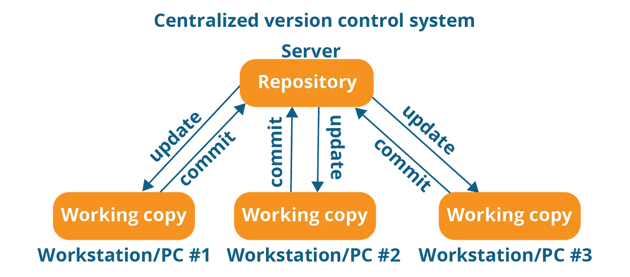
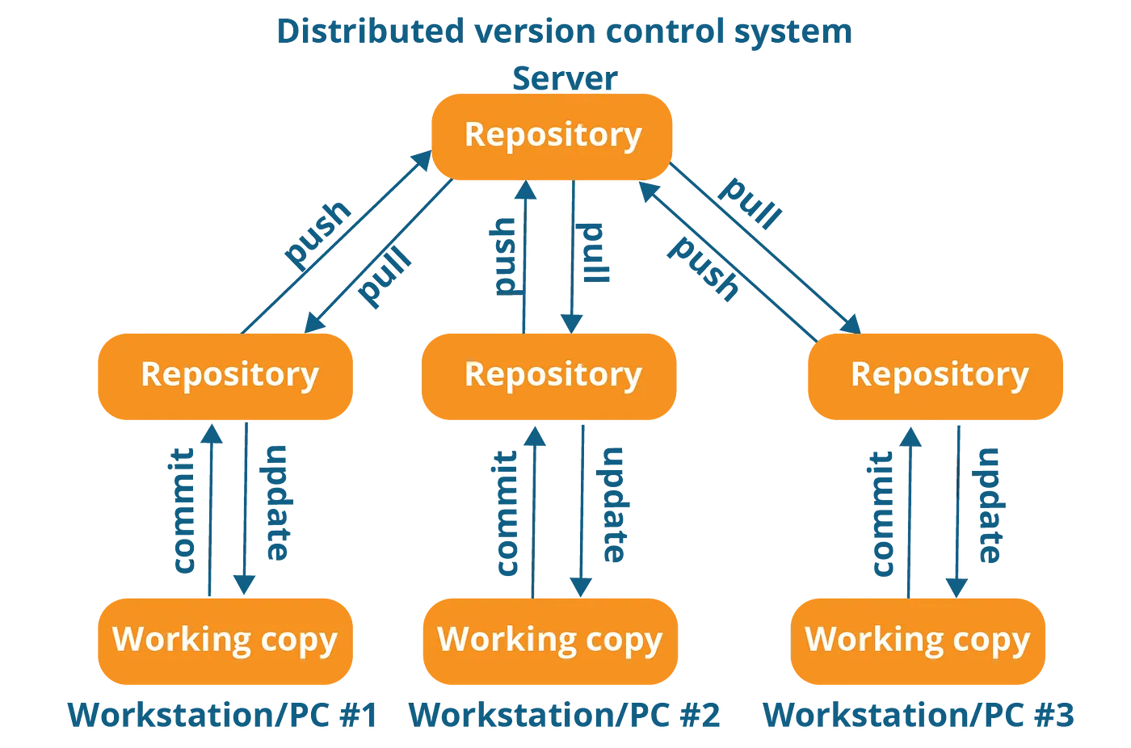
VCS Types
There is a single “central” copy of your project somewhere (probably on a server), and programmers will “commit” their changes to this central copy directly.
Each programmer has a full project copy on their local machine. They commit changes locally and use push and pull operations to sync with a shared server for collaboration.

Slide 6

Git
Git is a version control system that helps developers manage and track changes in their code. It's like a time machine for your code, allowing you to go back to previous versions if something goes wrong or if you need to see how your code looked at a certain point in time.

Slide 7
Git
A distributed version control system , used by most major corporations and labs
Keep a history of previous versions
Everyone mirrors the entire repository instead of simply checking out the latest version of the code
Unlike a centralized version control system, where the project is stored on a central server, each team member using Git has a copy of the project with its history stored on their local machine.
Develop simultaneously on different branches
Easily try out new features, integrate them into production or throw them out
Collaborate with other developers
“Push” and “pull” code from hosted repositories such as Github

Slide 8
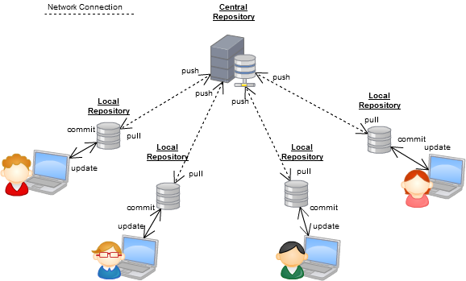
Why Git?
Most commonly used software for tracking changes in any set of files, usually used for coordinating work among programmers collaboratively developing source code during software development.

Slide 9
Installing Git
https://git-scm.com/book/en/v2/Getting-Started-Installing-Git

Slide 10
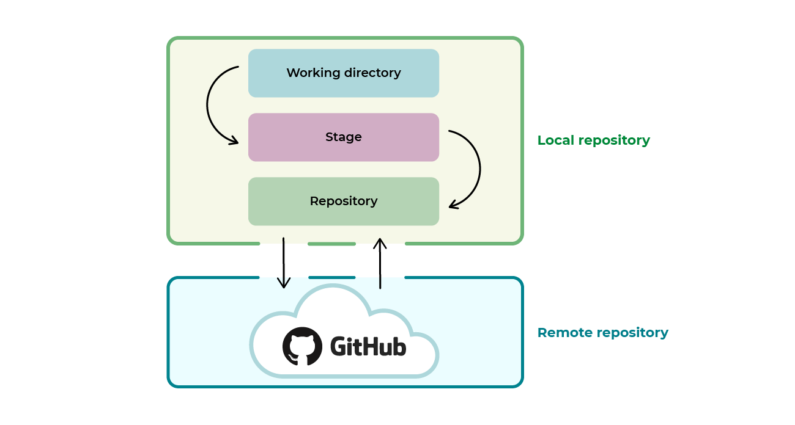
Git Repository
After installing Git, you can initialize it for a project to create a new Git repository.
The Git Repository, represented by the '.git' directory, is a database that contains all the project source code and the history of all code updates. The '.git' directory is typically located at the root of the project directory.

Slide 11
Git Repository
While a Git repository can be stored on your local machine, especially for solo projects, it's common practice to store project code in a repository on a remote server.
Git repositories may include configuration files such as .gitignore for specifying ignored files and directories, and .gitattributes for defining attributes like line endings or merge strategies (e.g., ensuring consistent line endings across platforms).

Slide 12
Github
GitHub is a web-based platform that serves as a hosting service for Git repositories.
Provides a wide range of features and tools to facilitate collaborative software development and version control.
Serves as a central hub for software development, enabling collaboration, code sharing, and project management for individuals, teams, and communities worldwide.

Slide 13
Git Commands
git clone <project URL>
git add my_file.c
git commit
git status
git branch
git checkout
git push

Slide 14
Git Command
command | description
git clone url [dir] | copy a git repository so you can add to it
git add files | adds file contents to the staging area
git commit | records a snapshot of the staging area
git status | view the status of your files in the working directory and staging area
git diff | shows diff of what is staged and what is modified but unstaged
git help [command] | get help info about a particular command
git pull | fetch from a remote repo and try to merge into the current branch
git push | push your new branches and data to a remote repository
others: init, reset, branch, checkout, merge, log, tag

Slide 15
To start a new project with Git
We can either
initialize a new repository in an existing project directory or
clone an existing repository from a remote location (like GitHub) onto your local machine.

Slide 16
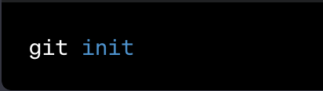
Git init
Initialize a new repository:
Git init creates an empty git repository for project tracking. Once the repository is created, any files added to the repository are automatically tracked.
command:

Slide 17
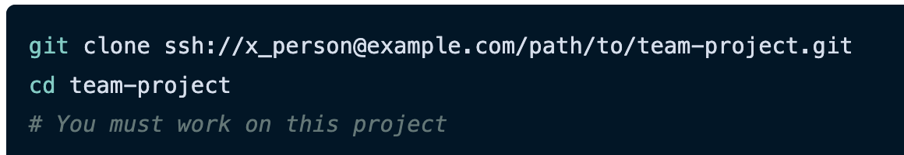
Git Clone
Creates a clone/copy of an existing repository into a new directory.
Eg.Clones a repository from a remote location to your local machine.

Slide 18
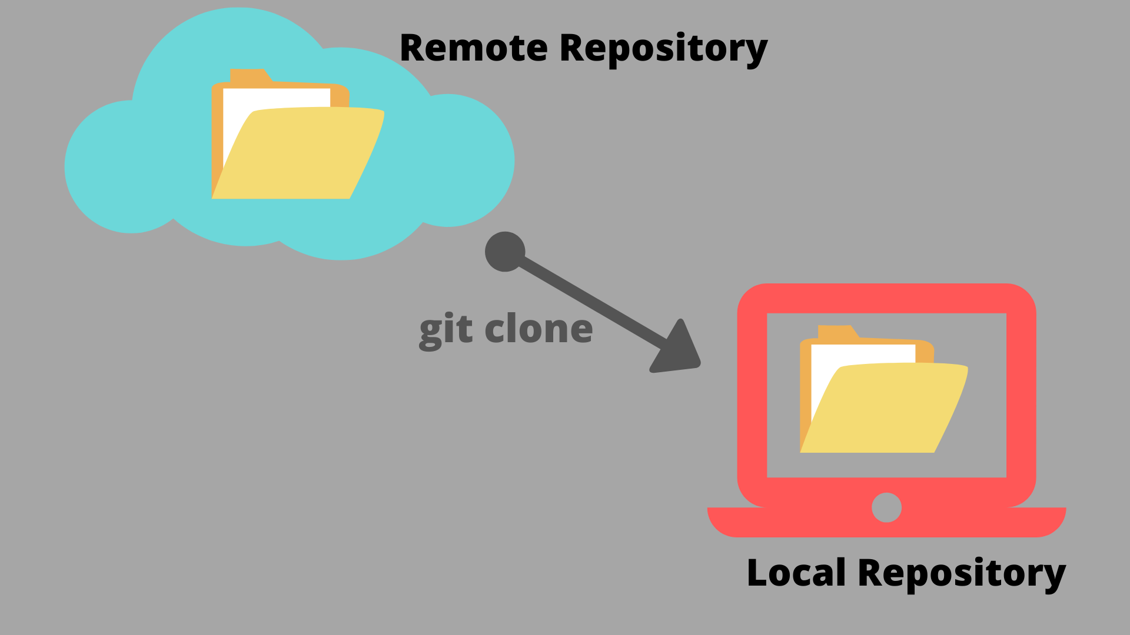
Git Clone
Downloads an exact copy of the files from the remote/central repository (hosted on a platform like GitHub, GitLab, etc.) into a newly initialized local repository on your computer.
From there, we can check out files and make changes.
This example establishes a new Git repository locally named 'team-project', allowing us to work on the project locally with version control.

Slide 19
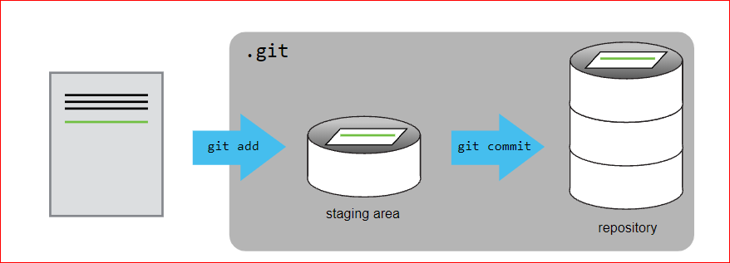
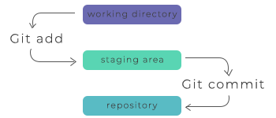
Adding a file to git repository: git add, commit
$ cd desktop/test-GitDemo
$ git init
$ echo “line1” >> firstfile.txt
$ echo “line1” >> secondfile.txt
$ git status
git init command is used to initialize a new Git repository in a directory.
→ shows which files have been changed and need to be committed to the repository.

Slide 20
Adding a file to git repository: git add, commit
$ git add >> firstfile.txt : add files to the staging staging areaOr $ git add >> firstfile.txt secondfile.txt
$ git commit –m “first two files commit” : permanently storing changes in the repository.
$ git status
$ git log : displays a history of commits in your Git repository
Step 1: Staging telling Git to include this file in the next commit.
Step 2: Commit committed those changes with a message
Staging is the process of organizing and preparing our project files for a commit. It is the intermediate step between modifying our files and storing them permanently in the repository.
Adding Files to Git

Slide 21
Git Staging Area
The staging area in Git is an intermediate area where changes are prepared before they are committed to the repository.
Staging is the process of organizing and preparing our project files for a commit.
It is the intermediate step between modifying our files and storing them permanently in the repository.

Slide 22
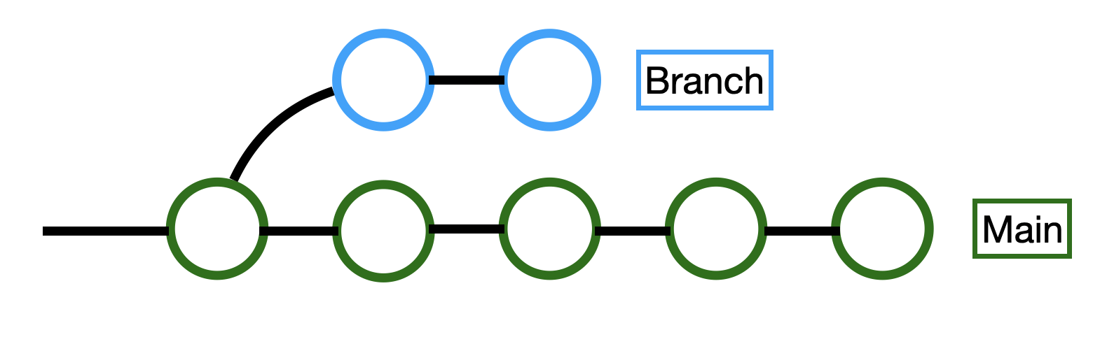
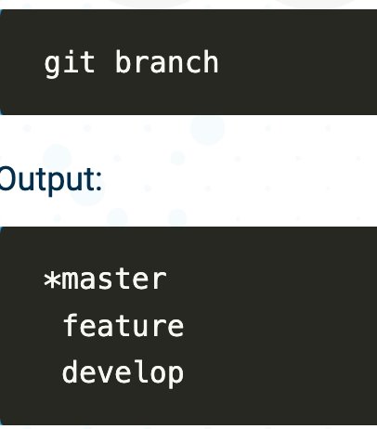
Git Branch
We can use the git branch command to
show/list all project branches.
create a new branch
delete an existing branch or
Show all the branches that exist in the rep
* 🡪 Current Branch

Slide 23

Git Branch
Delete an existing branch:
git branch -d <branch name>
Create a new branch
* 🡪 Current Branch
We start with a repository, create our branch, make changes on our branch, and when we're finished, we merge those changes into the "main" branch. We ensure everything works together and then upload it back to GitHub.

Slide 24
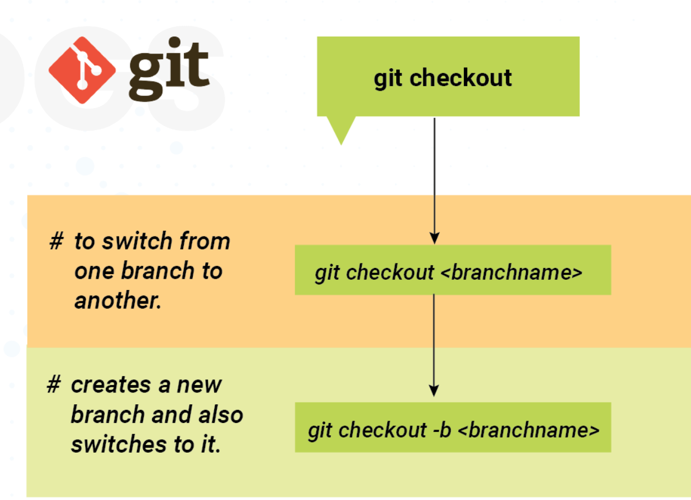
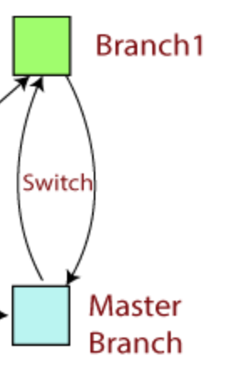
Git Checkout
REMEMBER:
Before switching to a new branch: Changes in the existing branch must be committed.
The new branch must exist on your local machine.
Switch between branches in a repository.

Slide 25
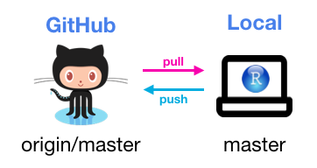
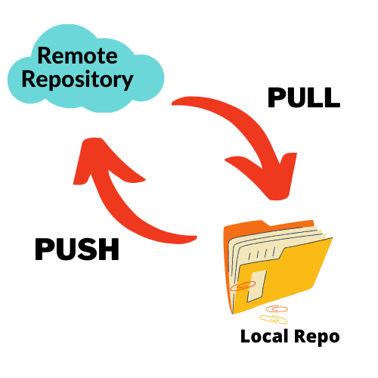
Git Push
Upload / push your local Git commits to a remote repository, such as one hosted on a platform like GitHub.
Crucial for collaborating with others and keeping your remote repository up to date.
$ git push origin-main local-master
Git Pull
Refers to refers to fetching changes from a remote repository. Download and update our local repository with the changes made to the remote repository. First fetch the changes and then merge them into the working branch.
$ git pull <remote-repo-url>

Slide 26
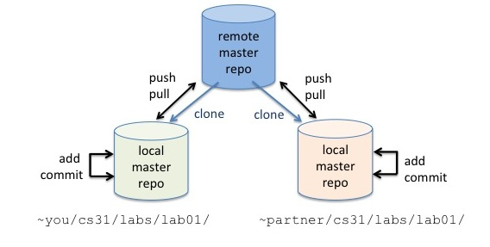
Git Overall
Use an existing remote master git repository
Clone a private local copy of the remote master repo
Add and commit changes to your local private cloned copies.
Local changes can be shared others by pushing them to the master repo.
Your partners will then pull your pushed changes from the remote master into their local repo.

Slide 27
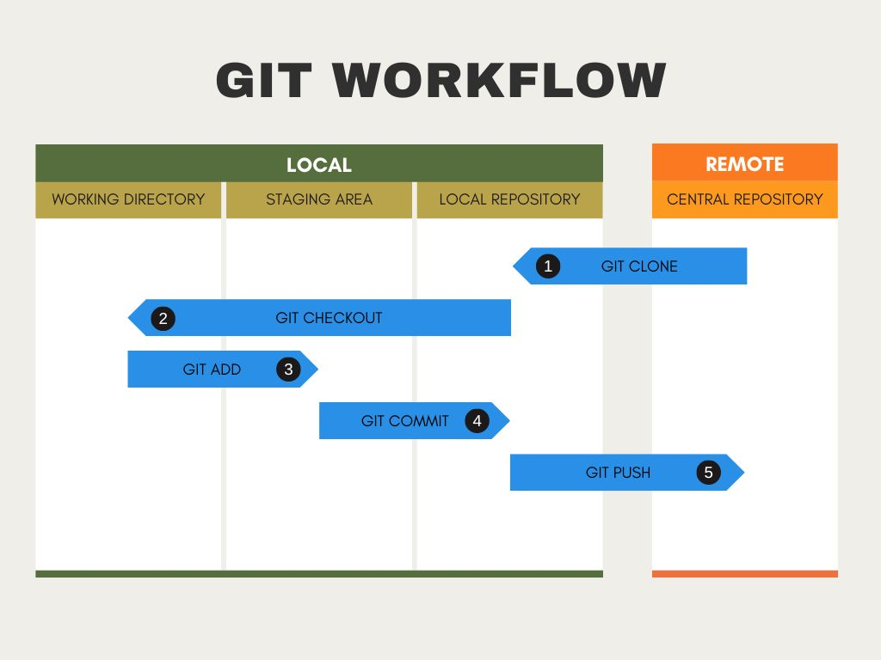
A Basic Git Workflow
Notes:
You start your git project by creating a git repository to track your files or copying a remote repository onto your local drive.
Once you have a local repository on your drive, you check out the project to a new or existing project branch. This creates a copy of the project files and directories in your working directory, which you can then update with your changes.
You copy the updated files to the staging area when you've completed your changes. The staging area (also called the index) allows you to review your changes before you commit your updates to your local repository.
After you've verified your code in the staging area, you're ready to commit it to the Git repository on your local machine.
You can then push your code to the remote repository

