Slide 1


Building Family Freedom:
A Simple Plan for You, Your Kids,
and the Generations to Come
A Strategic Approach to Wealth and Protection
Notes:
START: 'Thank you for inviting me into your home.' COVER: 'Today isn't a sales pitch; it's an architectural review of your financial life.' CONCLUDE: 'By the end, you will have a clear blueprint for your family's future.'

Slide 2

Starting the Conversation
Your Goals, Your Vision, Your Legacy
• What does Financial Freedom actually look like for your family?
• The Wealth Gap: Why some families move forward while others stay stuck.
• Mindset Shift: Moving from a 'Monthly Bill' to a 'Wealth Building' strategy.
• Defining your #1 priority: Protection, Growth, or Tax-Free Retirement?
BACK
NEXT
BACK
Notes:
START: 'Let's keep this simple.' COVER: 'Most people spend more time planning a 1-week vacation than a 30-year retirement.' CONCLUDE: 'I want to help you build a strategy that works as hard for you as you work for your money.'

Slide 3
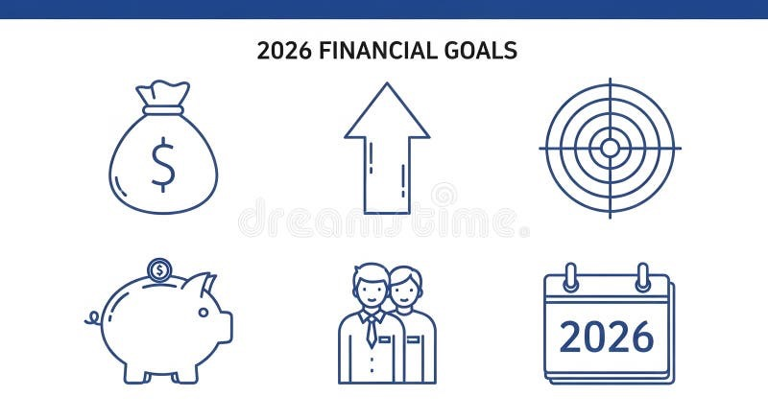
Our Roadmap for Today
The 4 Pillars of a Secure Financial Future
• Identifying the Problems: The 3 Silent Predators of your wealth.
• Introducing the Partners: The strength of WFG and Transamerica.
• Exploring the Solution: How the Indexed Universal Life (IUL) works.
• Taking Strategic Action: Securing yourself and your children today.
BACK
NEXT
Notes:
START: 'Here is how we will spend our time.' COVER: 'We will look at the risks, the solution, and the next steps.' CONCLUDE: 'Does this plan cover what you were hoping to discuss?'

Slide 4

Why Traditional Planning Fails
The Three Silent Predators of Wealth
• Inflation: The silent thief that makes your dollar buy less every year.
• Market Volatility: The 'Roller Coaster' effect where one crash resets your progress.
• Taxation: The IRS is a partner in your savings that you didn't choose.
• Risk of Inaction: The high price of doing nothing while time slips away.
BACK
NEXT
Notes:
START: 'Why are we even here?' COVER: 'Taxes, Inflation, and Market Crashes are eating your savings.' CONCLUDE: 'If we don't solve these three problems, you're running up a down-escalator.'

Slide 5


The Power of the Partnership
World Financial Group & Transamerica
• WFG: A platform dedicated to bringing financial literacy to every household.
• Transamerica: Over 100 years of Institutional-Grade Strength and Solvency.
• Main Street Access: Elite Wall Street strategies made simple for your family.
• Peace of Mind: Backed by a company with billions in assets and proven history.
BACK
NEXT
Notes:
START: 'Who is behind this?' COVER: 'WFG provides the education, and Transamerica provides the multi-billion dollar muscle.' CONCLUDE: 'You are partnering with a giant that has stood the test of time.'

Slide 6


The Indexed Universal Life (IUL)
The Swiss Army Knife of Financial Vehicles
• The 0% Floor: You participate in market gains but never lose money in a crash.
• Tax-Free Growth: Utilizing IRS codes to build wealth that the government can't touch.
• Market Indexing: Your money mirrors the S&P 500 growth without the risk.
• Living Benefits: Accessing your death benefit while you are still alive.
BACK
NEXT
Notes:
START: 'This is the most powerful tool in our kit.' COVER: 'With an IUL, Zero is your Hero. When the market drops, you stay flat. When it goes up, you go up.' CONCLUDE: 'It’s a shield and a sword for your money.'

Slide 7


Benefits While You Are Alive
Life Insurance You Don't Have to Die to Use
• Chronic & Critical Illness: Tax-Free cash if you face a heart attack, stroke, or cancer.
• Cash Value Liquidity: Accessing money for emergencies, house down payments, or college.
• Income Replacement: A self-funding plan that protects your family's lifestyle.
• Budget Scalability: A plan that grows and adjusts as your income increases.
BACK
NEXT
Notes:
START: 'Most people think life insurance is only for the end.' COVER: 'Living Benefits mean if you get sick, the policy pays YOU so you can focus on recovery.' CONCLUDE: 'It’s a living, breathing safety net.'

Slide 8

Generational Wealth & Continuity
Protecting Your Future and Your Children's Potential
• Adult Protection: Securing your income and paying off the family mortgage.
• The 'Head Start' Strategy: Locking in a child's Insurability before they grow up.
• Compounding Growth: Giving your kids a 40-year advantage in wealth building.
• Legacy Planning: Ensuring the family name is backed by a financial foundation.
BACK
NEXT
Notes:
START: 'This is about the next 100 years, not just the next 10.' COVER: 'By starting a child's policy now, you lock in their health and give them a massive head start.' CONCLUDE: 'Give your children the advantage you wish you had.'

Slide 9

Clearing the Path to Security
Common Questions and Strategic Clarifications
• 'Is it safe?' -> Your money is held by a company with Billions in Reserves.
• 'Is it flexible?' -> You control the contributions based on your lifestyle.
• 'Can I access it?' -> Unlike a 401k, you have Liquidity for major life events.
• 'Why haven't I heard of this?' -> These strategies were once reserved only for the top 1%.
BACK
NEXT
Notes:
START: 'It's natural to be cautious.' COVER: 'We address safety, accessibility, and cost.' CONCLUDE: 'If you had a machine in your basement that spit out money, would you insure it? YOU are that machine.'

Slide 10

The High Cost of Waiting
Why Taking a 'Step Back' is a Financial Risk
• The Age Penalty: Every birthday makes the strategy more expensive for life.
• The Health Risk: You buy insurance with your Health; money is only the payment.
• Lost Compounding: Every year you wait is a year of tax-free growth you'll never get back.
• Exposure: Leaving your family's future to chance for one more day.
BACK
NEXT
Notes:
START: 'What if you decide to wait?' COVER: 'A step back today is a massive loss in time and money.' CONCLUDE: 'You are the youngest and healthiest you will ever be right now. Let's act before life makes the decision for you.'

Slide 11

Your Path to Peace of Mind
Simple Integration and Eligibility Check
• Step 1: Financial Needs Analysis (FNA) to customize your plan.
• Step 2: Immediate Eligibility Check to verify your qualification.
• Step 3: Digital Application (eSig) to lock in your current age and rate.
• Step 4: Peace of Mind for you and your family starting today.
“The Simple Way to Stay Free for Generations is to Start Your Family Journey Today.“ – Upendra Rimal
BACK
Notes:
HIDDEN SPEED SCRIPT: Every family has a dream of being free. This plan is the map that shows us exactly how to get there. Today, we have the dream and the map in one place. Your family's safety is our Goal, and this plan is our Map. We have everything we need today. Let's start building your family’s future together right now."

