Slide 1

MAITRI 🩵
AI Assistant for Psychological & Physical Well-Being
Empowering emotional health through intelligent face, voice, and chat analysis

Slide 2
Meet MAITRI – Your Empathetic AI Companion
What is MAITRI?
Multi-Modal Understanding
MAITRI is an AI-powered emotional wellness assistant that understands your feelings through multiple channels – your facial expressions, voice tone, and written words. It responds with warmth and empathy, like a caring friend who's always there to listen.
MAITRI analyzes emotions through:
🎭 Facial expressions captured via webcam
🎙️ Voice tone and pitch from microphone
💬 Text sentiment from chat messages
Core Technologies: Flask | Gemini 2.5 Flash | OpenCV | SpeechRecognition | DeepFace
Each interaction is met with compassionate, personalized Hinglish responses that truly understand you.

Slide 3




The Growing Mental Health Challenge
Rising Mental Health Issues
Difficulty Expressing Emotions
In today's fast-paced world, stress, anxiety, and loneliness are becoming increasingly common. The pressure of modern life leaves many feeling overwhelmed and isolated.
Many individuals struggle to articulate their feelings or find it uncomfortable to seek help from others, leading to suppressed emotions and worsening mental states.
Lack of Real-Time Support
Need for Empathetic AI
Traditional support systems often lack immediate availability. There's a critical need for accessible, real-time emotional support that understands human emotions naturally and responds instantly.
What's missing is an AI-based companion that doesn't just analyze data, but truly listens, understands, and responds with genuine empathy – like a trusted friend who's always available.

Slide 4
Our Mission: Bridging Technology & Emotional Intelligence
01
02
03
Develop an Empathetic AI Assistant
Multi-Modal Emotion Detection
Human-Like Empathetic Responses
Create MAITRI as a sophisticated AI-powered emotional wellness companion that genuinely understands and responds to human emotions across multiple communication channels.
Implement advanced detection systems that accurately identify emotional states through facial expressions, voice tone analysis, and text sentiment – providing a comprehensive understanding of user feelings.
Generate warm, understanding responses in natural Hinglish that resonate with users emotionally, making them feel heard, validated, and supported in their emotional journey.
04
05
Personalized Wellness Recommendations
Bridge Technology & Humanity
Offer tailored motivational quotes, soothing music suggestions, and practical relaxation techniques based on the detected emotional state to help users navigate their feelings effectively.
Create a seamless integration between cutting-edge AI technology and emotional intelligence, making mental wellness support accessible, immediate, and genuinely helpful for everyone.

Slide 5
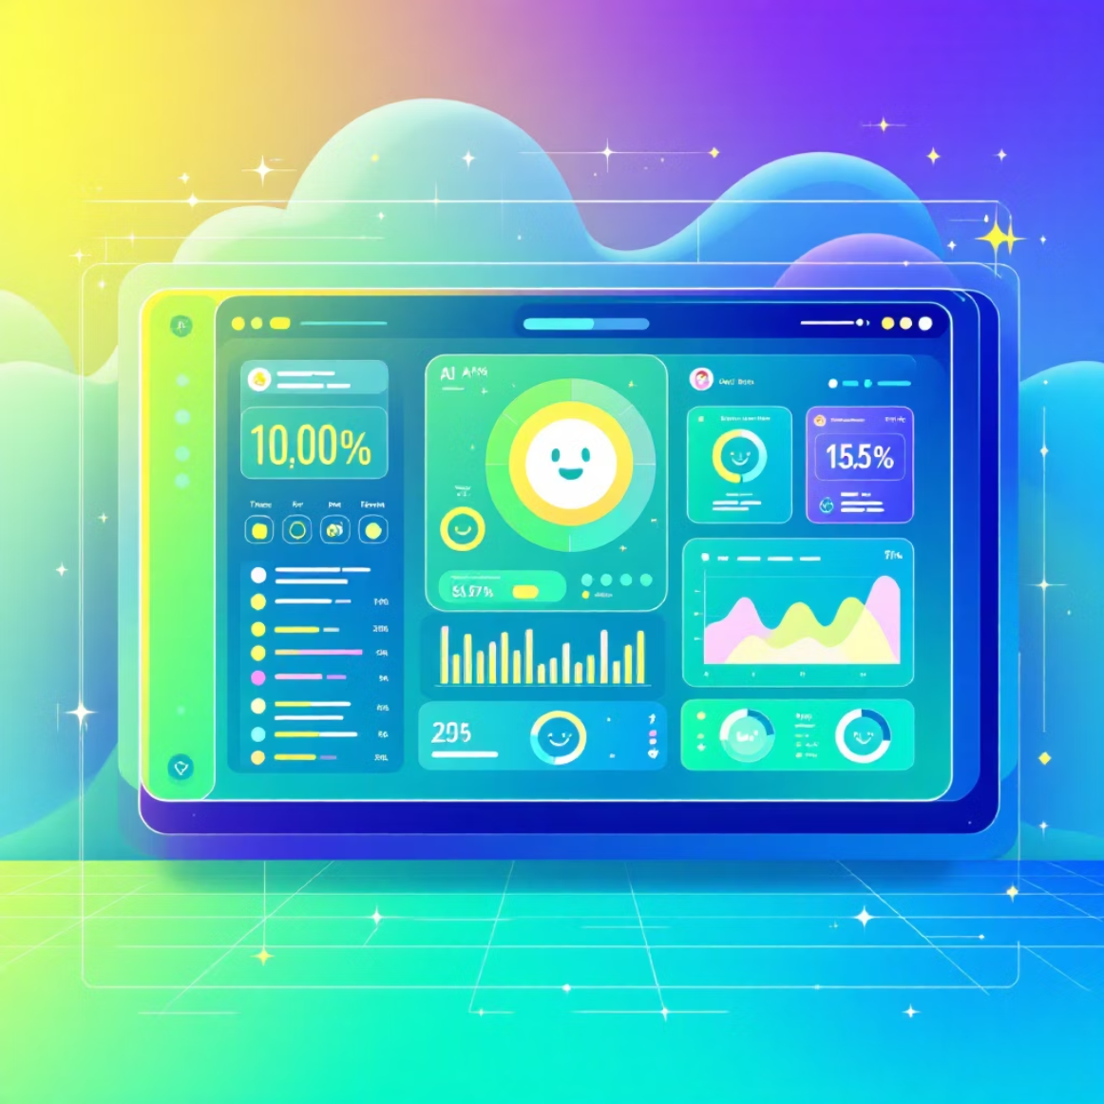

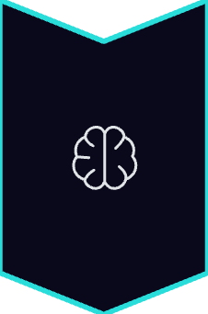


How MAITRI Works
Intelligent Emotion Processing Flow
Input Capture
User expresses emotion through face (webcam), voice (microphone), or text (chat interface)
AI Analysis
Gemini 2.5 Flash processes the emotional tone, context, and underlying sentiment with advanced understanding
Empathetic Response
MAITRI generates a warm, caring Hinglish response that acknowledges and validates the user's feelings
Personalized Suggestions
Offers mood-appropriate content: calming music, motivational quotes, or relaxation tips tailored to the emotional state
Output includes: Emotion label + Detailed reasoning + Empathetic response + Personalized wellness suggestion 🌈

Slide 6
Three Powerful Emotion Analysis Modules
1
2
3
Face Emotion Analysis
Voice Emotion Analysis
Chat Emotion Analysis
Using OpenCV and DeepFace, MAITRI captures and analyzes facial expressions in real-time through your webcam. It accurately recognizes seven core emotions: happiness, sadness, anger, fear, surprise, disgust, and neutral states.
MAITRI listens to your voice through the microphone, capturing subtle nuances in tone, pitch, energy, and speaking patterns that reveal hidden emotional states often missed in words alone.
Through advanced sentiment analysis and contextual understanding, MAITRI reads between the lines of your typed messages, picking up on emotional undertones and implicit feelings.
Using Gemini's sophisticated language model, it analyzes these vocal characteristics to understand your true feelings, then responds with motivational messages, calming reassurance, or energetic encouragement based on what you need.
It responds in a warm, conversational Hinglish tone that feels natural and friendly, demonstrating emotional awareness that makes you feel genuinely understood and supported in every conversation.
The system displays detected emotions instantly with intuitive emoji overlays, providing immediate visual feedback about your emotional state with remarkable accuracy.

Slide 7






Features That Make MAITRI Special
Multi-Modal Detection
Advanced AI Processing
Comprehensive emotion understanding through simultaneous analysis of facial expressions, voice tone, and text sentiment – providing a complete picture of your emotional state.
Powered by Gemini 2.5 Flash for sophisticated emotional reasoning and response generation that truly understands context and nuance.
Hinglish Empathy
Mood-Based Suggestions
Responds in natural, warm Hinglish that resonates culturally and emotionally – like talking to a caring friend who truly gets you.
Personalized recommendations including soothing music, uplifting quotes, and practical relaxation techniques tailored to your current emotional state.
Beautiful Interface
Real-Time Analysis
Friendly, minimalistic UI with a stunning neon futuristic theme and glassmorphic design that's both calming and visually appealing.
Lightning-fast processing with Flask backend and JSON-based output, delivering emotional insights and responses in under 5 seconds.

Slide 8

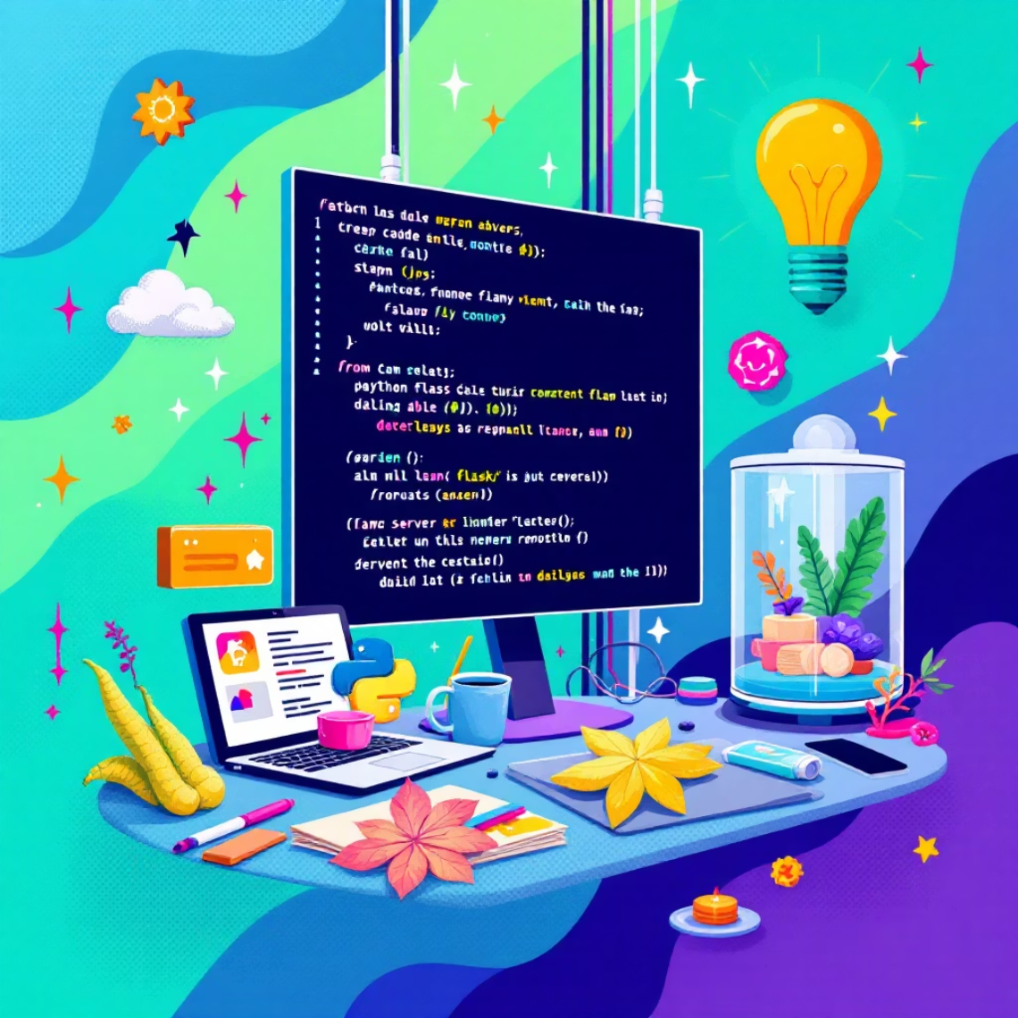
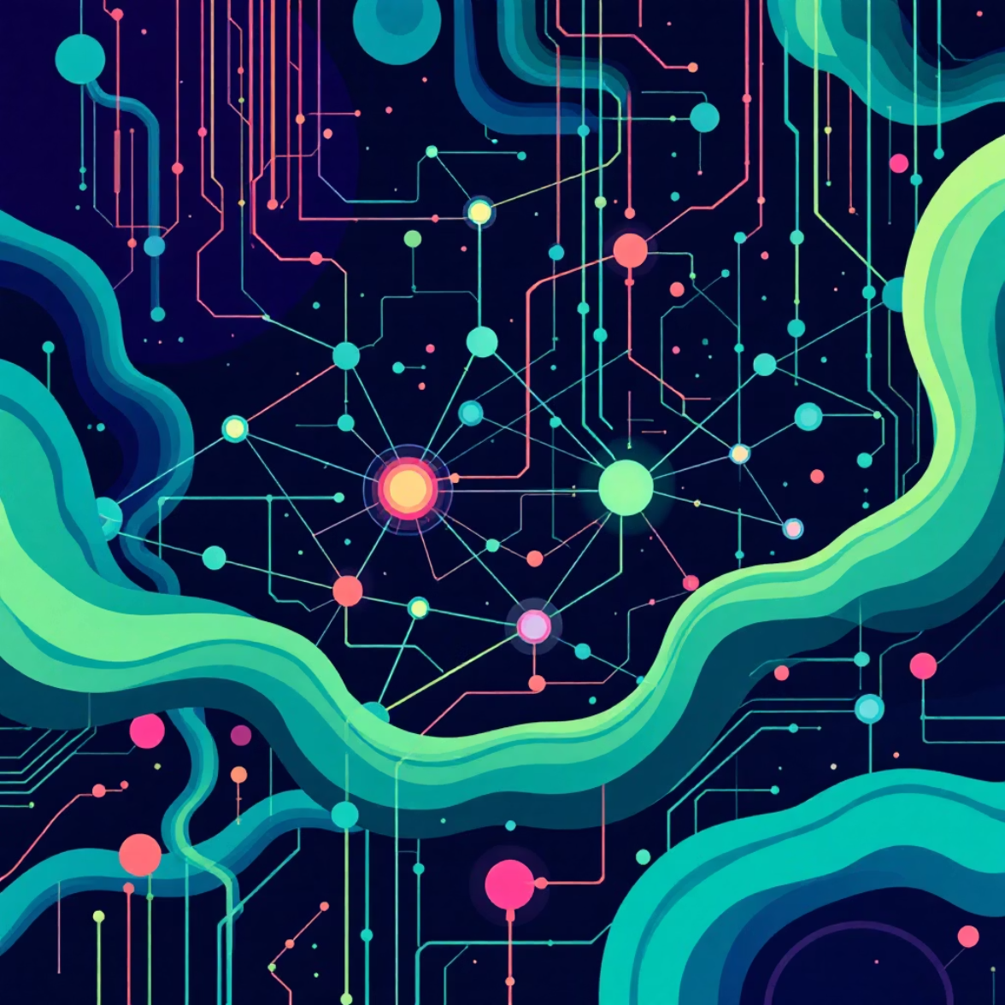
Technical Architecture
Frontend Layer
Backend Server
AI Models
Technologies: HTML5, CSS3, JavaScript
Framework: Flask (Python)
Gemini 2.5 Flash – Emotion reasoning & response generation
Interactive glassmorphic interface with smooth animations and intuitive controls. Seamlessly captures webcam, microphone, and text inputs.
Robust server handling real-time requests, processing multiple emotion inputs, and managing AI model communications efficiently.
DeepFace – Facial emotion detection
SpeechRecognition + PyAudio – Voice analysis
Data Flow Architecture
1
2
User Input
Emotion Detection
Face/Voice/Text
AI Processing
3
4
Response Generation
Personalized Support
Empathetic Output
Suggestions Delivered

Slide 9

Proven Results & Performance
3
<5s
100%
Input Modalities
Response Time
Web Compatible
Successfully detects emotions from face, voice, and text with high accuracy
Generates emotion-aware Hinglish responses in under 5 seconds
Works smoothly across modern browsers using webcam and microphone
Key Achievements
Live Demonstration
✅ Real-time emotion detection with minimal latency
MAITRI has been successfully demonstrated in real-time scenarios, showcasing the AI's human-like empathy and ability to provide genuine emotional support.
✅ Highly accurate sentiment analysis across all input types
✅ Natural, culturally-relevant Hinglish responses
Users report feeling understood, validated, and supported – exactly what an emotional wellness companion should deliver.
✅ Instant personalized emotional feedback and support
✅ Seamless integration of multiple AI models

Slide 10






The Future of MAITRI
We envision MAITRI evolving into a comprehensive emotional wellness ecosystem that reaches more people and provides even deeper support.
Multi-Language Support
Expanding emotion understanding beyond Hinglish to include Hindi, English, and regional Indian languages – making MAITRI accessible to diverse communities across India.
Mobile App Integration
Developing native MAITRI mobile applications using Flutter or React Native, bringing emotional wellness support to smartphones for anytime, anywhere access.
Voice-to-Voice Conversations
Implementing advanced text-to-speech capabilities for natural voice-based interactions, creating truly conversational AI experiences that feel more human.
Mood Analytics Dashboard
Building comprehensive mood tracking and analytics tools to help users understand their emotional patterns over time and identify triggers for better self-awareness.
Crisis Detection & Support
Developing intelligent crisis alert systems that recognize signs of severe distress and provide immediate connections to mental health professionals and emergency support resources.
Our Vision: To make empathetic AI-driven mental wellness support accessible to millions, reducing the stigma around mental health and ensuring no one faces emotional challenges alone. 🩵

