Slide 1
Viva-Voce Presentation
“myDeed” - A blockchain based storage solution for official documents.
By
Batch No: 45
Student Details
Name | Jaymin S Chandaria
Roll No | 20201CCS0106
Section | 7CCS02
Batch No | 45
Student Details
Name | Harsh Mehta
Roll No | 20201CCS0126
Section | 7CCS01
Batch No | 45
Student Details
Name | Keerthi Sai Adithiya
Roll No | 20201CCS0104
Section | 7CCS02
Batch No | 45
Under the supervision of
Ms. Sterlin Minish TN Assistant Professor Department of Computer Science & Engineering January , 2024

Slide 2
Introduction to myDeed
Significance of Government Documents: They're not just administrative; they hold historical and legal significance for a nation.
Traditional Storage Methods: Documents have been stored in centralized databases.
Issues with Conventional Approach: Increasingly inadequate due to vulnerabilities like system breakdowns and security breaches.
Demand for Improvement: There's a clear need for a more secure, robust, and transparent system.
Blockchain Technology Introduction: Known for its association with cryptocurrencies, blockchain technology is highlighted for its impact on data security and integrity.

Slide 3
Introduction to myDeed
Core Features: Decentralization, transparency, and immutability make it stand out.
Addressing Limitations: Offers a solution to the shortcomings of traditional data storage methods.
Decentralized Nature: Data is distributed across a network, making it highly resistant to tampering and unauthorized access compared to centralized systems.
Project "myDeed" Objective: Aims to revolutionize the storage and accessibility of government documents.
Holistic Approach: Not just a technological project, but a response to evolving cybersecurity threats and the call for governance transparency.

Slide 4
Introduction to myDeed
Blockchain Integration: Focuses on integrating blockchain into government data systems.
Defined Goals: Aim to set a new standard in document security and accessibility, emphasizing the integrity and confidentiality of crucial records.

Slide 5
About our team and reporting Guide and Reviewer
We would like to Thank
To help and guide us throughout the project
Ms. Sterlin Minish TN
Assistant Professor
School of CSE&IS
Presidency University
Ms. Mounika S
Assistant Professor
School of CSE&IS
Presidency University

Slide 6
About our team and reporting Guide and Reviewer
Jaymin S Chandaria, is a B. Tech student at Presidency University of Bangalore, Karnataka. His research interests include blockchain, cryptocurrency, IoT, and cybersecurity. He is yet to receive his bachelor’s degree in computer science Specialized in Cyber Security.
Keerthi Sai Adithiya, is a B. Tech student at Presidency University of Bangalore, Karnataka. His research interests include cybersecurity and the implementation of cybersecurity in the blockchain domain. He is yet to receive his bachelor’s degree in computer science Specialized in Cyber Security.
Harsh Mehta, is a B. Tech student at Presidency University of Bangalore, Karnataka. His interests include software development and front-end full-stack development. He is keen
on finding multiple ways to integrate different aspects of technology with software. He is yet to receive his bachelor’s degree in computer science Specialized in Cyber Security.

Slide 7
About the Project
Blockchain Innovation: "myDeed" harnesses blockchain for secure and decentralized government document management.
Security and Immutability: Ensures document integrity with tamper-proof recording and cryptographic security.
Enhanced User Experience: Provides an intuitive interface, simplifying document handling for users.
Environmental Efficiency: Aims to reduce the carbon footprint compared to conventional data storage solutions.
Trust through Transparency: Offers transparent transactions to build trust in public document authenticity.
Scalable Technology: Designed to adapt to growing data needs, ensuring long-term viability.

Slide 8
Objectives of myDeed
Scalability
Interoperability
Regulatory Compliance
Cybersecurity Measures
Environmental Impact
Web3 Integration

Slide 9
Objectives of myDeed
Fraud Reduction
Decentralized Record
Secure On-Chain Data
Blockchain Trilemma
UI/UX Enhancement

Slide 10
About the Working domain and the technology
The smart contract includes several key functionalities:
Add a new file to the blockchain with a unique hash. The file owner and other relevant information are stored in the smart contract.
Share access to a file with another user. The owner of the file can grant access to a specific user by modifying the smart contract state.
Revoke access to a file from a user. The owner of the file can remove access from a specific user by modifying the smart contract state.
Display the files associated with the current user's address. This function returns the file names, file hashes, and the owner's addresses of all the files that the user has access to.
Get a list of all users that a specific file is shared with.
These functionalities are implemented using Solidity, a high-level programming language for writing smart contracts on the Ethereum blockchain.
To use this smart contract, the user would interact with the Ethereum blockchain by calling the appropriate functions on the smart contract. For example, to add a new file, the user would call the add function and pass in the file hash and name. To share access to a file, the user would call the allow function and pass in the file hash and the address of the user they want to share the file with.

Slide 11
About the Working domain and the technology
Public Sector Document Management: "myDeed" operates primarily within the domain of public sector administration, focusing on the secure and efficient management of government documents.
Blockchain Technology: The project utilizes blockchain technology as its core framework, ensuring decentralized storage and robust security through a distributed ledger system.
Cryptographic Security: "myDeed" employs advanced cryptographic methods, including hashing and digital signatures, to protect data integrity and confidentiality.
Smart Contract Automation: The platform integrates smart contracts to automate verification processes, reducing human error and streamlining government operations.
User Interface Design: A significant emphasis is placed on user experience, with the development of a clean, accessible, and easy-to-navigate user interface for managing documents.
Eco-Friendly Platforms: "myDeed" is committed to using environmentally sustainable blockchain platforms, potentially employing proof-of-stake (PoS) or other energy-efficient consensus mechanisms.
Interoperability Focus: The system is designed to be interoperable with existing government IT infrastructures, allowing for seamless data exchange and continuity of service.

Slide 12
Methodology and Phases
Feasibility Study and Detailed Requirements Analysis
Comprehensive Design of Blockchain Architecture
Advanced Security Protocol Development
Smart Contracts for Enhanced Automation and Compliance
Rigorous Testing and Validation Regime

Slide 13
Methodology and Phases
Phased Deployment and Scalability Considerations
Comprehensive Training Programs and Support Systems
Continuous Monitoring and Iterative Improvement
Ensuring Legal and Regulatory Compliance

Slide 14
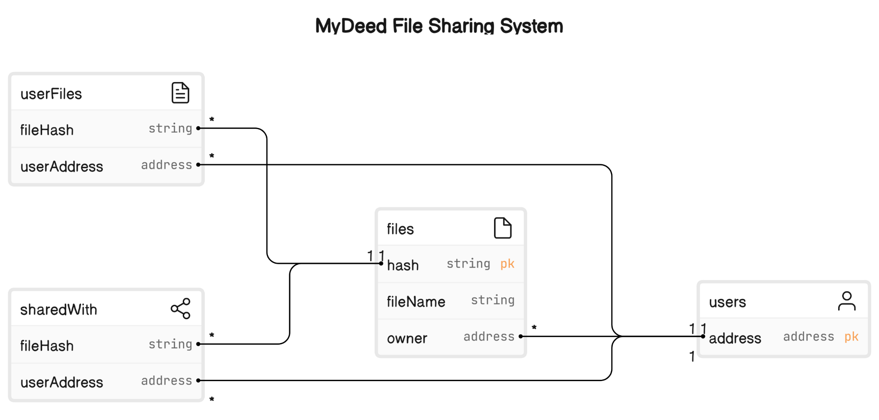
Project Workflow
Entity relationship module

Slide 15
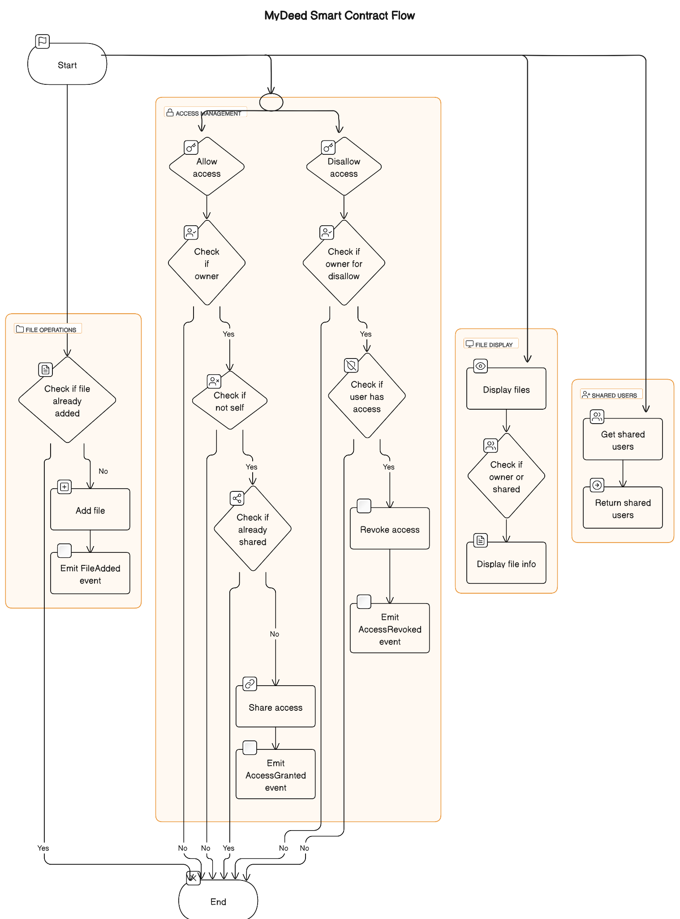
Project Workflow
mydeed smart contract architecture diagram

Slide 16
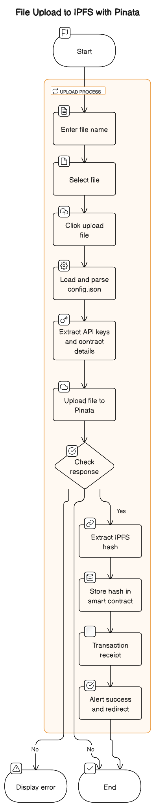
Project Workflow
flowchart of uploading a file to IPFS

Slide 17
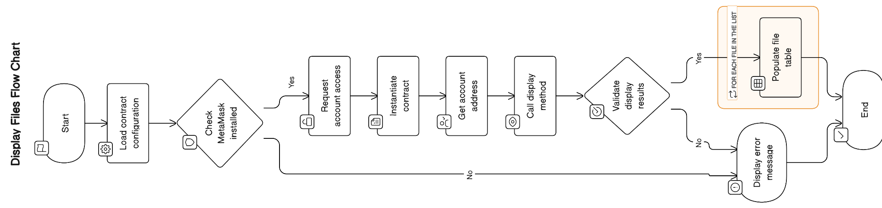
Project Workflow
flowchart of display a tabular view of the file details

Slide 18
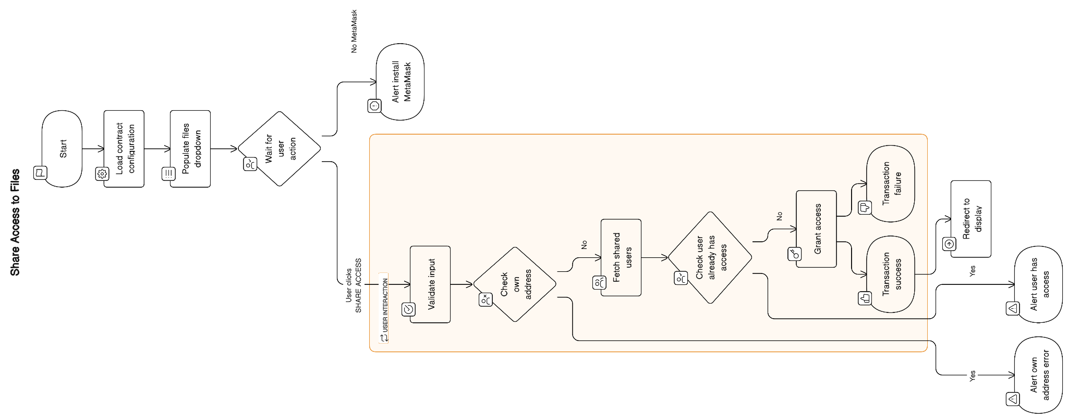
Project Workflow
flowchart of sharing access

Slide 19
Results and Discussion
Decentralized Storage Management System
Elimination of Fraud and Illegal Transactions
Improved User Interface and Experience
Environmental Sustainability
Immutability and Tamper Resistance
Enhanced Security and Privacy

Slide 20
Results and Discussion
Blockchain's move raised concerns about handling large data volumes. Efforts focus on boosting scalability and performance.
Initial costs of blockchain weighed against long-term gains: lower fraud, admin burdens, and increased efficiency.
Cross-sector teamwork was vital. Integration with government and insurers was key for success.
Regulatory compliance discussions stressed ongoing system adaptation for changing legal and industry norms.
Environmental impact mattered. Focus shifted to eco-friendly consensus mechanisms like proof-of-stake.

Slide 21
Challenges Faced in developing myDeed
Resource Limitations: Insufficient resources for comprehensive project development.
Smart Contract Testing: Ensuring thorough and accurate testing of smart contracts functionalities and security measures.
Smart Contract Deployment: Effective deployment strategies for seamless integration and operation within the system.
Webpage Load Time Enhancement: Improving the webpage loading speed to enhance user experience and accessibility.
Scalability: Handling increased user activity and data volume while maintaining system performance.

Slide 22

Q&A

Slide 23
Thank you !!

