Slide 1

Cristiano Ronaldo
Dataset Analysis
Rocco Caliandro

Slide 2

About Me
Graduated in Computer Science with top marks at the University of Bari (Bachelor’s Degree)
Student of the Master’s Degree in Computer Science at the same University
3+ years of work experience as Software Developer
3+ years of work experience in Business Intelligence
Skills
Data Engineer
Datawarehouse Expert
Teamwork and cooperation
Attention to detail
BI Engineer
Time management
Problem Solving

Slide 3
Project lifecycle
Gathering of Requirements: In CR7 project the requirements are sent
via email in date 02/08/2022.
Analysis of Requirements: It is requested to import the Ronaldo-Dataset
on Snowflake and create a reporting table from data.
Conceptual Design: The conceptual model is designed using DFM
(Data Fact Model)

Slide 4
Project lifecycle
Logical Design: The logical model define the relations among tables in our
datawarehouse.
Executing: The executing phase is divided in two sub-activities: build
the datawarehouse and creation of reports and dashboards.
Monitoring and control: Testing phase

Slide 5
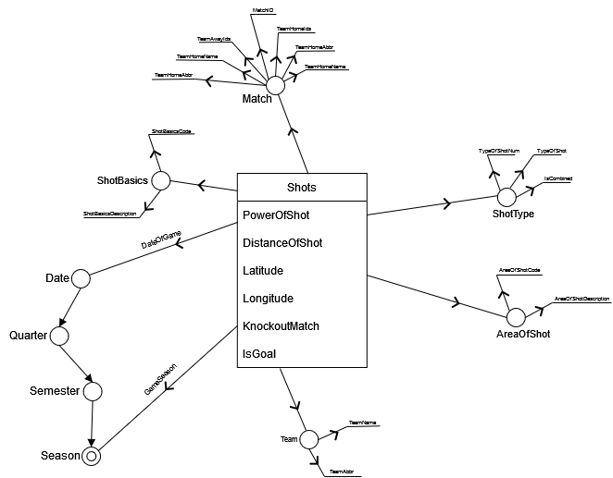
Conceptual Model (DFM)

Slide 6
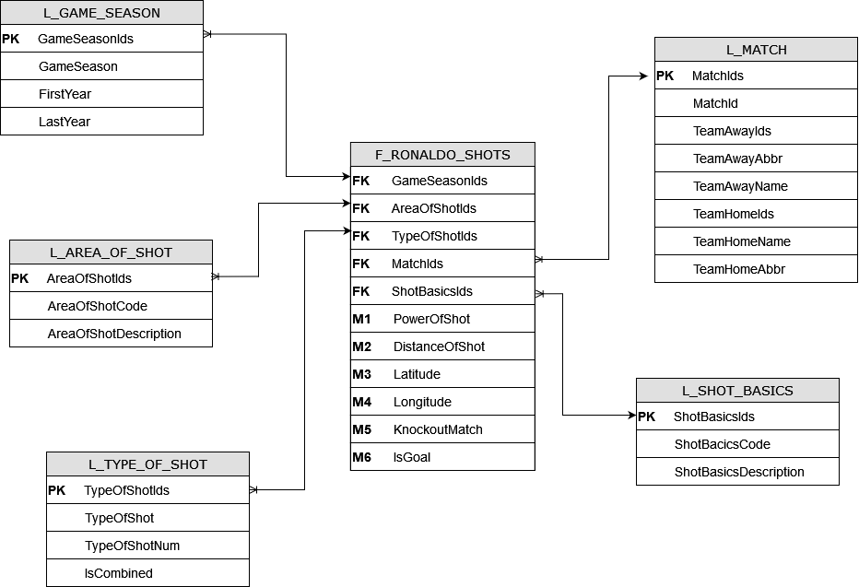
Star Schema

Slide 7
Data issues
In the dataset the first column is without header.
Data is inconsistent with the reality. For example, there are lot of goals for most of
matches scored only by Ronaldo. In the end of 90’s Ronaldo was not a player of Manchester
United. Also, Manchester United always play Home, never Away.
Duplicate columns: REMAINING_MIN, POWER_OF_SHOT, KNOCKOUT_MATCH, REMAINING_SEC,
DISTANCE_OF_SHOT. One strategy to manage duplicate columns is to get the value from the most
reliable/updated column and if there is a null, take the value from the second one.
Imported the column as ID, given that it is a unique
identifier for the entire dataset
Data from the dataset are not modified in this sense
In this specific dataset we decided to remove all duplicated columns also because
the data domain is not well defined and seems to be inconsistent
(remaining_min>90, remaining_sec decimal rather than integer, knockout_match
is a decimal rather than a flag and so on...

Slide 8
Data issues
The colum lat/lon contains a CSV separator and it can cause problems
Missing values
Fill coordinates (X, Y, Latitude, Longitude) with 0 if missing
REMAINING_MIN is something that it is possible to retrieve for a particular match based on the other shots. When missed is computed as the average between previous row and next row
If something related to the match is missing we can get the same information from other rows of the same match (for example GAME_SEASON)
TEAM_NAME it is possible to get the name of the team by the date of the game (For example if date is in 2016, the team is Real Madrid)
Used the Snowflake option FIELD_OPTIONALLY_ENCLOSED_BY = '“’
during the import phase

Slide 9
Data issues
Missing values
RANGE_OF_SHOT is computed as follows. The ranges are defined according data in the dataset:
Distance < 28: ‘Less Than 8 ft.’
Distance Between 28 and 38: ‘8-16 ft.’
Distance Between 36 and 42: ‘16-24 ft.’
Distance Between 42 and 66: ’24+ ft.’
Distance > 66: ‘Back Court Shot’
Given that is not easy to understand the unit of measurement related to the range, we also created a column called RANGE_OF SHOT_IN_FEETS as follows:
Distance < 8: ‘Less Than 8 ft.’
Distance Between 8 and 16: ‘8-16 ft.’
Distance Between 16 and 24: ‘16-24 ft.’
Distance Between 24 and 48: ’24+ ft.’
Distance > 48: ‘Back Court Shot’

Slide 10
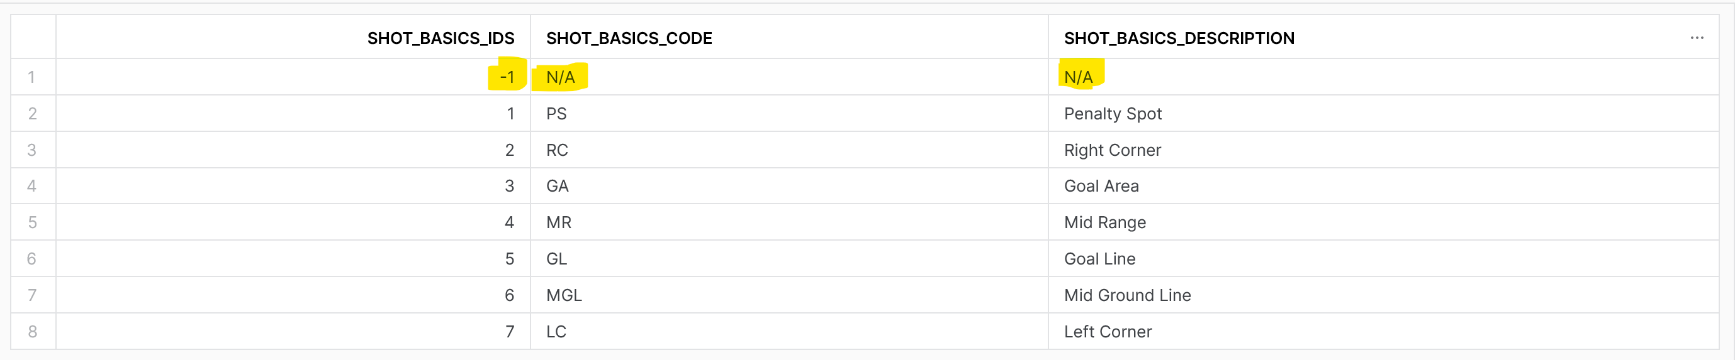
Data issues
Missing values
Replacement of some missing values with mode, median or average among all the table (for example, to fill the distance of shot, we used the mode when missing)
Using of dummy rows:
Dimension:
Fact Table:

Slide 11

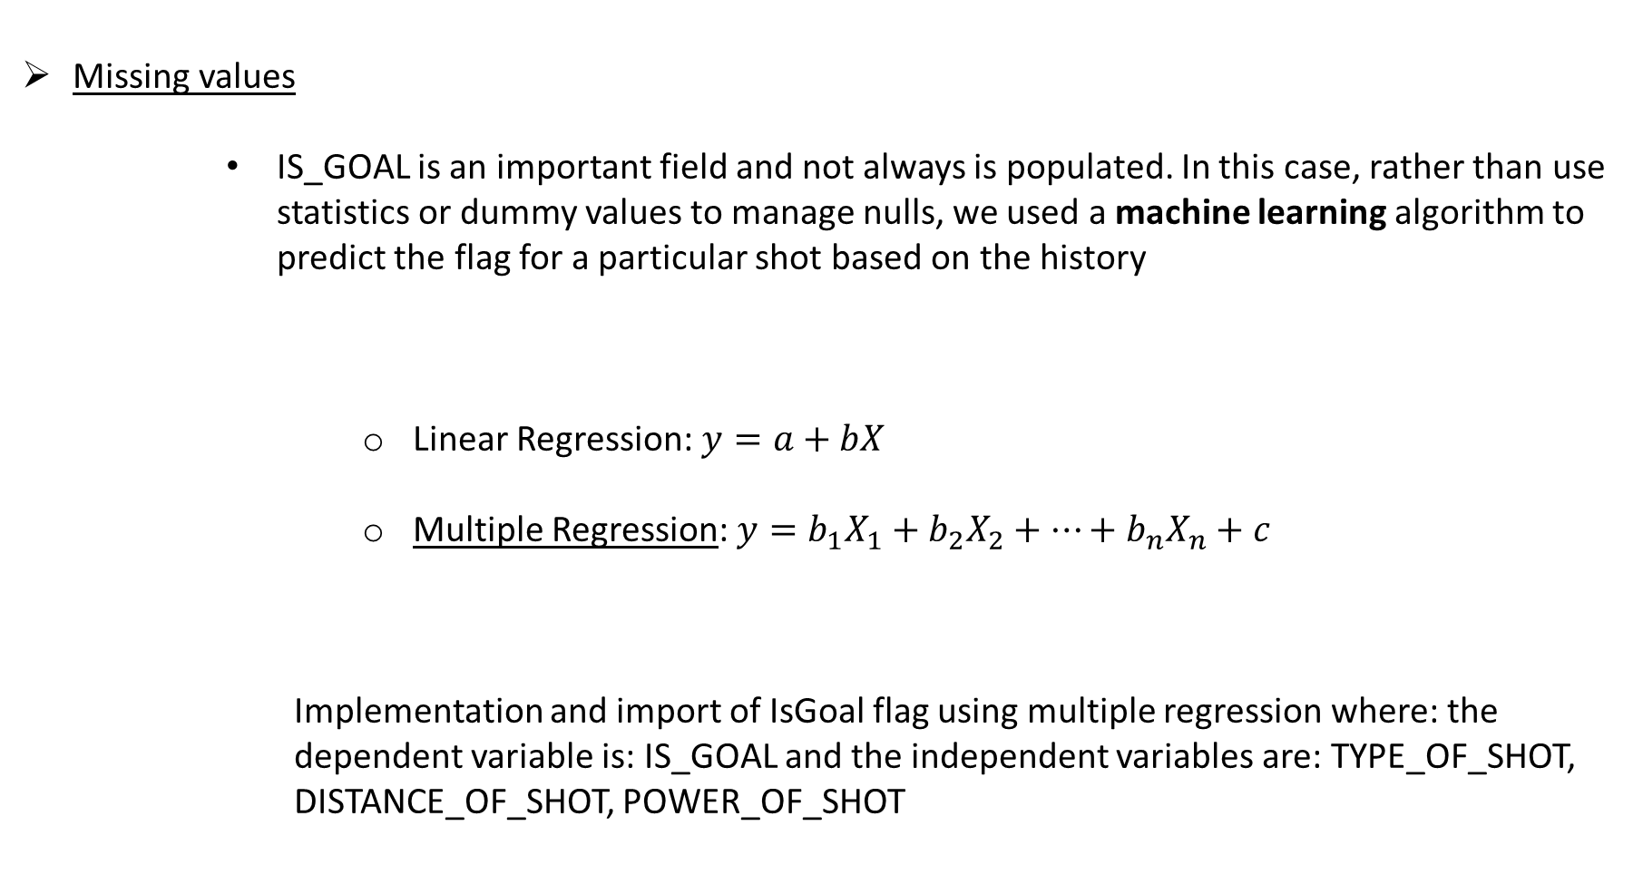
Data issues
Missing values
IS_GOAL is an important field and not always is populated. In this case, rather than use statistics or dummy values to manage nulls, we used a machine learning algorithm to predict the flag for a particular shot based on the history
Linear Regression: $y=a+bX$
Multiple Regression: $y=b_{1}X_{1}+b_{2}X_{2}+…+b_{n}X_{n}+c$
Implementation and import of IsGoal flag using multiple regression where: the dependent variable is: IS_GOAL and the independent variables are: TYPE_OF_SHOT, DISTANCE_OF_SHOT, POWER_OF_SHOT

Slide 12
% Missing
Column Name | % Missing Before | % Missing After
AREA_OF_SHOT | 4.89 | 4.89
DATE_OF_GAME | 5.05 | 0
DISTANCE_OF_SHOT | 5.1 | 0
GAME_SEASON | 19.1 | 0
HOME_AWAY | 4.88 | 0
ID | 0 | 0
IS_GOAL | 20.42 | 0
KNOCKOUT_MATCH | 4.94 | 0
LAT_LNG | 5.1 | 0
LOCATION_X | 4.76 | 0
LOCATION_Y | 5.02 | 0
MATCH_EVENT_ID | 5.09 | 5.09
MATCH_ID | 0 | 0
POWER_OF_SHOT | 4.84 | 0
RANGE_OF_SHOT | 5.1 | 0.29
REMAINING_MIN | 5.09 | 0
REMAINING_SEC | 5.19 | 0
SHOT_BASICS | 5.13 | 5.13
SHOT_ID_NUMBER | 5.09 | 5.09
TEAM_ID | 0 | 0
TEAM_NAME | 5 | 0
TYPE_OF_COMBINED_SHOT | 50.22 | 0
TYPE_OF_SHOT | 49.78 | 0

Slide 13


Build the datawarehouse
OLTP (OnLine Transaction Processing)
OLAP (OnLine Analytical Processing)
Application Oriented
CRUD Operations
Current and recent data
ER design in 3th Normal Form
Transaction management with ACID properties
Gigabytes
Subject Oriented
Complex Queries
Historical data
Stars schema or Snowflake schema
Large volume of data
Terabytes

Slide 14
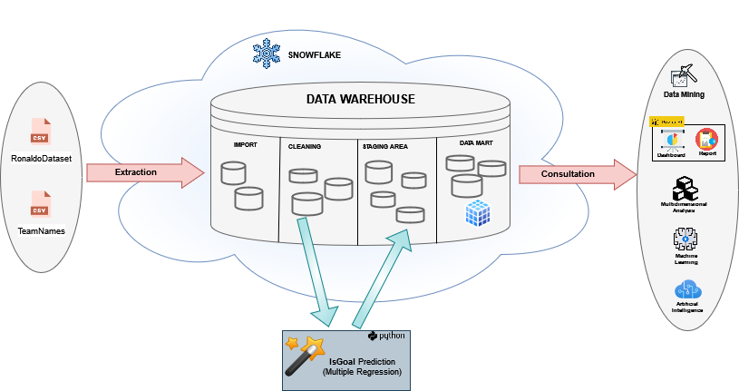
System

Slide 15

Data visualization
“You can have piles of facts and still fail to resonate. It’s not the information itself that’s important but the emotional impact of that information”
Nancy Duarte – Wrtiter, Speaker, CEO
“[few] grasp how to use data to tell a meaningful story that resonates both intellectually and emotionally with and audience”
Daniel Waisberg – Analytics Advocate, Google
Data visualization is the visual presentation of data or information
The goal of data visualization is to communicate data or information clearly and effectively to readers
Typically, data is visualized in the form of a chart, infographic, diagram or map
The field of data viz combines both art and data science. While a data visualization can be creative and pleasing to look at, it should also be functional in its visual communication of the data
The tool used for data visualization is: Power BI

Slide 16
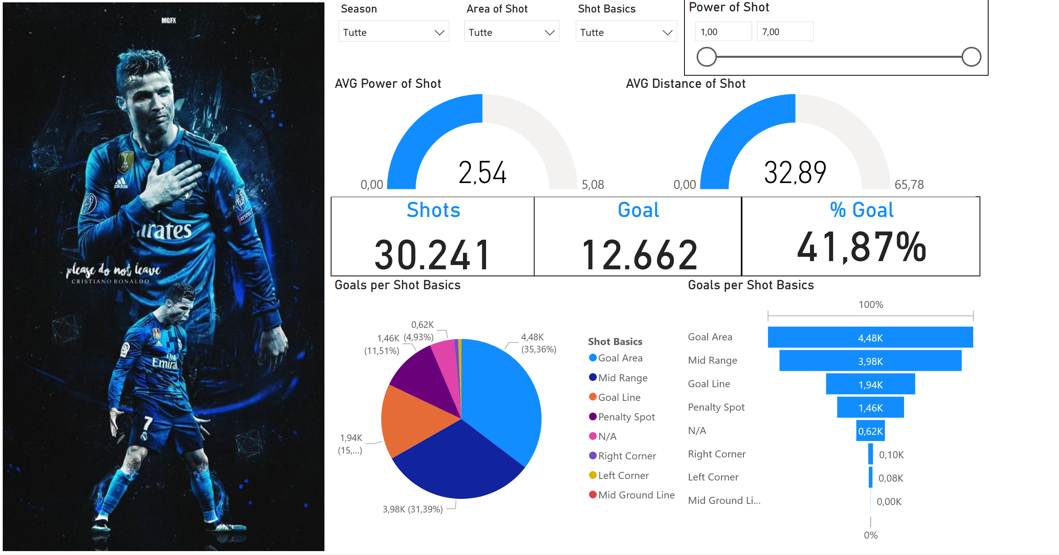
Data visualization

Slide 17
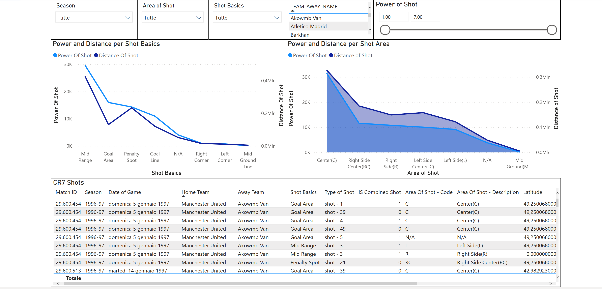
Data visualization

Slide 18

Thank you

