Slide 1
WSDL Parsing

Slide 2
Main Sections of WSDL
Types
  Defines the types used by the service
Messages
  Defines the messages sent/received by operations
PortTypes
  Define the operations for a particular port
Binding
  Defined the binding used
Service
  Defines the ports

Slide 3
Objective of BioCatalogue
Simplify view of service, its operations and the inputs and outputs of these operations without the abstractions implemented by WSDL

Slide 4
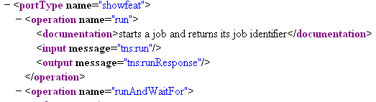
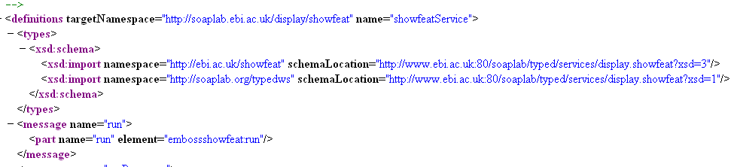
Mapping Messages Operation Inputs/Outputs
types from schema

Slide 5
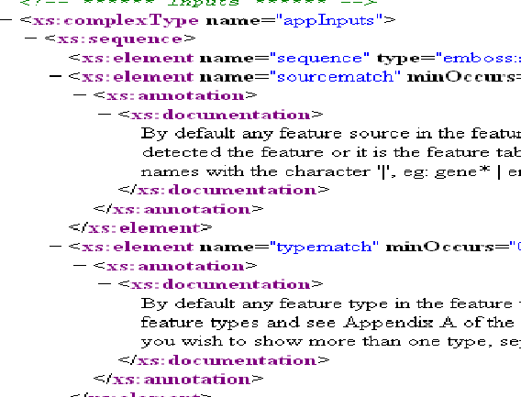

Mapping message to type

Slide 6
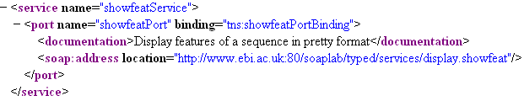
BioCatalogue View
input
input
operation
operation
(sourcematch)
operation
Operation
(run)
input
input
input
service

