Slide 1
BioCatalogue SAB
January 12th 2010

Slide 2
Summary
Definitions
Objectives
Usage Trends
Usage: Wider Context
Outreach
Feedback
SAB
Administrative Update

Slide 3

Definitions
Community curated catalogue of Life Science Web Services.
  Shared Marketplace to find and characterise Web Services in the life sciences.
  Content is contributed by service providers and users.
  BioCatalogue is funded by
  (BB/F01046X/1, BB/F010540/1)

Slide 4
Objectives (1/2)
Build and maintain a comprehensive, curated Web Services Catalogue.
Make the catalogue accessible:
  Over the WEB (http://www.biocatalogue.org)
  Web Services APIs to enable both consumption as well as submission.
Make the catalogue acquisition and curation openly participatory.

Slide 5
Objectives (2/2)
Build an Open Source suite of tools and back-end infrastructure to support and maintain the catalogue.
Make the catalogue known by, and accessible to, the world.

Slide 6
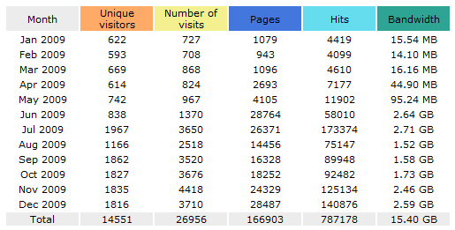
Usage Trends (traffic)
BioCatalogue launch at ISMB/ECCB 2009

Slide 7
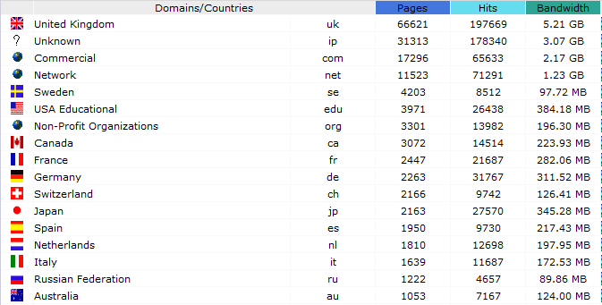
Usage Trends (provenance)
Only countries with more than 1000 pages shown

Slide 8
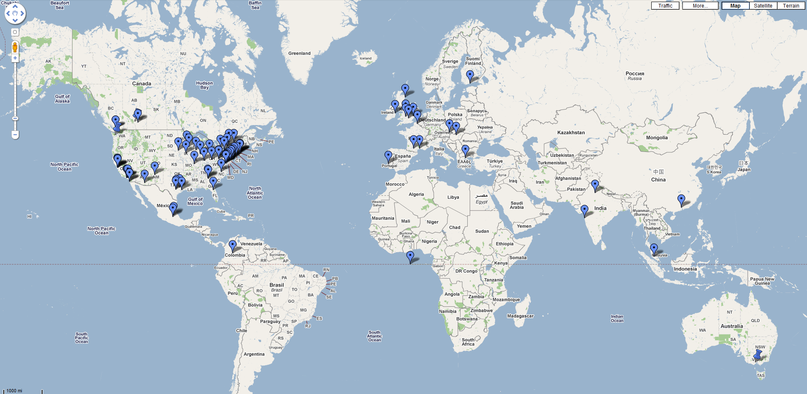
Usage Trends (worldwide)
For the period July-December 2009

Slide 9

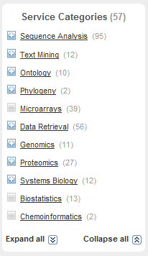
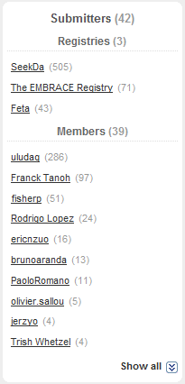
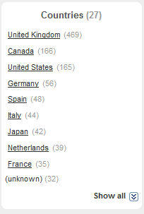
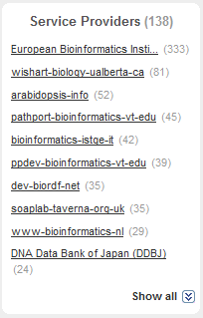
Usage Trends (content)

Slide 10
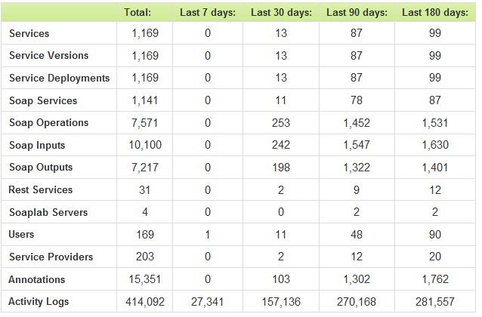
Usage Trends (content)

Slide 11















Usage: Winder Context
Partnerships:
Collaborations:

Slide 12
Outreach
Leverage on EBI and Manchester myGrid projects outreach.
Direct participation (invited talks and presentations) in 18 major workshops, exhibitions and conferences, in addition to 10 tutorials at various courses, and 1 annotation jamboree held in Manchester on the 27th November 2009.
Publications: 1st BioCatalogue paper planned for NAR Web Server Issue 2010. This in addition to various papers that mention/refer to it (e.g. biotechniques, Intl. J. of Life Science Meth., NAR Database issue 2009).

Slide 13
SAB
Membership:
  Chris Rawlings, Rothamsted Research, UK, (Bioinformatics);
  Anil Wipat, U Newcastle upon Tyne, UK (Bioinformatics);
  Jo Dicks, John Innes Centre, UK (Computational and Systems Biology);
  Robert Gill, STFC Constellation (Bioinformatics); Steve Kemp, U Liverpool, UK (Biology);
  Mark Wilkinson, U British Columbia, Canada (BioMOBY services);
  Antoine H.C. van Kampen, NBIC Scientific Director, (Bioinformatics);
  Holger Lausen, SeekDa OG, (CTO);
  Terry Payne, U Liverpool, UK, (Computer Scientist).

Slide 14
Administrative Update
Carole Goble (UoM), Steve Pettifer (UoM) & Rodrigo Lopez (EMBL-EBI)
Web and Software developers: Jiten Bhagat (UoM), Franck Tanoh (UoM), Eric Nzuobontane (EBI), Thomas Laurent (EBI), Hamish McWilliam (EBI), Mannie Tags, Sergejs Aleksejevs, Jerzy Orlowski

