Slide 1
EBI Web Services
A View from 30,000 ft

Slide 2
Overview
Diversity of Service
  Domains
  Technologies
Trends
Documenting Services
Addition of Metadata
Further Information

Slide 3
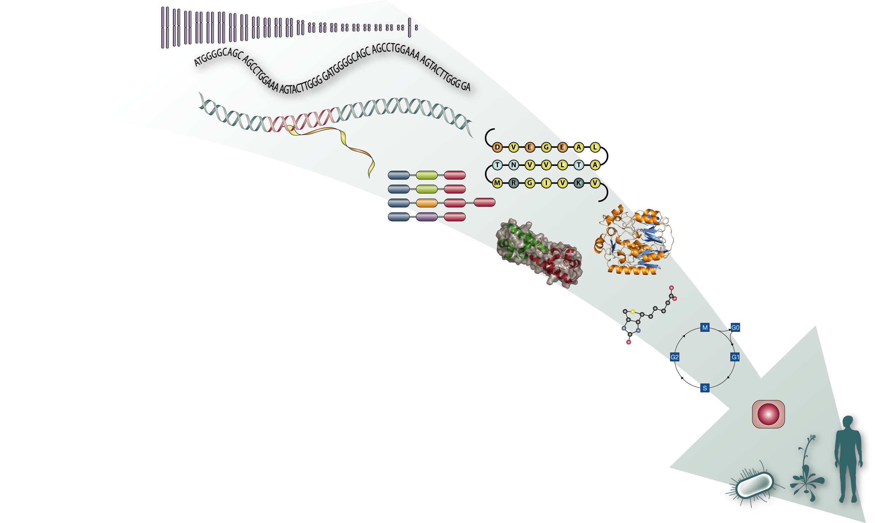
Domains
Search (EB-Eye)
Data Retrieval
(WSDbfetch)
Ensembl (MartService)
Sequence homology WSWUBlast
WSFasta
WSMPsrch
WSScanPS
Wise, PromoterWise
UniProt API
Expression Profiler
Integr8 API
Protein families,
motifs and domains (WSInterProScan)
Sequence alignment WSClustalW
WSMuscle
WSTCoffee
Protein structure & function: (MSD API)
Sequence analysis
(WSEmboss)
Literature and text mining
(Whatizit, CiteXplore)
DaliLite, MaxSprout
Ontologies (OntologyLookup)
ChEBI API
ID mapping (PICR, MartService)

Slide 4
Technologies
REST
  HTTP
  DAS
SOAP
  rpc/encoded: SOAP::Lite, Axis
  document/literal: JAX-WS

Slide 5
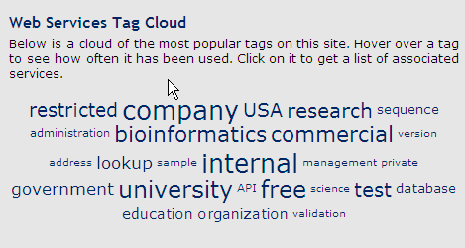
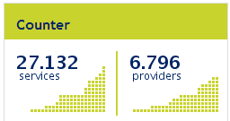
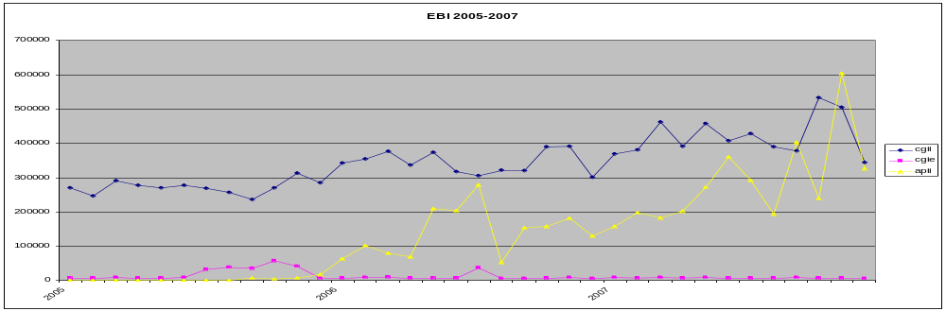

Slide 6
Documenting Services
WSDL <Documentation>
  Pro: Part of interface description
  Con: embedded in XML document, placement limitations
Service pages
  Overview
  Link to existing documentation (Help pages)
  API
    Methods & Data structures
Sample clients
  Java & Perl
  Plus more (C#, Python, PHP, Ruby, etc.) for popular services

Slide 7
Service Metadata
Why?
  Self documenting service
  Building interfaces
  Allowing for change in underlying tools and data
So...
  Methods to get option information
    Default value
    Option values (e.g. matrix names)
    Provide display information (e.g. display names)
  Allow for relationships between options (e.g. search type)
Problem
  Complex dependencies between parameters (e.g. NCBI BLAST)

Slide 8
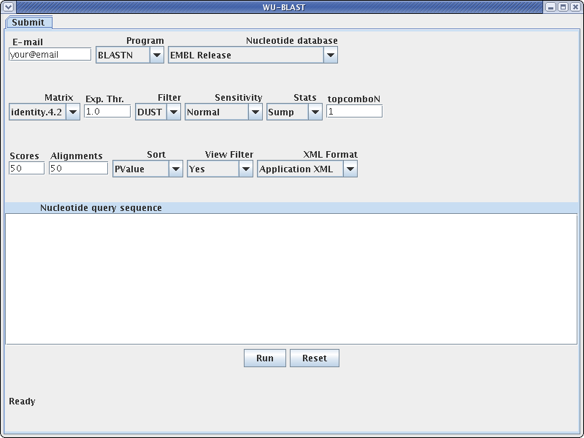
Using Service Metadata

Slide 9
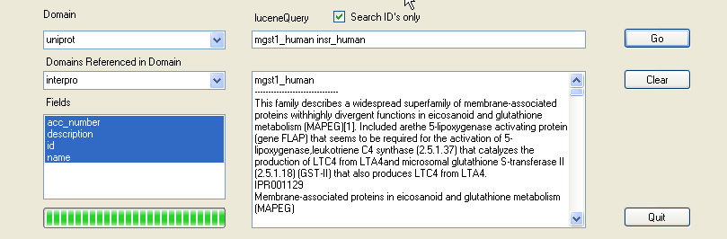
Metadata and EB-eye
The service provides the metadata required to build the
application interface.

Slide 10
Further Information
EBI Web Services:
  http://www.ebi.ac.uk/Tools/webservices/
EBI Support:
  http://www.ebi.ac.uk/support/

Slide 11


