Slide 1




A BioCatalogue
Cataloguing Web Services for the Life Science Community
Carole Goble, Khalid Belhajjame, Robert Stevens, Jiten Bhagat, Franck Tanoh, Katy Wolstencroft, Steve Pettifer
University of Manchester, UK
Rodrigo Lopez, Thomas Laurent,
Hamish McWilliams, Eric Nzuobontane
European Bioinformatics Institute, UK
David De Roure, myExperiment
Notes:
Based on the briefings paper -- read it!
and the educase paper

Slide 2
Web Services in the
Life Sciences
Programmatic Interfaces to services on the rise
EMBL-European Bioinformatics Institute
  3 million/month accesses to Web Service APIs
  1 million/month compute jobs > 50% are over WS
Guessimate 1000-1500 services.
Why?
  Specialisation and segregation of methods from monolithic servers.
  How one should publish data.
  Automated Life Science applications, like workflow systems - Taverna, Kepler, Triana, Trident, KNIME, BPEL …..
Notes:
How many web services are there?
What are the API submission statistics for 2008
Is there a graph showing an increase?
o 3 million/month accesses to various WS APIs (MSD, BioModels, ES-compute jobs, etc).
o 1 million/month compute jobs of which more than 50% are over WS (mostly by systematic users).
o 20K unique IPs/month for the whole. Of these Ca. 5K are systematic users and account for the vast majority of job submissions.
o User agents covering every single LS programming language have been detected (perl, python, C/C++, C#, Java, Ruby, PHP, etc).
o A guess for LSWS: >500 - < 1000 worldwide but growing as specialisation and segregation of methods from monolithic servers offering more than 20 methods takes place. This only includes SOAP (rpc &doclit). REST, JAX-WS and DAS are not included in this estimate. If you count DAS as a type of REST WS, you can say >700 - <1000. I'm being conservative.

Slide 3
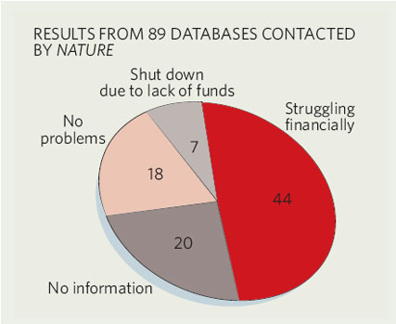
Chain stores and Boutiques
Major data centres and national centres
  EMBL-EBI (UK), DDBJ, PDBJ (Japan), NCBI, SDSC PDB (USA)
Investigator and community projects
  Kanehisa Laboratory, Kyoto, Japan
  BASIS, University of Newcastle, UK
  Biomolecular Interaction Network Database, BIND, University of Toronto, Canada
  Institute of Bioinformatics, Tsinghua University, China
  EMAP, Edinburgh Mouse Atlas Project, UK
  The Chemical Informatics and Cyberinfrastructure Collaboratory (CICC), Indiana University, USA
  and more and more….
Variable sustainable stewardship
Notes:
myGrid Feta registry
http://www.mygrid.org.uk/wiki/Mygrid/BiologicalWebServices

Slide 4
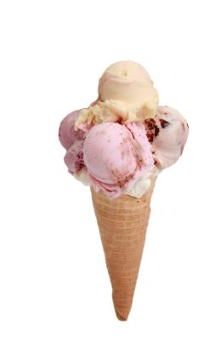
Service Flavours
Generalist
  SOAP
  REST
Specialist
  DAS (Distributed Annotation Services)
  BioMOBY
www.biodas.org
www.biomoby.org

Slide 5
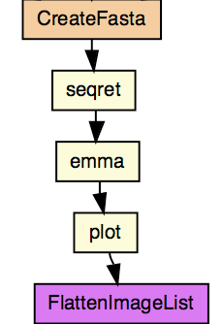
Web Services in the Wild
Visible? Findable?
“EMMA” is the Clustalw multiple sequence alignment program from the Emboss suite
Poor adoption for providers.
Forum for advertising and shopping.
Executable?
WSDL, WADL, WSDL2, Other kinds of services.
Transcend the specific grounding
Notes:
Scientists are naughty
Reuse is Hard
We have to try them to find out what they do…
IVOA referred to this too.
…I used it last time so it will work again the same way…damn!
change location, capabilities and signatures (BioMART changed its interface three times in 2006).
new ones appear and existing ones disappear (SeqHound)
they decay and become outdated or unreliable.

Slide 6
Web Services in the Wild
Understandable?
Input0:string, Output0: string?
What does the SeqRet actually do?
Examples? Example data? Example Parameter configurations? Input-Output correlations?
Adequate documentation for anonymous reuse.
Usable? Available?
Quality of Service, robustness, test scripts?
Stability and dependability (see BioMART)?
Licensing, execution restrictions?
Trust and risk.
Monitoring and intelligence gathering.
Notes:
Scientists are naughty
Reuse is Hard
We have to try them to find out what they do…
IVOA referred to this too.
…I used it last time so it will work again the same way…damn!
change location, capabilities and signatures (BioMART changed its interface three times in 2006).
new ones appear and existing ones disappear (SeqHound)
they decay and become outdated or unreliable.

Slide 7
Metadata from a WSDL
<wsdl:message name="getGlimmersResponse">
<wsdl:part name="getGlimmersReturn" type="xsd:string"/>
</wsdl:message>
<wsdl:message name="aboutServiceRequest"/>
<wsdl:message name="getGlimmersRequest">
<wsdl:part name="in0" type="xsd:string"/>
<wsdl:part name="in1" type="xsd:string"/>
<wsdl:part name="in2" type="xsd:string"/>
<wsdl:part name="in3" type="xsd:string"/>
<wsdl:part name="in4" type="xsd:string"/>
<wsdl:part name="in5" type="xsd:string"/>
<wsdl:part name="in6" type="xsd:string"/>
<wsdl:part name="in7" type="xsd:int"/>
<wsdl:part name="in8" type="xsd:string"/>
Name of the service
Uninformative names for parameters
What kind of string?
Pathport Web service from the Virginia Bioinformatics Institute http://pathport.vbi.vt.edu/services/wsdls/beta/glimmer.wsd

Slide 8
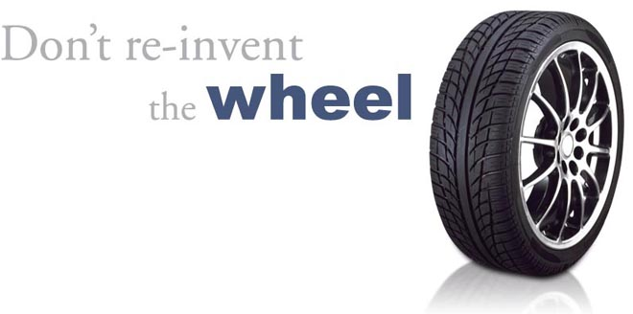
Result?
Reinvention
and reduce time to insights….
Notes:
Result reinvent!

Slide 9
Cataloguing Services
Investigator and project specific registries
  EMBRACE, BioSapien, Stargate Portal
Community lists
  Bioinformatics Links Directory, BioLinks, BioPlanet,
Project specialist registries
  BioMOBY Central, DAS Registry, myGrid Registry, Sswap
General catalogues and search engines
  SeekDa!, Web Services List, XMethods
Sustainability and curation
Accessibility
Rich annotation & customisation
Provider engagement
Notes:
Green indicates a special relationship with BioCatalogue
http://www.bioplanet.com/links.htm
Biology Specific Web Service Catalogues. Several independent initiatives have been established to collect and curate Web Services related to a specific Life Science field. The Stargate Portal [29] specializes in Glycoproteomics and is aimed at developers rather than expert or casual users and is tightly bound to WSDL-only services. Sswap (Simple Semantic Web Architecture and Protocol) [30] caters for proteomics researchers and has rich descriptions that exploit reasoning over an OWL ontology, but is hampered by an interface that requires the user to have a high degree of a priori knowledge of the underlying model to be effectively used. The DAS Registry [31, 32] logs over 500 DAS biology servers that use a unique http protocol that predates standardised Web Services. BioMoby Central [27, 33] is a registry of only BioMoby Web Services [34] and is a potentially rich source of well annotated services, though in practice the annotations are often rather general. The myGrid Service Registry [35] contains 700+ Web Service descriptions, expertly annotated by a full time curator; however, though publicly available and used by clients such as Find-O-Matic [12], its discovery tool, Feta [36] is only available as a plug-in from the Taverna Workflow Workbench. Other efforts include uncurated personal lists, group portals, and curated lists of links to web sites, such as the Bioinformatics Links Directory [4] but do not describe them in a way that they can be run.
General Web Service Catalogues and Search Engines Web Services List [37], XMethods[38], Salesforce [39] and Wsoogle [40] are commercial online directories with a wide range of services. They are general, tend to lack rich metadata, and tend to be aimed at service providers and tool developers, rather than expert or casual users, but they have huge coverage. All have some sort of community rating to record experience and the “quality” aspects of services. Woogle [41], was an early research attempt at a Web Service search engine with no commercial implementation. SeekDa [42] is an active commercial search engine site for any kind of Web Service with facilities for reviewing, testing and tagging services. An associated research project – Service Finder part of the SOA4 All initiative – promises a platform for service discovery embedded in a Web 2.0 environment and emphasises the use of semantics to describe and discriminate between services. There are plans for automated and semantic annotation, but other curation policies are unclear.
Workflow repositories are less mature and tend to be project specific portals, for example the INB MOWserver and BioWep [43] or product specific, e.g. InforSense’s Customer Hub [42], the Pipeline Pilot [44] and the Kepler component repository [45]. An exception is the myExperiment [46] social networking and scientific workflow repository [28]. This is a Web 2.0 style repository that emphasises community participation for workflow developers to upload their workflows for the common good of the community. Although developed for the Taverna workflow community, it is intended as a resource for all workflow systems, recently incorporating Triana workflows. myExperiment has particularly addressed the issues of sharing and credit, with an underlying model to support author attribution, versioning and cross-workflow reuse analysis. A custom Google search [47] finds workflows from a range of systems.
Present efforts to produce catalogues tend to be biased toward the developer community or experts (Table 1). Many have web-browser based interfaces and a few provide a client API to the catalogue itself such that it can be called from an application rather than just browsed from a web site. WSMO Studio, SAWSDL [37] and BioMoby have Eclipse plug-ins such that services can be found from the development environments used in their creation.

Slide 10
Lets Pool our Knowledge
A reliable, trusted, up to date and sustained catalogue customised for the Life Sciences.
  EBI curation and service commitment
Discovery interface for decision support.
  Drawing on myExperiment and EBI legacies
Community and specialist curation.
  Pooled and accumulative annotation.
  A platform for service monitoring and analytics.
Incorporated into applications and mashups.
  Itself a web service, with a (REST) API.
Notes:
A means to pool metadata about services in the wild
A means to discover and reuse those services
A means to curate services
A platform for service monitoring and analytics
A supermarket

Slide 11
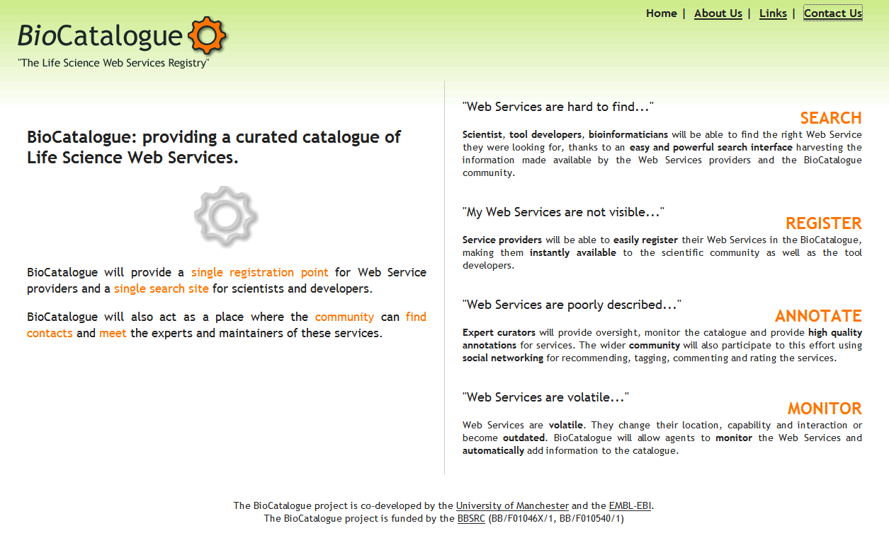

Started June 08
Closed pilot Dec 08
Pilot release April 09
BioCatalogue-Friends focus group
Perpetual beta
Three year award
Notes:
Started 1st June
6 months Pilot 1
Perpetual beta
“BioCatalogue-Friends” focus group
Extensible software
Built to be evolved and to be scaled.

Slide 12
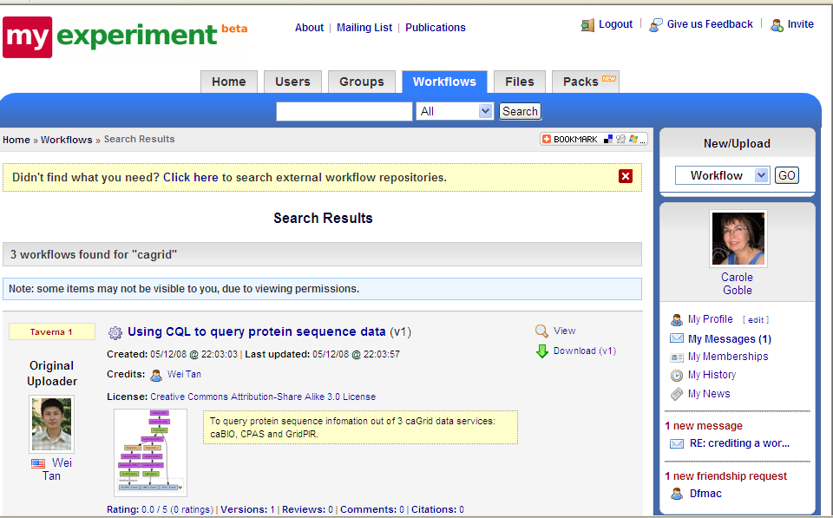
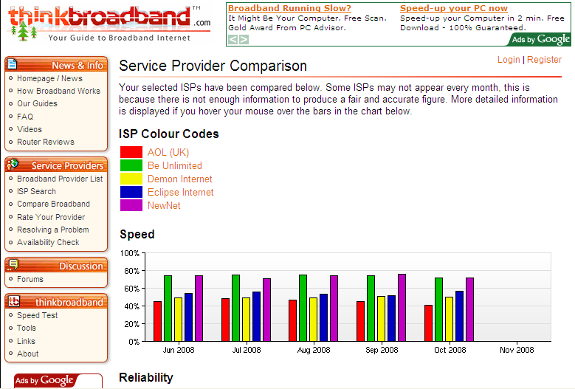
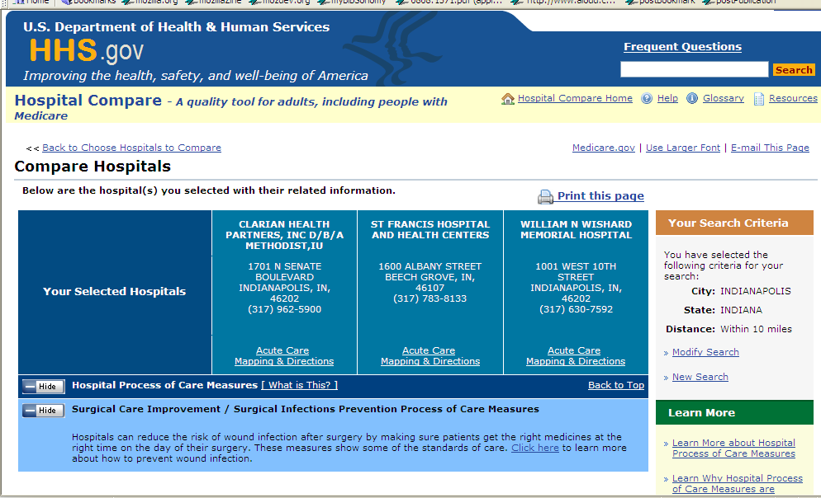
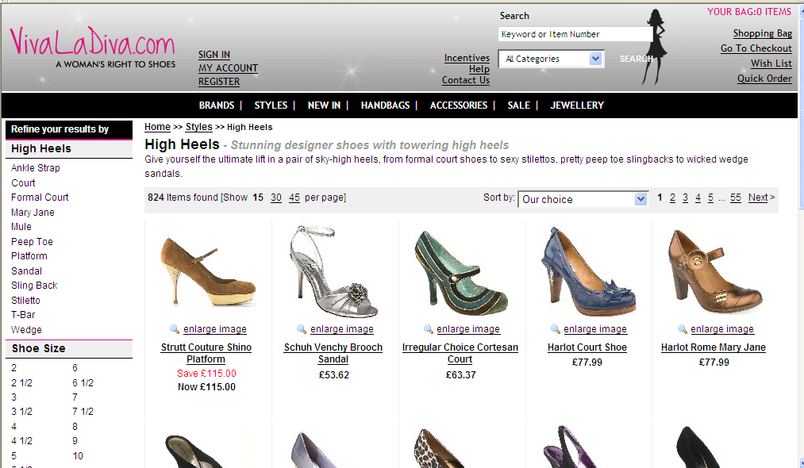
Influences
Notes:
Services comparison site.

Slide 13

Service Profile Wheel
Curation Model
Attribution
Versioning
Ratings
Tags
Quantitative
Content
Semantic
Content
Searching Statistics
Ontologies
Free text
Usage Statistics
Operational
Metrics
Functional
Capabilities
Service Model
Social Standing
Operational
Capabilities
Provenance
Use Policy
Notes:
See if I can colour differently.
Availability
Freshness
Buying rooms not buy shoes
Mobile phone
Take down policy

Slide 14
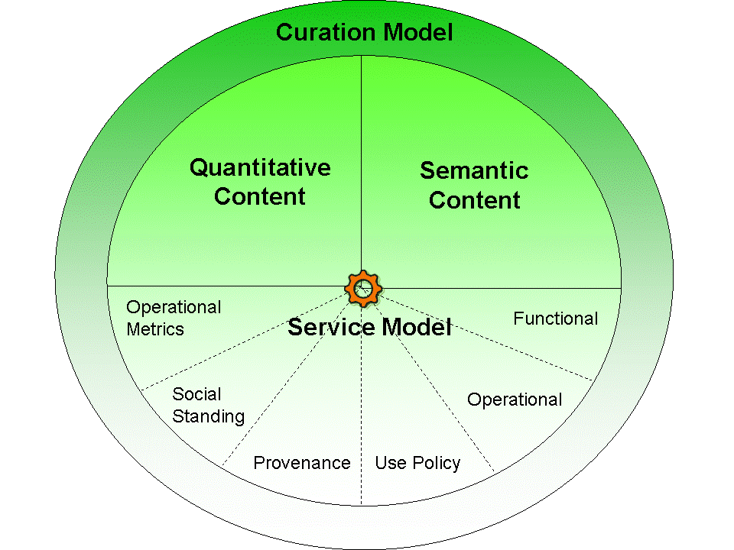
Discovery
Service Profile
External
Descriptions
Search
Parse
Browse/Shop
WADL
WSDL
Invoke
Sorting
Ranking
Matchmaking
WSDL2
Customised
Analytics
Searches
A.N.
Other
Services
Profiles
SAWSDL
Parse
Workflows
SA-REST
Generate
Monitoring
Validating
Notes:
Curation includes versioning
Analytics includes monitoring

Slide 15
Modelling Functional Capability
Automated service composition and validation
Decision Making
WSMO
http://www.wsmo.org
OWL-S http://www.w3.org/Submission/OWL-S
SAWSDL
http://www.w3.org/2002/ws/sawsdl/
…….
Tags
Ontology
myGrid Service Ontology
Text Descriptions
Gain
Effective
(anonymous)
Reuse -> Palpability
Discovery
Decision Support
Pain
[Lord et al 2004]
Notes:
Phillip Lord, Sean Bechhofer, Mark Wilkinson, Gary Schiltz, Damian Gessler, Carole Goble, Lincoln Stein, Duncan Hull. Applying semantic web services to bioinformatics: Experiences gained, lessons learnt. in Proc 3rd International Semantic Web Conference ISWC2004, Hiroshima, Japan, 9-11 Nov 2004 , Springer LNCS 3298 350-364

Slide 16
myGrid Functional Capability Ontology
Service
Operations
Informatics
Inputs
Domain Content
Bioinformatics
Outputs
Molecular Biology
Service features
Formats
Task
Method
Tasks
Grounding
Resource
WSDL
W3C OWL and RDFS
Number of classes ~750
myGrid and BioMOBY
[Wroe 2003]
Notes:
Wroe C., Stevens R.D., Goble C.A., Roberts A., Greenwood. M. A suite of DAML+OIL ontologies to describe bioinformatics web services and data. International Journal of Cooperative Information Systems. Special issue on Bioinformatics and Biological Data Management 12(2):197-224, 2003.
First version of the ontology ~ 2002
Originally developed in DAML+OIL
Now developed in OWL and a version exported to RDFS
Number of classes in the ontology ~750
Domain and service ontology used by myGrid users and developers of myGrid related plugins
Service ontology also used by BioMoby
W3C compliant WRT ontology modelling
Logically separated into two parts:
Service ontology
Physical and operational features of (web) services
Domain ontology (Semantic Content Model)
Annotation vocabulary for core bioinformatics data, data types and their relationships
Informatics: captures the key concepts of data, data structures, databases and metadata.
Bioinformatics: The domain-specific data sources (e.g. the model organism sequencing databases), and domain-specific algorithms for searching and analyzing data (e.g. the sequence alignment algorithm, clustalw).
Molecular biology: Concepts include examples such as, protein sequence, and nucleic acid sequence.
Formats: A hierarchy describing bioinformatics file formats. For example, fasta format for sequence data, or phylip format for phylogenetic data
Tasks: A hierarchy describing the generic tasks a service operation can perform. Examples include retrieving, displaying, and aligning.

Slide 17
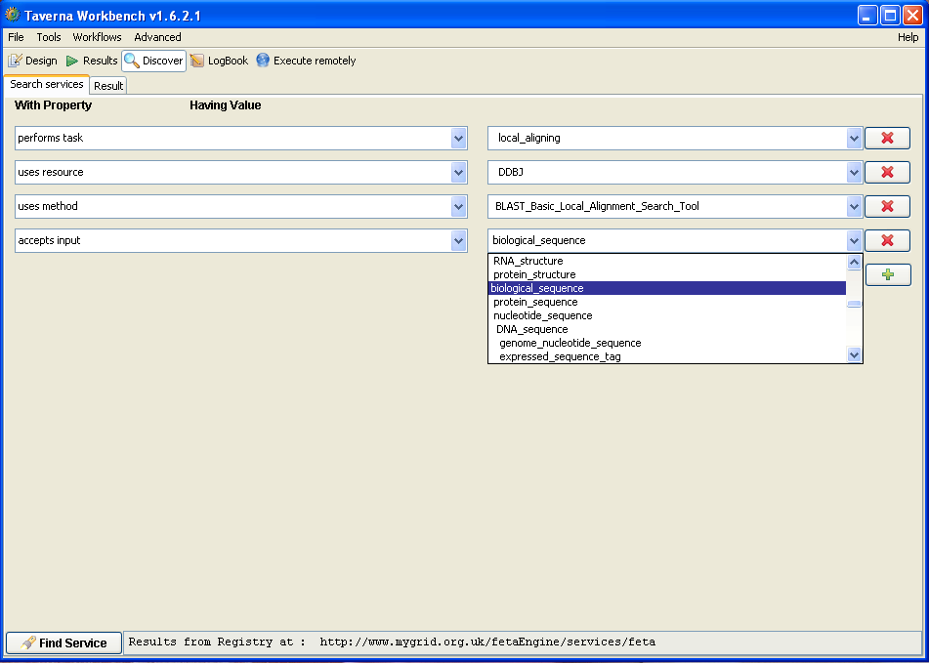
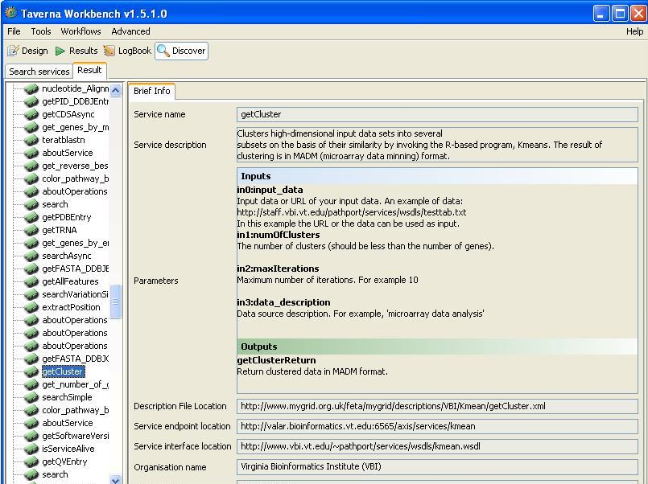

Slide 18
Free text and tagging in the user’s language
Smart interfaces for people
Semantically annotated services for driving interfaces and automated processing

Slide 19








Content Capture and Curation
Self by Service Providers
Experts
refine
validate
refine
validate
seed
seed
Workflows and Services
refine
validate
refine
validate
seed
seed
Social by User Community
Automated
Notes:
In particular a platform for research into curation practices
As in the panel today
Expert – Is library like
Suppliers and crowd are the web side
Automated is
Expert curators: bioinformaticians who understand the services and workflows whose job it is to annotate and set up the curation pipelines, for services and workflows that are not of their own making.
Self-curation: Some registries are closed – the myGrid registry is only curated by experts from the myGrid project itself. Others encourage service developers to self-curate, emphasising the use of plug-ins to service development environments such as Eclipse; examples include BioMoby’s jMoby plugin and SAWSDL4J, Lumina and Radiant toolkits for SAWSDL and WSMO Studio (21). Workflow repositories such as myExperiment rely on self-curation by the workflow developers and community curation by their users. Challenges include (a) the enforcement of controlled vocabularies by self-curators, particularly if the vocabularies are also managed by the developers as they can quickly become unruly and (b) incentivising people to contribute their services and workflows for the good of the community.
Community Curators: The trend is to follow in the footsteps of popular Web 2.0 social computing sites and encourage community curation through user feedback, blogging, e-tracking, recommendations and folksonomy based tagging. Community approach to services development and use being tried by Seekda and BioMoby and for workflows by myExperiment. Community and self-curation requires built-in incentive models for people to contribute such as credit and attribution, but can be made to work for example iCapture successfully pioneered community curation of ontologies (Wilkinson PSB).
Automated Curators: Automated scavengers and crawlers identify candidates for submission and extract as much metadata as possible. Functional metadata is hard to auto-curate, requiring: specialist metadata extraction tools [54]; software plug-ins that incidentally gather metadata from services as they are used in applications; or smart reasoning over seeded service descriptions and workflows [54]. Operational and usage metadata is ripe for automation, generated from monitoring services, application diagnostics, customer reports and Social Network Analysis. Workflow analytics is the term used for processing workflow collections to identify, for example, service co-use patterns and service popularity. Automated curation needs excellent infrastructure.

Slide 20
People-Powered Registration
By Provider and by Proxy.
Ownership.
Incentives
Completeness vs Cost.
Relative rankings feedback.
Visibility and reputation.
(which may not always be flattering)
Do not presume that providers are unhelpful.
Notes:
Community annotation
Must be easy and quick
Must allow partial descriptions
Multiple annotations of the same service
What is the minimum information to enable
service discovery
service invocation

Slide 21
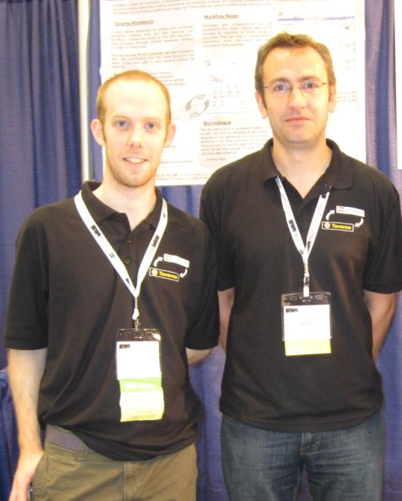
People-Powered Curation
Third party and Provider
Curation@Source/Delivery
Incentives.
  Quick and easy.
  Credit (and Blame).
Incremental and partial descriptions.
Peer review. The Wisdom of the Wisdom of the Crowd
  Quality, Slander
Content.
Distributed Human Grid of Annotators. Annotation Jamborees. T Shirts.
Notes:
Curation at the point of delivery and use in applications.
Community annotation
Must be easy and quick
Must allow partial descriptions
Multiple annotations of the same service
What is the minimum information to enable
service discovery
service invocation

Slide 22

Expert Curation
Added value of Biocatalogue
  Review
  Quality assurance and Trust
Enriched annotations
A curation pipeline.
  Tags to Ontologies.
  Ontology husbandry
A Sweatshop.
  How do we make this smarter?
Notes:
Community annotation
Must be easy and quick
Must allow partial descriptions
Multiple annotations of the same service
What is the minimum information to enable
service discovery
service invocation

Slide 23
Uniform Annotation model
Minimum for discovery and invocation
Partial annotations
Multiple annotations
Polymorphic: text, tags, statistics, ontologies
Annotation provenance
Trust
Curation pipeline and monitoring
Multiple providers
Multiple versions
Multiple deployments
Value
Free text
Tag term
Ontology term
Provenance
Annotation
Assertion
Service
Notes:
Free text
Tags
Statistical numerical measures
Ontologies
Who said what about what?
Harvesting community annotation
Verifying and augmenting by a curator
‘Trust’ Models
Annotation versions
In a workflow context
As stand alone services

Slide 24
Ranking, Sorting, Filtering and Comparing
Grading: bronze -> platinum
Presence, quantity and quality
Judgement by the users, not us.
Usable and Useful
Understandable
Notes:
Bronze – enough to locate the service. Example of service invocation.
Platinum – full description. All properties annotated – including dependencies between them, verified by a curator Rapid scanning of results

Slide 25
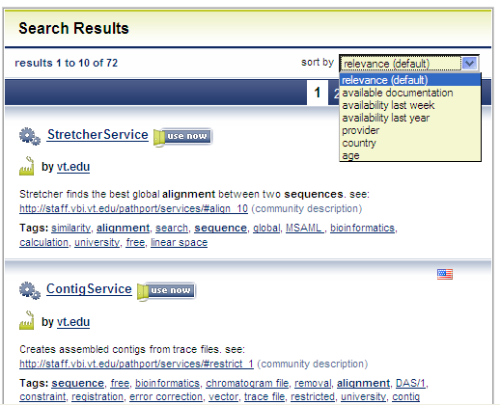
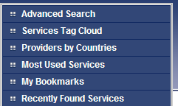
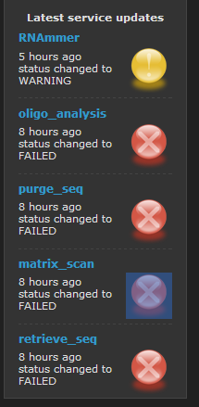
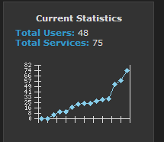
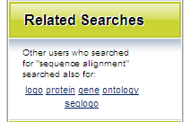
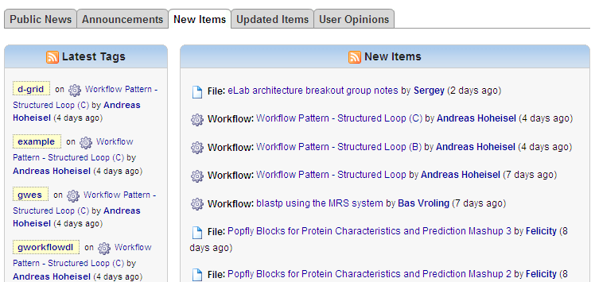
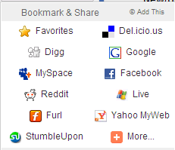

Slide 26
Auto Curation
Auto scavenging
SeekDa!
Auto Annotation
Specialist parsing
Auto-tagging
Text mining
Inferring service descriptions from myExperiment workflows (Quasar framework)
Auto Monitoring
Test Workflows / scripts
Service monitoring
Feeds from applications and third parties: dial home diagnostics, customer reports, predicted down times
Auto Usage Analytics
Workflow usage
Search patterns
Notes:
Feeds like predicted out times
Inferring service descriptions from workflows
Gathering usage data
How many workflows use this service
Gathering reliability data - monitoring
When is this service available
How many times does it fail
Helps with “shopping” for services
People who used this service also used this service
Top 10 services
Services that do the same things
Inferring service descriptions from workflows
Gathering usage data
How many workflows use this service
Gathering reliability data - monitoring
When is this service available
How many times does it fail
Helps with “shopping” for services
People who used this service also used this service
Top 10 services
Services that do the same things

Slide 27
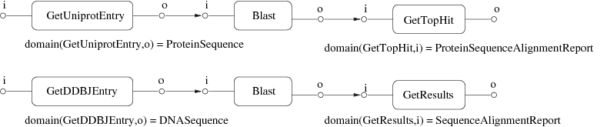
Quasar
Quality Assurance of Semantic Annotations for Services
Using mismatch-free workflows to infer information about the semantics of linked parameters
[K. Belhajjame 2008, 2006]
http://img.cs.man.ac.uk/quasar
Notes:
The idea of the proposed approach is that if we know that a workflow is free from mismatch, then we can infer information about the semantics of linked parameters.
To illustrate this idea I will use two simple workflows, both of which are intended to perform simple similarity searches over biological sequences. The first finds the most similar protein to the one specified in the input parameter. To do this, it retrieves the specified protein entry from the Uniprot database, runs the Blast algorithm to find similar proteins, and then extracts the protein with the highest similarity score from the resulting Blast report. The second workflow finds similar sequences to a given DNA sequence. It retrieves the DNA sequence from the DDBJ database, searches for similar sequences using Blast and finally extracts the sequences of all matches from the Blast report.
Notice that the semantics domain of the parameters of the Blast operation have not been annotated, while the semantic domains of the parameters of the other operations have. If we assume that these workflows are free from mismatch, then their data links must all be compatible and we can therefore infer some information about the annotations that the Blast operation should have. For example, we can see that the input Blast parameter must be compatible with both ProteinSequence and DNASequence, since parameters conforming to both these concepts are connected to it, and we can infer that:
Similarilly, the output blast parameter must be compatible with the inputs of the operations GetTopHit and GetResults, and we can infer that.

Slide 28
Users
registration
Identity management
profile management
ownership
account management
bookmarking
notification
Services
soap services
registration dashboard
versions
scavenging
wsdl parsing
instances
Identity management
Discovery
text search
browse and drill down
usage-based
tag search
sorting on criteria and categories
recommendations
Curation
tagging
specialist parsers.
ratings
500 services
250 full curated
seeded controlled vocab.
recommendations.
Monitoring
registration test scripts
live tests
QoS app feeds
Wsdl monitoring
Integration
REST API
myExperiment
Open Search
Pilot
Content
Batch migration
Policy identification
Provider engagement
Notes:
User managementRegistration of individuals using user/group registration model available in myExperiment/Wiki Identity managementManagement of identity life-cycle for entities (subjects or objects) Account managementCentralised administration as per myExperiment/Wiki AMS User profileSubject management of individual profilesMetadata annotationData model; 4 levels of completeness (bronze, silver, gold and platinum) FunctionWeb Service operational description OperationDescription of operations, methods/actions Conditions of UseIf required, to describe usage limitations, etiquette, contract and licensing ProvenanceDescription of the service(s) hosting server Community StandingAnnotation (submitter/community) of institutional service host Operational MetricsLevel of Service, Availability, Q&A OntologymyGrid OntologyService SubmissionSingle and multiple (batch) submission of service. Only registered users are allowed to submit services. Service typesSOAP Service versionsAs services get re-developed or remodelled Service instancesMultiple instance of same, mirror or equivalent services geographically distributed sites Submission dashboardFigure X – Service submission interface allowing checking for duplications. Intuitive displays of available service information and cueing for descriptors that may be incomplete or missing. Applies to the qualification of annotation standards described in the metadata section. Ability to preview submission before committing to the back-end database.Service Curation TaggingKeyword-base curation driven by controlled vocabularies and ontologies. Service popularity quantification tagging. Community driven. WSDL parsingParsing of the Web Service Description Language services operational descriptions file. This will expose methods/action and their corresponding inputs and outputs in human readable descriptionsService Monitoring Interface monitoringChecks for consistency and change-tracking Availability monitoringChecks for service availability. Simple operational tests. QoS monitoringChecks for consistency, robustness and long-term availability of services. 3rd Party AggregationChecks for pipe-line and workflow integrityService Discovery Simple/Advanced searchFull-text term searching. Available via the portal. Also to be made available via EB-eye and Google. Search of services matching free-text strings, filtering by date, type, provider, functionality, categories, tags and technologies. Tag searchSearch via tags – driven by annotation via ontologies (see above). RecommendationsBest-practise recommendation for service tagging and annotation to enable efficient and consistent searching across service types and service groups. Notification via RSS feeds (new and updated services, important service changes, status, BioCatalogue functionality, etc.) BrowserAmazon-like browsing interface with the capability to view details of services of interestSystem integration[with myExperiment? to complete] REST APIProgrammatic and non-programmatic access to service resources through URIs and HTTP verbs. Open SearchEnable addition of the BioCatalogue as a search engine in browsers that can handle the open search formatUse OpenSearch format as one of the formats for returning search queries myExperimentServices from BioCatalogue displayed in myExperiment so users of myExperiment can browse them. This includes a “Latest Services” and “Updated Services” list. Services within workflows in myExperiment reference the appropriate services in BioCatalogue so users can click through to the information in BioCatalogue.

Slide 29
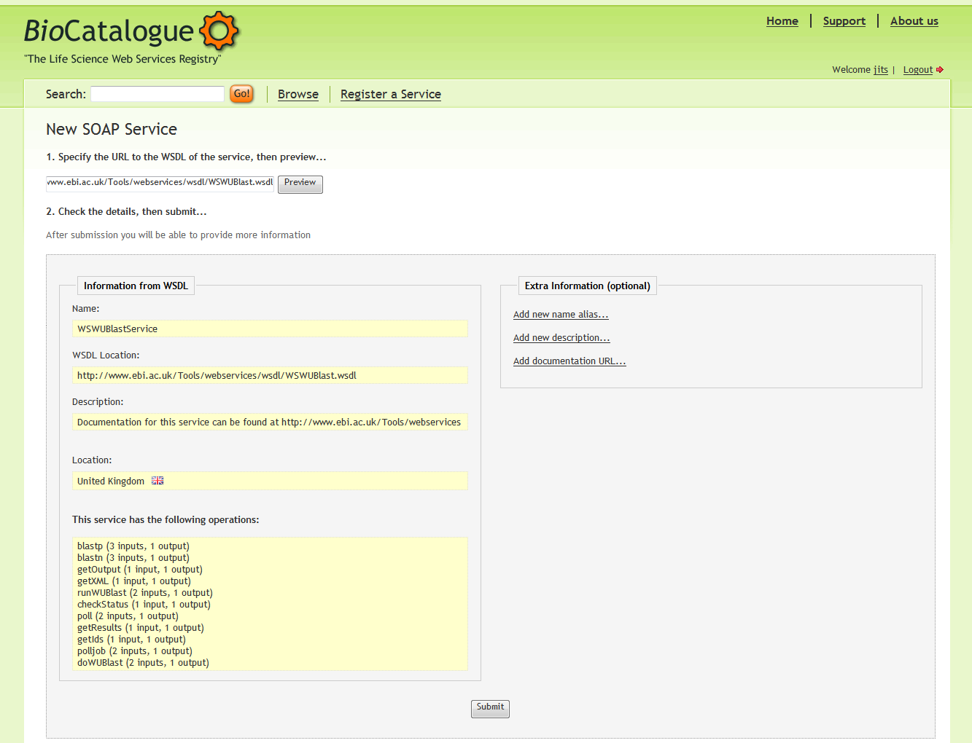
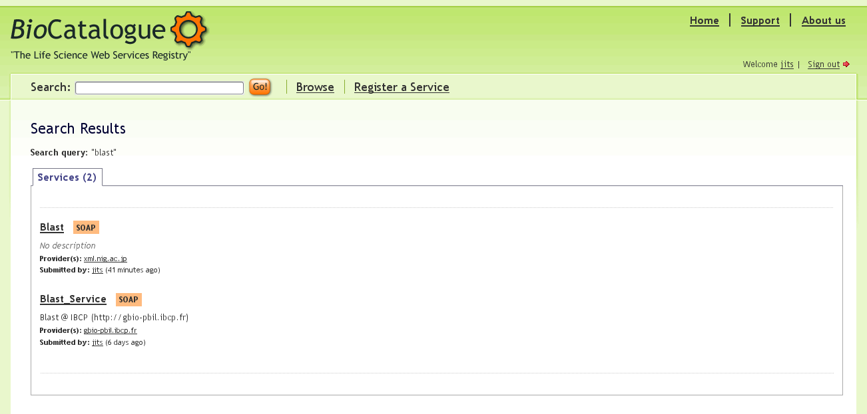
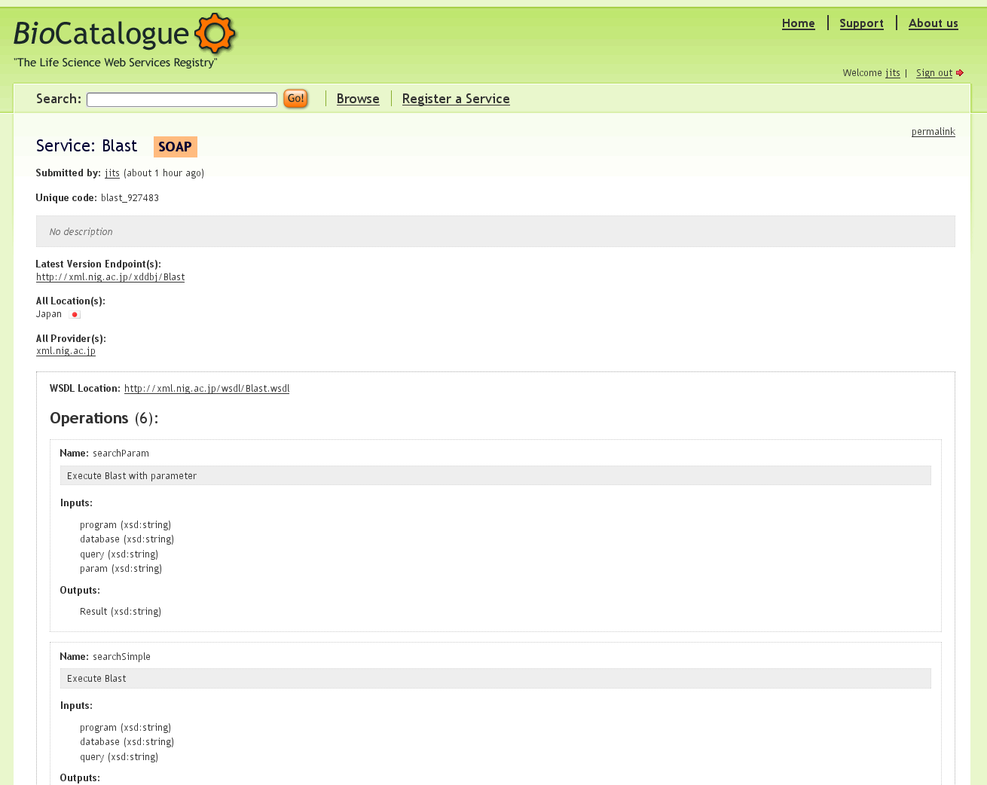

Slide 30

BioSapien
myGrid
SeekDa!
EMBRACE
Feed
Migrate
Feed and
Cross-link
Scrape
BioLinks
BioMOBY Central
myExperiment
Code Base
DAS Registry
Notes:
EMBRACE, BioSapien, Stargate Portal
Project specialist registries
BioMOBY Central, DAS Registry, myGrid Registry, Sswap
Community lists
BioLinks FINISH
General catalogues and search engines
SeekDa!, Web Services List, XMethods,

Slide 31

Integration Pilots
Workflow analytics
Alternative access
REST API
Discovery access
Curation application
Service use feeds
Workflow Management System

Slide 32
So why is it taking so damn long to get here?
The final 9 yards and 80:20 rule.
All or nothing.
Dedicated resources and best intentions.
Content, content, content.
Being too damn, and unnecessarily, clever.
A social activity

Slide 33









BioCatalogue Team
Rodrigo Lopez
Hamish McWilliams
Thomas Laurent
Mark Wilkinson
Carole Goble
Holger Lausen
Eric Nzuobontane
Jiten Bhagat
Franck Tanoh

Slide 34
Further information
http://www.biocatalogue.org
Join our friends
Supply technology!
Carole Goble, Robert Stevens, Duncan Hull, Katy Wolstencroft, Rodrigo Lopez, Data Curation + Process Curation = Data Integration + Science, Briefings in Bioinformatics, in press

