Slide 1

http://www.biocatalogue.org
http://beta.biocatalogue.org
Professor Carole Goble
University of Manchester, UK
Director myGrid Consortium
BioIT Alliance Lunch, 28 April 2009, Boston MA

Slide 2
Bottom Line
Public, Curated Catalogue of Life Science Web Services
Register, Find, Curate Web Services
Community-sourced annotation, expert oversee
Open content
Open platform with open REST interfaces
Web 2.0 site and development.
Open source code base.
Started June 2008. In first beta phase.
Launch June 2009 at ISMB.
beta.biocatalogue.org
MoU with BioIT Alliance under discussion.

Slide 3

Why?
Guessimate 3000+ Web Services in Life Science publicly available
Where…
can I find them? advertise?
What…
do they do? Can I use them?
How…
do they work? operational profile?
up to date?
Who…
provides them? recommends them?

Slide 4
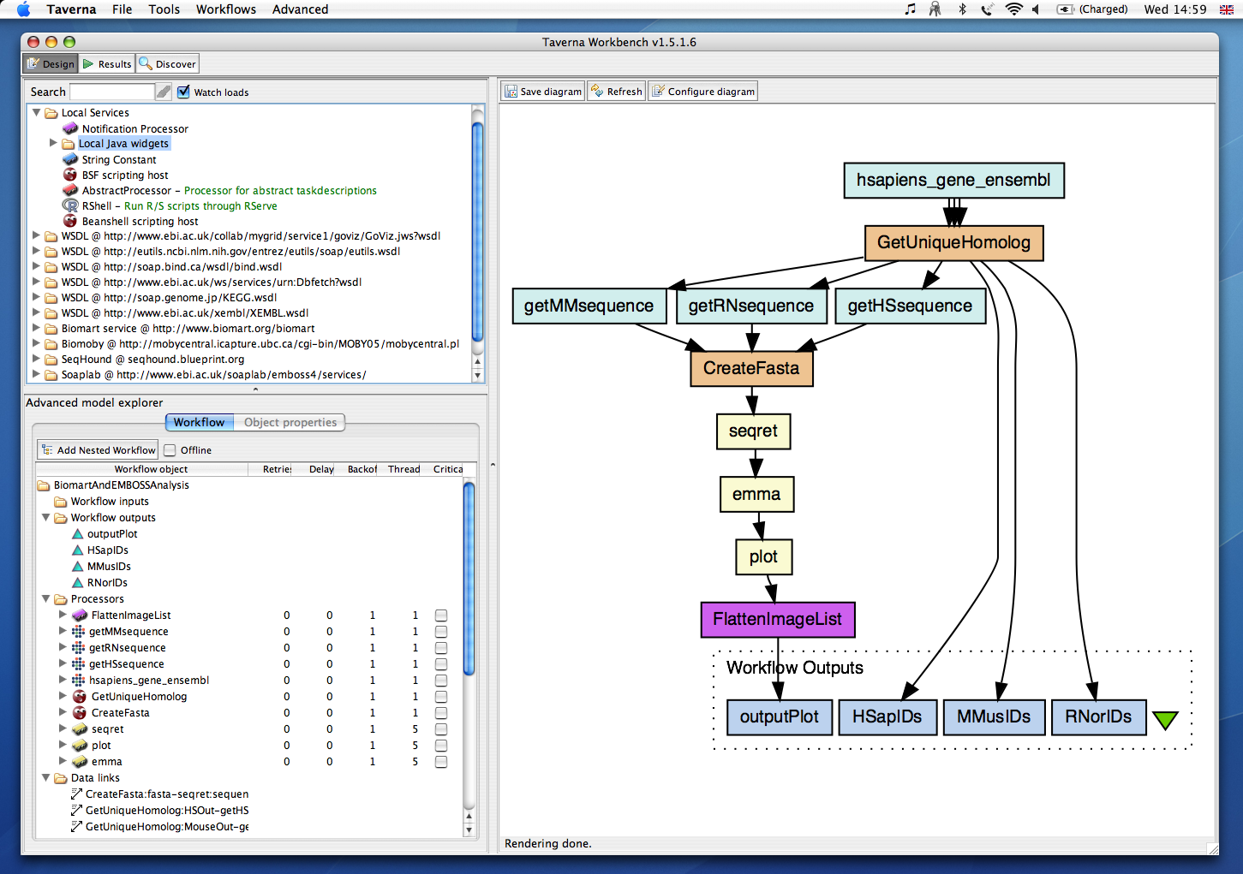


Why?
Scientific Workflow Management System
  Open Source
  Open Services
  Open Disciplines
http://www.taverna.org.uk
Data pipelines of web services in the wild
3500+ service operations
Notes:
7000+ downloads per version
350+ organisations
~1000 users per month

Slide 5

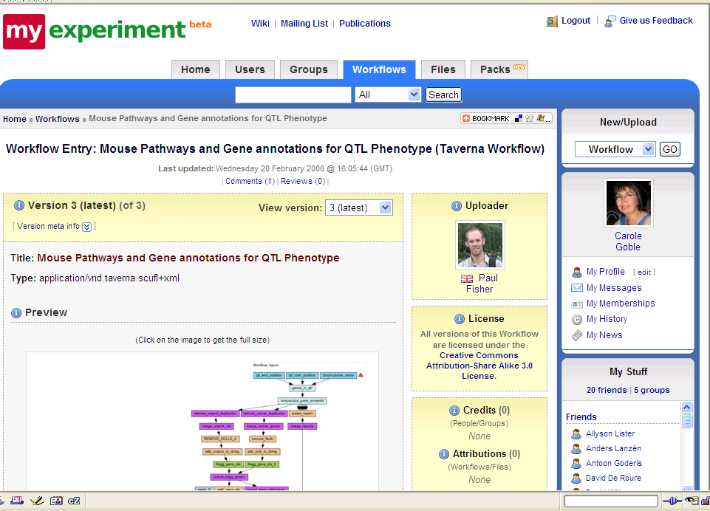
Why?
Socially share, discover and reuse workflows
Poster #30
http://myexperiment.org
Crowd sourced content
Social curation of scientific assets
Notes:
Library, repository

Slide 6
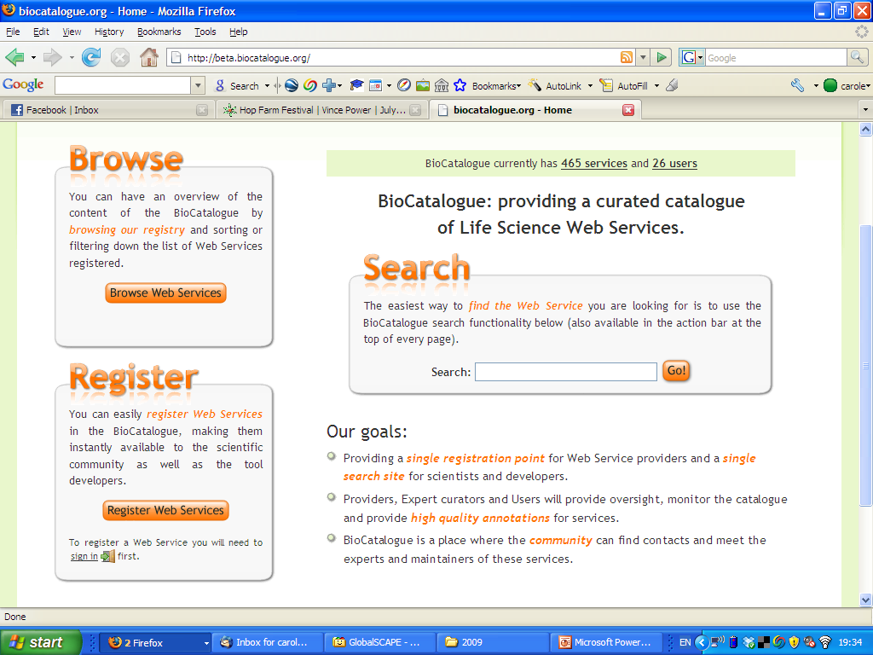
Notes:
Compare like with like
Integrated search

Slide 7
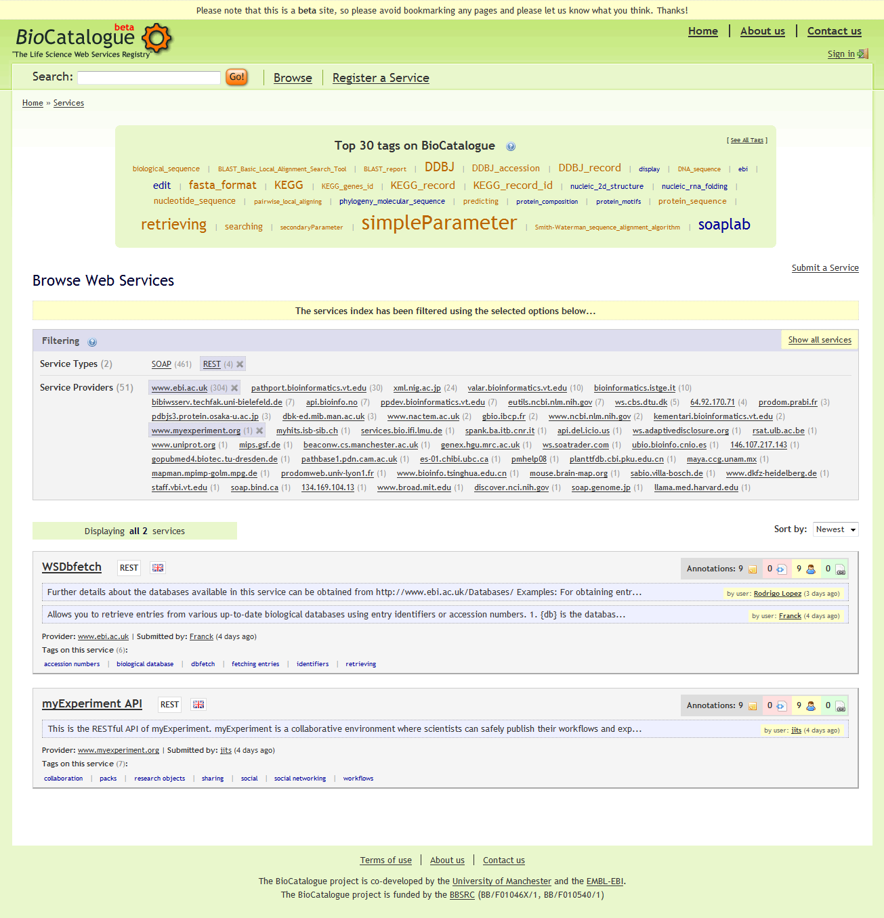
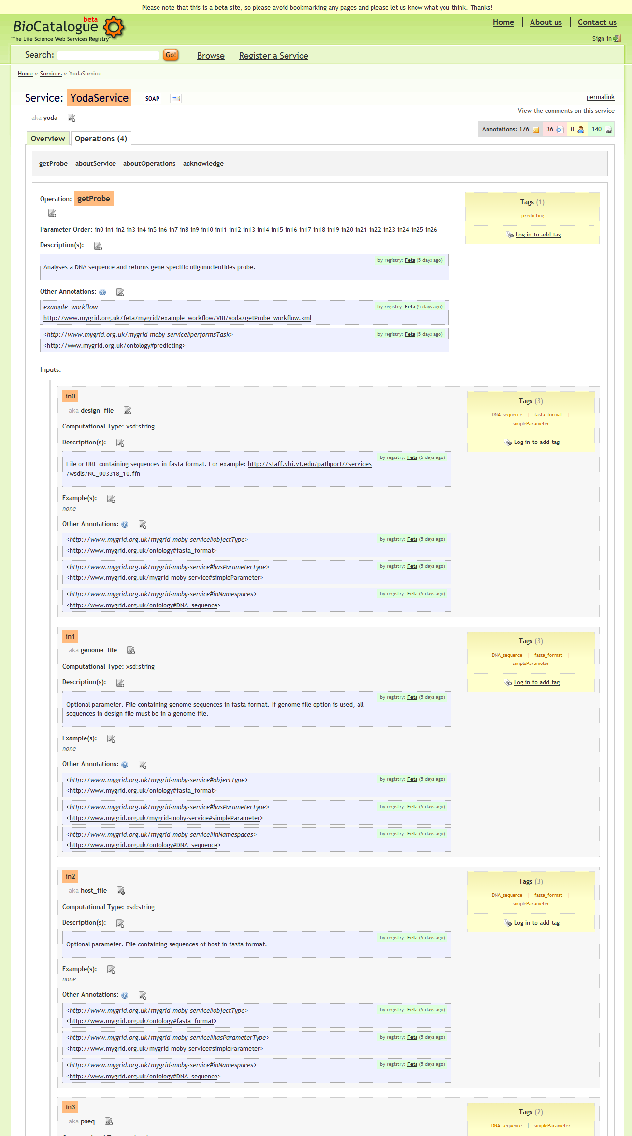
http://beta.biocatalogue.org

Slide 8
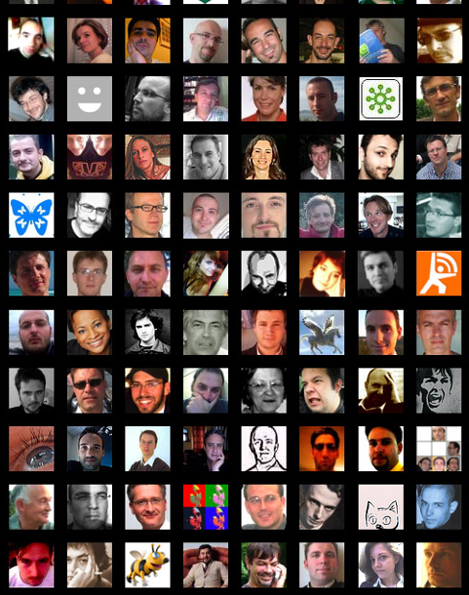
Content
Community contributed
  Service providers
  Third Parties
Automated crawling
Sourced from partners and registries
Chiefly public services

Slide 9






Content
Community contributed
  Service providers
  Third Parties
Automated crawling
Sourced from partners and registries
Chiefly public services

Slide 10
Content
SOAP
Community contributed
  Service providers
  Third Parties
Automated crawling
Sourced from partners and registries
Chiefly public services
REST
SoapLab
BioMOBY
DAS
Beta today:
465 Services (4 REST)
2691 Soap operations
51 Providers
Perpetual take-on

Slide 11

Curation Model
Attribution
Versioning
Tags
Ratings
Controlled vocabs
Quantitative
Content
Semantic
Content
Searching Statistics
Ontologies
Free text
Usage Statistics
Operational
Metrics
Functional
Capabilities
Service Model
Interfaces
Community Standing
Operational
Capabilities
Usable
and Useful
Usage Policy
Understandable
Provenance
Notes:
Syntactic and Semantic interop
Subjective and objective
Interfaces
Service Profile Wheel
Availability
Freshness

Slide 12

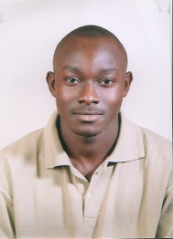

Curation
Just enough just in time
Universal annotation scheme
Mixed: Free text, Tags, controlled vocabs, community ontologies
Community sourced tags, comments, recommendations
Expert curation ontology-based annotation. myGrid OWL Ontology
Automated WSDL ripping and analytics
Automated monitoring & testing
Partner feeds (e.g. myExperiment)
Update feeds to users
tags
comments
recommendations
blog
twitter
syndicated feeds
ontologies
Notes:
Automated monitoring & testing
Test scripts, endpoint availability, meantime failure
Partner feeds
myExperiment.org Workflow profile
Update feeds to users
Develop incentives
Expert for oversight
How do we rank?
How do we compare non-alike?

Slide 13
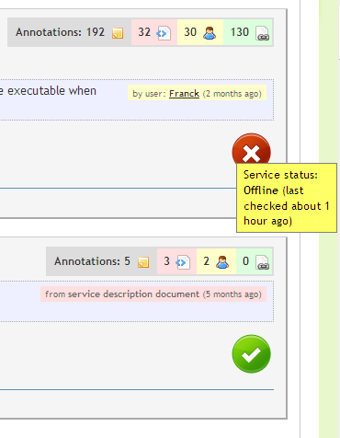
Curation
Just enough just in time
Universal annotation scheme
Mixed: Free text, Tags, controlled vocabs, community ontologies
Community sourced tags, comments, recommendations
Expert curation ontology-based annotation. myGrid OWL Ontology
Automated WSDL ripping and analytics
Automated monitoring & testing
Partner feeds (e.g. myExperiment)
Update feeds to users
Today: 14902 annotations
(provider, user, registries)
KEGG: 1433 annotations
Notes:
Automated monitoring & testing
Test scripts, endpoint availability, meantime failure
Partner feeds
myExperiment.org Workflow profile
Update feeds to users
Develop incentives
Expert for oversight
How do we rank?
How do we compare non-alike?

Slide 14
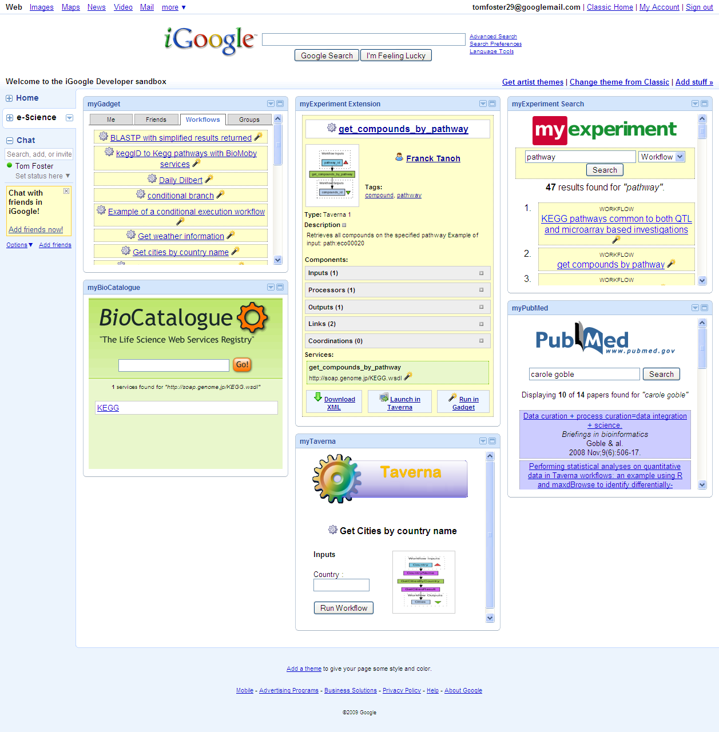
Open Platform
Export & import standards
  WSDL, SAWSDL, SA-REST, WSMO ….
  RDF and SPARQL
Web 2.0
  Open REST interface
  Plugin & Mash up
Open to Google
URLs for Bookmarking
Development model
  Perpetual beta
  User driven
  Biocatalogue Friends
Google Gadgets
Notes:
Develop incentives
Expert for oversight
How do we rank?
How do we compare non-alike?

Slide 15
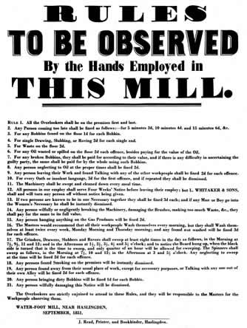
Governance
Submission
Content
Service update
Metadata update
Withdrawal
Take-down
Preservation

Slide 16
When?
Now:
  Silent Beta beta.biocatalogue.org
  Content take-on
  Performance and reliability testing
  Service testing framework commissioning
  Friends and family review
Launch:
  At ISMB, June 2009
Roadmap
  www.biocatalogue.org wiki
Notes:
Platform for service analytics

Slide 17





Who?
Three years guarantee funding (June08-May11)
Sustainability guarantee by EMBL-EBI

Slide 18

Why BioIT Alliance?
Mutual benefits
Content
Penetration
Sustainability route

Slide 19


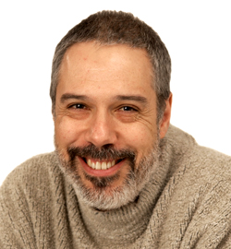

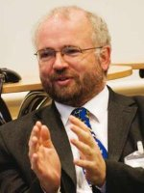
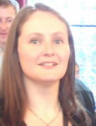

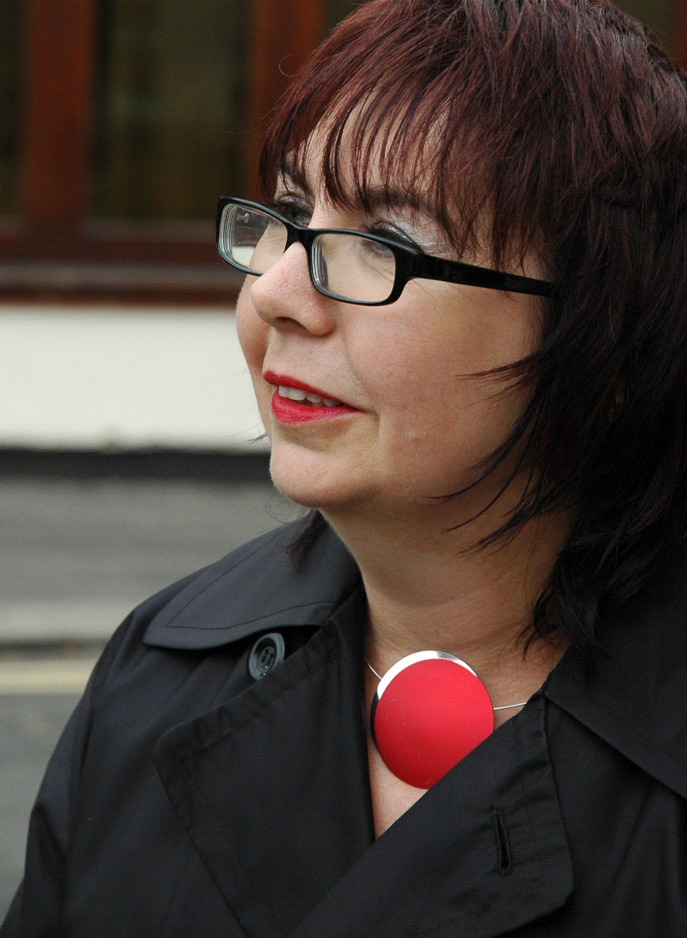
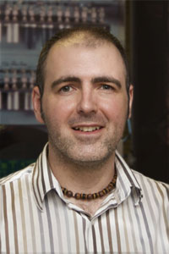
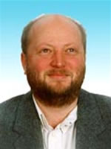

Credits
Eric Nzuobontane
Rodrigo Lopez
Hamish McWilliams
Thomas Laurent
David De Roure
Katy Wolstencroft
Carole Goble
Franck Tanoh
Jiten Bhagat
Steve Pettifer
Robert Stevens

