Slide 1
Service Oriented Architecture (SOA) with Governance
IBM Brussels
Sieds Eitens
SOA Governance Lead EMEA
sieds_eitens@nl.ibm.com

Slide 2

Service Oriented Architecture (SOA) with Governance
IBM Amsterdam
Sieds Eitens
SOA Governance Lead EMEA
sieds_eitens@nl.ibm.com

Slide 3
Agenda
  Why SOA Governance
  What is SOA governance?
  Services Governance
  The Organization of Governance - SOA Center of Excellence
  Services Oriented Enterprise (SOE) Governance
  How to get Started

Slide 4

Typical Enterprise is a complex, inconsistent, and proprietary environment
Business
Pressures:
Launch new and innovative products
Shorter change cycles
Customized products for niche markets
Partner
Employees
1000's of databases
100's of applications
Customers
Multiple Lines of Business
Suppliers
Millions of manual touches
Channels
3rd Party Providers
10,000's of users
Complex processes
and systems
Proprietary applications
and interfaces
IT budget priorities on maintenance, not new investments
IT Constraints:

Slide 5

How do you get from Business As Usual to an Agile Enterprise?
Customer Order
Customer Order
OE
OE
OE
Invoice
Order Entry / Order Management
Local
Business
Mobile
Decoupled Business Functions
Billing
Physical
Network
Physical
Network
Physical
Network
Provisioning
(Physical / Logical / Service)
Network
Assurance
Product A
Product B
Product C
Billing
System
Billing
System
Billing
System
Network resources are virtualized
Network
Consumer
Invoice
Business Invoice
Mobile Invoice

Slide 6
Development units will depend on other development units for services – how do you build trust?
Develop-ment Unit 1
Develop-ment Unit 2
Develop-ment Unit 3
Application A
SOA’s characteristics of loose-coupling, reuse and extensibility are the basis for creating the firm’s agile business environment for competitive advantage.
A1
A2
A3
For this example, Development Unit 1’s process is 2/3 dependent on the integrity, performance, reliability and currency of services managed by other development units.
Development Unit 1 Director tearing
his hair out!

Slide 7
Our experience indicates that a strong (but light) governance organization is required to enforce and encourage the use of services
‘SOA is an inherently distributed approach to architecture, and therefore requirements for governance are even more critical than in more centralized organizations or lines of business’ – Gartner Group
A shifting governance foundation makes the process of managing SOA impossible
A solid SOA governance foundation provides a controllable management architecture for SOA
The Consequences of Trying to Build A House On Sand
Build a House on a strong foundation

Slide 8
For SOA to succeed, it is a requirement that a convergence around organizational models occurs
A first core concept in the SOA Governance is a design authority defining end-to-end design method, which provides technical governance
  Standards for architecture, development and documentation, dev environment and tooling.
  Commonality across the projects make skills reusable, and communication easier
A second core concept in the SOA Governance is a layer of program management established across linked business projects to provide business governance and ensure:
  Common business services view
  Compatible SOA implementation
  Management of business priorities
  Management of interdependencies
Overall Program Management
Business Project
Business Project
Business Project
Common Business Services
SOA Competency Centre
Common Technical Services
Design
Build
Operate
End to end design methodology
Without both, projects tend to create duplicated and incompatible business services, technical services & interfaces

Slide 9
Without Effective Governance:

Slide 10
Agenda
  Why SOA Governance
  What is SOA governance?
  Services Governance
  The Organization of Governance - SOA Center of Excellence
  Services Oriented Enterprise (SOE) Governance
  How to get started

Slide 11

What is IT governance?
What is Governance?
It’s all part of Corporate Governance
1. Establishing and implementing decision making rights associated with IT.
2. Establishing mechanisms and policies
used to control and measure the way
IT decisions are made and carried out.
Corporate Governance
What is SOA governance?
SOA
Governance
SOA Governance is frequently a catalyst
for improving overall IT governance
Extension of IT governance focused on:
business services strategy
lifecycle of services to ensure the business value of SOA
IT Governance

Slide 12
SOA Governance, like SOA, usually goes through a phased implementation
1. A service lifecycle to get experience at governing services implementation.
ses
Goals
Goals
Refine
Metrics
Refine
Metrics
Goals
Refine
Metrics
2. An SOA Project Lifecycle and organization to be able to effectively govern IT projects that create and reuse services.
Report
Measure
Report
Measure
Report
Measure
Service Lifecycle
Lifecycle of the enterprise transition to a Service Oriented Enterprise
SOA Project Lifecycle
3. Governance mechanisms and controls for the plan and strategy to become a Service Oriented Enterprise (SOE).

Slide 13
SOA Capability Areas for SOA Governance Assessment
Planning &
Approach
Program
Controls
Service
Development
Lifecycle
Service
Operations
SOA Planning & Approach
SOA Diagnostic
Services Blueprint
Information Blueprint
Technology Blueprint
Business & IT Alignment
Financial Decision Making
Service Infrastructure
Ownership & Funding
Governance Vitality
Communications
Training & Recruiting
Program Management
Program Risk
Governance Oversight
Change Management
Resource Procurement
Vendor Management
Identify & Allocate Costs
SOA User Education
Monitor business benefits
Service controls
Service Identification
Service specification
Service certification
Non functional requirements
Service Security
Compliance with external requirements
Define and manage service levels
Operational monitoring of services
Quality of services
Service continuity
Service trouble management

Slide 14
Mechanics of the Governance Model
Business
Principles
IT
Principles
Compliance
Policies
Standards
Guide
Governed
Processes
Vitality
Managed by
Implemented by
Monitored by
Communication
Governance
Mechanisms
Standards &
Metrics
Procedures
Supported by
TRAINING
TOOLS
Exception/Appeals

Slide 15
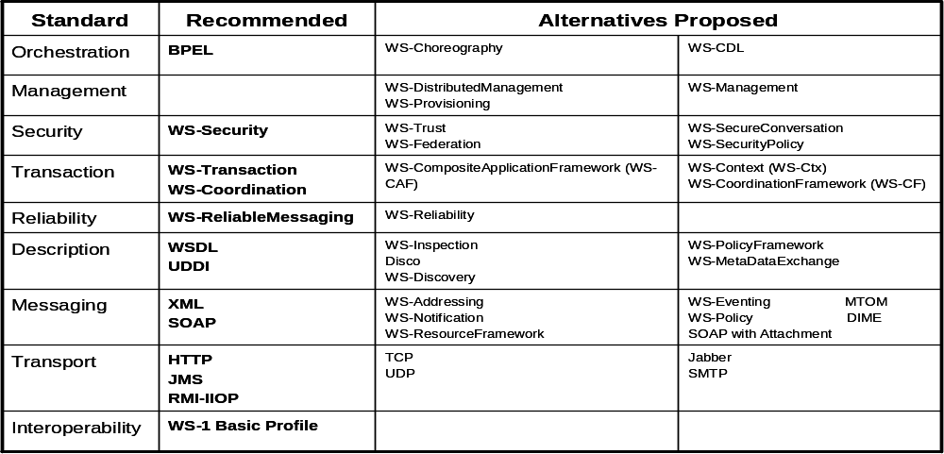
SOA Governance Standards Guidance
A standard is a rule or requirement that controls the service lifecycle. The governed service must adhere to the standard. Standards change very infrequently and a violation is not allowed or requires an explicit exception. For example Web Service Standards:

Slide 16
SOA Governance Policies Guidance
A policy is a plan of action to guide decisions and actions for the governed service.
Policies are best practices or an attempt to create a degree of common practice that improves the quality of a service.
Policies will change more often, and violations may be major and require an explicit exception or minor with a warning provided.
Policies need to address the overall impact to the business of the Services that are being created and deployed. Policies need to create a strong connection between the business and technology.
Companies need the ability to associate their business policies and technical policies with the actual implementation in a controlled fashion.

Slide 17
SOA Governance Policies Guidance
There are policies that all services must adhere to from an enterprise perspective. This then proceeds down through the enterprise, all of the way to the granular policies that a project team might implement, from the perspective of the division or business unit, department, or team.
Policies are technical and business requirements that aim to create a common utilized language of information and process.
Deployed in SOA, policies need to address the very distributed, asynchronous, and heterogeneous nature of the SOA environment.

Slide 18
SOA Governance Policies Examples
Policies might start at the business level:
  Projects must comply with Internal Architecture guidelines
  Security and regulatory compliance policy reviews are mandatory for all IT projects
Policies could represent more specific regulatory compliance issues:
  Patient personal identifiable information must be communicated and stored securely. (HIPPA)
  All financial transactions must provide traceability and tamper proof mechanisms for mandatory audit records. (Sarbanes Oxley)
Project outsourcing initiative might represent its policy as:
  Outsourced company must create same service lifecycle deliverables as are created in house.

Slide 19
SOA Governance Policies Examples
Higher level policies will often need to be translated to technical policies that can be effectively enforced by active policy enforcement tools.
Information security examples:
  Messages must contain an authorization token
  Password element lengths must be at least 6 characters long and contain both numbers and letters
  Every operation message must be uniquely identified and digitally signed
There are also design related technical policies that are needed to ensure interoperability and reuse:
  Do not use RPC encoded style web services
  Do not use Solicit-Response style of web service operations
  Do not use XML ‘anyAttribute’ wildcards

Slide 20
SOA Governance Policies Examples
Each organization, as part of the strategy and planning process for SOA, should think about and create its set of standards and policies for its SOA program and the SOA service development lifecycle. Specific policy service examples follow.
The Service Specification should contain:
  Descriptions of what function is performed by each service operation
  Input/output message formats, and sample data for each service operation
  A definition of the corresponding task in the Component Business Model (CBM)
The Service Specification should NOT contain:
  Any information on how the service will be implemented (provided the service contract is maintained, the provider may change the implementation of the service at any time, e.g. when retiring an obsolete IT system)
  Any reference to a sequence or order in which operations should be executed. Each operation call should be considered as a discrete task, and sequences of tasks should be defined as business processes/automated business processes) in separate documentation

Slide 21
Agenda
  Why SOA Governance
  What is SOA governance?
  Services Governance
  The Organization of Governance - SOA Center of Excellence
  Services Oriented Enterprise (SOE) Governance
  How to get started

Slide 22
Building services requires thinking ‘business’ and thinking ‘IT’ and SOA Governance supports that with control points
Business Assessment
Business Modeling
Governance Control Point
Service Identification
Governance Control Point
Service Specification
Governance Control Point
Governance Control Point
Service Development (and Test)
Governance Control Point
Governance Control Point
Service Management
Governance Control Point
Governance Control Point

Slide 23
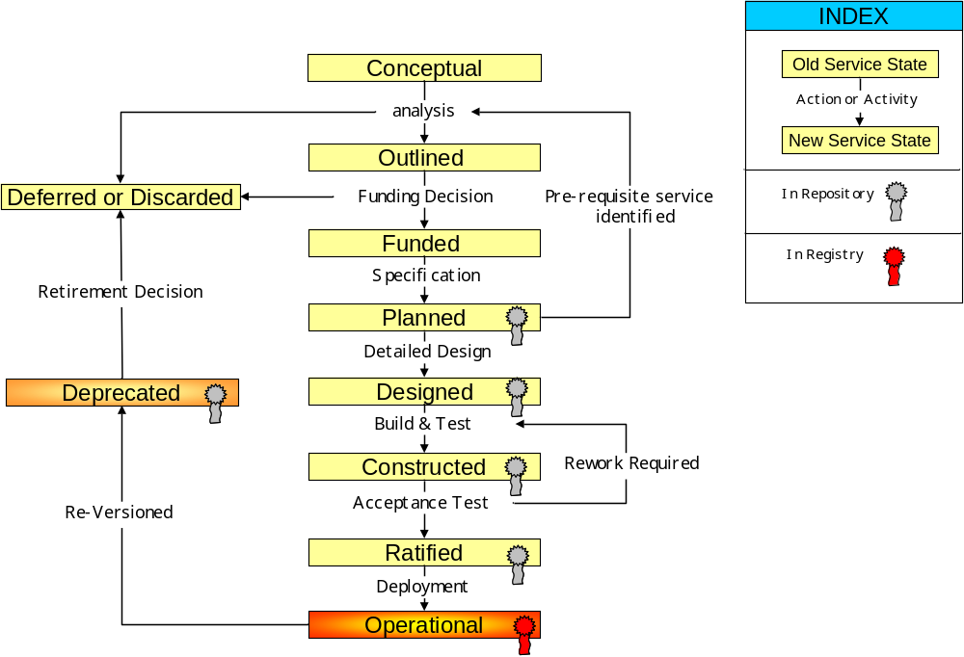
Service Development Lifecycle – State transitions

Slide 24
Service Development LifeCycle SDLC – State transitions
G0
G1
G2
G3
Gx
Governance Control Gate
G4
G5

Slide 25
SOA Governance – some typical questions
How do we regulate the creation of new services ?
  Control chaos associated with the proliferation of Web services
How do we establish good standards and best practices and see that they are enforced?
  Coding standards, IT infrastructure standards, etc.
How do we get more reuse? How do we make sure reuse happens smoothly?
  Discovery of services, service-level monitoring, service-level objectives
How do we control changes to services?
  Who is allowed to change services, impact analysis, communication to affected parties
How do I make my IT Architecture board and other decision making bodies have real impact on my ability to build better IT support for the business?
How can I use SOA Governance as a means to change the culture of my organization to have more discipline and rigor to deliver more reliable systems?
How does SOA Governance fit into my overall SOA strategy?
“In 2007, lack of working governance mechanisms in midsize-to-large (greater than 50 services) post-pilot SOA projects will be the most common reason for project failure (0.8 probability)” Gartner, 2007

Slide 26
Agenda
  Why SOA Governance
  What is SOA governance?
  Services Governance
  The Organization of Governance - SOA Center of Excellence
  Services Oriented Enterprise (SOE) Governance
  How to get started

Slide 27
Program Management
The business programs must be managed across the enterprise.
Only managing each project within a single ‘silo’ won’t work anymore.
Organization, controls, and procedures must be put in place to govern the set of programs.
SOA Governance addresses the portfolio management and program management.

Slide 28
What is a Center of Excellence (CoE)
The SOA Center of Excellence (CoE) is a cross-organization IT team that guides IT investment, design decisions and Implementation towards the strategic shared IT Solutions targeted by the SOA Vision and Strategy.
Governance
  Main Information Dissemination Vehicle for SOA in the Organization
  Management Body of the SOA Governance and Management Process
  Implementation Body of the SOA Governance and Management Process
Thought Leadership/Visioning
  Thought Leadership Center for SOA Governance and Management Process
Expert SOA Skills and Resources
Knowledge Management Harvesting of Assets
Communication

Slide 29
SOA Center of Excellence (COE) Mission
Provide Project Support
Provide direct project assistance to drive architecture and gain feedback on vitality & viability and harvest assets. Reduce project risk and accelerate delivery
Socialize Architecture
Communicate framework, best practices, assets, patterns, templates, recipes, methods and other blueprints
Provides Skills Transfer & Early Proof of Concepts
Identify skills gaps and create development roadmaps
Drive use of new technologies
Provide Architecture Vitality & Thought Leadership
Continuously assess, refine and architecture framework and supporting assets based on internal & external influences
Define High Value Business Services
Modeling business processes, information services. Best practices for identifying
and defining shared services
Center
of
Excellence
Manage SOA Lifecycle
Change management including policies for publishing, using and retiring services.
Infrastructure to help govern access and monitor service vitality. Perform independent reviews.
Provides Architectural Authority
Single point of accountability and provides expert resources to accelerate communications and delivery of critical SOA practices, reusable assets, and patterns.
Production Support
Enable infrastructure teams to
execute on build/deploy,
tuning, and metrics
reporting

Slide 30
SOA CoE Structure - Summary
Role Summaries
Key touch points to/from LOBs
Communicates business needs, priorities
Sets SOA vision, principles, policies
Prioritizes SOA efforts; allocates SOA funding
Resolves exception requests
Executive Steering Committee
Sets SOA standards, policies
Defines all SOA architecture elements (Tech., application, data, security…)
Provides thought leadership
Harvests assets
Supports SOA development and operations
(Permanent roles)
Core CoE Team
Sets business direction and priorities
Authorizes funding
Enforces SOA mandate
Resolves disputes (final)
Business Relationship Directors
SOA Board
Architecture Office
Project Teams
(Project Team Authority)
Pool of skilled resources
Executes day-to-day SOA functions
(Rotational) roles
CoE Sub-Teams
Develops applications using SOA assets, guidance of the CoE
Ensures project-level compliance
=SOA Architecture Review Board

Slide 31
SOA CoE Mechanisms – Used to Implement the Responsibilities of the CoE
SOA Board Manager
Invited SOA /EA Architects & Leads
Business experts (on Rotation)
Ensure SOA solution designs comply with the architecture
Maintain the SO Architecture
Project SOA Architects (on Rotation)
Chief Architect
Chief Architect
SOA Architecture Review Board
Lead SOA Architects
Business Relationship Directors
Office of the
Chief Architect or Architecture Office
Decides what Technologies Standards, Best Practices are best to meet Business needs
Decides when a change or addition in the SO Architecture is needed
Prioritise Initiatives
Maintaining the vitality and use of the SOA
Maintaining the authority of the SOA
Project Design
Authorities or Project Team Authority
Architecture Sponsors
SOA Project Teams – Implements SOA Projects
Enterprise Architects
Uses the SO Architecture to best satisfy the project’s needs
Solution Architects

Slide 32
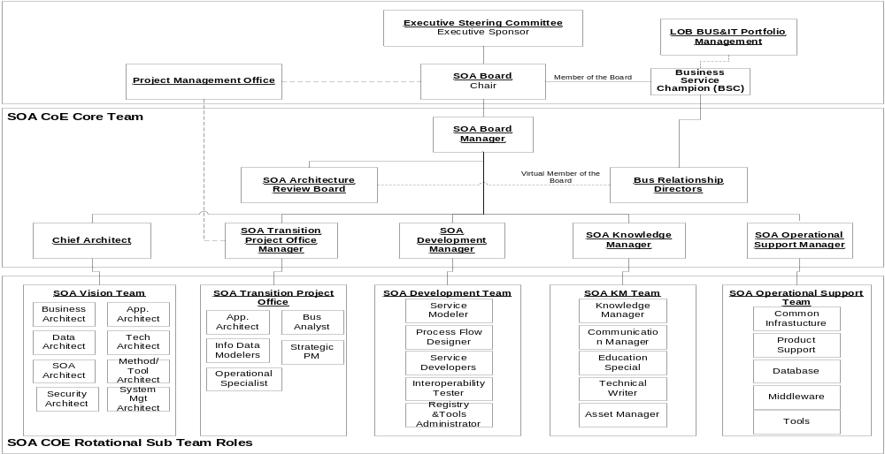
What’s the CoE’s Structure
Governance
Thought Leadership
Asset Harvesting
Expert Skills and Resources

Slide 33
SOA Org Roles
New Role
Existing Role
Enhanced Role
Control
SOA Executive Sponsor
Governance Leader (or PMO Lead)
Business Services Champion
Application Director
Integration Director
Data Director
SOA Executive Steering Committee
Manage
Service Architect
Program Management
Service Registrar
Center of Excellence (CoE)
BAs
Architects
Infrastructure & Integration
Software Development
Service Architects
Service Architects
Service Architects
Service Architects
Business Process Analyst
Solution Architect
Service Infra Developer
Service Designer
Service Architects
Service Architects
Service Architects
Business Service Analyst
Service Architects
Service Security Design
Service Developer
Security Architect
Service Architects
Service Architects
Service Architects
Business Process Architect
Business Monitoring Developer
Service Tester
Service Architects
Execute
Business Process Developer

Slide 34
Agenda
  Why SOA Governance
  What is SOA governance?
  Services Governance
  The Organization of Governance - SOA Center of Excellence
  Services Oriented Enterprise (SOE) Governance
  How to get started

Slide 35
SOA provides a value proposition for a distinct set of business challenges. SOA Governance requires we understand and drive the business goals
Increase revenue
create new routes to market, create new value from existing systems
Provide a flexible business model
react to market changes more quickly
Service Orientation
Value Propositions
Integrate across the enterprise
integrate historically separate systems, facilitate mergers and acquisitions of enterprises
Reduce cycle times and cost for external business partners
move from manual to automated transactions, facilitate flexible dealings with business partners
Drive down cost
eliminate duplicate systems, build once and leverage, improve time to market
Reduce risk and exposure
improve visibility into business operations

Slide 36
The Self-Funding IT Paradigm
The Self-Funding Ideal
① Invest in “Breakthrough” Strategic Projects
Multi-year
Strategic Initiatives
④ Use efficiency-driven cost-savings to subsidize next-generation projects
② Realize Business Productivity Gains
Business-Led Discretionary Projects
③ Streamline IT Operations
Core Infrastructure and Applications

Slide 37
IT Balanced Scorecard
SOA Governance puts policies and procedures in place to drive a business driven IT Portfolio – e.g. Balanced Scorecard
Corporate Strategic Goal
Functional Objectives
Metrics and Measures
Current Quarter Performance
Current Quarter Target
Next Quarter Target
Annual Target
Comments
Financial Performance
Goal 1
Objective 1
Measure 1
Objective 2
Measure 2
Internal Customer Satisfaction
Goal 2
Objective 3
Measure 3
Objective 4
Measure 4
Process Management (Internal and/or Business)
Goal 3
Objective 5
Measure 5
Objective 6
Measure 6
Talent Management
Goal 4
Objective 7
Measure 7
Objective 8
Measure 8
Notes:
See Companion Document, page 14

Slide 38

Business Services are the “Building Blocks” that Align Business Intent with IT Execution
Business Services definition:
A Business Service is a business function whose execution can be adapted at runtime based on business policy and user context.
  Designed at business level to represent a discrete business function (e.g. check credit, open account)
  Can provide flexible, adaptable behavior based on business policy and user context
  Derived from disparate IT resources
  Built using Web service and industry standards
  Provisioned through multiple communication channels
  Can be combined into loosely coupled Service Oriented Applications

Slide 39
Business Service Example: “Service Availability"
  Designed at business level to represent a discrete business function
    Service Availability is a coarse grained business function to determine if a Service (DSL, VoIP, Digital TV, …) is available for a consumer at a given location.
    Encapsulates multiple end points (per service type) and business policies
    Policies and metadata to enable flexible, adaptable behavior at run-time based on the context, content and contract of the service request
  Derived from disparate IT resources
    Comprised of 5 endpoints:
      DSL Availability (legacy - MQ)
      VoIP Availability (Database check – TIB Event)
      Digital TV Availability (BPEL process)
      2 Wireless Availability (custom APP –EJBs on BEA based on ZipCode for Midwest, and TIB Event based on Existing Wireless Number for West region)
  Built using industry standards
    WS-I: Web Services Interoperability compliance
    eTOM → Operations → Customer Relationship Management -> PreOrder Feasibility
    SID → Semantic data model to define the assertions and business policies
  Provisioned through multiple communication channels
    Web portal, JMS, legacy-based CRM systems, and IVR
  Provides flexible, adaptable behavior based on business policy and user context
    Business Policies created based on content (Product Type, zip codes, TN, …) and user context (mode of access, new customer, existing customer, agent,…)
15
5
30
45

Slide 40
Agenda
  Why SOA Governance
  What is SOA governance?
  Services Governance
  The Organization of Governance - SOA Center of Excellence
  Services Oriented Enterprise (SOE) Governance
  How to get Started

Slide 41
SOA Governance Management and Method's

Slide 42
SOA Governance Delivery Pattern
  Plan
  Mission for SOA Governance
  Current client organization chart
  Current client Roles & Responsibilities
  Existing client Governance structure
  Calculate as-is and to-be SOA Governance Maturity level
  Define KPI’s for SOA
  Review SOA Governance functions & prioritize
  Assess change readiness (if available)
  Scope Phasing of SOA Governance Define/Build/Measure
  Identify clients staff to work on Scope Phase

Slide 43
SOA Governance Delivery Pattern
Define
  System Development Lifecycle
  Services Development Lifecycle
  Service Management Lifecycle
  Service State Transition
  Control Gates Positioning (including Governance Vitality)
  Services Roles & Responsibilities (SOA best practices)
  Control Gate definition using client enhanced Roles (note: this means using client roles plus those added as a result of Services Roles & Responsibilities review)
  Control Gate Roles & Responsibilities Summary Check
  SOA Organization Best Practice review
  Define New Organization chart including COE (including interaction)
  SOA Governance Processes Best Practice review
  Prioritize and define client SOA Governance processes
  Governance Tool set study & application to Control Gates
  SOA Governance Strategic

Slide 44
SOA Governance Delivery Pattern
Enable
  Build transition plan
  Start execution
  Guidelines / coaching

Slide 45
SOA Governance Delivery Pattern
  Measure
  SOA KPI check (dashboards)
  SOA Governance metrics check (dashboards)
  Measure effectiveness of organizational changes
  Governance vitality
    Operational check
    Improvement plan

Slide 46
SOA Governance Delivery flow
BPW
Define
Plan
Workshop
Project(s)
Define Mission
High level Scope
Project(s)
Project(s)
Enable
5 days workshop
Project definition
Vision & Scope
Customer LoI*
Maturity level
current and to-Be
Startup
Creation artifacts
Based on the outcome of the workshop
Measure
Implementation & startup
Education
First iterations processes
Measure success
of Governance
implementation
and initiate
improvements
Optimize & Expand
* LOI Level of Involvement

Slide 47
SOA Governance within BPW
BPW
Goal
  Explain SOA Governance
  Explain SOA Governance approach
  Generate Customers buy-in into the SOA Governance workshop
  Define Mission
  Define High Level Scope
Deliverable
  Chapter into the BPW report advising how to get started with SOA Governance for this specific customer
Time investment
  3 to 5 days including report writing

Slide 48
Plan SOA Governance workshop
Workshop
Goal
  Define Vision & Scope for the SOA Governance implementation
  Maturity check current and to-be
  Define Key Performance Indicators KPI’s
  Roadmap to implement Governance
  Project Plan for the first phase
Deliverables
  Vision & Scope statement (document)
  Roadmap (document)
  Project Plan (document)
Time investment
  Workshop 3 ~5 days LoI Customer 3 ~ 5 days x number of participants
  Deliverables 10 days

Slide 49
Define Project Phase 1 Organization
Project(s)
Goal
  Define the charter of the Center of Excellence
  Setup the SOA Governance organization chart (CoE)
  Define Roles & Responsibilities
  Define interaction with other departments (PMO etc.)
  Interaction with other best practices (ITIL, Six Sigma etc.)
Deliverables
  Organization chart to be implemented
  Roles & Responsibilities description (document)
  Project plan next phase
Time investment
  T.b.d. Based on the outcome of the workshop and scope of the project
  Note: estimate 60% work done by the customer 40% IBM

Slide 50
Define Project Phase 2 Process & Procedures
Project(s)
Goal
  Define the Service Development Life Cycle including control gates
  Select Processes & Procedures to be implemented
  Document the Process & Procedures
Deliverables
  SDLC ready for implementation documented
  Processes & Procedures be used documented and ready for implementation
  Project plan next phase
Time investment
  SDLC estimate 12 days
  Process and procedures 15 days per Process
  Note: time estimates differ per organization
  LoI 50% customer 50% IBM

Slide 51
Project Phase 3 Transition
Project(s)
Goal
  Preparation for the Enable phase to get operational
  Introduce the SOA Governance model to the organization
  Define support toolset
Deliverables
  Educational package explaining the SOA Governance model and organization
  Roles and responsibilities assignment
  Transformation of the organization
Time investment
  T.b.d. Based on the size of the organization
  LoI 60~70% Customer organization 40~30% IBM

Slide 52
Enable
Startup
Goal
  Educated staff to get ready for the new R & R
  Initiated first rounds of process execution
  Monitor behavior of the new R & R
  Identify areas for improvement or shortcomings
Deliverables
  Organizational changes or implantation take effect
  New defined process becoming operational
  Initiated improvement process
Time investment
  T.b.d. Based on the size of the organization
  LoI 80% Customer organization 20% IBM

Slide 53
Measure
Measure
Goal
  Educated staff to get ready for the new R & R
  Initiated first rounds of process execution
  Monitor behavior of the new R & R
  Identify areas for improvement or shortcomings
Deliverables
  Organizational changes or implantation take effect
  New defined process becoming operational
  Initiated improvement process
Time investment
  T.b.d. Based on the size of the organization
  LoI 90% Customer organization 10% IBM

Slide 54
Optimize and Expand
Optimize & Expand
Goal
  Optimize the SOA Governance methodology
  Expand scope where appropriate
  Raise maturity level step by step
Deliverables
  Improvement program
  Expanded scoping and organization
  Initiated improvement process
Time investment
  T.b.d. Based on the size of the organization
  LoI 80% Customer organization 20% IBM

Slide 55
Agenda
  Why SOA Governance
  What is SOA governance?
  Services Governance
  The Organization of Governance - SOA Center of Excellence
  Services Oriented Enterprise (SOE) Governance
  How to get started
  How IBM can help you go faster!

Slide 56
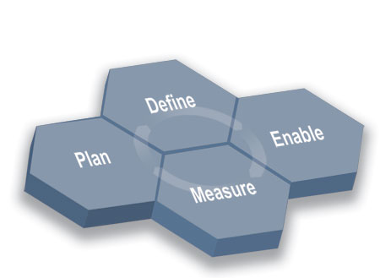
IBM SOA Governance and Management Method
Method
Establish the Governance Need
Define the Governance Approach
Customer tested IBM SOA Governance and Management Method
Detailed governance process guidance
Comprehensive framework and processes span lifecycle of SOA governance
Methodology to help clients establish SOA Centers of Excellence
Monitor and Manage the Governance Processes
Deploy the Governance Model Incrementally
Workproducts
Customer Value
SOA Business and IT Governance Principles
Customized processes
Center of Excellence Organization
Roles and responsibilities
Defined metrics
SOA Governance Transition Plan
Foundation to realize SOA business benefits
Leverages existing Governance structures
Methodology and tools based on best practices and thought leadership and support for open standards
Skills and experience gained from many SOA engagements
Catalyst to align business and IT strategy

Slide 57


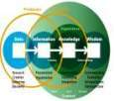




What is a registry … a repository?
Repository?
Stores information about the nature of service usage
Registry?
Contains information about services such as…
  Service interfaces
  Descriptions
  Parameters
An integrated Registry / Repository Solution
is needed to govern and manage SOA for maximum value
Business process vitality
New value through reuse of assets
Improved connectivity
Closer alignment of IT to business
Business Flexibility

Slide 58
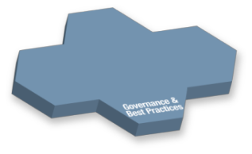

A federated set of capabilities enables support of end-to-end service lifecycle management
Service Development
Service Deployment
Service Discovery
Service Development Lifecycle
Development Time Service Use
Runtime Repository
Runtime Service Discovery
WebSphere Service Registry and Repository (WSRR)
Rational
Other Service Endpoint Registries / Repositories
Development Repositories
UDDI
Registries
Other
External
Reg / Rep
Rational
ClearCase
Rational ClearQuest
Info
based Services
Service Management
Tivoli Change and Configuration Management Database (CCMDB)
Operational Efficiency & Resilience
Configuration Data Discovery
Managing change
Notes:
Main Point: Going back to our original view of how registry/repository federation works, here are the IBM enabling tools that support each service Lifecycle phase.
RAM for Service Development with Rational Clearcase and Rational ClearQuest for Development repositories
WSRR will be the operations repository that will also interface to UDDI and other metadata registries.
CCMDB for collecting the operational/performance metadata related to services

Slide 59
Business needs federated service repositories to deliver solutions using governed services
Development
Deployment / Run-time
Rational
WebSphere Service Registry and Repository (WSRR)
Manages asset information for development and re-use
Deliver solutions with vetted/published services
Create and manage all types of assets
Provide asset traceability and details
Collaborate on asset development
Govern development time service changes
Manages service information for deployment and runtime operation
  Select service endpoints dynamically at runtime
  Govern runtime changes to service metadata
  Set runtime policies for service execution
  Receive deployed service details
.wsdl
Artifact
Federated Search
And Publish
Type
Service
.xsd
.doc, .uml
Asset
Policy
.ppt, .doc
Classification
.xml
Relationship Maps
Classifier
Classifier
Reusable Asset Specification (RAS)
Metadata
Lifecycle
Notes:
Main Point: Not every asset is a deployed service, so there will be assets in RAM that will not be in WSRR. RAM is about managing development of assets vs. WSRR which is tracking services in production.
Each provides a unique set of functionality. For example IBM Rational has systems development customers who are not implementing services but are reusing other software components and want to take advantage of the unique capabilities offered by Rational Asset Manager.
There are some customers who aren’t reusing components but are reusing services and want to take advantages of the unique runtime service mediation capabilities in WSRR.
Confusion sometimes arises around when to use these two products together when service is the type of asset that a customer wants to reuse. The reason is because there is a small set of similar functionality around search, categorization, access control, metadata and workflow
Although there is some overlapping functionality it applies to different use cases and content for each product.
Publish to WSRR from RAM will require security. Standard Websphere Security, LDAP.

Slide 60
Business needs federated service repositories to support production runtime services and operations
Deployment / Run-time
Operations / Management
Tivoli Change and Configuration Management Database (CCMDB)
WebSphere Service Registry and Repository (WSRR)
Manages service information for deployment and runtime operation
  Select service endpoints dynamically at runtime
  Govern runtime changes to service metadata
  Set runtime policies for service execution
  Receive deployed service details
Manages all types of information needed by Service Management process execution
  Capture both actual and authorized application and service data and topologies
  Establish relationships and references between all logical/physical entities
  Records configuration relationships using metadata
.wsdl
Application
Relationship Maps
Type
Service
.xsd
Configuration
Policy
Service discovery
& performance federation
Database
Web Service
Classification
Middleware
Interface
Relationship Maps
Classifier
Server
Access point
Metadata
Network
Storage
Port
Lifecycle
Notes:
Main Point: Once Services are in production and operational, there is metadata collected related to how the services are running including are they meeting their quality measures and can we perform chargeback to service users. WSRR can poll CCMDB for information.
That information is collected and stored in CCMDB and then made available to WSRR for the particular services.

Slide 61
SGMM also relates each phase to products.
Phase
Approach
Enabling SOA/ IT Governance Tools
Plan
Rational Method Composer
(plus SGMM plugin)
Rational Portfolio Manager
Define
Rational
Method
Composer
Rational
Portfolio
Manager
SOA Governance and
Management Method
Rational Requisite Pro
Enable
Rational
Asset Manager
WebSphere Service
Registry and Repository
Tivoli Change Management
and Configuration Database
Measure
Rational
Portfolio Manager
WebSphere Business Monitor
Tivoli Composite Application Manager for SOA
Tivoli Service
Level Advisor

Slide 62
SGIP Topology Map
Strategy
Enablement
Development
Program
Operations
S01 - Business Vision
E01 – Service Ownership & Funding Model
D01 – Services Development Process
D10 – Services sourcing decisions
P01 – Program Risk
O01 – Service Support
S02 – IT & Business Alignment
E02 – SOA specific Roles & Responsibilities
D02 – SOA Development Tooling Infrastructure
D11 – Govern the service development lifecycle process
P02– Program Business Case
O02– Service Execution, Monitoring & Reporting
S03 – Technology Model
E03 – SOA Communication
D03 – Business Process Models
D12 – Service Granularity, Visibility & Accessibility
P03 – Planning & Estimating
O03 – Service Operational Vitality
S04 – SOA Production Infrastructure
E04 - SOA Business Value & ROI
D04 – Requirements Gathering & Prioritization
D13 – Service Build & Test
P04 – Change Management
S05 – SOA standards and design patterns
E05 – Procurement & Supply Chain
D05 – Requirements of Service Providers and Consumers
D14 – Service Configuration Management
P05 – Govern SOA Programs
S06 – Business Data / Message Modeling
E06 – SOA Vendor Management
D06 – Regulatory Compliance
D15 – Service Acceptance
P06 – Manage Cross Program dependencies
S07 – Service Selection & Prioritization
E07 – Services Portfolio Management
D07 – Non-functional Requirements
D16 – Service Deployment Options
P07 – Cross Program Monitoring & Comparing
E08 – SOA & Governance Vitality
D08 – Deploy as Service vs. deploy as application decisions
D17 – Service Certification
E09 – Leading the governance process
D09 – Service Security
D18 – Service Versioning
E10 – Service Cost Accounting
E11 – SOA Education & Training

Slide 63
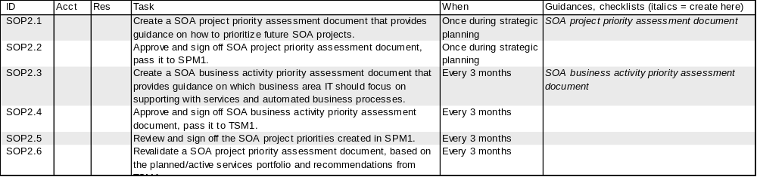
S02 : IT & Business Alignment
Description
The purpose of this component is to confirm the alignment of IS/IT and business operating unit goals at a strategic level. This component governs those strategic goals that may be influenced by the use of SOA.
Enterprises adopt SOA in order to attain business agility for the purpose of competitive advantage, so the motivation to adopt SOA is business-related not technology-based. Customer's investment in SOA is primarily focused on creating IS/IT-enabled business solution and change, rather than just implementing IS solutions.
Customer's SOA aim is to improve business agility through:
  creating automated business processes that can be rapidly changed to meet new opportunities and respond to competitive threats
  simplifying the technical issues arising during mergers and acquisitions.
  defining a common set of standard and service oriented solutions, and making it possible to search them.
  expanding business service reuse to GOM and AFL environment.
Note: Consideration for Customer's BASE MAP alignment should be addressed. SOA applications should be mapped into the BASE MAP and validated properly.
Major Related Components
Takes inputs from: | SPM1 : Project Alignment with Business & IS Goals
Passes outputs to: | SPM1 : Project Alignment with Business & IS Goals TSM1 : Project Business Case
Activities
Reference (COBIT)
PO1: Define Strategic IT Plan PO6:Communicate Mgmt Aims & Direction

Slide 64
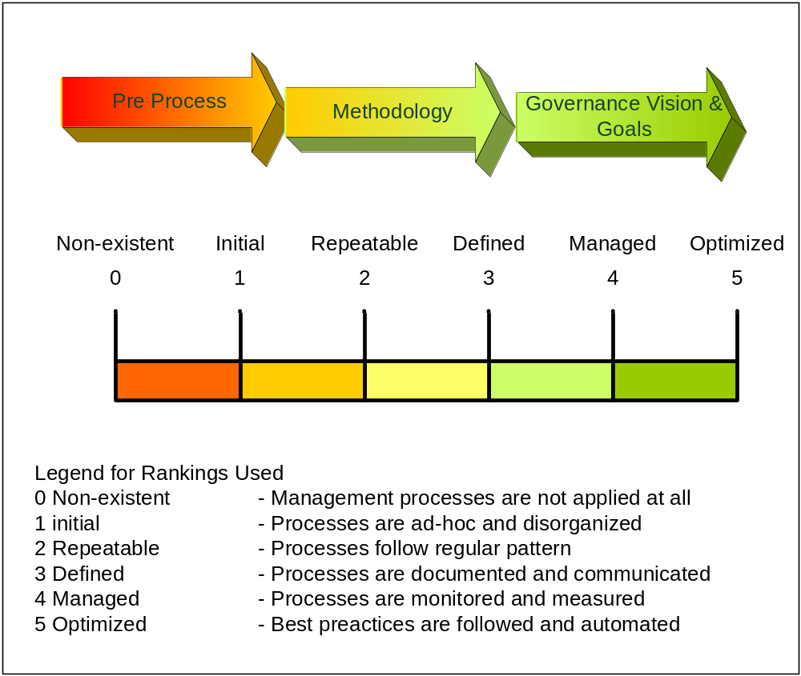
SOA Governance maturity
Control Objectives for Information and related Technology (COBIT)

Slide 65
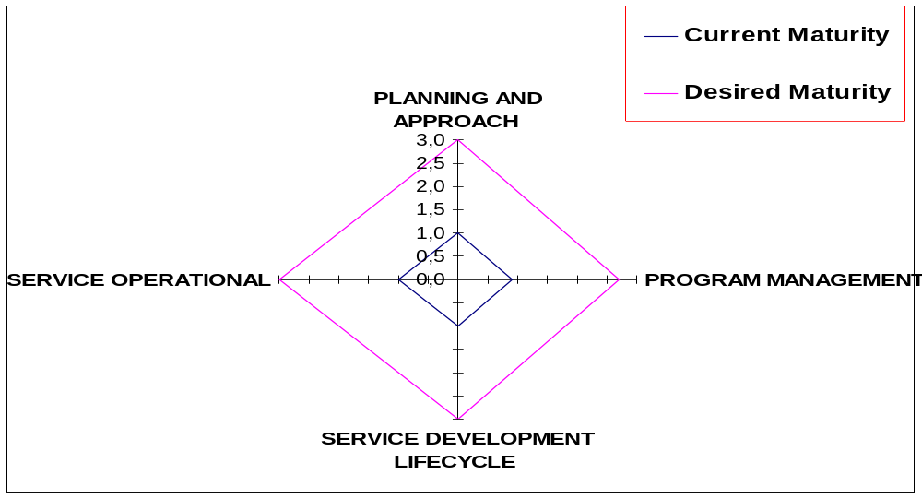
How to express maturity

Slide 66








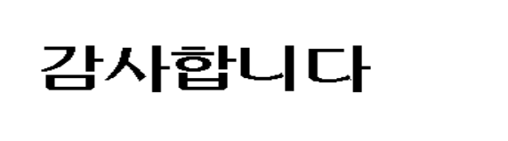
Hindi
Thai
Traditional Chinese
Obrigado
Brazilian Portuguese
Russian
Thank You
Gracias
English
Spanish
Danke
Arabic
German
Grazie
Merci
Italian
Simplified Chinese
French
Japanese
Korean

