Slide 1
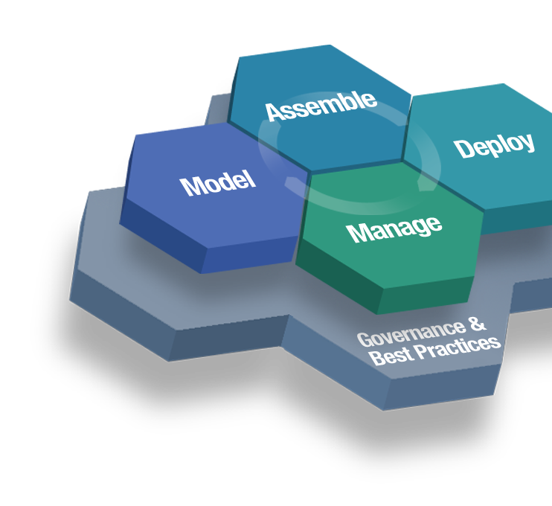
SOA Governance & COE
Lessons Learned
Sieds Eitens
Advanced Technology
SOA Governance Lead EMEA sieds_eitens@nl.ibm.com

Slide 2

Agenda
IBM SOA Governance
The purpose of this presentation is to communicate some key lessons learned from a survey of recent SOA engagements, with a focus on the application of SOA COEs and governance.
There are Many Paths to Failure
Lessons 1 thru 6
The step by step approach
Summary Lessons learned
Maturity statement
SOA Governance delivery approach (roadmap)
Licensed Materials - Property of IBM (C) Copyright IBM Corp. 2005 - 2009 All Rights Reserved.
This is an internal IBM asset and contains proprietary information. It is not to be distributed - in whole or in part - external to IBM.
Note:

Slide 3
There are Many Paths to Failure…
Transforming business to use SOA Governance and customizing governance to fit the organization can be quite complex. With that complexity comes challenges, and often failure to realize the benefits of SOA. Common outcomes include:
  LOB projects resist and avoid incorporating SOA into their efforts
  SOA efforts that were quick out of the chute also quickly dwindle to “shelfware”
  Scarce funding for SOA mechanisms and projects drags SOA Governance to a halt

Slide 4
There are Many Paths to Failure… Cont.
Transforming business to use an SOA and customizing governance to fit the organization can be quite complex. With that complexity comes challenges, and often failure to realize the benefits of SOA. Common outcomes include:
  Reuse and business relevance fail without enterprise-wide understanding
  Governance mechanisms are “toothless”; projects evade the processes
  Overwhelmed client personnel tapped to participate in governance end up rubber-stamping projects, standards, etc.
  SOA goals, metrics go astray of business priorities because management is not accessible/participating

Slide 5
Lesson #1 – “C-level” Backing Across the Board
SOA Governance absolutely requires buy-in and active support from the CxO level. It’s not enough to have the CIO on-board; the other CxO’s need to bring home the priority of SOA efforts to LOBs (where the funding often is).
Lack of real “C-level” understanding, commitment, and active support for SOA leaves governance efforts impotent, as incentives and enforcement for SOA on LOB projects are lacking.
With large-scale projects, SOA is often a sidecar to a bigger program effort; it will dwindle and eventually fail if the program is focused on “core” BAU functions that are challenging enough. CxOs can ensure that SOA stays center stage (or at least on it!).
Leadership absolutely must participate in the early stages of governance to clearly define the strategy, vision, principles, and processes for business to IT processes like funding.
This doesn’t mean that the CEO needs to be thinking about SOA every day; but they do have to lay down the law for compliance and back it up, even at the cost of short-term project delays.
Notes:
Large-scale projects – Need to do a better assessment of maturity and SOA readiness and/or put measures in place to enforce SOA focus.
SOA governance, as part of IT governance, and Corporate Governance as it relates to funding, prioritization, etc need to work hand in hand; they need to be aligned into a holistic governance process.

Slide 6
Lesson #2 – Establish SOA Funding Model for the Long Term… Cont.
There must be commitment to funding the dedicated resources necessary for SOA stewardship (COE & Gov.). While “doing” SOA doesn’t necessarily mean wholesale organizational change, there will need to be resources dedicated to SOA.
Roles and responsibilities (short & long term) for the COE in particular must be carefully planned and funded. Understaffing SOA Governance or the COE as a token nod to their importance is an SOA killer.
Some Governance roles will need to be permanent, and possibly full-time – plan and fund accordingly.
Notes:
While wholesale org change may not be required if existing governance is mature and well supported, a substantial level of org change is often required on both the LOB and IT sides for SOA.
The relationship of the COE to project teams must be clearly established and agreed to by those teams; then funding can be established accordingly. Assuming that project teams will just take advantage of the COE as needed won’t work – clearly define what the level of interaction/participation will be and who will fund it.
Initially, adding SOA to the mix in projects takes longer and adds a learning curve. LOB’s often control funding and aren’t compensated or evaluated for “SOA-ifying” their projects, so SOA becomes at best an afterthought; at worst a road block. Plan for some additional resources for projects new to SOA and enable them with resources from the COE and centralized funding support.

Slide 7
Lesson #2 – Establish SOA Funding Model for the Long Term
Centralized, deep-skill SOA resources with an enterprise view for SOA are often planned for at the start. In most cases, however, some subset will need to continue to play an active role – perhaps as a shared pool that projects can leverage.
Funding for projects must be linked to the governance processes so that there is no way around them. If there’s any way to shortcut the process, projects will take it.
Funding for SOA should seem to LOB projects like an advantage – not a penalty. A creative model that rewards the LOB for serving the enterprise at large is essential.
Notes:
While wholesale org change may not be required if existing governance is mature and well supported, a substantial level of org change is often required on both the LOB and IT sides for SOA.
The relationship of the COE to project teams must be clearly established and agreed to by those teams; then funding can be established accordingly. Assuming that project teams will just take advantage of the COE as needed won’t work – clearly define what the level of interaction/participation will be and who will fund it.
Initially, adding SOA to the mix in projects takes longer and adds a learning curve. LOB’s often control funding and aren’t compensated or evaluated for “SOA-ifying” their projects, so SOA becomes at best an afterthought; at worst a road block. Plan for some additional resources for projects new to SOA and enable them with resources from the COE and centralized funding support.

Slide 8
Lesson #3 – No SOA Without a Well-Defined EA
True SOA isn’t a departmental effort; it spans the enterprise*. Without access to an enterprise-level view of data, processes, interfaces, systems, service consumers, etc., it’s impossible to plan for enterprise-level reuse.
Project members usually don’t have visibility to entities and processes of other LOB’s nor the time to hunt them down to design every service for reusability. So, SOA becomes SOI – Services are used as EAI glue only; little to no reuse or business relevance. EA artifacts provide the necessary cross LOB visibility required by all parties.
SOA Governance needs a baseline to manage to; without EA, there is no foundation to govern against.
Notes:
*Of course, the definition of the enterprise in some conglomerates is up for debate…

Slide 9
Lesson #4 – Commitment to Roles, Responsibilities, and Resources
All too often, SOA roles and responsibilities are just piled on top of client personnel’s “day job”, so commitment to SOA falters. Clients often assign only 1-2 resources to participate in the governance design part-time, so the effort takes much longer and ends up a poor, ineffective fit for the organization.
There’s no getting around it: for SOA Governance implementations, some dedicated SOA resources will be necessary. We need to understand the existing roles & responsibilities of the folks tapped to participate to know how much time they will be able to commit to SOA.
Leadership must understand the level of effort required and enable enough key resources to make governance effective.
Notes:
Again, under-staffing key SME roles for SOA Governance and the COE will drag down efforts, making short-term wins nearly impossible – know clearly what is to be achieved and commit to staffing the necessary resources.

Slide 10
Lesson #5 – Get the Message Out
Too often, SOA fails because the right people don’t understand the “So what” for SOA relevant to them and the enterprise at large. An SOA evangelist, someone in leadership with influence, deep business knowledge, and a keen understanding of the value in SOA can make a big difference in getting and keeping buy-in.
Communication of SOA concepts, efforts, governance how-to’s, and COE offerings is often the difference between SOA success and failure. Involve some folks (S&C) skilled in formal communication and education campaigns.
Metrics are the key to knowing the effectiveness of any effort. Collect data periodically to make sure SOA is gaining traction in projects, that it’s widely understood conceptually, that folks know where to turn, etc.
The COE’s role(s) must be understood, documented, and propagated so that it can play an effective role across LOBs. With deeply skilled resources, the COE can be a massive influence on the success of SOA in projects – but people have to know it’s there and what it does.

Slide 11
Lesson #6 – Be Ready for SOA
SOA requires a certain level of IT maturity. Likewise, SOA Governance requires a certain level of business and IT governance maturity. Take the time to make an impartial evaluation of readiness and start at the right level.
Environment overhaul and wholesale outsourcing introduce substantial chaos in the transition period. Establish some stability first, or address SOA foundation efforts and areas that are relatively stable for SOA. Otherwise, to ensure the success of SOA in the storm, significant project oversight and a deep commitment to SOA aspects is required.
If we’re boiling the ocean, and SOA is to stay afloat, it’s crucial that we don’t just replicate “business as usual”. Silo-oriented LOBs need to be evaluated and possibly restructured to enable enterprise-wide efforts and cooperation. Involve some Change experts from the beginning to facilitate this.
Notes:
Transformation efforts make it extremely difficult to get access to client resources that not only have the requisite business/IT knowledge, but have the time and focus to participate in SOA efforts.

Slide 12
General Lessons
Real-world experience shows that effective governance combined with a compelling vision and proactive plan provides big payoffs (In the $Billions).
Governance isn’t just about compliance – it’s about promoting the right projects and making them better. With the right focus, support and funding, it can be an enabler by facilitating reuse, prioritizing spending, reducing costs, setting the technology direction, and subsidizing enterprise-value efforts like SOA.
There must be a concerted effort to streamline and empower governance processes wherever possible – give them teeth and make them efficient.
CoEs provide an opportunity to significantly accelerate an enterprise’s path up the SOA learning curve and actually bring the focus to business impact and innovation.
CoE participation also can provide employees with an enabling environment for expanding skills and advancing careers.

Slide 13

Summary
Transforming business to use an SOA and customizing governance to fit the organization can be quite complex. With that complexity comes challenges, and often failure to realize the benefits of SOA.
Key lessons learned from the field include:
  Insist on “CxO”-level backing Executive sponsorship is crucial
  Establish a clear, adequate, incentive-oriented funding model
  Successful SOA requires a well-defined EA
  Commit the necessary resources for SOA CoE and governance
  Communication and education about SOA is key
  Make sure the client environment and organization is truly ready for SOA and start at the right level for them.
  Avoid the big bang approach
  During the first SOA project at lot can be captured for the Governance model.
  Organizations do not change over night so it takes time
  An external party can help but the organization has to it herself

Slide 14
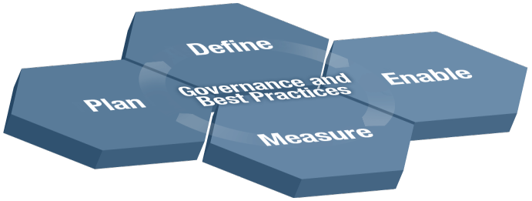
SOA Service Development Life Cycle SDLC

Slide 15
SOA Governance Delivery Pattern
  Plan
  Mission for SOA Governance
  Current client organization chart
  Current client Roles & Responsibilities
  Existing client Governance structure
  Calculate as-is and to-be SOA Governance Maturity level
  Define KPI’s for SOA
  Review SOA Governance functions & prioritize
  Assess change readiness (if available)
  Scope Phasing of SOA Governance Define/Build/Measure
  Identify clients staff to work on Scope Phase

Slide 16
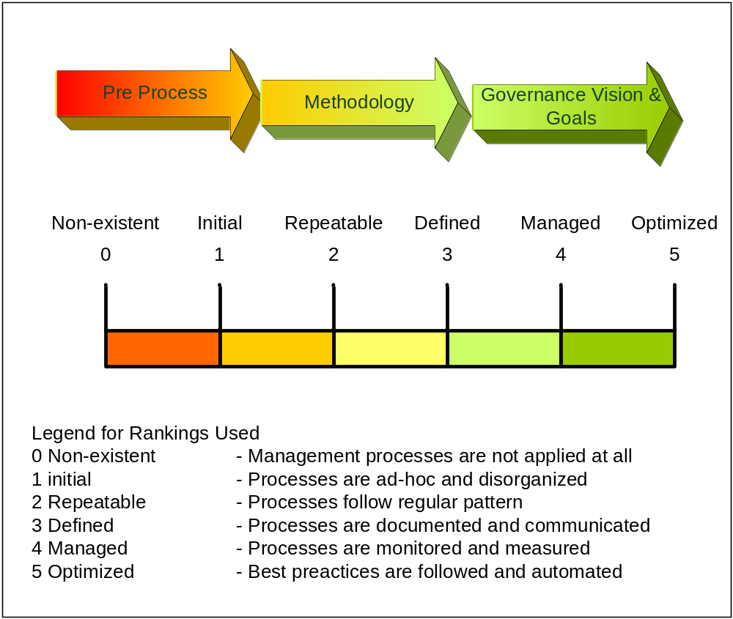
SOA Governance maturity
Control Objectives for Information and related Technology (COBIT)

Slide 17
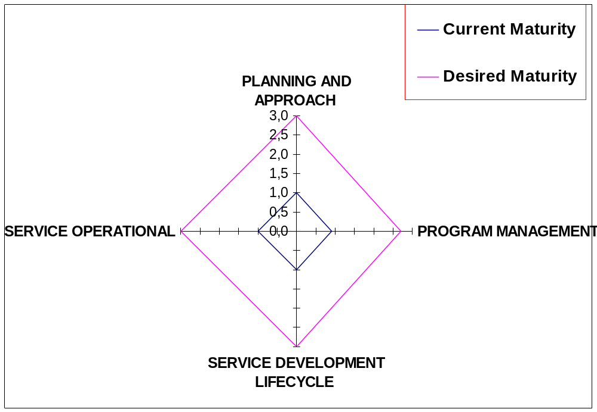
How to express maturity

Slide 18
SOA Governance Delivery Pattern
Define
  System Development Lifecycle
  Services Development Lifecycle
  Service Management Lifecycle
  Service State Transition
  Control Gates Positioning (including Governance Vitality)
  Services Roles & Responsibilities (SOA best practices)
  Control Gate definition using client enhanced Roles (note: this means using client roles plus those added as a result of Services Roles & Responsibilities review)
  Control Gate Roles & Responsibilities Summary Check
  SOA Organization Best Practice review
  Define New Organization chart including COE (including interaction)
  SOA Governance Processes Best Practice review
  Prioritize and define client SOA Governance processes
  Governance Tool set study & application to Control Gates
  SOA Governance Strategic

Slide 19
SOA Governance Delivery Pattern
Enable
  Build transition plan
  Start execution
  Guidelines / coaching

Slide 20
SOA Governance Delivery Pattern
  Measure
  SOA KPI check (dashboards)
  SOA Governance metrics check (dashboards)
  Measure effectiveness of organizational changes
  Governance vitality
    Operational check
    Improvement plan

Slide 21
SOA Governance Delivery flow Roadmap
Define
Plan
Workshop
Project(s)
Project(s)
Project(s)
Enable
5 days workshop
Project definition
Vision & Scope
Customer LoI*
Maturity level
current and to-Be
Startup
Creation artifacts
Based on the outcome of the workshop
Measure
Implementation & startup
Education
First iterations processes
Measure success
of Governance
implementation
and initiate
improvements
Optimize & Expand
* LOI Level of Involvement

Slide 22
SOA Governance Delivery flow
BPW
Define
Plan
Workshop
Project(s)
Define Mission
High level Scope
Project(s)
Project(s)
Enable
5 days workshop
Project definition
Vision & Scope
Customer LoI*
Maturity level
current and to-Be
Startup
Creation artifacts
Based on the outcome of the workshop
Measure
Implementation & startup
Education
First iterations processes
Measure success
of Governance
implementation
and initiate
improvements
Optimize & Expand
* LOI Level of Involvement

Slide 23
SOA Governance within BPW
BPW
Goal
  Explain SOA Governance
  Explain SOA Governance approach
  Generate Customers buy-in into the SOA Governance workshop
  Define Mission
  Define High Level Scope
Deliverable
  Chapter into the BPW report advising how to get started with SOA Governance for this specific customer
Time investment
  3 to 5 days excluding report writing

Slide 24
Plan SOA Governance workshop
Workshop
Goal
  Define Vision & Scope for the SOA Governance implementation
  Maturity check current and to-be
  Define Key Performance Indicators KPI’s
  Roadmap to implement Governance
  Project Plan for the first phase
Deliverables
  Vision & Scope statement (document)
  Roadmap (document)
  Project Plan (document)
Time effort
  Workshop 3 ~5 days LoI Customer 3 ~ 5 days x number of participants
  Deliverables 10 days

Slide 25
Define Project Phase 1 Organization
Project(s)
Goal
  Define the charter of the Center of Excellence
  Setup the SOA Governance organization chart (CoE)
  Define Roles & Responsibilities
  Define interaction with other departments (PMO etc.)
  Interaction with other best practices (ITIL, Six Sigma etc.)
Deliverables
  Organization chart to be implemented
  Roles & Responsibilities description (document)
  Project plan next phase
Time effort
  T.b.d. Based on the outcome of the workshop and scope of the project
  Note: estimate 60% work done by the customer 40% IBM

Slide 26
Define Project Phase 2 Process & Procedures
Project(s)
Goal
  Define the Service Development Life Cycle including control gates
  Select Processes & Procedures to be implemented
  Document the Process & Procedures
Deliverables
  SDLC ready for implementation documented
  Processes & Procedures be used documented and ready for implementation
  Project plan next phase
Time effort
  SDLC estimate 12 days
  Process and procedures 15 days per Process
  Note: time estimates differ per organization
  LoI 80% customer 20% IBM

Slide 27
Project Phase 3 Transition
Project(s)
Goal
  Preparation for the Enable phase to get operational
  Introduce the SOA Governance model to the organization
  Define support toolset
Deliverables
  Educational package explaining the SOA Governance model and organization
  Roles and responsibilities assignment
  Transformation of the organization
Time effort
  T.b.d. Based on the size of the organization
  LoI 80~90% Customer organization 10~20% IBM

Slide 28
Enable
Startup
Goal
  Educated staff to get ready for their new R & R
  Initiated first rounds of process execution
  Monitor behavior of the new R & R
  Identify areas for improvement or shortcomings
Deliverables
  Organizational changes or implantation take effect
  New defined process becoming operational
  Initiated improvement process
Time effort
  T.b.d. Based on the size of the organization
  LoI 90% Customer organization 10% IBM

Slide 29
Measure
Measure
Goal
  Educated staff to get ready for the new R & R
  Initiated first rounds of process execution
  Monitor behavior of the new R & R
  Identify areas for improvement or shortcomings
Deliverables
  Organizational changes or implantation take effect
  New defined process becoming operational
  Initiated improvement process
Time effort
  T.b.d. Based on the size of the organization
  LoI 90% Customer organization 10% IBM

Slide 30
Optimize and Expand
Optimize & Expand
Goal
  Optimize the SOA Governance methodology
  Expand scope where appropriate
  Raise maturity level step by step
Deliverables
  Improvement program
  Expanded scoping and organization
  Initiated improvement process
Time effort
  T.b.d. Based on the size of the organization
  LoI 60% Customer organization 40% IBM

Slide 31
Finally
The Momentum is there don´t lose it

Slide 32
Done this with:
A major bank in Spain
Several banks in South Africa
An electric components manufacturer in the UK
Have the first steps planned with South African Police and DoD
One of the top five banks in Norway
My team did this with the biggest bank in Australia
A Governmental department at the United Emirates
Car Registration Office in the Netherlands

Slide 33
SOA Center of Excellence (COE) Mission
Provide Project Support
Provide direct project assistance to drive architecture and gain feedback on vitality & viability and harvest assets. Reduce project risk and accelerate delivery
Socialize Architecture
Communicate framework, best practices, assets, patterns, templates, recipes, methods and other blueprints
Provides Skills Transfer & Early Proof of Concepts
Identify skills gaps and create development roadmaps
Drive use of new technologies
Provide Architecture Vitality & Thought Leadership
Continuously assess, refine and architecture framework and supporting assets based on internal & external influences
Define High Value Business Services
Modeling business processes, information services. Best practices for identifying
and defining shared services
Center
of
Excellence
Manage SOA Lifecycle
Change management including policies for publishing, using and retiring services.
Infrastructure to help govern access and monitor service vitality. Perform independent reviews.
Provides Architectural Authority
Single point of accountability and provides expert resources to accelerate communications and delivery of critical SOA practices, reusable assets, and patterns.
Production Support
Enable infrastructure teams to
execute on build/deploy,
tuning, and metrics
reporting

Slide 34
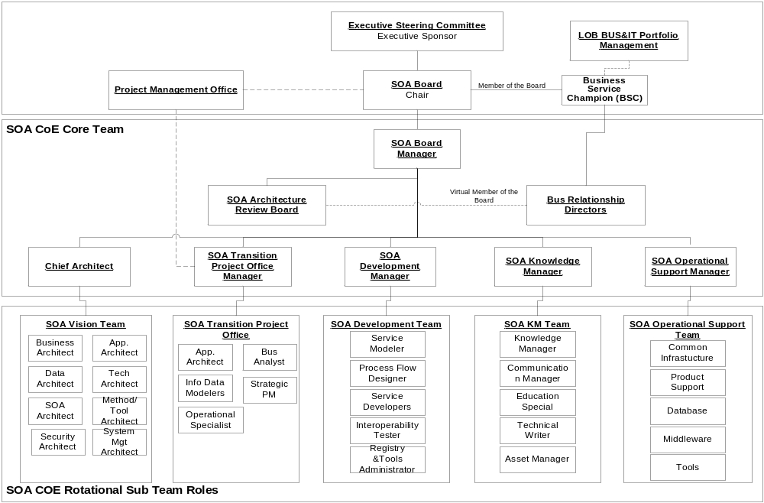
What’s the CoE’s Structure
Governance
Thought Leadership
Asset Harvesting
Expert Skills and Resources

Slide 35
SOA governance for the services lifecycle will address end-to-end service life cycle activities
Service Planning
Service Ownership
& Funding
Service Modeling
Service Implementation
Service Management
Identify Services
SOA Infrastructure Changes: Registry, Security, Services Management
Processes and Templates for Service Management
Manage Service QoS
Identify Service Owners
Design Services
Define Service Focus
Specify Services
Assemble Services
Manage Service Levels
IT Mechanisms for Service Orientation
Changes to Enterprise Architecture Processes
Organization Change for Service Orientation
Manage Service Change
Define Service Funding
Test Services
Service Ownership Domains
Service Ownership Process
Service Funding Process
Service Sharing Process
Service Modeling to identify, specify and make service realization decisions
SOA and Web Services Standards and Guidelines
Make Service Realization Decisions
Deploy Services
Manage Service Security

Slide 36
Created and staffed Center of Excellence
Executive Steering Committee
SOA CoE Board
SOA CoE Executive Sponsor
Business Service Champion
SOA CoE
Advisory Board
LOB Stakeholders (Business & IT)
Business Service Analyst
Service Architect
Service Designer/ Developer
SOA CoE Board Director
Information Data Modeler
Project Manager
Service Registrar
PMO
Service Tester
Service Assembler
SOA CoE Core Team
Governance body
SOA role
Key
Existing governance body or role
New governance body or role
Direct reporting relationship
Participation in governance body
Source: IBM experience.

