Slide 1
Detecting and distinguishing clusters of sand-ripples
Jonathan Winnaar
MSc topic: Detecting sand-ripples within Side-Scan Sonar images
12 April 2017

Slide 2
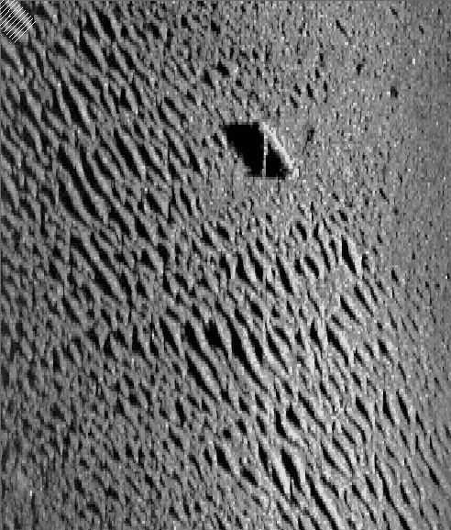
Concept:
Current focus area
Currently I calculate orientation per component.
And calculate pixel intensity profiles of lines over the component in this orientation.
Proposal: Maybe, by getting an average orientation for whole image:
I can use information of average orientation (and profiles thereof) to detect clusters of sand-ripples.

Slide 3
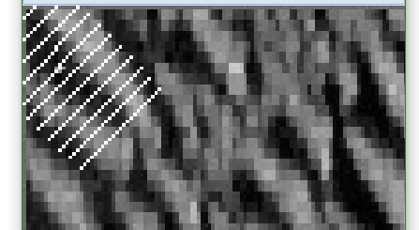
Current focus area
Zoomed in
Orientation for specific cluster:
PS:
My current code does not plot profile of center line – a bug that I still have to fix

Slide 4
PROPOSAL (1)
Given average orientation
Maybe by drawing lines (with same orientation) across whole image
One can use profiles to detect groups of sand-ripple clusters
What do you think?

Slide 5
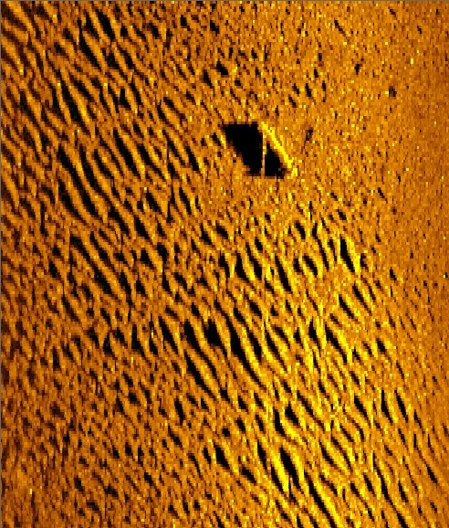

Slide 6
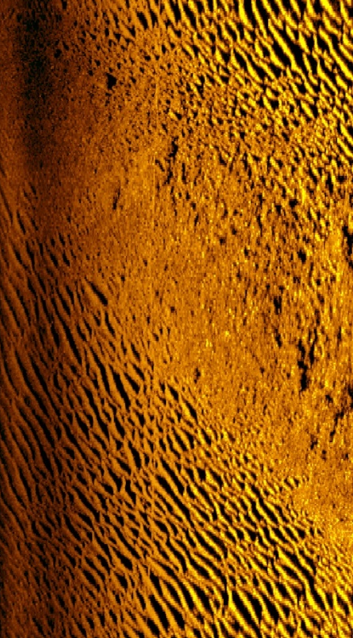
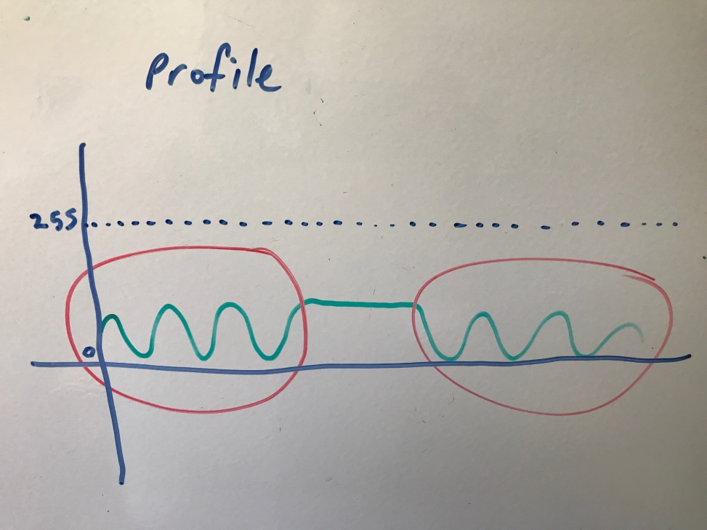
ESTIMATE PROFILE GRAPH OF ONE LINE THROUGH WHOLE IMAGE
One profile line through whole image
Image with two ripple groups

Slide 7
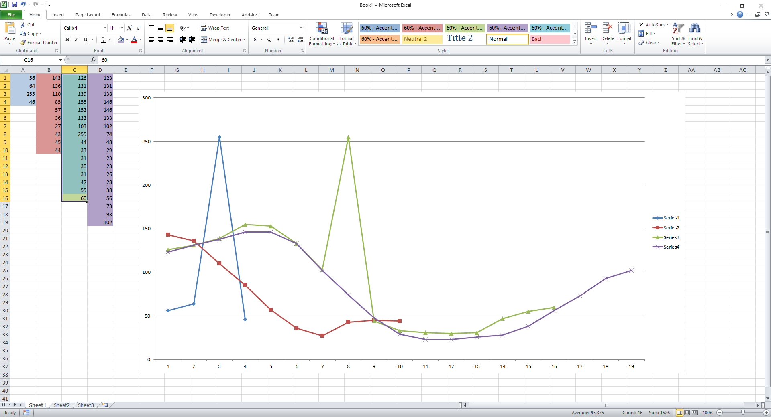
PROFILE GRAPHS (1)

Slide 8
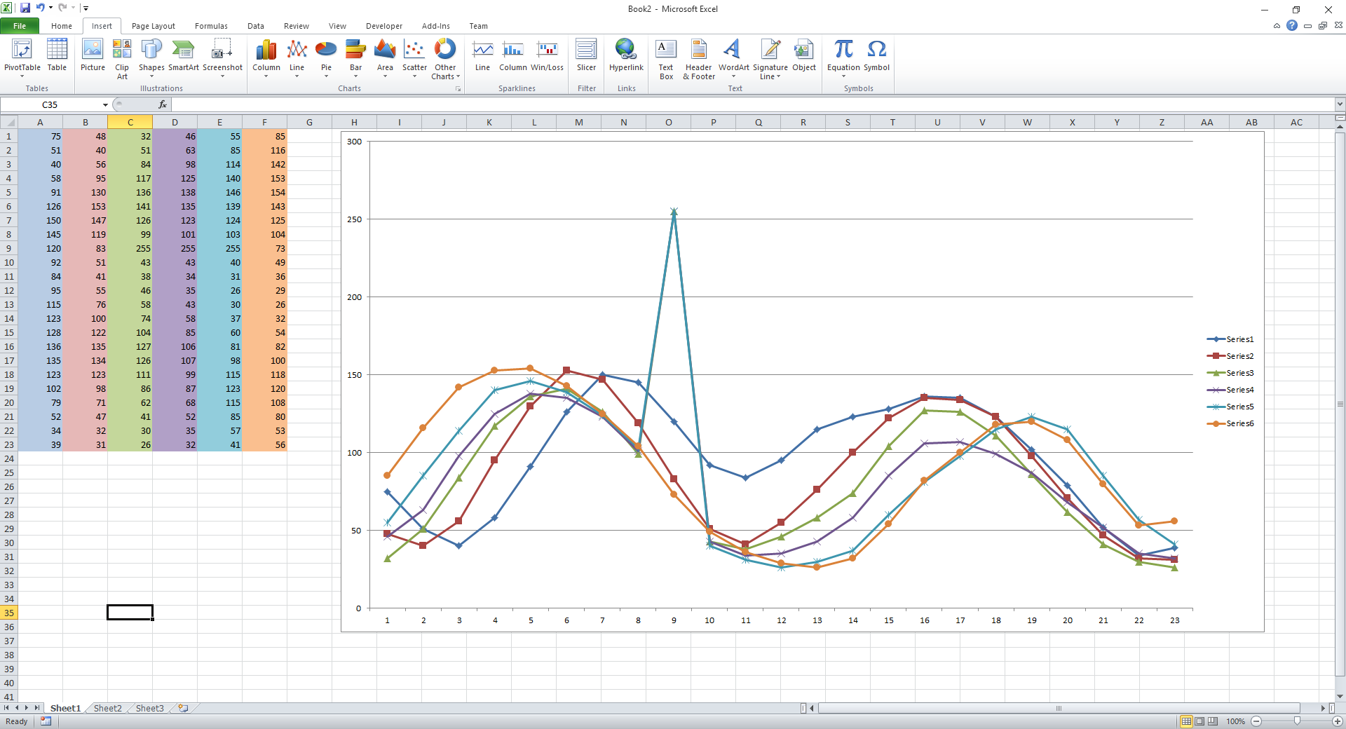
PROFILE GRAPHS (2)

Slide 9
PROFILE GRAPHS (3)
I was thinking of maybe we can use:
Maximum y-values,
Average profile
As possible measure to use, as a means to describe a “typical” profile graph.
Also, we will need to know what a “typical” profile graph of a non-sand-ripple look’s like (for comparison purposes)
Use these two descriptions, maybe come-up with a means to describe and detect a sand-ripple
What do you think?

Slide 10
