Slide 1
Patrick feedback session
Jonathan Winnaar
16 June 2017

Slide 2
CURRENT

Slide 3
MAIN GOAL
Distinguish ripples from anything else
Identify ripples – then anything left are possible MLO
Image pre-processing image
To better detect ripples
Remove nadir
Currently via connectedComponents
2nd and 3rd largest component
Patrick recommendation: Walk from centre line outwards – analyse pixel values
Identify Ripples:
Profile lines - analyse
Identify clusters of ripples
kNN analysis
To estimate a starting k = Histogram of ripple’s angles

Slide 4
IMAGE PRE-PROCESSING IMAGE
Possibilities:
Blur
bilateralFilter
Histogram Equalization

Slide 5
REMOVE NADIR
Currently via connectedComponents
Assumption:
2nd and 3rd largest component are nadir
These are removed then two halves stitched
Aware of stitching issue – as highlighted by Patrick
Maybe don’t stitch – treat s halves separate?
Patrick recommendation: Walk from centre line outwards – analyse pixel values
Will probably implement this at a later stage
Want to focus on histogram analysis of peaks in order to estimate k for kNN analysis

Slide 6
IDENTIFY RIPPLES
Have implemented profiling:
Detect components via connectedComponents
Implemented drawing of profile lines across each component
Have graph profiles (currently in excel not programmatically) to analyse components
(still to do) profile line outside image – exclude these components – as described here

Slide 7
IDENTIFY CLUSTERS OF RIPPLES(1)
Use k-Means to identify ripple clusters
K-Means Clustering for 1-D data set (1)
K-Means Clustering for 2D data set (2)
Using kNN to identify ripple clusters
Understanding kNN in OpenCV (4)
Flann (5), (6)
We originally spoke about using kNN to detect clusters
I was just looking at the differences between kNN and kMeans
kNN – classification algorithm – supervised learning
kMeans – Cluster algorithm – unsupervised learning

Slide 8
IDENTIFY CLUSTERS OF RIPPLES(2)
I am currently busy implementing a means to estimate a good k to be used with a kNN implementation
Based on this

Slide 9
Started with implementation:
Started testing on various source images
Started getting bugs
While debugging; discovered issues with previous implementations around storing components/masks (in memory) for further processing
Had to rewrite that code – could not establish reason for bug – could be previous implementation was to memory intensive (vectors C++)
Also got more source images to test each implementation step – to ensure code is stable for a host of test images
Just discovered; current connectedComponent nadir removal implementation is flawed – if source image contains a lot of noise, then 2nd and 3rd component is not nadir – bigger darker regions exist – bigger then nadir strips
Will now have to implement Patrick recommendation
This also hints to image pre-processing of source images (to cancel noise) – to optimise component calculation->ripple detection->ripple cluster detection
Be aware nadir removal - **
Filter – median filter – speckle removal, variation of median filter

Slide 10
OLDER DISCUSSIONS (1)

Slide 11
IDENTIFY NADIR VIA CONNECTEDCOMPONENTS (1)
Y = CC_STAT_TOP
(x,y) = (0,0)
X = CC_STAT_LEFT
CC_STAT_HEIGHT
CC_STAT_WIDTH

Slide 12
IDENTIFY NADIR VIA CONNECTEDCOMPONENTS (2)
1.Center pixel = m.
2.Step x-pixel from m to left and right.
3.Set pre-defined pixel intensity value for pixel m+x.
4.intensity (m+x) = 100.
for (x=m;x< image-cols;x--)
{
if (pixel.at(x)>100) then
{
return;
}
else
{
//found vertical line where to cut left nadir band
}
}

Slide 13
OLDER DISCUSSIONS (2)

Slide 14
Detecting and distinguishing clusters of sand-ripples
Jonathan Winnaar
MSc topic: Detecting sand-ripples within Side-Scan Sonar images
12 April 2017

Slide 15
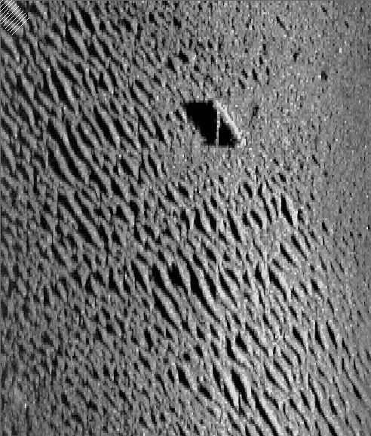
Concept:
Current focus area
Currently I calculate orientation per component.
And calculate pixel intensity profiles of lines over the component in this orientation.
Proposal: Maybe, by getting an average orientation for whole image:
I can use information of average orientation (and profiles thereof) to detect clusters of sand-ripples.

Slide 16
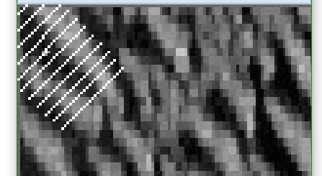
Current focus area
Zoomed in
Orientation for specific cluster:
PS:
My current code does not plot profile of center line – a bug that I still have to fix

Slide 17
PROPOSAL (1)
Given average orientation
Maybe by drawing lines (with same orientation) across whole image
One can use profiles to detect groups of sand-ripple clusters
What do you think?

Slide 18
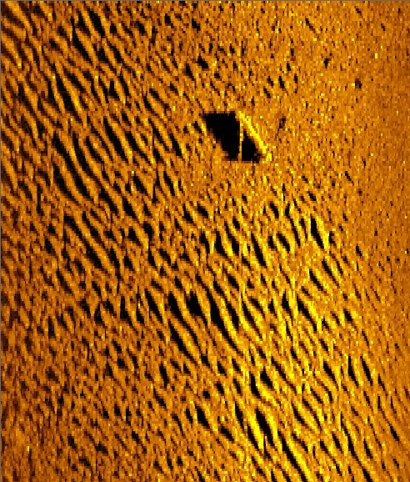

Slide 19
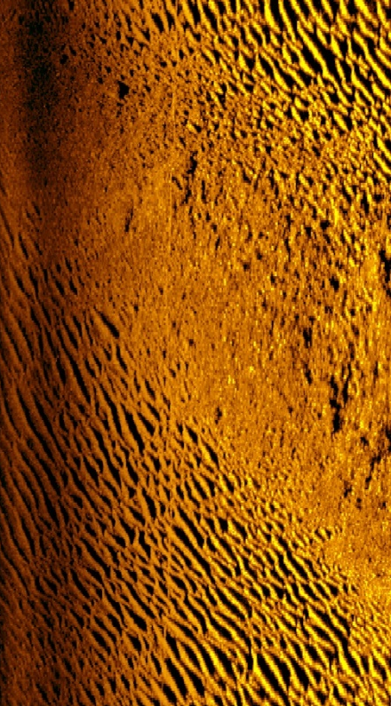
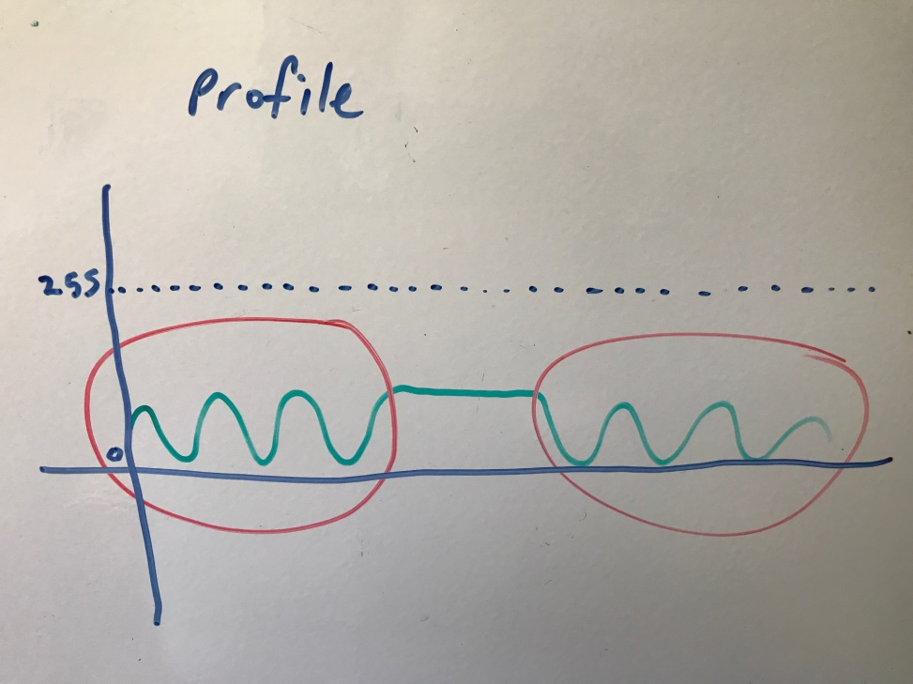
ESTIMATE PROFILE GRAPH OF ONE LINE THROUGH WHOLE IMAGE
One profile line through whole image
Image with two ripple groups

Slide 20
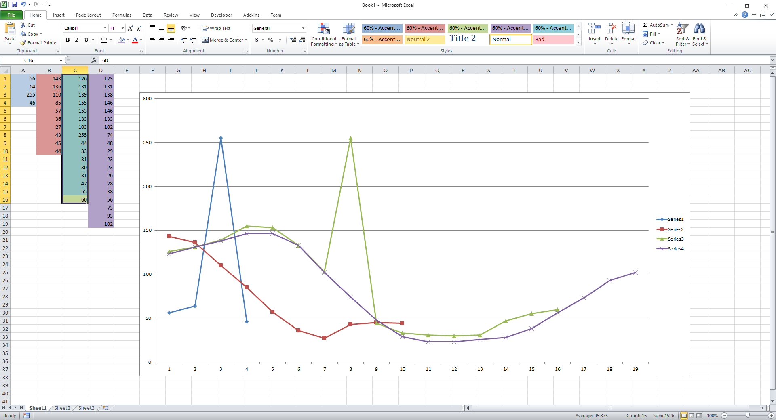
PROFILE GRAPHS (1)

Slide 21
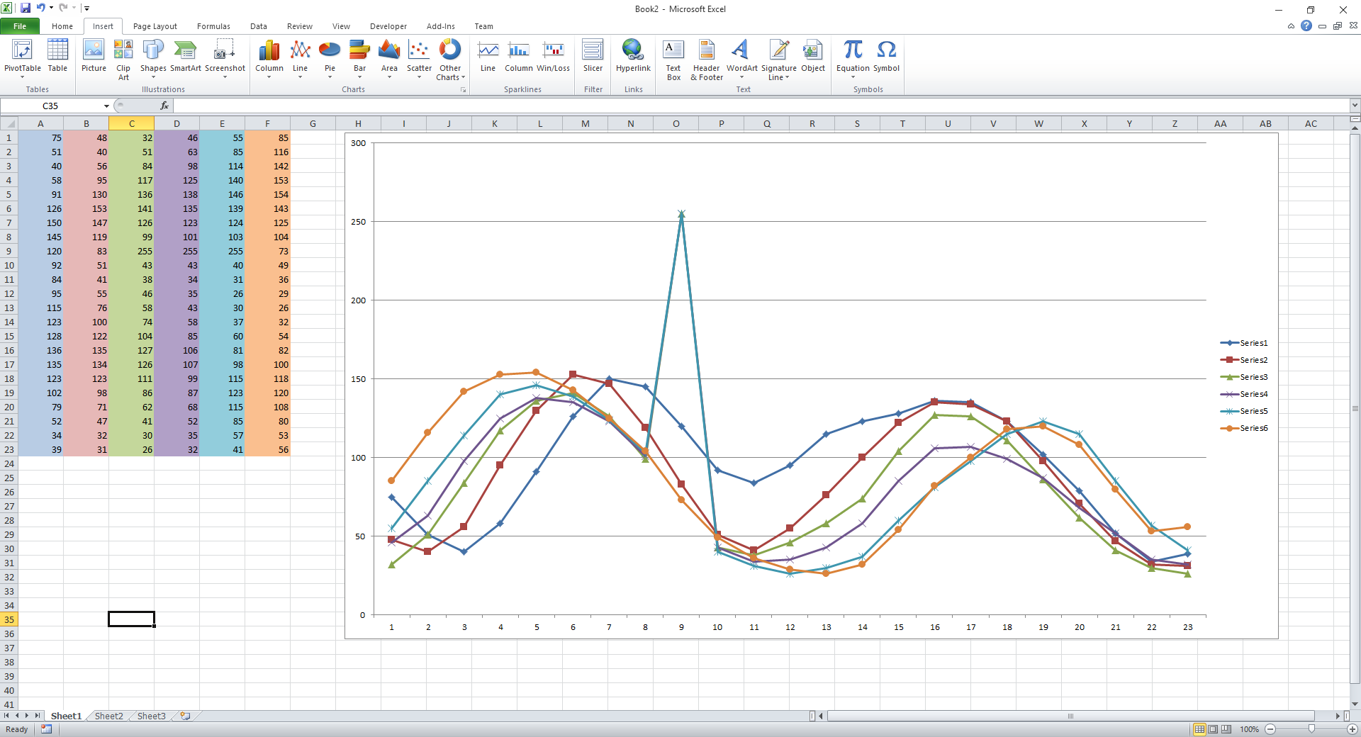
PROFILE GRAPHS (2)

Slide 22
PROFILE GRAPHS (3)
I was thinking of maybe we can use:
Maximum y-values,
Average profile
As possible measure to use, as a means to describe a “typical” profile graph.
Also, we will need to know what a “typical” profile graph of a non-sand-ripple look’s like (for comparison purposes)
Use these two descriptions, maybe come-up with a means to describe and detect a sand-ripple
What do you think?

Slide 23
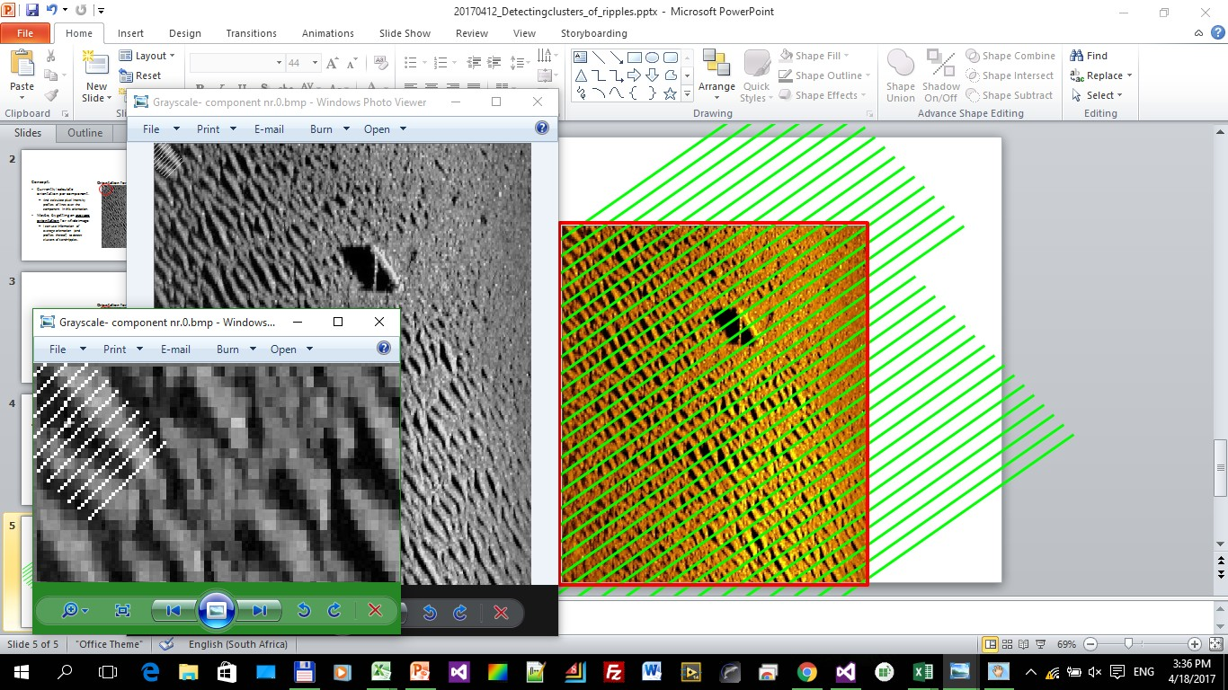

Slide 24
OLDER DISCUSSIONS (3)

Slide 25
Graphs
Analyse graphs (still to do)
Rectangle inside (Started)
Categorise components in image & rectangle
(Patrick clarify your statement)
Clusters
Nearest Neighbour
KNN – estimating K with watershed
(Patrick clarify your statement)
Your statement will be more clearer once I fully understand watershed, it’s purpose – how it works in OpenCV
Watershed – OpenCV implementation (busy understanding it)
Busy understanding watershed and C++ implementation
Peaks
Busy implementing component aspects
Angle per component
histogram

Slide 26
ESTIMATING K
(1) get histogram of angles across whole image
(2) hopefully this will show peaks
(3) hopefully these peaks are around each cluster's average angle
(4) if this is the case, then we have the number of clusters in our whole image = k
(5) now we can proceed with KNN algorithm

Slide 27
(1) watershed
Split water catchment areas
Understand watershed
Find opencv c++ watershed implementation
Understand that
Find out where peaks can be extracted inside algorithm
Revisit Patrick’s explanation
Apply example implementation to a simple image
Understand it and confirm results
Apply example implementation to my image

Slide 28
(2)CLUSTERS
Profile line outside image – ignore component
Compare vector
Use current profile line implementation
Drawing profile lines across components and extracting pixels
We know the size of our profile lines i.t.o. pixel-size
Test profile lines against each other and if we get one that’s shorter then the other – then we discard component – since shorter profile line means component is outside scope of image

Slide 29
OLDER DISCUSSIONS (4)

Slide 30
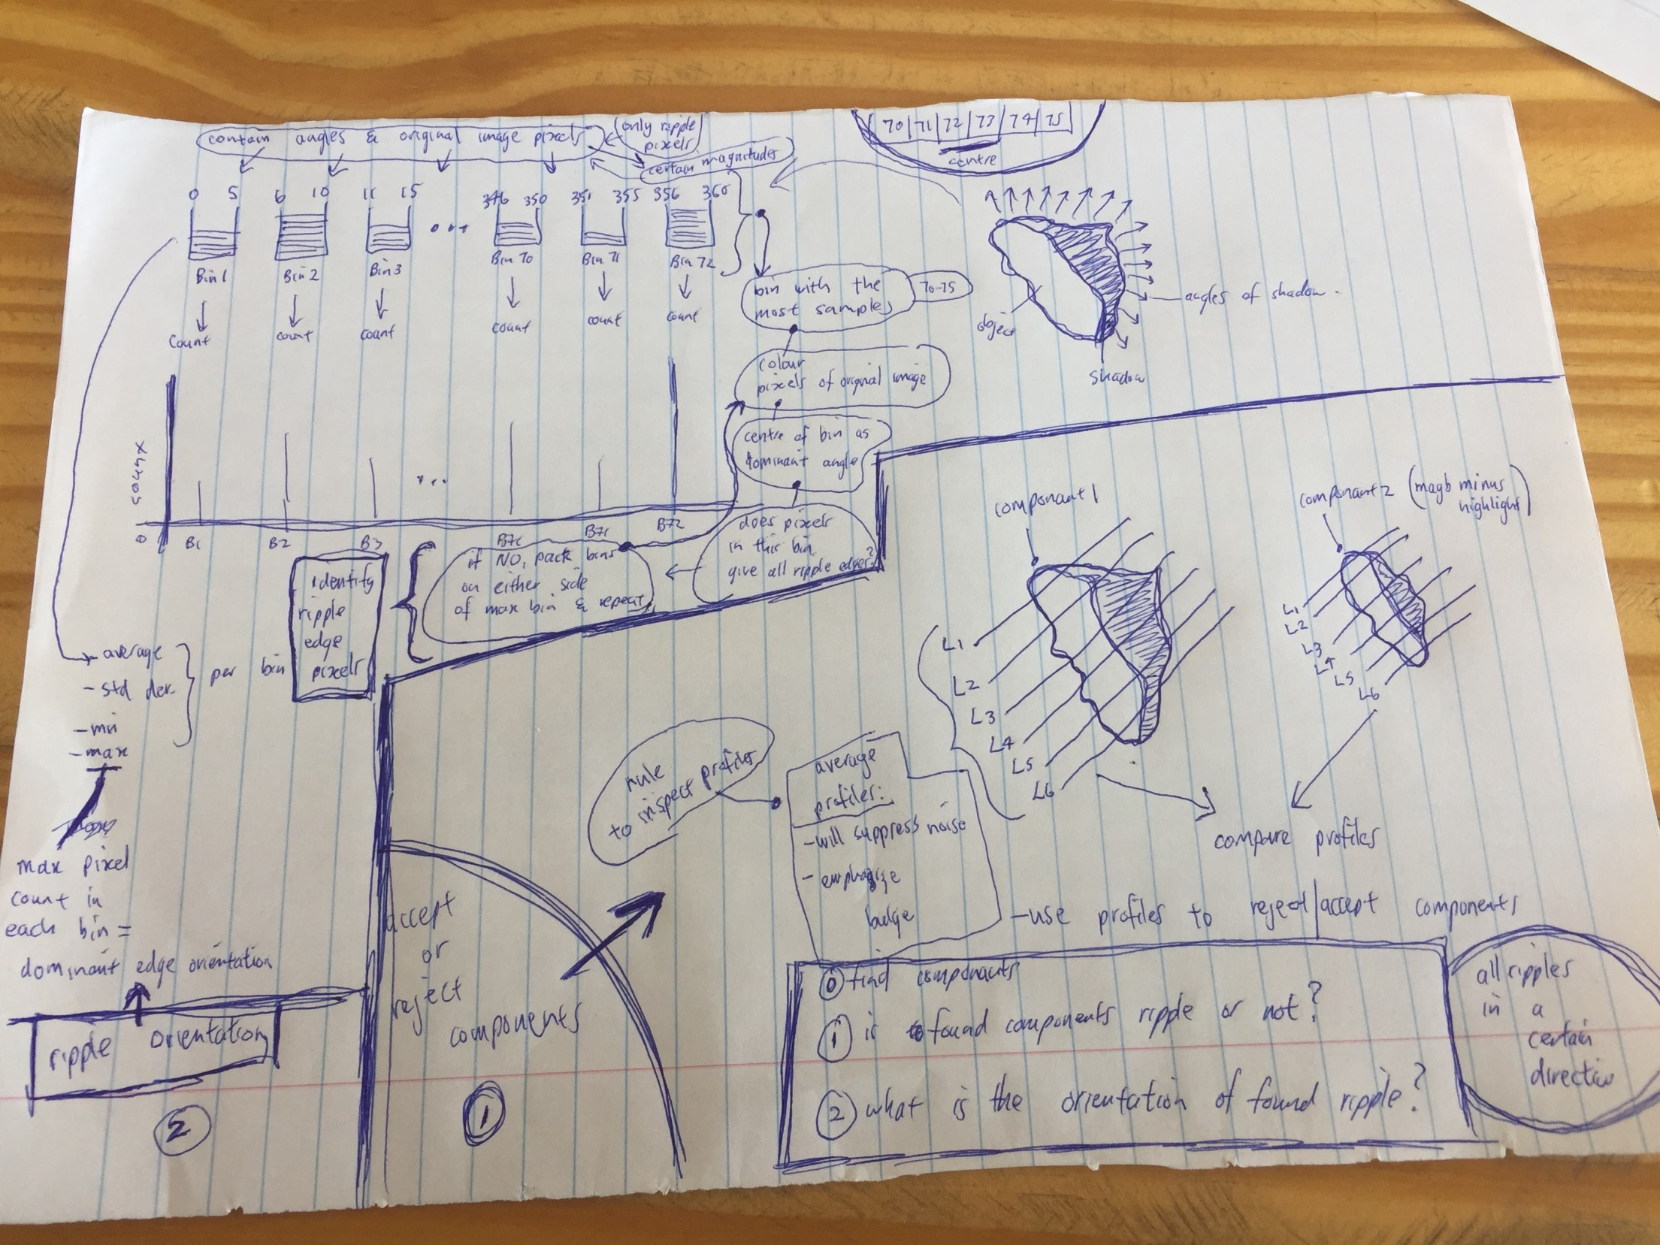

Slide 31
Find components
Is found components ripples? [profiling]
What is the orientation of found components? A cluster of ripples has roughly the same angle [histogram analysis]

Slide 32
(1) Find components
OPENCV connectedComponents
Find all components (of shadows)
Each component
Known as drawings/masks in source code

Slide 33
(2) Is found components ripples?
Get profiles of each component
Draw lines (profile lines)
Get component pixels under profile lines
Rules to inspect profiles:
Plot profiles and compare them
Will see the shape of component
Tapers down at the ends with bulge in middle
find average profile
will suppress noise &
emphasize bulge
Rules must help reject or accept component as ripple

Slide 34
(3) What is the orientation of found components?
Once component is found:
Create bins of 5 degrees wide
Pack all angles in bins
Pack corresponding original image pixels in bins
Find bin with the most (max)samples (pixels) in it (let’s say it is bin 70-75)
Find centre of bin – this is dominant angle – angle of bin – angle of all the pixels inside bin
Colour bin’s pixels & plot them back onto image/edge
Does plotted coloured pixels give components entire edge?
If not, pack a bin on either side of max bin and repeat from (a)
If yes, this bin’s orientation is the discovered dominant angle
Repeat for all bins

Slide 35
For (each component)
Profile component
Generate profiles of component
Does component have ripple shape?
Starting from one end of component, does number of component pixels increase as you move closer to centre of component, & then starts tapering down again?
Histogram analyse component
Find component angle
Does component have angle similar to other components?

Slide 36
Profiling
Profiling on grayscale image
Profile found components
Due to shape of ripple highlights+shadows, profile can tell if component is ripple

Slide 37
Angle Histogram Analysis (AHA)
Since ripples are clustered
Ripple clusters have a common angle
AHA is another test, to check if components are ripples

Slide 38
OLDER DISCUSSIONS (5)

Slide 39
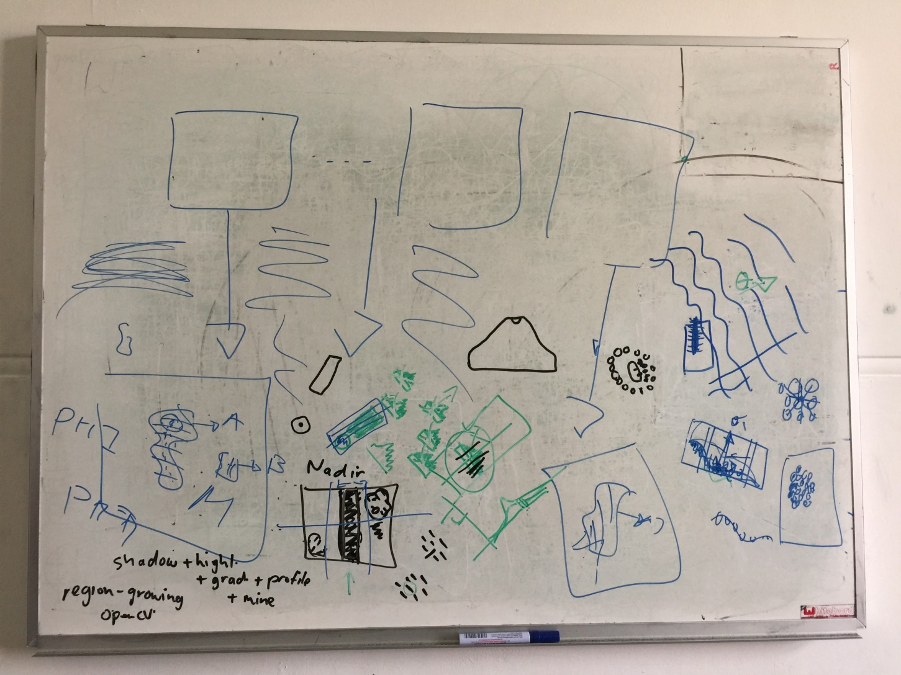

Slide 40
With regards to the use of profile:
the line of pixels are taken in the direction across the edge
(edge direction at the "centre" of the 'box' I drew; the box is obtained by finding the min/max extents of the connected component the edge pixel comes from, in the orthogonal direction, i.e. tangent to edge, or 90 degrees from it).
Edge direction at the centre of box
Box in sand ripple
Min & max extends of connected pixels

Slide 41
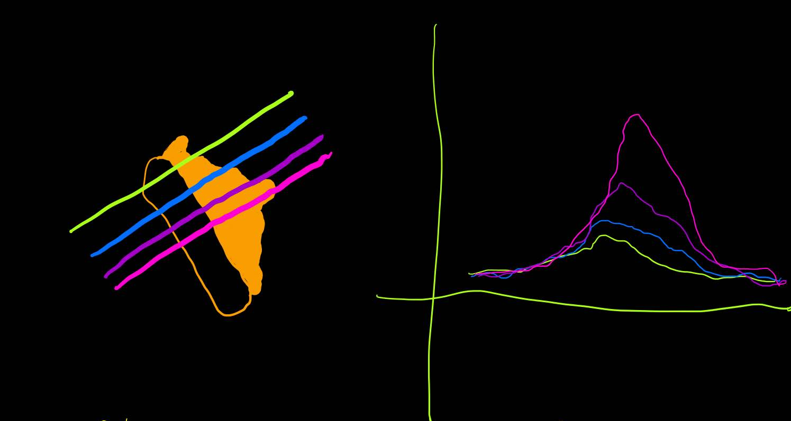
Several sample lines parallel to this initial line (on either side) are also taken, and their profiles compared.
Yes, which is what I was trying to indicate with picture

Slide 42
The point of the profiles is to have a 'model' that can be used to reject/accept connected components - built using region growing - that are ripples or non-ripples. However, it can also be used to decide if some part of a connected components is actual the edge of an object. The only way to decide this is to take the edge profiles and examine them for intensity peaks/dips, rising regions etc. So you could, for example, take all the profiles and 'average them'; this would suppress noise and emphasize common structures, like the big bulge that corresponds to the ripple.
Region growing
I have regions
Profiles
Use profiles to classify regions as either sand ripples or not
take profiles & examine them for peaks/dips
Take all profiles->average them
Bulge will dominmate -> indicatingripple
This will also suppress noise
Can also be used to identify found region’s edge

Slide 43
Basically, any 'rule' you can come up with from inspecting example profiles can be used to try and decide if a 'segment' is simply a ripple or something more interesting and if it is more interesting, what it is, and where the object boundary lies.

Slide 44
The only way to get a sense for these rules/heuristics, is to write some code that can extract these profiles and then plot them as a graph. It usually becomes clear if there is some pattern you can exploit. I really think that should be a priority? As soon as we have examples, we can look at them and think of better ways to exploit what they represent. Agreed – code something & display it
This way we have something to start with
Work our way further from that

Slide 45
PS I used models of profiles in my PhD many years ago to try and classify boundaries in brain tissue, so I am fond of them ;-)

Slide 46
OLDER DISCUSSIONS (6)

Slide 47
u
centroid(x,y)
w

Slide 48
