Slide 2
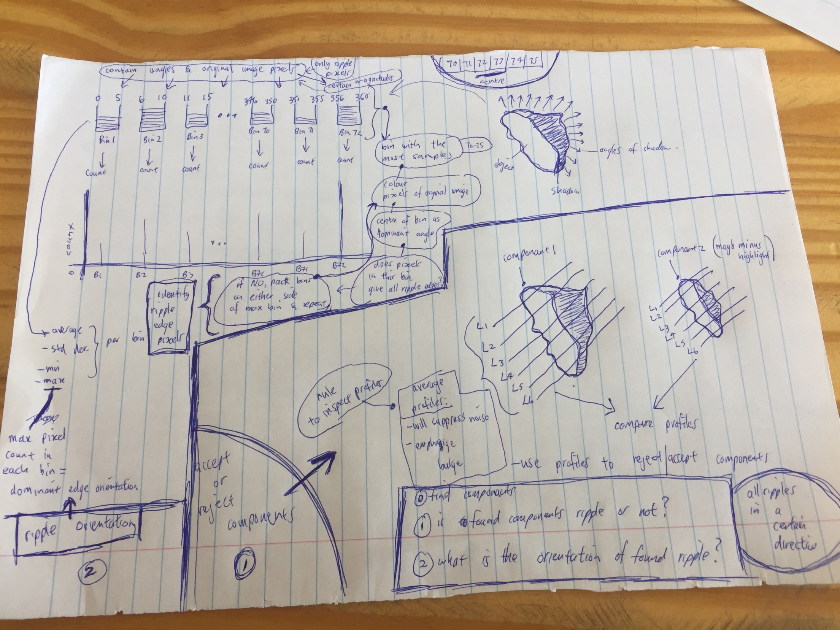

Slide 3
Find components
Is found components ripples? [profiling]
What is the orientation of found components? A cluster of ripples has roughly the same angle [histogram analysis]

Slide 4
(1) Find components
OPENCV connectedComponents
Find all components (of shadows)
Each component
Known as drawings/masks in source code

Slide 5
(2) Is found components ripples?
Get profiles of each component
Draw lines (profile lines)
Get component pixels under profile lines
Rules to inspect profiles:
Plot profiles and compare them
Will see the shape of component
Tapers down at the ends with bulge in middle
find average profile
will suppress noise &
emphasize bulge
Rules must help reject or accept component as ripple

Slide 6
(3) What is the orientation of found components?
Once component is found:
Create bins of 5 degrees wide
Pack all angles in bins
Pack corresponding original image pixels in bins
Find bin with the most (max)samples (pixels) in it (let’s say it is bin 70-75)
Find centre of bin – this is dominant angle – angle of bin – angle of all the pixels inside bin
Colour bin’s pixels & plot them back onto image/edge
Does plotted coloured pixels give components entire edge?
If not, pack a bin on either side of max bin and repeat from (a)
If yes, this bin’s orientation is the discovered dominant angle
Repeat for all bins

Slide 7
For (each component)
Profile component
Generate profiles of component
Does component have ripple shape?
Starting from one end of component, does number of component pixels increase as you move closer to centre of component, & then starts tapering down again?
Histogram analyse component
Find component angle
Does component have angle similar to other components?

Slide 8
Profiling
Profiling on grayscale image
Profile found components
Due to shape of ripple highlights+shadows, profile can tell if component is ripple

Slide 9
Angle Histogram Analysis (AHA)
Since ripples are clustered
Ripple clusters have a common angle
AHA is another test, to check if components are ripples

