Slide 1
Your last email with my comments (in blue)
Jonathan Winnaar
18 Nov 2016

Slide 2
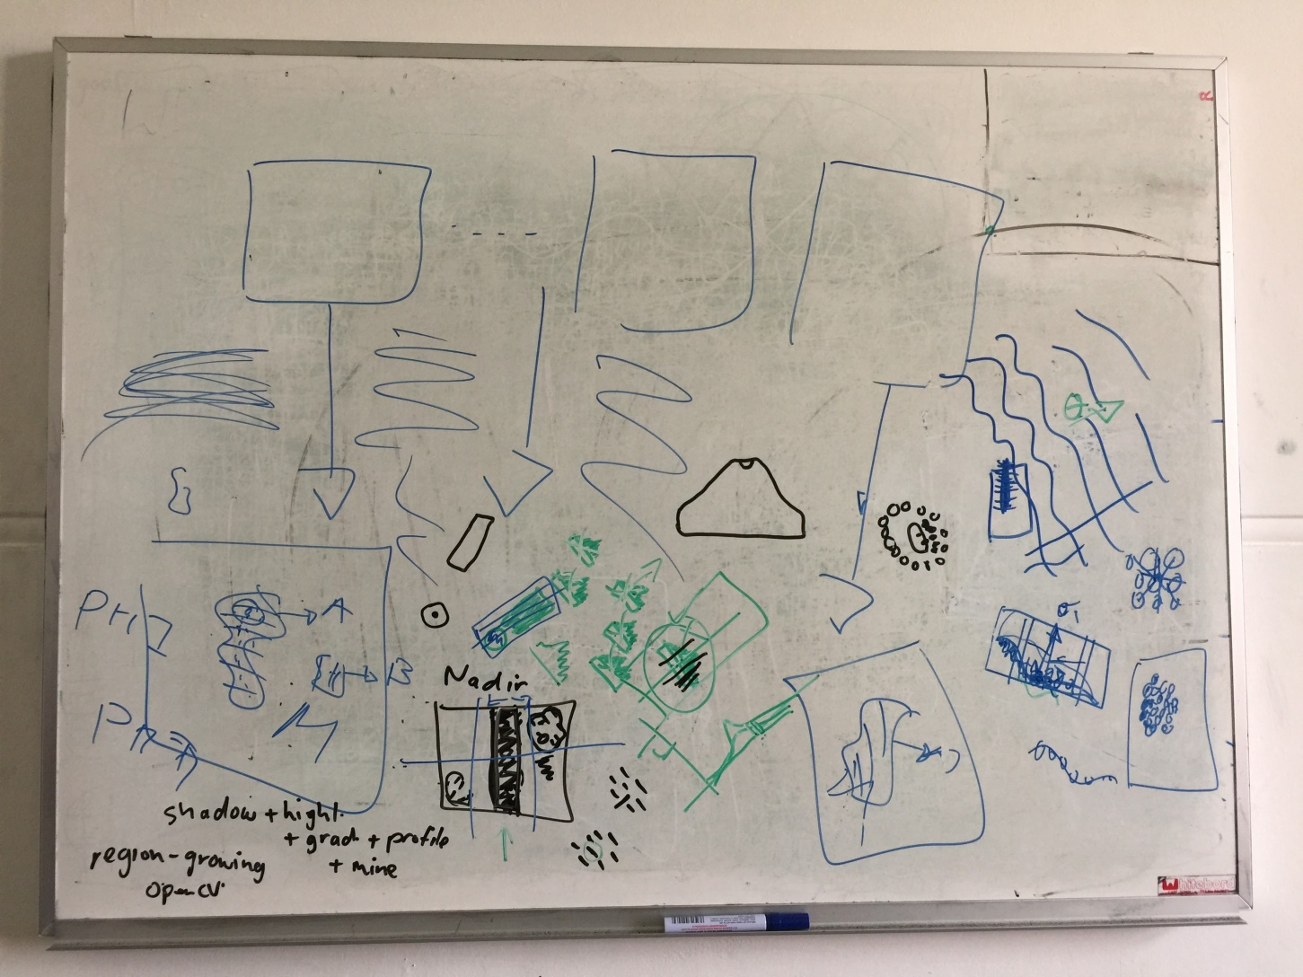

Slide 3
With regards to the use of profile:
the line of pixels are taken in the direction across the edge
(edge direction at the "centre" of the 'box' I drew; the box is obtained by finding the min/max extents of the connected component the edge pixel comes from, in the orthogonal direction, i.e. tangent to edge, or 90 degrees from it).
Edge direction at the centre of box
Box in sand ripple
Min & max extends of connected pixels

Slide 4
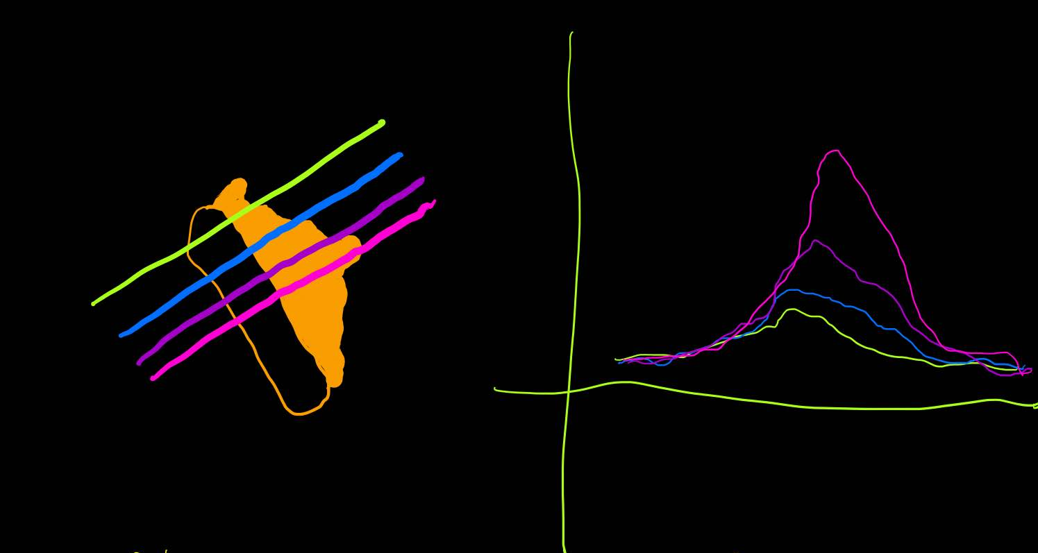
Several sample lines parallel to this initial line (on either side) are also taken, and their profiles compared.
Yes, which is what I was trying to indicate with picture

Slide 5
The point of the profiles is to have a 'model' that can be used to reject/accept connected components - built using region growing - that are ripples or non-ripples. However, it can also be used to decide if some part of a connected components is actual the edge of an object. The only way to decide this is to take the edge profiles and examine them for intensity peaks/dips, rising regions etc. So you could, for example, take all the profiles and 'average them'; this would suppress noise and emphasize common structures, like the big bulge that corresponds to the ripple.
Region growing
I have regions
Profiles
Use profiles to classify regions as either sand ripples or not
take profiles & examine them for peaks/dips
Take all profiles->average them
Bulge will dominmate -> indicatingripple
This will also suppress noise
Can also be used to identify found region’s edge

Slide 6
Basically, any 'rule' you can come up with from inspecting example profiles can be used to try and decide if a 'segment' is simply a ripple or something more interesting and if it is more interesting, what it is, and where the object boundary lies.

Slide 7
The only way to get a sense for these rules/heuristics, is to write some code that can extract these profiles and then plot them as a graph. It usually becomes clear if there is some pattern you can exploit. I really think that should be a priority? As soon as we have examples, we can look at them and think of better ways to exploit what they represent. Agreed – code something & display it
This way we have something to start with
Work our way further from that

Slide 8
PS I used models of profiles in my PhD many years ago to try and classify boundaries in brain tissue, so I am fond of them ;-)

