Slide 1
What are Linked List?
Linked List are a group of nodes which contains data and the address of pointer.

Slide 2
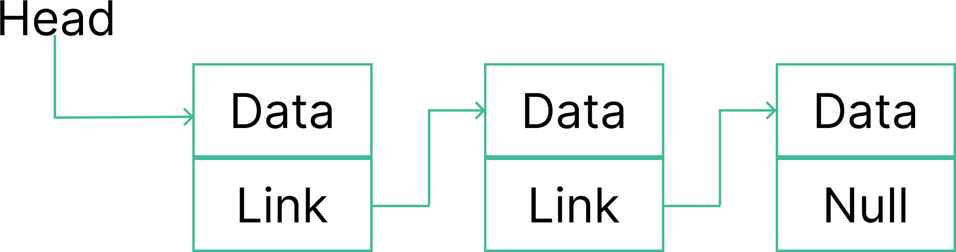
What are Linked List?
Linked List are a group of nodes which contains data and the address of pointer.

Slide 3
What are Linked List?

Slide 4
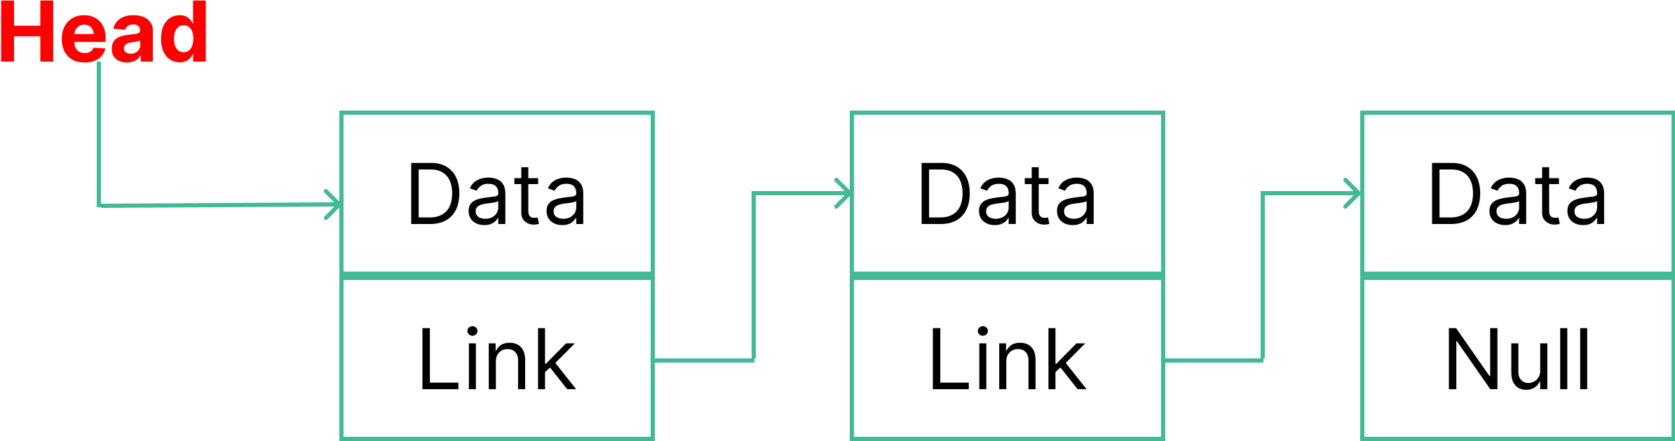
What are Linked List?

Slide 5
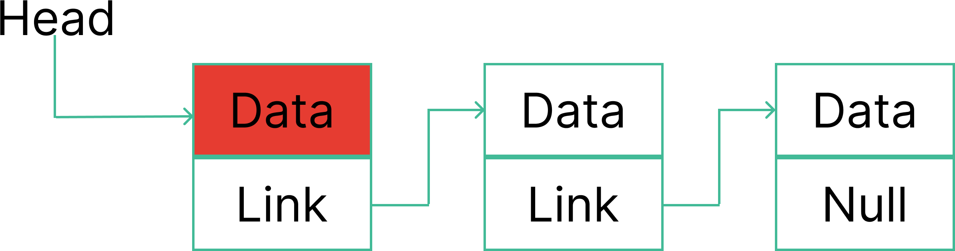
What are Linked List?

Slide 6
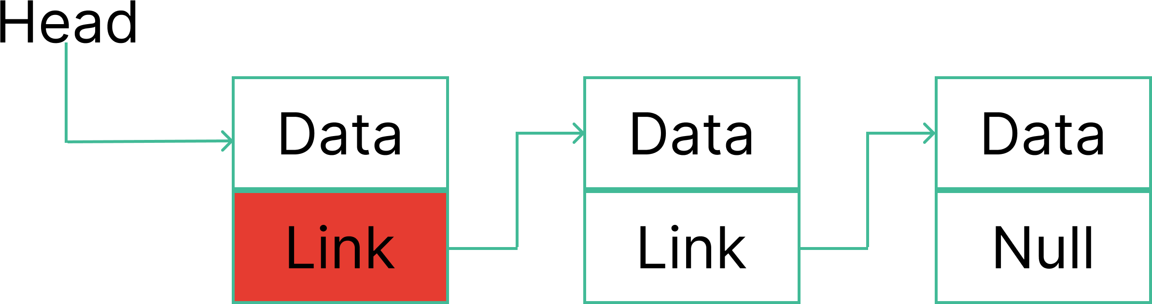
What are Linked List?

Slide 7
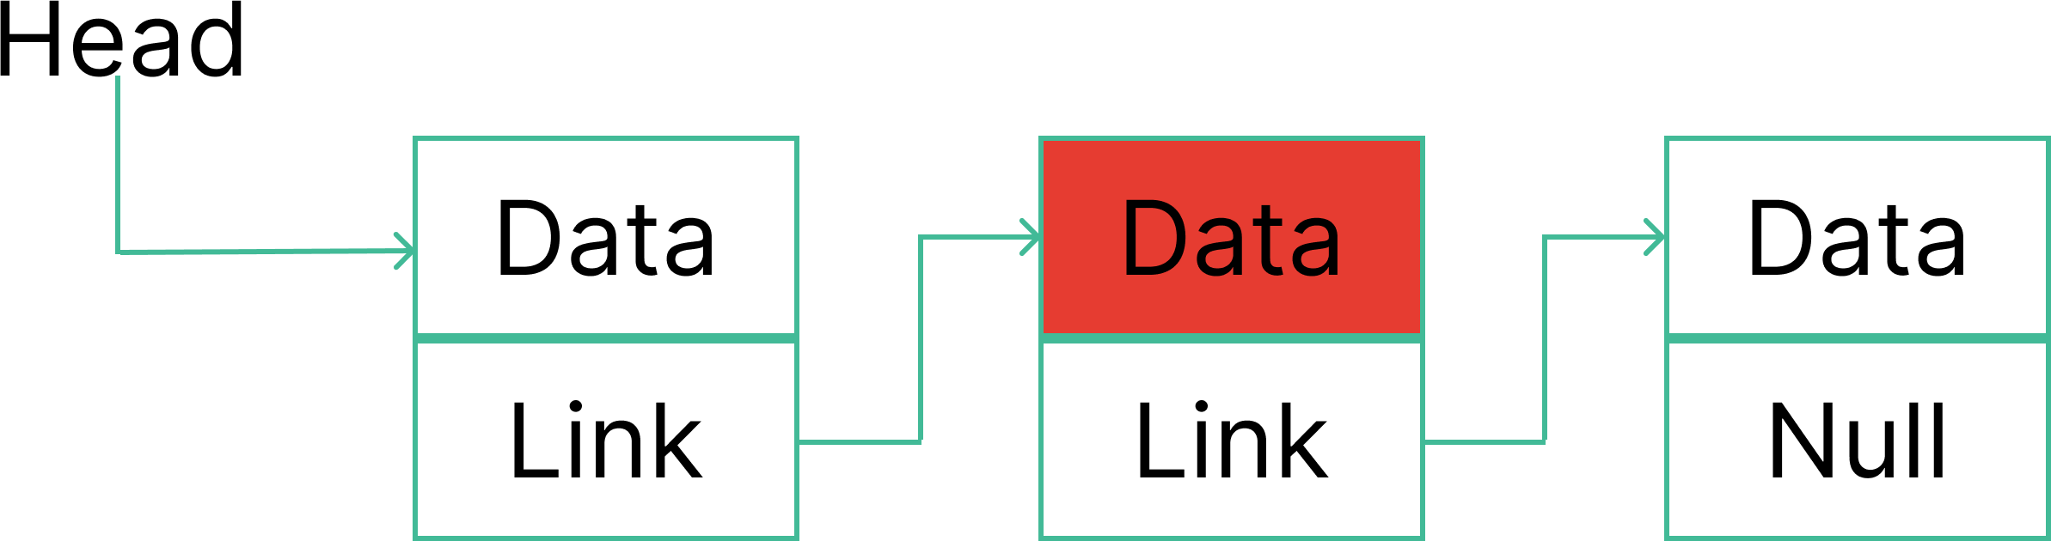
What are Linked List?

Slide 8
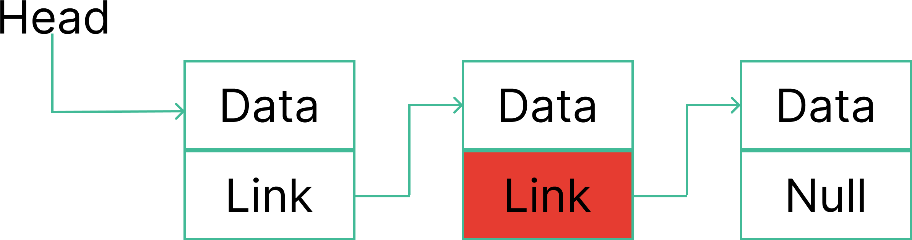
What are Linked List?

Slide 9
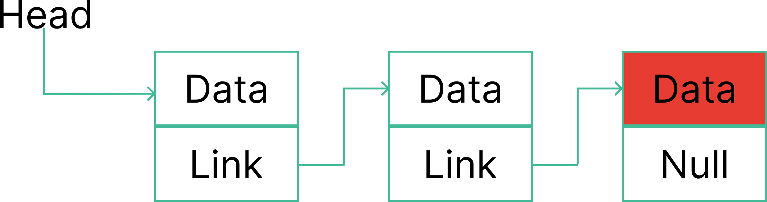
What are Linked List?

Slide 10
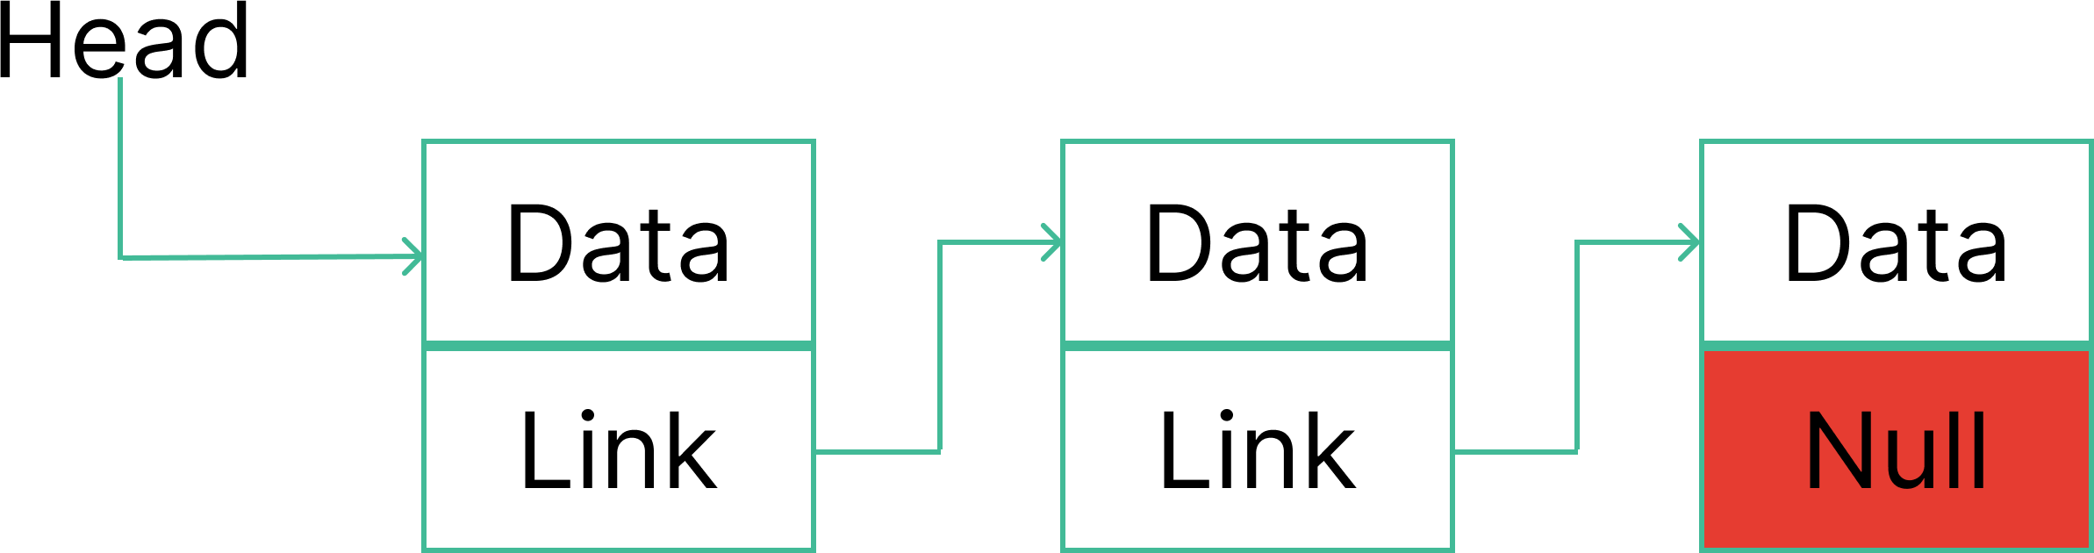
What are Linked List?

Slide 11
Uses of Linked Lists
List do not always have to be present in the memory. A node can be anywhere in memory and then can be linked to make a list.
The List size is dependent on the memory size.
We can store more then basic type.

Slide 12
Why use Linked List over arrays
The memory is dynamically assigned. All the nodes are linked with pointer.
There is no problem with sizing, because the list grow as per the programs demand.

Slide 13
Singly Linked List or one way Chain
In Singly linked list has a node which contains 2 parts: The Data part and the link part. In Singly linked list the direction is only forward.

Slide 14
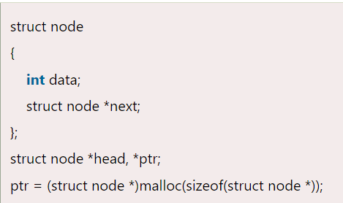
Node Creation

Slide 15
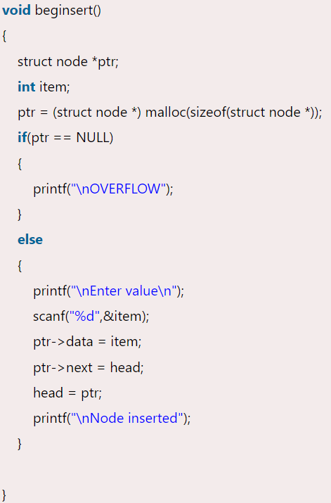
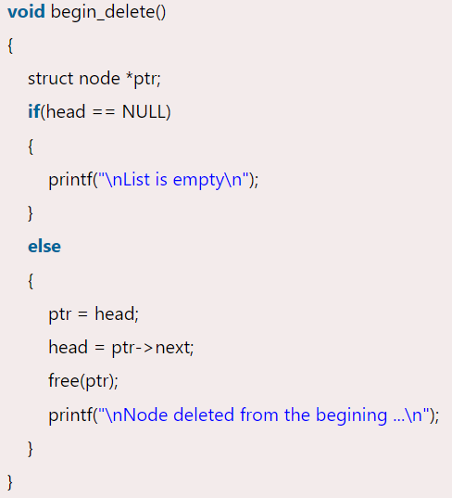
Linked List in C: Important

Slide 16
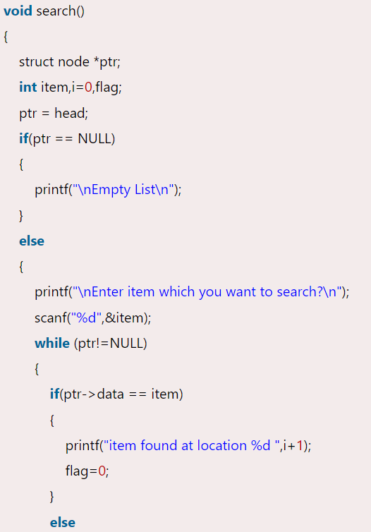
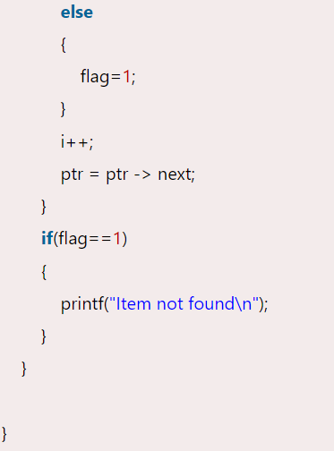
Linked List in C: Important

