Slide 1

Introduction
Programming in Network Environments
Biomedicine Engineering Degree 2018-2019
Boni García (bgarcia@gsyc.es)
Juan Gonzalez Gomez (juan.gonzalez.gomez@urjc.es)

Slide 2

Course Goals
To understand the computers networks and how to create software applications over them in order to find solutions to the current challenges that biomedicine has in the present.
The course will be very practical with all the sessions in the laboratories and most of them with programming exercises to be implemented in order to learn the concepts presented in the course, and also, to learn programming.
The human genome has 3000 millions of elements in its sequence. There are 7500 millions of persons in the Earth. How to manage this huge volume of data? Computers networks.

Slide 3
Course Contents
Introduction to the tools
Object Oriented Programming
Network Service Models (client/server)
Communication Protocols Programming (TCP/IP, HTTP)
Web Applications Programming

Slide 4




Block 0. Tools
PyCharm

Slide 5
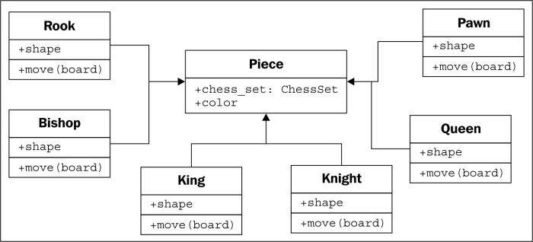
Block 1. Object Oriented Programming
Classes
Inheritance
Objects and Methods

Slide 6

Block 2. Network Services Models
Network Services Models Introduction
Peer to Peer Model (P2P)
REST Model
Cloud Computing for network services deployment

Slide 7
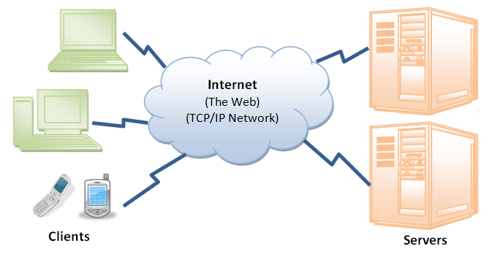
Block 3. Communications Protocols Programming
Protocolo TCP/IP Protocol
Protocolo HTTP Protocol
Security in Computer Networks
Distributed Applications Programming Techniques

Slide 8
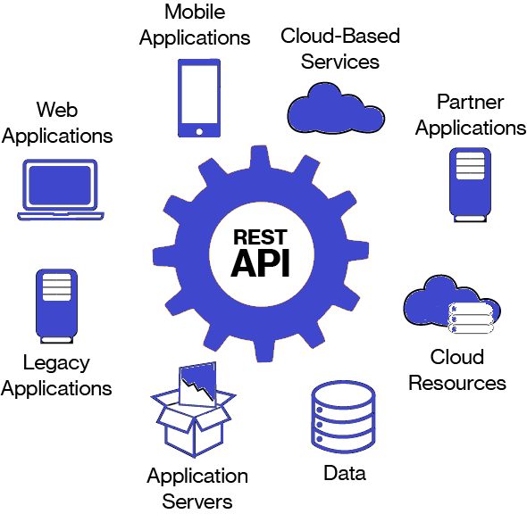
Block 4. Web Applications Programming
Basic Elements
API REST Description
API REST Design
API REST Use

Slide 9

Basic information
Schedule:
Tuesdays: 15:00 a 17:00 (theory + practice) 106 Aulario I
Wednesday: 17:00 to 19:00 (practice) 106 Aulario I
Ask for an appointment by email to the teachers of the course for personal support.

Slide 10
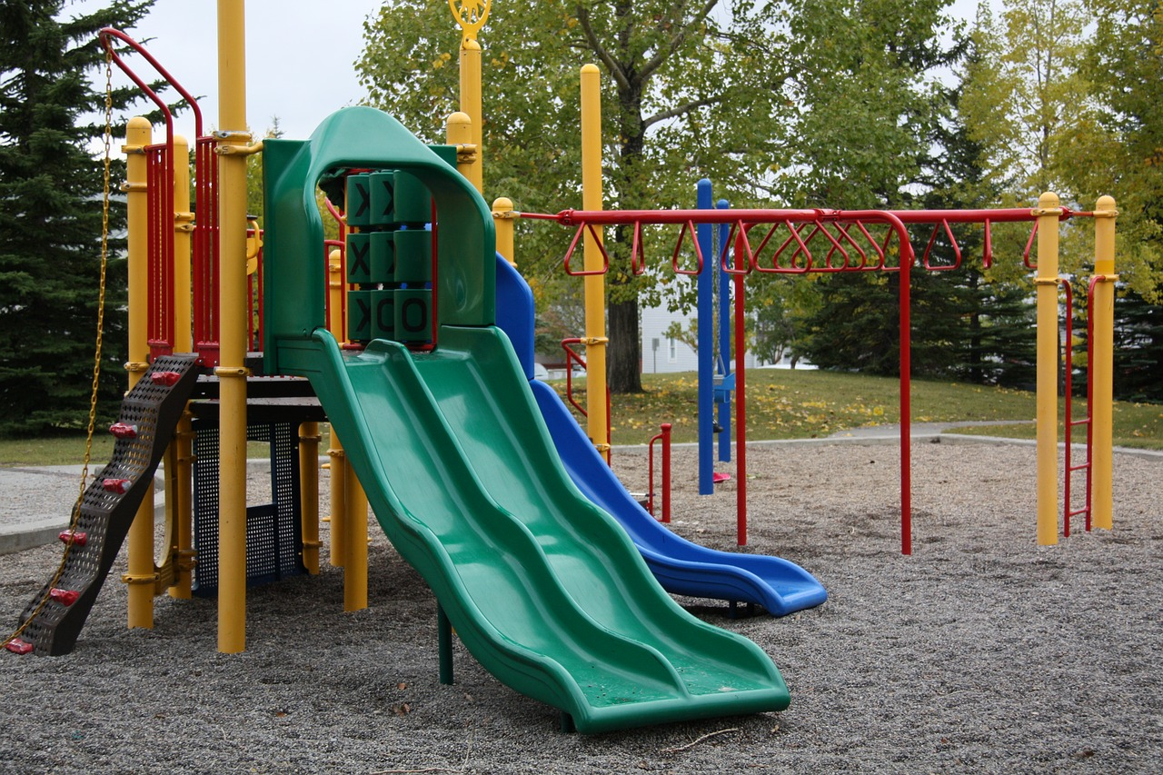
Practices
Evaluation
The description of the practices will be available both in “Aula Virtual” and in github: https://github.com/myTeachingURJC/2018-19-PNE/wiki
All the practices will be done using the Python programming language.
The evaluation will be based in the practices, and especially, in the final project.
Each student will upload the practices to his/her github account following the instructions provided

