Slide 1
HIV Patient Lost-to-Follow Up Predictor Application (Course Project)
Mohammed Yushawu Abdulai
(Student of MS Health Informatics)
Michigan Technological University

Slide 2
Introduction
The prevalence of Lost to Follow Up (LFU) is high among PLHIV receiving treatment in Ghana.
Frequent LFU can cause drug resistance which may lead to serious complications if not properly managed.
Drug resistance increases cost of the treatment.
This motivated me to develop this application as my course project to assist in identifying patients who are likely to get LFU at point of care .

Slide 3
Long Term Goal
Improve on the accuracy of the model by adding viral load data and increasing the size of dataset.
Deploy the application for use to help reduce LFU.

Slide 4
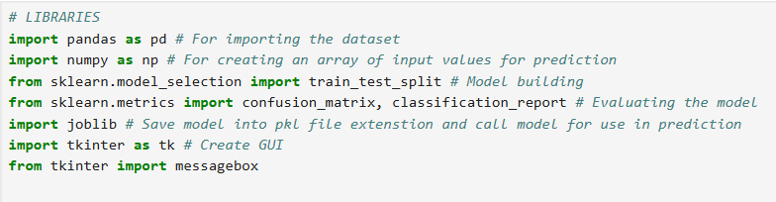
Implementation

Slide 5
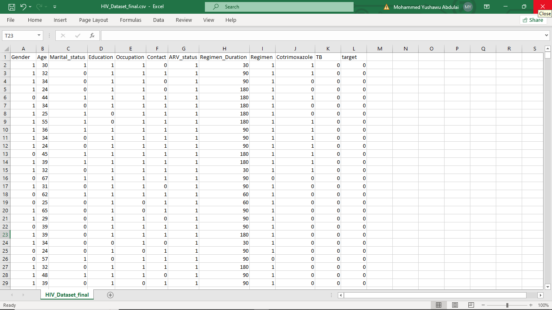
Screenshot of the dataset used

Slide 6
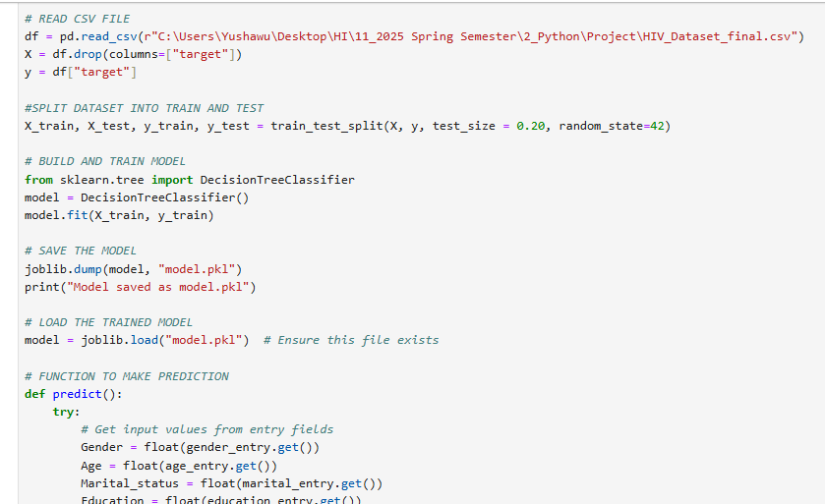
Screenshot of Model codes for Prediction

Slide 7
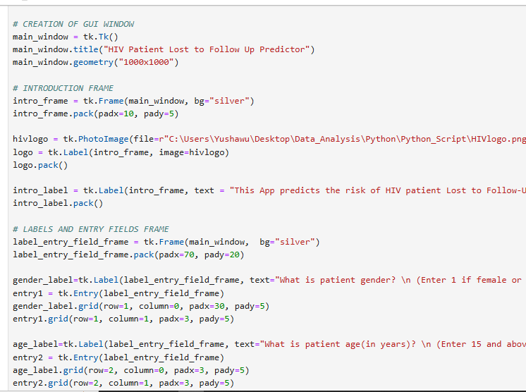
Screenshot of GUI codes

Slide 8
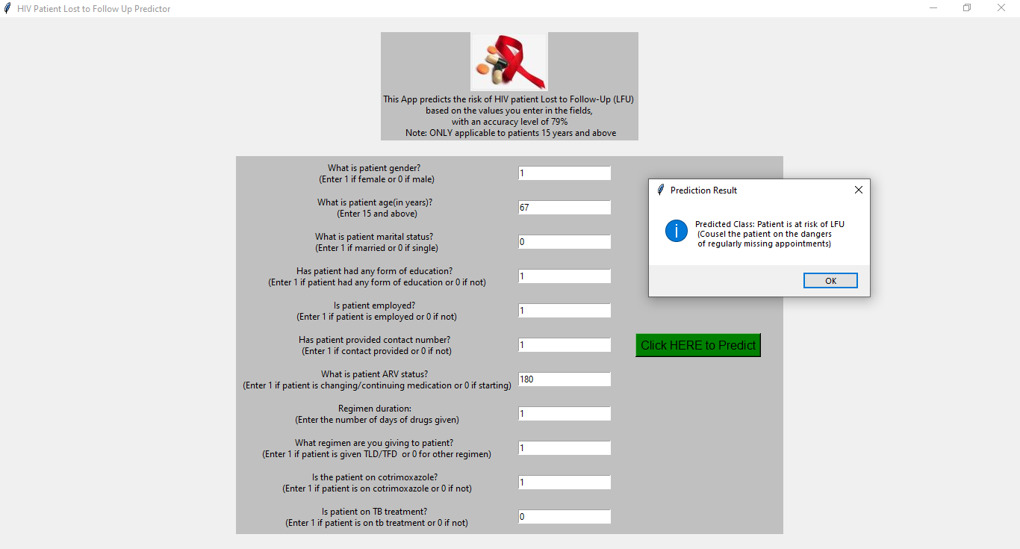
Screenshot of output

Slide 9
Thank you

