Slide 1

ELECTRONIC HEALTH RECORD
“The role of Electronic Health Records (EHRs) on Public Health data driven decision making in Michigan State Department of Health and Human Services (MDH)
Peter Mvuma M25437243
Mohammed Yushawu Abdulai M17144312

Slide 2
Introduction
Electronic Health Records is the digital versions of patients' paper charts. It reduces errors associated with manual documentation and prescribing.
EHRs contain a wide range of information, including medical history, diagnoses, medications, treatment plans, immunization data, allergies, radiology images, and laboratory test results.
EHRs assist in tracking public health trends and outbreaks.
EHRs are designed to be shared across different healthcare settings, allowing for the seamless exchange of information among healthcare providers.
The primary goal of EHRs is to enhance patient care by providing healthcare professionals with timely access to accurate and up-to-date patient information, which can lead to better decision-making and improved health outcomes.
EHRs are central to the Meaningful Use program, which incentivizes healthcare providers to use EHR technology effectively to improve healthcare quality and efficiency.
It is against this background we explore the role of EHRs particularly on public health decision making at the Michigan Department of Human and Health Service (MDHHS)
Source: Magnuson et al (2020). Public Health Informatics and Information Systems.

Slide 3
Impact to the Population/Public Health Field
Enhanced Data Sharing
Enables immediate data exchange across local, state, and federal agencies
Facilitates aggregation and analysis of health data based on environmental and demographic factors
Improved Public Health Surveillance
Enhances tracking of communicable diseases and chronic conditions
Supports timely interventions for better health outcomes
Monitoring Health Trends
Helps officials monitor outbreaks and overall population health
Improves decision-making and response strategies

Slide 4
Challenges Associated with the Chosen Research Area
According to a survey conducted by ONC, 70% of hospitals experienced at least one challenge related to public health reporting with common issues being:
Lack of Capacity for Electronic Information Exchange: 50% of hospitals reported a lack of capacity to electronically exchange information.
Interface-Related Issues: 40% hospitals encountered technical problems and complexities with the interfaces used for reporting.
Vocabulary Standards Challenges: 19% reported difficulties due to differing vocabulary standards, highlighting the complexity of electronic health records (EHR) usage.
These challenges affect the ability of public health officials to effectively monitor trends of diseases.
Source: ONC (2021). Challenges to Public Health Reporting Experienced by Non-Federal Acute Care Hospitals

Slide 5
Literature Review
History of EHRs
Early EHR Development and growth
1960s: Lockheed’s system set a foundation with fast processing and multi-user support
University of Utah & 3M developed HELP, an early clinical decision support system
In the 1970s, the Department of Veteran Affairs launched VistA, reducing medical errors and improving record integration
Expanding Focus in the 1980s
Institute of Medicine (IOM) promoted EHR for improved patient care
Computer-Based Patient Record Institute (CPRI) was established to address EHR adoption challenges
Major Policy Shift in 2009
President Obama incorporated EHR into the American Recovery and Reinvestment Act
Linked higher payments to the adoption of meaningful use standards.
These developments highlight the increasing importance of EHR in enhancing patient care and healthcare delivery.
Source: Dick et al(1997). The ComputerBased Patient Record: An Essential Technology for Health Care.

Slide 6
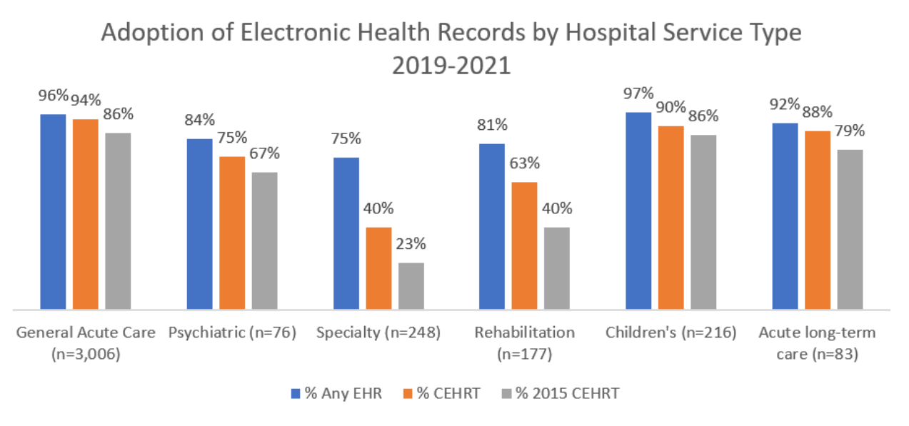
Literature Review
Adoption of EHRs
Since 2008, the use of electronic health records (EHRs) among hospitals has increased by 87 percentage points. 96% of nonfederal acute hospitals adopted EHRs.
Source: ONC (2022). Adoption of Electronic Health Records by Hospital Service Type 2019-2021

Slide 7
Literature Review
Impact of EHRs on Interoperability
2014–2023
From 2014 to 2023, hospitals demonstrated increased engagement in interoperable data exchange, with 70% participating in all four domains (find, send, receive, integrate).
2021
E-prescribing adoption surged from 7% in 2008 to 92% in 2021, with significant improvements in the electronic prescribing of controlled substances (EPCS) as well.
2022
Public health reporting capabilities among hospitals and primary care physicians have improved. By 2022, 90% of hospitals could report immunization data electronically.
Source: Barker et al (2024). The Evolution of Health Information Technology for Enhanced Patient-Centric Care in the United States

Slide 8
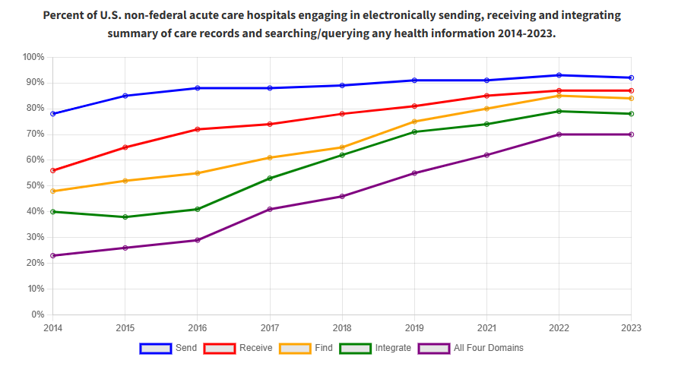
Literature Review
Impact of EHRs on Interoperability
Source: ONC. https://www.healthit.gov/data/quickstats/electronic-health-information-exchange-hospitals

Slide 9
Literature Review
Impact of EHRs on Interoperability
Source: Barker et al (2024). The Evolution of Health Information Technology for Enhanced Patient-Centric Care in the United States

Slide 10
Example of EHR in Disease Management – Specific to Michigan
Utilization of EHR to Improve Cardiovascular Health, particularly focusing on the management of HBP
Prevalence of HBP: In 2013, the prevalence of HBP among adults in Michigan was 34.6%, which is a major risk factor for heart disease and stroke.
Intervention: The MDHHS received a grant aimed at preventing and controlling cardiovascular diseases through the use of HIT
Training Programs: Primary care providers received education on utilizing HIT tools, including decision-making aids, patient portals, and guidance on recording information in EHRs.
EHR Utilization: As a result of the training, the percentage of Federally Qualified Health Centers (FQHCs) with appropriate EHRs for treating HBP rose from 91% to 100%.
Controlled Hypertension: The number of clinics reporting controlled hypertension increased significantly, with 63% of patients treated by experienced providers achieving blood pressure control compared to 61% for first-time participants.
Providers who used clinical decision support tools had 8% more patients with controlled hypertension compared to those who did not use such technology (64% versus 56%).
Source: Michigan Department of Health and Human Services

Slide 11
Opportunities for new areas/gaps in research on the topic
Gaps
Limited data on rural and underserved populations.
Minimal longitudinal studies on EHR impact on long-term public health planning.
Need for standardized EHR datasets for AI integration.
Opportunities
Explore integration with AI for predictive analytics.
Policy research on funding models to support HIT infrastructure.
Investigate EHR usability enhancements for frontline workers.

Slide 12
Take on Research Project
EHRs not only facilitated better information exchange but also enhanced the quality of care for patients leading to improved health outcomes.
EHRs enhances continuity of patient care overtime.

Slide 13
References
Barker W, Chang W, Everson J, Gabriel M, Patel V, Richwine C, Strawley C (2024). The Evolution of Health Information Technology for Enhanced Patient-Centric Care in the United States: Data-Driven Descriptive Study, J Med Internet Res 2024;26:e59791, URL: https://www.jmir.org/2024/1/e59791, DOI: 10.2196/59791
Dick RS, Steen EB, Detmer DE, eds; Institute of Medicine. The Computer-Based Patient Record: An Essential Technology for Health Care. 2nd ed.Washington, DC: National Academies Press, 1997.
Magnuson, A., & Fu, Jr., P. C. (2020). Public Health Informatics and Information Systems.
Michigan Department of Health and Human Services. Increasing Utilization of Electronic Health Records to Improve Cardiovascular Health. https://www.michigan.gov/-/media/Project/Websites/mdhhs/Folder1/Folder8/MDHHS_Health_Impact_Statement_Increasing_Utilization_of_Elec_Hlth_Records_to_Imp_CVD_Hlth_.pdf?rev=945cf920a80f48a0971b190de059e360
Policy/Office of the National Coordinator for Health IT. Electronic Health Information Exchange by Hospitals. https://www.healthit.gov/data/quickstats/electronic-health-information-exchange-hospitals
Office of National Coordinator for HIT (2021). Challenges to Public Health Reporting Experienced by Non-Federal Acute Care Hospitals. https://www.healthit.gov/sites/default/files/page/2021-09/Challenges-to-PH-Reporting.pdf
Office of the National Coordinator for Health Information Technology. Adoption of Electronic Health Records by Hospital Service Type 2019-2021, Health IT Quick Stat #60. April 2022. https://www.healthit.gov/data/quickstats/adoption-electronic-health-records-hospital-service-type-2019-2021
US Department of Health and Human Services (2011)

