Slide 1
Identity Connectors: Extending Authentication Beyond MyAccessID Federation
National Federated
Compute Services
NetworkPlus
MyAccessID Online Workshop – 28 April 2026
Deepak Aggarwal, Research Computing Services

Slide 2
Recap: MyAccessID
Federated Identity via MyAccessID
Build on eduGAIN
Provides
Trusted authentication
Persistent identifiers
Attribute assurance
Works well for academic users and DRIs can provide the services trusting authentication with MyAccessID
How do DRIs onboard and support users who cannot use MyAccessID?
MyAccessID: https://wiki.geant.org/display/MyAccessID

Slide 3
How MyAccessID Work for AIRR Service Portals?
MyAccessID looks up user’s university Identity Provider (IdP) via eduGAIN
MyAccessID redirects user to University login page
User provides University credentials
User selects MyAccessID on the login page
Once authenticated, MyAccessID sends limited user info (name, email, affiliation) to site portal using OIDC
User is invited and visits the AIRR Service site Portal
User now successfully logged into AIRR site portal

Slide 4
The Gap
Not all users can use MyAccessID
Not in eduGAIN
Industry
Government
Missing attributes (e.g. username, affiliation)
Local policy restrictions
DRIs must support alternative authentication paths!
But without
Increasing admin overhead
Creating security risks
Breaking federation principles

Slide 5
Identity Connectors
Controlled authentication pathways that extend access beyond federated identity systems like MyAccessID
Provide controlled alternative login paths
Maintain security + traceability + policy
They answer:
They do not decide:
Who is this user? Can they prove control of this identity? Which identity provider authenticated them?
Which project can they access? Which resources (compute and storage) can they use? Can they access DAWN login-web or SSH?

Slide 6


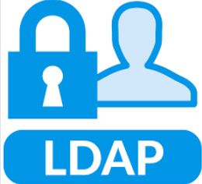

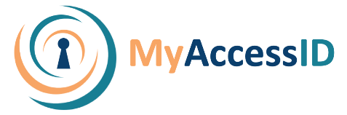
Identity & Access Architecture for AIRR at Cambridge
Before identity connector
Identity Broker
Realm | Behaviour
Realm1 | MyAccessID user login Non-MyAccessID user need local Keycloak account
Realm2 | Only users existing in LDAP can log in via MyAccessID or another user local Keycloak account
Realm1
Realm2
User is invited in a project
SSH Access
In Keycloak, users are realm-specific. A user in Realm1 is not visible in Realm2 unless:
the realms are federated via an IdP like MyAccessID, or
a separate user account exists in both realms
Admin overhead for creating local Keycloak accounts in each realm

Slide 7
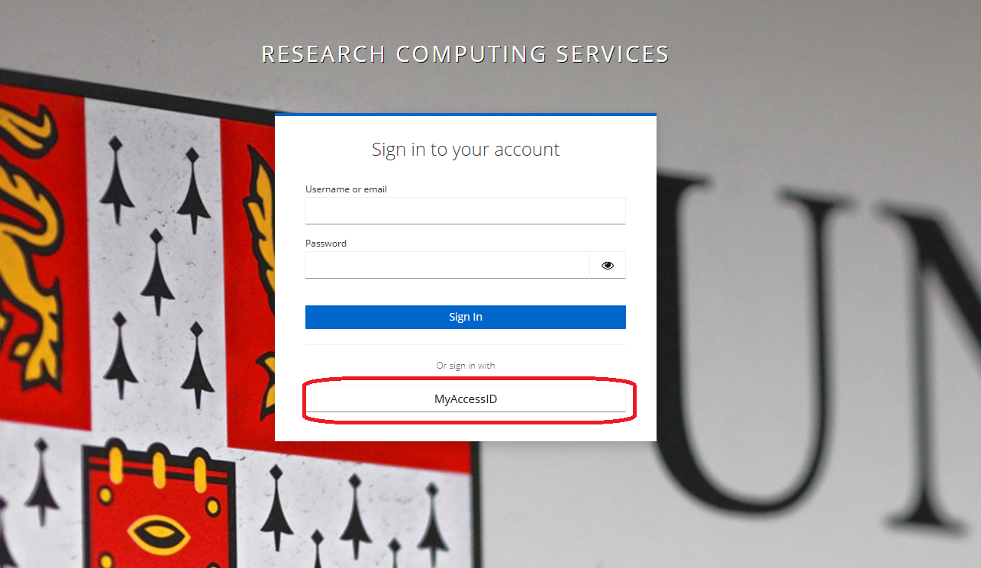

Slide 8
Identity & Access Architecture for AIRR at Cambridge
After identity connector Guest-IdP
Identity Broker
Realm | Behaviour
Ream3 Guest-IdP | User self-registers and gets userid (email) and password
Realm1 | MyAccessID user login Non-MyAccessID user login using Guest-IdP
Realm2 | Only users existing in LDAP can log in via MyAccessID or Guest-IdP
Realm1
Realm2
User is invited in a project
SSH Access
Guest-IdP users
Guest-IdP users
Realm3
Guest-IdP

Slide 9
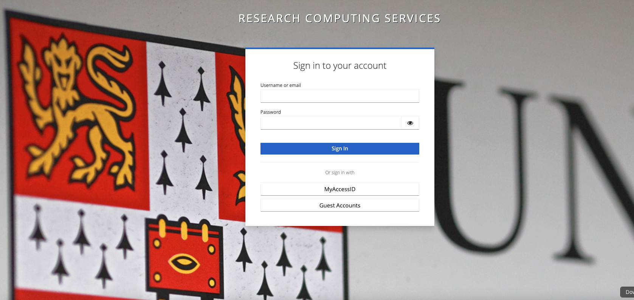

Slide 10
Guest-IdP (Identity Connector)
A central Keycloak Identity Provider that enables self-service onboarding for users who cannot authenticate via MyAccessID.
It gives us a single, reusable identity for external users without breaking federation or increasing operational overhead.
Before: Multiple identities across HPC services, manual onboarding
After: Single identity, self-service access

Slide 11
Summary
MyAccessID gives us a strong foundation
But real-world systems require flexibility
Identity connectors provide that flexibility without compromising security or increasing operational overhead

Slide 12

In-person Workshop-3, University of Cambridge on 6th June 2026
Thank You
Questions?
Project Website: https://myaccessid-uk.github.io/site/
NFCS project: https://nfcs-networkplus.ac.uk/projects/exploring-the-governance-requirements-for-enabling-uk-dris-to-adopt-myaccessid/

