Slide 1


MyAccessID Online Workshop Tuesday 2nd December 2025: 10am-12pm
NFCS NetworkPlus Project
Exploring the Governance Requirements for Enabling UK DRIs to Adopt MyAccessID
https://myaccessid-uk.github.io/site/workshops/MyAccessID-Online-Workshop
This workshop will be recorded

Slide 2
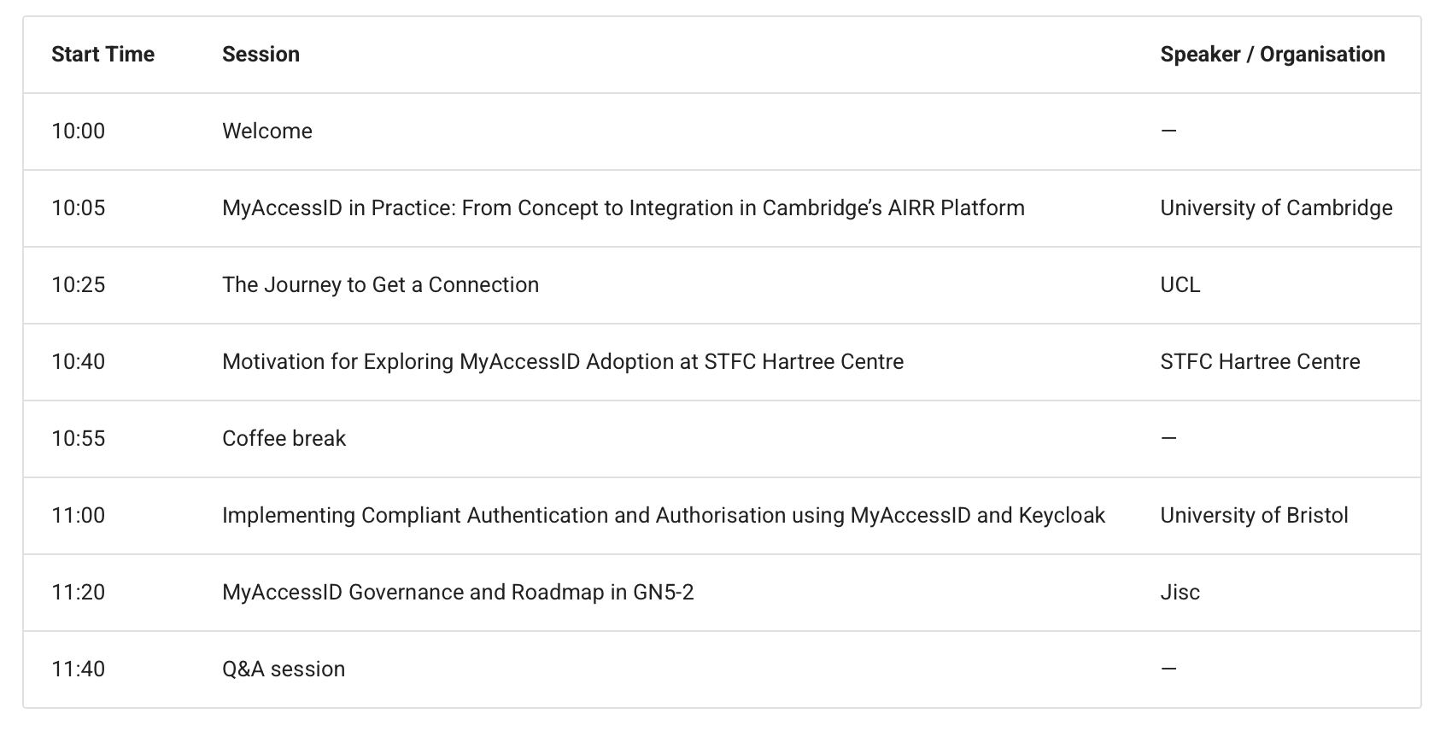

Slide 3


https://nfcs-networkplus.ac.uk

Slide 4
Exploring the governance requirements for enabling UK DRIs to adopt MyAccessID
We want to create a community of practice around the rollout of federated identity and access management across UK DRIs
The project will collect and publish case studies, technical documentation, compliance documentation etc. to help sites explore and adopt federated identity and access management solutions
Focus is MyAccessID and Keycloak – but happy to explore options with the community
GitHub repository, Mailing List (IAM4DRI@JISCMAIL.AC.UK), Website (https://myaccessid-uk.github.io/site) and workshops
Aim to build a supportive community that shares experiences and explores and develops best practice

