Slide 1




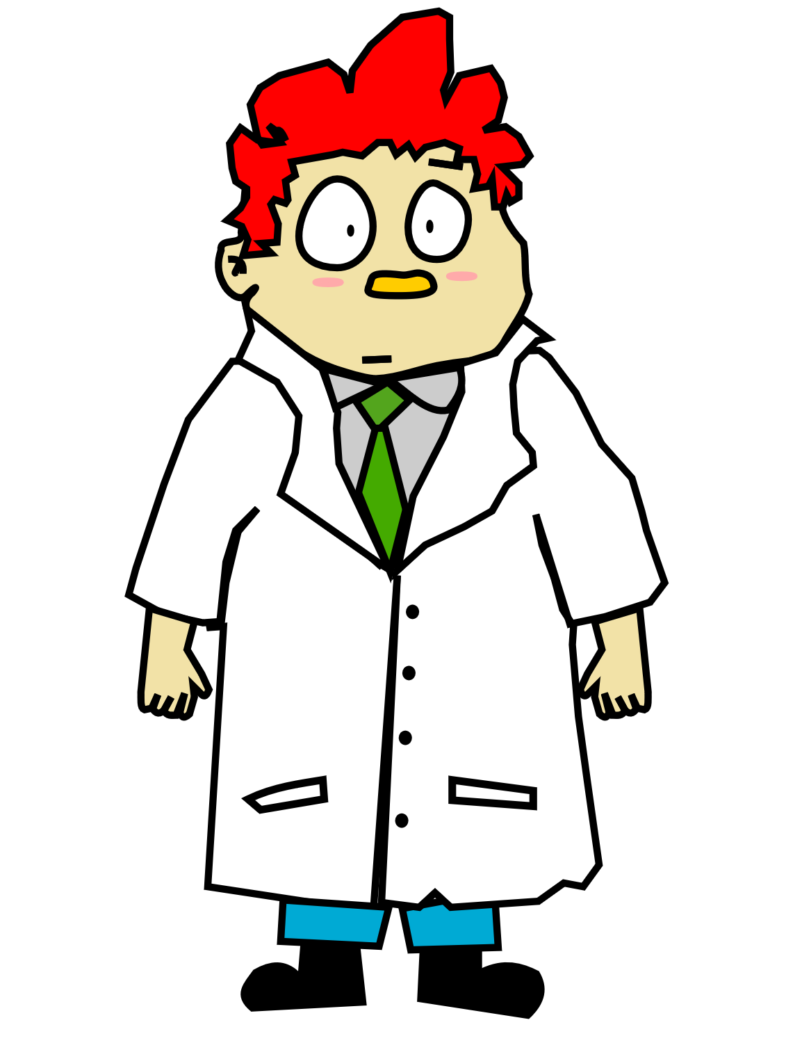




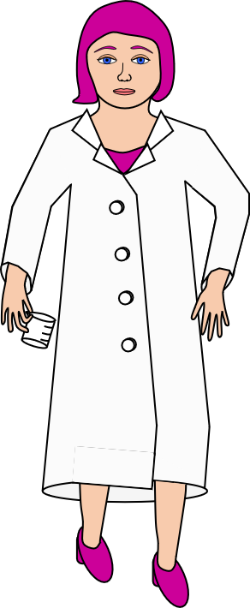

Centre for Advanced Research Computing
A digital home for your research group
ARC User Authentication
Your local team
- at home in their tenancy
Another University IdP
ARC CLOUD TENANCIES
Prof. Oversight (external user)
Group HQ
MyAccessID
University of Elsewhere IdP
Tenancy with compute and storage
Dr. Vital Collaborator
(external user)
PRIVATE CLOUD
Login request and access
Verification path for Dr. Vital Collaborator
Verification path difference for Prof. Oversight
= Identity Provider
MyAccessID is a broker facilitating access to diverse identity providers
IdP
The Project:
ARC at UCL is building a proof-of-concept private cloud tenancies for research groups using the MyAccessID service in the log in solution for external users, enabling all team members to process and access the group’s data with the same resources. No more access and synchronisation problems. The project will produce a case study on how to set this up and information on the regulatory issues to be faced, and, with its sister projects, will found a community of practice. Funded by: National Federated Compute Services NetworkPlus
Join the club:
The more institutions participate in MyAccessID the more useful it is! So:
Access home compute with MyAccessID
Connect your IdP to MyAccessID
Join the community of practice
More information:
Co-lead at UCL: j.legg@ucl.ac.uk (It’s my poster – talk to me!)
Community website: https://myaccessid-uk.github.io/site/ - includes workshops and mailing list sign up
https://wiki.geant.org/spaces/MyAccessID/pages/290717698/MyAccessID+Home
See also - https://www.ukfederation.org.uk/
Regulatory Issues:
Data Protection
Security
Eligibility
Employment Law
Dispute Resolution
Data Ownership
User Attribute Integrity
Funding
Incident Response
Jurisdictions
Clip art credits: All licensed as CC0 1.0 Universal, from openclipart.org:
https://openclipart.org/detail/16333/isometric-cloud-base - Ericlemerdy
https://openclipart.org/detail/170096/green-house - DominiqueChappard
https://openclipart.org/detail/174369/wall-2 - Jarda
https://openclipart.org/detail/308730/female-scientist-doing-research - GDJ
https://openclipart.org/detail/270563/african-scientist - J4p4n
https://openclipart.org/detail/231773/cartoon-scientist-guy - Dog99x
https://openclipart.org/detail/216555/scientist-with-purple-hair - Barnheartowl
https://openclipart.org/detail/334891/male-teacher-7 - Oksmith https://openclipart.org/detail/282240/dome - Firkin
https://openclipart.org/detail/231626/under-construction - Hochmohr
Notes:
Ensure sufficient contrast between your image and the ‘UCL’ cut out and banner
Make sure your image is at least 200 pixels per inch at the printed output size.
Always include an alt-tag description for any images used (right click on uploaded image > view alt text). Never mark the image as decorative as it won’t be read by a screen reader.

