Slide 1

Linux Concurrent Producer–Consumer System Using Semaphores
Team :
M Ramya Sree – 2520030094
S Lohitha – 2520030109
D Teja Sadwika - 2520030536

Slide 2

Problem Statement & Objectives
Goal
Build a user-space Producer–Consumer system using Linux system-programming primitives.
OS Interaction
Demonstrate use of the system-call interface to request kernel services from user space.
Process Control
Create and manage child processes with fork(), exec(), waitpid(), and orderly termination.
IPC & Base for Concurrency
Implement one-way IPC with an anonymous pipe; prepare for thread-based synchronization (mutexes, semaphores).

Slide 3

System Architecture
Runtime Flow
The parent process (main.c) creates an anonymous pipe, then forks two children. One child becomes the Producer (writes values to the pipe); the other becomes the Consumer (reads from the pipe). Parent monitors and reaps children using waitpid().
Parent: create pipe, fork, redirect, exec producers/consumers.
Producer → writes values to pipe.
Consumer ← reads values from pipe and prints them.

Slide 4
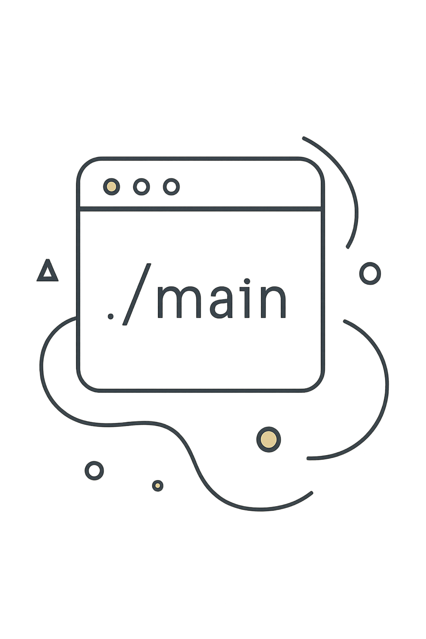
CO1 — Linux & System-Programming Foundation
The program is launched from a shell as a normal user-space executable. It exercises the Linux system-call interface to request OS services (process creation, I/O redirection, inter-process communication). This demonstrates the boundary between user space and kernel space and how applications rely on kernel-provided primitives.

Slide 5

CO2 — Process Control
01
fork()
Duplicate the calling process to create a parent/child pair.
02
execl()/execlp()
Replace child image with Producer or Consumer program binary.
03
waitpid()
Parent blocks (or polls) to collect child exit status and avoid zombies.
04
exit()
Terminate processes cleanly on completion or error.

Slide 6


CO3 — Inter-Process Communication
Key calls and redirections:
pipe(pipefd) — create a pair: pipefd[0] (read), pipefd[1] (write).
dup2(pipefd[1], STDOUT_FILENO) — Producer: standard output → pipe write end.
dup2(pipefd[0], STDIN_FILENO) — Consumer: standard input ← pipe read end.
Close unused ends in each process to avoid blocking and EOF issues.
Parent creates pipe
call pipe(pipefd) to open
Anonymous Pipe Data Flow
Consumer reads from pipe
Producer writes to pipe
dup2(pipefd[0], STDIN_FILENO)
dup2(pipefd[1], STDOUT_FILENO)
Data flow summary : Producer → Pipe → Consumer (one-way, stream of bytes).

Slide 7




Implementation
main.c
producer.c
consumer.c
README.md
Creates the pipe, forks children, sets up dup2 redirections, execl() calls, and waits for both children to complete.
Generates the sequence of values (10, 20, 30, 40, 50) and writes them to stdout (redirected into the pipe).
Reads values from stdin (pipe read end) and prints "Consumer received: " for each item.
Documents architecture, CO mapping, build and run instructions, and notes for future concurrency extension.

Slide 8
Testing & Result
Build & run (example):
gcc main.c -o main
gcc producer.c -o producer
gcc consumer.c -o consumer
./main
Observed output (condensed) :
=== Linux Producer-Consumer System === Pipe created successfully. Consumer started. Consumer received: 10 Consumer received: 20 Consumer received: 30 Consumer received: 40 Consumer received: 50 Consumer finished. Producer and Consumer completed successfully.

Slide 9





Technologies & OS Concepts Demonstrated
Execution Environment
Linux / WSL Ubuntu — process model and shell-based invocation.
Language & Toolchain
C with GCC — low-level control and POSIX APIs.
Process APIs
fork(), execl(), waitpid(), exit() — lifecycle and parent/child interactions.
IPC
Anonymous pipe, dup2(), stream redirection via standard I/O.
Scope: CO1–CO3 implemented. Synchronization mechanisms (mutexes, semaphores, threads) are reserved for the concurrency extension.

Slide 10
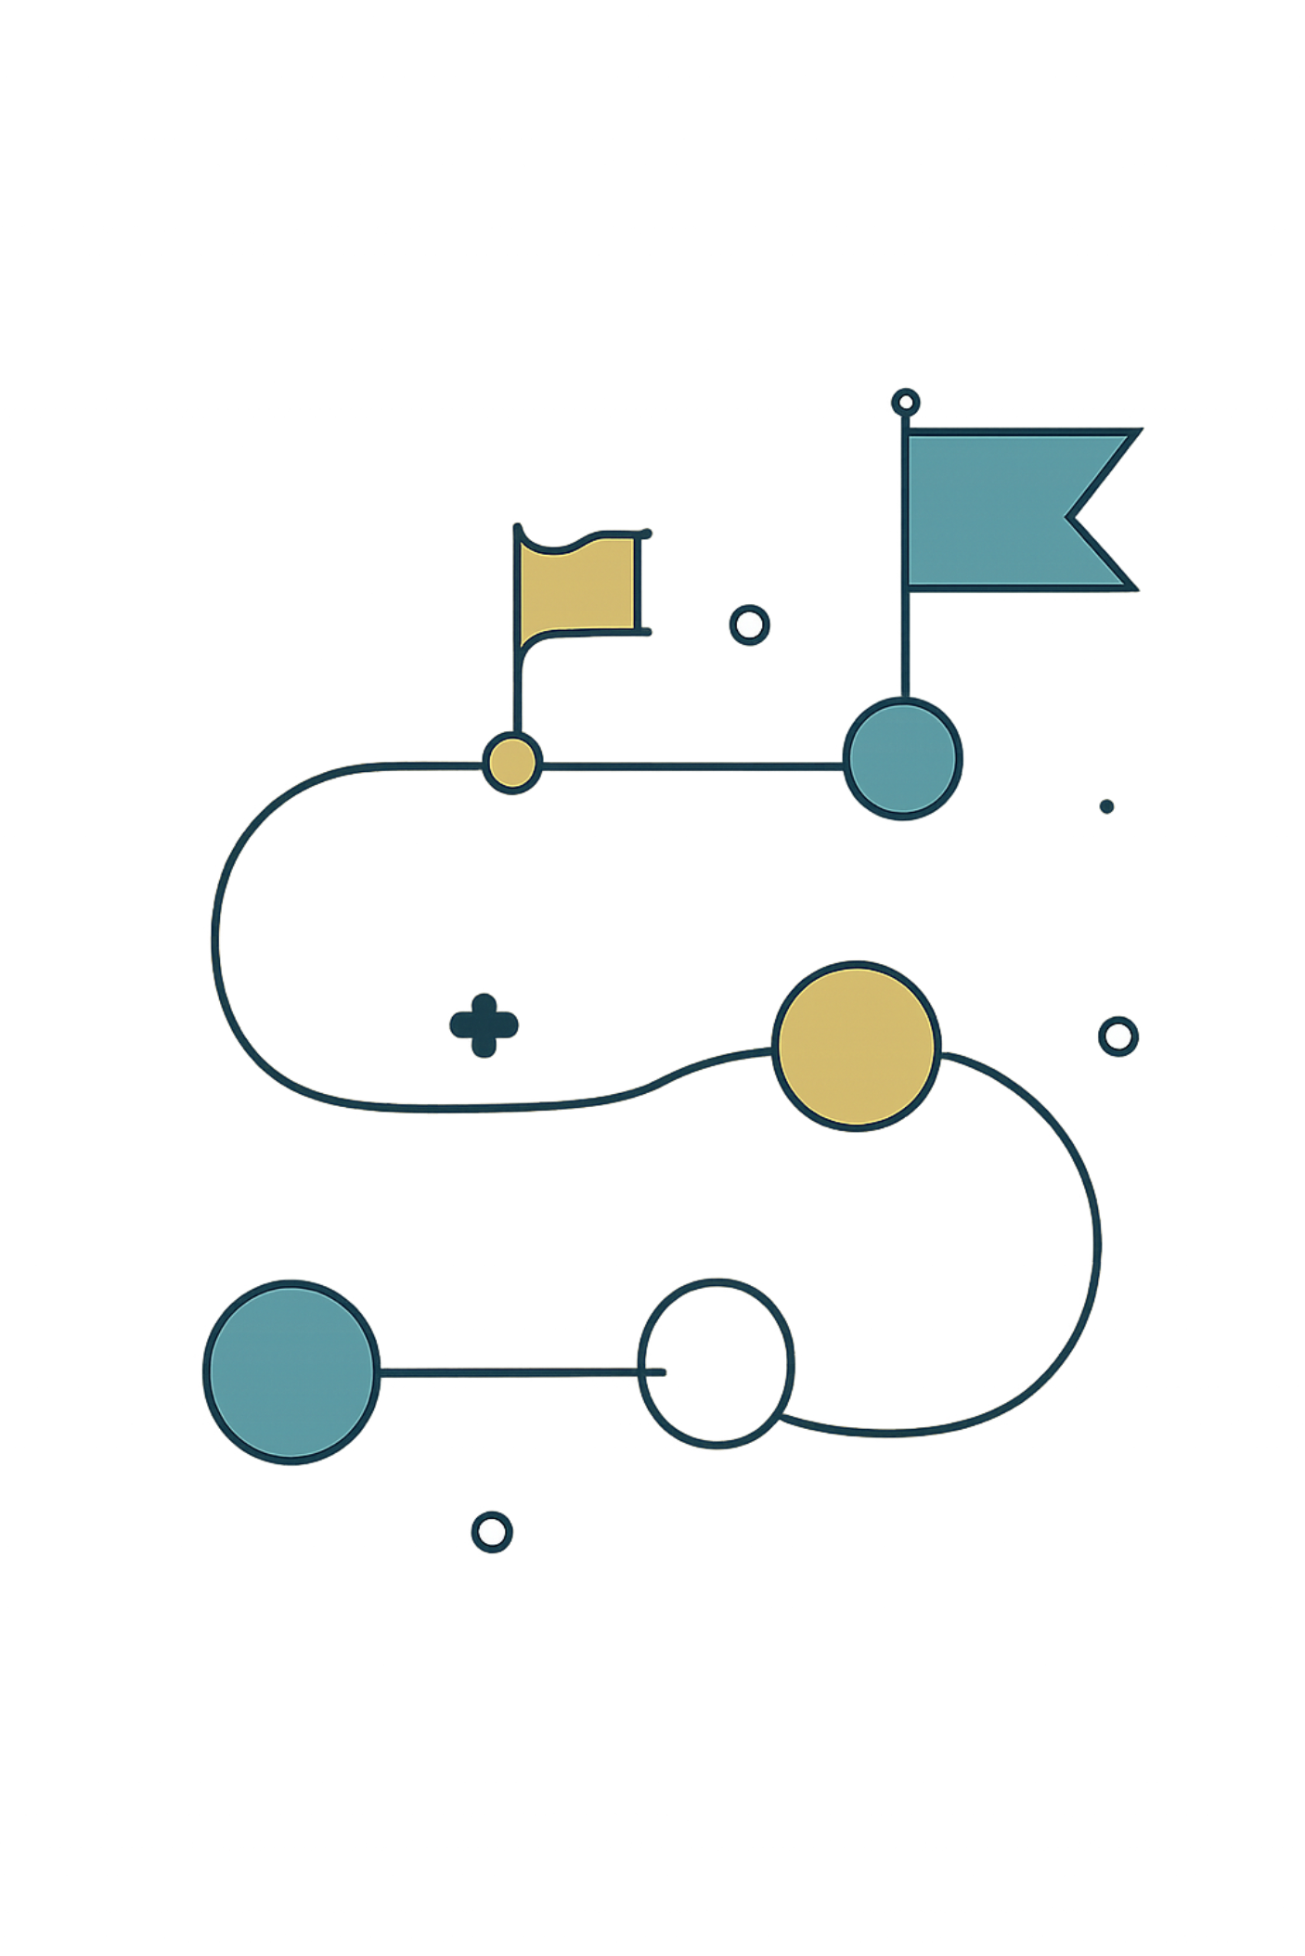
Conclusion & Future Extension
Current Achievement
Next Steps :
Working Producer–Consumer prototype using processes and an anonymous pipe.
CO1: System-programming fundamentals validated.
CO2: Process creation, exec, and reaping implemented.
CO3: One-way IPC via anonymous pipe verified.
Introduce POSIX threads (pthreads) to enable shared-memory producers/consumers.
Use mutexes and condition variables to protect shared buffers and signal availability.
Implement counting semaphores for buffer-slot accounting and synchronization.
Perform race-condition and deadlock analysis; add instrumentation and tests.

Slide 11
THANK YOU

