Slide 1
DEANNA: Natural Language Questions for the Web of Data
Mohamed Yahya† | Klaus Berberich† | Shady Elbassiousni*
Maya Ramanath‡ | Volker Tresp# | Gerhard Weikum†
† Max Planck Institute for Informatics | *Qatar Computing Research Institute | ‡IIT Delhi | # Siemens

Slide 2
“Classical” QA
“Who played in Casablanca and was married to a writer born in Rome?”

Slide 3
“Classical” QA
“Who played in Casablanca and was married to a writer born in Rome?”
Ingrid Bergman (29 August 1915 – 29 August 1982) was a Swedish actress who starred in a variety of European and American films. She won three Academy Awards, two Emmy Awards, and the Tony Award for Best Actress. She is ranked as the fourth greatest female star of American cinema of all time by the American Film Institute. She is best remembered for her roles as Ilsa Lund in Casablanca (1942), a World War II drama co-starring Humphrey Bogart and as Alicia Huberman in Notorious (1946), an Alfred Hitchcock thriller co-starring Cary Grant.

Slide 4
“Classical” QA
“Who played in Casablanca and was married to a writer born in Rome?”
Ingrid Bergman (29 August 1915 – 29 August 1982) was a Swedish actress who starred in a variety of European and American films. She won three Academy Awards, two Emmy Awards, and the Tony Award for Best Actress. She is ranked as the fourth greatest female star of American cinema of all time by the American Film Institute. She is best remembered for her roles as Ilsa Lund in Casablanca (1942), a World War II drama co-starring Humphrey Bogart and as Alicia Huberman in Notorious (1946), an Alfred Hitchcock thriller co-starring Cary Grant.
In 1950, after a decade of stardom in American films, she starred in the Italian film Stromboli, which led to a love affair with director Roberto Rossellini while they were both already married. The affair and then marriage with Rossellini created a scandal that forced her to remain in Europe until 1956, when she made a successful Hollywood return in Anastasia, for which she won her second Academy Award, as well as the forgiveness of her fans. Many of her personal and film documents can be seen in the Wesleyan University Cinema Archives.^{[4]}

Slide 5
“Classical” QA
“Who played in Casablanca and was married to a writer born in Rome?”
Ingrid Bergman (29 August 1915 – 29 August 1982) was a Swedish actress who starred in a variety of European and American films. She won three Academy Awards, two Emmy Awards, and the Tony Award for Best Actress. She is ranked as the fourth greatest female star of American cinema of all time by the American Film Institute. She is best remembered for her roles as Ilsa Lund in Casablanca (1942), a World War II drama co-starring Humphrey Bogart and as Alicia Huberman in Notorious (1946), an Alfred Hitchcock thriller co-starring Cary Grant.
In 1950, after a decade of stardom in American films, she starred in the Italian film Stromboli, which led to a love affair with director Roberto Rossellini while they were both already married. The affair and then marriage with Rossellini created a scandal that forced her to remain in Europe until 1956, when she made a successful Hollywood return in Anastasia, for which she won her second Academy Award, as well as the forgiveness of her fans. Many of her personal and film documents can be seen in the Wesleyan University Cinema Archives.^{[4]}
Roberto Gastone Zeffiro Rossellini (8 May 1906 – 3 June 1977) was an Italian film director and screenwriter. Rossellini was one of the directors of the Italian neorealist cinema, contributing films such as Roma città aperta (Rome, Open City 1945) to the movement.

Slide 6
“Classical” QA
“Who played in Casablanca and was married to a writer born in Rome?”
Ingrid Bergman (29 August 1915 – 29 August 1982) was a Swedish actress who starred in a variety of European and American films. She won three Academy Awards, two Emmy Awards, and the Tony Award for Best Actress. She is ranked as the fourth greatest female star of American cinema of all time by the American Film Institute. She is best remembered for her roles as Ilsa Lund in Casablanca (1942), a World War II drama co-starring Humphrey Bogart and as Alicia Huberman in Notorious (1946), an Alfred Hitchcock thriller co-starring Cary Grant.
Rossellini was born in Rome. His mother, Elettra (née Bellan), was a housewife, and his father, Angiolo Giuseppe "Beppino" Rossellini, owned a construction firm. His mother was of part French descent, from immigrants who had arrived in Italy during the Napoleonic Wars. He lived on the Via Ludovisi, whereBenito Mussolini had his first Roman hotel in 1922 when Fascism obtained power in Italy.
In 1950, after a decade of stardom in American films, she starred in the Italian film Stromboli, which led to a love affair with director Roberto Rossellini while they were both already married. The affair and then marriage with Rossellini created a scandal that forced her to remain in Europe until 1956, when she made a successful Hollywood return in Anastasia, for which she won her second Academy Award, as well as the forgiveness of her fans. Many of her personal and film documents can be seen in the Wesleyan University Cinema Archives.^{[4]}
Roberto Gastone Zeffiro Rossellini (8 May 1906 – 3 June 1977) was an Italian film director and screenwriter. Rossellini was one of the directors of the Italian neorealist cinema, contributing films such as Roma città aperta (Rome, Open City 1945) to the movement.

Slide 7
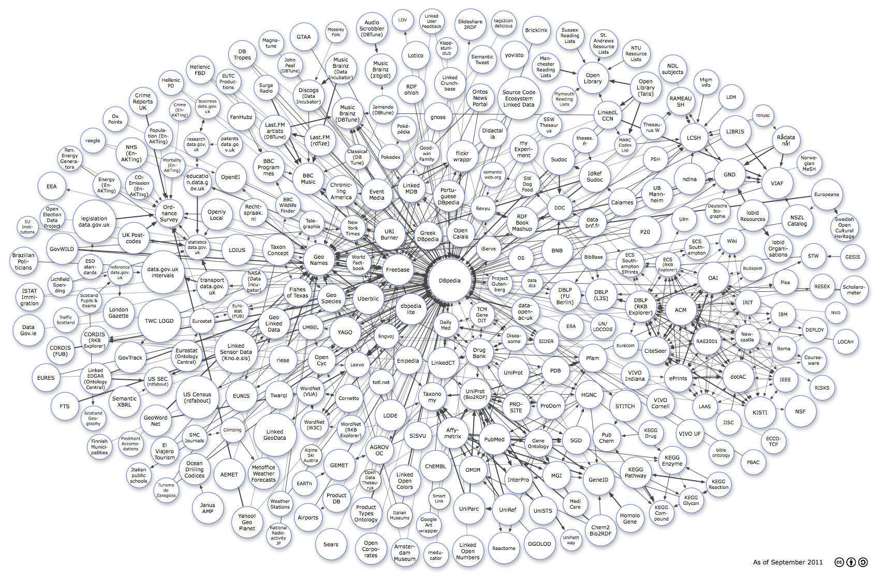
QA, meet the (semantic) Web of Data

Slide 8
QA, meet the (semantic) Web of Data

Slide 9
QA, meet the (semantic) Web of Data

Slide 10



QA, meet the (semantic) Web of Data
WordNet
+
Subject Predicate Object
Rome isA city
city subclassOf location
Roberto_Rossellini mariedTo Ingrid_Bergman

Slide 11
QA, meet the (semantic) Web of Data
WordNet
+
YAGO2: 120 million facts on 10 million entities
Subject Predicate Object
Rome isA city
city subclassOf location
Roberto_Rossellini mariedTo Ingrid_Bergman

Slide 12

QA, meet the (semantic) Web of Data
WordNet
+
YAGO2: 120 million facts on 10 million entities
Subject Predicate Object
Rome isA city
city subclassOf location
Roberto_Rossellini mariedTo Ingrid_Bergman

Slide 13

QA, meet the (semantic) Web of Data
WordNet
+
YAGO2: 120 million facts on 10 million entities
Subject Predicate Object
Rome isA city
city subclassOf location
Roberto_Rossellini mariedTo Ingrid_Bergman

Slide 14
QA, meet the (semantic) Web of Data
LOD: > 31 BILLION triples
WordNet
+
YAGO2: 120 million facts on 10 million entities
Subject Predicate Object
Rome isA city
city subclassOf location
Roberto_Rossellini mariedTo Ingrid_Bergman

Slide 15

Semantics Types
U.S. Cities
Its largest airport was named for a World War II hero; its second largest, for a World War II battle
What is
Toronto???

Slide 16
Crash Course: Querying the Web of Data
“Who played in Casablanca and was married to a writer born in Rome?”

Slide 17
Crash Course: Querying the Web of Data
“Who played in Casablanca and was married to a writer born in Rome?”
SELECT ?p WHERE{
?p type person .
?p actedIn Casablanca_(film).
?p isMarriedTo ?w .
?w type writer .
?w bornIn Rome }
SPARQL

Slide 18
Crash Course: Querying the Web of Data
“Who played in Casablanca and was married to a writer born in Rome?”
Projection Variable
SELECT ?p WHERE{
?p type person .
?p actedIn Casablanca_(film).
?p isMarriedTo ?w .
?w type writer .
?w bornIn Rome }
SPARQL

Slide 19
Crash Course: Querying the Web of Data
“Who played in Casablanca and was married to a writer born in Rome?”
Dot: conjunction
Projection Variable
SELECT ?p WHERE{
?p type person .
?p actedIn Casablanca_(film).
?p isMarriedTo ?w .
?w type writer .
?w bornIn Rome }
SPARQL

Slide 20
Crash Course: Querying the Web of Data
“Who played in Casablanca and was married to a writer born in Rome?”
Dot: conjunction
?p, ?w: variables to be bound
Projection Variable
SELECT ?p WHERE{
?p type person .
?p actedIn Casablanca_(film).
?p isMarriedTo ?w .
?w type writer .
?w bornIn Rome }
SPARQL

Slide 21
Crash Course: Querying the Web of Data
“Who played in Casablanca and was married to a writer born in Rome?”
Dot: conjunction
?p, ?w: variables to be bound
Same variable → same binding (join)
Projection Variable
SELECT ?p WHERE{
?p type person .
?p actedIn Casablanca_(film).
?p isMarriedTo ?w .
?w type writer .
?w bornIn Rome }
SPARQL

Slide 22
Crash Course: Querying the Web of Data
“Who played in Casablanca and was married to a writer born in Rome?”
Dot: conjunction
?p, ?w: variables to be bound
Same variable → same binding (join)
Projection Variable
SELECT ?p WHERE{
?p type person .
?p actedIn Casablanca_(film).
?p isMarriedTo ?w .
?w type writer .
?w bornIn Rome }
SPARQL
?p ?w

Slide 23
What is DEANNA?
Question
DEANNA
SPARQL
KB
Answers

Slide 24
What is DEANNA?
Question
“Who played in Casablanca and was married to a writer born in Rome?”
DEANNA
SPARQL
KB
Answers

Slide 25
What is DEANNA?
Question
“Who played in Casablanca and was married to a writer born in Rome?”
DEANNA
?p type person.
?p actedIn Casablanca_(film).
?p isMarriedTo ?w.
?w type writer .
?w bornIn Rome .
SPARQL
KB
Answers

Slide 26
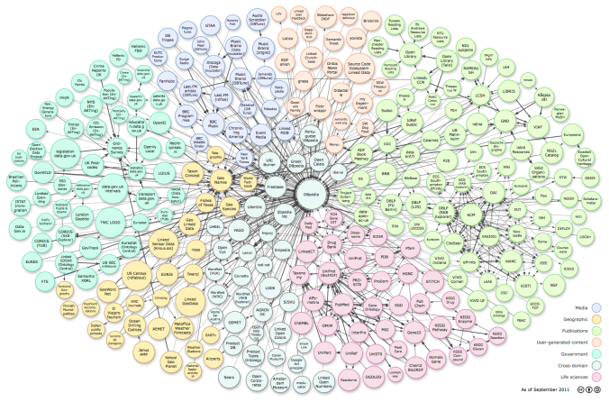
What is DEANNA?
Question
“Who played in Casablanca and was married to a writer born in Rome?”
DEANNA
?p type person.
?p actedIn Casablanca_(film).
?p isMarriedTo ?w.
?w type writer .
?w bornIn Rome .
SPARQL
KB
Answers

Slide 27
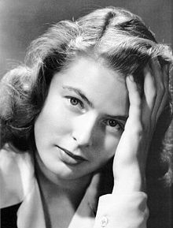
What is DEANNA?
Question
“Who played in Casablanca and was married to a writer born in Rome?”
DEANNA
?p type person.
?p actedIn Casablanca_(film).
?p isMarriedTo ?w.
?w type writer .
?w bornIn Rome .
SPARQL
KB
Answers

Slide 28
Inside DEANNA
Question
DEANNA
SPARQL
KB
Answers

Slide 29
Inside DEANNA
Question
Phrase detection
DEANNA
Phrase
mapping
Dependency
detection
SPARQL
Joint
Disambig.
KB
Query
Generation
Answers

Slide 30
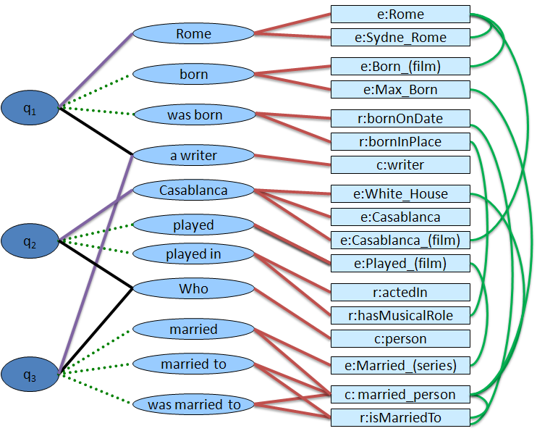
Inside DEANNA
Question
Phrase detection
DEANNA
Phrase
mapping
Dependency
detection
SPARQL
Joint
Disambig.
KB
Query
Generation
Answers

Slide 31
Inside DEANNA
Question
Phrase detection
DEANNA
Phrase
mapping
Dependency
detection
SPARQL
Joint
Disambig.
KB
Query
Generation
Answers

Slide 32
Inside DEANNA
Question
Phrase detection
DEANNA
Phrase
mapping
Dependency
detection
SPARQL
Joint
Disambig.
KB
Query
Generation
Answers

Slide 33
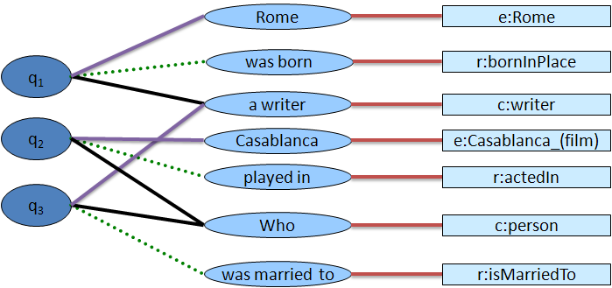
Inside DEANNA
Question
Phrase detection
DEANNA
Phrase
mapping
Dependency
detection
SPARQL
Joint
Disambig.
KB
Query
Generation
Answers

Slide 34
Inside DEANNA
Question
Phrase detection
DEANNA
Phrase
mapping
Dependency
detection
SPARQL
Joint
Disambig.
KB
Query
Generation
Answers

Slide 35
Structured Query Generation
Rome
e:Rome
q₁
was born
r:bornInPlace
a writer
c:writer
q₂
Casablanca
e:Casablanca_(film)
played in
r:actedIn
q₃
Who
c:person
was married to
r:isMarriedTo
SELECT ?p WHERE {
?p type person.
?p actedIn Casablanca_(film).
?p isMarriedTo ?w.
?w type writer .
?w bornIn Rome }

Slide 36
Outline
Question
Phrase detection
1
DEANNA
Phrase
mapping
Disambiguation graph construction
2
3
Dependency
detection
SPARQL
Joint
Disambig.
KB
Disambiguation graph processing
4
Query
Generation
5
Experiments & Results

Slide 37
Outline
Question
Phrase detection
1
DEANNA
Phrase
mapping
2
3
Dependency
detection
SPARQL
Joint
Disambig.
KB
4
Query
Generation
5
Experiments & Results

Slide 38
Phrase Detection
Concepts: entities & classes: Dictionary-based
Relations:
Mainly use Reverb [Fader et al. EMNLP’11]: V | VP | VW*P
… was/VBD married/VBN to/TO a/DT…
Concept | Phrase
Casablanca | Casablanca
Casablanca | Casablanca, Morocco
Casablanca_(film) | Casablanca the film
Casablanca_(film) | Casablanca
… | …

Slide 39
Phrase Detection
Concepts: entities & classes: Dictionary-based
Relations:
Mainly use Reverb [Fader et al. EMNLP’11]: V | VP | VW*P
… was/VBD married/VBN to/TO a/DT…
Concept | Phrase
Casablanca | Casablanca
Casablanca | Casablanca, Morocco
Casablanca_(film) | Casablanca the film
Casablanca_(film) | Casablanca
… | …
a writer
Casablanca
played
played in
Who
married
married to
was married to

Slide 40
Phrase Detection
Concepts: entities & classes: Dictionary-based
Relations:
Mainly use Reverb [Fader et al. EMNLP’11]: V | VP | VW*P
… was/VBD married/VBN to/TO a/DT…
Concept | Phrase
Casablanca | Casablanca
Casablanca | Casablanca, Morocco
Casablanca_(film) | Casablanca the film
Casablanca_(film) | Casablanca
… | …
a writer
Casablanca
played
played in
Who
married
married to
was married to

Slide 41
Outline
Question
Phrase detection
1
Phrase
mapping
DEANNA
2
Dependency
detection
3
SPARQL
Joint
Disambig.
KB
4
Query
Generation
5
Experiments & Results

Slide 42
Outline
Question
Phrase detection
1
Phrase
mapping
DEANNA
2
Dependency
detection
3
SPARQL
Joint
Disambig.
KB
4
Query
Generation
5
Experiments & Results

Slide 43
Phrase Mapping
Casablanca
played
played in

Slide 44
Phrase Mapping
Concepts: entities & classes: Dictionary-based
Concept | Phrase
Casablanca | Casablanca
Casablanca | Casablanca, Morocco
Casablanca_(film) | Casablanca the film
Casablanca_(film) | Casablanca
Played_(film) | Played
Casablanca
played
played in

Slide 45
Phrase Mapping
Concepts: entities & classes: Dictionary-based
Concept | Phrase
Casablanca | Casablanca
Casablanca | Casablanca, Morocco
Casablanca_(film) | Casablanca the film
Casablanca_(film) | Casablanca
Played_(film) | Played
Casablanca
e:White_House
played
e:Casablanca
e:Casablanca_(film)
played in
e:Played_(film)

Slide 46
Phrase Mapping
Concepts: entities & classes: Dictionary-based
Relations: Dictionary -based
Concept | Phrase
Casablanca | Casablanca
Casablanca | Casablanca, Morocco
Casablanca_(film) | Casablanca the film
Casablanca_(film) | Casablanca
Played_(film) | Played
Casablanca
e:White_House
played
e:Casablanca
e:Casablanca_(film)
played in
e:Played_(film)
Relation | Phrase
actedIn | acted in
actedIn | played in
hasMusicalRole | plays
hasMusicalRole | mastered

Slide 47
Phrase Mapping
Concepts: entities & classes: Dictionary-based
Relations: Dictionary -based
Concept | Phrase
Casablanca | Casablanca
Casablanca | Casablanca, Morocco
Casablanca_(film) | Casablanca the film
Casablanca_(film) | Casablanca
Played_(film) | Played
Casablanca
e:White_House
played
e:Casablanca
e:Casablanca_(film)
played in
e:Played_(film)
r:actedIn
r:hasMusicalRole
Relation | Phrase
actedIn | acted in
actedIn | played in
hasMusicalRole | plays
hasMusicalRole | mastered

Slide 48
Outline
Question
Phrase detection
1
Phrase
mapping
DEANNA
2
Dependency
detection
3
SPARQL
Joint
Disambig.
KB
4
Query
Generation
5
Experiments & Results

Slide 49
Outline
Question
Phrase detection
1
Phrase
mapping
DEANNA
2
Dependency
detection
3
SPARQL
Joint
Disambig.
KB
4
Query
Generation
5
Experiments & Results

Slide 50
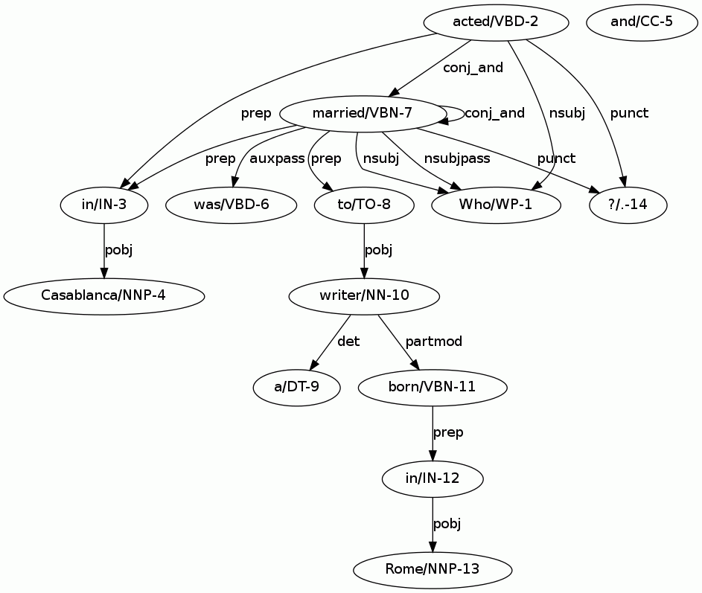
Dependency Detection
Look for specific patterns in dependency parses
[de Marneffe et al. LREC’06]
e:Rome
Rome
e:Sydne_Rome
born
e:Born_(film)
e:Max_Born
was born
r:bornOnDate
r:bornInPlace
a writer
c:writer

Slide 51
Dependency Detection
Look for specific patterns in dependency parses
[de Marneffe et al. LREC’06]
e:Rome
Rome
e:Sydne_Rome
born
e:Born_(film)
e:Max_Born
was born
r:bornOnDate
r:bornInPlace
a writer
c:writer

Slide 52
Dependency Detection
Look for specific patterns in dependency parses
[de Marneffe et al. LREC’06]
e:Rome
Rome
e:Sydne_Rome
born
e:Born_(film)
e:Max_Born
was born
r:bornOnDate
writer
r:bornInPlace
partmod
a writer
c:writer
born
prep
in
pobj
Rome

Slide 53
Dependency Detection
Look for specific patterns in dependency parses
[de Marneffe et al. LREC’06]
e:Rome
Rome
e:Sydne_Rome
born
e:Born_(film)
q₁
e:Max_Born
was born
r:bornOnDate
writer
r:bornInPlace
partmod
a writer
c:writer
born
prep
in
pobj
Rome

Slide 54
Result

Slide 55
Disambiguation Graph
Semantic nodes
Phrase-nodes
e:Rome
Rome
e:Sydne_Rome
q-nodes
born
e:Born_(film)
q₁
e:Max_Born
was born
r:bornOnDate
r:bornInPlace
a writer
c:writer
Casablanca
e:White_House
played
e:Casablanca
q₂
e:Casablanca_(film)
played in
e:Played_(film)
Who
r:actedIn
r:hasMusicalRole
married
c:person
q₃
married to
e:Married_(series)
was married to
c: married_person
r:isMarriedTo

Slide 56
Outline
Question
Phrase detection
1
Phrase
mapping
DEANNA
2
Dependency
detection
3
SPARQL
Joint
Disambig.
KB
4
Query
Generation
5
Experiments & Results

Slide 57
Outline
Question
Phrase detection
1
Phrase
mapping
DEANNA
2
Dependency
detection
3
SPARQL
Joint
Disambig.
KB
4
Query
Generation
5
Experiments & Results

Slide 58
Outline
Question
Phrase detection
1
Phrase
mapping
DEANNA
2
Dependency
detection
3
SPARQL
Joint
Disambig.
KB
4
Query
Generation
5
Experiments & Results

Slide 59

Joint Disambiguation - ILP
ILP: Integer Linear Programming
maximize α Σi,j wi,jYi,j + β Σk,l vk,l Zk,l + …
Subject to:
No token in multiple phrases,
Triples observe type constraints, …

Slide 60
Joint Disambiguation – Objective
Semantic nodes
Phrase nodes
Similarity Edges
e:Rome
Rome
e:Sydne_Rome
Coherence Edges
q-nodes
e:Born_(film)
born
e:Max_Born
q₁
was born
r:bornOnDate
r:bornInPlace
a writer
c:writer
α Σi,j wi,jYi,j + β Σk,l vk,l Zk,l
Prior

Slide 61
Joint Disambiguation – Objective
Semantic nodes
Phrase nodes
Similarity Edges
e:Rome
Rome
e:Sydne_Rome
Coherence Edges
q-nodes
e:Born_(film)
born
e:Max_Born
q₁
was born
r:bornOnDate
r:bornInPlace
a writer
c:writer
α Σi,j wi,jYi,j + β Σk,l vk,l Zk,l
Coherence

Slide 62
Joint Disambiguation – Constraints
A phrase node can be assigned to one semantic node:
Semantic nodes
Y_{a,1}
1
Phrase nodes
e:White_House
a
Y_{a,2}
Casablanca
e:Casablanca
2
Y_{a,3}
3
e:Casablanca_(film)
α Σi,j wi,jYi,j + β Σk,l vk,l Zk,l

Slide 63
Joint Disambiguation – Constraints
A phrase node can be assigned to one semantic node:
Semantic nodes
Y_{a,1}
1
Phrase nodes
e:White_House
a
Y_{a,2}
Casablanca
e:Casablanca
2
Y_{a,3}
3
e:Casablanca_(film)
α Σi,j wi,jYi,j + β Σk,l vk,l Zk,l

Slide 64
Joint Disambiguation – Constraints
Classes translate to type-constrained variables
→ Every semantic triple should have a class to join & project!
person actedIn Casablanca_(film)
▼
?x type person . ?x actedIn Casablanca_(film)

Slide 65
Joint Disambiguation – Constraints
Classes translate to type-constrained variables
→ Every semantic triple should have a class to join & project!
person actedIn Casablanca_(film)
▼
?x type person . ?x actedIn Casablanca_(film)

Slide 66
Joint Disambiguation – Constraints
Classes translate to type-constrained variables
→ Every semantic triple should have a class to join & project!
person actedIn Casablanca_(film)
▼
?x type person . ?x actedIn Casablanca_(film)
Phrase nodes
Semantic nodes
e:Rome
Rome
q-nodes
e:Sydne_Rome
q₁
r:bornOnDate
was born
r:bornInPlace
e:The_Writer (magazine)
a writer
c:writer

Slide 67
Joint Disambiguation – Constraints
Classes translate to type-constrained variables
→ Every semantic triple should have a class to join & project!
person actedIn Casablanca_(film)
▼
?x type person . ?x actedIn Casablanca_(film)
Phrase nodes
Semantic nodes
e:Rome
Rome
q-nodes
e:Sydne_Rome
q₁
r:bornOnDate
was born
r:bornInPlace
e:The_Writer (magazine)
a writer
c:writer

Slide 68
Joint Disambiguation – Constraints
Classes translate to type-constrained variables
→ Every semantic triple should have a class to join & project!
person actedIn Casablanca_(film)
▼
?x type person . ?x actedIn Casablanca_(film)
Phrase nodes
Semantic nodes
e:Rome
Rome
q-nodes
e:Sydne_Rome
q₁
r:bornOnDate
was born
r:bornInPlace
e:The_Writer (magazine)
a writer
c:writer

Slide 69
Outline
Question
Phrase detection
1
Phrase
mapping
DEANNA
2
Dependency
detection
3
SPARQL
Joint
Disambig.
KB
4
Query
Generation
5
Experiments & Results

Slide 70
Outline
Question
Phrase detection
1
Phrase
mapping
DEANNA
2
Dependency
detection
3
SPARQL
Joint
Disambig.
KB
4
Query
Generation
5
Experiments & Results

Slide 71
Structured Query Generation
Rome
e:Rome
q₁
was born
r:bornIn
a writer
c:writer
q₂
Casablanca
e:Casablanca_(film)
played in
r:actedIn
q₃
Who
c:person
was married to
r:isMarriedTo
SELECT ?p WHERE {
?w type writer .
?w bornIn Rome .
?p type person.
?p actedIn Casablanca_(film).
?p isMarriedTo ?w }

Slide 72
Outline
Question
Phrase detection
1
Phrase
mapping
DEANNA
2
Dependency
detection
3
SPARQL
Joint
Disambig.
KB
4
Query
Generation
5
Experiments & Results

Slide 73
Outline
Question
Phrase detection
1
Phrase
mapping
DEANNA
2
Dependency
detection
3
SPARQL
Joint
Disambig.
KB
4
Query
Generation
5
Experiments & Results

Slide 74
Evaluation Methodology
3-stage evaluation for more insight:
Disambiguation
Query generation
Query answering
We rely on human judges

Slide 75
Datasets
QALD-1
YAGO2
27/50 questions within scope
“Which software has been published by Mean Hamster Software?”
NAGA [Elbassuoni et al. CIKM’09]
YAGO+IMDB
44/87 questions within scope
“Which director has won the Academy Award for Best director and is married to an actress that has won the Academy Award for Best Actress?”

Slide 76
Results 1/3: Disambiguation
e:White_House
Casablanca
e:Casablanca
e:Casablanca_(film)
Benchmark | QALD-1 | NAGA
covmacro | 0.973 | 0.934
precmacro | 1.000 | 0.934
covmicro | 0.963 | 0.945
precmicro | 1.000 | 0.941
cov = correct/ideal
prec = correct / retrieved

Slide 77
Results 2/3: Query Generation
Issues:
Incorrect disambiguation
Incorrect dependencies.
Benchmark | QALD-1 | NAGA
covmacro | 0.975 | 0.894
precmacro | 1.000 | 0.941
covmicro | 0.963 | 0.847
precmicro | 1.000 | 0.906
cov = #correct triples/#ideal triples
prec = #correct triples/#retrieved triples

Slide 78
Results 3/3: Answering
Benchmark | QALD-1 | NAGA
#questions | 27 | 44
#queries | 20 | 41
#satisfactory | 10 | 15
#relaxed | +3 | +3

Slide 79
Results 3/3: Answering
Benchmark | QALD-1 | NAGA
#questions | 27 | 44
#queries | 20 | 41
#satisfactory | 10 | 15
#relaxed | +3 | +3
unsatisfactory: main problem is
empty result set

Slide 80
Results 3/3: Answering
Relaxation: Keep type constraints, everything else to keywords
?x type writer . ?x bornIn Rome
▼
?x type writer . ?x bornIn ?y [“Rome”]
Benchmark | QALD-1 | NAGA
#questions | 27 | 44
#queries | 20 | 41
#satisfactory | 10 | 15
#relaxed | +3 | +3
unsatisfactory: main problem is
empty result set

Slide 81
Wrap-up
Question
DEANNA
SPARQL
KB
Answers

Slide 82
Wrap-up
Question
“Who played in Casablanca and was married to a writer born in Rome?”
DEANNA
SPARQL
KB
Answers

Slide 83
Wrap-up
Question
“Who played in Casablanca and was married to a writer born in Rome?”
DEANNA
SPARQL
KB
Answers

Slide 84
Wrap-up
Question
“Who played in Casablanca and was married to a writer born in Rome?”
DEANNA
SPARQL
?p type person.
?p actedIn Casablanca_(film).
?p isMarriedTo ?w.
?w type writer .
?w bornIn Rome
KB
Answers

Slide 85
Wrap-up
Question
“Who played in Casablanca and was married to a writer born in Rome?”
DEANNA
Rome isA city
city subclassOf location
Rossellini mariedTo Bergman
SPARQL
?p type person.
?p actedIn Casablanca_(film).
?p isMarriedTo ?w.
?w type writer .
?w bornIn Rome
KB
Answers

Slide 86
Wrap-up
Question
“Who played in Casablanca and was married to a writer born in Rome?”
DEANNA
Rome isA city
city subclassOf location
Rossellini mariedTo Bergman
SPARQL
?p type person.
?p actedIn Casablanca_(film).
?p isMarriedTo ?w.
?w type writer .
?w bornIn Rome
KB
Answers

Slide 87

Questions/comments?
Thank you.
bit.ly/mpi-deanna

