Slide 1
NMAP Commands

Slide 2
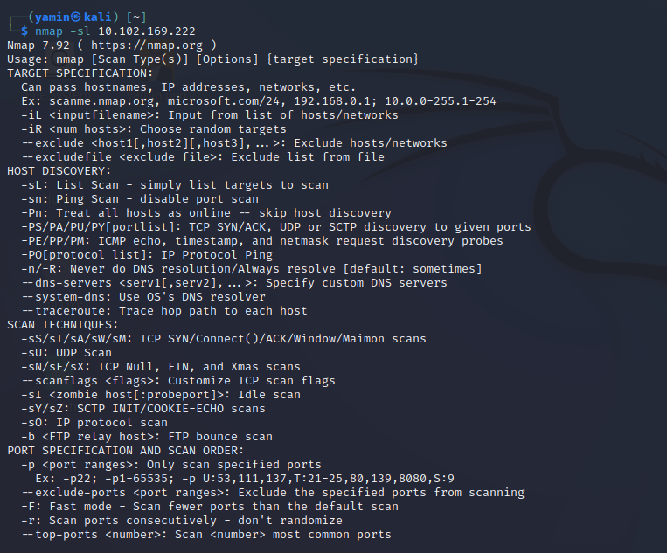
Nmap –sl 10.102.169.222
find hostnames for the given host by completing a DNS query for each one

Slide 3
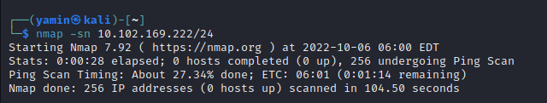
Nmap –sn 10.102.169.222/24
tells Nmap not to do a port scan after host discovery, and only print out the available hosts that responded to the scan

Slide 4
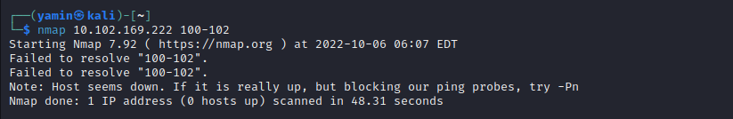
Nmap 10.102.169.222 100-102
Find Open Ports on Hosts:

Slide 5
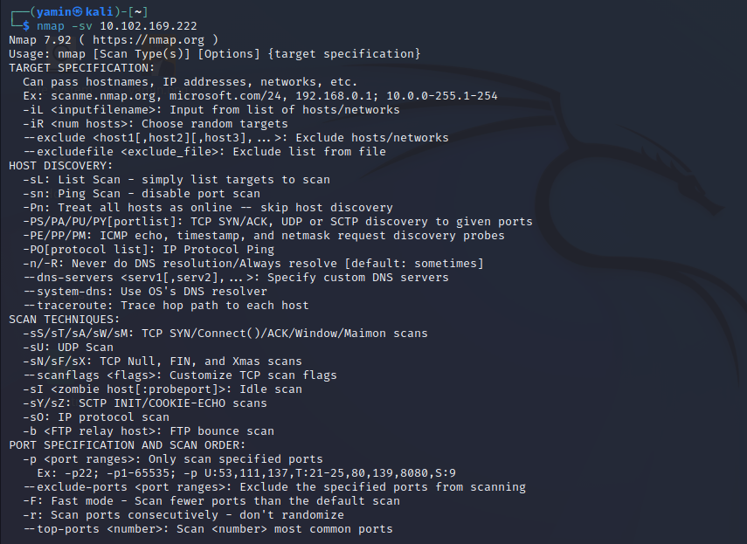
Nmap –sV 10.102.169.222
Finding Services Listening on Ports on Hosts

Slide 6
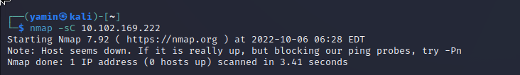
nmap -sC 10.102.169.222
Find Anonymous FTP Logins on Hosts

Slide 7
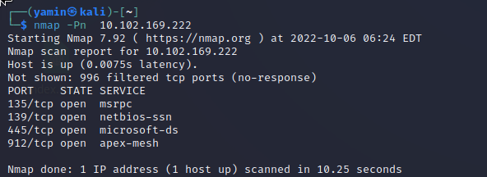
Nmap –nP 10.102.169.222
This option skips the host discovery stage altogether

Slide 8
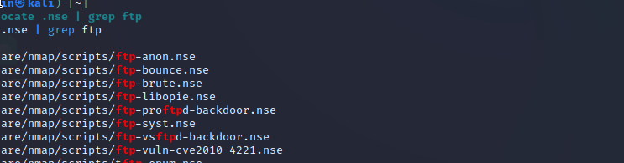
# locate .nse | grep ftp
Check for Vulnerabilities on Hosts:

Slide 9
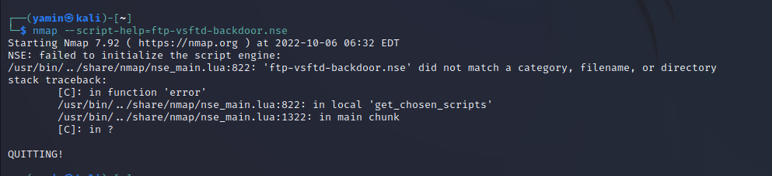
# nmap --script-help=ftp-vsftd-backdoor.nse
this script can be used to attempt to see if this particular machine is vulnerable to ExploitDB issue identified earlier

Slide 10
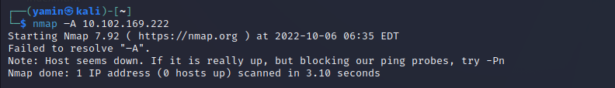
nmap –A 10.102.169.222
Aggressive Scan: with one command, nmap has returned a lot of the information it returned earlier about the open ports, services, and configurations running on this particular machine.

Slide 11

nmap --script=ftp-vsftpd-backdoor.nse 10.102.169.222 -p 21
This machine is likely a good candidate for a serious investigation.

Slide 12
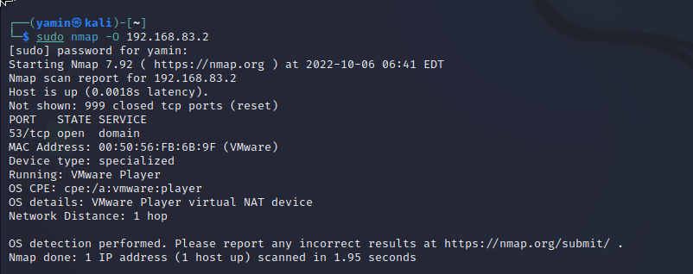
Nmap –O 10.102.169.222
Find host operating system

Slide 13
Nmap –sl 10.102.169.222
find hostnames for the given host by completing a DNS query for each one

Slide 14

Nmap –F 10.102.169.222
Scan for 100 common ports

Slide 15

Nmap –sF 10.0.0.0
find hostnames for the given host by completing a DNS query for each one

Slide 16
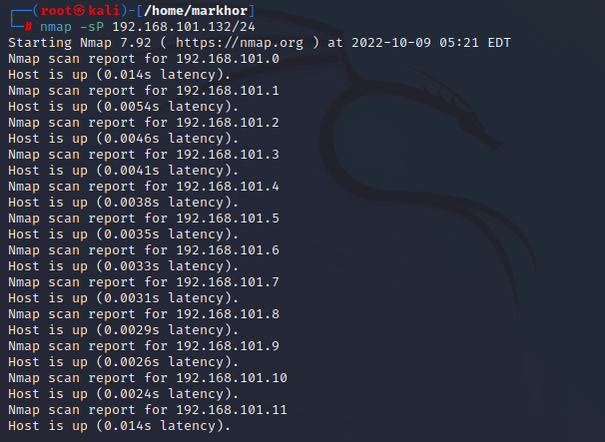
Command
Output:
Commad: nmap –sP 192.168.101.132/24
Syntax: nmap -sP <Target>
Description: Sometimes you just want to know which hosts are running on the network at this time. Nmap can do this by sending an ICMP echo request packet to each IP address in the network you specify.
It will respond if the host is running. Unfortunately, some sites such as microsoft.com block ICMP echo request packets

Slide 17
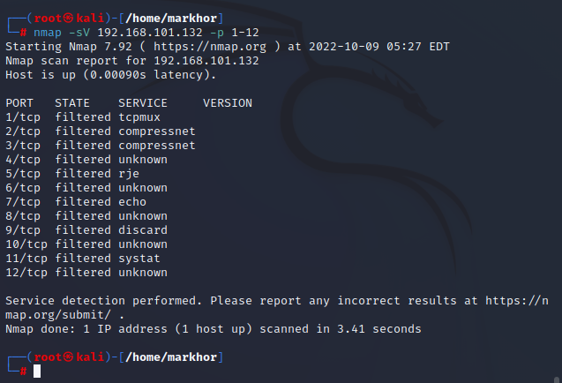
Command
Output:
Command: nmap -sV 102.168.101.132 -p 1-12
Syntax: nmap -sV<Target> -p 1-12
Description: This is the command to scan for running service. Nmap contains a database of more than 2000+ well-known services and associated ports.

Slide 18
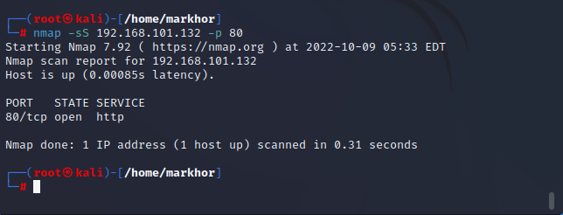
Command
Output:
Command: nmap -sS 192.168.101.132 -p 80
Syntax: nmap -sS<Target> -p 80
Description: Since it is not necessary to open all TCP connections, it is usually called half-open. You can issue a TCP sync packet (SYN) and wait for a response.
If the other party returns a SYN|ACK (response) packet, it indicates that the target port is listening;
if the RST packet is returned, it means that the target port has no listener;
if a SYN|ACK packet is received, the source host will immediately issue a RST (reset).

Slide 19
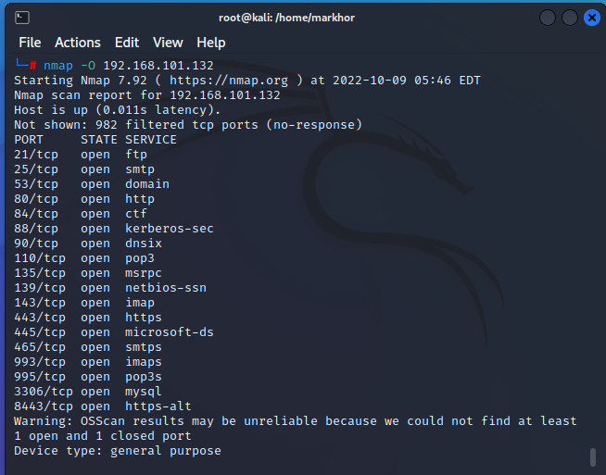
Command
Output:
Command: nmap -O 192.168.101.132
Syntax: nmap -O <Target>
Description: This is the command to scan and search for the OS (and the OS version) on a host. This command will provide valuable information for the enumeration phase of your network security assessment.

Slide 20
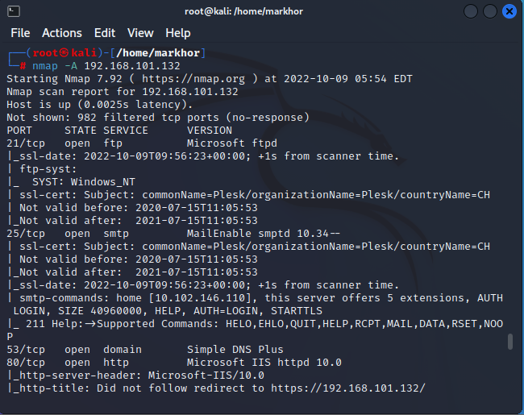
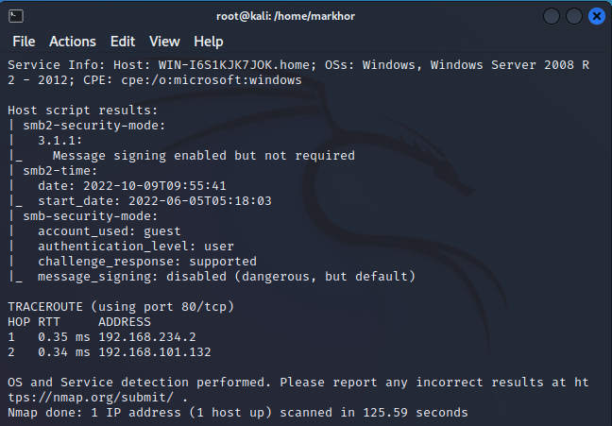
Command
Output:
Command: nmap -A 192.168.101.132
Syntax: nmap -A <Target>
Description: Nmap is one of the most popular tools used for the enumeration of a targeted host. Nmap can use scans that provide the OS, version, and service detection for individual or multiple devices.
Detection scans are critical to the enumeration process when conducting penetration testing of a network. It is important to know where vulnerable machines are located on the network so they can be fixed or replaced before they are attacked

Slide 21
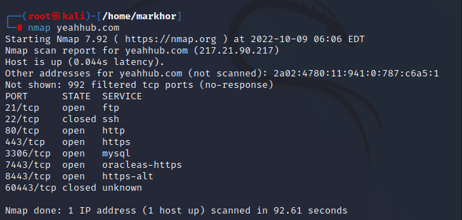
Command
Output:
Command: nmap yeahhub.com
Syntax: nmap <domain>
Description: You will notice the information returned is PORT | STATE | SERVICE. Before we take a deeper dive into the commands, it would be valuable to know what the different “STATES” mean.
Open – The target port actively responds to TCP/UDP/SCTP requests.
Closed – The target port is active but not listening.
Filtered – A firewall or packet filtering device is preventing the port state being returned.
Unfiltered – The target port is reachable but Nmap cannot determine if it is open or closed.
Open/Filtered – Nmap cannot determine if the target port is open or filtered.
Closed/Filtered – Nmap cannot determine if the target port is closed or filtered.

Slide 22
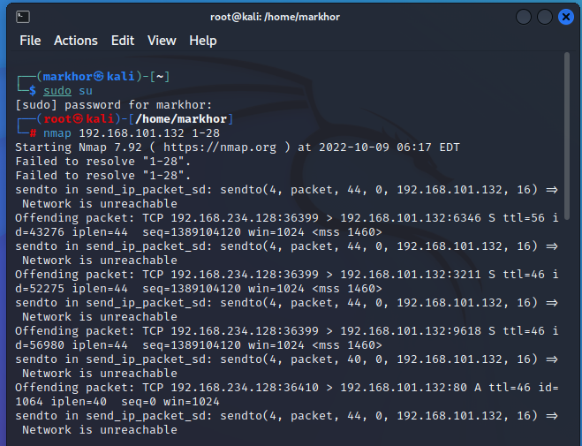
Command
Output:
Command: nmap 192.168.101.132 1-28
Syntax: nmap <IP Range 1 – IP Range 2>
Description:If you want to specify a range like 192.168.20.1 to 192.168.20.128, then you can use the following command:

Slide 23
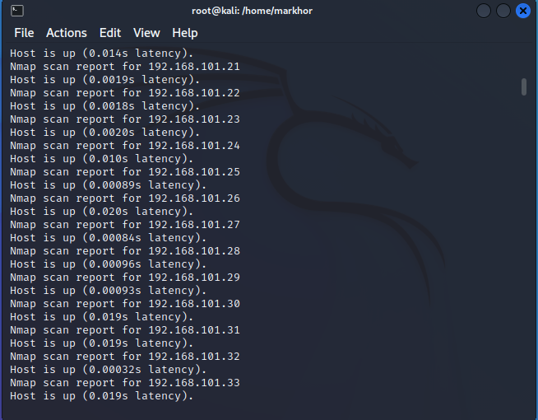
Command
Output:
Command: nmap –sn 192.168.101.132/24
Syntax: nmap -sn <IP/Domain/Range>
Description: In its standard mode, nmap does two different types of scan: a host scan, to determine which hosts are available for further port scanning, and a port scan, which reveals the status of ports on available machines.
With -sn does no port scan, but it does a host scan, this is particularly useful when scanning a range with nmap, where it will print out those hosts that responded to the scan or you can say that, it will scan for active hosts only.

Slide 24
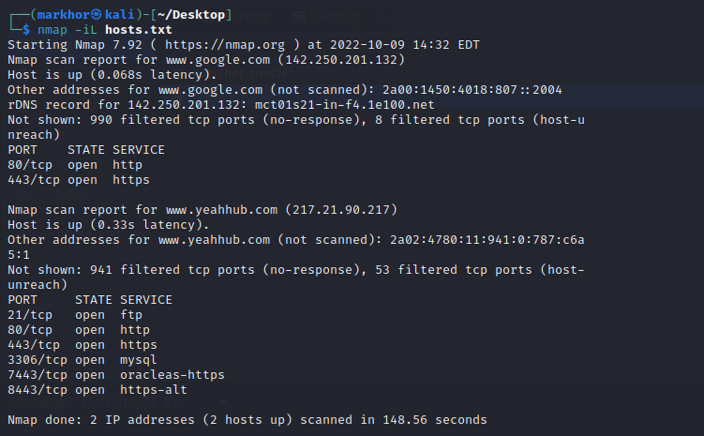
Command
Output:
Command: nmap –iL hosts.txt
Syntax: nmap -iL <file>
Description: With this option, you can even pass a huge list of hosts. Entries can be in any of the formats accepted by Nmap on the command line (IP address, hostname, CIDR, IPv6, or octet ranges). Each entry must be separated by one or more spaces, tabs, or newlines.

Slide 25
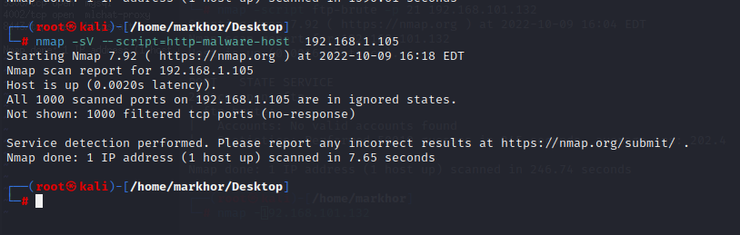
Command
Output:
Command: nmap -sV --script=http-malware-host 192.168.1.105
Syntax: nmap -sV --script=http-malware-host <IP>
Description:Nmap is able to detect malware and backdoors by running extensive tests on a few popular OS services like on Identd, Proftpd, Vsftpd, IRC, SMB, and SMTP. It also has a module to check for popular malware signs inside remote servers and integrates Google’s Safe Browsing and VirusTotal databases as well.

Slide 26
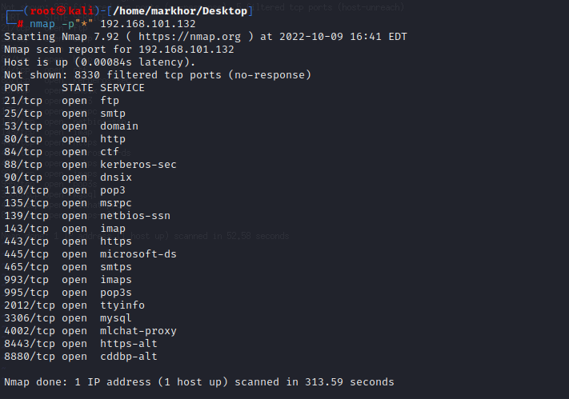
Command
Output:
Command: nmap -p “*” 192.168.101.132
Syntax: nmap -p “*” <IP>
Description: The beginning and/or end values of a range may be omitted, causing Nmap to use 1 and 65535, respectively. So you can specify -p- or -p “*” to scan ports from 1 through 65535.

Slide 27
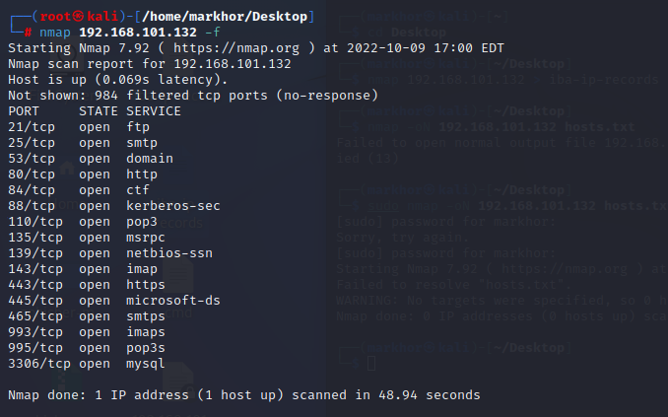
Command
Output:
Command: nmap 192.168.101.132 -f
Syntax: nmap <IP> -f
Description: Requested scan (including ping scans) use tiny fragmented IP packets. Harder for packet filters

Slide 28
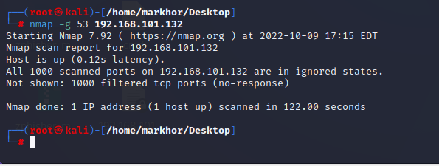
Command
Output:
Command: nmap -g 53 192.168.101.132
Syntax:
Description: Use given source port number

Slide 29
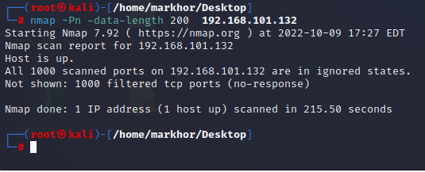
Command
Output:
Command: nmap –data-length 200 192.168.1.1
Syntax:
Description: Appends random data to sent packets

Slide 30
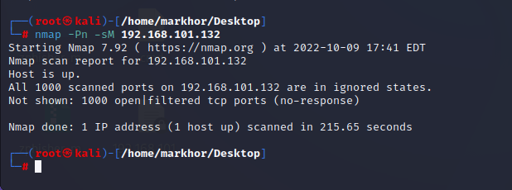
Command
Output:
Command: nmap 192.168.101.132 -sM
Syntax: nmap –sM <IP>
Description: TCP Maimon port scan

Slide 31
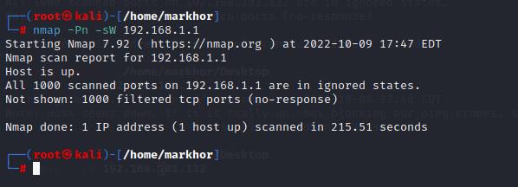
Command
Output:
Command: nmap 192.168.1.1 -sW
Syntax: nmap <IP> -sW
Description: TCP Window port scan

Slide 32
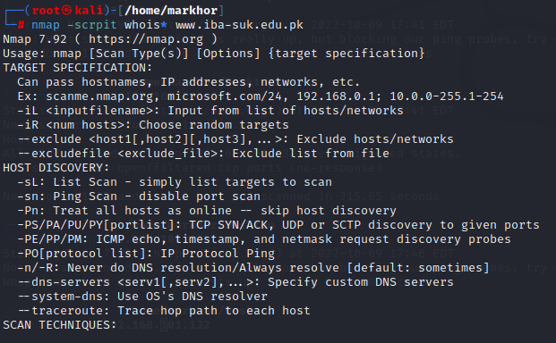
Command
Output:
Command: nmap –script whois* www.iba-suk.edu.pk
Syntax: nmap –script whois* <domain>
Description: Aggressive (4) speeds scans; assumes you are on a reasonably fast and reliable network

Slide 33
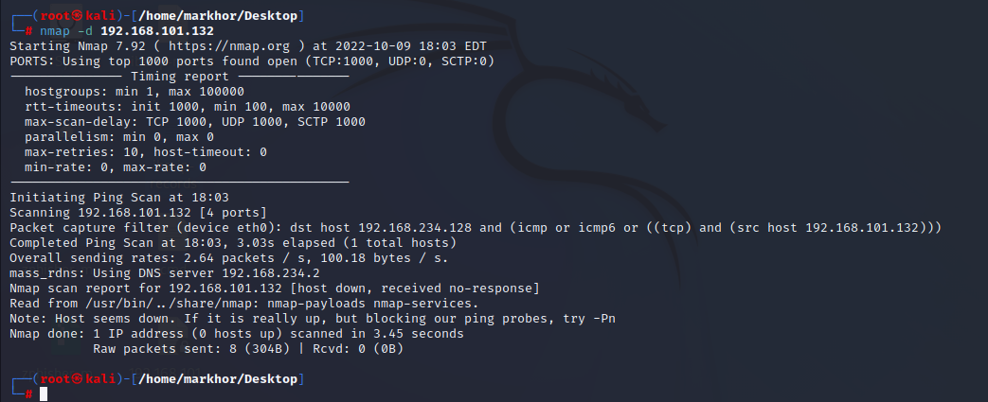
Command
Output:
Command: nmap –d 192.168.101.132
Syntax: nmap –d <IP>
Description: Increase debugging level (use -dd or more for greater effect)

