Slide 1
NMAP Commands

Slide 2
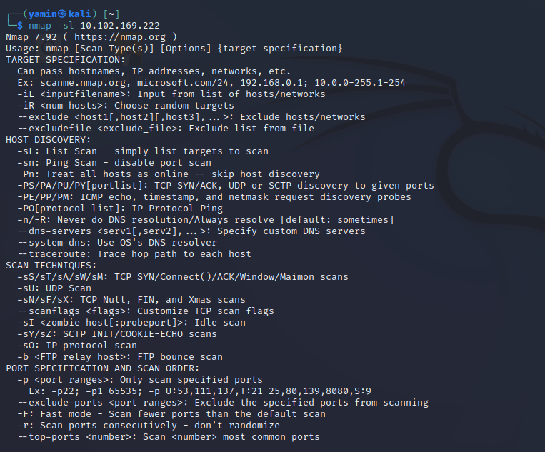
Nmap –sl 10.102.169.222
find hostnames for the given host by completing a DNS query for each one

Slide 3
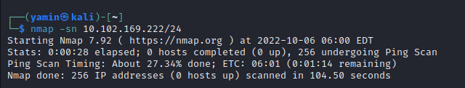
Nmap –sn 10.102.169.222/24
tells Nmap not to do a port scan after host discovery, and only print out the available hosts that responded to the scan

Slide 4
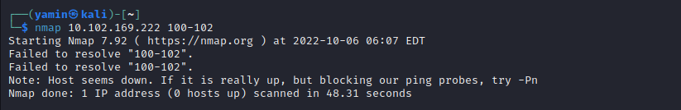
Nmap 10.102.169.222 100-102
Find Open Ports on Hosts:

Slide 5
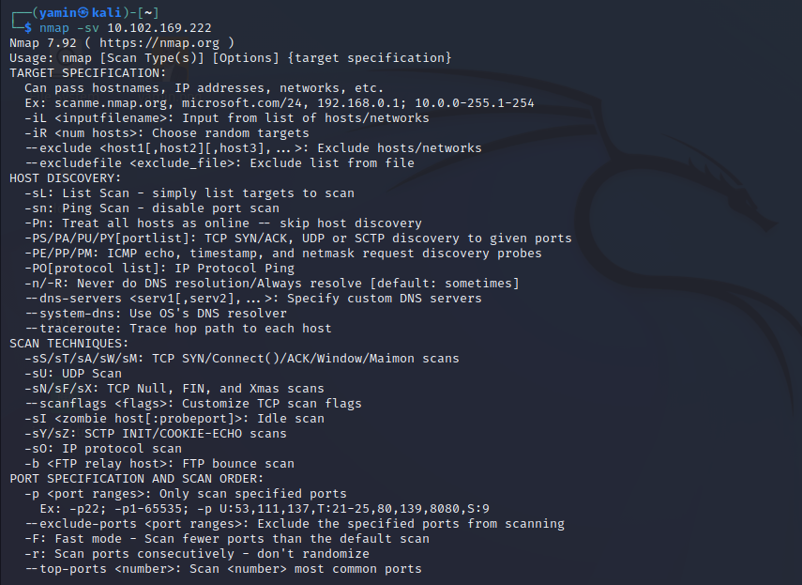
Nmap –sV 10.102.169.222
Finding Services Listening on Ports on Hosts

Slide 6
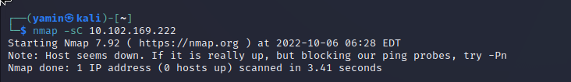
nmap -sC 10.102.169.222
Find Anonymous FTP Logins on Hosts

Slide 7
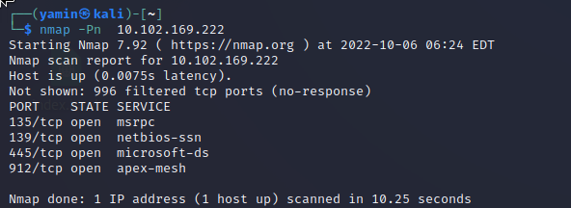
Nmap –nP 10.102.169.222
This option skips the host discovery stage altogether

Slide 8
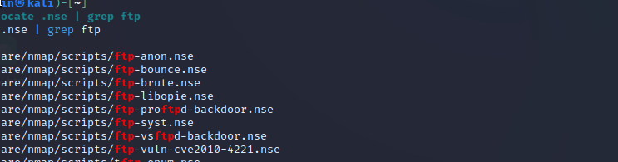
# locate .nse | grep ftp
Check for Vulnerabilities on Hosts:

Slide 9
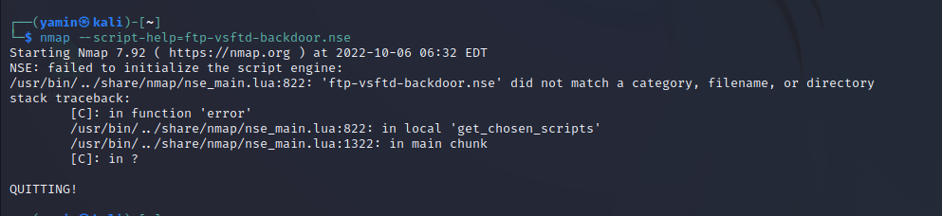
# nmap --script-help=ftp-vsftd-backdoor.nse
this script can be used to attempt to see if this particular machine is vulnerable to ExploitDB issue identified earlier

Slide 10
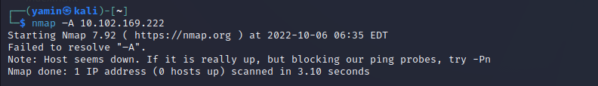
nmap –A 10.102.169.222
Aggressive Scan: with one command, nmap has returned a lot of the information it returned earlier about the open ports, services, and configurations running on this particular machine.

Slide 11

nmap --script=ftp-vsftpd-backdoor.nse 10.102.169.222 -p 21
This machine is likely a good candidate for a serious investigation.

Slide 12
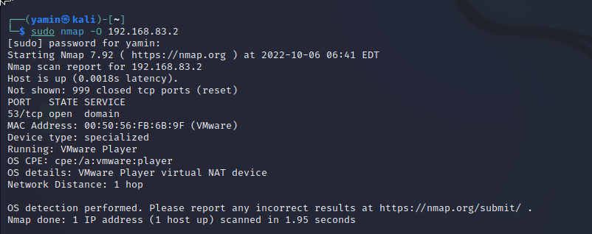
Nmap –O 10.102.169.222
Find host operating system

Slide 13
Nmap –sl 10.102.169.222
find hostnames for the given host by completing a DNS query for each one

Slide 14
Nmap –sn 10.102.169.222/24
tells Nmap not to do a port scan after host discovery, and only print out the available hosts that responded to the scan

Slide 15
Nmap 10.102.169.222 100-102
Find Open Ports on Hosts:

Slide 16
Nmap –sV 10.102.169.222
Finding Services Listening on Ports on Hosts

Slide 17
nmap -sC 10.102.169.222
Find Anonymous FTP Logins on Hosts

Slide 18
Nmap –nP 10.102.169.222
This option skips the host discovery stage altogether

Slide 19
# locate .nse | grep ftp
Check for Vulnerabilities on Hosts:

Slide 20
# nmap --script-help=ftp-vsftd-backdoor.nse
this script can be used to attempt to see if this particular machine is vulnerable to ExploitDB issue identified earlier

Slide 21
nmap –A 10.102.169.222
Aggressive Scan: with one command, nmap has returned a lot of the information it returned earlier about the open ports, services, and configurations running on this particular machine.

Slide 22
nmap --script=ftp-vsftpd-backdoor.nse 10.102.169.222 -p 21
This machine is likely a good candidate for a serious investigation.

Slide 23
Nmap –O 10.102.169.222
Find host operating system

Slide 24
Nmap –O 10.102.169.222
Find host operating system

Slide 25
Nmap –O 10.102.169.222
Find host operating system

Slide 26
Nmap –O 10.102.169.222
Find host operating system

Slide 27
Nmap –O 10.102.169.222
Find host operating system

Slide 28
Nmap –O 10.102.169.222
Find host operating system

Slide 29
Nmap –O 10.102.169.222
Find host operating system

Slide 30
Nmap –O 10.102.169.222
Find host operating system

