Slide 1
Support Vector Machines
Data Science in Context
September 18, 2019
Michael Y.

Slide 2
Last week we looked into Unsupervised Learning.
Today I would like to look at a specific Supervised Learning technique which is discussed in the current reading (Chapter 4 of Data Science for Business):
Support Vector Machines (SVM)

Slide 3
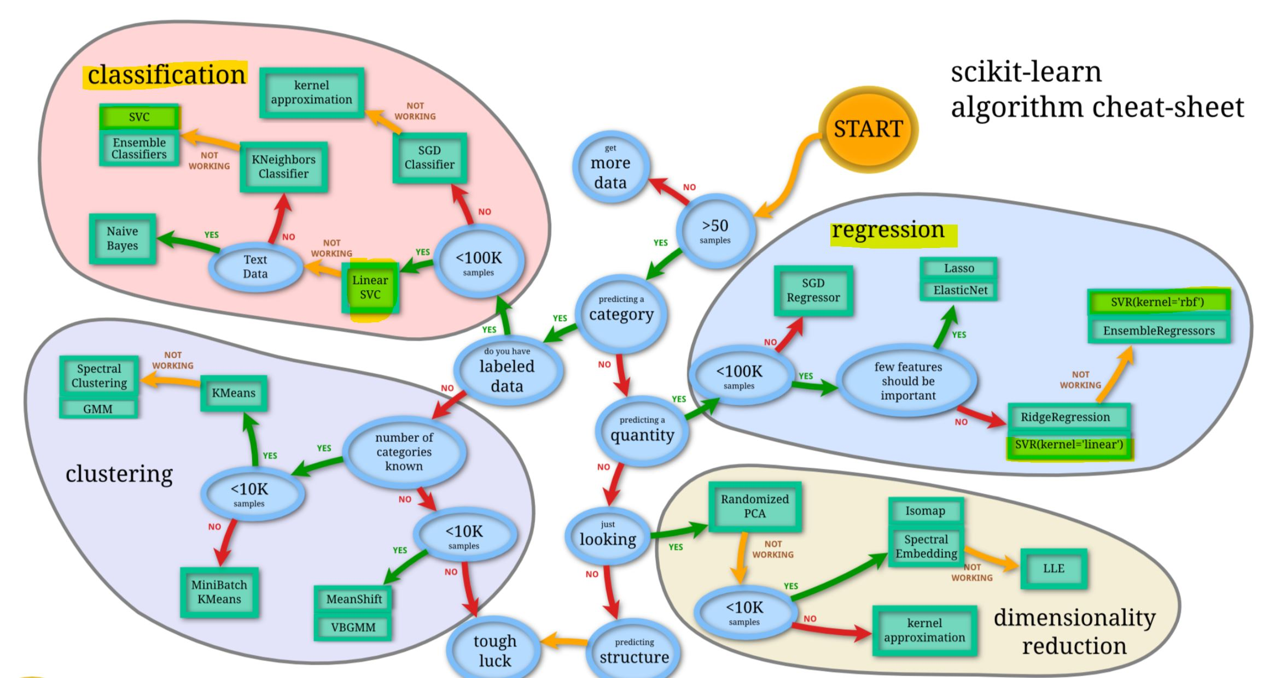
Support Vector Machines are used for both Classification (SVC) and for Regression (SVR):
Source: scikit-learn, a key python library implementing numerous machine-learning algorithms
https://scikit-learn.org/stable/tutorial/machine_learning_map/index.html

Slide 4
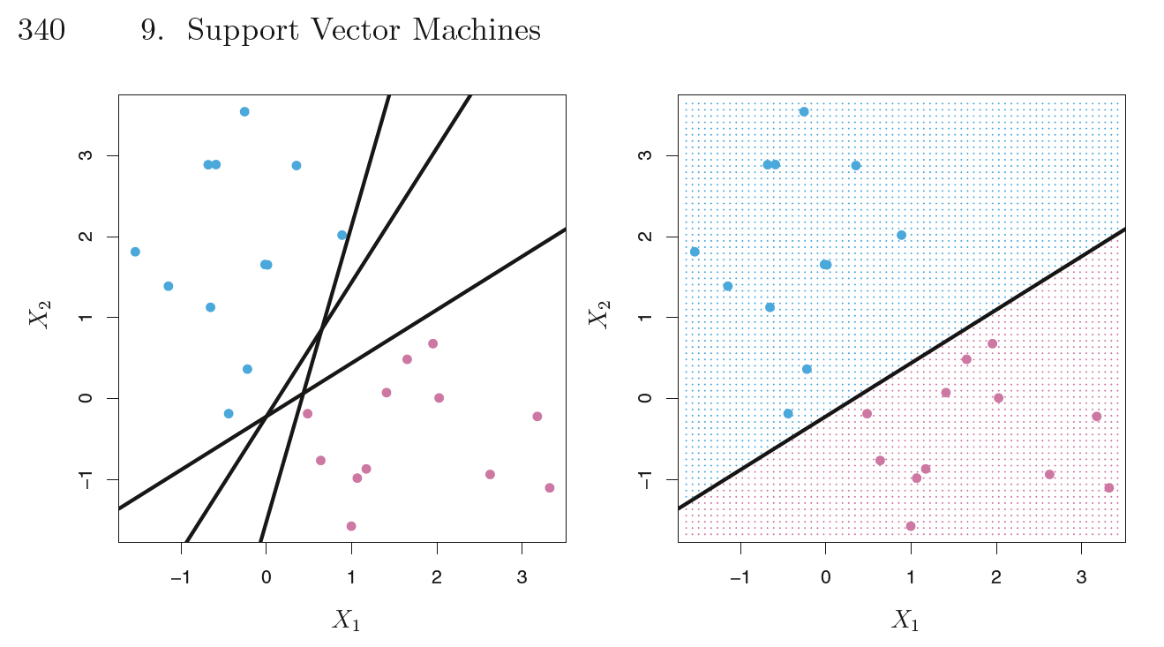
A Support Vector Machine performs classification by splitting the data set using “Hyperplanes”.
Below are three possible separations on the dataset:
Source: James, Witten, Hastie, Tibshirani: Introduction to Statistical Learning, p.340

Slide 5
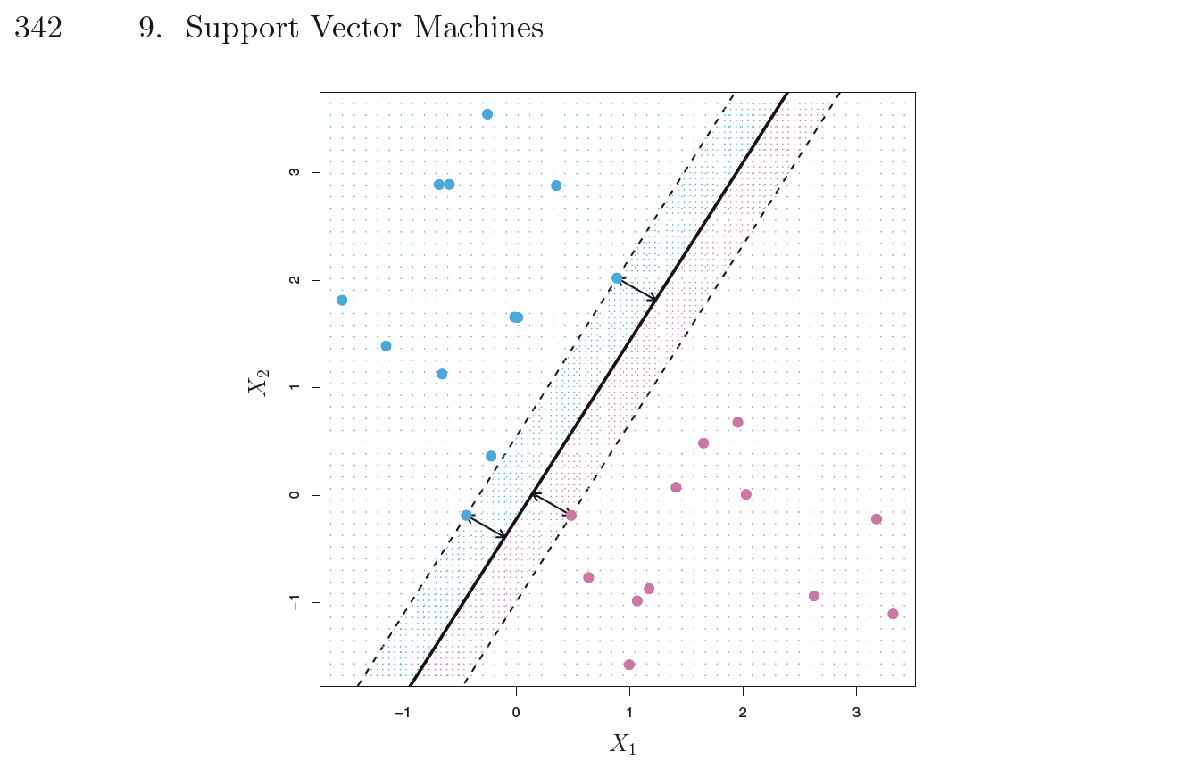
One method used by Support Vector Machines is to seek the “Maximal Margin Classifier”, which finds the largest separation (“Margin”) between the classes:
Source: James, Witten, Hastie, Tibshirani: Introduction to Statistical Learning, p.342

Slide 6
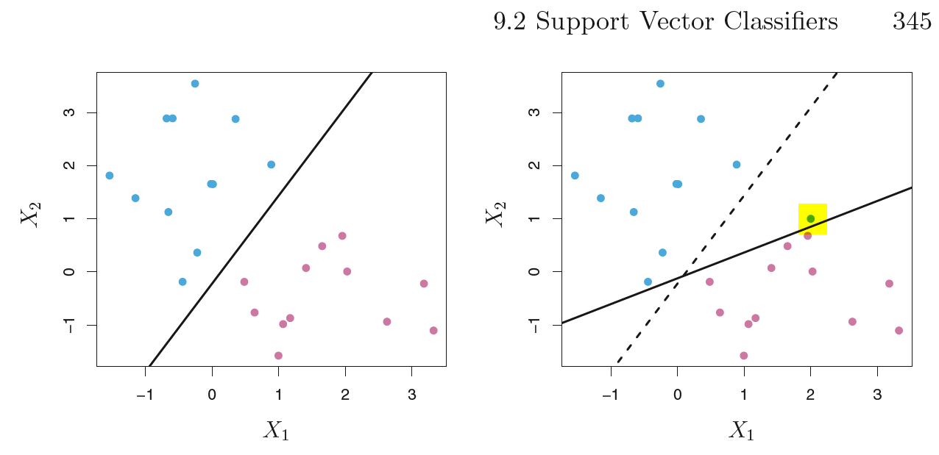
However, this method can is highly subject to outliers, as shown below.
One additional point (in the Blue category), highlighted in yellow, is added to the picture, in a location close to the Red points.
The Maximal Margin Classifier undergoes a dramatic shift:
Source: James, Witten, Hastie, Tibshirani: Introduction to Statistical Learning, p.345

Slide 7
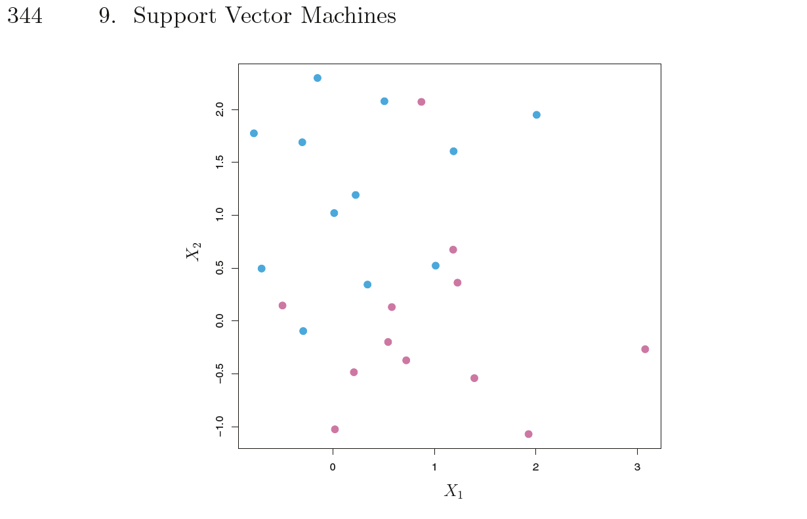
However, it is not always possible to find such a pure separation, because the data may not be separable, such as in the example below:
Source: James, Witten, Hastie, Tibshirani: Introduction to Statistical Learning, p.344

Slide 8
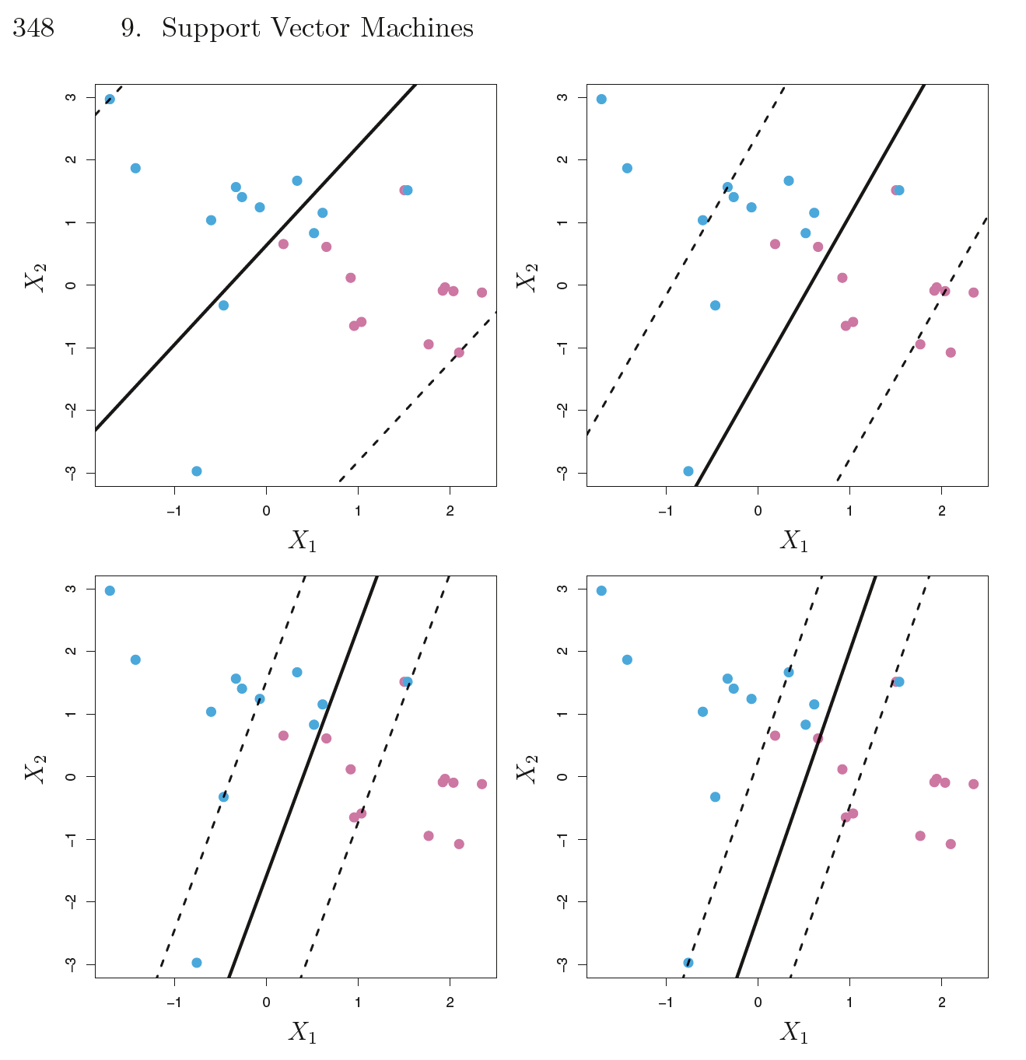
The distance by which observations fall on the incorrect side is measured as an “error.”
An observation which falls on the correct side of the hyperplane, but within the margin, is assigned an error between 0 (on the margin) and 1 (on the hyperplane.)
An observation which falls on the wrong side of the hyperplane is assigned an error > 1.
An constrained optimization is performed which seeks to find the widest possible Margin while limiting the sum of “errors” to be less than a specified “tuning parameter.”
Large tuning parameter ➔ wide margin,
many breaches, high bias, low variance
Small tuning parameter ➔ narrow margin,
fewer breaches, low bias, high variance
Source: James, Witten, Hastie, Tibshirani: Introduction to Statistical Learning, p.348

Slide 9
Results of a case study:
Comparison of various ML techniques for
Detection of Fraudulent Financial Statements among Chinese companies listed in Shanghai and Shenzhen
Yao, Pan, Yang, Chen and Li, “Detecting Fraudulent Financial Statements for the Sustainable Development of the Socio-Economy in China: A Multi-Analytic Approach”, in Sustainability 2019, 11, 1579;
https://www.mdpi.com/journal/sustainability ;
https://doi.org/10.3390/su11061579

Slide 10
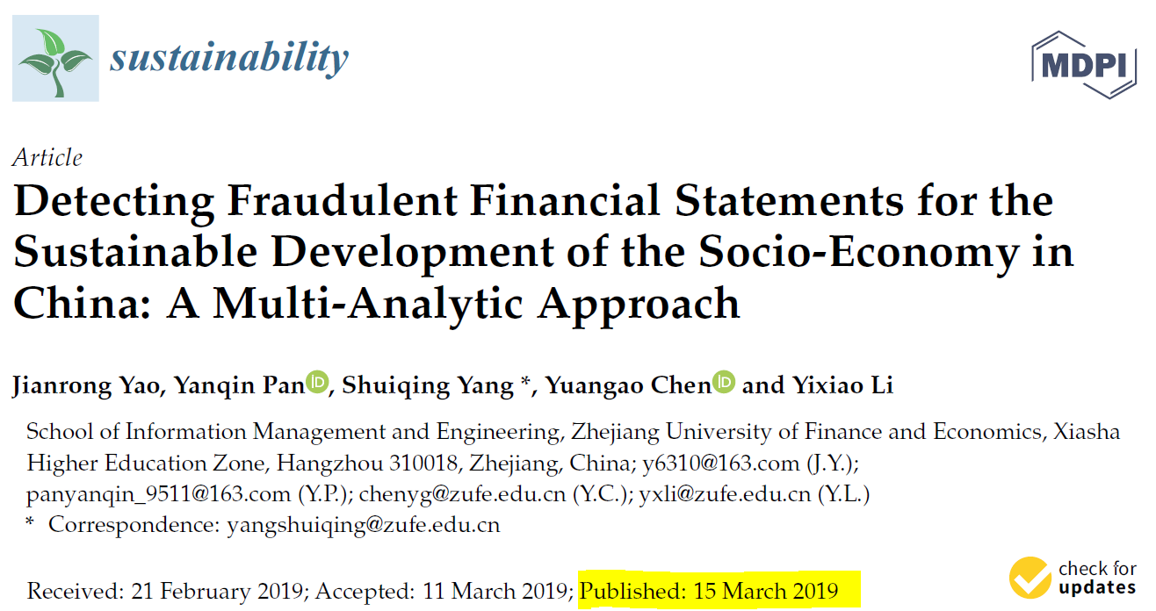

Slide 11
Earlier this year, a team of Chinese researchers published a paper examining detectability of financial statement fraud using various machine-learning classification techniques, performed on:
  a full set of 24 features
and on dimensionally-reduced variables, selected via:
  stepwise regression (13 features) and
  principal components (16 components.)
Number of firms analyzed – matched samples
A total of n=134 instances of fraudulent financial reporting between 2008 and 2017 were identified among companies listed on the Shanghai and Shenzhen Stock Exchanges
To obtain “matched samples”, for each of the above companies the researchers identified 3 similar firms which were not accused of fraudulent reporting, where each firm was similar in asset size and industry classification during the same year as the fraudulent reporting (m=402)
Thus, the total sample size was m+n = 134+402 = 536
The data is randomly split between training and testing, with the results of the classification or misclassification of the test data tabulated and analyzed as shown below.
Yao, Pan, Yang, Chen and Li, “Detecting Fraudulent Financial Statements for the Sustainable Development of the Socio-Economy in China: A Multi-Analytic Approach”, in Sustainability 2019, 11, 1579; https://www.mdpi.com/journal/sustainability ; https://doi.org/10.3390/su11061579

Slide 12
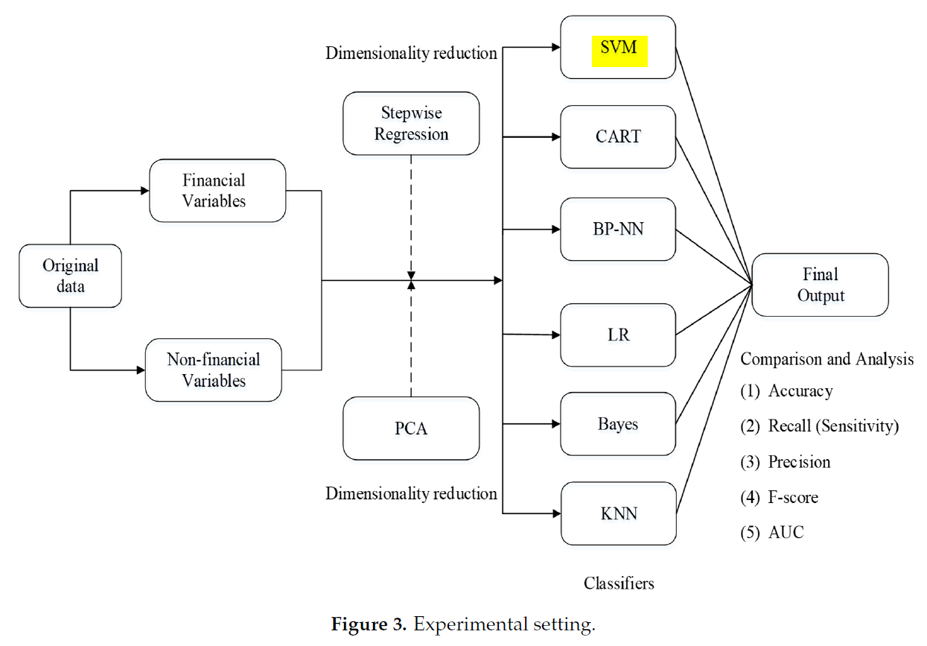
The diagram below illustrates the experimental setting, where the data was analyzed on all 24 variables, and again following two separate dimensionality reduction techniques, using 6 different classifiers:

Slide 13
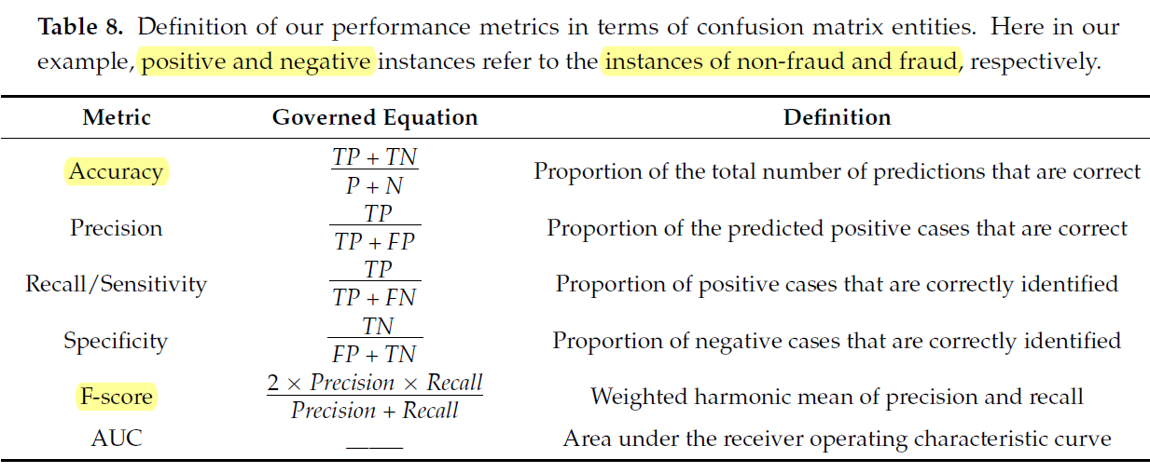
Results in the confusion matrix:
  (TP) true positive (a non-fraud firm correctly classified as a non-fraud firm);
  (FN) false negative (a non-fraud firm incorrectly classified as a fraud firm);
  (TN) true negative (a fraud firm correctly classified as a fraud firm);
  (FP) false positive (a fraud firm incorrectly classified as a non-fraud firm).
The quality of the results were evaluated using these standard metrics:
Yao, Pan, Yang, Chen and Li, “Detecting Fraudulent Financial Statements for the Sustainable Development of the Socio-Economy in China: A Multi-Analytic Approach”, in Sustainability 2019, 11, 1579; https://www.mdpi.com/journal/sustainability ; https://doi.org/10.3390/su11061579

Slide 14
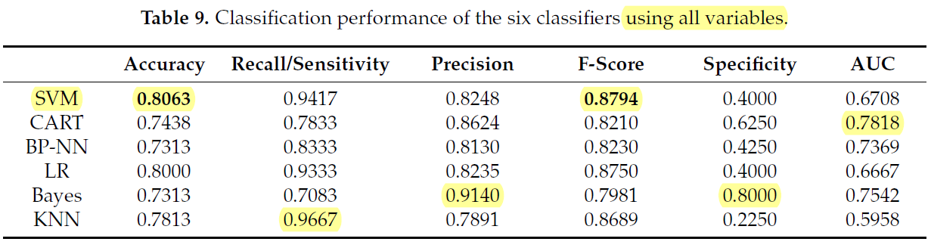
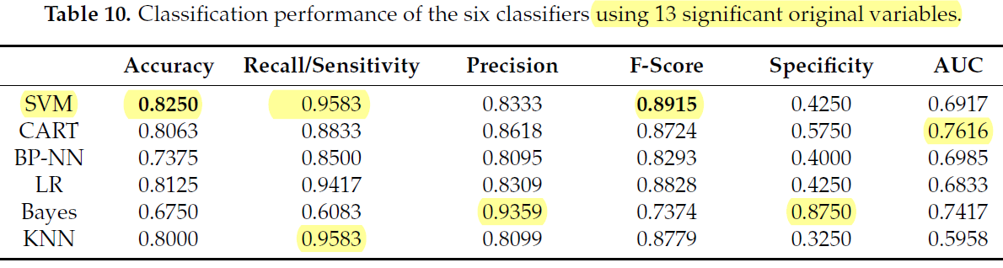
Comparing the various classifiers, SVM performed best on Accuracy and on F-score:
Reducing the number of features using stepwise regression, SVM still performed best on Accuracy and on F-score,
and also improved its result on Recall/Sensitivity to match KNN (K-Nearest Neighbors):

Slide 15
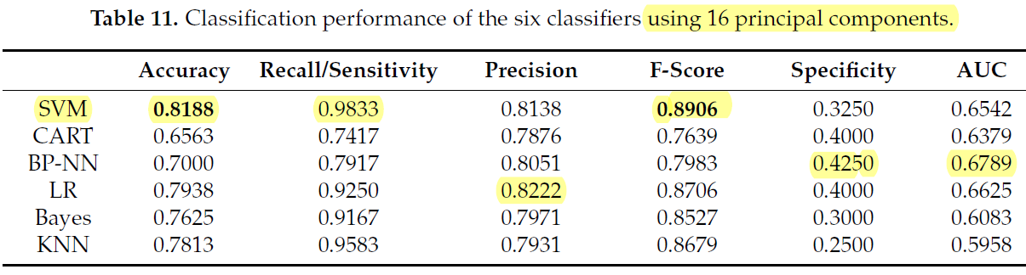
Comparing the various classifiers, SVM performed best on Accuracy and on F-score:
Reducing the number of features using Principal Components (PCA), SVM still performed best on
Accuracy and on F-score, and also improved its result on Recall/Sensitivity to take the lead:

Slide 16
Conclusions from the authors of the study:
Part 1: We found that the SVM classifier performs most outstandingly when there are 24 input variables and the accuracy is 0.8063.
Part 2: The accuracy of the classification of financial statements can be further improved by using the 13 input variables selected by the stepwise regression method compared to the 24 input variables used. Moreover, the performance of the SVM classifier is the most outstanding.
Part 3: After using the PCA method to transform the original 24 input variables, we selected the first 16 principal components based on previous studies. The accuracy of almost all classifiers decreased compared to classifiers that use 24 input variables.
Overall, the experimental results based on accuracy and F-score indicated that SVM is the top performer and the classification performance is improved more by stepwise regression rather than PCA.

Slide 17
SVM can be accessed via several R packages:
library e1071 : use function svm()
library LiblineaR : function is also named LiblineaR()
library kernlab : use function ksvm() or lssvm()
library caret : use function train() with a method parameter:
  method = 'svmLinearWeights2’ (uses LiblineaR)
  method = 'svmLinear3’ (uses LiblineaR)
  method = 'lssvmLinear’ (uses kernlab)
  method = 'lssvmPoly’ (uses kernlab)
  method = 'lssvmRadial’ (uses kernlab)
  method = 'svmLinearWeights’ (uses e1071)

