Slide 1
Visual Analysis of Recurrent Neural Networks
Yao MING
Jan 11, 2017
Notes:
Today I’m going to present my idea of applying visual analysis of recurrent neural networks.
I am still learning both visualization and neural networks. This is not yet a concrete idea.

Slide 2
Introduction
Recurrent Neural Networks (RNNs)
More general and flexible than Feedforward Neural Network or CNN, operates on sequential data like text and audios
Effective in: language modeling, machine translation, speech recognition, sentiment analysis, image captioning…
With fast growing research attention
Notes:
First, what is RNN?
More general and flexible neural networks than simple multilayer neural networks or CNN.
As many of you may know, CNNs are good at classifying images.
RNNs are very good at sequential data, like text and audios and other time series data, and sometimes they can handle image related problems too.
What makes RNNs special is that RNNs can take data with unfixed length, their output length is also flexible.
I will introduce RNN model in detail later.
Researchers have proved RNNs’ effectiveness in …..
RNNs are also getting popular these days,
As you can see from the search results of RNN, the publication number over time is growing exponentially

Slide 3
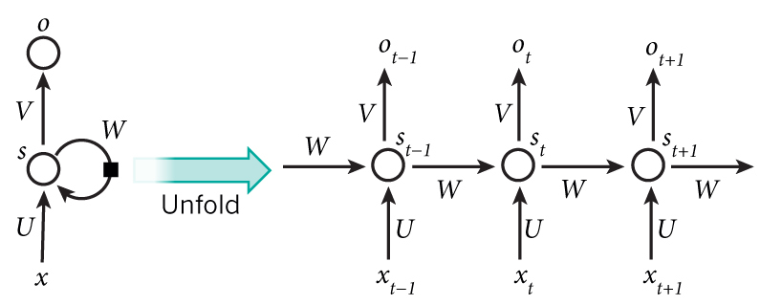
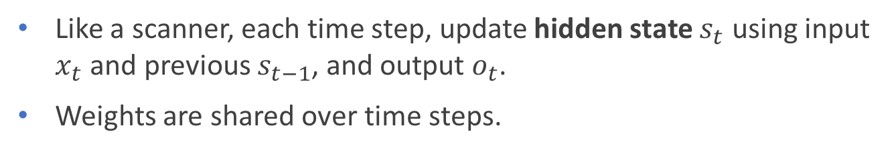



Introduction
Vanilla RNN (single layered)
Like a scanner, each time step, update hidden state $s_{t}$ using input $x_{t}$ and previous $s_{t−1}$, and output $o_{t}$.
Weights are shared over time steps.
$$s_{t}=f(Ux_{t}+Ws_{t−1})$$
$$o_{t}=softmax(Vs_{t})$$
$f$ is nonlinear e.g.: tanh
Variants
Long Short Term Memory networks (LSTMs)
Gated Recurrent Unit (GRU)
Bi-directional LSTMs
Notes:
So lets see what exactly RNN does
The most basic RNN works as scanner which maintains a vector of hidden states:
The input is modeled as a sequence of vectors.
At each time step, the scanner get an input vector x t (could be a word or a character),
it use the x t and previous hidden state s t-1 to update hidden state to s t,
as shown in the first equation, which includes a linear composition of x t and s t-1, and taking nonlinear transform over it
After that, RNN output a vector o t based on the hidden state s t
The key of RNNs is that they maintain hidden states vector, this vector is like a memory, which helps recording information from previous data.

Slide 4
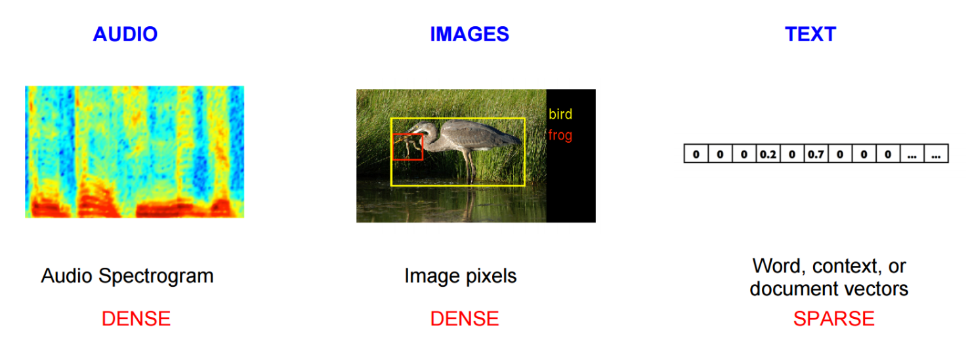
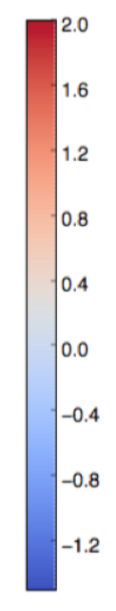
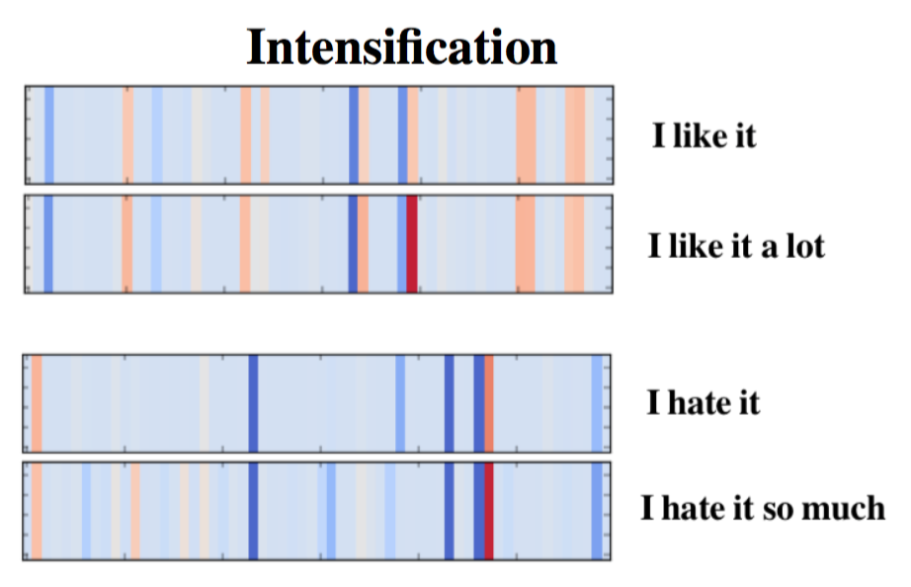
Introduction
Word Embedding (compress input of RNNs)
Compress word vector from several thousands of dimensions to tens or hundreds of dimensions
Some of the dimensions may contain semantic meaning or sentiments
Notes:
Before clarifying the research problem, I want further introduce word embedding
A technique used to compress input data used in RNNs

Slide 5
The Problem is
In one sentence,
How to compare different RNNs and better understand their inner mechanisms (capture keyword, long term memory) to help improvements and understanding of RNNs
Specifically,
How to encode the hidden states and gate activation information into visualization to intuitively presents what RNNs learned from text (or audios).
Design more convenient visualization for comparatively analyzing model’s performance/error on datasets for improvements.
Notes:
So what is the problem
The problem that I am interesting is, in one sentence,
…
The inner mechanisms are, for example, how do they capture keywords, how do they utilize long term memories?
With a better understanding of their inner mechanisms, we can then help researchers and engineers improve their model or applications.
In detail,
…
Gate activations are like activations of neurons in CNN, but they have more complex meaning I will talk about them latter

Slide 6
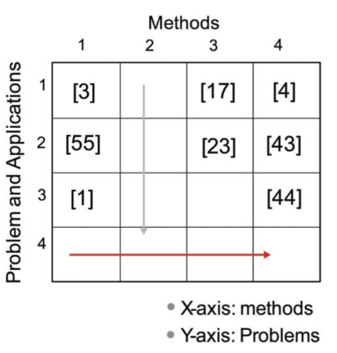
The Problem is
An "Old" Problem
Known issues of interpretability of what deep Neural Networks (with millions of parameters) have learned
Poor knowledge in the source of RNNs’ impressive performance and the shortcomings of different RNNs (Karpathy et. al, 2015)
Visualizing RNNs are less studied than CNNs, and are more challenging (Images are visualizations, but text/audios are not.)
Existing work (LSTMVis, 2016) only focus on exploring hidden state patterns of pre-trained models.
Notes:
Generally, Interpretability of what neural networks have learned is a well known issue,
For RNNs, there are few knowledge in understanding what they learned.
We don’t know why they are effective, and we also don’t know when they do badly
Compared with CNNs, RNNs are less studied, and are more challenging,
Since images are already visualizations, but text/audios are not
This is not an innovative problem actually. It’s more likely to fill the holes in the research matrix.

Slide 7
Contributions
Clearer understanding on RNNs’ inner mechanism (long and short term learning ability, hidden state interpretation, gating mechanisms, etc.), which drives further improvements on RNNs’ architecture
A user-friendly visualization tool for:
analyzing model’s comprehensive performance (debugging)
comparing pros and cons of different models (understanding)
exploring datasets and alternative models (improvements)

Slide 8
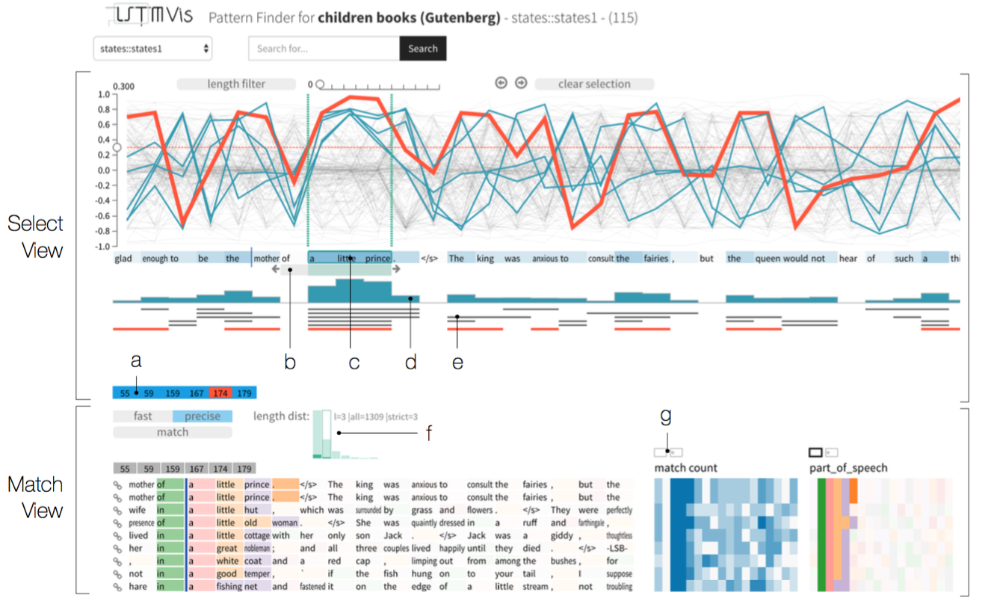
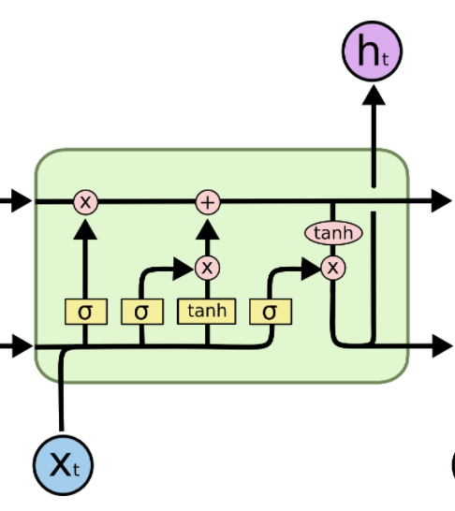
Related Works
Closely Related
Visual Analysis of Hidden State Dynamics in Recurrent Neural Networks. (arxiv Jun, 2016)
It fails to analyze gating structure -- a key design of popular RNNs (LSTM, GRU) to control the update of hidden states and output.
Also fails to analyze error/performance of a RNN (which is important in model evaluation).

Slide 9
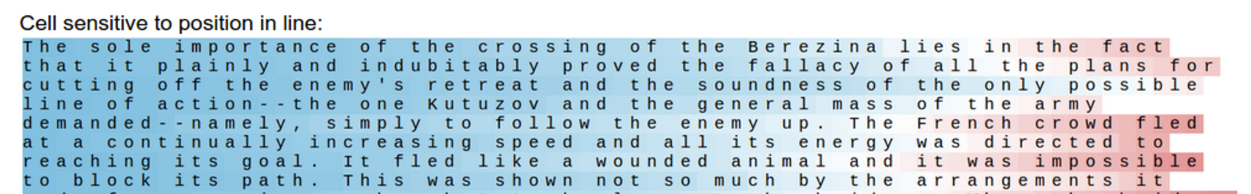
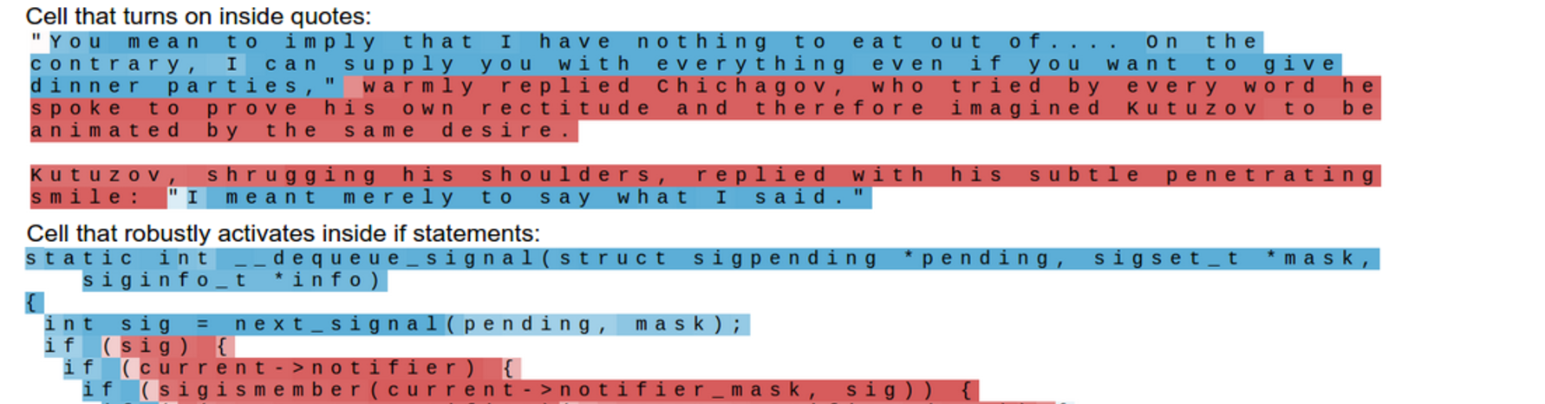
Related Works
Understanding RNNs
Visualizing and Understanding Recurrent Networks (Karpathy, A., Johnson, J. and Fei-Fei, L., arxiv 2015 / ICLR 2016):
a practical error analysis method which break errors into different categories to guide model improvements;
model interpretations which can be of reference in case study.
Notes:
The machine learning researchers have done several work towards understanding RNNs.
The first one that is very useful is published in 2015, by Li Feifei and her students.
They provide a very practical error analysis method which we can borrow. Since unlike CNN Classifiers, the error of RNN problems can be very complex, and can not be easily analyzed.
They also presents several interpretations of RNNs hidden state
They plot the value of single hidden state over the sequence as heatmap and find interesting cases
…

Slide 10
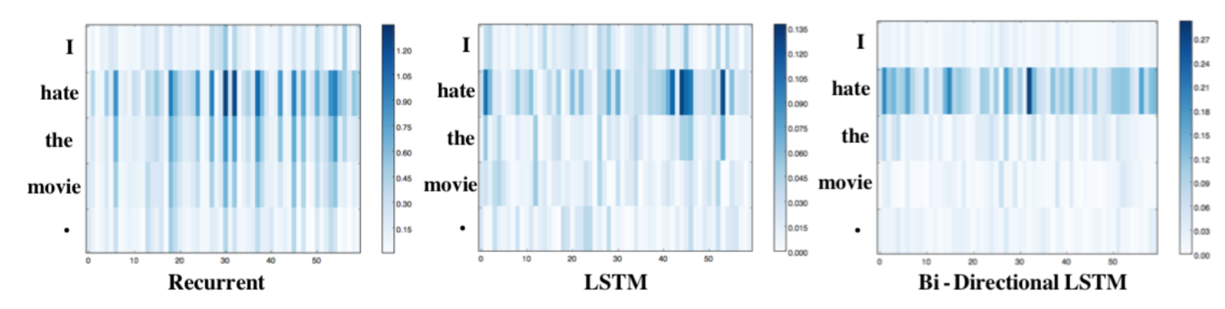
Related Works
Understanding RNNs
Visualizing and Understanding Neural Models in NLP (Li, J. et. al., NAACL-HLT 2016):
explorations of models’ capability in several language phenomenon (concessive sentence, negation, intensification) (for case study)
visual designs to compare models ability in learning word embedding and capturing keywords (design alternatives)
Notes:
This is another paper I am think of reference. It was published this year.
They provide several examples which can be borrowed as case study.
Also they presents a method to compute saliency score of word embedding in a sequence.
The saliency score can be regard as how important that the model values a dimension of a input word

Slide 11
Related Works
Visual analysis of Neural Networks
Visualizing the Hidden Activity of Artificial Neural Networks (VAST 2016)
t-SNE projection of neuron activations is inspiring, maybe used in the exploration phase.
Towards Better Analysis of Deep CNNs (VAST 2016)
Formulate CNN as DAG and bi-clusters, structural visualization.
Others:
Model Performance Analysis: Squares (VAST 2016) …
Interactive Machine Learning…
Notes:
There are other related works in analysis of CNNs and general neural networks,
and analysis of model performance, which I won’t go into details

Slide 12
Design Tasks
High
Presents the learned features of RNNs (hard)
Need to be intuitively interpretable (language phenomenon etc.)
Should provide convenient exploration interactions (many dimensions of hidden states make no sense)
Experts are interested in hidden state and gate activation information (haven’t validated with experts yet)
Comprehensively analyze model’s error/performance
Comparative analysis of different models
Visualization of RNNs’ training process and debugging information
Priority
Low
Notes:
In the following, I will introduce the design tasks that I abstract from the problem and give a visual design drafts.
The design tasks are listed from high priority to low priority.
Most importantly, our visualization should be able to present what RNNs have learned in a understandable way.
This is also a hard one, with several further requirements.
1. interpretable
2. Support interactive exploration, since many dimensions of hidden states are hard to associate meanings
3. Since many RNN variants are based on gating designs, experts are very interested in the gate activations of RNN.
Second we need to analyze models performance
Third, comparative analysis is required to investigate models’ performance difference.
Why some are better, how they are better, is there any conditions they are bad?
Last, we need visualize general information for debugging.

Slide 13
Visual Designs
Summary View (T2, T4):
Error: simple pie chart and data sample for categorical error analysis
Training Information: simple line chart for loss curve
Exploration View (T1.b,c):
Exploring interpretable hidden states, salient dimensions of word embedding and analyze gate activation.
Detail View (T2):
Use heat map to show detailed hidden state change and gate activations
For T3, add compare (side by side / overlay) to each views
Notes:
This is the first time that I am trying to do visual designs for a specific problem.
And I haven’t got a very clear idea on visual designs yet,
It’s just the designs of previous works only solves part of the problem, and I would like to have a more complete solution.
As for now, I am thinking of separating the visualization into 3 parts according to their functions,
namely, summary view, exploration view and detail view.
Summary provides an overview of the performance and training statistics,
I think simple pie charts or line charts can do the work. And have got no idea whether there is a more elegant solution, So I won’t discuss this view
The most important task is T1 how to understand what RNN have learned from data.
Since experts are more interested in specific meaningful states and the salient dimensions of word embedding in word level model,
The intention of this view is to provide convenient exploration functions for users to find interesting states or dimensions.
As for gate activation, I haven’t got good solutions yet, I will do some trying first.
And last is the detail view, which provide direct details of the hidden states and gate activations on the data.
As for task 3, comparative analysis, I am thinking of adding compare functions in each views.

Slide 14
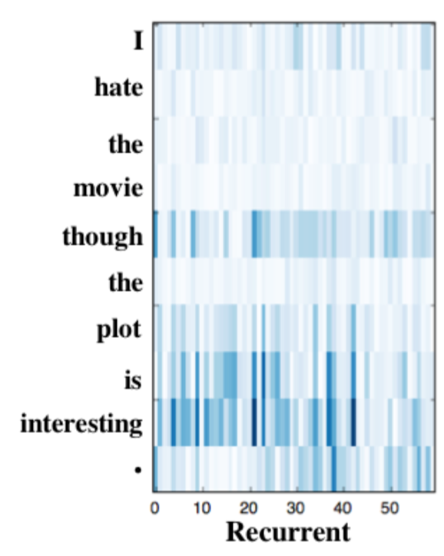
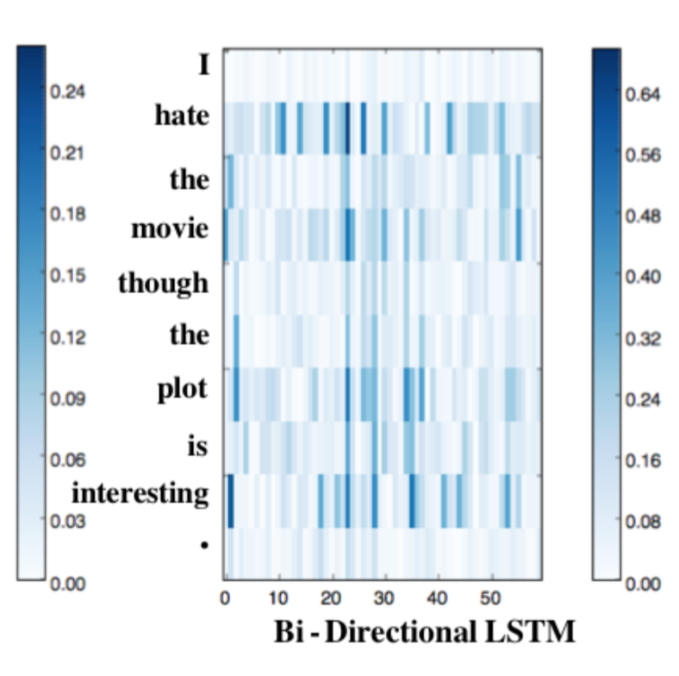
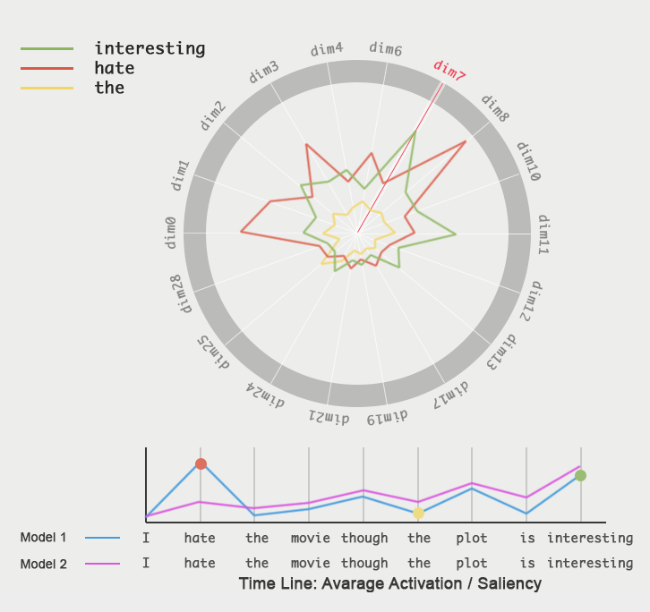
Visual Designs
Exploration View – Semantic Radar
(Li et. al. 2016) Hard to find which dim of word embedding is more salient
Notes:
For the exploration view,
I am thinking of using a radar to detect interesting dimensions of hidden states or word embedding.
Before explaining my design, I want to talk about previous design first.
The previous work in NLP use a heat map to explain how well a RNN captures the key words.
The x axis is the dimensions of word embedding, the y axis is the input sequence,
Here the darker color means that the model think the dimension of a word is more important.
As seen here, the input is a sentence, I hate the movie though the plot is interesting.
And the model is trying to understand the sentiments of the sentence
For me I would think hate, interesting are the most important words, since they reveals the most emotions
We can see that the second model captures the keywords better, the first one fails to address the word hate.
But this design fails to help us find salient interesting dimensions.
So trying to solve the problem, I use a radar plot combined with a timeline chart.
The line charts presents the average saliency, through this we can directly see how well a model masters the importance of words
To explore interesting dimensions, the user can select several dimensions of the word embedding and several different words on the time line to draw a radar plot
Since interesting and hate kind of representing 2 different emotion attitude. The dimension 7 and dimension 8 may be representing emotions to some extent
The metaphor of the design is like using a radar to detect interesting dimension

Slide 15
Visual Designs
Exploration View – Semantic Radar
Functions:
Finding interpretable states
Validate Gate Mechanism
Compare keyword capturing capability
Options:
Hidden states (50~1000d/lr.)
Gate Activations (same as )
Saliency scores of each dim of word embedding (50~1000d)
Notes:
The input of the visualization is actually a matrix, with saliency of each word as a vector.
So This visualization can also be used to discover interesting interpretable dimensions of the hidden states by changing the saliency vector of a word to hidden state vector.
Gate activations may also be explored, but I am not sure whether there will be interesting cases.
Scalability is kind of a problem, the dimension of hidden state and gate activations are often at hundred level
While Radar plot can handle several tens pretty well.
For word embedding, the dimension is often at tens level, so I think it will do the work well

Slide 16
Visual Designs
Detail View – Heat map (Karpathy et. al. 2015)
Notes:
As for detail view, I haven’t got better designs either.
I think the heat map is already not bad for presenting details of the hidden states information on the data.
If you have better idea, we can discuss later.

Slide 17
Expected Results
Tools
RNN implementation: TensorFlow
Visualization: D3.js
Framework: Flask (app), Vue.js(front-end)
Datasets:
Treebanks: Penn Treebank, Stanford Sentiment Treebank
Plain Text and source code: Linux Kernel Code
…
Notes:
The coding stack is actually the same as what Qiaomu introduced.
For back-end RNN implementation, I will be using tensorflow
The datasets I am expecting to use are either treebanks or just plain text.
Treebanks contains explicit language labels,
While plain text or source code like the code of Linux Kernel may also be very interesting to try.

Slide 18
Remaining Tasks
Unsolved Major Problems
Complete and refine visual design
More literature reviews on existing methods in understanding RNNs and text visualization
…
Workload:
Coding
RNN and Data Preprocessing ?
Visual System ? ?
Visual Design and Evaluation ?
Writing:
Notes:
The remaining tasks is mainly that the visual design is far from complete now.
And I am still trying to learn more about text visualization and how to understand RNNs
I think the design and coding of visualization is the most heavy one.
Since I don’t have experience in developing visualization Systems, I am actually not sure about its workload.

Slide 19
Milestones
 | Idea | Coding | Writing
Feb 1st | Fix problem definition & visual designs | Prototype system framework & back-end RNN and data module | Review Related Works
Feb 15th | Refine visual design, compare design alternative | Finish back-end module & Finish Summary View & Prototype Exploration View and Detail View
Mar 1st |  | Refine Visualization | Intro, related works & background
Mar 15th |  | Finish Interactions | System Overview & Visual design
Mar 23rd |  | Finish experiment and cases | Case study
Mar 29th |  |  | Finish all writings
Notes:
This is a brief milestone

