Slide 1
Indexing
Michael Yarichuk
Hibernating rhinos
michael.yarichuk@hibernatingrhinos.com

Slide 2
What happens when you query?
Clue: This is NOT how queries are implemented:
foreach(var doc in docs)
if (IsMatch(query,doc)) yield return doc;

Slide 3
Implementing Queries
How would you do that?
Consider:
When to index?
How to index schema-less data?
What indexing format?

Slide 4
RavenDB Query Optimizer
Applies to all dynamic queries (no explicit index requested).
Select best index. (Only one index per query).
What happens where there isn’t an index?
What happens where there are several that can server?
Optimized behavior for production environment.

Slide 5

RavenDB Indexes
Lucene
BlogsByTitle
Title
UsersByAll
Username
DateJoined
BlogsByCategory
Category
Storage
Documents
Updates
Queries

Slide 6
Mapping
{
'User': 'Oren Eini',
'Phones': ['052-548-6969', '972-52-548-6969',],
'Email': 'Ayende@ayende.com',
'Address': {
'City': 'Hadera',
'Country': 'Israel'
}
}
from doc in docs.Users
select new
{ doc.User,
doc.Email
}
__document_id | User | Email
users/1 | Oren Eini | Ayende@ ayende.com

Slide 7
How does this work?
Indexing function
Incremental indexing
Output the terms to the index
Background operation
Parallelized
What is the result of querying the index?
Can query on the terms

Slide 8
Querying the index
Step 3: result
Query: Email: Ayende@Ayende.com
Step 1: Search index
for match
{
'User': 'Oren Eini',
'Phones': ['052-548-6969],
'Email': 'Ayende@ayende.com'
}
Step 2: Get users/1 from docs store
__document_id | User | Email
users/1 | Oren Eini | Ayende@ ayende.com
Documents Store

Slide 9
Mapping Collections
{
'User': 'Oren Eini',
'Phones': ['052-548-6969', '972-52-548-6969',],
'Email': 'Ayende@ayende.com',
'Address': {
'City': 'Hadera',
'Country': 'Israel'
}
}
from doc in docs.Users
from phone in doc.Phones
select new
{ doc.User,
Phone = phone
}
__document_id | User | Phone
users/1 | Oren Eini | 052-548-6969
users/s | Oren Eini | 972-52-548-6969

Slide 10
Mapping Collections
{
'User': 'Oren Eini',
'Phones': ['052-548-6969', '972-52-548-6969',],
'Email': 'Ayende@ayende.com',
'Address': {
'City': 'Hadera',
'Country': 'Israel'
}
}
Recommended!
from doc in docs.Users
select new
{ doc.User,
doc.Phones
}
__document_id | User | Phones
users/1 | Oren Eini | 052-548-6969 972-52-548-6969
Notes:
Discuss about why?

Slide 11
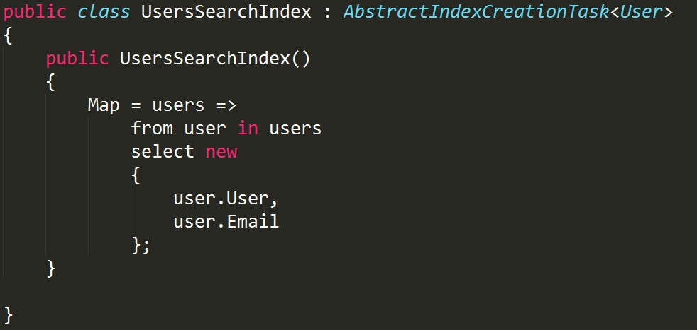
AbstractIndexCreationTask
Useless

Slide 12
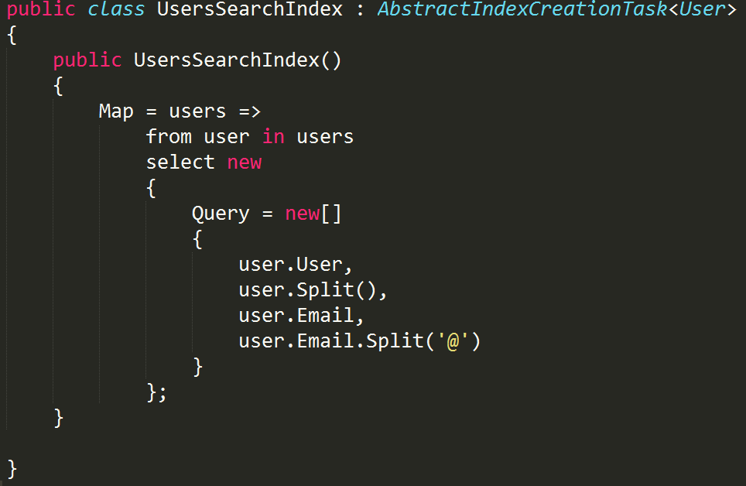
Doing something interesting…
What kind
of queries?

Slide 13
Dynamic Fields
{
'User': 'Oren Eini',
'Phones': ['052-548-6969', '972-52-548-6969',],
'Email': 'Ayende@ayende.com',
'Address': {
'City': 'Hadera',
'Country': 'Israel'
}
}
from doc in docs.Users
select new
{ doc.User,
_ = doc.Address.Select(x=>CreateField(x.Key, x.Value))
}
__document_id | User | City | Country
users/1 | Oren Eini | Hadera | Israel

Slide 14
Multi map indexes
Query multiple collections
A single index
Must have same output
AbstractMultiMapIndexCreationTask
Notes:
Union between two indexing types

Slide 15
Dynamic Indexes vs Static Indexes
When to let the query optimizer handle this?
When to create manually?

Slide 16
Staleness
Usually a good thing (optimizations!), but…
WaitForNonStaleResults()
WaitForNonStaleResultsAsOfNow()
WaitForNonStaleResultsAsOfLastWrite()

Slide 17
Query Statistics
RavenQueryStatistics stats;
var results = session.Query<User>()
.Statistics(out stats)
.Where(x => x.User == “MICHAEL”)
.ToArray();
var totalResutls = stats.TotalResults;
Notes:
Discuss the statistics objects
Total results is one use
Skipped results is another – when applying an aggregation operation

Slide 18
Questions?

Slide 19
Indexing – MAP/REDUCE

Slide 20
Aggregation
SELECT t.Category, COUNT(*)
FROM SomeTable t
GROUP BY t.Category
SQL
from doc in docs
group doc by doc.Category into g
select new
{
g.Key,
g.Count() }
LINQ

Slide 21
Problems?
How do we aggregate over multiple documents?
No computation during query…
Can’t just aggregate using Linq’s group by

Slide 22
Map/Reduce
Map: from dog in docs.Dogs from owner in dog.Owners
select new
{
Owner = owner,
Count = 1
}
Reduce: from result in results
group result by result.Owner into g
select new
{
Owner = g.Key,
Count = g.Sum(x=>x.Count)
}
Notes:
Parallelism
Faster updates (doesn’t require recalculating everything)

Slide 23
Map
{
'Name': 'Arava',
'Type': 'German Shepherd',
'Owners': ['users/1', 'users/2'],
'Gender': 'Female'
}
{ ‘Owner’: ‘users/1’, ‘Count’: 1 }
{ ‘Owner’: ‘users/2’, ‘Count’: 1 }
Map: from dog in docs.Dogs from owner in dog.Owners
select new
{
Owner = owner,
Count = 1
}

Slide 24
Reduce
{ ‘Owner’: ‘users/1’, ‘Count’: 1 }
{ ‘Owner’: ‘users/2’, ‘Count’: 1 }
{ ‘Owner’: ‘users/1’, ‘Count’: 1 }
{ ‘Owner’: ‘users/2’, ‘Count’: 1 }
Reduce: from result in results
group result by result.Owner into g
select new
{
Owner = g.Key,
Count = g.Sum(x=>x.Count)
}

Slide 25
Another dog…
{
'Name': ‘Oscar',
'Type': Mixed',
'Owners': ['users/2'],
'Gender': Male'
}

Slide 26
Map
{
'Name': ‘Oscar',
'Type': Mixed',
'Owners': ['users/2'],
'Gender': Male'
}
{ ‘Owner’: ‘users/2’, ‘Count’: 1 }
Map: from dog in docs.Dogs from owner in dog.Owners
select new
{
Owner = owner,
Count = 1
}

Slide 27
Reduce
{ ‘Owner’: ‘users/1’, ‘Count’: 1 }
{ ‘Owner’: ‘users/2’, ‘Count’: 1 }
{ ‘Owner’: ‘users/2’, ‘Count’: 1 }
{ ‘Owner’: ‘users/2’, ‘Count’: 1 }
Final Result:
{ ‘Owner’: ‘users/2’, ‘Count’: 2 }
Reduce: from result in results
group result by result.Owner into g
select new
{
Owner = g.Key,
Count = g.Sum(x=>x.Count)
}

Slide 28
Why so complex?
Allows to handle updates to aggregation in incremental fashion.
Queries are done over the pre-computed results, very fast.

Slide 29
In RavenDB…
A bit more complex
Terms:
Document
Mapped Result / Reduce Result
Reduce Key
Final Result
There are several strategies for calculating this.
Single step reduce
Multi step reduce
Auto select appropriate one

Slide 30
Implications
Querying based on output from map/reduce index fields is easy.
Very fast, because of pre-computation
Hard to do dynamic aggregation, though.
For that, we have DynamicAggregationQuery (see: Facets).

Slide 31
Practice
Multi map / reduce indexes
Create an index that will give me all the user names along with all their dog names…

Slide 32
Indexing – FULL TEXT SEARCH

Slide 33
By default…
RavenDB index to Lucene.
Uses case insensitive exact term match
Can use full text search: Analyzed
Different analyzers
Complex work possible

Slide 34
Search 101: Inverted Index
Term | Freq | List
and | 1 | 6
big | 2 | 2 3
dark | 1 | 6
did | 1 | 4
gown | 1 | 2
had | 1 | 3
house | 2 | 2 3
in | 5 | 1 2 3 5 6
keep | 3 | 1 3 5
keeper | 3 | 1 4 5
keeps | 3 | 1 5 6
light | 1 | 6
never | 1 | 4
night | 3 | 1 4 5
old | 4 | 1 4 5
sleep | 1 | 4
sleeps | 1 | 6
the | 6 | 1 2 3 5 6
town | 2 | 1 3
where | 1 | 4
# | Text
1 | The old night keeper keeps the keep in the town
2 | In the big old house in the big old gown.
3 | The house in the town had the big old keep
4 | Where the old night keeper never did sleep.
5 | The night keeper keeps the keep in the night
6 | And keeps in the dark and sleeps in the light.

Slide 35
Search 101: Inverted Index Starts With
Term | Freq | List
and | 1 | 6
big | 2 | 2 3
dark | 1 | 6
did | 1 | 4
gown | 1 | 2
had | 1 | 3
house | 2 | 2 3
in | 5 | 1 2 3 5 6
keep | 3 | 1 3 5
keeper | 3 | 1 4 5
keeps | 3 | 1 5 6
light | 1 | 6
never | 1 | 4
night | 3 | 1 4 5
old | 4 | 1 4 5
sleep | 1 | 4
sleeps | 1 | 6
the | 6 | 1 2 3 5 6
town | 2 | 1 3
where | 1 | 4
# | Text
1 | The old night keeper keeps the keep in the town
2 | In the big old house in the big old gown.
3 | The house in the town had the big old keep
4 | Where the old night keeper never did sleep.
5 | The night keeper keeps the keep in the night
6 | And keeps in the dark and sleeps in the light.

Slide 36
Search 101: Stemming
Term | Freq | List
and | 1 | 6
big | 2 | 2 3
dark | 1 | 6
did | 1 | 4
gown | 1 | 2
had | 1 | 3
house | 2 | 2 3
in | 5 | 1 2 3 5 6
keep | 9 | 1 3 4 5 6
light | 1 | 6
never | 1 | 4
night | 3 | 1 4 5
old | 4 | 1 4 5
sleep | 1 | 4
sleeps | 1 | 6
the | 6 | 1 2 3 5 6
town | 2 | 1 3
where | 1 | 4
# | Text
1 | The old night keeper keeps the keep in the town
2 | In the big old house in the big old gown.
3 | The house in the town had the big old keep
4 | Where the old night keeper never did sleep.
5 | The night keeper keeps the keep in the night
6 | And keeps in the dark and sleeps in the light.

Slide 37
Search 101: Stop Words
Term | Freq | List
and | 1 | 6
big | 2 | 2 3
dark | 1 | 6
did | 1 | 4
gown | 1 | 2
had | 1 | 3
House | 2 | 2 3
In | 5 | 1 2 3 5 6
Keep | 9 | 1 3 4 5 6
light | 1 | 6
Never | 1 | 4
Night | 3 | 1 4 5
Old | 4 | 1 4 5
Sleep | 1 | 4
Sleeps | 1 | 6
the | 6 | 1 2 3 5 6
town | 2 | 1 3
where | 1 | 4
# | Text
1 | The old night keeper keeps the keep in the town
2 | In the big old house in the big old gown.
3 | The house in the town had the big old keep
4 | Where the old night keeper never did sleep.
5 | The night keeper keeps the keep in the night
6 | And keeps in the dark and sleeps in the light.

Slide 38
Suggestions
String Distance
Jaro Winkler
Levenstein
Ngram
Fuzzy – during query
Suggestions prepared ahead of time
Dictionary of options
Notes:
Don’t forget to mention that suggestions is expensive!

Slide 39
More Like This
Recommendations
Terms Freq

Slide 40
Indexing – SPATIAL INDEX

Slide 41
Spatial is..
Making queries on a map
Handled by Lucene

Slide 42
Spatial Queries
Support for queries on geometries defined in Simple Features specification (http://en.wikipedia.org/wiki/Simple_Features --> Open Geospatial Consortium and ISO standard)
Points, Circles, Polygons
WKT (Well-known Text markup)

Slide 43
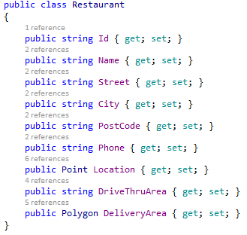
Model

Slide 44
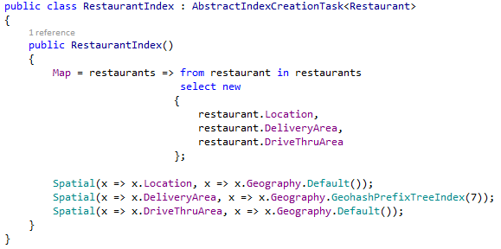
Spatial Index

Slide 45
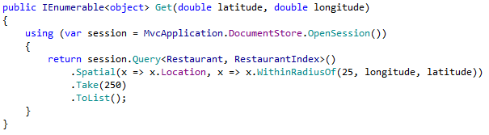
Spatial Query 1

Slide 46
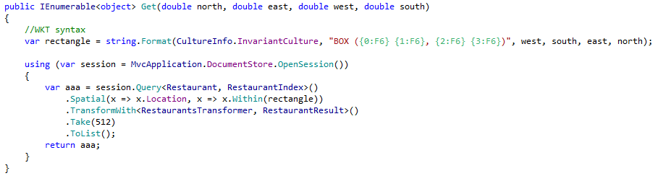
Spatial Query 2

Slide 47
Demo
Raven Burger Co

