Slide 1
TRNLTK
Turkish Natural Language Toolkit
Turkish NLP for everyone

Slide 2
Overview
Natural language processing
From Wikipedia: “... a field of computer science (…) concerned with the interactions between computers and human (natural) languages.”
Natural language toolkit : nltk.org
“Suite of libraries and programs (...) for NLP”
Functionality to make use of speech/text data by investigating semantics, morphology, etc.

Slide 3
NLP Tasks and Possibilities
Easy
Spell checker
...
Hard
Grammar checker
Synonym & antonym detection
Very hard
Machine translation
Named entity recognition
Plagiarism detection
...
Part of speech tagging
...

Slide 4
Some properties of Turkish
Agglutination
ev : (the) house
eviniz : your house
evinizde : at your house
evinizdeyim : I am at your house
Vowel harmony : front/back and rounding harmonies
masa-da : on the table (masa+Singular+Locative)
pencere-de : on the window (pencere+Singular+Locative)
batı-nın : west’s (batı+Singular+Genitive)
doğu-nun : east’s (doğu+Singular+Genitive)
Need to parse words morphologically
Makes morphological parsing harder

Slide 5
Some properties of Turkish (cont’d)
Voicing, devoicing:
talep : the request
talep+im → talebim : my request
kitap : (the) book
kitap+da → kitapta : in the book
Lack of grammatical gender
Pronoun “o” = “he/she/it”
Word order
Ben okula gittim : I went to school
Okula ben gittim : It is me who went to school
Gittim ben okula
...
Makes morphological parsing harder
This makes things a little bit easier!
Part-of-speech tagging is very hard!

Slide 6
Tasks Revisited - Turkish
Spell checker: A dictionary based solution doesn’t work. Cannot store all possible Turkish words in advance
Grammar checker : Word ordering makes it harder
Machine translation : A direct-statistical approach doesn’t work (unless you’re Google and have the text of billions of books)
Too many unique tokens
Corpus size | Vocabulary size
 | English | Turkish
1 Million words | 34K | 110K
10 Million words | 100K | 420K
Much larger vocabulary.
It grows faster too!
Turkish NLP needs a different approach! → TRNLTK

Slide 7
Most Basic Operation in NLP for Turkish: Morphological Parsing
Why needed?
Phrases represented in multiple words in other languages might be only one word in Turkish → Machine translation is not possible w/o it
Too many unique “tokens” → Can’t implement even a simple spell checker w/o it
Knowledge must be enormous → Part of speech tagging is not really possible w/o it
siyah arabaya : to the black car
siyah arabada : in the black car
To determine “siyah” is an adjective, we need to find relations. This relation has to defined with the stem, “araba”; not the forms with suffixes “arabada” and “arabaya”
...

Slide 8
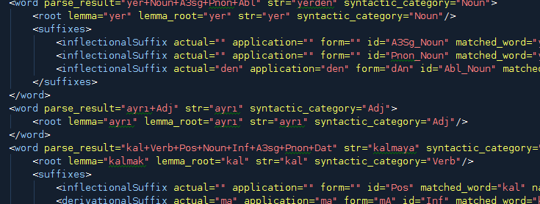
TRNLTK
Context Independent Operations
Tokenizing
Morphologic parsing
Context Dependent Operations
Tokenizing
Morphologic parsing
Part of speech tagging
...

Slide 9
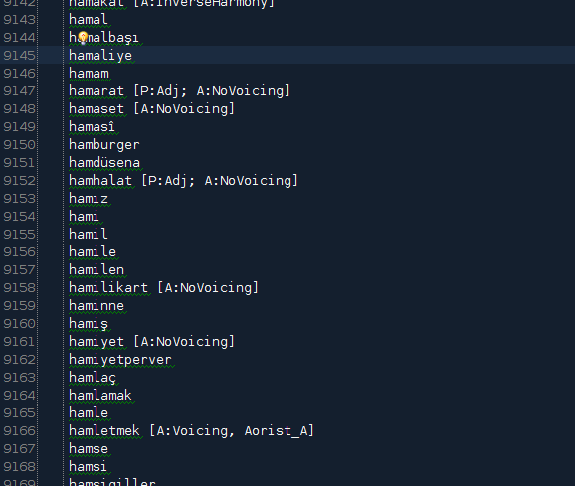
PART I
Context Independent Operations

Slide 10
Context Independent Operations
Context is ignored
No statistics etc. is used to check previous knowledge on the similar situations, only rule based
Ambiguity is not tried to be solved –yet –
Operations:
Context independent tokenizing
Context independent morphologic parsing
Rule based part-of-speech tagging

Slide 11
Context free tokenizing
Tokenize text to sentences
Tokenize sentences to words
Rule-based : does not check previous knowledge in a case of ambiguity
Daha sonra birçok gezgin ve bilim insanı bu bölgeye gelerek araştırmalar yapmış ve bu araştırmalar çeşitli kaynaklarda yayımlanmıştı.
Daha
Daha sonra birçok gezgin ve bilim insanı bu bölgeye gelerek araştırmalar yapmış ve bu araştırmalar çeşitli kaynaklarda yayımlanmıştı. Bu araştırmalar sonucunda elde edilen buluntular, o dönemde Osmanlı İmparatorluğu’nun başkenti İstanbul’da yeni kurulan “Müze-i Hümayun” a getiriliyordu
sonra
birçok
Bu araştırmalar sonucunda elde edilen buluntular, o dönemde Osmanlı İmparatorluğu’nun başkenti İstanbul’da yeni kurulan “Müze-i Hümayun” a getiriliyordu
gezgin
...

Slide 12
Turkish – An Agglutinative Language
Like other Turkic languages
Example:
Turkish | English
ev | (the) house
evler | (the) houses
evim | my house
evimde | in my house
evimdeydi | (it) was in my house
evimdeyse | if (it) is in my house
A more complicated example:
“Karnıyarık Türkmutfağı nın vazgeçilmezlerindendir.”
“Karnıyarık* is one of the indispensibles of Turkish kitchen.”
vazgeç-il-mez-leri-nden-dir
abandon/give_up+ Passive + Aorist_Negative + Plural + One_Of + Copula(is/are)

Slide 13
Context Free Morphologic Parsing
Parsing the given words without the context
Finding all morphologic possibilities for a given word
These possibilities later will be evaluated within the context
>>> from trnltk.playground import playground
>>> playground.parse_context_free('masadan')
masa(masa)+Noun+A3sg+Pnon+Abl(dAn[dan])
>>> playground.parse_context_free('derim')
de(demek)+Verb+Pos+Aor(+Ar[r])+A1sg(+Im[im])
deri(deri)+Noun+A3sg+P1sg(+Im[m])+Nom
from the table
I say
my skin
A3sg: 3rd singular person/number agreement
Pnon: Possession agreement “None”
Abl : Ablative noun case agreement
Pos: Positive verb polarity
Aor : Aorist tense
P1sg: 1st singular person possession agreement
Nom: Nominative noun case agreement

Slide 14
Context Free Parsing : Approach#1
A normalized suffix graph with rules for succession of each suffix
e.g. “Suffix Y can follow suffix X”
Too many nodes (~300) and edges (~10000)
Hard to maintain, hard to have an overview of the graph
Better support for exceptional cases at the cost of difficulty in maintenance

Slide 15
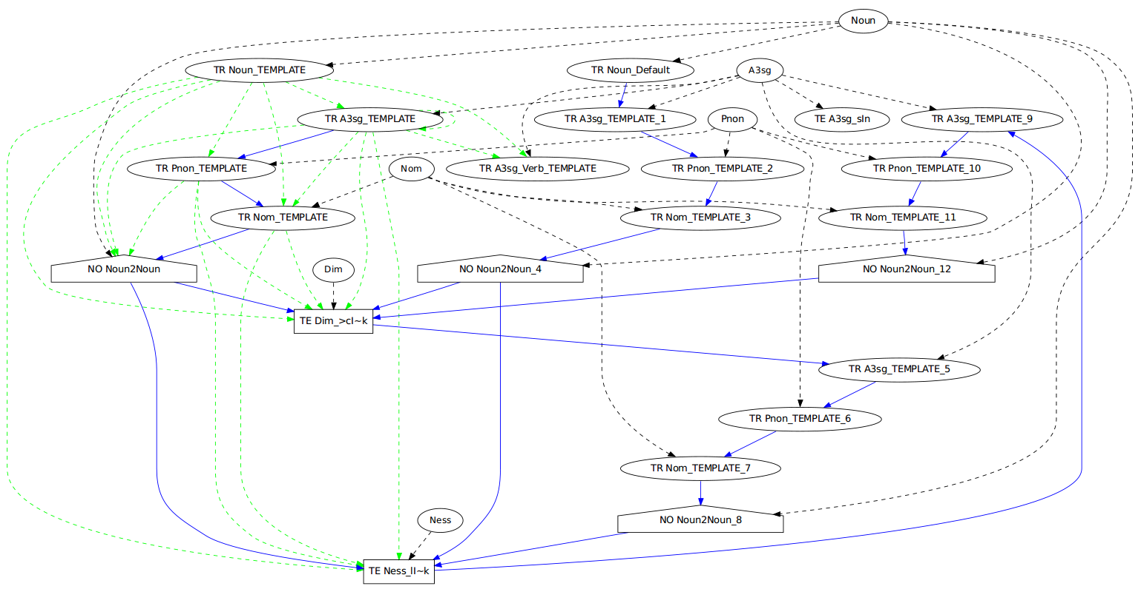
Approach#1 : A trimmed graph with 5 suffixes

Slide 16
Context Free Parsing : Approach#2
Approach used in TRNLTK
A semi-normalized suffix graph with rules for edges that go out from a syntactic category
E.g. “Suffix X can be applied to Nouns” or “Suffix Y can apply to singular Nouns which don’t have possession yet”
Merging the transfer states of the previous Approach#1 in a logical way
Less nodes (~50), less edges (~150)
Graphical visualization of the entire graph is possible → good for debugging, analysis, extending etc.
Harder to support exceptional cases
e.g. : Suffix –sız works with singular nouns:
“vicdansız” works, but “vicdanlarsız” doesn’t

Slide 17
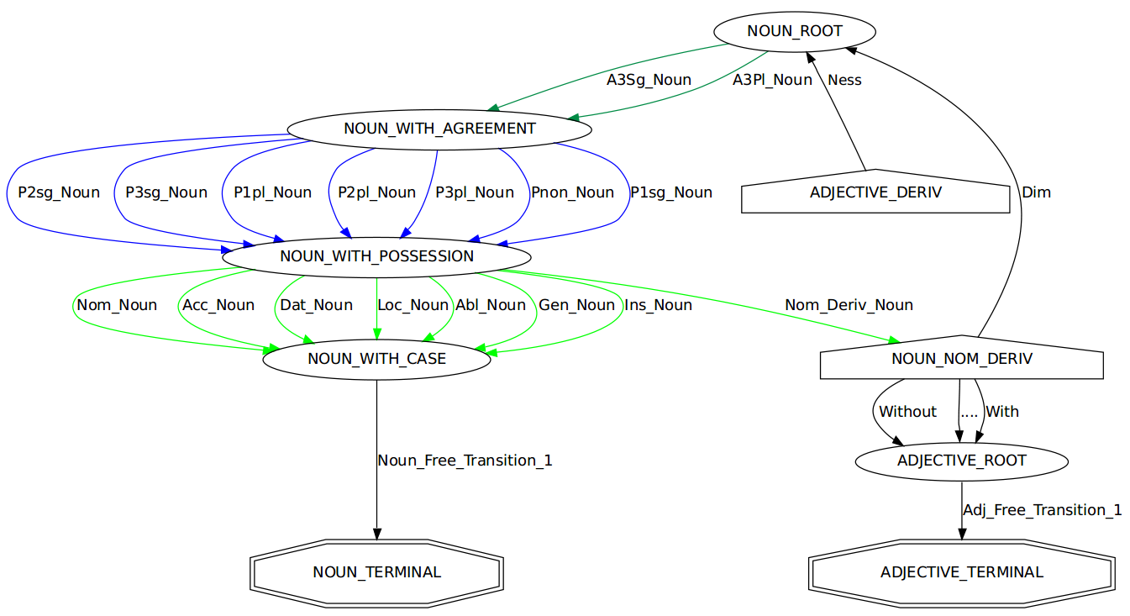
Approach#2 : A trimmed graph with ~20 suffixes

Slide 18
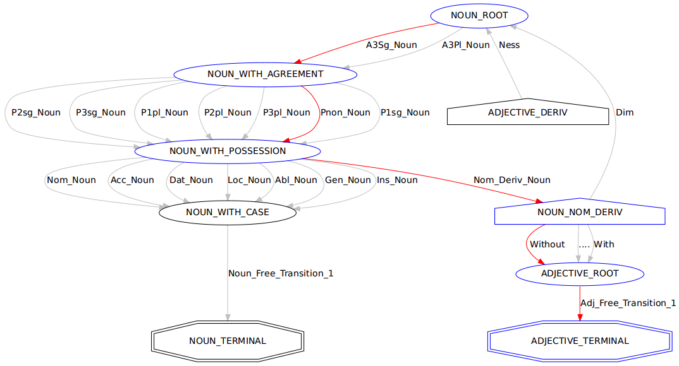
Graph traversal for word : “vicdansız”
vicdan:Noun
-sız → Adjective

Slide 19
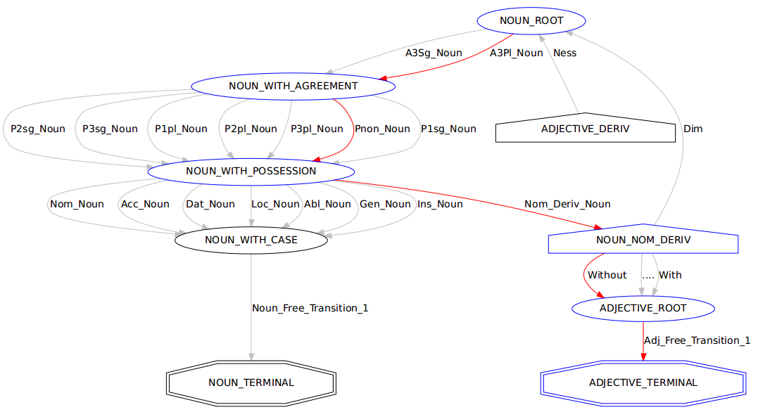
Graph traversal for word : “vicdanlarsız”
vicdan:Noun
-lar
-sız → Adjective

Slide 20
Graph traversing for word : “vicdanlarsız”
The parse shown in previous slide should NOT work
TRNLTK solution: rules for suffixes
Actually, traversal for “vicdanlarsız” is stopped, because of the rule of the suffix “-sız” (Without)
self.NOUN_NOM_DERIV.add_out_suffix(self.Without, self.ADJECTIVE_ROOT)
self.Without.add_suffix_form(u"sIz", doesnt_come_after(self.A3Pl_Noun))
Matchers, using Specification Design Pattern
More of them:
comes_after(someSuffix)
doesnt_come_after_derivation(someSuffix)
applies_to_root(someWordRoot)
...
Could be combined, etc. Support for “and”, “or”, “negation” operations
comes_after(someSuffix) | comes_after(someOtherSuffix)
~applies_to_root(someWordRoot) & ~applies_to_root(someOtherWordRoot)

Slide 21
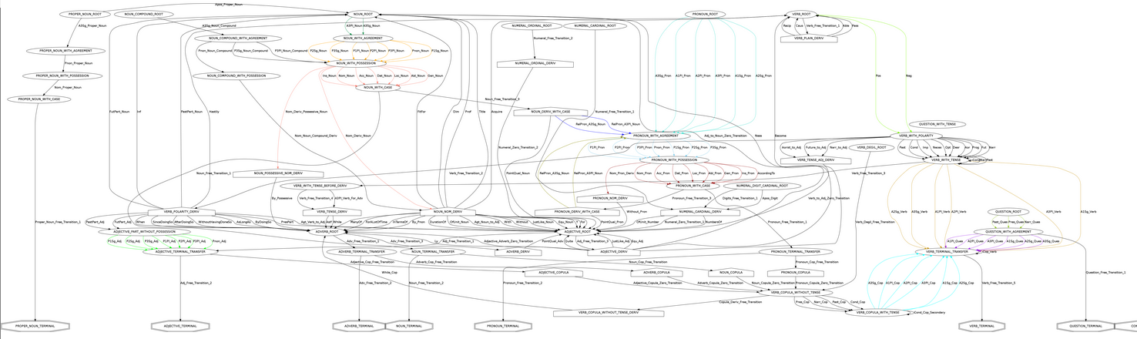
Complete suffix graph
https://raw.github.com/aliok/trnltk/master/suffixGraphExtended_20121010.png

Slide 22
Some numbers
Some numbers when TRNLTK contextless morphological parser is run on METU-Sabanci annotated corpus (~60000 words):
For 89% of the words, tagged parse result is given among the possible parse results
Average time to find the possible parse results for a word : 12 ms
Fast enough -for now- : would take 3.3 hours to parse a 1M word corpus

Slide 23
Implementation
Annotated dictionary (lexicon):
No derived or inflected words in it, only lemmas
Words tagged with syntactic categories except nouns and verbs (verbs are in infinitive forms and can be recognized)
Words tagged with exceptions (e.g. no vowel harmony)
A little bit scary : 24% of 25000 entries has tags
Orthographics engine : handles voicing, vowel harmony etc
Morphotactics engine : checks the conditions for suffixes
Traversing engine : Goes over the FSM by using tools above
Numerals : a digit-to-text converter is implemented
1990’da : in 1990 ←→ 1991’de : in 1991
Same suffix, but because of vowel harmony, applied form is different → Need to find the last vowel
Checking only the last digit won’t work : last digits of 100 and 1000 are same, but last vowel is different

Slide 24
Implementation (cont'd)
Predefined paths for exceptional words
Prepare partially traversed paths for some words
When that word is seen, start from the last point of the prepared path
Needed for pronouns and words “to eat” and “to say”
Proper nouns : can’t really recognize them easily
Mark a word as a proper noun when an apostrophe is used : most of the time they have no suffixes → Not perfect
Mark a word as a proper noun if it starts with a capital letter → Other word types can be like that in the beginning of a sentence → Not good
Can’t be done without context (a better approach is described later)
Same problems with acronyms as proper nouns
ABD’de : in USA ←→ EMU’da : in EMU (European Monetary Union) →vowel harmony, find the last vowel

Slide 25
Part II

Slide 26
Tokenizing
“RNA (Ribonükleik asit) bir polimerdir.”
“Müze-i Hümayun’a konuldu.”
“Ali bana ‘Ben gelmiyorum.’ dedi.”
“Bu işleme ‘fotosentez’ denir.”
“Bu zincirin kesilmesine neden olabilir [Mikkola, s75].”
“N’apıyorsun?”

Slide 27
Problem with context independency : Ambiguity
Ambiguity
Agglutination creates ambiguity
leaf+es : leaves ←→ leave+s : leaves
derim : “de”+Positive+Aorist+A1sg → “I say”
derim : “deri”+P1sg → “my skin”
Some of the ambiguity types:
Polysemies:
My head←→ Head chief
Yakacak odun : “wood to burn” →Adjective
Roma’yı yakacak : “(He/she/it) will burn Rome” →Verb
Homographs:
Grizzly bear ←→ Bear in mind
Denizde yüz : “swim in the sea”
Yüz kişi : “hundred people”
Syntactic ambiguity : “I’m going to sleep.”
I am (now) falling asleep
I am leaving (this event) to (go and) sleep
Main problem since Turkish is an agglutinative language
Different syntactic categories for the same surfaces of a lexeme
Not in scope -yet-

Slide 28
Ambiguity in Morphological Parsing
Contextless morphological parser is only rule-based
It finds all of the possible parse results for a given word (will be now on called as “surface”)
How to find the correct morphological parse?
We can’t!
But we can find the likelihoods for each parse result

Slide 29
Contextful Morphological Parse : Metrics
Collocation : Check the context that the word is used in and find a likelihood for the parse result by searching previous knowledge
???Sparse data icin normalizasyon???
Collocation diye isimlendir
Kelime icin parse result daha once olmus mu? Tek kelime verildiginde uygulamak icin de iyi olur
Mesela, kelime daha once sifat olarak kullanilmis mi?
Syntactic category “takip etmesi”: Syntactic kategoriye gore rule based + statistical birsey : sifatlar isimlerden once gelirler
Suffix – word collocation: Check if a suffix is used just before the surface we evaluate and if it is common to have that suffix in front of the surface we evaluate
Kelime, bir onceki kelimenin bir ekinden (ya da sonraki) kullanilmis mi? –e kadar, -den beri
Word – suffix collocation: Check if a word is used just after the surface with a suffix we evaluate and if it is common to have that word after that particular suffix
Yukaridakinin tersi (gelen ekin sonraki kelime ile birlikte kullanilma ihtimali) –e kadar, -den beri
6) ??? Verb’in accusative olmasi durumu mesela. Cumleyi komple gozden gecirip, fiile bak. Eger fiil accusative ise, ve baska “nesne” yoksa, buyuk ihtimalle bizim kelime objedir. Tabi eger Acc eki almissa. 4 ve 5’ in onceki veya sonraki kelime degil de, cumleye komple bakan hali
7) Suffix transition probability matrix??? Su andaki ek buysa, sonraki ek ne olacak? Ekleri tek tek gezerek her ek icin probability cikarma. Bu bi ise yaramayabilir, uzerinde dusunmek lazim orneklerle

Slide 30
Collocation
Context kontrol etme BUNUN ADI collocation
Onceki kelime ile iliski (onceki kelime parse edilmemisken, bizim kelimenin formlari ne kadar kullanilmis?)
Sonraki kelimeyi de dahil edip goster
Onceki kelimenin parse result’i biliniyorsa
Onceki kelimenin formlari ile bizim kelimenin formlari ne kadar kullanilmis
Sonraki kelimeyi de dahil edip goster

Slide 31
Collocation - Example
Word “yaz”
“to write” and “summer” : homograph (also homonym -> pronunciation is also the same)
Surface “yazdı”
“(he/she/it) wrote” and “(it) was summer”
Parse results for “yazdı”
yaz+Verb+Past+A3sg
yaz+Noun+..+Verb+Past+A3sg
How to determine?

Slide 32
Collocation - Example
Answer (one of the answers) : Check context
Context: leading and following words
Context example with one leading word
“deftere yazdı” : “(he/she/it) wrote to the notebook”
“sıcak yazdı” : “(it) was (a) hot summer”
New question : “What is the correct parse result among possible ones, when the previous word is ‘deftere’ ?”

Slide 33
Collocation – cont’d
Answer :
Find in previous knowledge: how many times “deftere” and “yaz+Verb+Past+A3sg” are used together
Find in previous knowledge: how many times “deftere” and “yaz+Noun+...+Past+A3sg” are used together
The parse result with more occurrences is more likely to be correct parse result
Likelihood : count of collocation divided by occurrence count of “deftere”
Collocation metric is not a definitive answer!
There might be cases where the correct parse result has actually less likelihood!
But it is a hint. To be combined with other hints (are listed before, will be described later)

Slide 34
Parse result’lar bilinirken word ve parse result’larin sequence’inin bir textte gecme ihtimali => Markov chain
Markov chain’i ciz
Context’in parse result’i bilinirken word ve parse result’larin sequence’inin bir textte gecme ihtimali => HMM (rc is known)
HMM’yi ciz
Ayni durumda rw’nin ihtimali
Context’in parse result’i bilinmezken word ve parse result’larin sequence’inin bir textte gecme ihtimali => HMM (rc is not known) => Tum rci leri dene
HMM’yi (leri) ciz
Ayni durumda rw’nin ihtimali
Burada rci’nin weightlerinin normalizasyonunu graph ile goster
2’nin Ngramlara uygulanmis hali, N>2
Cumulative distribution
3’un Ngramlara uygulanmis hali, N>2
Cumulative distribution
Leadin context = 0.6, following context = 0.4
5Gramlarla calismamak icin 2gram + word + 2gram

Slide 35
Likelihood of a surface and parse result sequence existing in a text
r₁
r₂
r₃
Markov chain with start and end states ignored
Since we’re looking for the parse result sequence, surfaces are not shown and ignored

Slide 36

Likelihood of a parse result sequence when parse result for context is known
w₁
w₂
r₁ (known)
r₂₀
...
r_{2n}
One of these are the correct parse result for surface w₂

Slide 37
Likelihood of a word and parse result sequence existing in a text
w₁
w₂
r₁₀
...
r_{1n}
r₂₀
...
r_{2n}
Let’s try calculating P(r₂₀,w₁ w₂)

Slide 38


w₁
w₂
=
r₁₀
...
r_{1n}
r₂₀
w₁
w₂
x
+
r₁₀
r₂₀
The weight for each part is pure statistical.
So, if no <surface-parse_result>exists in the existing knowledge with given <surface-parse_result>, it will be ignored.
...
w₁
w₂
NOT GOOD!
Need smoothing
x
r_{1n}
r₂₀

Slide 39

Context parse result weight smoothing
For discrete values sum is 1
Sum should be still 1
P function
Call it W function
By experiment => 0.4 is a good value for α
Note: for multiple context words, need to apply weighted addition

Slide 40
Leading and following contexts
w_{leading0}
w_{leadingn}
w_{target}
w_{following0}
w_{followingn}
...
...
r_{leading0}
r_{leadingn}
r_{following0}
r_{followingn}
..
..
Leading context
r_{target0}
...
r_{targetn}
Following context
Target surface

Slide 41
Leading and following contexts
Say, context length to check is 2
Instead of looking for the collocation of 2+1+2=5 words (leading1+leading2+target+following1+following2)
Check 2+1=3 and 1+2=3 words (leading1+leading2+target) and (target+following1+following2)
Hard to work with 5Gram instead of 3Gram
Need to have different weights for leading and following context collocation
These weights will be picked depending on the syntactic category ➔ a metric to be described later
Weight _{Leading} = 0.6
Weight _{Following} = 0.4

Slide 42
Multiple Context words
An example of context length = 2
w_{leading0}
w_{leading1}
w_{target}
r_{leading0}
r_{leading1}
r_{target0}
...
r_{targetn}
Say, function O(x,y) ➔Occurrence of x and y used together (Ngram x,y)
O(w_{leading0},w_{leading1},w_{target}) often does not exist in existing knowledge
Instead, use weighted interpolation with weights as cumulative distribution➔
Find collocation metric value for N=2 by combining O(w_{leading0}, w_{leading0}) and O(w_{leading0},w_{leading1},w_{target})

Slide 43


Multiple Context words
N=2
N=3
This means, having an occurrence of 3Gram is 10 times important than having a 2Gram occurrence
Having 3Grams with more than once occurrence is very rare already
N>3 ➔ Supported, but impractical

Slide 44
Multiple Context words
α, β, γ are static
For better results they need to be context dependent ➔Big task, TBD later

Slide 45
Target surface, stem and root collocations
Turkish -> Agglutinative Language
“yazdı” : “(he/she/it) wrote”
“yazıyor” : “(he/she/it) is writing”
“yazacak” : “(he/she/it) will write”
The relation is between “to write” and “notebook” → Better check the stem and the root in addition to the surface
Occurrences of “deftere yazacak” is also useful for “deftere yazdı”

Slide 46
Wordforms
Wordforms
Surface : full token
Stem : Last derived word
Lexeme: The simplest atomic part
Token | Surface | Stem | Lexeme
kitap+Noun | kitap+Noun | kitap+Noun | kitap+Noun
book+Noun | book+Noun | book+Noun | book+Noun
yiyebildim+Verb | yiyebildim+Verb | yiyebil+Verb | ye+Verb
I was able to eat | I was able to eat | be able to eat | eat
Lexeme and stem matters!
Occurrences of “he is able to eat” is useful for “I was able to eat” (both are single words in Turkish, as shown above)

Slide 47
Wordform collocations
Occurrences of context word + surface
Full word has occurrence with same context →A less often situation
Weight: 0.55
Occurrences of context word + stem
Stem of the word has occurrence with same context → Might be still rare
Weight: 0.30
Occurrences of context word + lexeme
Root of the word has occurrence with same context → This can happen a lot
Weight: 0.15
Note : Wordforms are looked up in the knowledge with the syntactic category (Noun, Verb, etc) →Eliminate homonyms of stem and lexeme with different syntactic categories

Slide 48
Wordform collocations, cont’d
Same situation with context!
“defterde yazdı” : “defter+Noun+..+Loc yaz+Verb+A3sg+Past”
“deftere yazdı” : “defter+Noun+...+Dat yaz+Verb+A3sg+Past”
Occurrences with wordforms of context words are also important
Occurrences of context surface + target
Very important : →coefficient = 0.60
Occurrences of context stem + target
Important : →coefficient = 0.30
Occurrences of context lexeme + target
Less important →coefficient = 0.10

Slide 49

Wordform collocations, cont’d
Remember diagram and formula below?
Likelihood of a parse result sequence when parse result for context is known
w₁
w₂
r₁ (known)
r₂₀
...
r_{2n}
➔ To be expanded to use more information by looking at the wordform collocations

Slide 50




Wordform collocations, cont’d

Slide 51
Problem: sparse Ngram data
When finding the collocation metric, co-occurrence of e.g. 2 words could be very rare
Cannot say, “this words don’t co-occur and thus collocation metric is 0” ➔ Too many situations like that
From Metu-Sabanci annotated corpus which have 49961 unigrams:
Unigrams | Surface | Stem | Lexeme
Distinct | 17285 | 8606 | 4686
Distinct with multiple occurrences | 4920 | 3881 | 2846
Sparse data
e.g. only ~10% of surfaces exist more than once
e.g. ~35% of surfaces are distinct : very big rate

Slide 52
Problem: sparse Ngram data
Bigram data is much sparser
From Metu-Sabanci annotated corpus which have 49962 bigrams:
Bigrams | Surface |  |  | Stem |  |  | Lexeme
 | Surface | Stem | Lexeme | Surface | Stem | Lexeme | Surface | Stem | Lexeme
Distinct | 40441 | 38203 | 36897 | 37583 | 35045 | 33403 | 35959 | 33228 | 31477
Distinct with multiple occurrences | 3570 | 4205 | 4644 | 4108 | 4900 | 5464 | 4355 | 5218 | 5816
Sparser data :
e.g. only ~7% of two surfaces co-occur more than once
e.g. ~81% of surface-surface bigrams are distinct

Slide 53
Good-Turing smoothing for NGrams
Need smoothing for estimating the collocation likelihood of a co-occurrence which doesn’t exist in the previous knowledge
Good-Turing smoothing:
“Use count of things you’ve seen once to help estimate the count of things you’ve never seen.”
Not very complicated → see Wikipedia page
N₀ = V^{N} minus CountOfDistinctNGrams
V: vocabulary size (distinct unigram count)

Slide 54

Improved Good-Turing smoothing for NGrams
However, definition of Good-Turing as written in Wikipedia is not very efficient
How about the zero frequency of frequencies?
Use log linear regression : log(N_{c})=a + b*log(c)
That will give an estimation
Called “Simple Good-Turing”
Don’t need to apply it to bigger frequencies
Threshold: k=5

Slide 55
Improved Good-Turing smoothing for NGrams
Inspecting wordform collocations → we have different NGram types
Something special in TRNLTK
E.g. trigrams
surface surface surface
surface surface stem
surface surface lemma_root
...
surface stem stem
...
Need to apply smoothing considering the NGram type for given count

Slide 56
Putting it all together
// Returns List<ParseResult, CollocationLikelihoodValue>
FindCollocationLikelihoods(target word, leading context, following context):
TWPRs ← parse target word
CPLs ← parse leading context
CPFs ← parse following context
CCPL ← create cartesian product of CPLs
CCPF ← create cartesian product of CPFs
for each parse result TWPR in TWPRs:
LCTWPRCLs ← <leading context,target word> parse results collocation likelihoods
for each parse result sequence CPRS in CCPL:
LCTWPRCLs += FindParseResultsCollocationLikelihood(CPRS, TWPR)
LCTWPRCLs ← SmoothParseResultsCollocationLikelihoods(LCTWPRCLs)
FCTWPRCLs ← <following context,target word> parse results collocation likelihoods
for each parse result sequence CPRS in CCPF:
FCTWPRCLs += FindParseResultsCollocationLikelihood(TWPR, CPRS)
FCTWPRCLs ← SmoothParseResultsCollocationLikelihoods(FCTWPRCLs)
Ls += WeightedSummingMergeOfContextLikelihoods(weighted sum of LCTPRCLs, weighted sum of FCTPRCLs)
return Ls

Slide 57
Algorithm details
Many coefficients to tweak the algorithm
WordForm collocation weights: 6
Leading-following context weights: 1
Context-targetWord occurrence weight smoothing factor: 1
Weighted interpolation for Ngram : 1+2+3 = 6
TOTAL : 14 parameters → Need to tweak well to make algorithm work better
For the moment, they’re just instinctive
Need to work on a big annotated corpus to make them better → However, there is no any!

Slide 58
Implementation
Mongodb
Why
Capped collections
Indexes
100Gram’i bile destekleyebilir kod!
Sadece bu context bulma islemi icin bir Ngram collection hazirlandi. Tum morpheme container (parse result)lari koymak yerine → performans
Zaman : 56000 kelime icin context bulma ne kadar zaman aliyor.
Tek yonlu (onceki veya sonraki)
Cift yonlu (onceki ve sonraki)
Onceki 1 kelimeye bakinca ne oluyor, iki kelimeye bakinca ne oluyor zaman olarak?
Sadece context bulma ile dogru parse result ne kadar oranda tutturuluyor? Sabanci treebank’taki dogru sonucu % kac oraninda alabiliyoruz?
Bu oran neden yeterli degil? Ne gibi degerli bilgileri kullanmiyoruz (henuz)?

Slide 59
Big picture

Slide 60
tscorpus :
“Kalemini” her zaman p3sg olarak isaretlenmis
“Onunla” p2sg olarak isaretlenmis vs
491M kelime var ama cok yanlis!
Gecen :p2sg
Turkiyenin : p2sg+Gen
Proper nounlar yok gibi bisey!
Transformation olayi. Corpusta bir hata bulunca, diger yerlerde de bunu duzeltme! Otomatik veya supervised!
Terimler.docx dosyasina bak

Slide 61
Advanced topics
Proper noun detection : Proper noun olarak daha once kullanilmis mi? Ya da annotated olmayan bir textte, hic cumle ortasinda buyuk harfle baslatilmis mi? Veya hic kesme ile ayrilmis mi?
Pronoun resolution: “Onu bana verdi” → “o” kim?

Slide 62
Contact
Ali Ok (@aliok_tr)
Developer @ Innflow AG, Zurich, Switzerland
Apache MyFaces committer (not a very active one though)
Questions to aliok[AT]apache[DOT]org

