Slide 1
The Banking App
By Josh Del Toro and Matt Yaswinski

Slide 2
What is this?
Banking app
Mainly geared toward mobile/computer use, but ATM capability could be added
Can check balance and/or credit score, freeze credit card, transfer funds between accounts
Checking and Savings accounts

Slide 3
Where can this be used?
Web-based app for banks
Only on a local network for this project, but if it is able to work online, could be used for banks
On ATM’s
With transfer and withdraw functions, could be used to get money at an ATM

Slide 4
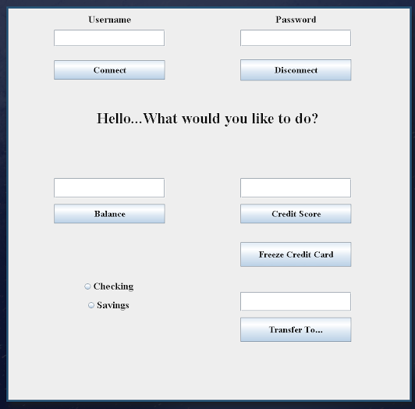
GUI

Slide 5
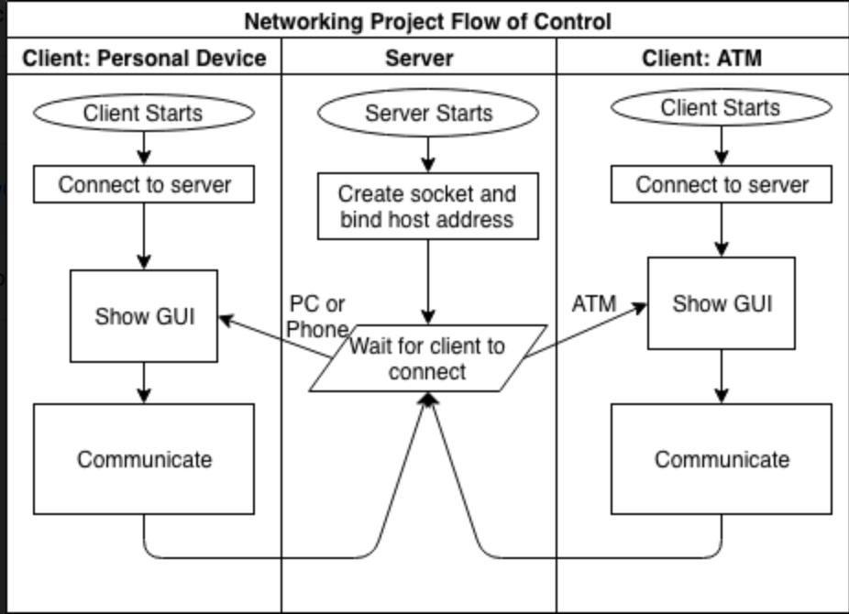

Slide 6
Step-by-step
Connect to server using a predefined port
Use username and password fields to enter the respective information
Message will be displayed saying “Hello [name]. What would you like to do?” when the username and password are recognized from a text file
Transferring funds will change values in the text file based on the amounts being moved from accounts; allows users to transfer between their Checking and Savings accounts
Credit Score and Balance will read values from the text file
Balance reads either the Checking or Savings value
Freeze will change the status of the credit card in the text file
All values will be displayed in the text boxes above the respective buttons, and values can be typed in the text boxes when transferring funds
Disconnect will log the user out of the session

Slide 7
Possible Features
Different options depending on whether user is at ATM or on mobile/computer app
Withdraw for ATM since you cannot withdraw from a phone or computer
Transfer funds between users
User can choose what other person to send money to, and the money would be taken out of Checking account from the source user and put into the Checking account of destination user
Creation of user account

