Slide 1
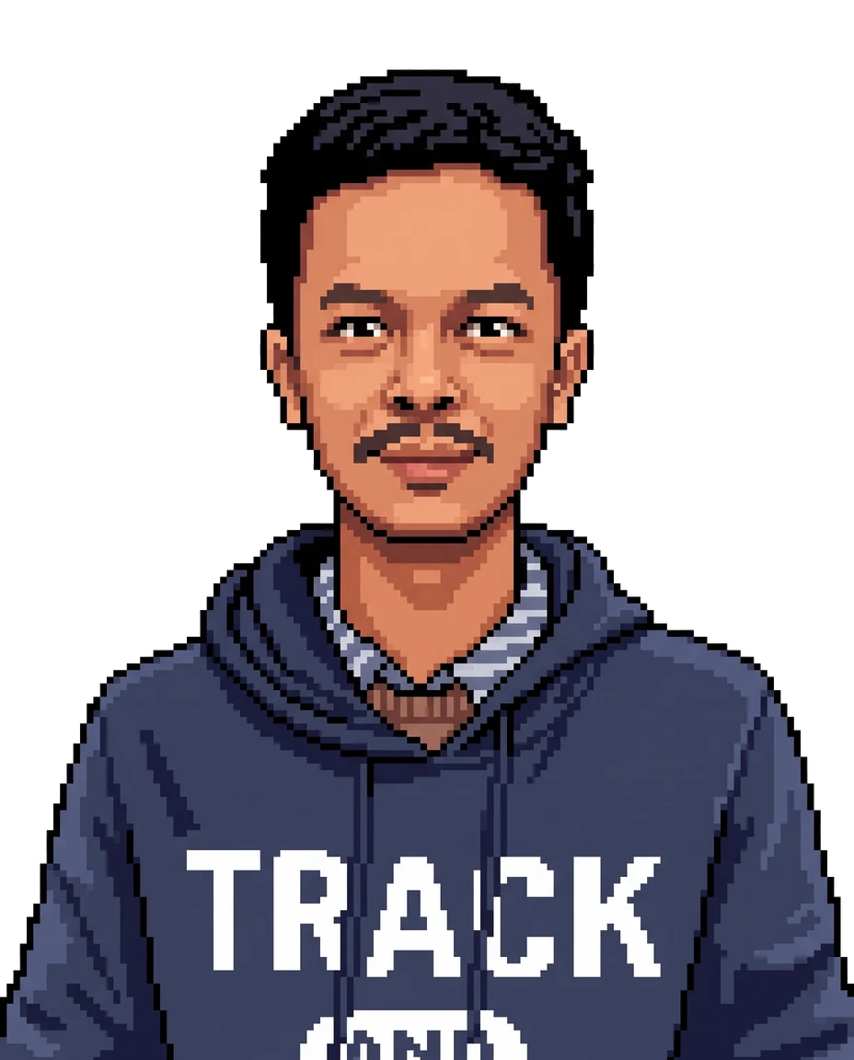
Myat Htoo Khaing
PRODUCT DESIGN PORTFOLIO
Product Designer who ships in code
9+ years · Bangkok, GMT+7 · Open to remote, contract & freelance
myathtookhine.github.io/portfolio-of-mhk
Notes:
Hello — I am Myat Htoo Khaing, a product designer with nine years of experience. What makes me different is that I do not stop at Figma: I ship the design in code.

Slide 2
A product designer who ships in code
PROFILE
For 9+ years I've turned complex business needs — restaurant POS, logistics, ticketing — into clear, responsive products, from Figma all the way to production-ready UI.
9+
Years of experience
FOCUS
Enterprise, POS, logistics
4
Platforms: web, tablet, iOS, Android
PLATFORMS
Web, tablet, iOS & Android
STACK
Figma + React / Tailwind
10+
Restaurants running Axtra POS
LANGUAGES
English (professional), Burmese (native)
Notes:
Nine years, four platforms, and work that is in daily use — Axtra POS runs in more than ten restaurants in Yangon.

Slide 3
Four things I am hired for
WHAT I BRING
Complex flows, made simple
Responsive to the last pixel
Restaurant POS, delivery logistics, ticketing and museum management turned into clear, usable screens.
Web, desktop, tablet and phone. On Axtra POS I checked and fixed the whole product, directly in the code.
Design that ships in code
AI-accelerated prototyping
Expert CSS, plus React, TypeScript and Tailwind. At OMS I built the design system inside the codebase.
AI as a prototyping partner: a full app redesign in two weeks, accepted by the client.
Notes:
These four are the through-line of every project in this deck.

Slide 4
Selected work
01
Two case studies, and the projects around them

Slide 5
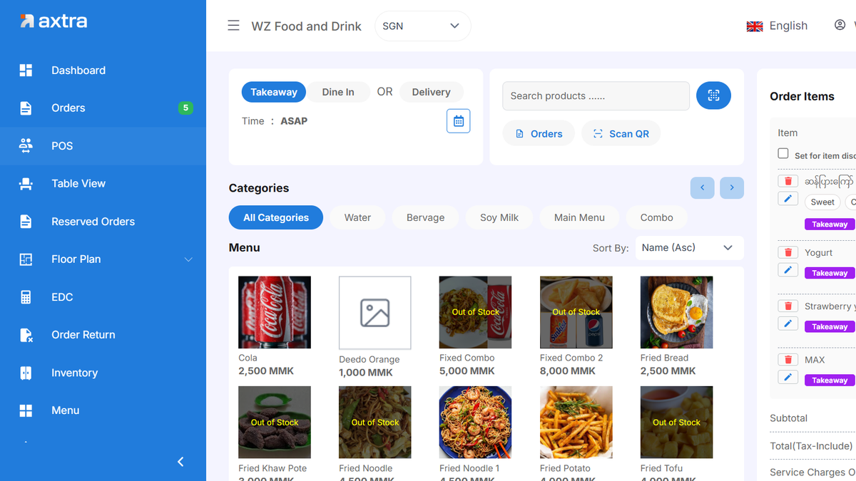
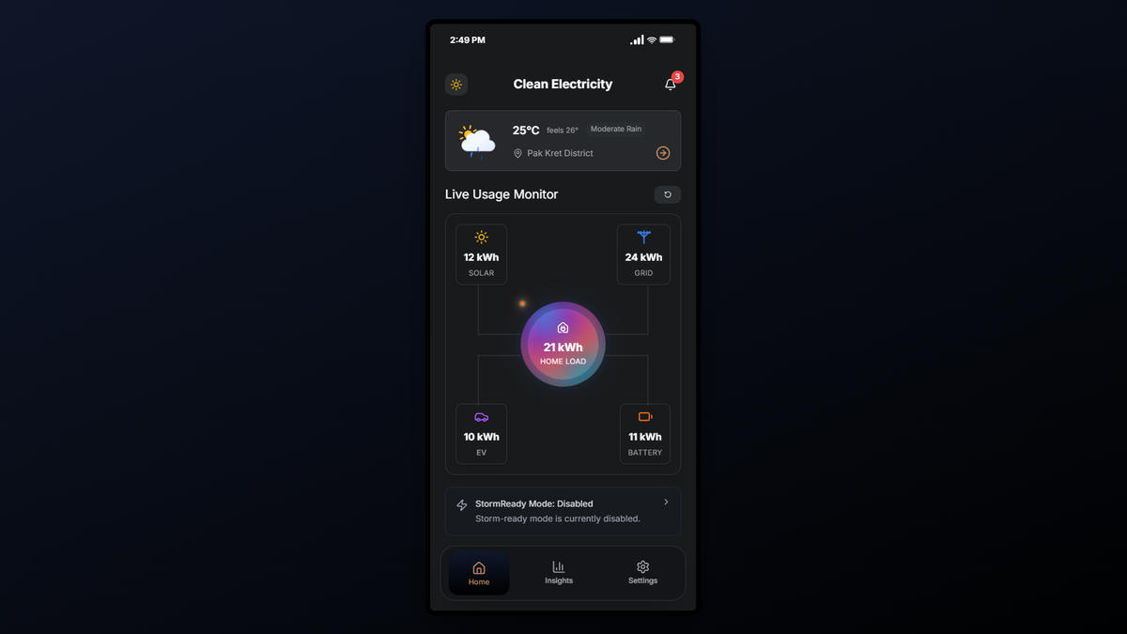
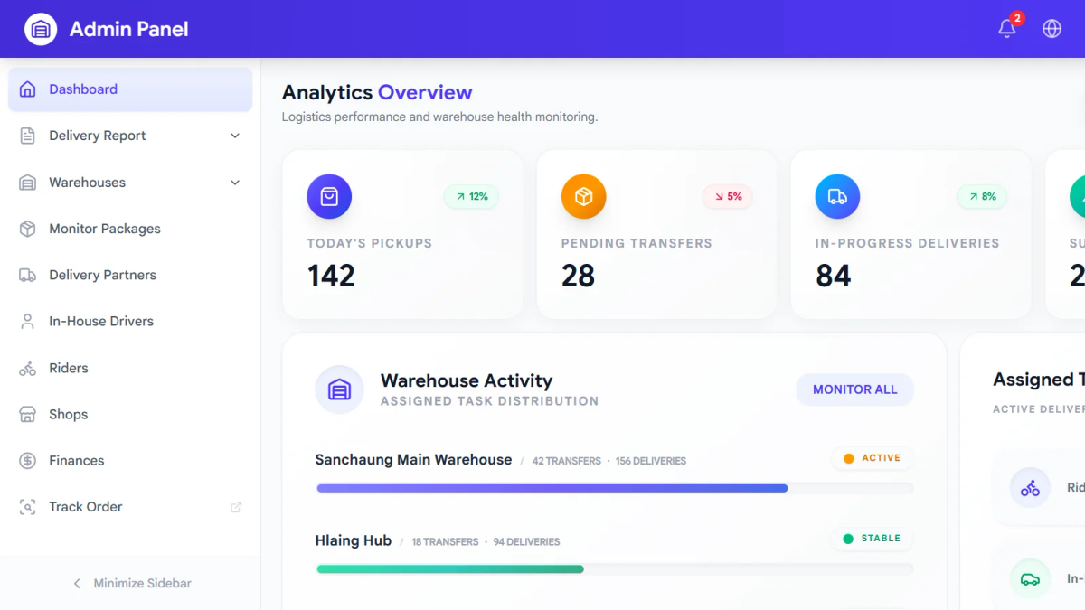
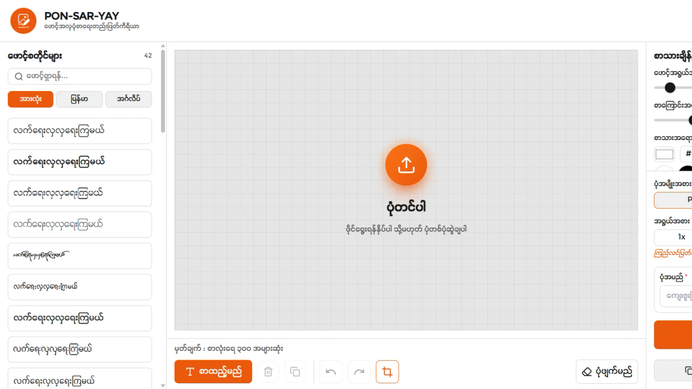
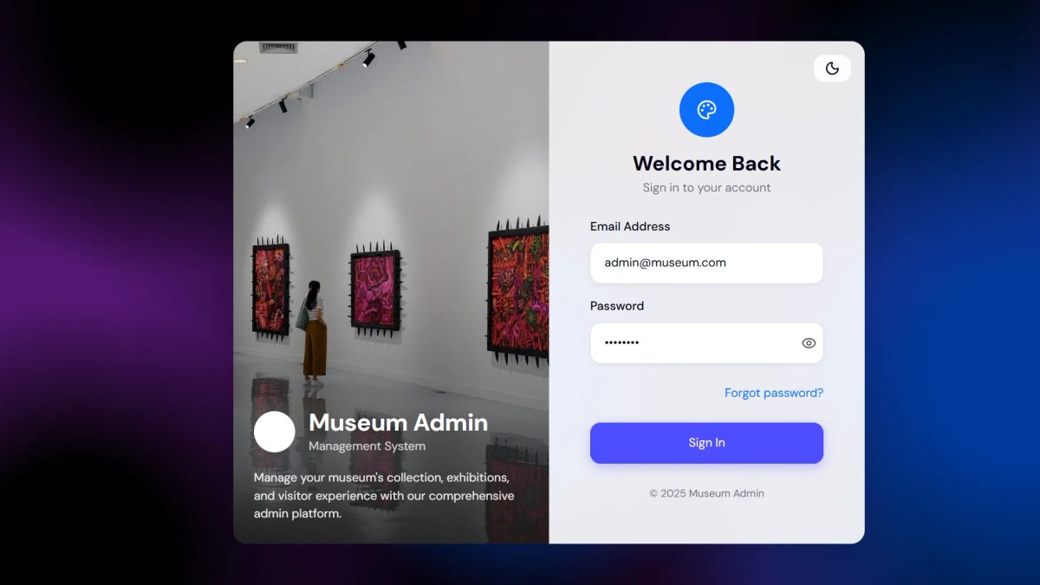
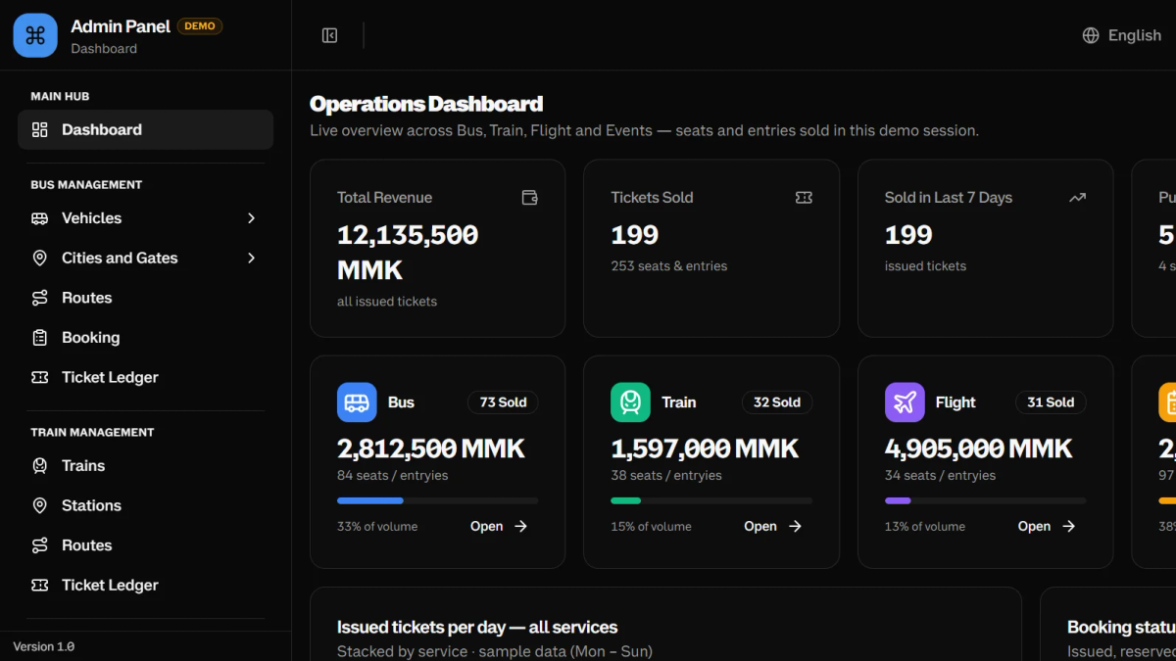
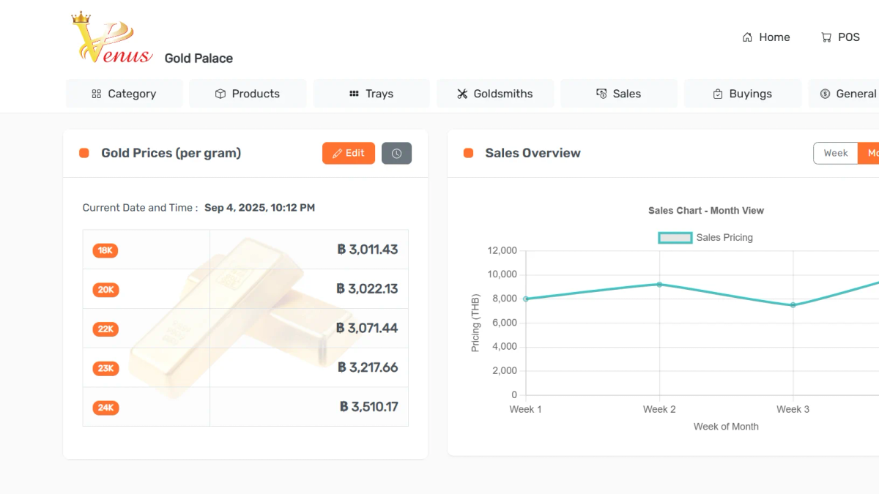
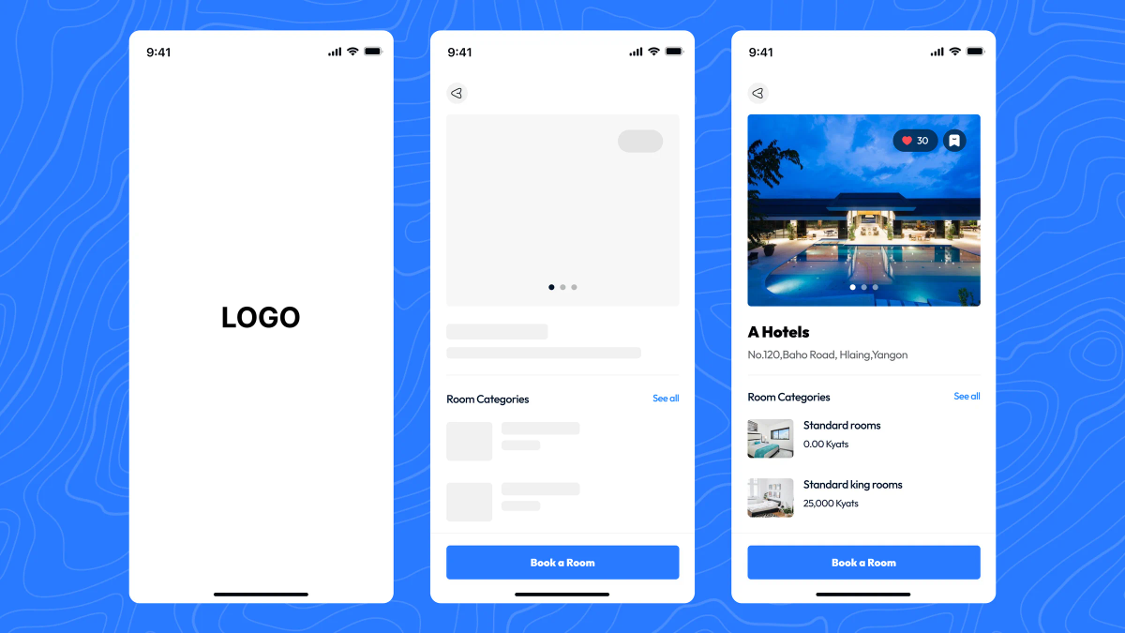
Nine years of work, at a glance
INVENTORY
Axtra POS
Smart Energy
Delivery & Warehouse
PonSarYay
Point of sale · Restaurants
Client · AI-assisted redesign
Logistics · Enterprise
Open source · Web app
Museum Management
E-ticket Management
Gold Shop Management
Hotel Booking
Culture · Admin & visitor app
Ticketing · Admin console
Retail · Dashboard
Customer & owner platform
Notes:
Enterprise tools, mostly: the kind of product where the hard part is making a complicated operation feel simple.

Slide 6
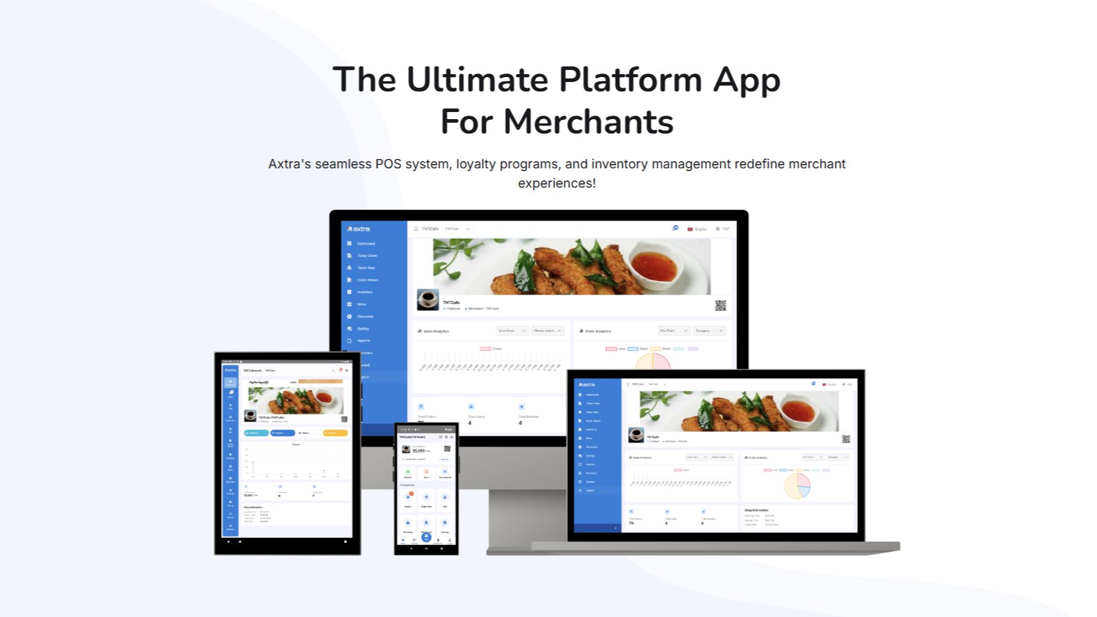
Axtra POS
CASE STUDY 01 · POINT OF SALE
A cross-platform POS for restaurants: one product that had to work on web, desktop, tablet and phone. The hard part was responsive design across a product that kept growing for over a year.
ROLE
Lead Designer & Frontend Dev
TEAM
PO, PM, developers, operations
DURATION
1+ year, start to finish
OUTCOME
In use at 10+ restaurants in Yangon
One consistent product across four screen sizes
Layouts fixed in the codebase, not in specs
Notes:
Axtra POS runs a restaurant’s daily work: orders, menus, inventory, reports. I worked with the operations team as well as the PO and PM, and fixed responsive layouts directly in the code rather than handing over mockups.

Slide 7
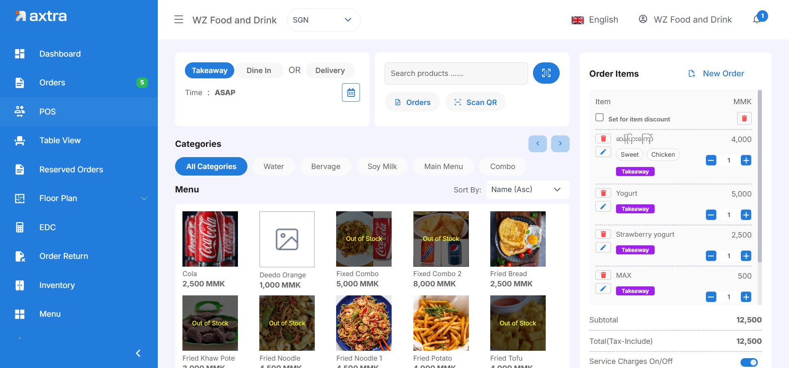
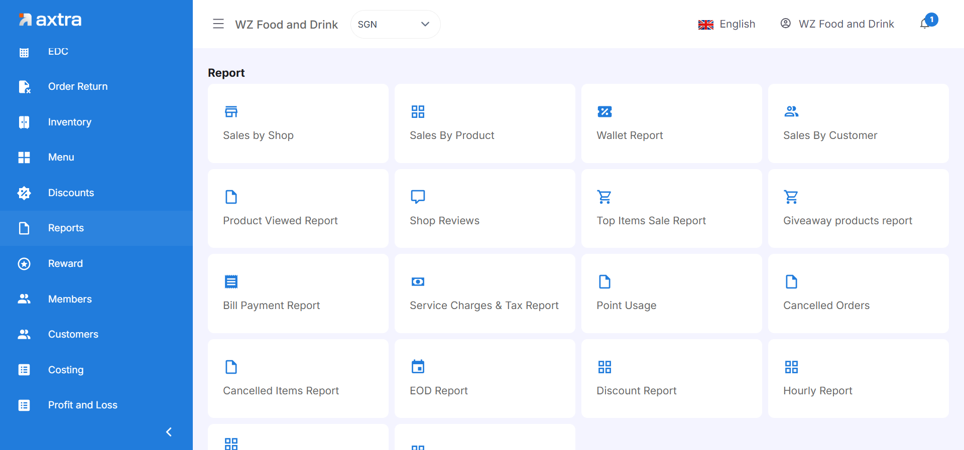
The same product on every screen
AXTRA POS · SCREENS
Order screen, built for speed at the counter
Reports: the day’s numbers at a glance
Notes:
Every screen was checked on web, desktop, tablet and phone, and fixed until the experience held up on all of them.

Slide 8

Smart Energy Management
CASE STUDY 02 · AI-ASSISTED REDESIGN
A full redesign of a home energy app bringing solar, grid, battery and EV charging into one place. A PRD covered the core; the rest I designed myself — in a two-week window.
ROLE
Product Designer & Frontend
TEAM
Solo, direct with the client
DURATION
2 weeks
OUTCOME
Whole app redesigned in two weeks
Design accepted by the client
Interactive prototype live online
Notes:
I used Antigravity and Gemini as prototyping partners, so the client reacted to working screens rather than static mockups. I designed the flows the PRD left open: storm mode, EV control and battery configuration.

Slide 9
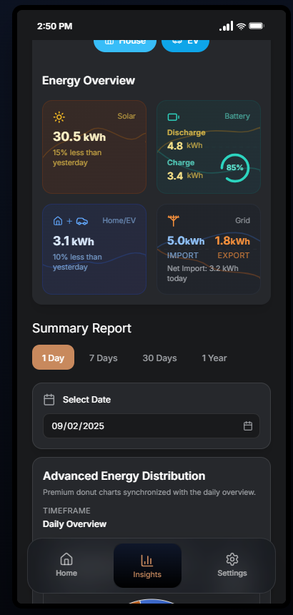
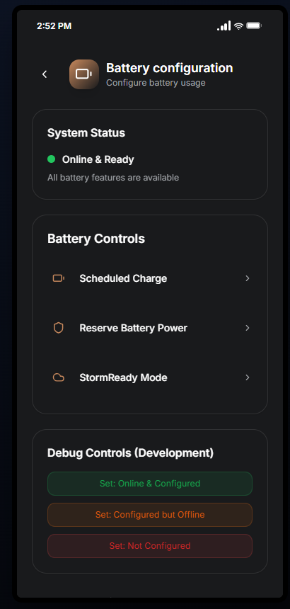
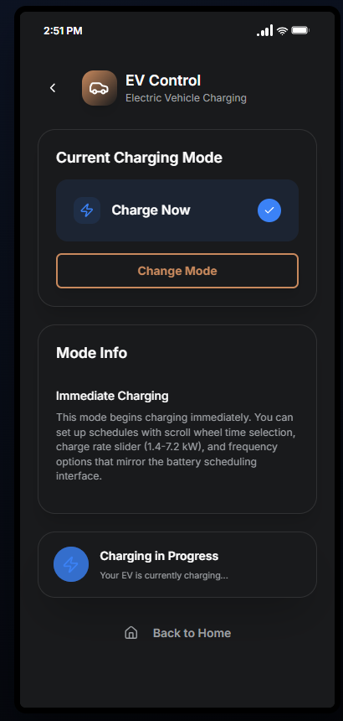
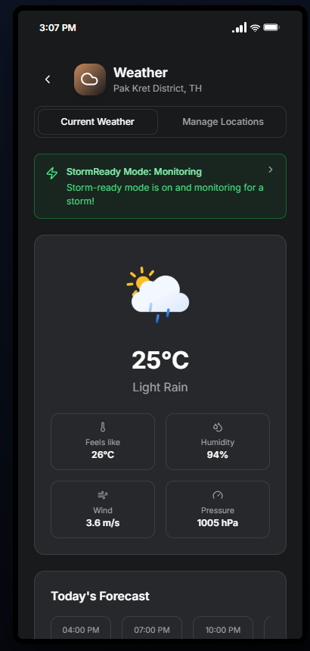
Flows the brief left open
SMART ENERGY · SCREENS
Insights
Battery
EV charging
Weather
Usage by day, week, month, year
System status and controls
Current mode at a glance
StormReady monitoring
Notes:
The animated energy-flow lines on the home screen come in three display modes; the weather screen uses a live OpenWeather integration.

Slide 10
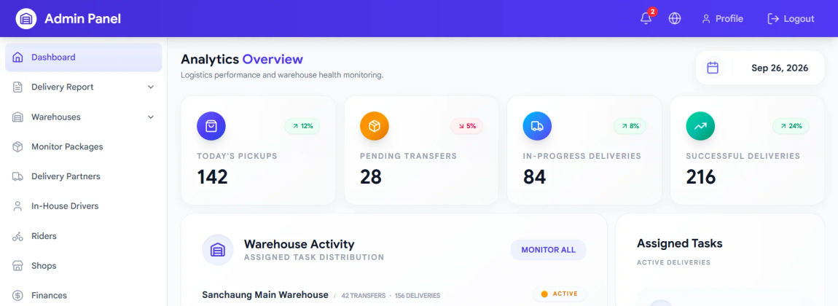
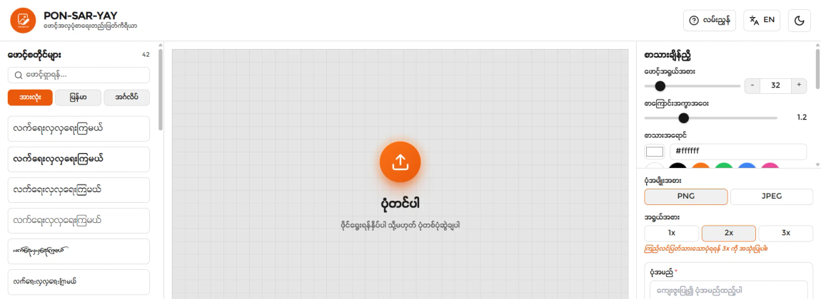
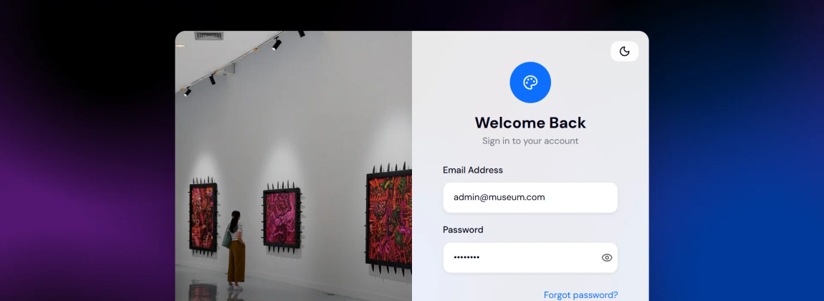
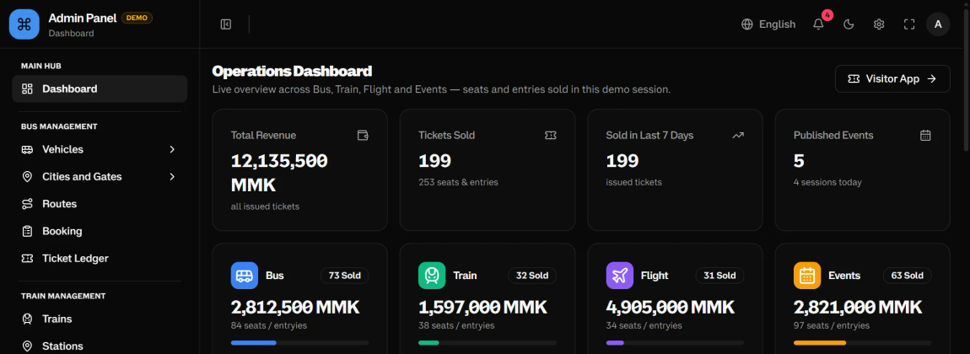
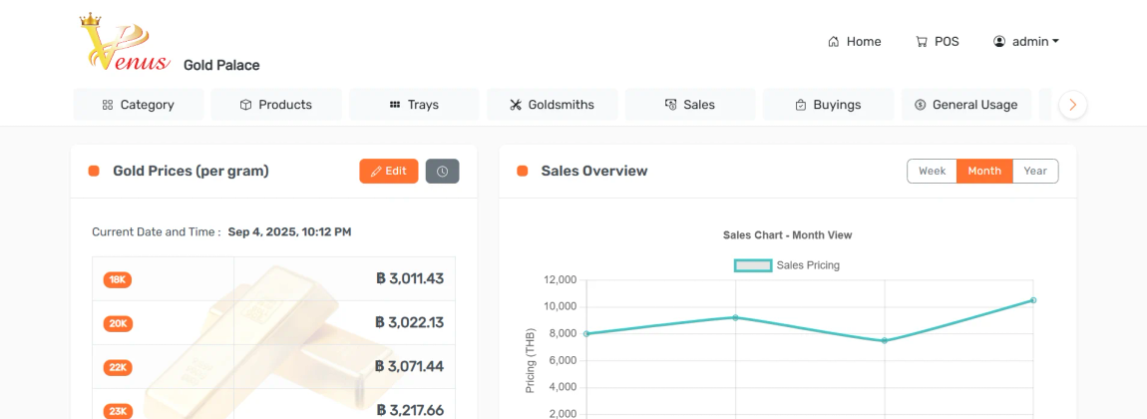
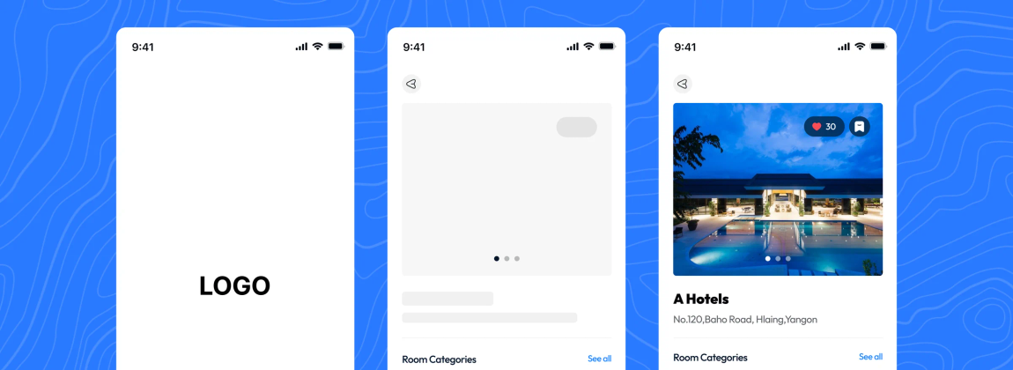
Six more products
ALSO IN THE INVENTORY
Delivery & Warehouse
PonSarYay
Museum Management
Warehouses, partners, drivers and riders in one admin panel — prototyped as working React apps.
My open-source text-on-image editor with Burmese fonts, refined using GA4 insights.
Collection and exhibitions, plus a visitor app that reads artifact stories aloud.
E-ticket Management
Gold Shop Management
Hotel Booking
Bus, train, flight and event ticketing run from a single operations console.
Daily gold price board by purity, sales overviews and a built-in POS.
Booking for travellers, with room, pricing and availability tools for owners.
Notes:
Most of these are freelance work from the past year, several of them end-to-end: admin console plus the companion app.

Slide 11
How the work actually gets done
PROCESS
1
2
3
4
5
Learn the operation
Design with engineering
Build in the product
Prototype at AI speed
Test every screen
Talk to the people who use the product every day, not only the product team.
Sit beside the developers while features are built, instead of handing work over a wall.
Refine the UI in the codebase with CSS, so fixes ship as working screens.
Turn a brief into screens a client can click, in days rather than weeks.
Web, desktop, tablet and phone, until the layout holds up on all of them.
Notes:
The common thread: I stay close to the people who use the thing, and close to the code that ships it.

Slide 12
Background
02
Where the nine years went, and what I work with

Slide 13
Nine years, four chapters
EXPERIENCE
2025 — Present
Freelance Product Designer
Self-employed
Museum, gold shop and e-ticket systems, plus PonSarYay, my own open-source editor.
2023 — 2025
Lead Designer & Frontend Dev
Online Merchant Solutions
Axtra POS across web, tablet and mobile; React prototypes for logistics.
2019 — 2023
Senior UI/UX Designer
Online Merchant Solutions
Rider app, booking and guest systems; built the design system and UI kit.
2016 — 2019
Web & Graphic Designer
Narigo Travel and Tour
Responsive pages from scratch, plus logos, icons and vector illustration.
Notes:
Six years at Online Merchant Solutions, from senior designer to lead designer and frontend developer, and the last year freelance.

Slide 14
What I work with
TOOLKIT
DESIGN & PROTOTYPING
FRONTEND
UI/UX design · Wireframing · High-fidelity prototyping · Design systems · Design engineering · Vector illustration · Logo & icon design
CSS/SCSS (expert) · HTML · JavaScript · TypeScript · React · Next.js · React Native · Vue · Svelte · Angular · Vite · Tailwind · Bootstrap
TOOLS
PLATFORMS & DEPLOYMENT
Figma · Adobe Illustrator · Adobe XD · Framer · Lottie Lab · Gemini · Antigravity · Claude Code · ChatGPT · Git · GitHub · GitLab
Vercel · GitHub Pages · Cloudflare · Supabase · Render · Resend
Education · BA in English, Pakokku University · Google UX Design Professional Certificate (in progress) · Foundations of UX Design, Coursera
Notes:
CSS is where I am strongest — it is what lets me finish a design in the product instead of describing it in a spec.

Slide 15
Let’s work together
GET IN TOUCH
EMAIL
myathtookhine@gmail.com
MOBILE
+66 80 414 8062
LINKEDIN
linkedin.com/in/myat-htoo-khaing-084242b3
Open to remote, contract and freelance work, with flexible hours for international teams.
GITHUB
github.com/myathtookhine
PORTFOLIO
myathtookhine.github.io/portfolio-of-mhk
Notes:
Thank you. The portfolio has the full case studies, and the résumé is downloadable there.

