Slide 1
How do annual members and casual riders
use Cyclistic differently?
Five million rides, one clear answer
5,727,115
12 months
5
rides analysed
Jun 2025 – May 2026
dimensions compared
Prepared for Lily Moreno and the executive team · Divvy trip data under the Cyclistic case framing
Notes:
The business task is conversion: turning casual riders into annual members. To do that we first need to know how the two groups actually differ. Five measures, one consistent answer.

Slide 2
The two groups peak on opposite days
Rides by day of week
Members
Member
Peak Thursday, trough Sunday. Ride length varies by under 2 minutes all week, the signature of a repeated journey.
Casual riders
Casual
Peak Saturday, 84% busier than Tuesday. Duration swings 40% across the week.
Notes:
Two opposite shapes. Members form an inverted U with a midweek peak. Casual riders form a U with weekend peaks. The consistency of member ride length is the tell same length, same hours, five days a week.

Slide 3
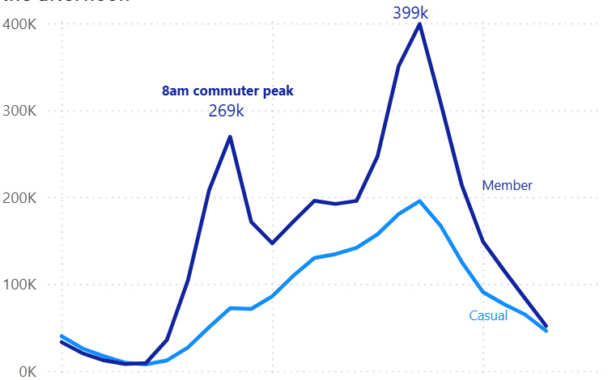
Members ride at commuting hours; casual riders do not
Rides by hour of day
Members
Twin peaks: 269,314 rides at 8am, 399,013 at 5pm, with a clear trough between.
Casual riders
No morning peak at all. One continuous rise from dawn to a broad late-afternoon hump.
Both groups reach their daily maximum at 5pm but members arrive there from a second daily peak while casual riders arrive from a climb with no morning counterpart.

Slide 4
Casual riding nearly stops in winter
Rides by month, June 2025 to May 2026
13.6×
more casual rides in August than in January
4.0×
Member
the same swing for members — they keep riding through winter
Casual
In January, members outnumber casual riders 4.6 to 1. In August the ratio narrows to 1.4 to 1.
Notes:
This is the constraint on the whole conversion strategy. An annual membership asks for a twelve-month commitment from an audience that rides for about five.

Slide 5
No overlap in where the two groups start
Top ten starting stations, by rider type
Casual — lakefront and attractions
Member — West Loop and Near North Side
Casual riding also concentrates: Navy Pier alone runs 72% above the busiest member station. Member volume spreads evenly across all ten.
Notes:
Station coordinates were checked on a map. Members start in the West Loop commuter corridor near Union Station and in the Near North Side — the places people travel from, not the destination. This analysis excludes the 21% of rides with no station name.

Slide 6
Three recommendations
Drop the commuter-value pitch
01
Casual rides cluster on Saturday and Sunday and nearly stop in winter. The savings argument for membership assumes frequent use, and casual riding is not frequent. Cyclistic should stop selling membership to this group on commuting savings, because the case rests on a pattern of use these riders do not have.
Offer a shorter or seasonal membership
02
Seventy percent of casual riding falls in five months, so an annual pass asks riders to pay for a year to use it for less than half of one. Cyclistic should offer a monthly or summer-season option instead. The data can't say which is better, as it holds no pricing or revenue.
Target by place and time
03
Casual rides start at a small number of stations, mainly Navy Pier, Millennium Park and the lakefront, and concentrate on summer weekend afternoons. Cyclistic should focus marketing at those stations and times rather than spreading it across the network, as the concentration makes the audience easy to reach.
Notes:
Recommendation two is the one to press. The others are marketing adjustments; this one says the product itself may be wrong for this audience.

Slide 7
What this analysis cannot tell you
Stated up front, because each one bounds a recommendation
No rider identifiers
21% of rides lack station data
Ride counts are not rider counts. One casual rider taking fifty trips looks identical to fifty riders taking one. The number of casual riders who could become members is unknown.
All on electric bikes, which can be locked anywhere. Geographic findings therefore rest disproportionately on dock-based trips.
Winter casual riders may differ
One year of data
Those still riding in January could be a distinct group rather than the same people riding less. Without rider IDs this cannot be tested.
Seasonal patterns may partly reflect this year's weather rather than a stable annual cycle.
A timezone error was found and corrected during analysis; the detection and fix are documented in the process notes.
Notes:
Including this slide is deliberate. It shows the limits were considered rather than missed, and it pre-empts the questions an executive would otherwise ask.

