Slide 1
AI Defense against black arts with HAProxy
(Advanced Technical)

Slide 2
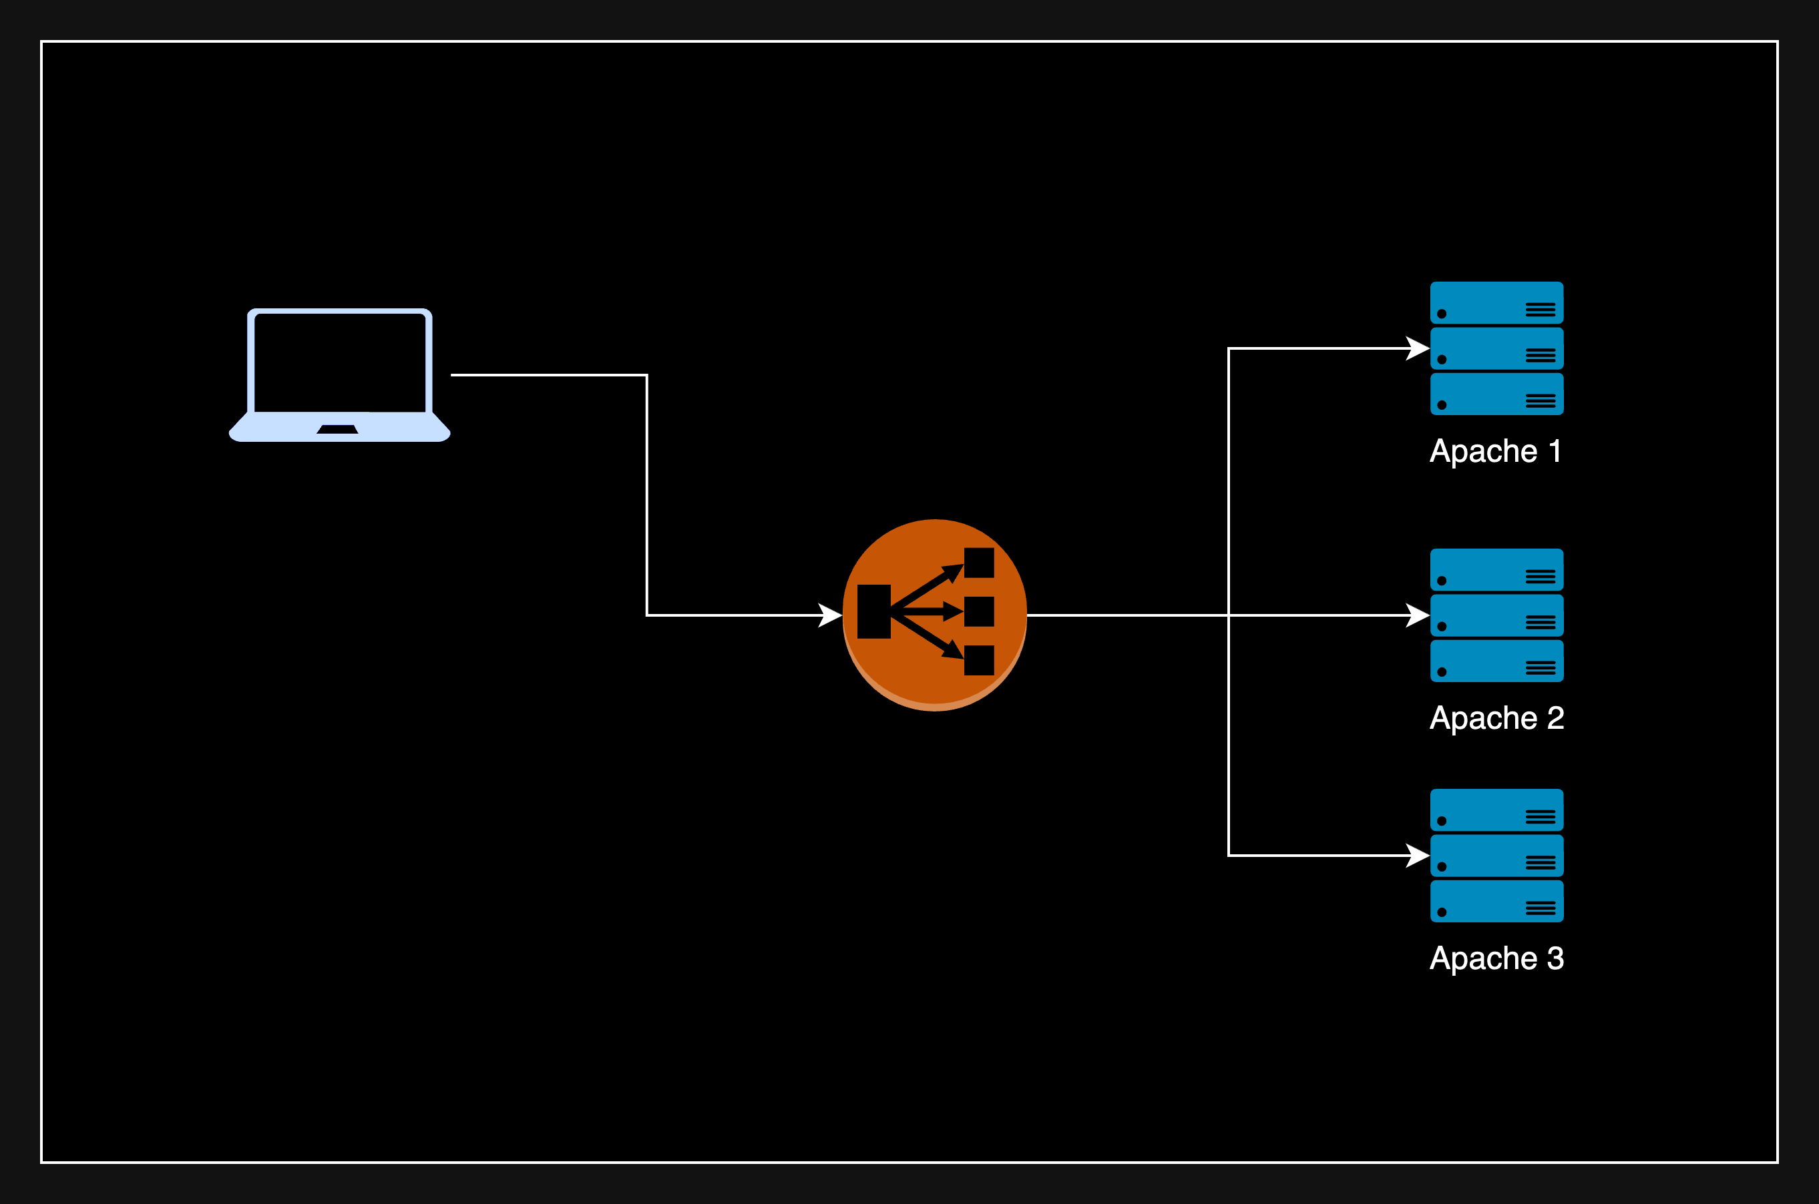

Slide 3
SQL Injection
Why It Matters: SQL injection attacks can compromise your application's security. Detecting and blocking them at the network level helps prevent data breaches and ensures system integrity.
Solution Overview: A Lua script for HAProxy to detect and block SQL injection attempts.
Key Features of the Script:
Pattern Matching
Identifies common SQL injection patterns in requests.
Request Inspection
Examines request parameters, headers, and body content for suspicious patterns.
Automated Blocking
If patterns are detected, the request is denied with a 403 Forbidden response.
Outcome: Enhanced security by preventing malicious requests from reaching your web applications.

Slide 4
Custom Error Pages for backend errors
Objective: Serve dynamic, custom error pages for specific backend failures.
How It Works:
Lua-Driven Content:
Generates error messages dynamically based on the error type.
Personalized Responses:
Customizes error messages using client request details or the specific backend that encountered the error.
Benefit:
Improves user experience by providing relevant, informative error messages.
Hides server errors and expetions

Slide 5
Custom Rate Limiting
Objective: Define flexible, custom rate-limiting policies beyond HAProxy’s basic capabilities.
Key Features:
User-Specific Limits:
Set rate limits per user or API key.
Context-Aware Limiting:
Adjust limits based on time of day or user’s geographic location.
Path-Based Limits:
Apply different rate limits to specific request paths.
Benefit: Enhances control over traffic, improving performance and user experience.

Slide 6
Dynamic HTTP Redirects
Purpose: Enhance redirection capabilities by dynamically generating redirects based on request attributes.
Capabilities:
User-Based Redirects:
Redirect users to mobile or desktop versions based on headers or cookies.
SEO-Friendly Redirects:
Create redirects for content migrations, preserving SEO value.
Flexible Rules:
Inspect paths, query parameters, and ports to apply specific redirect rules.
Benefits: Improves user experience and optimizes traffic flow by targeting redirection conditions precisely.

Slide 7
IP Whitelisting
Purpose: Restrict access to specific resources by allowing only approved IP addresses.
How It Works:
Define Whitelisted IPs:
Create a list of allowed IP addresses or ranges.
Inspect Incoming Requests:
Retrieve the client’s IP address from each incoming request.
Whitelist Validation:
Check if the client’s IP is in the whitelist.
If not, block the request and return a 403 Forbidden status with a custom error message.
Benefits: Provides an additional layer of security by controlling access based on IP addresses, ensuring only authorized users can access protected resources.

Slide 8
IP Blacklist
Purpose: Enhance application security by blocking access from known malicious or unwanted IP addresses.
How It Works:
Define Blacklisted IPs:
Set up a list of IP addresses to be denied access.
Inspect Incoming Requests:
Retrieve the client’s IP address from each request.
Blacklist Validation:
Check if the client’s IP is in the blacklist.
If so, block the request and return a 403 Forbidden status with a custom error message.
Benefits: Provides a proactive security measure, preventing access from known threats and reducing the risk of attacks from malicious sources.

Slide 9
Dynamic HTTP header manipulation
Purpose: Dynamically adjust HTTP headers for enhanced security and custom behavior.
Capabilities:
Strip Sensitive Headers:
Remove headers like X-Forwarded-For when requests come from untrusted networks.
Add Custom Headers:
Insert headers such as X-RateLimit-Remaining to communicate rate-limiting status to clients based on IP.
Modify Existing Headers:
Tailor headers based on specific conditions (e.g., User-Agent, IP, or URL path) to meet security and operational requirements.
Benefits: Improves control over request and response headers, enabling customized security, visibility, and user experience.

Slide 10
Authentication via External Systems
Objective: Integrate HAProxy with external authentication systems for robust, flexible access control.
Capabilities:
External Credential Verification:
Authenticate users by verifying credentials against an OAuth server or LDAP directory.
Custom Single Sign-On (SSO) Flow:
Handle login requests within HAProxy and forward validated tokens to backend services, streamlining authentication across multiple applications.
Benefits: Enables advanced, centralized authentication management, enhancing security and simplifying user access control.

Slide 11
Geolocation-based Request Routing
Objective: Enhance performance and user experience by routing traffic based on client location.
Capabilities:
Location-Based Backend Routing:
Direct European clients to a European data center and U.S. clients to a U.S.-based server.
Localized Content Delivery:
Serve region-specific content, such as language preferences, based on the client’s geolocation.
Benefits: Improves latency, optimizes resource usage, and personalizes content for users in different regions.

Slide 12
Client Browser Detection
Objective: Customize responses based on the client’s browser type.
Key Features:
User-Agent Inspection:
Extract the User-Agent header from incoming requests.
Browser Detection:
Identify browsers like Chrome, Firefox, Safari, or Internet Explorer and tailor responses accordingly.
Fallback Handling:
If User-Agent is missing, respond with a 400 Bad Request.
Benefits: Enhances user experience with browser-specific messaging and improves compatibility handling.

Slide 13
Cookie sizе validation
Objective: Ensure incoming requests comply with cookie size constraints for secure and efficient session management.
Key Features:
Cookie Inspection:
Analyze the Cookie header in each incoming request.
Size Calculation:
Measure the total size of cookies in the request.
Threshold Enforcement:
Respond with an error if the cookie size exceeds a defined limit (e.g., 4096 bytes).
Benefits: Helps maintain application stability and security by enforcing cookie size limits, reducing the risk of overflow or excessive data transfer.

Slide 14
Local File Inclusion (LFI) Protection
Objective: Safeguard your application by detecting and blocking LFI attack attempts.
Key Features:
Request Inspection:
Analyze request paths and parameters for potential LFI indicators.
Pattern Detection:
Identify common LFI patterns, such as directory traversal sequences (../, ..%2f, etc.).
Automated Blocking:
Block requests that match LFI patterns to prevent unauthorized file access.
Benefits: Enhances security by proactively defending against LFI vulnerabilities and protecting sensitive files from exposure.

Slide 15
Remote File Inclusion (RFI) Protection
Objective: Prevent unauthorized remote file execution by detecting RFI attack patterns in incoming requests.
Key Features:
Request Body Inspection:
Analyze request body content for indicators of RFI attempts, such as URLs or specific file extensions.
Pattern Detection:
Identify potential RFI patterns, including external URLs and executable file types.
Automated Blocking:
Block requests that match RFI patterns to prevent malicious code execution.
Benefits: Strengthens security by blocking requests that attempt to include remote files, protecting the server from malicious file execution.

Slide 16
Cross-Site Scripting (XSS) Protection
Objective: Safeguard users from XSS attacks by detecting and blocking malicious script injections.
Key Features:
Request Inspection:
Analyze both the query parameters and request body for potential XSS indicators.
Pattern Detection:
Identify common XSS patterns such as <script> tags, javascript: URIs, event handlers (e.g., onclick=, onerror=), and JavaScript functions (alert(, eval().
Automated Blocking:
Block requests containing XSS patterns and respond with a 403 Forbidden status.
Benefits: Enhances security by preventing malicious scripts from reaching users, protecting them from potential data theft and session hijacking.

Slide 17
Admin path protection
Objective: Prevent unauthorized access to sensitive admin areas of your web application.
Key Features:
Path Inspection:
Analyze each request URI to identify attempts to access restricted admin paths (e.g., /admin).
Access Control:
Enforce authentication checks on admin paths, allowing only authorized users to proceed.
Automated Blocking:
If authentication is missing or invalid, block the request and return a 403 Forbidden status with a custom error message.
Benefits: Strengthens security by restricting access to sensitive paths, reducing the risk of unauthorized access and protecting critical application functions.

Slide 18
log4j_rce (Log4Shell) Protection
Objective: Detect and block attempts to exploit the Log4j RCE vulnerability, "Log4Shell."
Key Features:
Request Inspection:
Analyze headers and body of incoming requests for indicators of Log4j RCE attempts.
Pattern Detection:
Identify common exploit patterns such as:
JNDI lookups (${jndi:ldap://, ${jndi:rmi://, ${jndi:http://)
Environment variable injections (${env:)
Nested variable injections (${${::)
Automated Blocking:
Block any requests containing these patterns with a 403 Forbidden response and a custom error message.
Benefits: Proactively defends against Log4Shell attacks, protecting systems from unauthorized code execution and ensuring application security.

Slide 19
Bot detection
Objective: Safeguard your web application from malicious bots and excessive request rates.
Key Features:
User-Agent Analysis:
Inspect the User-Agent header to identify requests from known bots based on a list of bot signatures.
IP-Based Rate Limiting:
Track request counts per IP within a one-minute window, blocking IPs that exceed a specified limit.
Automated Blocking:
Respond with:
403 Forbidden for requests identified as bots.
429 Too Many Requests for IPs exceeding the rate limit.
Benefits: Mitigates risks from data scraping, denial-of-service attacks, and automated threats, preserving server resources and enhancing security.

Slide 20
Unit testing
Key Components:
Function Definition:
check_response: Takes three inputs—URL, expected status code, and expected content.
Uses curl to fetch responses, capturing both status and body.
Response Validation Logic:
Verifies the status code and checks for expected text in the response body.
Outputs results for each test as pass/fail.
Cleanup:
Removes temporary files used during testing to keep the environment clean.
Benefits: Streamlines HTTP response validation, making it easy to confirm application behavior under different conditions.
Objective: Efficiently test HTTP responses to ensure they meet expected outcomes.
Script Overview:
Automated Requests:
Use curl to make HTTP requests to specific URLs.
Response Validation:
Capture both HTTP status codes and response body content.
Compare actual responses against expected outcomes (status and keywords).
Result Reporting:
Output a pass/fail result based on whether responses meet expected criteria.

Slide 21
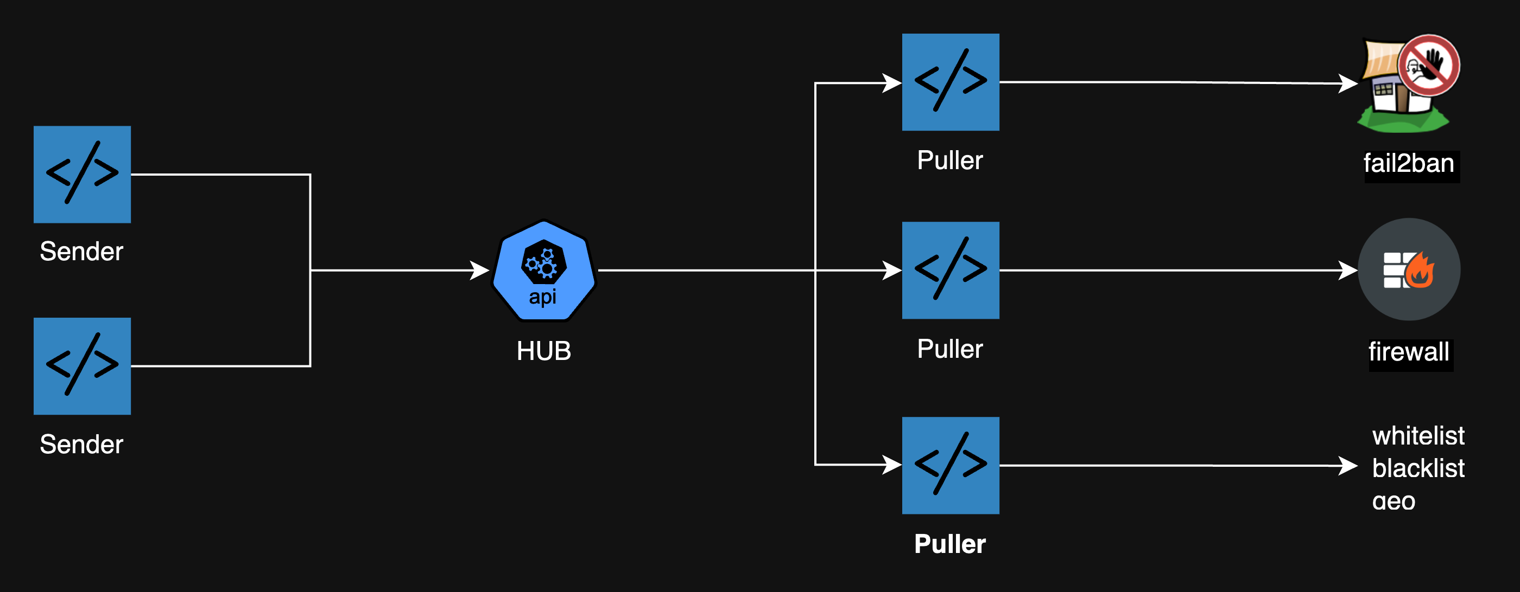
Hub

Slide 22

Обратна връзка

