Slide 1
Predicting sales win or lose
Herman Toeante

Slide 2
INTRODUCTION
Better understanding of sales pipeline can help any sales team organization can expect win or lose based on data. In this project, I am going to be the sales manager at an automotive supply company. Any B2B company like GE, AMAZON, GOOGLE, ADP, etc can use the same approach that I demonstrated on this project to their sales team. As a manager, I'm trying to assess a sales execution issue. We have not been able to convert enough opportunities lately.

Slide 3
DATA
The data contains over 78K of sales lead for the last two years
Each sales lead data contains information such as SupllierSubGroup, Region, Route, TotalDaysQualified, TotalDaysClosing, Competitor, etc
The number of loss sales lead data is 75%

Slide 4
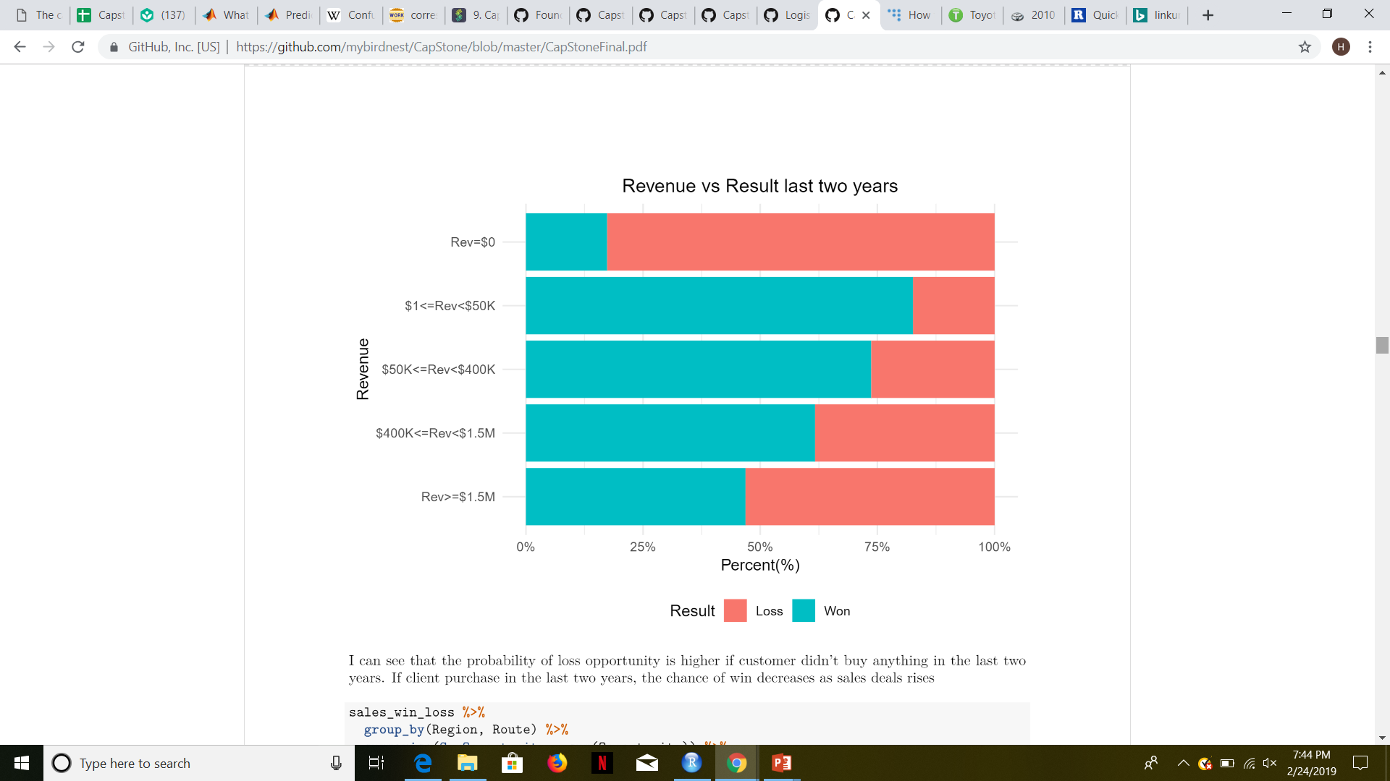
Data Exploration
The probability of loss opportunity is higher if customer didn't buy anything in the last two years. If client purchase in the last two years, the chance of win decreases as sales deals rises

Slide 5
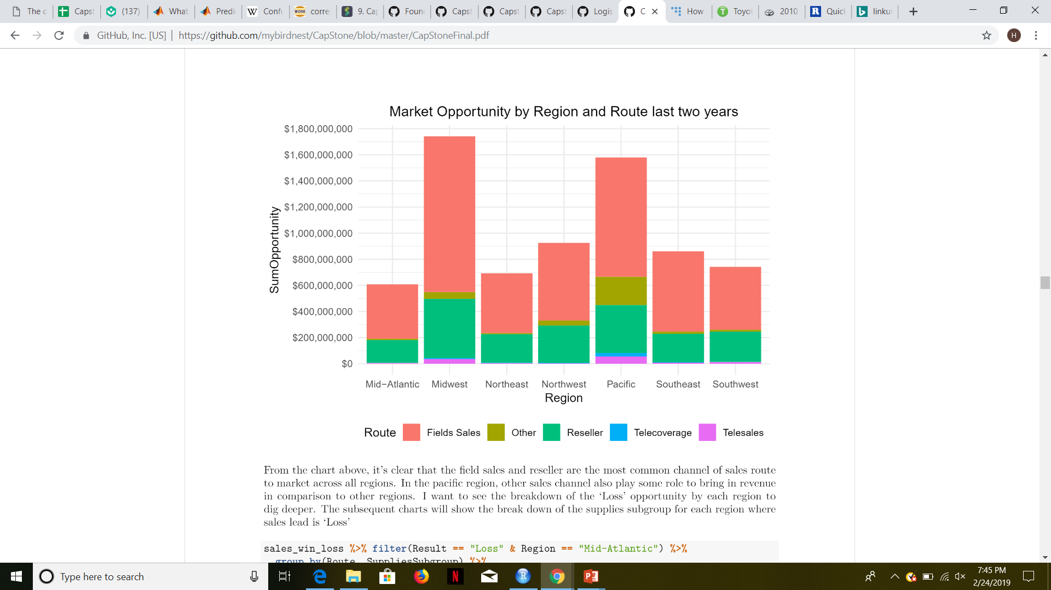
Data Exploration
From the chart below, it's clear that the field sales and reseller are the most common channel of sales route to market across all regions. In the pacific region, other sales channel also play some role to bring in revenue in comparison to other regions.

Slide 6
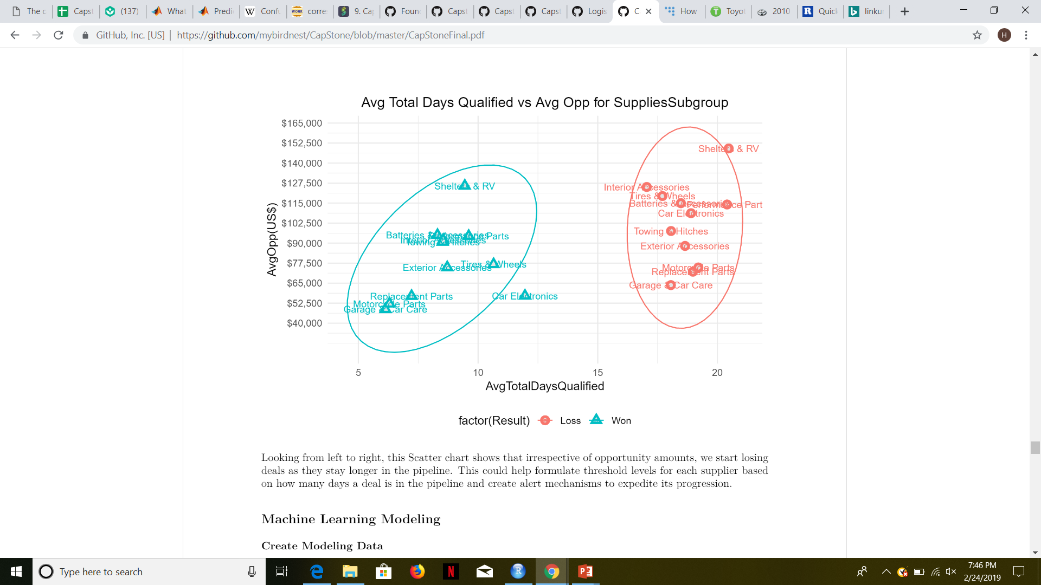
Data Exploration
Looking from left to right, this Scatter chart shows that irrespective of opportunity amounts, we start losing deals as they stay longer in the pipeline. This could help formulate threshold levels for each supplier based on how many days a deal is in the pipeline and create alert mechanisms to expedite its progression.

Slide 7
Machine Learning Model
Partitioning data set into: Training, Validation, and Testing
Train the data set using Logistic and Random Forest model
Validating using validation data set. Validation data is the sample of data used to provide an unbiased evaluation of a model fit on the training dataset while tuning model parameters.
Random Forest model is selected as the best with higher F1 score; 0.54 vs 0.34
Applied testing data set on Random Forest model. The F1 score on Random Forest model produce the same F1 score result using validation and testing data set.

Slide 8
Recommendations
From the exploratory data analysis, it looks like the company start losing deals as the sales lead stays longer in the pipeline more than 10 days. Using this information, the sales team should be able to formulate threshold levels for each supplier based on how many days a deal is in the pipeline and create alert mechanisms to expedite its progression.
More depth machine learning model should also be done. Especially learning the interaction of other independent variables such as RDaysValidated and RDaysQualified.
The current Random Forest model F1 score is 0.55. Other regression model such as clustering k-means model or other classification model that can produce higher accuracy should be explored.
As someone who is going to need a new prediction, the variable such as TotalDaysClosing or TotalDaysQualified are moving variable as days have passed until the present time. In order to use the prediction model, based on the two years data, the user need to be aware of these type of variable

