Slide 1
Theory for Practice:
Positive Psychology and Leadership
James O. Pawelski
Director of Education and Senior Scholar
Positive Psychology Center
University of Pennsylvania
Harvard University
April 26, 2006

Slide 2

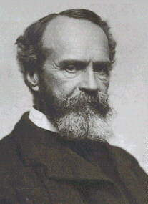
William James
Intellectual knowledge vs. experiential knowledge
New branch of psychology to study optimal human functioning

Slide 3
Preview
Philosophical introduction to positive psychology
Psychological introduction to positive psychology
Application of positive psychology to leadership
    Education
    Business
    Law
    Medicine

Slide 4
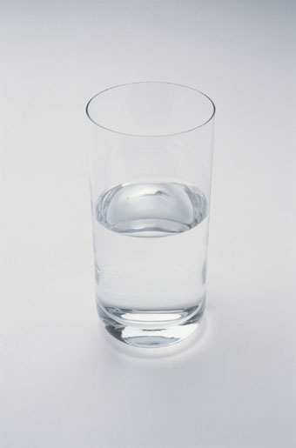
Is the glass half full, or half empty?

Slide 5
Optimism in Psychology
A focus on good things.
An expectation of good things.
A particular explanatory style.

Slide 6
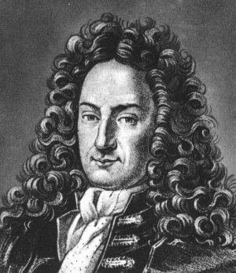
Optimism in Philosophy
“This is the best of all possible worlds.”
The glass is as full as it can get.
Relative optimism
G. W. Leibniz

Slide 7
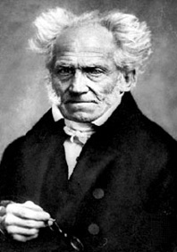
Pessimism in Philosophy
“This is the worst of all possible worlds.”
The glass is as empty as it can get.
Relative pessimism.
Schopenhauer

Slide 8
Some New Thought and Eastern Views
There is no such thing as evil.
The glass is completely full.
Absolute optimism.

Slide 9
Severe Depression
There is no such thing as good.
The glass is completely empty.
Absolute pessimism.

Slide 10
Who is right?

Slide 11
Who cares?

Slide 12
Clues from Etymology
Optimism – from Latin optimus (best)
Pessimism – from Latin pessimus (worst)
Meliorism – from Latin melior (better)

Slide 13
Meliorism
“The doctrine that the world, or society, may be
improved and suffering alleviated through rightly
directed human effort.”
-Oxford English Dictionary

Slide 14
William James
Optimists—the salvation of the world is inevitable
Pessimists—the salvation of the world is impossible
“Meliorism treats salvation as neither inevitable nor impossible. It treats it as a possibility, which becomes more and more of a probability the more numerous the actual conditions of salvation become.”

Slide 15
Two Kinds of Meliorism

Slide 16
Two Kinds of Meliorism

Slide 17
Two Kinds of Meliorism
Mitigative Meliorism
-Focused on getting less of what we don’t want.

Slide 18
Two Kinds of Meliorism
Mitigative Meliorism
-Focused on getting less of what we don’t want.
-e.g. appendicitis

Slide 19
Two Kinds of Meliorism
Mitigative Meliorism
-Focused on getting less of what we don’t want.
-e.g. appendicitis
Constructive Meliorism
-Focused on getting more of what we do want.

Slide 20
Two Kinds of Meliorism
Mitigative Meliorism
-Focused on getting less of what we don’t want.
-e.g. appendicitis
Constructive Meliorism
-Focused on getting more of what we do want.
-e.g. physical fitness

Slide 21
Two Kinds of Meliorism
Mitigative Meliorism
-Focused on getting less of what we don’t want.
-e.g. appendicitis
Constructive Meliorism
-Focused on getting more of what we do want.
-e.g. physical fitness
Different but related approaches

Slide 22
Which Is Better?
Mitigative Meliorism?
Constructive Meliorism?

Slide 23
Which Would You Choose?

Slide 24
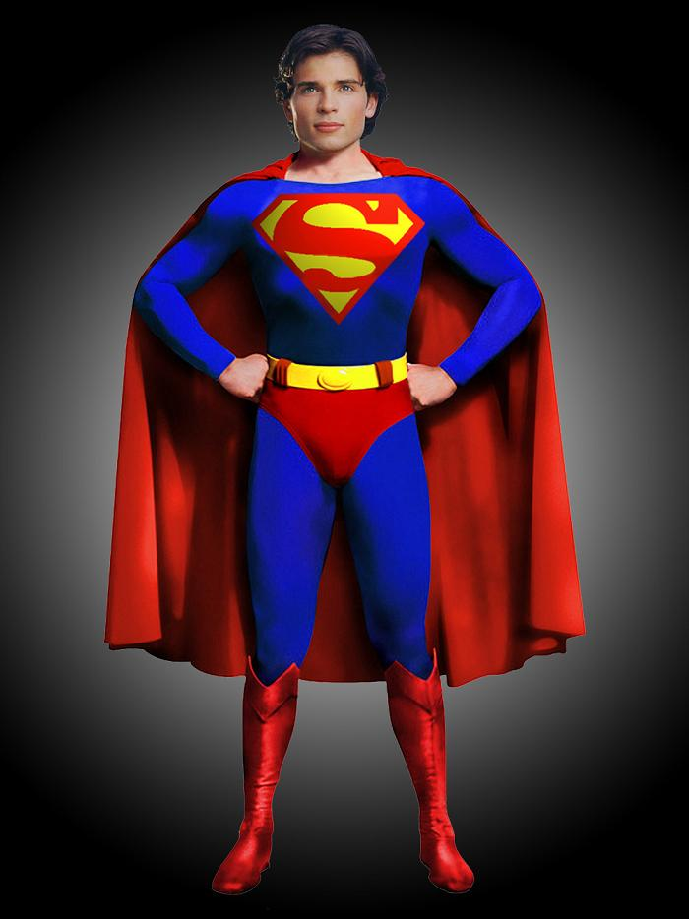
Which Would You Choose?
Red Cape
Mitigative Meliorism

Slide 25
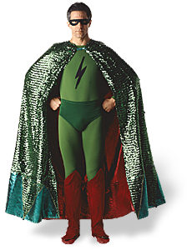
Which Would You Choose?
Red Cape Green Cape
Mitigative Meliorism Constructive Meliorism

Slide 26
Balanced Meliorism
Continuum—complex situations may call for both mitigative and constructive approaches
Sometimes—shift toward mitigative meliorism is needed
  John Dewey—fighting propaganda, unjust power
More often—shift toward constructive meliorism needed
  Politics
  Psychology

Slide 27
Department of Peace
Congressman Dennis Kucinich, Walter Cronkite, and others
Secretary of Peace
To promote peace in our homes, in our nation, and around the world.
Vs. Defense Department
War on Terror

Slide 28
Psychology
Mainstream Psychology
  Mitigative
  Focuses on helping us get less of what we don’t want
Positive Psychology
  Constructive
  Focuses on helping us get more of what we do want

Slide 29
A (Very) Brief Introduction to Positive Psychology
Spearheaded by Martin Seligman
  American Psychological Association (1998)
  Presidential Initiative
Hundreds of researchers around the world
  International Conferences
  Burgeoning Literature
Education
  Largest course at Harvard this term
  First degree program started (Penn, 2005)

Slide 30
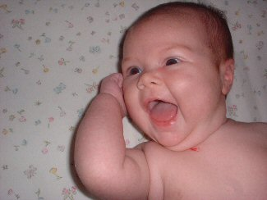
Three Pathways to Happiness
(Seligman)

Slide 31
1. The Pleasant Life
Positive subjective experience
The Importance of Cultivating Positive Emotions
  Fredrickson: Broaden-and-Build Theory
Positive Emotions
  About the past (gratitude, forgiveness)
  About the present (mindfulness, savoring)
  About the future (hope, optimism)

Slide 32
2. The Engaged Life
Positive Individual Traits
Diagnostic and Statistical Manual (DSM)
Values in Action Classification of Strengths and Virtues (VIA)

Slide 33
VIA Classification of Character Strengths
(Peterson and Seligman)
Wisdom
-Creativity
-Curiosity
-Judgment
-Love of Learning
-Perspective
Courage
-Bravery
-Industry
-Authenticity
-Zest
Love
-Intimacy
-Kindness
-Social Intelligence
Justice
-Citizenship
-Fairness
-Leadership
Temperance
-Forgiveness
-Humility
-Prudence
-Self-Control
Transcendence
-Awe
-Gratitude
-Hope
-Humor
-Spirituality

Slide 34
3. The Meaningful Life
Positive Insitutions

Slide 35
3. The Meaningful Life
Positive Insitutions
Using your Signature Strengths in the service of something larger than yourself
-Community
-School
-Church
-Nation
-World

Slide 36
Positive Interventions
Is it possible to cultivate more happiness?
Three blessings exercise
Gratitude visit
Identify your signature strengths and use them in a new way.

Slide 37
Study
(Seligman, et al.)
Steen Happiness Index
Exercise Pre Post 1 Week 1 Month 6 Months
Memory 58.5 61.6 58.3 57.6 58.7
Blessings 57.1 58.8 59.9 62.2* 62.4*
Gratitude 58.5 64.7* 61.8* 60.9* 59.0
Strengths 57.2 58.6 59.4* 62.1* 61.2*

Slide 38
Positive Psychology and Leadership
Self-Development
  Subjective well-being
  Character strengths
  Meaning and Purpose
Development of Others
  Subjective well-being
  Character strengths
  Meaning and Purpose

Slide 39
Call for Leaders
What is your intended career?
How can you apply positive psychology perspectives in your career?
How might you use constructive meliorism to transform your profession?

Slide 40
Education
John Yeager, Ed.D.
  Director of Character Excellence, Culver Academies
Humanities
  Philosophy
  Literature
  History
  Religious Studies

Slide 41
Business
Giselle Nicholson
  Full-time MAPP student
  Microfinance
Appreciative Inquiry
Gallup Organization

Slide 42
Law
Dave Shearon, J.D.
  Executive Director of Tennessee Commission of Continuing Legal Education and Specialization
Law school is depressing (Sheldon and Krieger)
Seeing the worst
Pessimistic thinking
Flexible optimism

Slide 43
Medicine
Peter Minich, M.D., Ph.D.
  Center for Clinician Leadership
  Training physicians to be leaders
Chris Feudtner, M.D., Ph.D.
  Assistant Professor of Pediatrics, University of Pennsylvania
  Hope in palliative care

Slide 44
For More Information
Introduction to Positive Psychology: Authentic Happiness (Seligman)
Positive Psychology Center: www.positivepsychology.org
VIA Signature Strengths Survey: www.authentichappiness.org
Master of Applied Positive Psychology: www.pennpositivepsych.org
Office Hours: 2:00-4:00 this afternoon
MAPP Students
mapp-info@sas.upenn.edu

Slide 45
Remember Your Green Cape!

