Slide 1
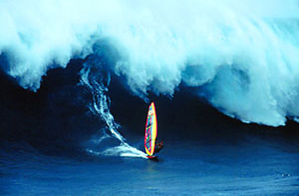
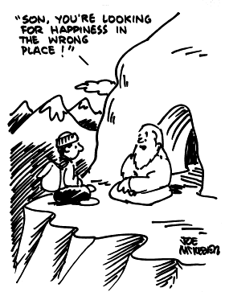
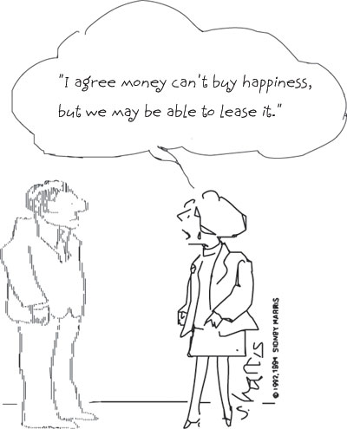
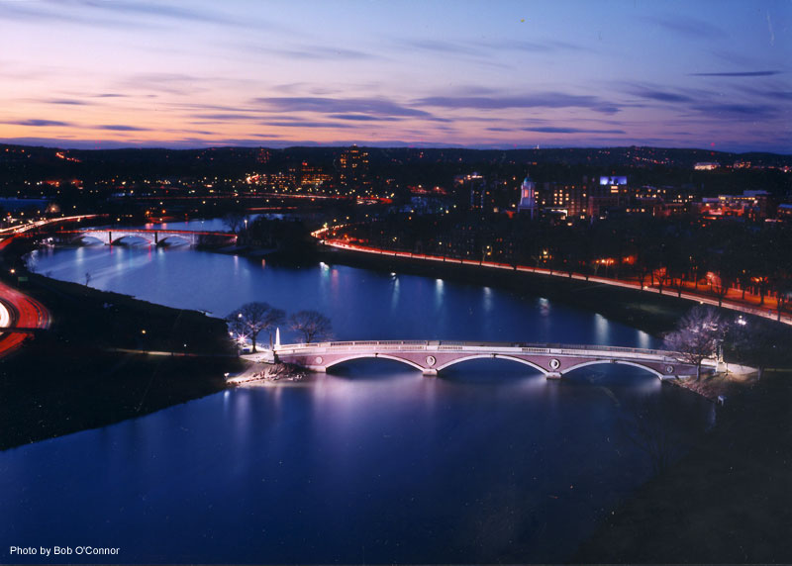
1504:
Basic Premises

Slide 2
Passive Victim Vs. Active Agent
___________________________________________
self pity
blame
frustration
anger
confidence
responsibility
hope and optimism
forgive/forget

Slide 3
The Premises
Bridge building Vs. Division and separation
Change is possible Vs. Change is illusive
Internal factors primarily determine happiness Vs. Happiness is primarily a function of external circumstances
Human nature must be obeyed Vs. Human nature must be perfected
Happiness is and ought to be the ultimate end Vs. Happiness should be a secondary pursuit

Slide 4
PREMISE 1:
Bridge building
VS.
Division and separation

Slide 5
Bridging Ivory Tower and Main Street
“The careful shielding of a university from the activities of the world around us is the best way to chill interest and to defeat progress. Celibacy does not suit a university. It must mate itself with action.” Alfred North Whitehead

Slide 6
The Need for Practical Idealists
The desire to make a difference
False stereotypes
  Generous Harvardians
  Generous Americans
Influential positions
Goodwill and idealism necessary but not sufficient

Slide 7
Psychology Can Help
Applied research
  in the classroom
  for increasing self-esteem
  bridging mind and body
  in conflict resolution
Taking research seriously
Our responsibility

Slide 8
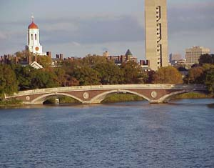
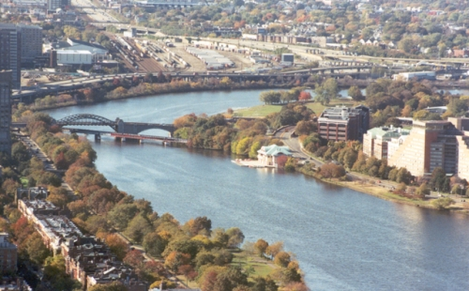
Bridge Among Disciplines
Enhanced learning
Enhanced creativity
True to reality
More interesting

Slide 9
PREMISE 2:
Change is possible
VS.
Change is illusive

Slide 10
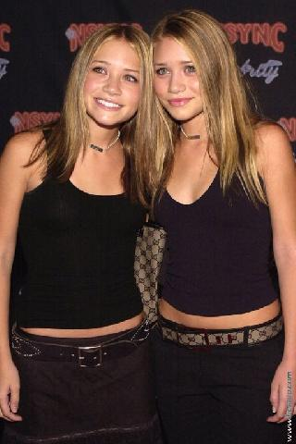
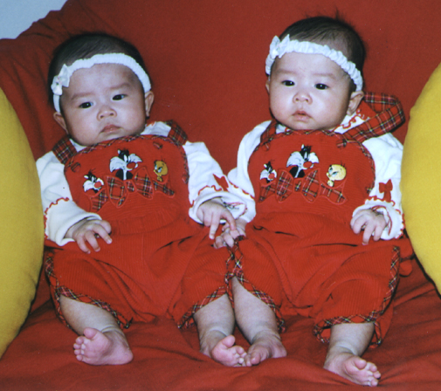

Minnesota Twin Studies
“It may be that trying to be happier is as futile as trying to be taller and is therefore counterproductive.” Lykken and Tellegan (1996)

Slide 11
Change is Possible
Counter evidence: People do change
Error of the average
Exception proves the rule
Detrimental research
Studying the best

Slide 12
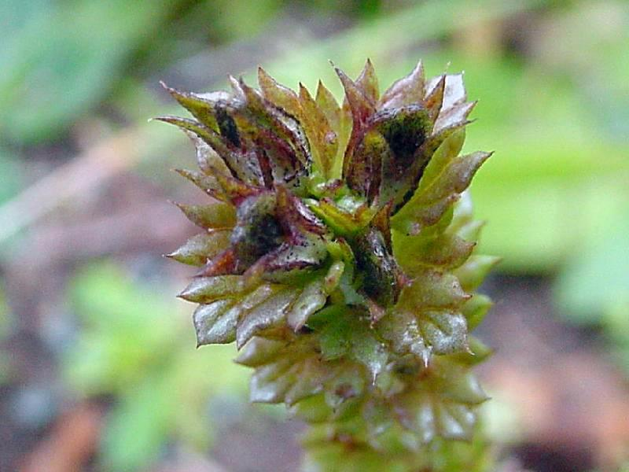

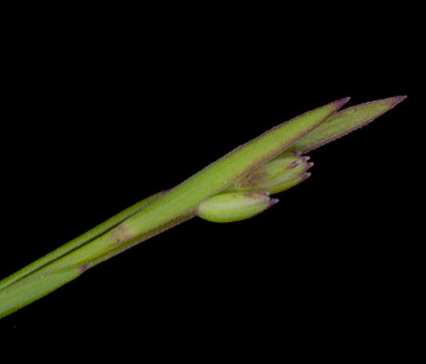
Growing-Tip Statistics
“What this kind of research design means is a change in our conception of statistics, and especially of sampling theory. What I am frankly espousing here is what I have been calling ‘growing-tip statistics,' taking my title from the fact that it is at the growing tip of a plant that the greatest genetic action takes place...”
Abraham Maslow

Slide 13
“If we want to know how fast a human being can run, then it is no use to average out the speed of a ‘good sample’ of the population; it is far better to collect Olympic gold medal winners and see how well they can do. If we want to know the possibilities for spiritual growth, value growth, or moral development in human beings, then I maintain that we can learn most by studying our most moral, ethical, or saintly people. On the whole I think it is fair to say that human history is a record of the ways in which human nature has been sold short. The highest possibilities of human nature have practically always been underrated.... Certainly it seems more and more clear that what we call ‘normal’ in psychology is really a psychopathology of the average, so undramatic and so widely spread that we don’t even notice it ordinarily.”

Slide 14

Growing-Tip Statistics
Elitist?
Doesn’t exclude studying the average
Everyone benefits
  Study of resilience
  Study of meditation
  Study of relationships

Slide 15
Studying Our Personal Best
Describe or prescribe
“Few in number though they be, we can learn a great deal about values from the direct study of these highly evolved, most mature, psychologically healthiest individuals, and from the study of the peak moments of average individuals, moments in which they become transiently self-actualized.” Abraham Maslow

Slide 16
Changing the World?
The Cambridge-Somerville Youth Study
  A five year intervention
  Twice-a-month caseworkers visit
  Academic tutoring
  Psychiatric attention
  Boy Scouts, YMCA, etc.

Slide 17
Measuring Outcome
Random assignment
40 year followup
Shocking results
  No difference in juvenile offenses
  No difference in adult offenses
  No difference on health, mortality, wellbeing
  Significant difference on alcoholism and job status
… IN THE “WRONG” DIRECTION

Slide 18
Is Societal Change Possible?
Exception proves the rule
Practical idealists unite!
“What I am suggesting is Manhattan-Project-type attacks upon what I consider to be the truly Big Problem of our time, not only for psychology but for all human beings with any sense of historical urgency...”
Abraham Maslow

Slide 19
The Power of One
“All history is a record of the power of minorities, and of minorities of one.”
Ralph Waldo Emerson
“Never doubt that a small group of thoughtful, committed citizens can change the world. Indeed, it is the only thing that ever has.”
Margaret Mead
Human networks as exponential

Slide 20
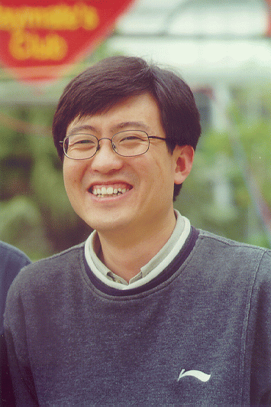
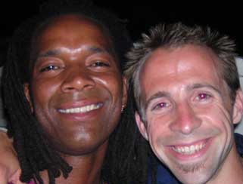


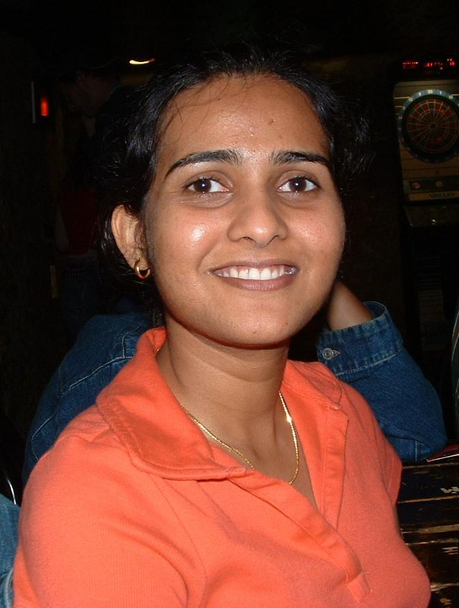


Slide 21

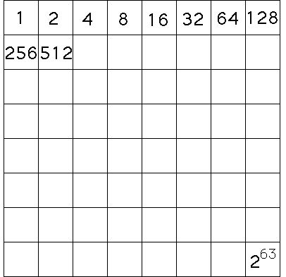
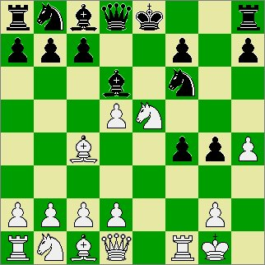

Exponential Growth

Slide 22
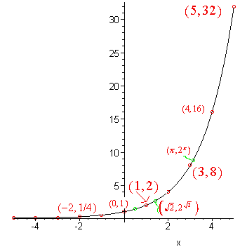
We underestimate our capacity to effect change because we underestimate the growth of an exponential function.

Slide 23
PREMISE 3:
Internal factors primarily determine happiness
VS.
Happiness is primarily a function of external circumstances

Slide 24
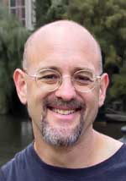
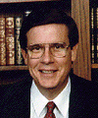
Subjective Well-Being Research
Affective forecasting (Dan Gilbert)
Happiness levels (Ed Diener)
  Income matters little
  No change across generations
  Place of residence irrelevant

Slide 25
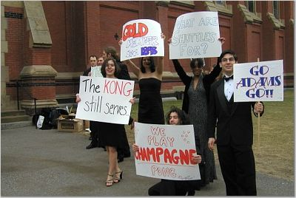

Slide 26
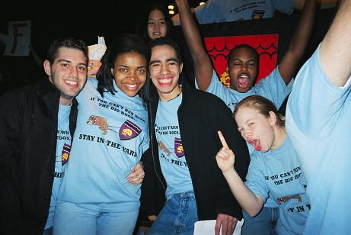

Slide 27
Subjective Well-Being Research
Affective forecasting (Dan Gilbert)
Happiness levels (Ed Diener)
  Income matters little
  No change across generations
  Place of residence irrelevant
  Democracy and oppression

Slide 28


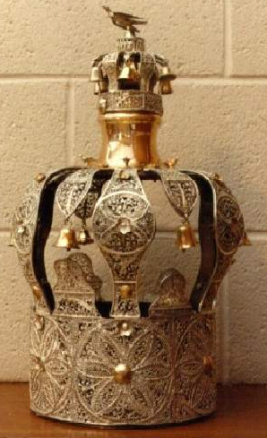

Our readiness and potential to experience happiness is mostly dependent on our state of mind, not on our status or the state of our bank account.

Slide 29
Our readiness and potential to experience happiness is mostly dependent on our state of mind, not on our status or the state of our bank account.
Is change illusive?
Not if the focus is on trans-formation

Slide 30
PREMISE 4:
Human nature must be obeyed
VS.
Human nature must be perfected

Slide 31
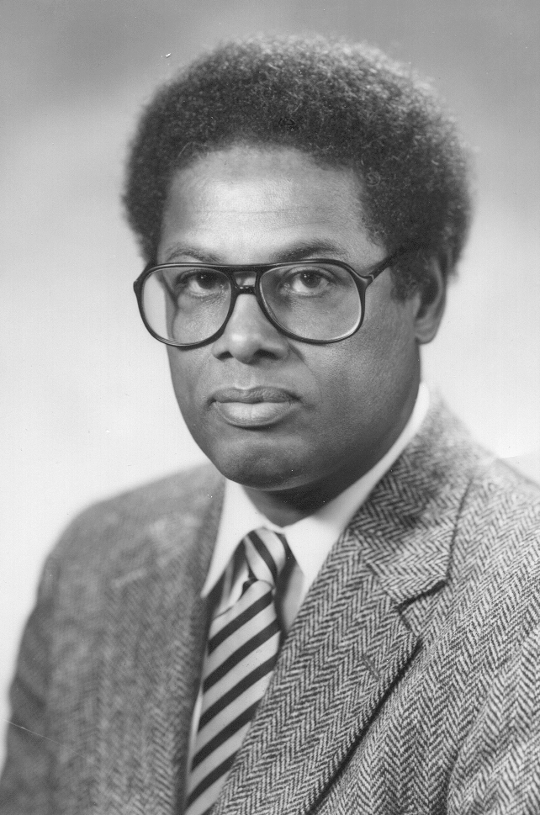


Slide 32
Constrained Unconstrained
Vision Vision
_____________________________________________
Human nature immutable
Flaws inevitable
Acceptance
Channel nature
Can be improved
Perfectible
Solutions exist
Change nature
“Nature to be commanded must be obeyed”
Francis Bacon
“It is for self-perfectioning that destiny calls us”
Benjamin Constant

Slide 33
Vision of Psychology
Human nature immutable (constrained)
Role is to understand nature…
… and make best use of it

Slide 34





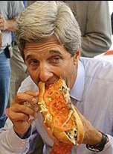
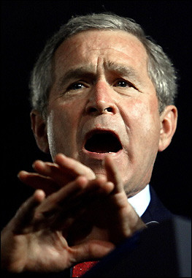

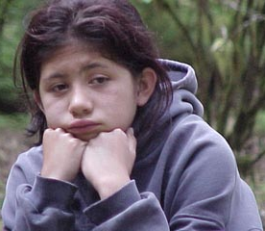
Permission to be Human
Unconditional acceptance
Not same as resignation
Rejecting nature leads to unhappiness
“The Great Deception”
True to reality

Slide 35
Permission to be Human
“God, grant me the serenity to accept the things I cannot change, the courage to change the things I can change, and the wisdom to know the difference.” Reinhold Niebuhr

Slide 36
PREMISE 5:
Happiness is and ought to be our ultimate end
VS.
Happiness should be a secondary pursuit

Slide 37
Happiness as the Highest End
“Happiness is the meaning and purpose of life, the whole aim and end of human existence.”
Aristotle
“If we were to ask the question: ‘What is human life's chief concern?’ one of the answers we should receive would be: ‘It is happiness.’ How to gain, how to keep, how to recover happiness, is in fact for most men at all times the secret motive of all they do, and of all they are willing to endure.” William James
“Whether one believes in religion or not, whether one believes in this religion or that religion, the very purpose of our life is happiness, the very motion of our life is towards happiness.”
Dalai Lama

Slide 38
What’s Good About Positive Emotions?
It feels good to feel good
Broaden and build (Fredrickson, 2002)
“We should work to cultivate positive emotions in ourselves and in those around us not just as end states in themselves, but also as a means to achieving psychological growth and improved psychological and physical health over time... I call this the broaden-and-build theory of positive emotions because positive emotions appear to broaden people’s momentary thought-action repertoires and build their enduring personal resources... Through experiences of positive emotions people transform themselves, becoming more creative, knowledgeable, resilient, socially integrated, and healthy individuals.”

Slide 39
What’s Good About Positive Emotions?
It feels good to feel good
Broaden and build
Overcoming negative emotions
Increased creativity
Increased motivation and energy
Success
Physical health

Slide 40
But what about others?
Happiness is a positive sum game
“Thousands of candles can be lighted from a single candle, and the life of the candle will not be shortened. Happiness never decreases by being shared.”
Buddha
Better relationships
Increased generosity
Helping ourselves and helping others

Slide 41
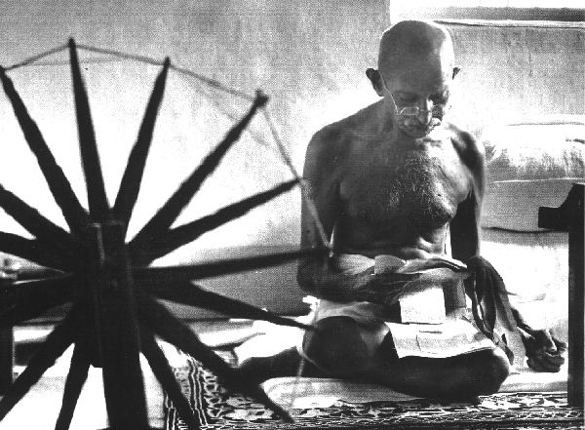
Spreading Happiness
“Be the change you want to see in the world.”
Gandhi

Slide 42
The Premises
Bridge building Vs. Division and separation
Change is possible Vs. Change is illusive
Internal factors primarily determine happiness Vs. Happiness is primarily a function of external circumstances
Human nature must be obeyed Vs. Human nature must be perfected
Happiness is and ought to be the ultimate end Vs. Happiness should be a secondary pursuit

Slide 43
Bibliography and Recommendations
Diener, E., Suh, E. M., Lucas, R. E., & Smith, H. L. (1999). Subjective well-being: Three decades of progress. Psychological Bulletin, 125: 276-302.
Gilbert, D. T., Pinel, E. C., Wilson, T. D., Blumberg, S. J., & Wheatley, T. P. (1998). Immune Neglect: A Source of Durability Bias in Affective Forecasting. Journal of Personality and Social Psychology, 75, 617-638.
Lykken, D., & Tellegen, A. (1996). Happiness is a stochastic phenomenon. Psychological Science, 7, 186–189.
Maslow, A. H. (1993). The Farther Reaches of Human Nature. Arkana.
Snyder, C. R. & Lopez, S. J. (Eds.) (2002). Handbook of Positive Psychology, 528-540. Oxford University Press.
Sowell, T. (2002). A Conflict of Visions: Ideological Origins of Political Struggles. Basic Books.

