Slide 1


Getting Started with Apache Camel
Claus Ibsen (@davsclaus)
Principal Software Engineer, Red Hat
Javagruppen Århus, may 2013

Slide 2
Agenda
History of Camel
What is Apache Camel?
A little Example
Riding Camel
What's in the Camel box?
Deploying Camel
Creating new Camel Projects
Q and A

Slide 3


Your Speaker
Principal Software Engineer at Red Hat
Apache Camel
  5 years working with Camel
Author of Camel in Action book
Contact
  EMail: cibsen@redhat.com
  Twitter: @davsclaus
  Blog: http://davsclaus.com
  Linkedin: http://www.linkedin.com/in/davsclaus

Slide 4
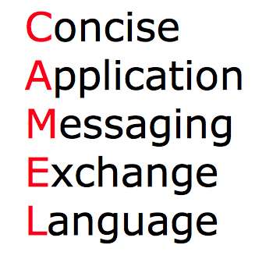
Why the name Camel?

Slide 5
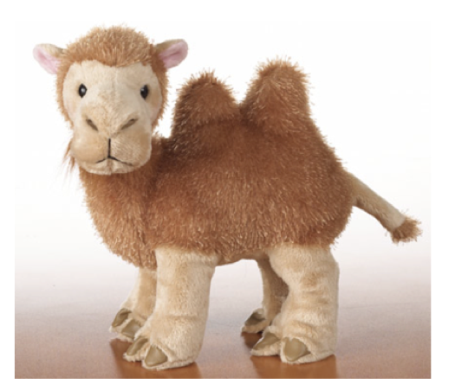
Why the name Camel?
Because Camel is
easy to remember and type ...

Slide 6
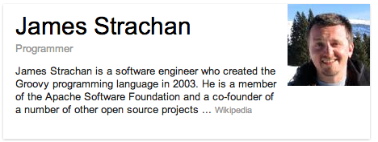
Why the name Camel?
… or the creator used to smoke cigarets!
http://camel.apache.org/why-the-name-camel.html

Slide 7

Camel's parents

Slide 8
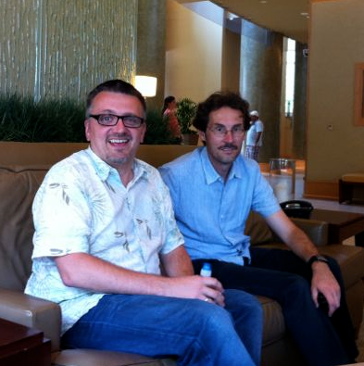
Camel's parents
James Strachan (creator of Camel)
Gregor Hohpe (author of EIP book)

Slide 9
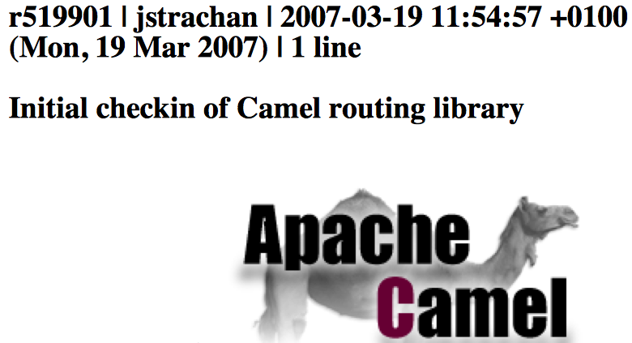
The birth of Camel
First Commit

Slide 10
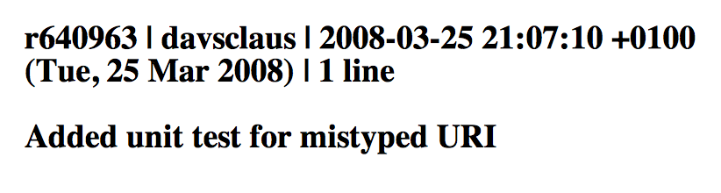
The birth of Camel
My first Commit

Slide 11
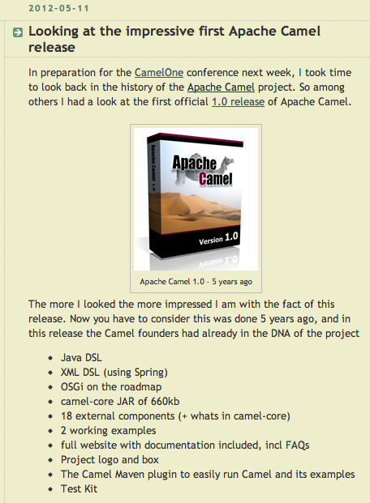
The birth of Camel
First Release
  Apache Camel 1.0
  June 2007
http://www.davsclaus.com/2012/05/looking-at-impressive-first-apache.html

Slide 12
Agenda
History of Camel
What is Apache Camel?
A little Example
Riding Camel
What's in the Camel box?
Deploying Camel
Creating new Camel Projects
Q and A

Slide 13
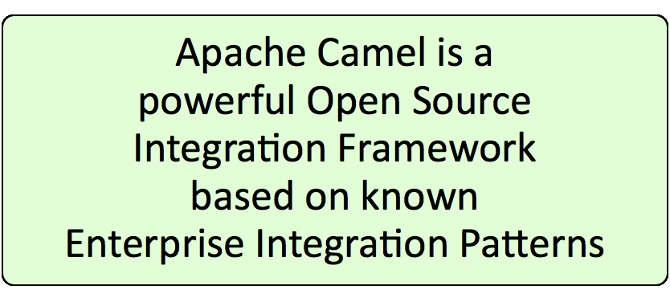
What is Apache Camel?
Quote from the website

Slide 14
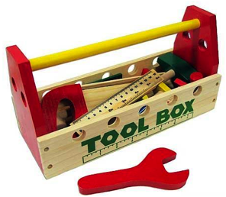
What is Apache Camel?
Why do we need integration?
  Critical for your business to integrate
Why Integration Framework?
  Framework do the heavy lifting
  You can focus on business problem
  Not "reinventing the wheel"

Slide 15
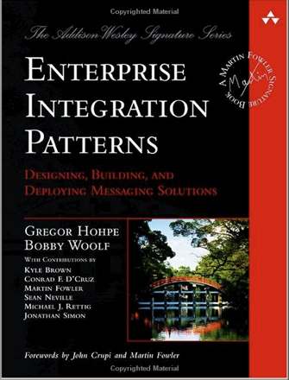
What is Apache Camel?
What is Enterprise Integration Patterns?
It's a book

Slide 16
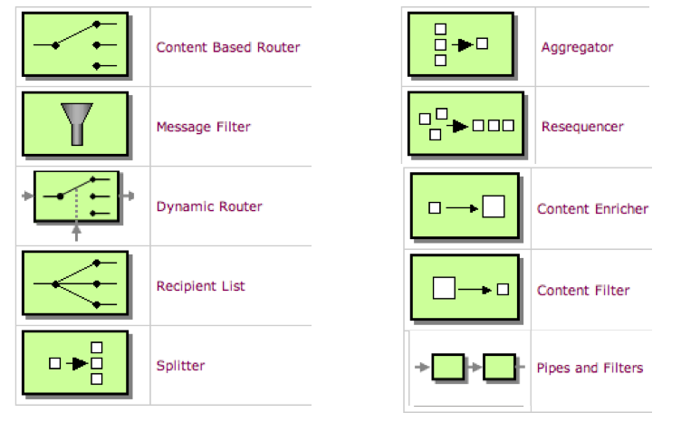
What is Apache Camel?
Enterprise Integration Patterns
http://camel.apache.org/eip

Slide 17
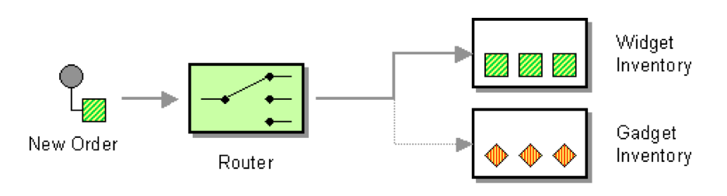
What is Apache Camel?
EIP - Content Based Router

Slide 18
What is Apache Camel?
from newOrder

Slide 19
What is Apache Camel?
from newOrder
choice

Slide 20
What is Apache Camel?
from newOrder
choice
when isWidget to widget

Slide 21
What is Apache Camel?
from newOrder
choice
when isWidget to widget
otherwise to gadget

Slide 22
What is Apache Camel?
from(newOrder)
choice
when(isWidget) to(widget)
otherwise to(gadget)

Slide 23
What is Apache Camel?
from(newOrder)
.choice()
.when(isWidget).to(widget)
.otherwise().to(gadget);

Slide 24
What is Apache Camel?
Endpoint newOrder = endpoint("activemq:queue:newOrder");
from(newOrder)
.choice()
.when(isWidget).to(widget)
.otherwise().to(gadget);

Slide 25
What is Apache Camel?
Endpoint newOrder = endpoint("activemq:queue:newOrder");
Predicate isWidget = xpath("/order/product = 'widget'");
from(newOrder)
.choice()
.when(isWidget).to(widget)
.otherwise().to(gadget);

Slide 26
What is Apache Camel?
Endpoint newOrder = endpoint("activemq:queue:newOrder");
Predicate isWidget = xpath("/order/product = 'widget'");
Endpoint widget = endpoint("activemq:queue:widget");
Endpoint gadget = endpoint("activemq:queue:gadget");
from(newOrder)
.choice()
.when(isWidget).to(widget)
.otherwise().to(gadget);

Slide 27
What is Apache Camel?
Java Code
public void configure() throws Exception {
Endpoint newOrder = endpoint("activemq:queue:newOrder");
Predicate isWidget = xpath("/order/product = 'widget'");
Endpoint widget = endpoint("activemq:queue:widget");
Endpoint gadget = endpoint("activemq:queue:gadget");
from(newOrder)
.choice()
.when(isWidget).to(widget)
.otherwise().to(gadget)
.end();
}

Slide 28
What is Apache Camel?
Java Code
import org.apache.camel.Endpoint;
import org.apache.camel.Predicate;
import org.apache.camel.builder.RouteBuilder;
public class MyRoute extends RouteBuilder {
public void configure() throws Exception {
Endpoint newOrder = endpoint("activemq:queue:newOrder");
Predicate isWidget = xpath("/order/product = 'widget'");
Endpoint widget = endpoint("activemq:queue:widget");
Endpoint gadget = endpoint("activemq:queue:gadget");
from(newOrder)
.choice()
.when(isWidget).to(widget)
.otherwise().to(gadget)
.end();
}
}

Slide 29
What is Apache Camel?
Camel Java DSL
import org.apache.camel.builder.RouteBuilder;
public class MyRoute extends RouteBuilder {
public void configure() throws Exception {
from("activemq:queue:newOrder")
.choice()
.when(xpath("/order/product = 'widget'"))
.to("activemq:queue:widget")
.otherwise()
.to("activemq:queue:gadget")
.end();
}
}

Slide 30
What is Apache Camel?
Camel XML DSL
<route>
<from uri="activemq:queue:newOrder"/>
<choice>
<when>
<xpath>/order/product = 'widget'</xpath>
<to uri="activemq:queue:widget"/>
</when>
<otherwise>
<to uri="activemq:queue:gadget"/>
</otherwise>
</choice>
</route>

Slide 31
What is Apache Camel?
use file instead
Endpoint as URIs
<route>
<from uri="file:inbox/orders"/>
<choice>
<when>
<xpath>/order/product = 'widget'</xpath>
<to uri="activemq:queue:widget"/>
</when>
<otherwise>
<to uri="activemq:queue:gadget"/>
</otherwise>
</choice>
</route>

Slide 32
What is Apache Camel?
parameters
Endpoint as URIs
<route>
<from uri="file:inbox/orders?delete=true"/>
<choice>
<when>
<xpath>/order/product = 'widget'</xpath>
<to uri="activemq:queue:widget"/>
</when>
<otherwise>
<to uri="activemq:queue:gadget"/>
</otherwise>
</choice>
</route>

Slide 33
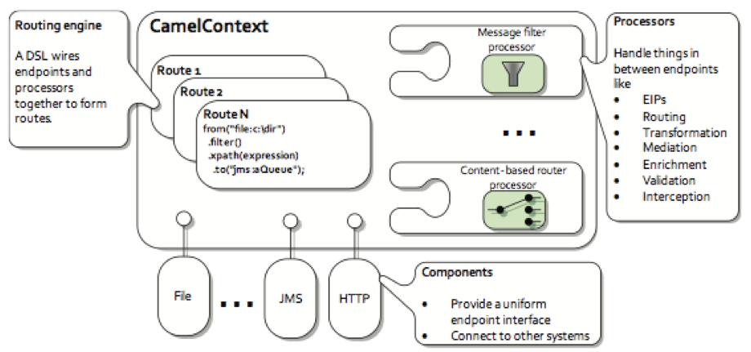
What is Apache Camel?
Camel's Architecture

Slide 34
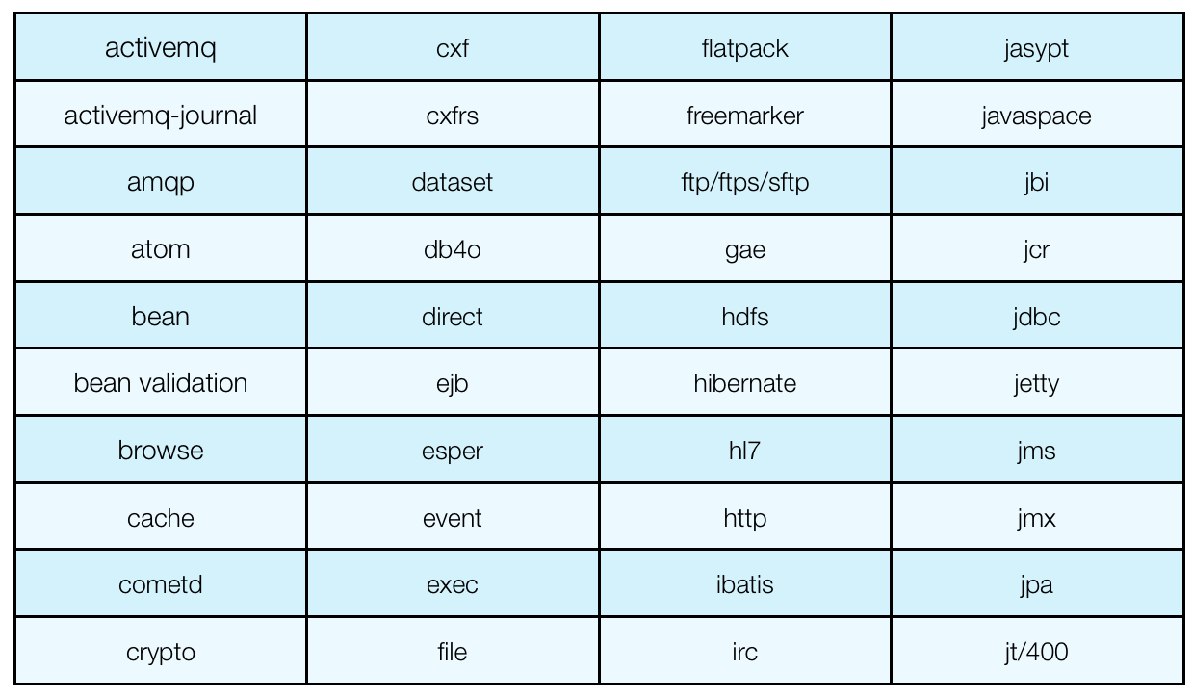
What is Apache Camel?
120+ Components

Slide 35
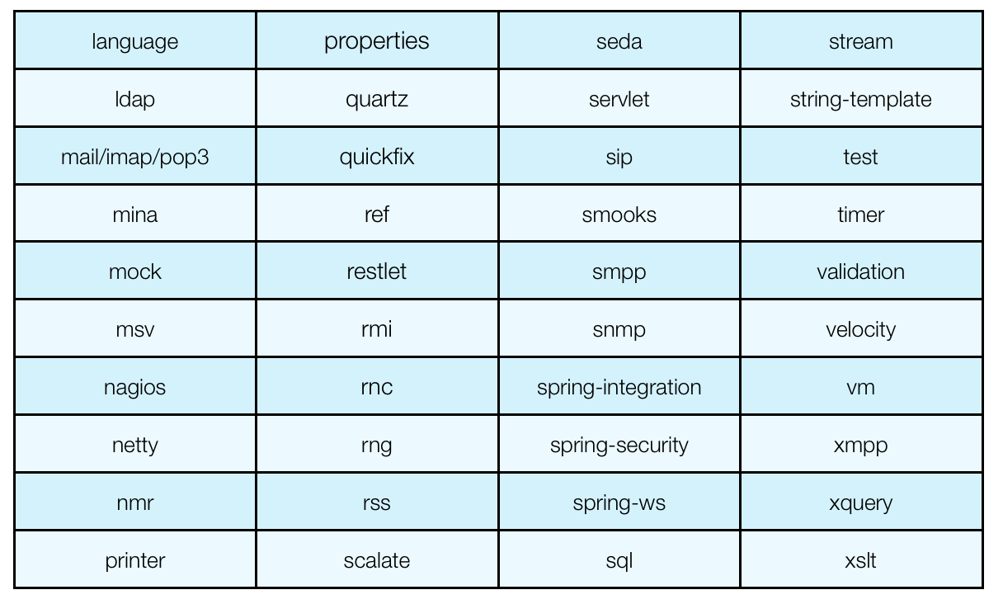
What is Apache Camel?
120+ Components

Slide 36

What is Apache Camel?
Summary
  Integration Framework
  Enterprise Integration Patterns (EIP)
  Routing (using DSL)
  Easy Configuration (endpoint as uri's)
  Payload Agnostic
  No Container Dependency
  A lot of components

Slide 37
Agenda
History of Camel
What is Apache Camel?
A little Example
Riding Camel
What's in the Camel box?
Deploying Camel
Creating new Camel Projects
Extending Camel
Q and A

Slide 38
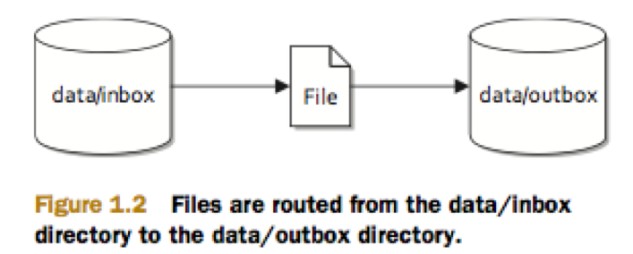
A Little Example
File Copier Example

Slide 39
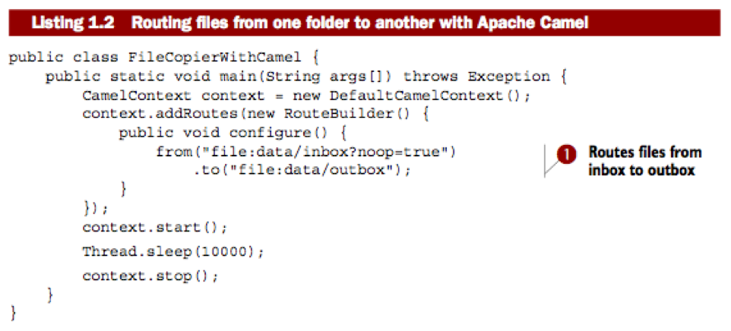
A Little Example
File Copier Example

Slide 40
A Little Example
File Copier Example

Slide 41
A Little Example
File Copier Example

Slide 42
A Little Example
File Copier Example

Slide 43
Agenda
History of Camel
What is Apache Camel?
A little Example
Riding Camel
What's in the Camel box?
Deploying Camel
Creating new Camel Projects
Q and A

Slide 44
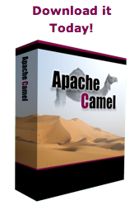
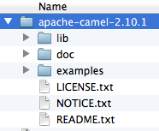
Riding Camel
Downloading Apache Camel
  zip/tarball (approx 14mb)
http://camel.apache.org

Slide 45
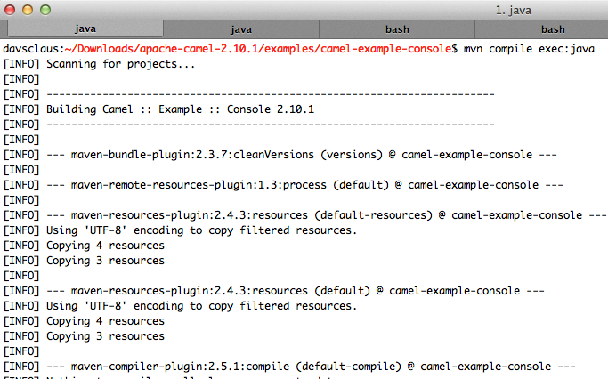

Riding Camel
Using Command Shell
  Requires: Apache Maven
From Eclipse

Slide 46
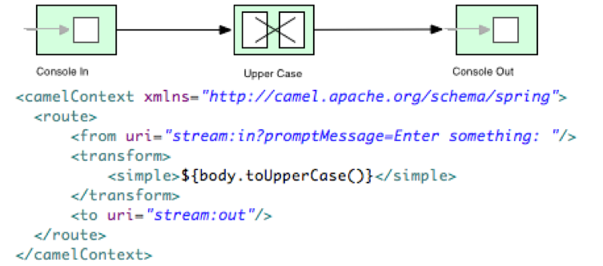
Riding Camel
Console Example
cd examples/camel-example-console
mvn compile exec:java

Slide 47
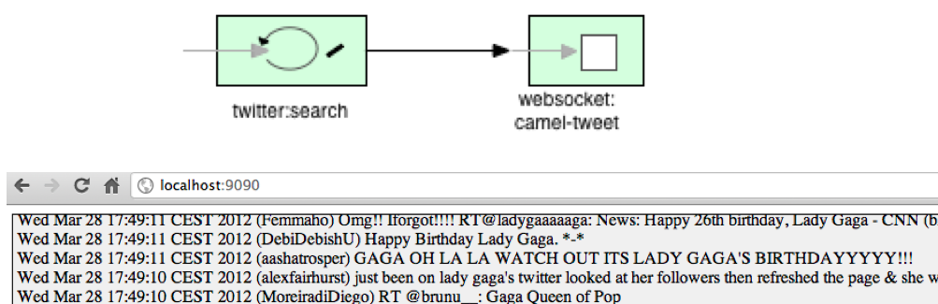
Riding Camel
Twitter Example
cd examples/camel-example-twitter-websocket
mvn compile exec:java
http://localhost:9090/index.html

Slide 48
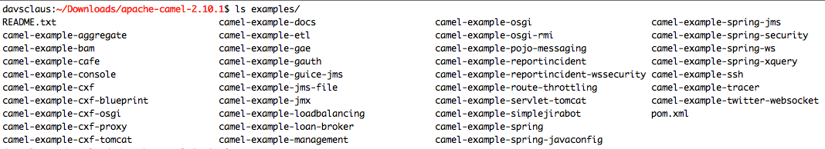
Riding Camel
More examples ...
... and further details at website.
http://camel.apache.org/examples

Slide 49
Agenda
History of Camel
What is Apache Camel?
A little Example
Riding Camel
What's in the box?
Deploying Camel
Creating new Camel Projects
Q and A

Slide 50
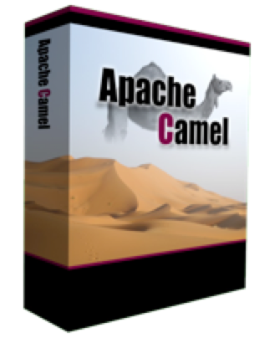
What's in the box?

Slide 51
What's in the box?
Enterprise Integration Patterns
http://camel.apache.org/eip

Slide 52
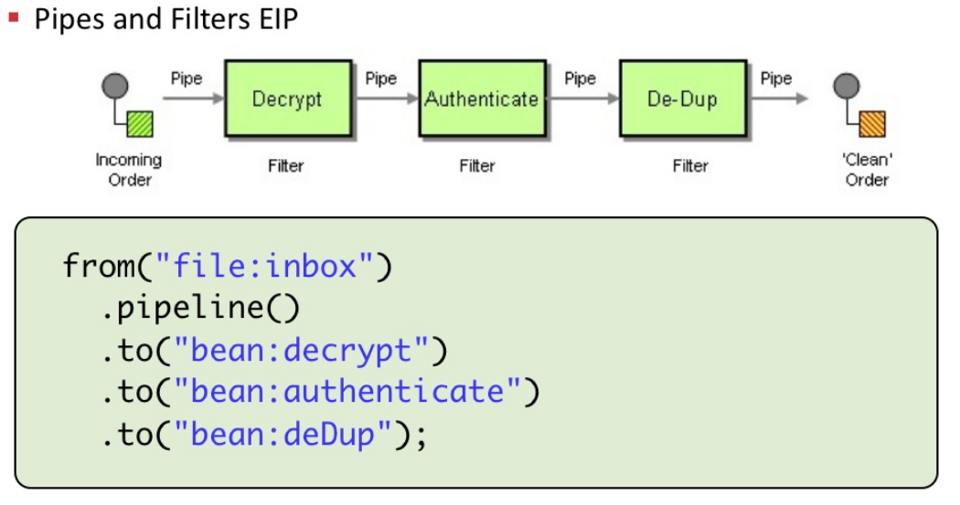
What's in the box?
Pipes and Filters EIP

Slide 53
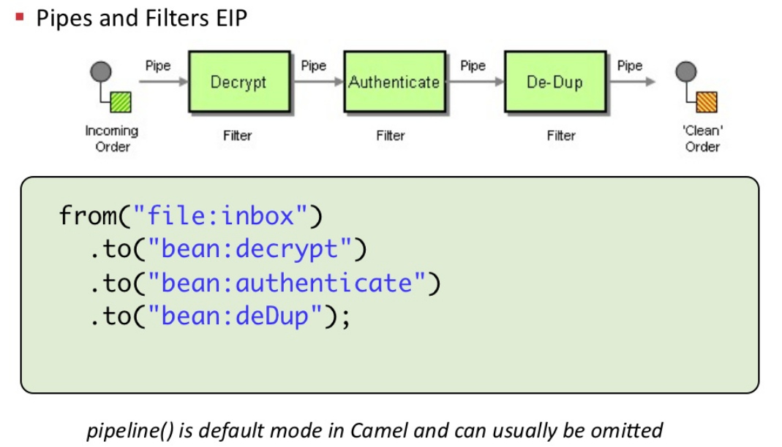
What's in the box?
Pipes and Filters EIP

Slide 54
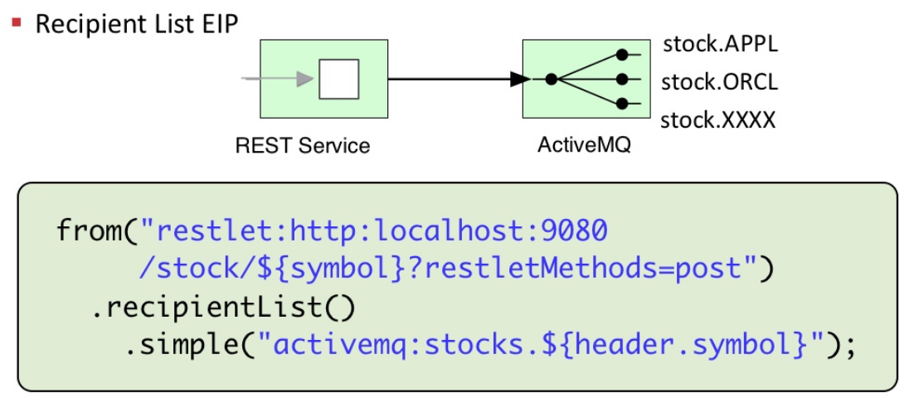
What's in the box?
Recipient List EIP

Slide 55
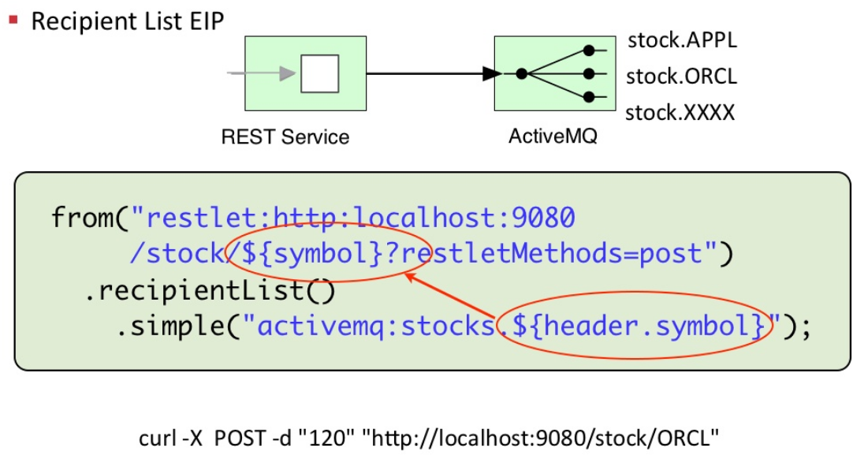
What's in the box?
Recipient List EIP

Slide 56
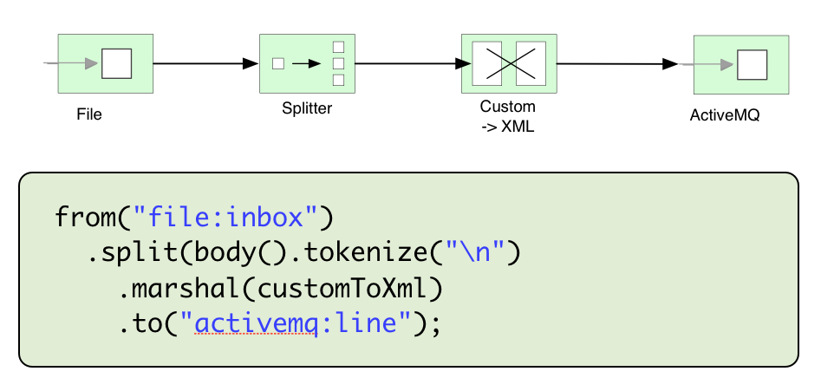
What's in the box?
Splitter EIP

Slide 57
What's in the box?
120+ Components

Slide 58
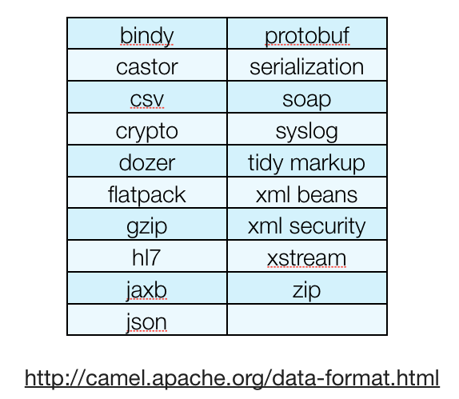
What's in the box?
19 Data Formats

Slide 59
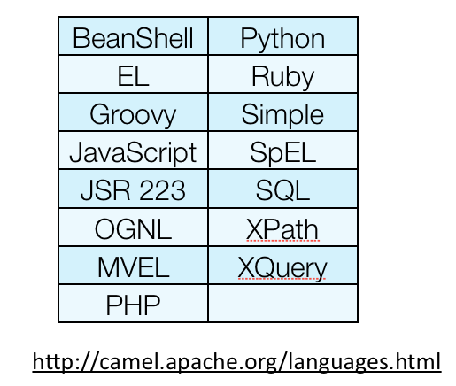
What's in the box?
15 Expression Languages

Slide 60
What's in the box?
5+ DSL in multiple languages
  Java DSL
  XML DSL (Spring and OSGi Blueprint)
  Groovy DSL
  Scala DSL
  Kotlin DSL (work in progress)

Slide 61
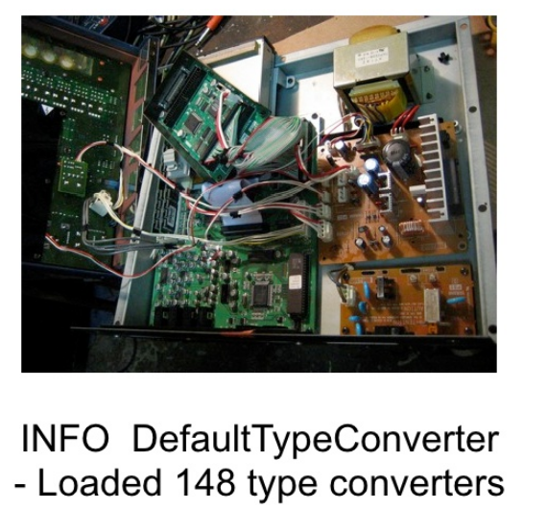
What's in the box?
Type Converters

Slide 62
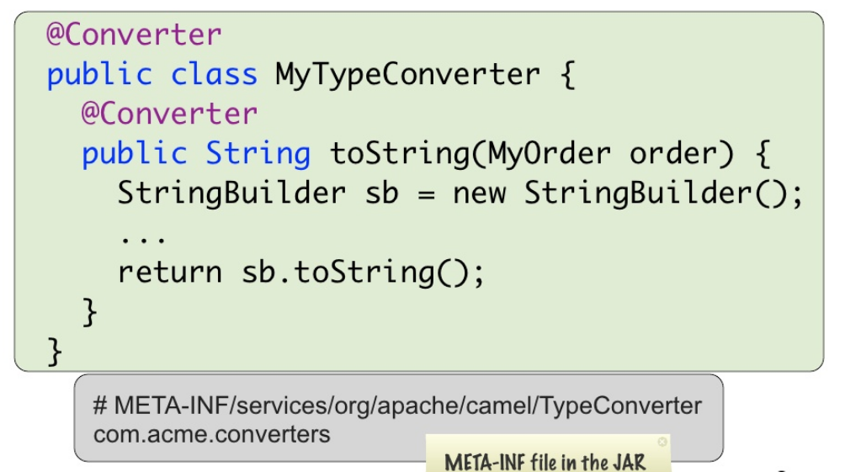
What's in the box?
Writing Custom Type Converter

Slide 63
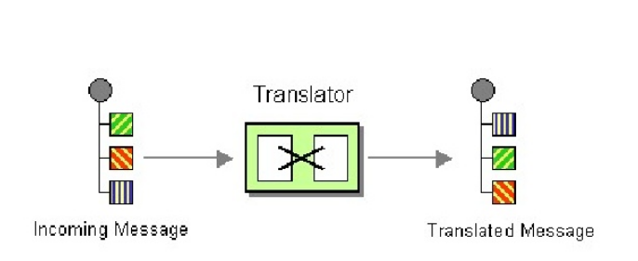
What's in the box?
Bean as Message Translator

Slide 64
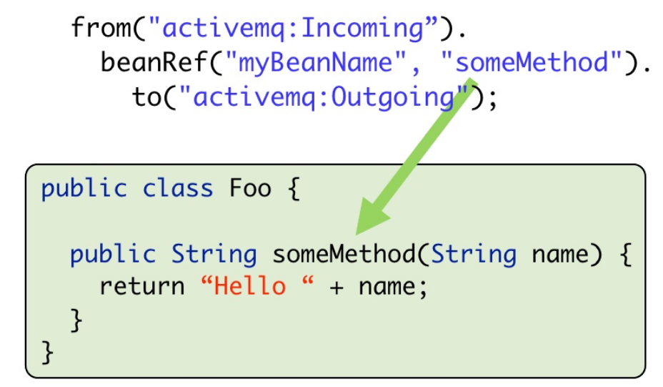
What's in the box?
Bean as Message Translator

Slide 65
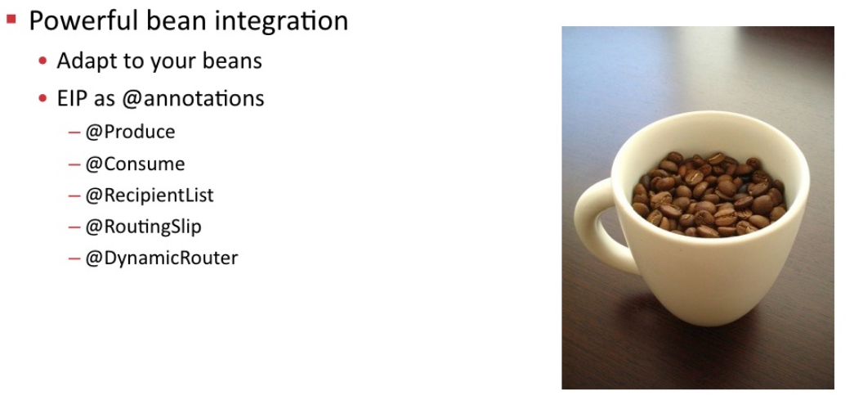
What's in the box?
Working with beans

Slide 66
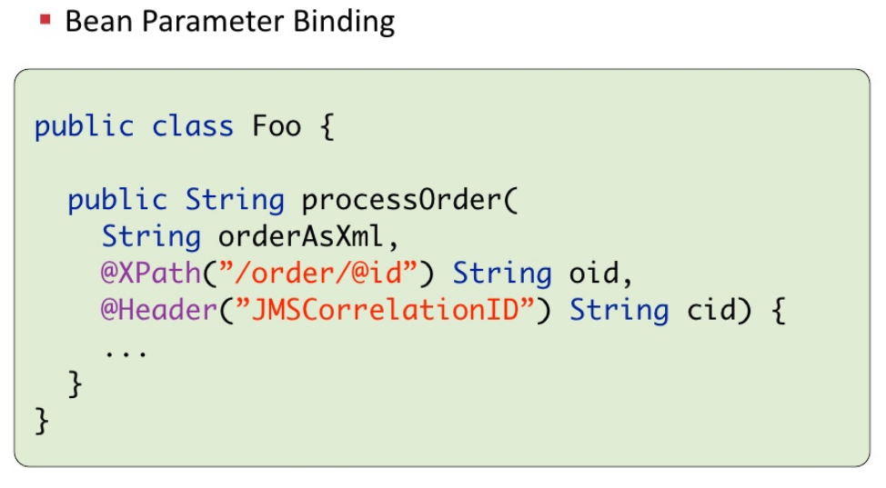
What's in the box?
Working with beans

Slide 67
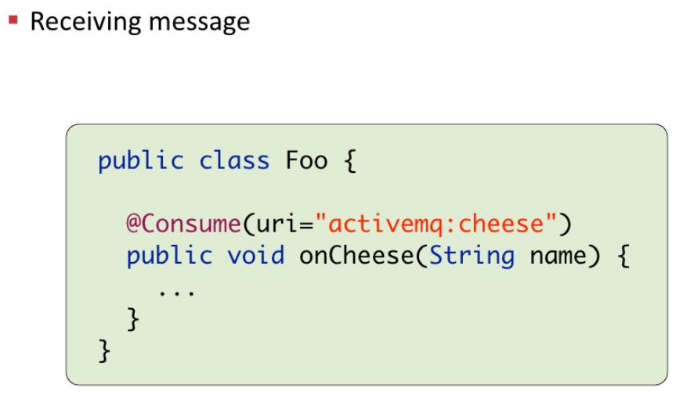
What's in the box?
Working with beans

Slide 68
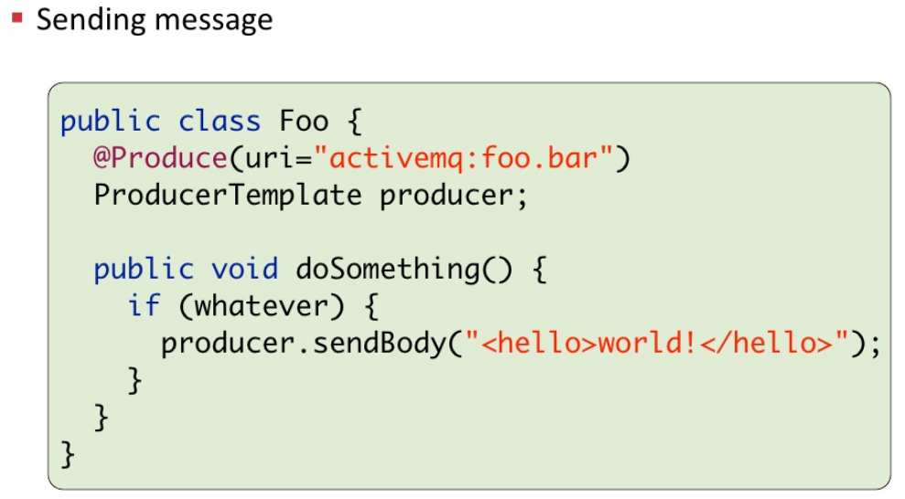
What's in the box?
Working with beans

Slide 69
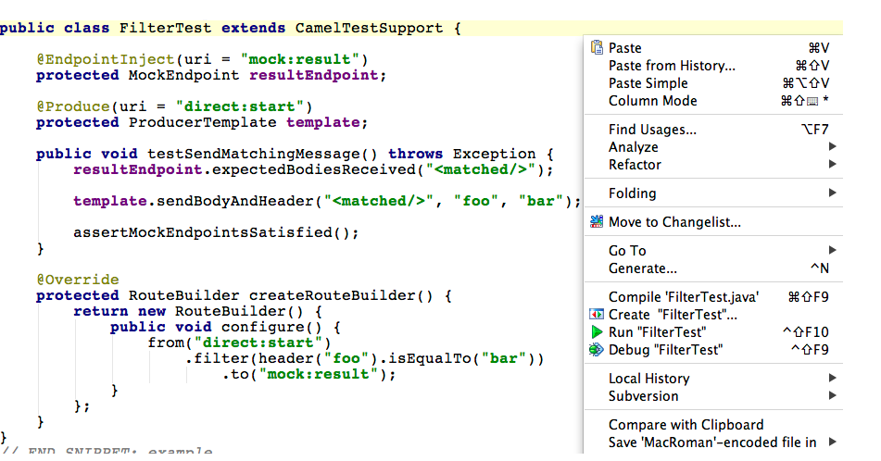
What's in the box?
Test Kit
  camel-test camel-test-spring
  camel-test-blueprint camel-testng

Slide 70
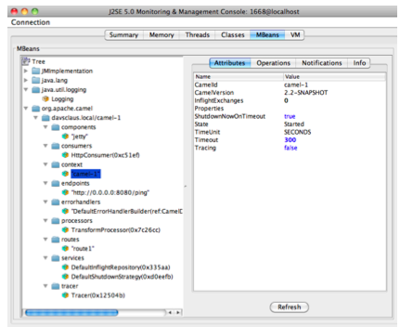
What's in the box?
Management
  JMX
  REST
  (@deprecated)

Slide 71
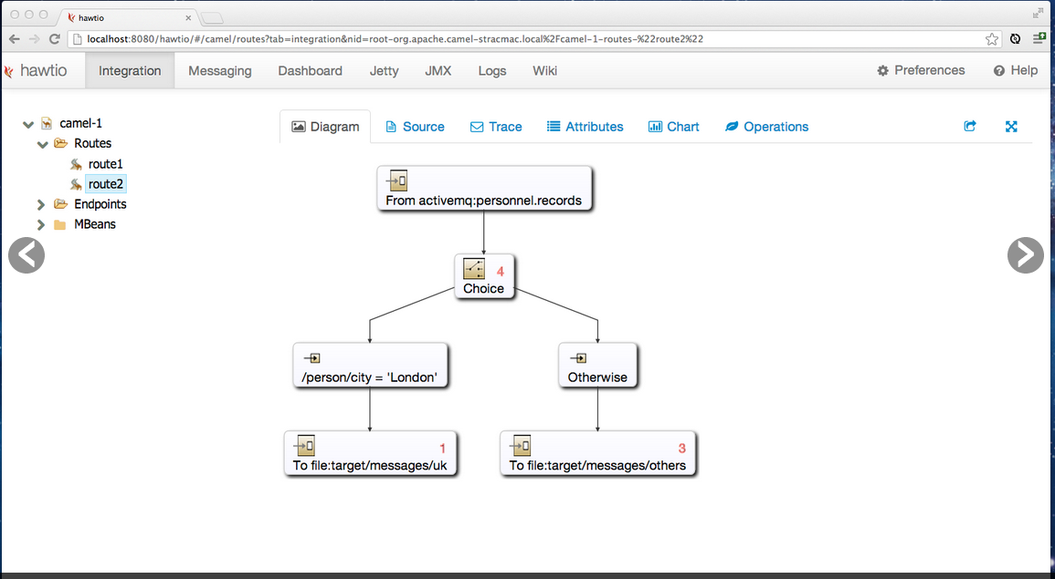
What's in the box?
Tooling – Web console - HawtIO
http://hawt.io

Slide 72
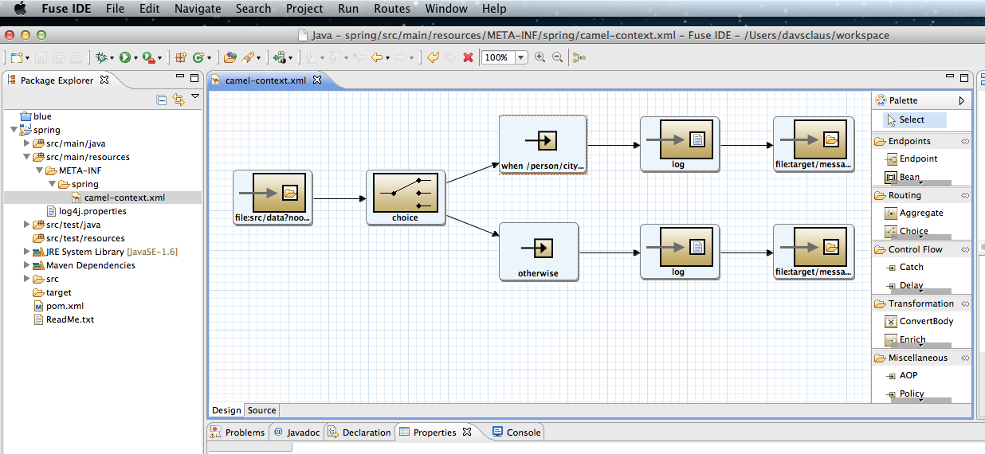
What's in the box?
Tooling – Eclipse Plugin – Fuse IDE
http://github.com/fusesource/fuseide

Slide 73

What's in the box?
Error Handling

Slide 74
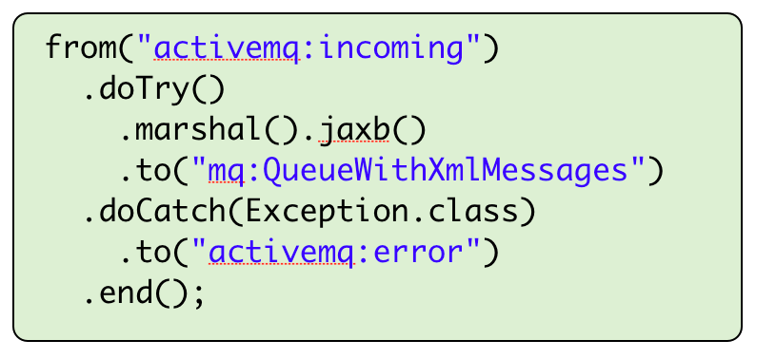
What's in the box?
try .. catch style

Slide 75
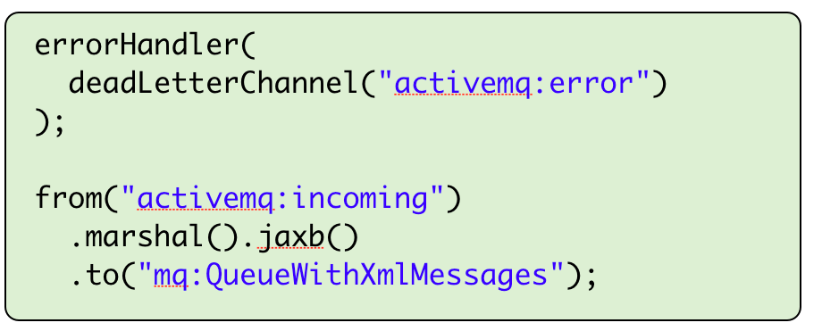
What's in the box?
Dead Letter Channel (EIP style)

Slide 76
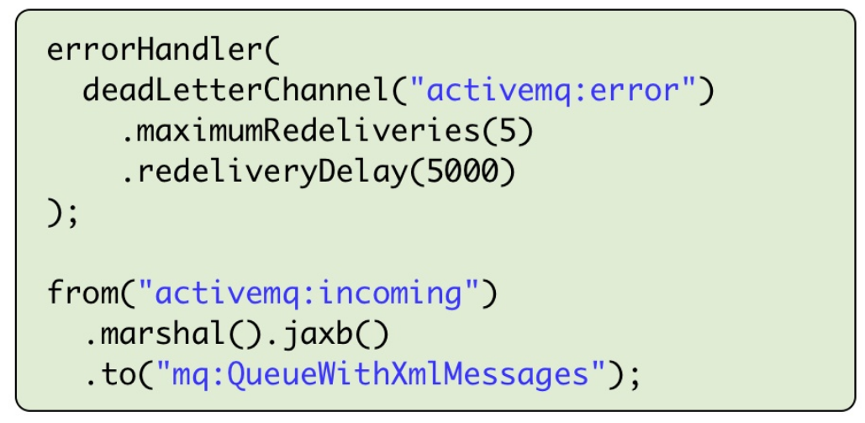
What's in the box?
Dead Letter Channel (EIP style)

Slide 77
What's in the box?
The Rest
  Interceptors
  Security
  Route Policy
  Type Converters
  Transaction
    Compensation as rollback
  Asynchronous non-blocking routing engine
  Thread management
  Maven Tooling
  ... and much more

Slide 78
Agenda
History of Camel
What is Apache Camel?
A little Example
Riding Camel
What's in the Camel box?
Deploying Camel
Creating new Camel Projects
Extending Camel
Q and A

Slide 79
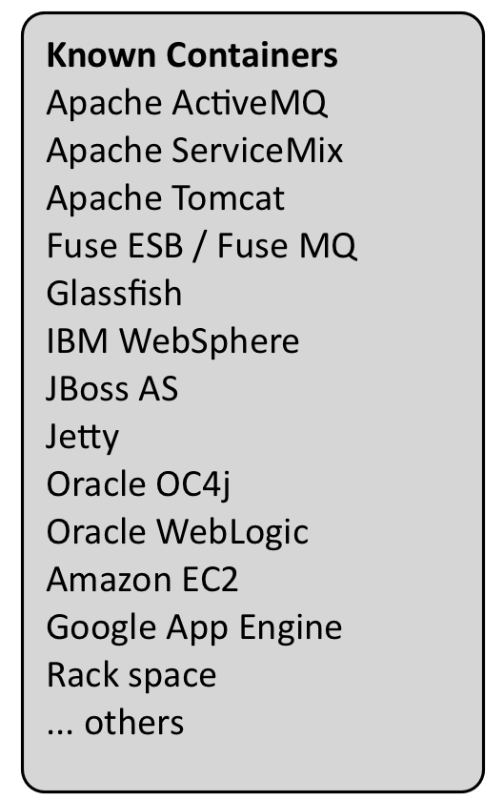
Deploying Camel
Deployment Strategy
  No Container Dependency
  Lightweight & Embeddable
Deployment Options
  Standalone
  WAR
  Spring
  JEE
  OSGi
  Cloud

Slide 80
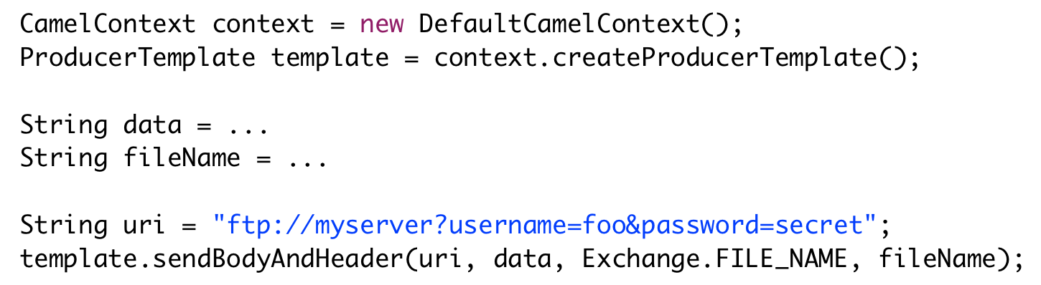
Camel as a Client
Java Client Application (no routes)
Example
  Upload a file to a FTP server

Slide 81
Agenda
History of Camel
What is Apache Camel?
A little Example
Riding Camel
What's in the Camel box?
Deploying Camel
Creating new Camel Projects
Q and A

Slide 82
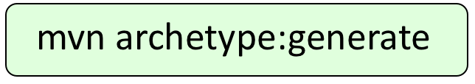
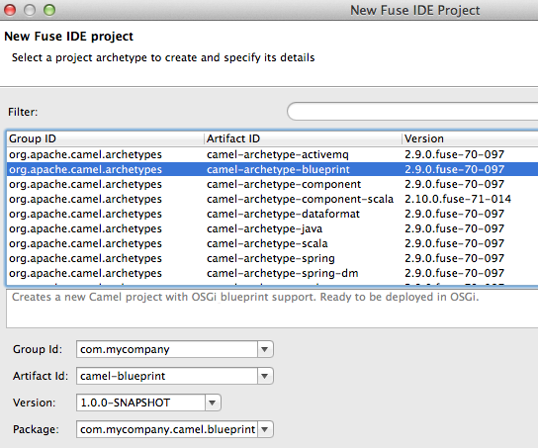
Creating new Camel Projects
Using Command Shell
From Eclipse

Slide 83

Creating new Camel Projects
Maven Archetypes

Slide 84


Creating new Camel Projects
camel-archetype-blueprint

Slide 85

Creating new Camel Projects
Importing into Eclipse
Existing Maven Project

Slide 86


Creating new Camel Projects
Testing Camel Projects
... from inside Eclipse

Slide 87
Agenda
History of Camel
What is Apache Camel?
A little Example
Riding Camel
What's in the Camel box?
Deploying Camel
Creating new Camel Projects
Q and A

Slide 88

Where do I get more information?
Best Article covering what Apache Camel is
  http://java.dzone.com/articles/open-source-integration-apache
Link to article from “Getting Started”

Slide 89

Where do I get more information?
Try Camel Examples
  http://camel.apache.org/examples.html
Read other blogs and articles
  http://camel.apache.org/articles.html
Use the “search box” on the Camel front page

Slide 90
Where do I get more information?
Use the mailing list / forum
  http://camel.apache.org/mailing-lists.html
Use stackoverflow
  http://stackoverflow.com/questions/tagged/apache-camel

Slide 91

Where do I get more information?
Buy the Camel in Action book
Use code ...
camel40
… for 40% discount
http://manning.com/ibsen/

Slide 92

Any Questions ?
Contact
  EMail: cibsen@redhat.com
  Twitter: @davsclaus
  Blog: http://davsclaus.com
  Linkedin: http://www.linkedin.com/in/davsclaus

