Slide 1
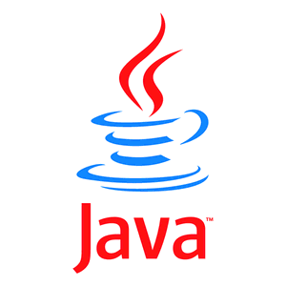

with

Slide 2
Basics of MongoDB

Slide 3
Introduction to MongoDB
MongoDB (from "humongous") is a
scalable, high-performance, open source,
schema-free, document-oriented
database.
- mongodb.org
First developed by the software company 10gen (now MongoDB Inc.) in October 2007 as a component of a planned platform as a service product, the company shifted to an open source development model in 2009, with 10gen offering commercial support and other services.

Slide 4
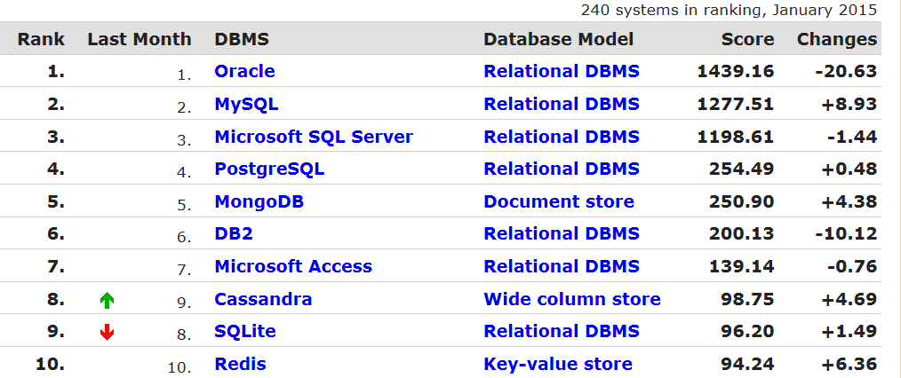

http://db-engines.com/en/ranking
Who is using it

Slide 5
Features of Mongodb
“One size fits all” approach no longer applies
Document-oriented – Documents are stored in BSON (binary JSON)
Standard Database stuff
Indexing
Replication/failover support
Schema-less; very flexible – no more blocking ALTER TABLE
Super Easy to install
Makes for easy horizontal scaling
Querying: Rich, javascript-based query syntax, nested queries
Auto-sharding
Replication
Load balancing
Efficient Binay object store via GridFS i.e store images,videos, anything
Aggregation

Slide 6
Installation of MongoDB
Installation on Windows
Determine which MongoDB build you need
Download MongoDB for Windows
Unzip the zip download and extract it in C: drive C:\MongoDB
4. Configuration File
Create a MongoDB config file, it’s just a text file,
for example : C:\MongoDB\mongo.config
##store data here
dbpath=D:\mongodb\data
##all output go here
logpath=D:\mongodb\log\mongo.log
5. Run MongoDB server
Use mongod.exe --config d:\mongodb\mongo.config to start MongoDB server.
6. Connect to MongoDB
Uses mongo.exe to connect to the started MongoDB server.
7. MongoDB as Windows Service
Add MongoDB as Windows Service, so that MongoDB will start automatically following each system restart.
d:\mongodb\bin> mongod --config D:\mongodb\mongo.config --install

Slide 8
Getting started with
Java and MongoDB

Slide 9
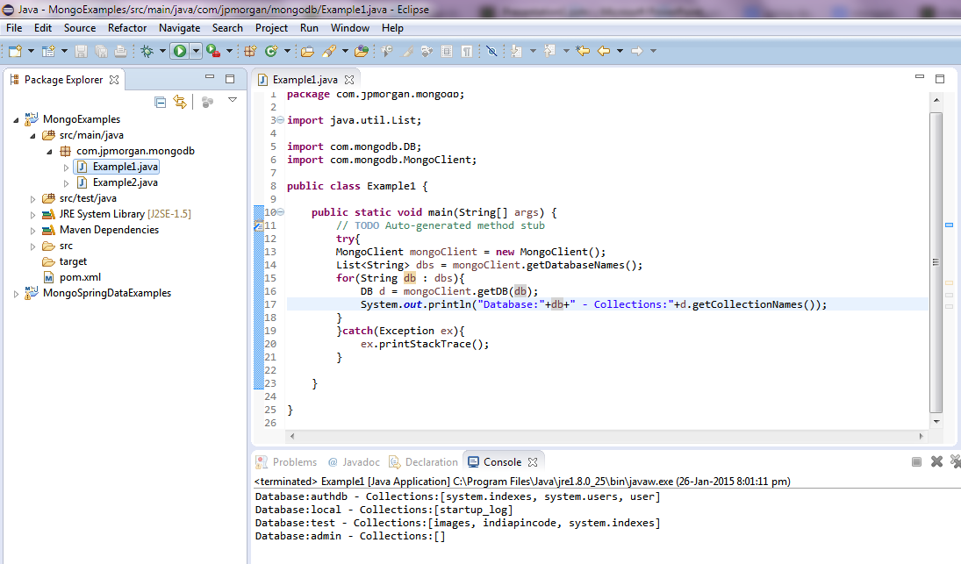
Tools and technologies used
1)Eclipse – Kepler or higher version
2)Maven 3.x
3)MongoDB
4)JDK1.6 or higher
5) MongoDB-Java-Driver 2.10.1

Slide 10
Getting Started with Java Driver
Using the Java driver is very simple
POJO Mappers
Morphia
Morphium
Spring MongoDB
DataNucleus JPA/JDO
lib-mongomapper
JavaBean Mapper (No annotations)
MongoJack
Jongo
Hibernate OGM
Misc
mongo-queue-java Java message queue using MongoDB as a backend.
mongo-java-logging a Java logging handler
log4mongo

Slide 11
MongoDB import and export
mongoexport
Export MongoDB data to CSV, TSV or JSON files.
options:
-h [ --host ] arg mongo host to connect to ( <set name>/s1,s2 for
-u [ --username ] arg username
-p [ --password ] arg password
-d [ --db ] arg database to use
-c [ --collection ] arg collection to use (some commands)
-q [ --query ] arg query filter, as a JSON string
-o [ --out ] arg output file; if not specified, stdout is used
mongoexport -d test -c testcollection -o data.json
mongoimport
Import CSV, TSV or JSON data into MongoDB.
options:
-h [ --host ] arg mongo host to connect to ( <set name>/s1,s2 for sets)
-u [ --username ] arg username
-p [ --password ] arg password
-d [ --db ] arg database to use
-c [ --collection ] arg collection to use (some commands)
-f [ --fields ] arg comma separated list of field names e.g. -f name,age
--file arg file to import from; if not specified stdin is used
--type arg (csv,json,tsv)
--headerline
--drop drop collection first
--upsert insert or update objects that already exist

Slide 12
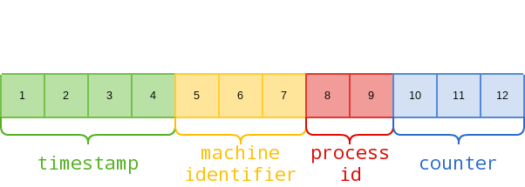
Java MongoDB API
To make a connection to a MongoDB, you need to have at the minimum, the name of a database to connect to. The database doesn’t have to exist - if it doesn’t, MongoDB will create it for you.
Additionally, you can specify the server address and port when connecting
MongoClient: MongoClient instance actually represents a pool of connections to the database; you will only need one instance of class MongoClient even with multiple threads. MongoClient.close() to clean up resources.
DB: An abstract class that represents a logical database on a server
DBCollection: This class provides a skeleton implementation of a database collection
_id and ObjectId: A special 12-byte BSON type that guarantees uniqueness within the collection. The ObjectId is generated based on timestamp, machine ID, process ID, and a process-local incremental counter.
BasicDBObject: A basic implementation of bson object that is mongo specific. This class to create the document (including the inner document)
{
"name" : "MongoDB",
"type" : "database",
"count" : 1,
"info" : { x : 203, y : 102 }
}
BasicDBObject doc = new BasicDBObject("name", "MongoDB") .append("type", "database") .append("count", 1) .append("info", new BasicDBObject("x", 203).append("y", 102));
DBCursor: An iterator over database results. Doing a find() query on a collection returns a DBCursor thus
DBCursor cursor = collection.find( query );
if( cursor.hasNext() )
DBObject obj = cursor.next();

Slide 13
Create, Read, Update and Delete (CRUD)
data with java

Slide 14
Java MongoDB : Insert a document
Test Data
Test data in JSON format.
{
"database" : “MyDB",
"table" : "hosting",
"detail" : { records : 99, index : "vps_index1", active : "true” }
}
4 ways to insert below JSON data into a “document“ via Java MongoDB API.
1) BasicDBObject
2) BasicDBObjectBuilder
3) Map
4) JSON parse

Slide 15
Java MongoDB : Update a document
There are 3 ways to update documents
DBCollection.update() with $set
Using only DBCollection.update() will replaced document with another new document. To update a particular value only, uses $set update modifier.
2) DBCollection.update() with $inc
use of $inc modifier to increase a particular value
3) DBCollection. updateMulti() with multi
use of multi parameter to update a set of matched documents

Slide 16
Java MongoDB : Query document
findOne() Get first matched document only.
Find() Get all matched documents.
find(query, fields) Get single field from matched document.
query:
i)

