Slide 1
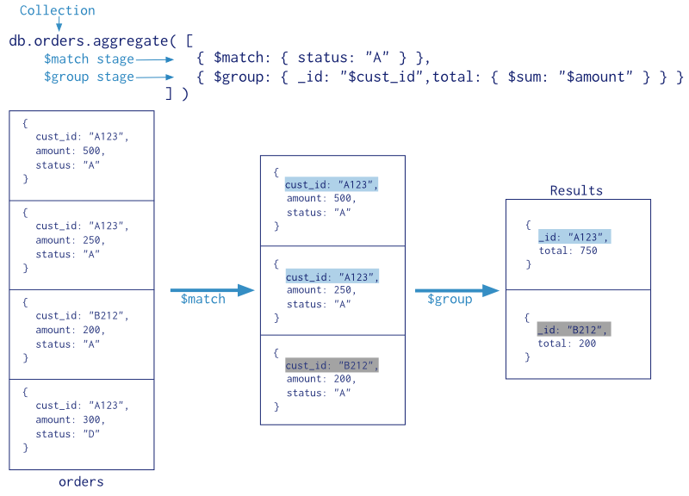
Aggregation Framework
Aggregations are operations that process data records and return computed results. MongoDB provides a rich set of aggregation operations that examine and perform calculations on the data sets
MongoDB 2.2 introduced a new aggregation framework, modelled on the concept of data processing pipelines. Documents enter a multi-stage pipeline that transforms the documents into an aggregated result.
db.collection.aggregate( [ { <stage> }, ... ] )

Slide 2
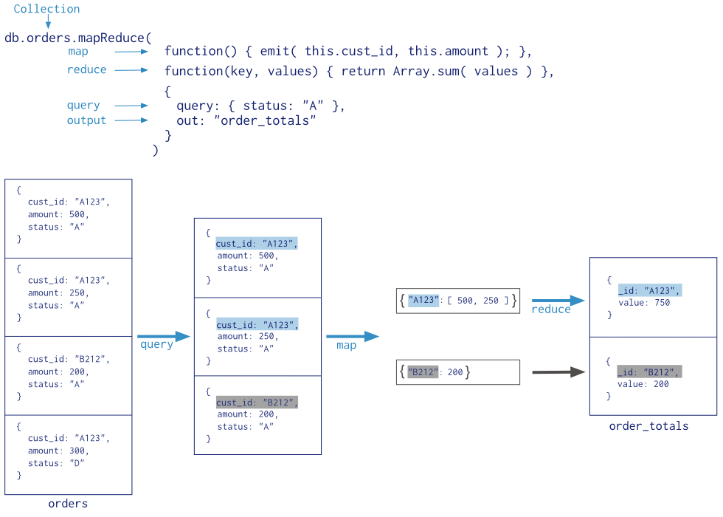
Map Reduce
Map-reduce is a data processing paradigm for condensing large volumes of data into useful aggregated results.

Slide 3
Pipeline Operations
Stage Operators
$match - Uses a query predicate (like .find({…})) as a filter
$project - Uses a sample document to determine the shape of the result (similar to .find()’s optional argument) • This can include computed values
$unwind - Hands out array elements one at a time
$group - Aggregates items into buckets defined by a key
$sort - Sort documents
$limit - Only allow the specified number of documents to pass
$skip - Skip over the specified number of documents
Expression Operators
{ <operator>: [ <argument1>, <argument2> ... ] }
Boolean Operators: $and,$not,$or
Set Operators: $allElementsTrue,$anyElementTrue,$setDifference,$setEquals,$setIntersection,
$setIsSubset, $setUnion
Comparison Operators: $cmp,$eq ,$gt,$gte,$lt,$lte,$ne
Arithmetic Operators: $add ,$divide,$mod,$multiply,$subtract
String Operators: $concat,$strcasecmp,$substr,$toLower,$toUpper
Array Operators: $size
Variable Operators: $let,$map
Date Operators: dayOfMonth,$dayOfWeek,$dayOfYear,$hour,$millisecond,$minute,$month,$second, $week,$year
Conditional Expressions: $cond, $ifNull
Accumulators
$addToSet,$avg,$first,$last,$max,$min,$push,$sum

Slide 4
Index
Indexes support the efficient execution of queries in MongoDB. Indexes are special data structures [1] that store a small portion of the collection’s data set in an easy to traverse form. The index stores the value of a specific field or set of fields, ordered by the value of the field. All MongoDB collections have an index on the _id field that exists by default
Sorted Results
MongoDB can use indexes to return documents sorted by the index key directly from the index without requiring an additional sort phase.
Covered Results
When the query criteria and the projection of a query include only the indexed fields, MongoDB will return results directly from the index without scanning any documents or bringing documents into memory.
db.collection.ensureIndex(keys, options)
db.collection.ensureIndex( { a: 1, b: 1, c: -1 } )
db.collection.dropIndex({x:1})
db.collection.dropIndexes()
db.collection.reIndex()

Slide 5
