Slide 1
Building Your First Application in Java
Bryan Reinero
bryan.reinero@10gen.com

Slide 2

is a…
High performance
Highly available
Easily scalable
Easy to use
Feature rich
Document store

Slide 3
Data Model
A Mongo system holds a set of databases
A database holds a set of collections
A collection holds a set of documents
A document is a set of fields
A field is a key-value pair
A key is a name (string)
A value is a
basic type like string, integer, float, timestamp, binary, etc.,
a document, or
an array of values

Slide 4
High Availability: Replica Sets
Initialize -> Election
Primary + data replication from primary to secondary
Node 1
Secondary
Node 2
Secondary
Heartbeat
Node 3
Primary
Replication
Replication

Slide 5
Replica Set - Failure
Primary down/network failure
Automatic election of new primary if majority exists
Node 1
Secondary
Primary Election
Node 2
Secondary
Heartbeat
Node 3
Primary

Slide 6
Replica Set - Failover
New primary elected
Replication established from new primary
Node 1
Secondary
Node 2
Primary
Heartbeat
Node 3
Primary

Slide 7
Durability
Fire and forget
Wait for error
Wait for journal sync
Wait for flush to disk
Wait for replication

Slide 8
Read Preferences
PRIMARY
PRIMARY PREFERRED
SECONDARY
SECONDARY PREFERRED
NEAREST
Notes:
Read from any of the fastest responding nodes.

Slide 9
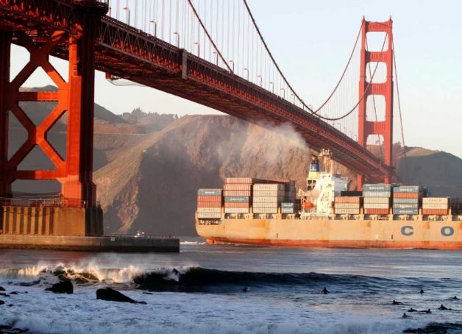
Let’s build a location based surf reporting app!

Slide 10
Let’s build a location based surf reporting app!
Report current conditions

Slide 11
Let’s build a location based surf reporting app!
Report current conditions
Get current local conditions

Slide 12
Let’s build a location based surf reporting app!
Report current conditions
Get current local conditions
Determine best conditions per beach

Slide 13
Document Structure
{
"_id" : ObjectId("504ceb3d30042d707af96fef"),
"reporter" : "test",
"location" : {
"coordinates" : [
-122.477222,
37.810556
],
"name" : "Fort Point"
},
"conditions" : {
"height" : 0,
"period" : 9,
"rating" : 1
},
"date" : ISODate("2011-11-16T20:17:17.277Z")
}

Slide 14
Document Structure
{
"_id" : ObjectId("504ceb3d30042d707af96fef"),
"reporter" : "test",
"location" : {
"coordinates" : [
-122.477222,
37.810556
],
"name" : "Fort Point"
},
"conditions" : {
"height" : 0,
"period" : 9,
"rating" : 1
},
"date" : ISODate("2011-11-16T20:17:17.277Z")
}
Primary Key,
Unique,
Auto-indexed

Slide 15
Document Structure
{
"_id" : ObjectId("504ceb3d30042d707af96fef"),
"reporter" : "test",
"location" : {
"coordinates" : [
-122.477222,
37.810556
],
"name" : "Fort Point"
},
"conditions" : {
"height" : 0,
"period" : 9,
"rating" : 1
},
"date" : ISODate("2011-11-16T20:17:17.277Z")
}
Primary Key,
Unique,
Autoindexed
Compound Index,
Geospacial

Slide 16
Document Structure
{
"_id" : ObjectId("504ceb3d30042d707af96fef"),
"reporter" : "test",
"location" : {
"coordinates" : [
-122.477222,
37.810556
],
"name" : "Fort Point"
},
"conditions" : {
"height" : 0,
"period" : 9,
"rating" : 1
},
"date" : ISODate("2011-11-16T20:17:17.277Z")
}
Primary Key,
Unique,
Autoindexed
Compound Index,
Geospacial
Indexed for
Time-To-Live

Slide 17
Get local surf conditions
db.reports.find(
{
"location.coordinates" : { $near : [-122, 37] ,
$maxDistance : 0.9},
date : { $gte : new Date(2012, 8, 9)}
},
{"date" : 1, "location.name" :1, _id : 0, "conditions" :1}
).sort({"conditions.rating" : -1})

Slide 18
Get local surf conditions
db.reports.find(
{
"location.coordinates" : { $near : [-122, 37] ,
$maxDistance : 0.9},
date : { $gte : new Date(2012, 8, 9)}
},
{"date" : 1, "location.name" :1, _id : 0, "conditions" :1}
).sort({"conditions.rating" : -1})
Get local reports

Slide 19
Get local surf conditions
db.reports.find(
{
"location.coordinates" : { $near : [-122, 37] ,
$maxDistance : 0.9},
date : { $gte : new Date(2012, 8, 9)}
},
{"date" : 1, "location.name" :1, _id : 0, "conditions" :1}
).sort({"conditions.rating" : -1})
Get local reports
Get today’s reports

Slide 20
Get local surf conditions
db.reports.find(
{
"location.coordinates" : { $near : [-122, 37] ,
$maxDistance : 0.9},
date : { $gte : new Date(2012, 8, 9)}
},
{"location.name" :1, _id : 0, "conditions" :1}
).sort({"conditions.rating" : -1})
Get local reports
Get today’s reports
Return only the relevant info

Slide 21
Get local surf conditions
db.reports.find(
{
"location.coordinates" : { $near : [-122, 37] ,
$maxDistance : 0.9},
date : { $gte : new Date(2012, 8, 9)}
},
{"location.name" :1, _id : 0, "conditions" :1}
).sort({"conditions.rating" : -1})
Get local reports
Get today’s reports
Return only the relevant info
Show me the best surf first

Slide 22
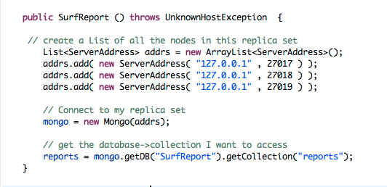
Get local surf conditions: Connecting

Slide 23
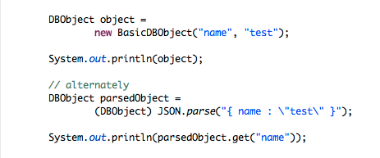
DBObjects
Output:
{ "name" : "test"}
parsed

Slide 24
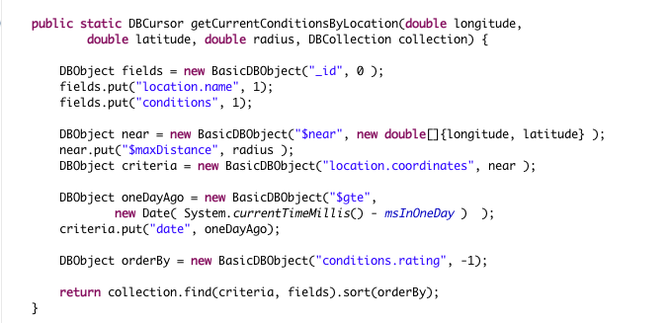
Building the query

Slide 25
Results
{ "location" : { "name" : "Montara" }, "conditions" : { "height" : 6, "period" : 20, "rating" : 5 } }
{ "location" : { "name" : "Maverick's" }, "conditions" : { "height" : 5, "period" : 13, "rating" : 3 } }
{ "location" : { "name" : "Maverick's" }, "conditions" : { "height" : 3, "period" : 15, "rating" : 3 } }
{ "location" : { "name" : "Maverick's" }, "conditions" : { "height" : 3, "period" : 16, "rating" : 2 } }
{ "location" : { "name" : "Montara" }, "conditions" : { "height" : 0, "period" : 8, "rating" : 1 } }
{ "location" : { "name" : "Linda Mar" }, "conditions" : { "height" : 3, "period" : 10, "rating" : 1 } }
{ "location" : { "name" : "Sharp Park" }, "conditions" : { "height" : 1, "period" : 15, "rating" : 1 } }
{ "location" : { "name" : "Sharp Park" }, "conditions" : { "height" : 5, "period" : 6, "rating" : 1 } }
{ "location" : { "name" : "South Ocean Beach" }, "conditions" : { "height" : 1, "period" : 6, "rating" : 1 } }
{ "location" : { "name" : "South Ocean Beach" }, "conditions" : { "height" : 0, "period" : 10, "rating" : 1 } }
{ "location" : { "name" : "South Ocean Beach" }, "conditions" : { "height" : 4, "period" : 6, "rating" : 1 } }
{ "location" : { "name" : "South Ocean Beach" }, "conditions" : { "height" : 0, "period" : 14, "rating" : 1 } }

Slide 26
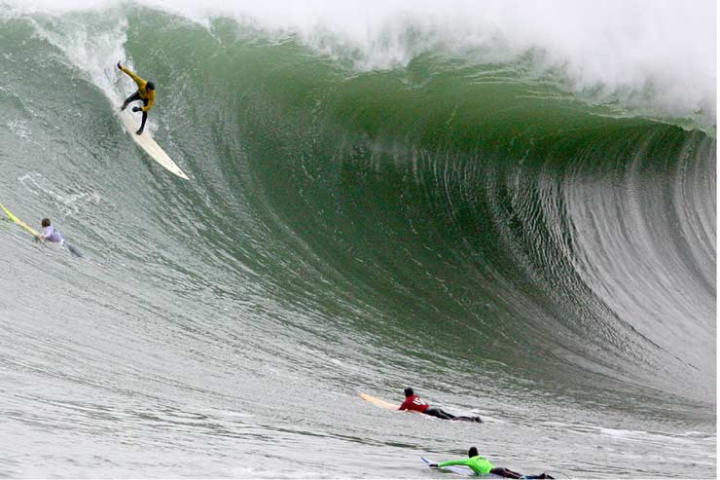
Analysis Features: Aggregation Framework
What are the best conditions for my local beach?

Slide 27
Pipelining Operations
$match
Match “Linda Mar”
$project
Only interested in conditions
Group by rating, averaging
wave height and wave period
$group
$sort
Order by best conditions

Slide 28
Aggregation Framework
{ "aggregate" : "reports" ,
"pipeline" : [
{ "$match" : { "location.name" : "Linda Mar"}} ,
{ "$project" : { "conditions" : 1}} ,
{ "$group" : {
"_id" : "$conditions.rating" ,
"average height" : { "$avg" : "$conditions.height"} ,
"average period" : { "$avg" : "$conditions.period"}}} ,
{ "$sort" : { "_id" : -1}}
]
}

Slide 29
Aggregation Framework
{ "aggregate" : "reports" ,
"pipeline" : [
{ "$match" : { "location.name" : "Linda Mar"}} ,
{ "$project" : { "conditions" : 1}} ,
{ "$group" : {
"_id" : "$conditions.rating" ,
"average height" : { "$avg" : "$conditions.height"} ,
"average period" : { "$avg" : "$conditions.period"}}} ,
{ "$sort" : { "_id" : -1}}
]
}
Match “Linda Mar”

Slide 30
Aggregation Framework
{ "aggregate" : "reports" ,
"pipeline" : [
{ "$match" : { "location.name" : "Linda Mar"}} ,
{ "$project" : { "conditions" : 1}} ,
{ "$group" : {
"_id" : "$conditions.rating" ,
"average height" : { "$avg" : "$conditions.height"} ,
"average period" : { "$avg" : "$conditions.period"}}} ,
{ "$sort" : { "_id" : -1}}
]
}
Only interested in conditions

Slide 31
Aggregation Framework
{ "aggregate" : "reports" ,
"pipeline" : [
{ "$match" : { "location.name" : "Linda Mar"}} ,
{ "$project" : { "conditions" : 1}} ,
{ "$group" : {
"_id" : "$conditions.rating" ,
"average height" : { "$avg" : "$conditions.height"} ,
"average period" : { "$avg" : "$conditions.period"}}} ,
{ "$sort" : { "_id" : -1}}
]
}
Group by rating & average conditions

Slide 32
Aggregation Framework
{ "aggregate" : "reports" ,
"pipeline" : [
{ "$match" : { "location.name" : "Linda Mar"}} ,
{ "$project" : { "conditions" : 1}} ,
{ "$group" : {
"_id" : "$conditions.rating" ,
"average height" : { "$avg" : "$conditions.height"} ,
"average period" : { "$avg" : "$conditions.period"}}} ,
{ "$sort" : { "_id" : -1}}
]
}
Show me best conditions first

Slide 33
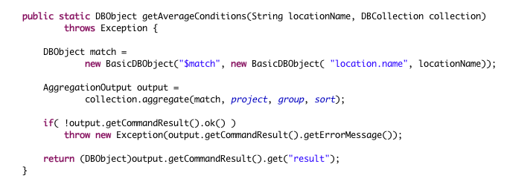
The Aggregation Helper

Slide 34
Scaling
Sharding is the partitioning of data among multiple machines
Balancing occurs when the load on any one node grows out of proportion

Slide 35

Scaling MongoDB
Sharded cluster
MongoDB
Single Instance
Or
Replica Set
Client Application

Slide 36
The Mechanism of Sharding
Complete Data Set
Define Shard Key on Location Name
Fort Point
Linda Mar
Maverick’s
Ocean Beach
Rockaway

Slide 37
The Mechanism of Sharding
Chunk
Chunk
Define Shard Key on Location Name
Fort Point
Linda Mar
Maverick’s
Ocean Beach
Rockaway

Slide 38
The Mechanism of Sharding
Chunk
Chunk
Chunk
Chunk
Fort Point
Linda Mar
Maverick’s
Ocean Beach
Rockaway

Slide 39
The Mechanism of Sharding
Chunk
Chunk
Chunk
Chunk
Fort Point
Linda Mar
Maverick’s
Ocean Beach
Rockaway
Shard 1
Shard 2
Shard 3
Shard 4

Slide 40
The Mechanism of Sharding
Chunkc
Chunkc
Chunkc
Chunkc
Chunkc
Chunkc
Chunkc
Chunkc
Chunkc
Chunkc
Shard 1
Shard 2
Shard 3
Shard 4

Slide 41
The Mechanism of Sharding
Client Application
Query: Linda Mar
Chunkc
Chunkc
Chunkc
Chunkc
Chunkc
Chunkc
Chunkc
Chunkc
Chunkc
Chunkc
Shard 1
Shard 2
Shard 3
Shard 4

Slide 42
The Mechanism of Sharding
Client Application
Query: Maverick’s
Chunkc
Chunkc
Chunkc
Chunkc
Chunkc
Chunkc
Chunkc
Chunkc
Chunkc
Chunkc
Shard 1
Shard 2
Shard 3
Shard 4

Slide 43
Thanks!
Office Hours
Thursdays 4-6 pm
555 University Ave.
Palo Alto
We’re Hiring !
Bryan.reinero@10gen.com

