Slide 1



Node.JS Overview
Eyal Vardi
Microsoft MVP ASP.NET blog: eyalvardi.wordpress.com

Slide 2
“Everything that can be written in JavaScript will eventually be written in JavaScript”. (Atwood’s law)

Slide 3
Agenda
JavaScript History
Node Has Arrived
Node Global Objects
Modules System

Slide 4
JavaScript History

Slide 5
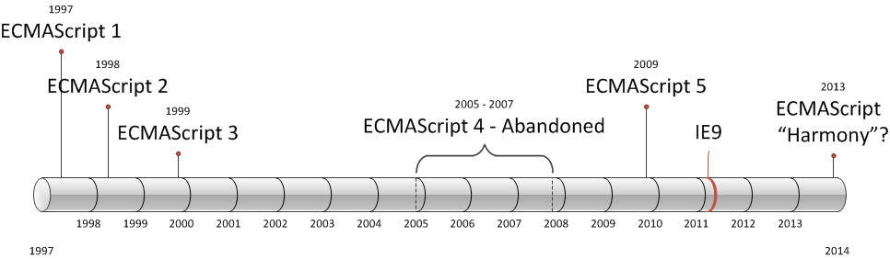
ECMAScript Versions

Slide 6

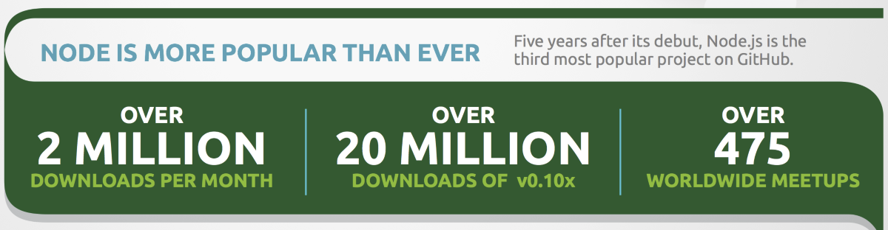
Node Has Arrived

Slide 7
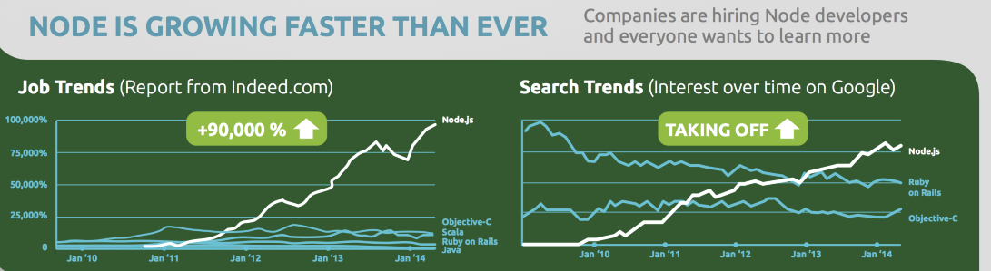
Node Has Arrived

Slide 8
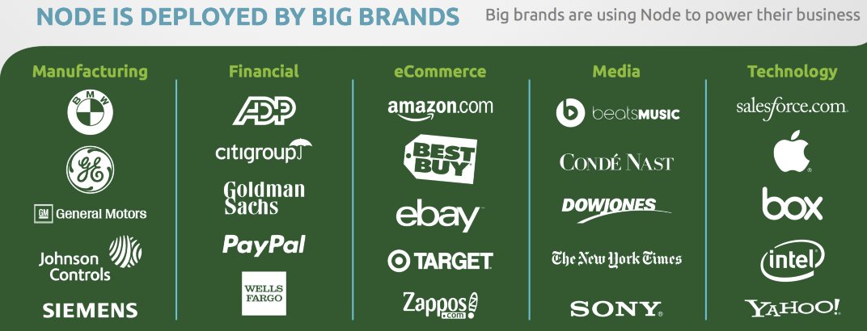
Node Has Arrived

Slide 9
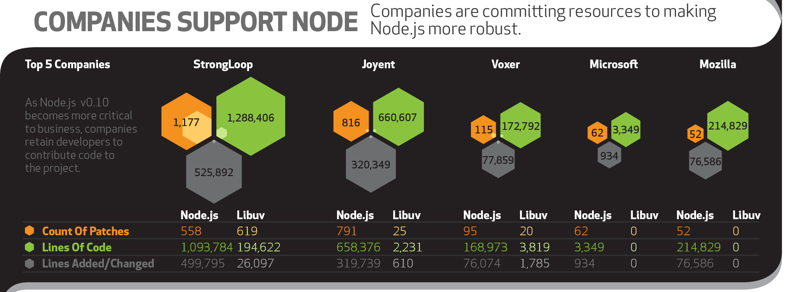
Node Has Arrived

Slide 10

Node Has Arrived

Slide 11
Node.js Building Blocks
A high performance, cross-platform evented I/O library
libuv
V8
Js, C++
Node.js
Google JavaScript engine

Slide 12








Node.JS Advantages
Architecture
Single Thread
App == Server
Middleware
Deployment
XCopy
Run Everywhere
Community
53,228 Packages
2.5M Download in day.
Tools

Slide 13
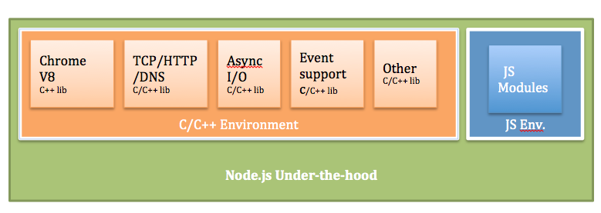
Node.js Under The Hood
(source: Future-proofing Your Apps: Cloud Foundry and Node.js)

Slide 14
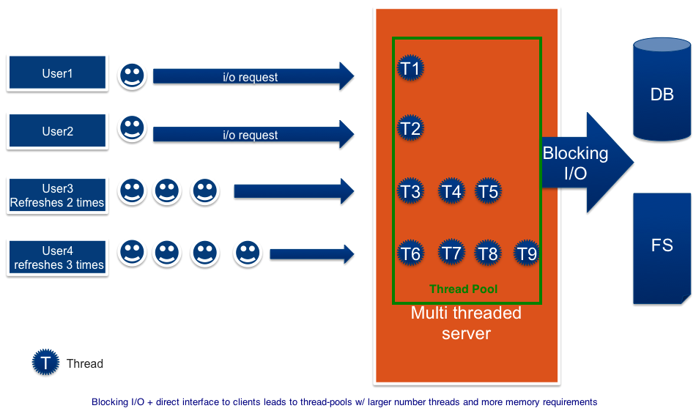
Multi-threaded HTTP Server Using Blocking I/O
(source: Future-proofing Your Apps: Cloud Foundry and Node.js)

Slide 15
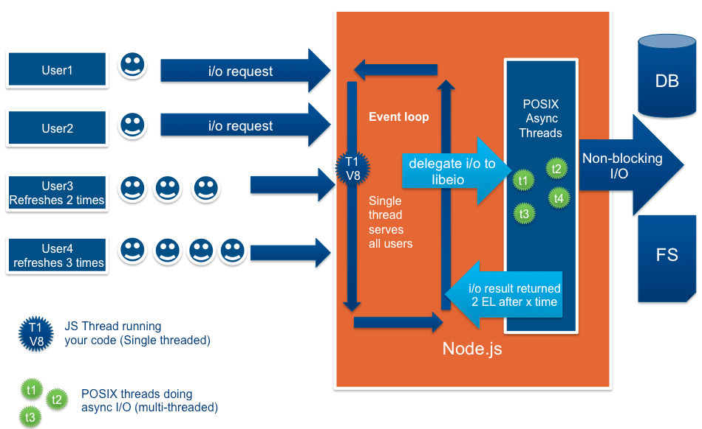
Event-driven, Non-Blocking I/O
(source: Future-proofing Your Apps: Cloud Foundry and Node.js)

Slide 16

Node.js Hello World

Slide 17
Global Objects
These objects are available in all modules. Some of these objects aren't actually in the global scope but in the module scope.
Objects:
global
process
Console
module
exports
functions:
Buffer
require()
setTimeout(cb,ms) , clearTimeout(t)
setInterval(cb,ms) , clearInterval(t)

Slide 18
Modules System

Slide 19
Modules
Node has a simple module loading system.
Files and modules are in one-to-one correspondence.
var circle = require('./circle.js');
console.log('The area of radius 4: '+ circle.area(4));
foo.js
The variable PI is private to circle.js
var PI = Math.PI;
exports.area = function (r) {return PI * r * r;};
exports.circumference = function (r) {return 2 * PI * r;};
circle.js
exports === module.exports

Slide 20
The module Object
In each module, the module free variable is a reference to the object representing the current module.
For convenience, module.exports is also accessible via the exports module-global.
Module object properties:
id
filename
loaded
parent
children

Slide 21
Module Cycles
a.js
console.log('a starting');
exports.done = false;
var b = require('./b.js');
console.log('in a,b.done= %j', b.done);
exports.done = true;
console.log('a done');
console.log('b starting');
exports.done = false;
var a = require('./a.js');
console.log('in b,a.done= %j', a.done);
exports.done = true;
console.log('b done');
b.js
console.log('main starting');
var a = require('./a.js');
var b = require('./b.js');
console.log('in main, a.done=%j, b.done=%j', a.done, b.done);
main.js
Output
main starting
a starting
b starting
in b, a.done = false
b done
in a, b.done = true
a done
in main, a.done=true, b.done=true
b.js tries to load a.js. In order to prevent an infinite loop an unfinished copy of the a.js exports object is returned to the b.js module.

Slide 22
Core Modules
Node has several modules compiled into the binary.
The core modules are defined in node's source in the lib/ folder.
Core modules name:
Assert
Buffer
child_process
Cluster
Crypto
Dgram
Dns
Events
Fs
http
https
Net
Os
Path
Punycode
Querystring
Readline
Repl
string_decoder
Tls
Tty
url
Util
Vm
zlib

Slide 23
File Modules
If the exact filename is not found, then node will attempt to load the required filename with the added extension of .js, .json, and then .node.
A module prefixed:
'/' is an absolute path to the file.
'./' is relative to the file calling require().
Without a leading '/' or './' to indicate a file, the module is either a "core module" or is loaded from a node_modules folder.

Slide 24
Folders as Modules
There are two ways in which a folder may be passed to require() as an argument.
Create a package.json file in the root of the folder, which specifies a main module.
If there is no package.json file present in the directory, then node will attempt to load an index.js or index.node file out of that directory.

Slide 25
Module Caching
Modules are cached after the first time they are loaded.
Multiple calls to require() may not cause the module code to be executed multiple times.
Modules are cached based on their resolved filename.
Since modules may resolve to a different filename based on the location of the calling module, it is not a guarantee that require() will always return the exact same object, if it would resolve to different files.

Slide 26
Thanks
eyalvardi.wordpress.com
Eyal Vardi
Microsoft MVP ASP.NET blog: eyalvardi.wordpress.com

