Slide 1
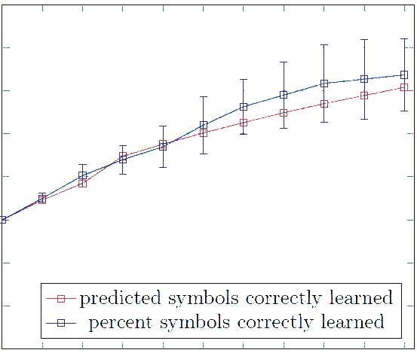
8
7
6
5
Number of Correctly Learned Symbols
4
3
2
1
predicted symbols correctly learned
percent symbols correctly learned
0
1
2
3
4
5
6
7
8
9
10
Iteration Number

