Slide 1
Git

Slide 3
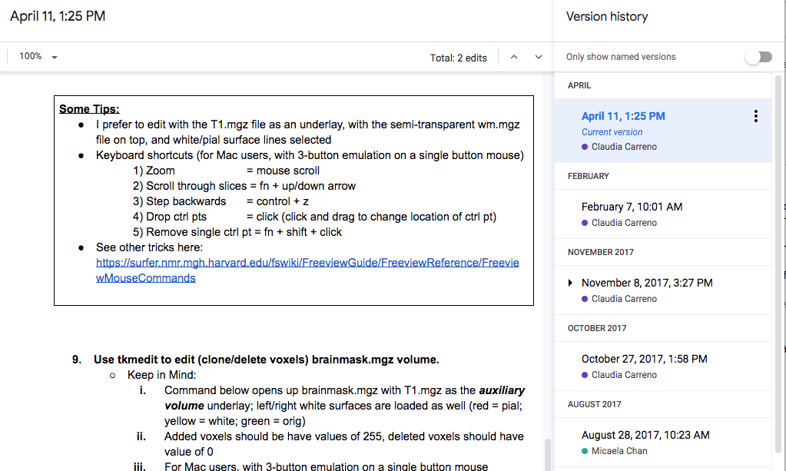
Version Control
Like track changes & version history
Microsoft Word
Changes are highlighted, and you know who did it (ideally)
Google-doc
All changes are recorded, and you can go back to see how things were like before a certain change.

Slide 4
Separate changes can be incorporated together

Slide 5
1. Setting up git
1.1 - Download git
1.2 - Configure git
Username & email
Line break
Text editor

Slide 6
2. Creating a repository > git init
2.1 – Create a directory in your Desktop
> mkdir ~/Desktop/workdir
> cd ~/Desktop/workdir
2.2 – Create a repository (stores the versions of your files)
> git init

Slide 7
3. Tracking Changes > git add, commit
3.1 – Adding new files/modification to staging area
> touch foo.txt
> git add foo.txt
3.2 – Saving these changes to the repository
> git commit –m “Add foo.txt to repo”
BONUS – Checking what has changed before add/commit
> echo hello >> foo.txt
> git diff
> git add –A
> git commit
> git log

Slide 8
File versions let us go back in time!
What is wrong with just using `my_script_version100.sh`?
Codes that worked last week don’t work anymore!?
Codes crashed after someone else changed it!?
(don’t murder them)
New lab member joins the lab, inherit a project started 4 years ago by an ex-lab-member……
Notes:
Give example from gitlab

Slide 9
4. Exploring History > git diff & show
4.1 – Difference between current file and N commit ago
> git diff HEAD
> git diff HEAD~1
> git diff efakb1
4.2 – What was done in ____ commit?
> commit show HEAD~1 foo.txt
Identifer is different for every commit/repo, use git log to check.

Slide 10
5. Reverting to a previous commit > git checkout
5.1 – Going back to a specific version of a file
> git checkout HEAD~1 foo.txt
> cat foo.txt
> git checkout HEAD foo.txt
5.2 Going back to an entire commit - Detached HEAD (CAUTION)
> git checkout HEAD~1
IF you checkout a previous commit without first committing your current state, then anything not committed would be lost!!!
> git checkout HEAD

Slide 11

6. Telling git to ignore certain files .gitignore
Sometimes we don’t want git to track a certain type of files
Temporary files (e.g., bla.m~, .bla.txt)
Big data files (e.g., huge_matrix.mat, pca_result.Rdata)
OS files (e.g., .DS_Store)
Use a .gitignore file
> touch ignore_this.txt
> echo ignore_this.txt >> .gitignore
> git add ignore_this.txt
NOTE: .gitignore can ignore an entire subdirectory.
Here is how a typical .gitignore file might look like:
This will now tell Git to not track ignore_this.txt

Slide 12
BREAK
This ends the version control portion of git.
There is a lot more, google is your friend.
What makes git a very strong tool in science is the power to collaborate via sharing and incorporating codes with others.

Slide 13
7. Github and other remote hosts
Thus far everything is within your local computer and done using `git`. That is the version control portion of git. Which is important and powerful. But what makes git a very strong tool for collaboration.

